Slide 1
Turing Machine Variations
Shakir Ullah Shah

Slide 2
The Standard Model
Infinite Tape
Read-Write Head
(Left or Right)
Control Unit
Deterministic

Slide 3
Variations of the Standard Model
Turing machines with:
Stay-Option
Multi-Tape
Multi Track tape
Nondeterministic
Different Turing Machine Classes

Slide 4
Same Power of two machine classes:
both classes accept the
same set of languages
We will prove:
each new class has the same power
with Standard Turing Machine
(accept Turing-Recognizable Languages)

Slide 5
Same Power of two classes means:
for any machine of first class
there is a machine of second class
such that:
and vice-versa

Slide 6
Equivalence of TMs
To show that two models of TM are equivalent we need to show that we can simulate one by another.

Slide 7
Simulation:
A technique to prove same power.
Simulate the machine of one class
with a machine of the other class
Second Class
Simulation Machine
First Class
Original Machine
simulates

Slide 8
Turing Machines with Stay-Option
Note: transition function of a TM in our deﬁnition forces the head to move to the left or right after each step. Let us vary the type of transition function permitted.
Suppose that we allow the head to stay put,
Does this feature allow TM to recognize additional languages? Answer: NO
Sketch of proof:
An S transition can be represented by two transitions: one that move to the left followed by one that moves to the right.
Since we can convert a TM which stay put into one that doesn’t have this facility, the extension does not increase its power.

Slide 9
Turing Machines with Stay-Option
The head can stay in the same position
Left, Right, Stay
L,R,S: possible head moves

Slide 10
Example:
Time 1
Time 2

Slide 11
Stay-Option Machine
Simulation in Standard Machine
For every possible tape symbol

Slide 12
For other transitions nothing changes
Stay-Option Machine
Simulation in Standard Machine
Similar for Right moves

Slide 13
example of simulation
Stay-Option Machine:
1
2
Simulation in Standard Machine:
1
2
3
END OF PROOF

Slide 14
Multitape Turing Machines
A multitape TM is like an ordinary TM with several tapes
Each tape has its own head for reading/writing Initially the input is on tape 1 and other are blank
Transition function allow for reading, writing, and moving the heads on all tapes simultaneously, i.e.,

Slide 15
Multitape Turing Machines
Formal expression
means that:
if the machine is in state qi and heads 1 through k are reading symbols a1 through ak the machine goes to state qj writes b1 through bk on tapes 1 through k respectively and moves each head to the left or right as specified by

Slide 16
Theorem
Every multitape Turing machine has an equivalent single tape Turing machine.
Proof: we show how to convert a multitape TM M into a single tape TM S. The key idea is to show how to simulate M with S

Slide 17
Simulating M with S
Assume that M has k tapes
S simulates the effect of k tapes by storing their information on its single tape
S uses a new symbol # as a delimiter to separate the contents of different tapes
S keeps track of the location of the heads by marking with a.

Slide 18
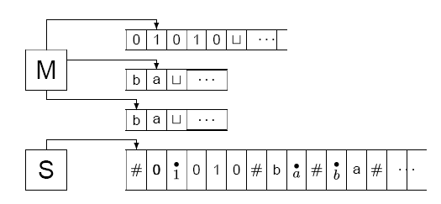
Example simulation
Figure below shows how to represent a machine M with 3 tapes by a machine S with one tape.

Slide 19
Multiple Track Tape
A useful trick to perform more
complicated simulations
One Tape
track 1
track 2
One head
One symbol

Slide 20
track 1
track 2
track 1
track 2

Slide 21
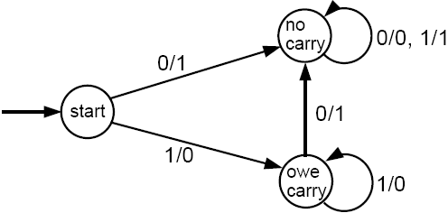
Adding of two numbers by ktrack TM
Below is given a ? machine for incrementing a binary number by 1.
Can you build a Multi track TM on the same logic for
adding two decimal numbers

Slide 22
Adding of two numbers by ktrack TM
Below is given a mealy machine for incrementing a binary number by 1.
Can you build a Multi track TM on the same logic for
adding two decimal numbers

Slide 23
Nondeterministic Turing Machines
Choice 1
Choice 2
Allows Non Deterministic Choices

Slide 24
Time 0
Time 1
Choice 1
Choice 2

Slide 25
All possible computation paths
Initial state
Step 1
Step 2
Step i
reject
accept
infinite
path
Step i+1

Slide 26
A bad idea:
Design DTM to explore tree in depth-first search fashion
Note :
A depth-first search goes all the way down on one branch before backing up to explore next branch.
Hence D could go forever down on an infinite branch and miss an accepting configuration on an other branch.

Slide 27
A better idea
Design DTM to explore tree in breadth-first search fashion
Note:
This strategy explores all branches at the same depth before going to explore any branch at the next depth.
Hence, this method guarantees that D will visit every node of tree until it encounters an accepting configuration

Slide 28
Formal proof
Design DTM D having three tapes
Tape 1 always contains the input and is never altered
Tape 2 (called the simulation tape) maintains a copy of N’s tape on some branch of its nondeterministic computation
Tape 3 (called address tape) keeps track of s
location in N’s nondeterministic computation tree

Slide 29
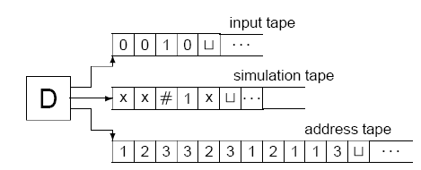
Formal proof

Slide 30
Post Machine
Uspenski V., La Máquina de Post. Editorial Mir, Moscú, 1980.
Vladimir A. Uspensky, Post’s machine, Mir Publishers (Little Mathematics Libarary), Moscow, 1983, Originally published in 1979. Translated from Russian by R. Alavina.

Slide 31
POST Machine
A Post machine denoted by PM is a collection of five things
The alphabet Σ plus the special symbol #. We generally use Σ = { a, b}.
A linear storage location (a place where a string of symbols is kept called the STORE or QUEUE, which initially contains the input string.
This location can be read by which we mean the leftmost character can be removed for inspection.
The STORE can also be added to, which means a new character can be concatenated onto the right of whatever is there already.
We allow for the possibility that characters not in Σ cab be used in the STORE, characters from an alphabet Γ called the store alphabet.

Slide 32
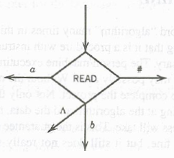
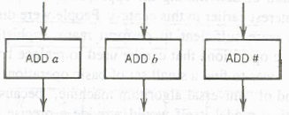
POST Machine Contd.
READ states, for example,
PMs are deterministic, so no two edges from the READ have the same edges
ADD states:

Slide 33
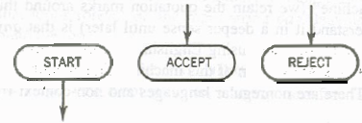
POST Machine Contd.
A START state (un-enterable) and some halt states called ACCEPT and REJECT

Slide 34
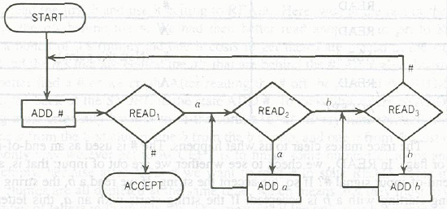
Example
Consider the following PM and guess the language?

Slide 35
 | State | Store

Slide 36
 | State | Store
1 | Start | aaabbb

Slide 37
 | State | Store
1 | Start | aaabbb
2 | ADD # | aaabbb#

Slide 38
 | State | Store
1 | Start | aaabbb
2 | ADD # | aaabbb#
3 | READ 1 | aabbb#

Slide 39
 | State | Store
1 | Start | aaabbb
2 | ADD # | aaabbb#
3 | READ 1 | aabbb#
4 | READ 2 | abbb#

Slide 40
 | State | Store
1 | Start | aaabbb
2 | ADD # | aaabbb#
3 | READ 1 | aabbb#
4 | READ 2 | abbb#
5 | ADD a | abbb# a

Slide 41
 | State | Store
1 | Start | aaabbb
2 | ADD # | aaabbb#
3 | READ 1 | aabbb#
4 | READ 2 | abbb#
5 | ADD a | abbb# a
6 | READ 2 | bbb#a

Slide 42
 | State | Store
1 | Start | aaabbb
2 | ADD # | aaabbb#
3 | READ 1 | aabbb#
4 | READ 2 | abbb#
5 | ADD a | abbb# a
6 | READ 2 | bbb#a
7 | ADD a | bbb#aa

Slide 43
 | State | Store
1 | Start | aaabbb
2 | ADD # | aaabbb#
3 | READ 1 | aabbb#
4 | READ 2 | abbb#
5 | ADD a | abbb# a
6 | READ 2 | bbb#a
7 | ADD a | bbb#aa
8 | READ 2 | bb#aa

Slide 44
 | State | Store
1 | Start | aaabbb
2 | ADD # | aaabbb#
3 | READ 1 | aabbb#
4 | READ 2 | abbb#
5 | ADD a | abbb# a
6 | READ 2 | bbb#a
7 | ADD a | bbb#aa
8 | READ 2 | bb#aa
9 | READ 3 | b#aa

Slide 45
 | State | Store
1 | Start | aaabbb
2 | ADD # | aaabbb#
3 | READ 1 | aabbb#
4 | READ 2 | abbb#
5 | ADD a | abbb# a
6 | READ 2 | bbb#a
7 | ADD a | bbb#aa
8 | READ 2 | bb#aa
9 | READ 3 | b#aa
10 | ADD b | b#aab

Slide 46
 | State | Store
1 | Start | aaabbb
2 | ADD # | aaabbb#
3 | READ 1 | aabbb#
4 | READ 2 | abbb#
5 | ADD a | abbb# a
6 | READ 2 | bbb#a
7 | ADD a | bbb#aa
8 | READ 2 | bb#aa
9 | READ 3 | b#aa
10 | ADD b | b#aab
 | State | Store
11 | READ 3 | # aab

Slide 47
 | State | Store
1 | Start | aaabbb
2 | ADD # | aaabbb#
3 | READ 1 | aabbb#
4 | READ 2 | abbb#
5 | ADD a | abbb# a
6 | READ 2 | bbb#a
7 | ADD a | bbb#aa
8 | READ 2 | bb#aa
9 | READ 3 | b#aa
10 | ADD b | b#aab
 | State | Store
11 | READ 3 | # aab
12 | ADD b | # aabb

Slide 48
 | State | Store
1 | Start | aaabbb
2 | ADD # | aaabbb#
3 | READ 1 | aabbb#
4 | READ 2 | abbb#
5 | ADD a | abbb# a
6 | READ 2 | bbb#a
7 | ADD a | bbb#aa
8 | READ 2 | bb#aa
9 | READ 3 | b#aa
10 | ADD b | b#aab
 | State | Store
11 | READ 3 | # aab
12 | ADD b | # aabb
13 | READ 3 | aabb

Slide 49
 | State | Store
1 | Start | aaabbb
2 | ADD # | aaabbb#
3 | READ 1 | aabbb#
4 | READ 2 | abbb#
5 | ADD a | abbb# a
6 | READ 2 | bbb#a
7 | ADD a | bbb#aa
8 | READ 2 | bb#aa
9 | READ 3 | b#aa
10 | ADD b | b#aab
 | State | Store
11 | READ 3 | # aab
12 | ADD b | # aabb
13 | READ 3 | aabb
14 | ADD # | aabb#

Slide 50
 | State | Store
1 | Start | aaabbb
2 | ADD # | aaabbb#
3 | READ 1 | aabbb#
4 | READ 2 | abbb#
5 | ADD a | abbb# a
6 | READ 2 | bbb#a
7 | ADD a | bbb#aa
8 | READ 2 | bb#aa
9 | READ 3 | b#aa
10 | ADD b | b#aab
 | State | Store
11 | READ 3 | # aab
12 | ADD b | # aabb
13 | READ 3 | aabb
14 | ADD # | aabb#
15 | READ 1 | abb#

Slide 51
 | State | Store
1 | Start | aaabbb
2 | ADD # | aaabbb#
3 | READ 1 | aabbb#
4 | READ 2 | abbb#
5 | ADD a | abbb# a
6 | READ 2 | bbb#a
7 | ADD a | bbb#aa
8 | READ 2 | bb#aa
9 | READ 3 | b#aa
10 | ADD b | b#aab
 | State | Store
11 | READ 3 | # aab
12 | ADD b | # aabb
13 | READ 3 | aabb
14 | ADD # | aabb#
15 | READ 1 | abb#
16 | READ 2 | bb#

Slide 52
 | State | Store
1 | Start | aaabbb
2 | ADD # | aaabbb#
3 | READ 1 | aabbb#
4 | READ 2 | abbb#
5 | ADD a | abbb# a
6 | READ 2 | bbb#a
7 | ADD a | bbb#aa
8 | READ 2 | bb#aa
9 | READ 3 | b#aa
10 | ADD b | b#aab
 | State | Store
11 | READ 3 | # aab
12 | ADD b | # aabb
13 | READ 3 | aabb
14 | ADD # | aabb#
15 | READ 1 | abb#
16 | READ 2 | bb#
17 | ADD a | bb#a

Slide 53
 | State | Store
1 | Start | aaabbb
2 | ADD # | aaabbb#
3 | READ 1 | aabbb#
4 | READ 2 | abbb#
5 | ADD a | abbb# a
6 | READ 2 | bbb#a
7 | ADD a | bbb#aa
8 | READ 2 | bb#aa
9 | READ 3 | b#aa
10 | ADD b | b#aab
 | State | Store
11 | READ 3 | # aab
12 | ADD b | # aabb
13 | READ 3 | aabb
14 | ADD # | aabb#
15 | READ 1 | abb#
16 | READ 2 | bb#
17 | ADD a | bb#a
18 | READ 2 | b#a

Slide 54
 | State | Store
1 | Start | aaabbb
2 | ADD # | aaabbb#
3 | READ 1 | aabbb#
4 | READ 2 | abbb#
5 | ADD a | abbb# a
6 | READ 2 | bbb#a
7 | ADD a | bbb#aa
8 | READ 2 | bb#aa
9 | READ 3 | b#aa
10 | ADD b | b#aab
 | State | Store
11 | READ 3 | # aab
12 | ADD b | # aabb
13 | READ 3 | aabb
14 | ADD # | aabb#
15 | READ 1 | abb#
16 | READ 2 | bb#
17 | ADD a | bb#a
18 | READ 2 | b#a
19 | READ 3 | #a

Slide 55
 | State | Store
1 | Start | aaabbb
2 | ADD # | aaabbb#
3 | READ 1 | aabbb#
4 | READ 2 | abbb#
5 | ADD a | abbb# a
6 | READ 2 | bbb#a
7 | ADD a | bbb#aa
8 | READ 2 | bb#aa
9 | READ 3 | b#aa
10 | ADD b | b#aab
 | State | Store
11 | READ 3 | # aab
12 | ADD b | # aabb
13 | READ 3 | aabb
14 | ADD # | aabb#
15 | READ 1 | abb#
16 | READ 2 | bb#
17 | ADD a | bb#a
18 | READ 2 | b#a
19 | READ 3 | #a
20 | ADD b | #ab

Slide 56
 | State | Store
1 | Start | aaabbb
2 | ADD # | aaabbb#
3 | READ 1 | aabbb#
4 | READ 2 | abbb#
5 | ADD a | abbb# a
6 | READ 2 | bbb#a
7 | ADD a | bbb#aa
8 | READ 2 | bb#aa
9 | READ 3 | b#aa
10 | ADD b | b#aab
 | State | Store
11 | READ 3 | # aab
12 | ADD b | # aabb
13 | READ 3 | aabb
14 | ADD # | aabb#
15 | READ 1 | abb#
16 | READ 2 | bb#
17 | ADD a | bb#a
18 | READ 2 | b#a
19 | READ 3 | #a
20 | ADD b | #ab
 | State | Store
21 | READ 3 | ab

Slide 57
 | State | Store
1 | Start | aaabbb
2 | ADD # | aaabbb#
3 | READ 1 | aabbb#
4 | READ 2 | abbb#
5 | ADD a | abbb# a
6 | READ 2 | bbb#a
7 | ADD a | bbb#aa
8 | READ 2 | bb#aa
9 | READ 3 | b#aa
10 | ADD b | b#aab
 | State | Store
11 | READ 3 | # aab
12 | ADD b | # aabb
13 | READ 3 | aabb
14 | ADD # | aabb#
15 | READ 1 | abb#
16 | READ 2 | bb#
17 | ADD a | bb#a
18 | READ 2 | b#a
19 | READ 3 | #a
20 | ADD b | #ab
 | State | Store
21 | READ 3 | ab
22 | ADD # | ab#

Slide 58
 | State | Store
1 | Start | aaabbb
2 | ADD # | aaabbb#
3 | READ 1 | aabbb#
4 | READ 2 | abbb#
5 | ADD a | abbb# a
6 | READ 2 | bbb#a
7 | ADD a | bbb#aa
8 | READ 2 | bb#aa
9 | READ 3 | b#aa
10 | ADD b | b#aab
 | State | Store
11 | READ 3 | # aab
12 | ADD b | # aabb
13 | READ 3 | aabb
14 | ADD # | aabb#
15 | READ 1 | abb#
16 | READ 2 | bb#
17 | ADD a | bb#a
18 | READ 2 | b#a
19 | READ 3 | #a
20 | ADD b | #ab
 | State | Store
21 | READ 3 | ab
22 | ADD # | ab#
23 | READ 1 | b#

Slide 59
 | State | Store
1 | Start | aaabbb
2 | ADD # | aaabbb#
3 | READ 1 | aabbb#
4 | READ 2 | abbb#
5 | ADD a | abbb# a
6 | READ 2 | bbb#a
7 | ADD a | bbb#aa
8 | READ 2 | bb#aa
9 | READ 3 | b#aa
10 | ADD b | b#aab
 | State | Store
11 | READ 3 | # aab
12 | ADD b | # aabb
13 | READ 3 | aabb
14 | ADD # | aabb#
15 | READ 1 | abb#
16 | READ 2 | bb#
17 | ADD a | bb#a
18 | READ 2 | b#a
19 | READ 3 | #a
20 | ADD b | #ab
 | State | Store
21 | READ 3 | ab
22 | ADD # | ab#
23 | READ 1 | b#
24 | READ 2 | #

Slide 60
 | State | Store
1 | Start | aaabbb
2 | ADD # | aaabbb#
3 | READ 1 | aabbb#
4 | READ 2 | abbb#
5 | ADD a | abbb# a
6 | READ 2 | bbb#a
7 | ADD a | bbb#aa
8 | READ 2 | bb#aa
9 | READ 3 | b#aa
10 | ADD b | b#aab
 | State | Store
11 | READ 3 | # aab
12 | ADD b | # aabb
13 | READ 3 | aabb
14 | ADD # | aabb#
15 | READ 1 | abb#
16 | READ 2 | bb#
17 | ADD a | bb#a
18 | READ 2 | b#a
19 | READ 3 | #a
20 | ADD b | #ab
 | State | Store
21 | READ 3 | ab
22 | ADD # | ab#
23 | READ 1 | b#
24 | READ 2 | #
25 | READ 3 | Λ

Slide 61
 | State | Store
1 | Start | aaabbb
2 | ADD # | aaabbb#
3 | READ 1 | aabbb#
4 | READ 2 | abbb#
5 | ADD a | abbb# a
6 | READ 2 | bbb#a
7 | ADD a | bbb#aa
8 | READ 2 | bb#aa
9 | READ 3 | b#aa
10 | ADD b | b#aab
 | State | Store
11 | READ 3 | # aab
12 | ADD b | # aabb
13 | READ 3 | aabb
14 | ADD # | aabb#
15 | READ 1 | abb#
16 | READ 2 | bb#
17 | ADD a | bb#a
18 | READ 2 | b#a
19 | READ 3 | #a
20 | ADD b | #ab
 | State | Store
21 | READ 3 | ab
22 | ADD # | ab#
23 | READ 1 | b#
24 | READ 2 | #
25 | READ 3 | Λ
26 | ADD # | #

Slide 62
 | State | Store
1 | Start | aaabbb
2 | ADD # | aaabbb#
3 | READ 1 | aabbb#
4 | READ 2 | abbb#
5 | ADD a | abbb# a
6 | READ 2 | bbb#a
7 | ADD a | bbb#aa
8 | READ 2 | bb#aa
9 | READ 3 | b#aa
10 | ADD b | b#aab
 | State | Store
11 | READ 3 | # aab
12 | ADD b | # aabb
13 | READ 3 | aabb
14 | ADD # | aabb#
15 | READ 1 | abb#
16 | READ 2 | bb#
17 | ADD a | bb#a
18 | READ 2 | b#a
19 | READ 3 | #a
20 | ADD b | #ab
 | State | Store
21 | READ 3 | ab
22 | ADD # | ab#
23 | READ 1 | b#
24 | READ 2 | #
25 | READ 3 | Λ
26 | ADD # | #
27 | READ 1 | Λ

Slide 63
 | State | Store
1 | Start | aaabbb
2 | ADD # | aaabbb#
3 | READ 1 | aabbb#
4 | READ 2 | abbb#
5 | ADD a | abbb# a
6 | READ 2 | bbb#a
7 | ADD a | bbb#aa
8 | READ 2 | bb#aa
9 | READ 3 | b#aa
10 | ADD b | b#aab
 | State | Store
11 | READ 3 | # aab
12 | ADD b | # aabb
13 | READ 3 | aabb
14 | ADD # | aabb#
15 | READ 1 | abb#
16 | READ 2 | bb#
17 | ADD a | bb#a
18 | READ 2 | b#a
19 | READ 3 | #a
20 | ADD b | #ab
 | State | Store
21 | READ 3 | ab
22 | ADD # | ab#
23 | READ 1 | b#
24 | READ 2 | #
25 | READ 3 | Λ
26 | ADD # | #
27 | READ 1 | Λ
28 | ACCPT

Slide 64
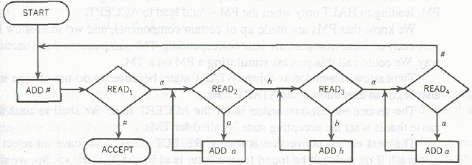
Another POST Machine

Slide 65
Simulating a PM on TM
Theorem:
A language accepted by PM can also be accepted by TM.
Proof:
We can simulate a PM over TM. PM consists of many components. By simulating we means, we will show how to convert each of these components into corresponding TM components that function the same way.

Slide 66
Simulating PM on TM
Start state of PM is same as TM’s start state. So no conversion needed.
Accept state of PM will be renamed as HALT state of TM.
REJECT state of PM will converted by deleting the REJECT states and all the edges coming into REJECT states.
Now how to keep track of PM store contents when simulating over TM tape?

Slide 67

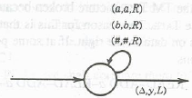
HOW to simulate STORE over TAPE?
Can be simulated by

Slide 68

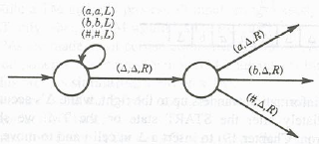
Can be simulated by

Slide 69
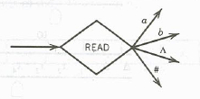
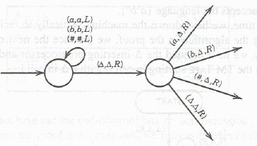
If PM reads empty STORE
Then it becomes

Slide 70
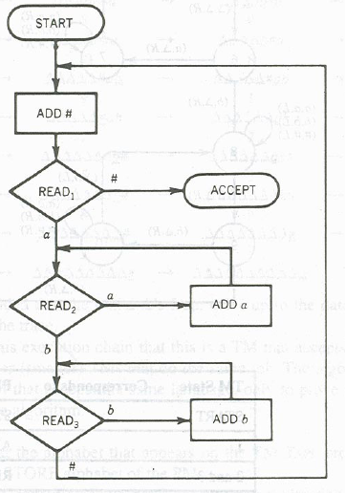

Slide 71
