Slide 1

BIT SINDRI
B.Tech 7th Semester
PROJECT PRESENTATION
by
SAPAN RAVIDAS VIMAL TUDU
BRANCH-CSE BRANCH-CSE
ROLL NO-1809038 ROLL NO-1809038
REG NO-180304400 REG NO-180304400

Slide 2
PROJECT TITLE:
“Information Retrieval using tf-idf algorithm”

Slide 3
INTRODUCTION
The amount of information has increased tremendously over past years due to rapid growth of internet and expansion of data. Due to which it is difficult to fetch relevant information.However, the information retrieval systems are being used in order to get the desired information.
Each information retrieval system mainly composed of two parts the indexer and the ranking algorithm. The index is helpful in finding the set of documents which best fullfills the information need. The purpose of the ranking algorithm is to retrieve from the collection of documents the most relevant ones based on the rank. Ranking directly affects retrieval quality
In this project we will focus on the tf-idf algorithm for fetching information. TF-IDF is a statistical measure that evaluates how relevant word is to a document in a collection of documents.Term frequency(tf) indicates how important a specific term in a document.Whereas inverse document frequency(idf) is the weight of the term.It aims to reduce the weight if the the term’s occurrences is scattered.Ranking of the document is tf-idf score which is the product of tf and idf.

Slide 4
BACKGROUND
TF (Term Frequency):
The TF is a frequency count of a term in a document. There are several ways of calculating this frequency, with simple raw count of instance of a word appears in a document. Then there are ways to adjust the frequency of the most frequent word in a document. One of the way is to divide the frequency count with the length of the document (the number of set of different instances).
IDF (Inverse Document Frequency):
The Inverse Document Frequency is the frequency of a word across set of documents. These means how common or rare a word is in the entire document set. The closer it is 0, the more common, a word is. The metric can be calculated by taking the total number of documents, dividing it by the number of documents that contain a word, and calculating the algorithm upon it.

Slide 5
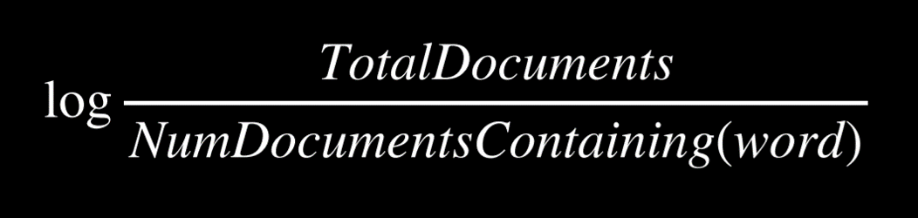
TF-IDF
Multiplying these two values results in the TF-IDFs score. The higher the score, the more relevant that word is in that particular document.The TF-IDF score for the word ‘t’ in the document ‘d’ from the document set ‘D’ is calculated as follows:
Where

Slide 6
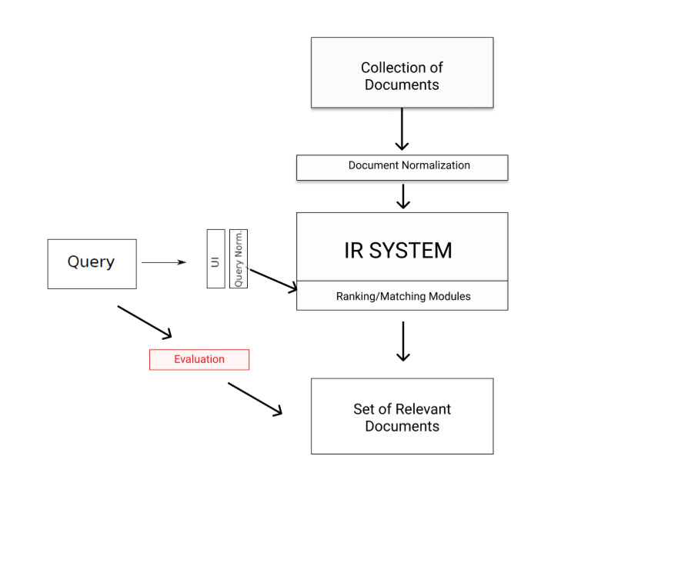
IMPLEMENTATION
The system has access to bunch of documents (corpus) of text. Using TF-IDF try to find out the most relevance sentences or passages from these documents.

Slide 7
Corpus(all the document) is normalized/preprocessed.
Query is taken from the user through UI and normalization of query is also done.
Both this preprocessed corpus and query is fed to the IR system.IR System has tf-idf ranking/matching modules.
IR system is responsible for finding the suitable files among the corpus and relevant sentence or passage within them and return to the user.
Evaluation is done to find whether set of document returned is releveant or not.Further the relevancy of sentence or passage returned is also validated.

Slide 8
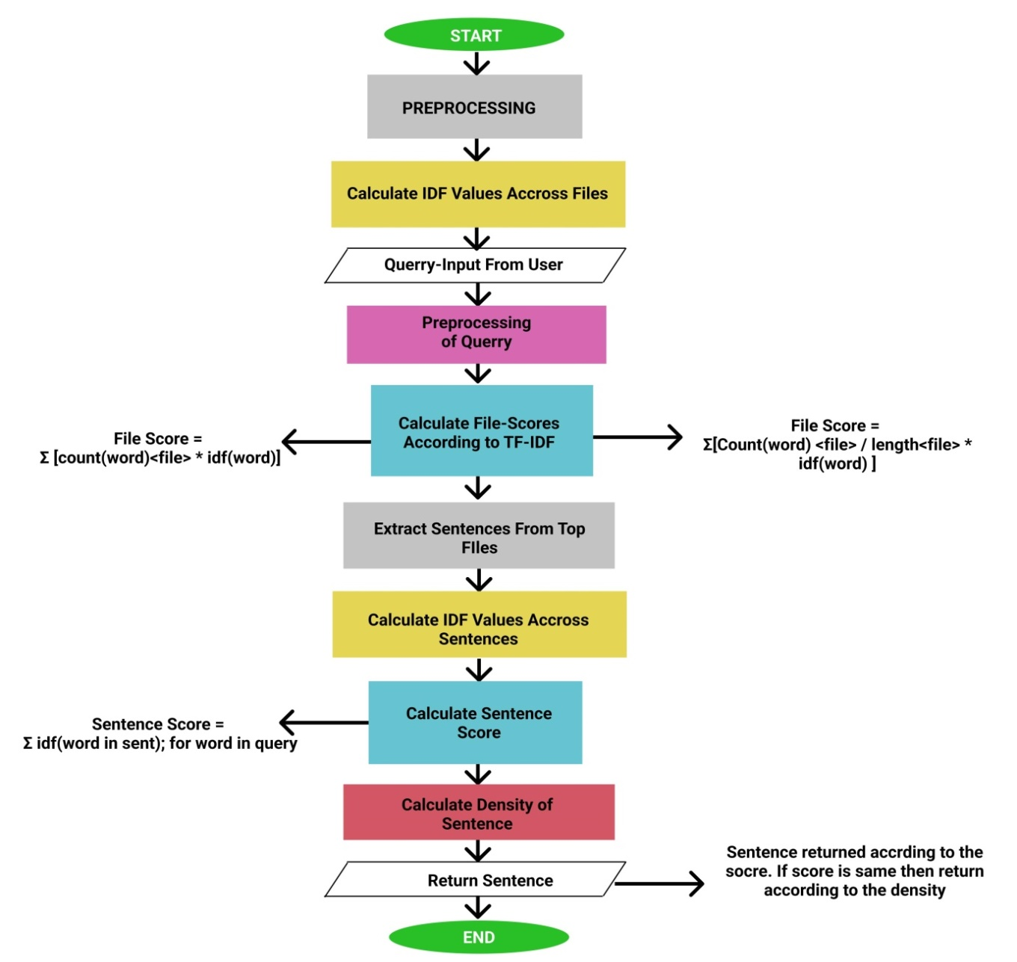
WORKFLOW

Slide 9
Table:Words with their corresponding idf values
Comparison between both Computation methods :
File Score = Σ [count(word)<file> * idf(word)]
File Score = Σ[Count(word) <file> / length<file> * idf(word) ]
SNO. | Words | IDF Values
1 | Visual | 0.40546
2 | Require | 0.69314
3 | Learning | 0.0
4 | Design | 0.40546
5 | Model | 0.0
6 | Estimated | 0.69314
7 | One | 0.0
8 | Many | 0.0
9 | History | 0.0

Slide 10
We have a corpus of text containing information about different domain like Pyhton, Machine Learning, Artificial Intelligence etc.
The user will asks some queries that the answer might be present in those text documents. The algorithm will first find out the most relevant document among them. And again it will look for the most relevant information based on the query the user has asked and return the answer.
The flow starts with the preprocessing of the corpus data which involves process like ex. tokenization, removing stop words and etc. After that IDF value of very set of pre-processed unique words are calculated across the documents. As mentioned earlier idf value of the word is logarithm of ratio of total document in the corpus and the no. document in which word is present.
Then it asks a query from the user and again preprocessing is done in the user input. For calculating file score two techniques for term frequency are used both are shown in the diagram below.

Slide 11
Then it asks a query from the user and again preprocessing is done in the user input. For calculating file score two techniques for term frequency are used both are shown in the diagram below.
After that it find out top the files form the bunch of documents based on the score of file. This is done by counting the frequency(tf-term frequency) of words in query in the each document.And multiplying with their corresponding idf values.Finally adding all the tf-idf values of all words in query to find out the scores of the document.Ranking of document is done accordingly based on the score.In the second method also same procedure is followed except the term frequency is normalized i.e.,it is divided with the length of document.
After that the computation limits to the particular documents which is in top list.The top files to be considered may be just a single file or more than that depending upon the user.It is basically taken one.
Once the top files have been found.Then the top sentences within that document is found.The IDF values across sentences present in the document is calculated followed by the score of the sentence is calculated and top matching sentences are found and returned

Slide 12
CONCLUSION
The set of 90 questions query was performed and the result of both the methods were compared by matching the characters present in them.
After comparing the both formulas over 90 questions by using the parameter number of matching sentences to be returned = 1, 2, 3
We found that out of 90, 73 answers were same in all the parameters for number of matching sentences (1, 2 ,3) that had taken. That means 81.1111% were same answer.
Although it is found that in the different answers cases. Some answers are appeared to most resemble accordance with the query. i.e. Normalizing the term frequency by dividing it with the length of document.
We can conclude that normalization of term frequency leads to the better information retrieval.This is because as the total length of documents can vary from very small to large, so it is a possibility that any term may occur more frequently in large documents in comparison to small documents. So, to solve this issue, the occurrence of any term in a document is divided by the total terms present in that document, to find the term frequency.But the main point to be noted is that both techniques are mostly same.

Slide 13
PROS AND CONS
Pros:
It is easy to compute as it does not involve complex calculation thus making it simpler than the othe algorithm.It has some basic metric to extract the most descriptive terms in a document.It is easy to compute the similarity between 2 documents using it.Measure the uniqueness and relevance of content effectively.
Cons:
The limitations with the TF-IDF algorithms that need to be noted that the algorithm cannot identify the words even a slight change for example change in tense. It will consider ‘go’ and ‘goes’ a different entity, ‘play’ and ‘playing’ as different entity. Due to this limitations when TF-IDF algorithm is applied, sometimes it gives some unexpected results.
TF-IDF cannot check the semantics of text in the documents and due this it only useful until lexical level.
There are many techniques that can be used to improve the performance and accuracy such as Decision Tree, Pattern or rule based classifiers, SVM classifiers, Neural Network classifiers and Bayesian classifiers etc.

Slide 14
SOLUTIONS TO OVERCOME LIMITATIONS:
Preprocessing of the documents can effect the results we are getting.Stemming process can be used to overcome the issues of TF-IDF not being able to identify that ‘go’ and ‘goes’ are basically the same words. Secondly the Stop Words can be added as much as possible so that the words that are not of any values as ‘the’ , ‘for’ are filtered. These will ensure to some extent that you are getting useful words as output.
Many improved version of tf-idf algorithm has been proposed.Those algorithm incorporated hill climbing for boosting performance.A variant of tf-idf algorithm can be applied in cross language by using statistical translation.Gentic algorithm can be also used to improved the tf-idf.

Slide 15
REFRENCES:
[1] Shazad Qaiser,Ramsha Ali (2018):Text Mining:Use of TF-IDF to examine the relevance of words to documents. July 2018 International Journal of Computer Applications 181(1) DOI:10.5120/ijca2018917395
[2]Arfiani Nur Khusna,Indri Augistina Informatics Engineering Universities Ahmad Dahlan Yogyakarta,Indonessia. Implementation of Information Retrieval Using Tf-Idf Weighting Method On Detik.Com’s Website October 2018
DOI:10.1109/TSSA.2018.8708744 Conference: 2018 12th International Conference on Telecommunication Systems, Services, and Applications (TSSA)
[3]S. Jabri, A. Dahbi, T. Gadi and A. Bassir, Ranking of text documents using TF-IDF weighting and association rules miningApril 2018 DOI:10.1109/ICOA.2018.8370597 Conference: 2018 4th International Conference on Optimization and Applications (ICOA) Project: Mining of association rules
[4] https://www.nltk.org/
[5] https://cs50.harvard.edu/ai/2020/

Slide 16
THANK YOU

