Slide 1
Chapter 11: Advance Database System
Centralized Systems
Client--Server Systems
Parallel Systems
Distributed Systems
Network Types

Slide 2
Centralized Systems
Run on a single computer system and do not interact with other computer systems.
General-purpose computer system: one to a few CPUs and a number of device controllers that are connected through a common bus that provides access to shared memory.
Single-user system (e.g., personal computer or workstation): desk-top unit, single user, usually has only one CPU and one or two hard disks; the OS may support only one user.
Multi-user system: more disks, more memory, multiple CPUs, and a multi-user OS. Serve a large number of users who are connected to the system vie terminals. Often called server systems.

Slide 3
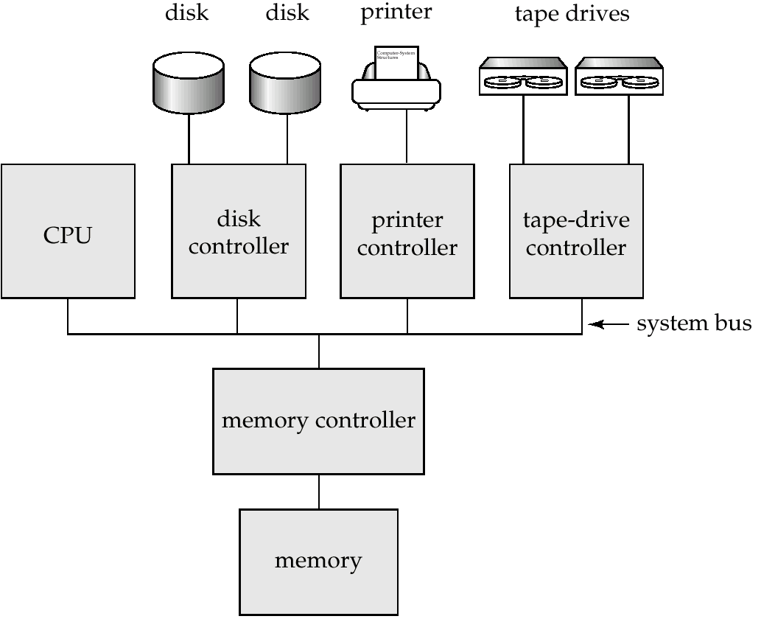
A Centralized Computer System

Slide 4
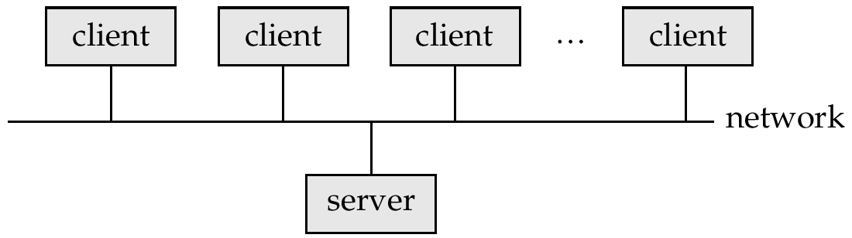
Client-Server Systems
Server systems satisfy requests generated at m client systems, whose general structure is shown below:

Slide 5
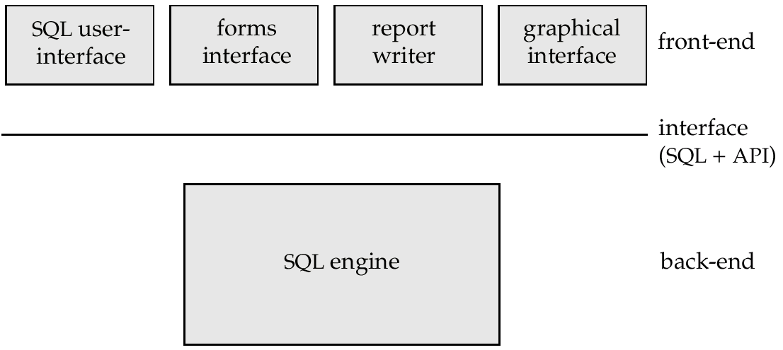
Client-Server Systems (Cont.)
Database functionality can be divided into:
  Back-end: manages access structures, query evaluation and optimization, concurrency control and recovery.
  Front-end: consists of tools such as forms, report-writers, and graphical user interface facilities.
The interface between the front-end and the back-end is through SQL or through an application program interface.

Slide 6
Client-Server Systems (Cont.)
Advantages of replacing mainframes with networks of workstations or personal computers connected to back-end server machines:
  better functionality for the cost
  flexibility in locating resources and expanding facilities
  better user interfaces
  easier maintenance
Server systems can be broadly categorized into two kinds:
  transaction servers which are widely used in relational database systems, and
  data servers, used in object-oriented database systems

Slide 7
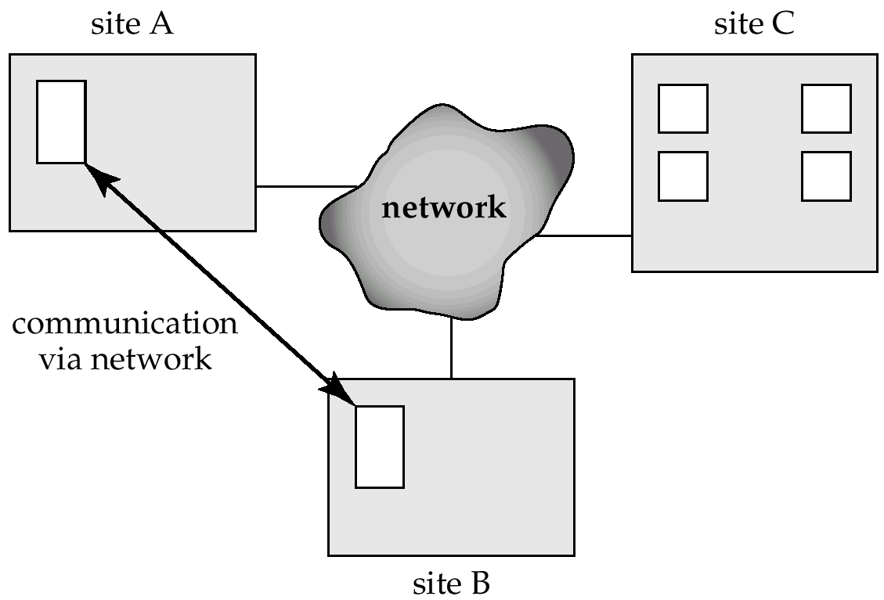
Distributed Systems
Data spread over multiple machines (also referred to as sites or nodes.
Network interconnects the machines
Data shared by users on multiple machines

Slide 8
Distributed Databases
Homogeneous distributed databases
  Same software/schema on all sites, data may be partitioned among sites
  Goal: provide a view of a single database, hiding details of distribution
Heterogeneous distributed databases
  Different software/schema on different sites
  Goal: integrate existing databases to provide useful functionality
Differentiate between local and global transactions
  A local transaction accesses data in the single site at which the transaction was initiated.
  A global transaction either accesses data in a site different from the one at which the transaction was initiated or accesses data in several different sites.

Slide 9
Trade-offs in Distributed Systems
Sharing data – users at one site able to access the data residing at some other sites.
Autonomy – each site is able to retain a degree of control over data stored locally.
Higher system availability through redundancy — data can be replicated at remote sites, and system can function even if a site fails.
Disadvantage: added complexity required to ensure proper coordination among sites.
  Software development cost.
  Greater potential for bugs.
  Increased processing overhead.

Slide 10
Implementation Issues for Distributed Databases
Atomicity needed even for transactions that update data at multiple site
  Transaction cannot be committed at one site and aborted at another
The two-phase commit protocol (2PC) used to ensure atomicity
  Basic idea: each site executes transaction till just before commit, and the leaves final decision to a coordinator
  Each site must follow decision of coordinator: even if there is a failure while waiting for coordinators decision
    To do so, updates of transaction are logged to stable storage and transaction is recorded as “waiting”
2PC is not always appropriate: other transaction models based on persistent messaging, and workflows, are also used
Distributed concurrency control (and deadlock detection) required
Replication of data items required for improving data availability

Slide 11
Distributed Database System
A distributed database system consists of loosely coupled sites that share no physical component
Database systems that run on each site are independent of each other
Transactions may access data at one or more sites

Slide 12
Homogeneous Distributed Databases
In a homogeneous distributed database
  All sites have identical software
  Are aware of each other and agree to cooperate in processing user requests.
  Each site surrenders part of its autonomy in terms of right to change schemas or software
  Appears to user as a single system
In a heterogeneous distributed database
  Different sites may use different schemas and software
    Difference in schema is a major problem for query processing
    Difference in softwrae is a major problem for transaction processing
  Sites may not be aware of each other and may provide only
  limited facilities for cooperation in transaction processing

Slide 13
Distributed Data Storage
Assume relational data model
Replication
  System maintains multiple copies of data, stored in different sites, for faster retrieval and fault tolerance.
Fragmentation
  Relation is partitioned into several fragments stored in distinct sites
Replication and fragmentation can be combined
  Relation is partitioned into several fragments: system maintains several identical replicas of each such fragment.

Slide 14
Data Replication
A relation or fragment of a relation is replicated if it is stored redundantly in two or more sites.
Full replication of a relation is the case where the relation is stored at all sites.
Fully redundant databases are those in which every site contains a copy of the entire database.

Slide 15
Data Replication (Cont.)
Advantages of Replication
  Availability: failure of site containing relation r does not result in unavailability of r is replicas exist.
  Parallelism: queries on r may be processed by several nodes in parallel.
  Reduced data transfer: relation r is available locally at each site containing a replica of r.
Disadvantages of Replication
  Increased cost of updates: each replica of relation r must be updated.
  Increased complexity of concurrency control: concurrent updates to distinct replicas may lead to inconsistent data unless special concurrency control mechanisms are implemented.
    One solution: choose one copy as primary copy and apply concurrency control operations on primary copy

Slide 16
Data Fragmentation
Division of relation r into fragments r₁, r₂, …, r_{n} which contain sufficient information to reconstruct relation r.
Horizontal fragmentation: each tuple of r is assigned to one or more fragments
Vertical fragmentation: the schema for relation r is split into several smaller schemas
  All schemas must contain a common candidate key (or superkey) to ensure lossless join property.
  A special attribute, the tuple-id attribute may be added to each schema to serve as a candidate key.
Example : relation account with following schema
Account-schema = (branch-name, account-number, balance)

Slide 17
Horizontal Fragmentation of account Relation
branch-name
account-number
balance
Hillside
Hillside
Hillside
A-305
A-226
A-155
500
336
62
account₁=σ_{branch-name=“Hillside”}(account)
branch-name
account-number
balance
Valleyview
Valleyview
Valleyview
Valleyview
A-177
A-402
A-408
A-639
205
10000
1123
750
account₂=σ_{branch-name=“Valleyview”}(account)

Slide 18
Vertical Fragmentation of employee-info Relation
branch-name
customer-name
tuple-id
Hillside
Hillside
Valleyview
Valleyview
Hillside
Valleyview
Valleyview
Lowman
Camp
Camp
Kahn
Kahn
Kahn
Green
1
2
3
4
5
6
7
deposit₁=Πbranch-name, customer-name, tuple-id(employee-info)
account number
balance
tuple-id
A-305
A-226
A-177
A-402
A-155
A-408
A-639
500
336
205
10000
62
1123
750
1
2
3
4
5
6
7
deposit₂=Πaccount-number, balance, tuple-id(employee-info)

Slide 19
Advantages of Fragmentation
Horizontal:
  allows parallel processing on fragments of a relation
  allows a relation to be split so that tuples are located where they are most frequently accessed
Vertical:
  allows tuples to be split so that each part of the tuple is stored where it is most frequently accessed
  tuple-id attribute allows efficient joining of vertical fragments
  allows parallel processing on a relation
Vertical and horizontal fragmentation can be mixed.
  Fragments may be successively fragmented to an arbitrary depth.

Slide 20
Data Transparency
Data transparency: Degree to which system user may remain unaware of the details of how and where the data items are stored in a distributed system
Consider transparency issues in relation to:
  Fragmentation transparency
  Replication transparency
  Location transparency

Slide 21
Naming of Data Items - Criteria
1. Every data item must have a system-wide unique name.
2. It should be possible to find the location of data items efficiently.
3. It should be possible to change the location of data items transparently.
4. Each site should be able to create new data items autonomously.

Slide 22
Centralized Scheme - Name Server
Structure:
  name server assigns all names
  each site maintains a record of local data items
  sites ask name server to locate non-local data items
Advantages:
  satisfies naming criteria 1-3
Disadvantages:
  does not satisfy naming criterion 4
  name server is a potential performance bottleneck
  name server is a single point of failure

Slide 23
Object-Oriented Data Model
Loosely speaking, an object corresponds to an entity in the E-R model.
The object-oriented paradigm is based on encapsulating code and data related to an object into single unit.
The object-oriented data model is a logical data model (like the E-R model).
Adaptation of the object-oriented programming paradigm (e.g., Smalltalk, C++) to database systems.

Slide 24
Object Structure
An object has associated with it:
  A set of variables that contain the data for the object. The value of each variable is itself an object.
  A set of messages to which the object responds; each message may have zero, one, or more parameters.
  A set of methods, each of which is a body of code to implement a message; a method returns a value as the response to the message
The physical representation of data is visible only to the implementor of the object
Messages and responses provide the only external interface to an object.
The term message does not necessarily imply physical message passing. Messages can be implemented as procedure invocations.

Slide 25
Messages and Methods
Methods are programs written in general-purpose language with the following features
  only variables in the object itself may be referenced directly
  data in other objects are referenced only by sending messages.
Methods can be read-only or update methods
  Read-only methods do not change the value of the object
Strictly speaking, every attribute of an entity must be represented by a variable and two methods, one to read and the other to update the attribute
  e.g., the attribute address is represented by a variable address and two messages get-address and set-address.
  For convenience, many object-oriented data models permit direct access to variables of other objects.

Slide 26
Object Classes
Similar objects are grouped into a class; each such object is called an instance of its class
All objects in a class have the same
  Variables, with the same types
  message interface
  methods
  The may differ in the values assigned to variables
Example: Group objects for people into a person class
Classes are analogous to entity sets in the E-R model

