Slide 1

SAPIENZA UNIVERSITÀ DI ROMA · INTERACTIVE GRAPHICS
LUMEN DRIFT
A sci-fi exploration & platforming game, built in Three.js
Fabio Falconi
Student ID 2048079
Professor: Marco Schaerf · Academic Year 2025/2026

Slide 2
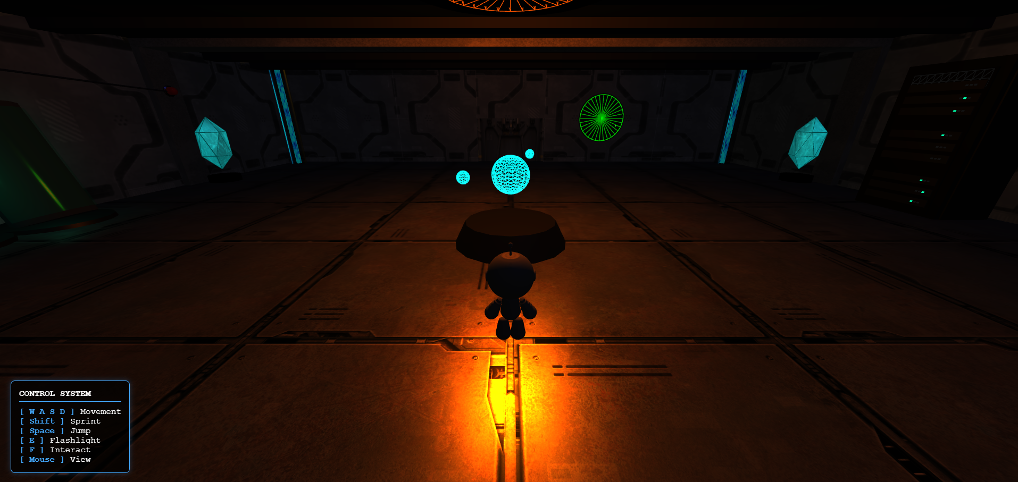



01 — OVERVIEW
Introduction
Browser-executable 3D application for the Interactive Graphics course, built entirely with Three.js and WebGL.
The player controls an android unit in third-person view aboard a spaceship damaged by proximity to a black hole's event horizon. The player will have to recover the spaceship’s reactor by solving a puzzle and face a platform section.
In the environment background, a simulated star system orchestrates the orbital movement of six celestial bodies and their satellites in real time.
Beyond the astronomical simulation: gravity & jump physics, a player-controlled flashlight, and light-driven environmental puzzles.
Core Libraries
Three.js (r128)
GLTFLoader
Tween.js
Object-oriented wrapper over WebGL; manages the full scene graph.
Loads .gltf/.glb assets — planets & structures — preserving UVs and materials.
Interpolates transforms; drives the main door's progressive movement.
LUMEN DRIFT
01

Slide 3



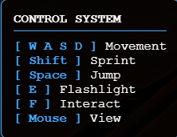




02 — USER MANUAL
Controls & Interaction
Movement is third-person with a self-adjusting camera. Approaching a valid object shows an on-screen “Press [F] to interact” prompt.
W A S D
Mouse
Move forward, left, backward, and right relative to facing direction.
Rotate the camera and dictate the character's facing direction.
Space
Shift
Jump over obstacles and gaps.
Hold while moving to sprint at a higher speed.
E
F
Toggle the android's built-in flashlight on and off.
Interact with terminals, buttons, and key items.
Esc
Open the pause menu, that allows to regulate the audio volume.
LUMEN DRIFT
03

Slide 4
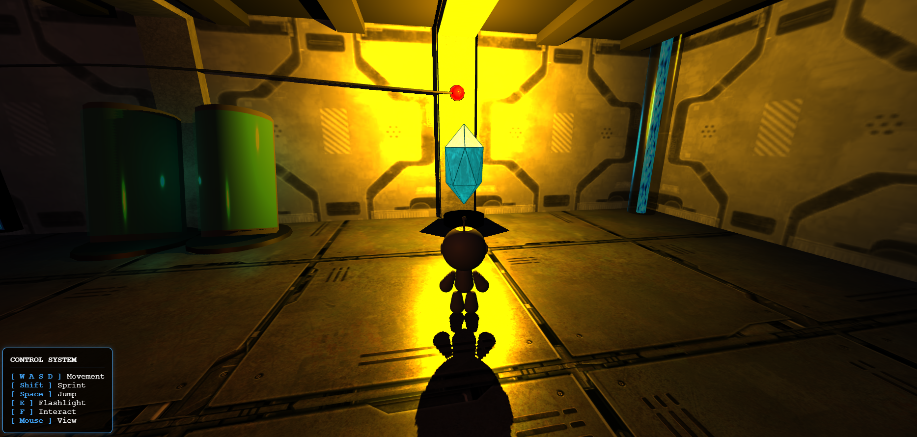



02 — USER MANUAL
The Light Puzzle
To exit the starting room, the player must overload two photo-sensitive crystal sensors at the exact same time.
Console Logs
The wall terminal hints at the solution: overload both crystals with a light beam simultaneously.
Fixed Light Source
A button activates an environmental point light aimed at the first crystal.
The Flashlight
With only one torch, the player must manually aim it (via E) at the second crystal.
The Airlock
Once both crystals register light simultaneously, the sealed main door opens.
LUMEN DRIFT
04

Slide 5



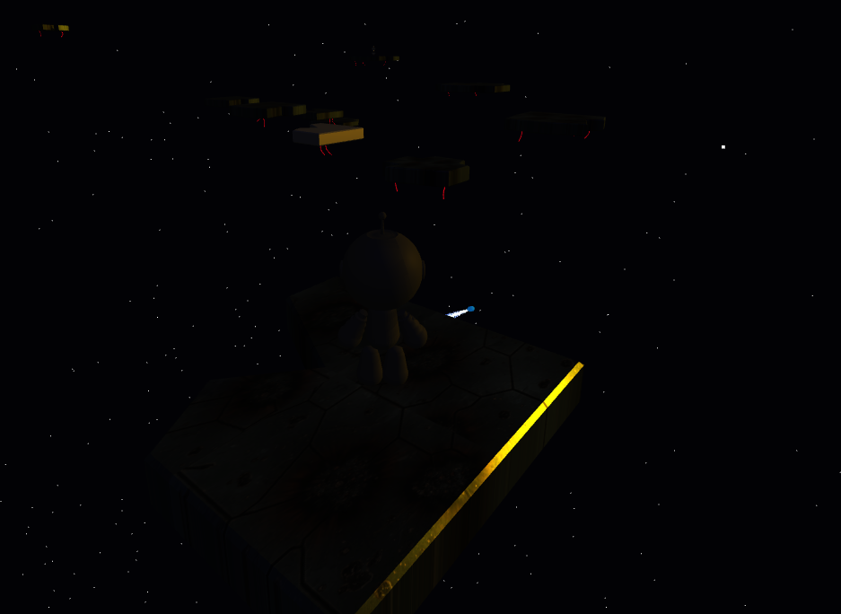
02 — USER MANUAL
Platforming Phase
In the external sector, the player leaps across floating wreckage. The flashlight becomes essential: platforms react dynamically to illumination.
Light-only Platforms
Shadow Platforms
Invisible and lack collision by default — they materialize and become solid only when struck by a light source.
Solid in the dark, but they vanish the instant they are illuminated by the flashlight.
The player must carefully toggle the flashlight on and off to navigate this section — eventually reaching the lost reactor in the debris field.
LUMEN DRIFT
05

Slide 6

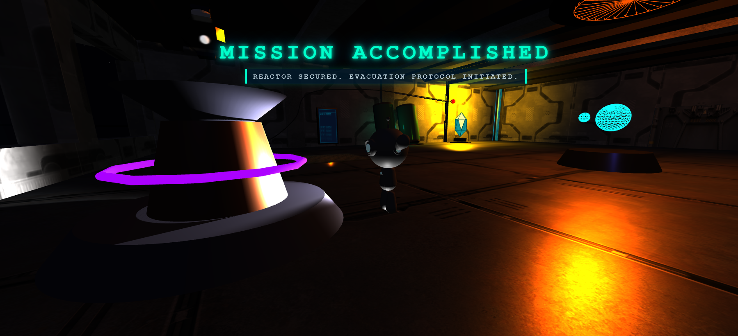



02 — USER MANUAL
The Victory Scene
Once the reactor is carried back and placed on the central pedestal, the game transitions into a scripted ending cinematic.
Camera Detach
The player loses control as the camera smoothly orbits around the protagonist.
Victory Animation
The android performs a celebratory animation, swinging its arms.
Holographic UI
A futuristic “Mission Accomplished” panel fades into the center of the screen.
LUMEN DRIFT
06

Slide 7

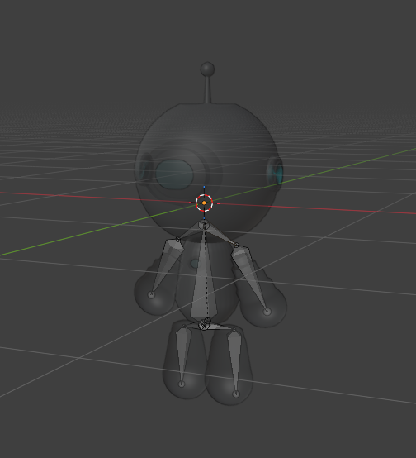
03 — MODELS
The Player: Hierarchical Model
Original monolithic mesh sourced from Sketchfab, then reorganized in Blender into five functional components: Torso (root), LeftArm, RightArm, LeftLeg, RightLeg.
A local kinematic chain is built with Blender's Object (Keep Transform) parenting, mapped directly into the scene graph by GLTFLoader.
Global translation/rotation on the Torso propagates natively to every limb via matrix concatenation, while each limb still animates independently around its own joint during the walk cycle.
Torso (Root)
LeftArm
RightArm
LeftLeg
RightLeg
Scene-graph topology of the player character
LUMEN DRIFT
07

Slide 8

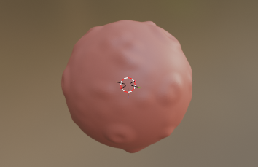
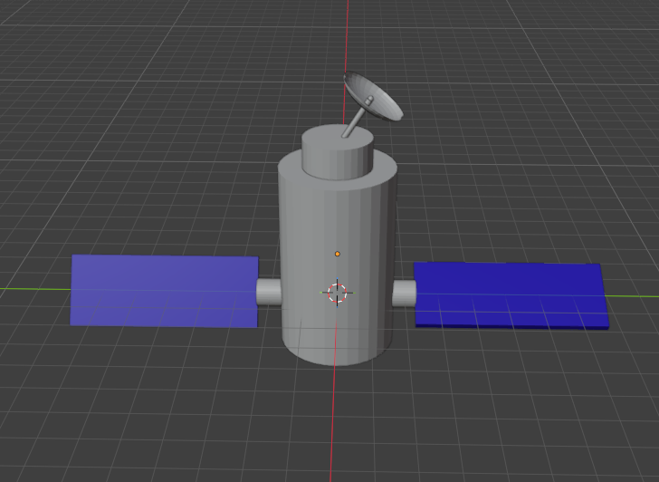
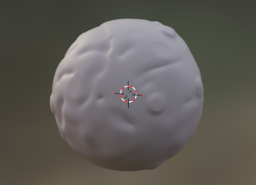
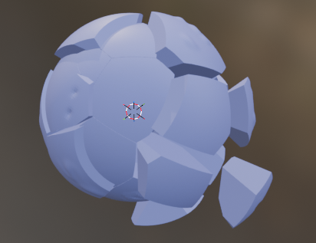
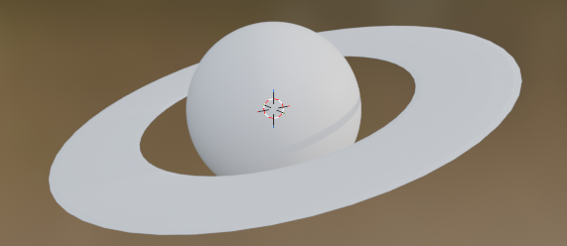


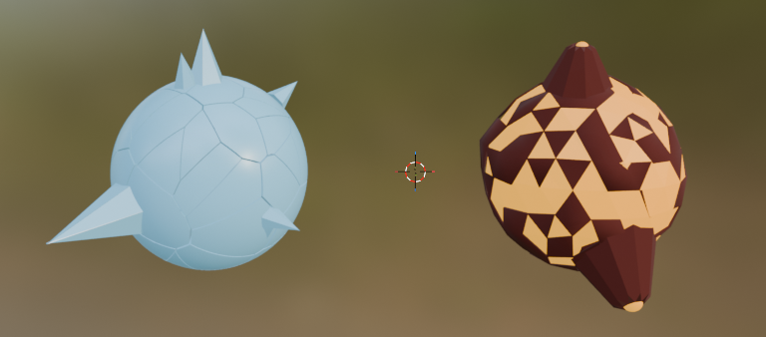
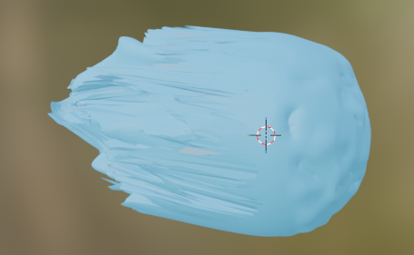


03 — MODELS
Celestial Bodies
All major planetary assets were modeled from scratch in Blender using sculpting and material shading techniques.
Planets & Moon
Shattered Planet
Ringed Planet
UV spheres sculpted with brushes to create surface irregularities and craters. One of the standard planet has a satellite orbiting around it.
Cell-Fracture add-on splits a sphere via a Voronoi algorithm into grouped shards, lit by an internal purple point light.
A sculpted sphere paired with a flattened Torus ring using a custom gradient texture.
Volcanic Planet
Glacial Planet
The Comet
Emissive magma core wrapped by a cratered crust with deleted faces and extruded volcano cones.
Pale-blue emissive sphere, Cell-Fractured for cracks, scattered with independent ice-crystal meshes.
Asymmetrical sculpted nucleus with an attached particle system simulating its tail.
LUMEN DRIFT
08

Slide 9
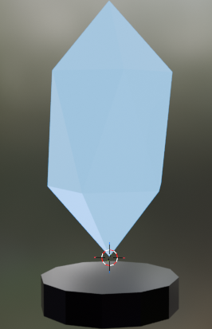
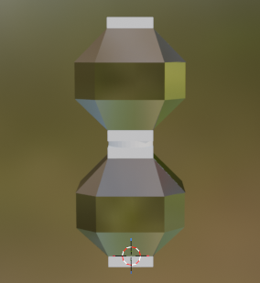
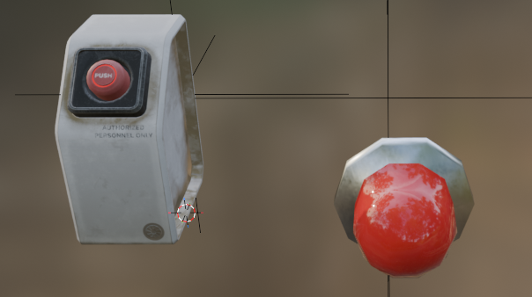

03 — MODELS
Interactive Elements
Light Sensors
Sci-fi geometry crafted in Blender. The crystalline top is a detached object, allowing the script to spin it continuously whenever its activation state updates.
Interactive Buttons
A Sketchfab prop refactored so the movable Key mesh is isolated from the static Base — letting Tween.js interpolate the key's Z-depth for a pressing animation. Triggers a Sketchfab alarm-lamp model.
The Reactor
The mission's primary objective, modeled from scratch in Blender. Can be picked up outside the ship and carried back to the core pedestal.
Textures ship embedded inside each glTF asset. Sketchfab models keep their downloaded textures. Blender-made models use custom-authored ones.
LUMEN DRIFT
09

Slide 10


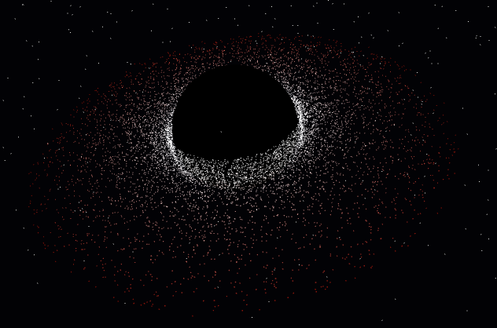
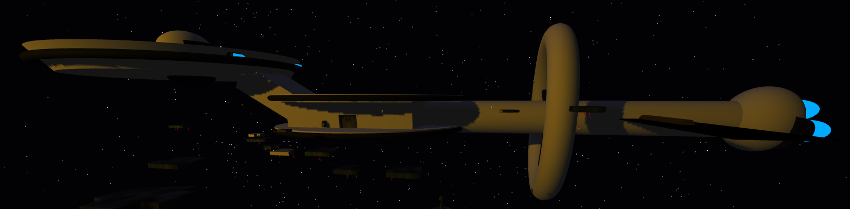
04 — ENVIRONMENT
The Command Vessel & The Black Hole
The Command Vessel
The Black Hole
The visible hull is a hierarchical assembly of Three.js group objects composed with local transformations — a convincing massive spaceship without heavy imported meshes.
The accretion disk is a THREE.BufferGeometry particle system: thousands of vertices whose position and color are computed each frame via trigonometric functions, simulating matter spiraling toward the event horizon.
LUMEN DRIFT
10

Slide 11




04 — ENVIRONMENT
Galactic Clusters & Sci-Fi Furnishings
Galactic Clusters
Sci-Fi Industrial Furnishings
Each background galaxy is a point-based BufferGeometry cloud of 15,000 particles arranged on a spiral, with interpolated size and color gradients. Treated as particle clouds rather than monolithic meshes, the engine culls off-screen points and manages thousands of entities with minimal GPU pressure.
Cryo-pods
Mainframe
Nested geometry simulating glass reflections.
Procedural hardware with periodic LED blinking.
Reactor Pedestal
Radar
Cylinder & torus altar for the reactor.
Cylindrical primitives with a scanning blip.
Hologram
Wall Console
Rotating wireframe solar-system display.
Layered box primitives for reading logs.
LUMEN DRIFT
11

Slide 12



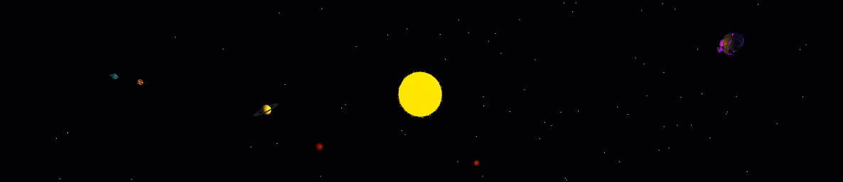
05 — ANIMATIONS
Character Kinematics & Orbital Motion
A single centralized animate() loop, synced to requestAnimationFrame(), drives every transform. No animation is imported.
Walk Cycle
Pivot-Based Orbits
On WASD input, a sine function of elapsed time drives limb rotation; phases invert between opposite limbs for a natural gait. The speed change if walking/running. On stop, a lerp eases every limb back to rest.
Four planets orbit the star at distinct constant angular velocities by parenting each to an invisible Pivot group rotated on Y; a moon compounds this via a secondary pivot on its parent planet.
Gravity & Jump Arc
The Binary Pair
A constant gravity value continuously decreases velocityY, applied each frame to the player's Y-position until a collision is detected.
Volcanic & Glacial planets orbit a shared barycenter. A sine wave drives both rotation speed and separation distance — an “elastic” approximation of Kepler's Second Law.
LUMEN DRIFT
12

Slide 13
05 — ANIMATIONS
Kepler-Inspired Motion
Elliptical Comet Orbit
Black Hole Accretion Disk
The orbit is an ellipse (a = 550, b = 320) on the XZ plane, offset so the star sits at a true focus rather than the center.
10,000 particles live in a single BufferGeometry; positions are rewritten directly in the buffer every frame instead of managing individual objects.
c = √(a² − b²)
ω(t) = α / r(t), α = 20
θ(t+Δt) = θ(t) + ω(t)·0.02
Ω(r) = μ / r¹˙⁵, μ = 15
Angular speed scales inversely with radius¹˙⁵ — particles near the center whirl far faster than those on the outer edge, giving the disk its characteristic swirl. Each frame, positions are rotated with a 2D rotation matrix and the buffer's needsUpdate flag is set for the GPU.
Orbital speed is inversely proportional to distance from the star — the comet accelerates at perihelion and slows at aphelion, a simplified Second Law. Its tail length and flutter also scale with distance, always oriented away from the sun via lookAt().
LUMEN DRIFT
13

Slide 14
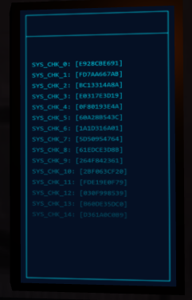
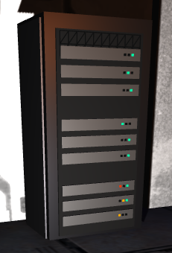
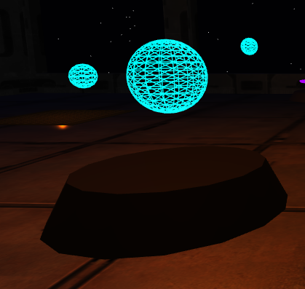
05 — ANIMATIONS
Props animations
Many small models have animations hidden in them.
Crystals and Platforms have oscillating floating movements
Some materials change their opacity overtime, like background stars and The radar blip
lights in the mainframe turn on and off
Console log screen have moving writings
Central Hologram rotates on itself
Plasma pipes have moving textures to simulate moving substance inside them
LUMEN DRIFT
12

Slide 15


05 — ANIMATIONS
Gravity, Collisions & Camera
Gravity & Fall
Collision Detection
A constant acceleration accumulates into velocityY every frame, simulating realistic free-fall until a surface is hit.
Box-intersection checks against platforms, the central hull disk, and walls lock the player's position, zero the velocity, and reset the jump state on contact.
Fail-Safe Respawn
Anti-Clipping Camera
If the player falls below a depth threshold (Y < −30), coordinates are reset to a safe spawn point.
A THREE.Raycaster is cast from the player toward the camera's ideal position each frame; if it hits geometry, the camera is pulled in front of the obstacle and smoothly moved into place, always looking back at the player.
LUMEN DRIFT
14

Slide 16

06 — LIGHTING
The Lighting System
Three layers combine to balance a dark atmospheric aesthetic.
Global Illumination
Local & Decorative
Dynamic Flashlight
A faint Ambient Light keeps shadows from ever being pitch black; a distant PointLight simulates the sun, lighting planets and outdoor platforming.
A shadow-free ceiling PointLight fills the main room; tiny micro-lights inside props (vents, engines) add emissive accents only.
A THREE.SpotLight attached to the player, toggled on/off, is the main driver of puzzle logic — plus one interactive PointLight over a sensor, triggered by a button.
Physical Light Logic — a ray-tracing approximation
Inverse-square attenuation from source to target, discarded early beyond a 20-unit distance cutoff for performance.
Spotlight cone modeling via dot product against the lamp direction, remapped by the penumbra for a soft-edged falloff.
A shadow ray (THREE.Raycaster) checks visibility, restricted only to walls, platforms, and the target itself — keeping thousands of light/object checks cheap enough to run every frame.
LUMEN DRIFT
15

Slide 17
07 — AUDIO
The Audio System
Built on native Three.js audio classes. A single AudioListener on the camera routes every sound; its master volume is set from the pause menu.
Ambient Music
Positional Audio
Sound Effects
A looping non-positional track plays for the whole session at low volume, unlocked on the first canvas click. Its volume is dimmed while the game is paused.
A continuous buzz is a PositionalAudio source attached to the mainframe mesh: the engine scales its volume with listener distance.
Short non-positional clips preloaded once and replayed on demand, restarting the sample if re-triggered in quick succession.
Event-Triggered Sound Effects
Buttons, the sci-fi door opening and closing, the flashlight toggle, and reactor pickup and placement each fire their own cue.
The respawn after a fall and the final victory jingle punctuate the key state transitions of the run.
Footsteps are gated behind a timer, not played per frame. its interval shortens while sprinting, so the step rhythm matches the character’s movement speed.
LUMEN DRIFT
16

Slide 18
Thanks for your attention
Lumen Drift · Interactive Graphics · Fabio Falconi · 2048079

