Slide 1

Mobile Automation
Using
Appium and RedwoodHQ
Presented by:
Dinkar Kumar
© Talentica Software India Pvt. Ltd.

Slide 2
Contents
What is RedwoodHQ
What is Appium
What is Wheat
Video of Wheat in action
Live Demo over WhatsApp
Onboarding
© Talentica Software India Pvt. Ltd.

Slide 3
RedwoodHQ
FOSS Test Case Management and Test Automation Framework.
VERY easy to install!
Allows multiple users to develop automation code, create readable action/keyword driven test cases.
User friendly web interface.
@see http://redwoodhq.com/
© Talentica Software India Pvt. Ltd.

Slide 4
Appium
FOSS, cross-platform Test Automation tool for native, hybrid and mobile web apps.
Run tests on emulators or real devices.
Black Box testing
Write tests in your choice of language (Java, JavaScript with Node.js, PHP, Python, Ruby, C#,Robot)
Very Active community
@see http://appium.io/
© Talentica Software India Pvt. Ltd.

Slide 5

Wheat
A BASIC HOWEVER MUST-HAVE INGREDIENT FOR AUTOMATED FUNCTIONAL TESTING FOR MOBILE​
© Talentica Software India Pvt. Ltd.

Slide 6
Wheat
Bridge between RedwoodHQ and Appium.
Say BYE to coding for automation.
Least to No learning curve.
Run Simultaneously on multiple device/simulator.
Supports almost all actions from Appium + extra actions to ease testing.
No prior knowledge of writing automations required.
© Talentica Software India Pvt. Ltd.

Slide 7
RedwoodHQ
Test case/suite creation
Wheat
Pass Test case/suite data and results between RedwoodHQ and Appium
Appium
Execute RedwoodHQ test cases/suites on mobile emulators/simulators/devices
Run Test cases
Reports
Push results to RedwoodHQ for its reports through Wheat
Action creation
Provide generic action scripts
Provide Assertion scenario
© Talentica Software India Pvt. Ltd.

Slide 8
Wheat Actions
Appium Provided Actions
Customized Actions
Click
Long press
Set text
Zoom
Screenshot
Swipe
Pinch
...
Scroll and find element with direction
Make Interruption
Check Text
Will add new as per QA requirement
© Talentica Software India Pvt. Ltd.

Slide 9
Demo Video
© Talentica Software India Pvt. Ltd.

Slide 10
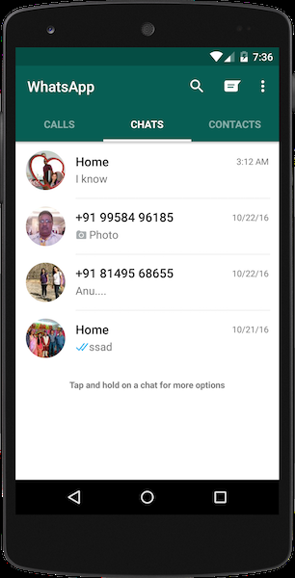
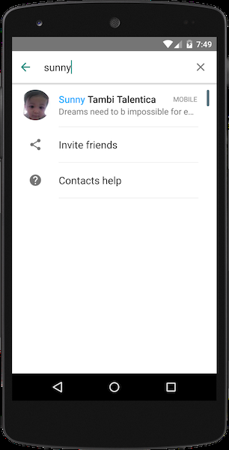
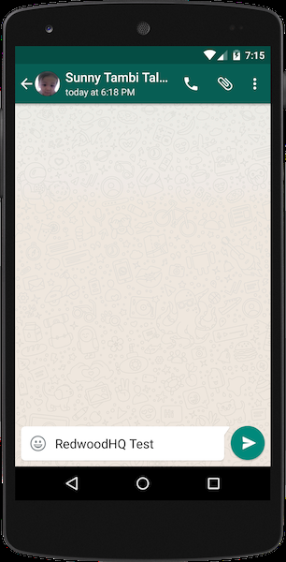
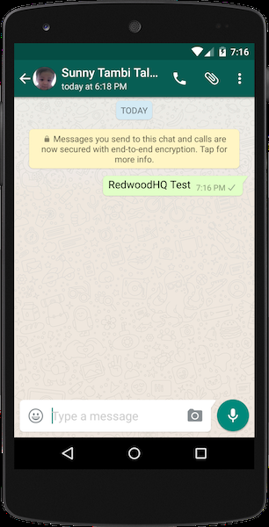
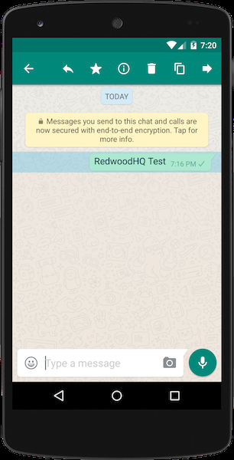
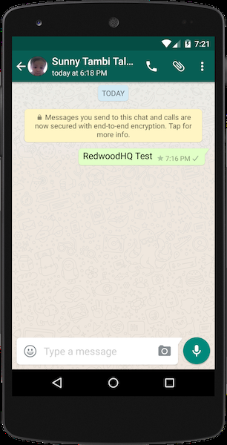
Live Demo
1. Launch WhatsApp
2. Search for friend
3. Write a message
4. Send the message
5. Long Press the message
6. Mark as favourite

Slide 11
WITHOUT WHEAT | WITH WHEAT
Have to write too much code Steep learning Curve High Time per Test case Write code for custom action Handle bugs in existing Appium actions | No coding Zero to minimal learning curve Minimal Time per Test case Custom actions provided Open Sourced – Open for enhancements and shape it as you need
© Talentica Software India Pvt. Ltd.

Slide 12
Onboarding
Things you need to install in your Mac:
Appium
RedwoodHQ agent
Xcode
Android Studio
© Talentica Software India Pvt. Ltd.

Slide 13
Thank You. Questions Please!!
© Talentica Software India Pvt. Ltd.

