Slide 1
UML Diagram
Anomaly Detection Server

Slide 2
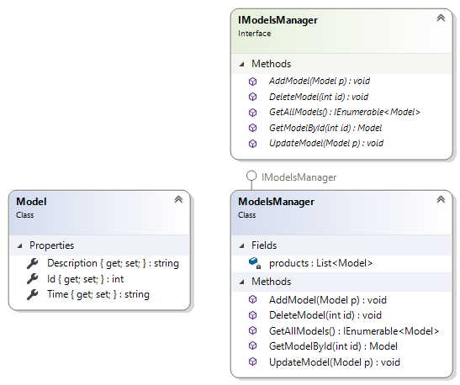
Model

Slide 3
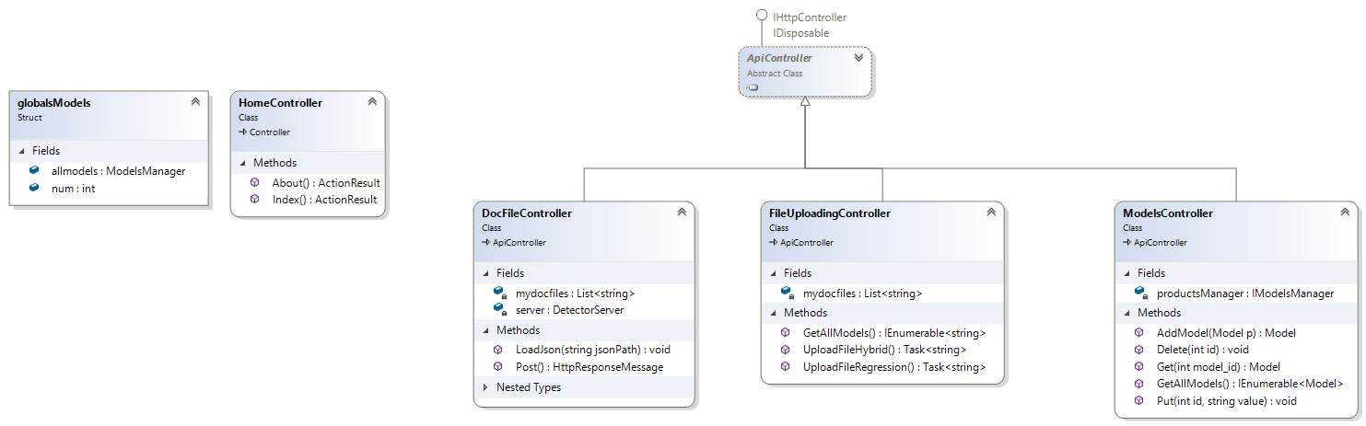
controller

Slide 4
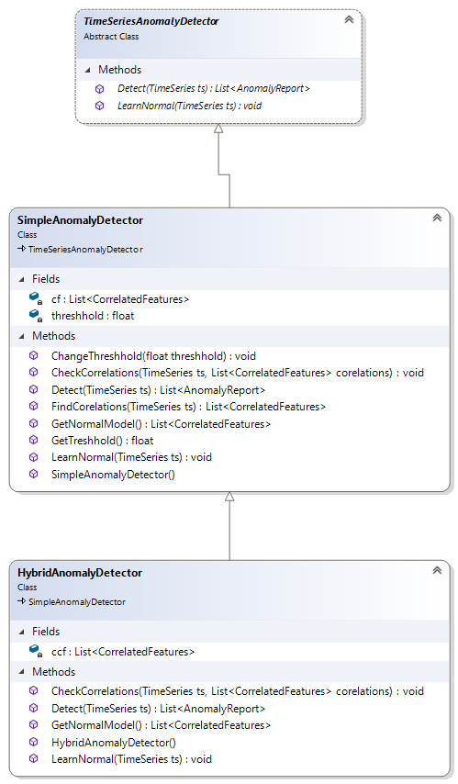
Server - Part One

Slide 5
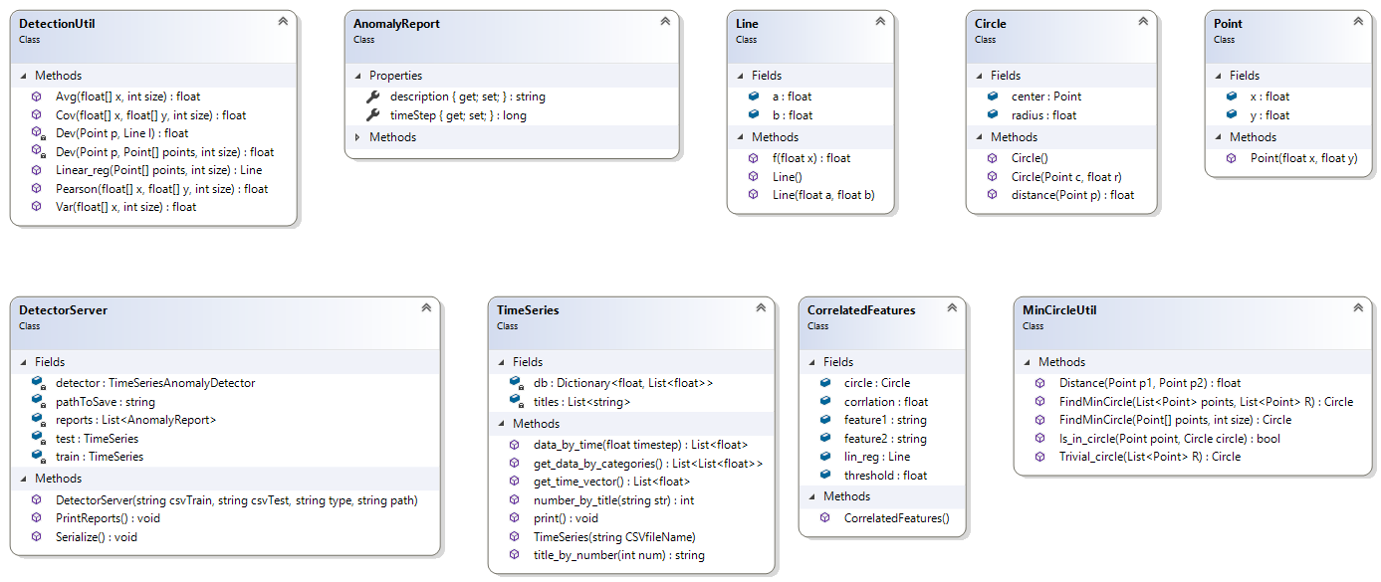
Server – Part Two

