Slide 1
Achieving Self-organizing Maps
on clustering analysis of temporal characteristics of car crashes
The A Team

Slide 2
Project information
Title:
Achieving Self-organizing Maps on clustering analysis of temporal characteristics of car crashes
Team name:
The A team
Team member:
Shuyang Zhang(zsy2018@tamu.edu)
Arielle Wood (wood22975@tamu.edu)
Gabriel Ibiassi Nambila (gabrielnambila@tamu.edu)
Luke Anderton (lukeanderton@tamu.edu)
Sapir Carlo Dooley (sapirdooley@gmail.com）

Slide 3
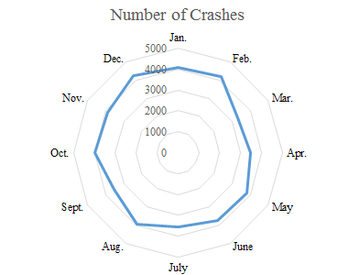
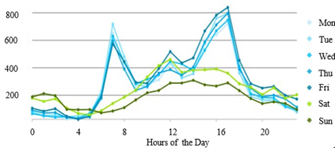
Project overview
Objective:
Achieving Self-organizing Maps algorithm with Python to cluster car crash data from Scott and Polk county, Iowa.
Draw temporal characteristics from the clustering results to understand car crash better and eventually help to identify
factors of car crashes and provide innovative insights on road safety.
For example:
(a)Crashes occurred every month (b)Crashes occurred every hour

Slide 4
Project overview
Knowledge gaps in Related works:
Conventional geostatistical methods (i.e., KDE and Hotspot analysis) cannot represent traffic risk. How to better depict collision-prone road segments need to be explored;
2) Conventional geostatistical methods focus only on the spatial distribution of car crashes. The number of car crashes varying in the temporal domain should also be considered;
3) The studies of crash severity estimation and the implementation of association rule mining mainly rely on historical crash data, therefore cannot be applied to the newly-constructed road.

Slide 5
Project overview
Outcomes:
Python code for SOM algorithm
Graphs that can help to illustrate temporal characteristics
Final draft of project proposal
Powerpoint draft for final presentation
Each member’s responsibility:
Data collection: Shuyang
Python Code: Everyone
Graphs: Shuyang,Luke
Powerpoint draft: Gabriel
Final presentation: Everyone
Project Proposal draft: Carlo, Arielle

Slide 6
Project overview
Timeline:
Week 5-6 Data collection
Week 7-11 Python Code editing
Week 12 Graphs
Week 13 Powerpoint
Week 13-15 Proposal draft

Slide 7
Thank You!

