Slide 1
Achieving Self-organizing Maps
on clustering analysis of temporal characteristics of car crashes
The A Team

Slide 2
Status Report
Title:
Achieving Self-organizing Maps on clustering analysis of temporal characteristics of car crashes
Team name:
The A team
Team member:
Shuyang Zhang(zsy2018@tamu.edu)
Arielle Wood (wood22975@tamu.edu)
Gabriel Ibiassi Nambila (gabrielnambila@tamu.edu)
Luke Anderton (lukeanderton@tamu.edu)
Sapir Carlo Dooley (sapirdooley@gmail.com）

Slide 3
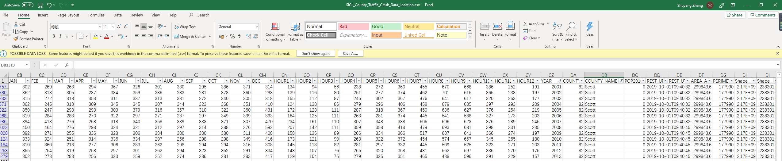
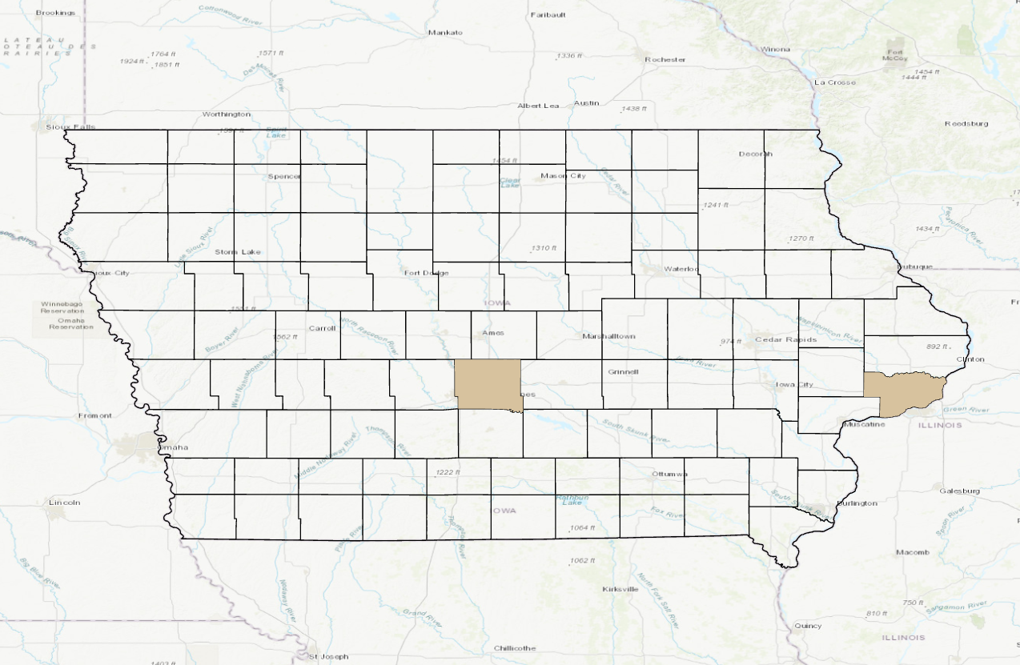
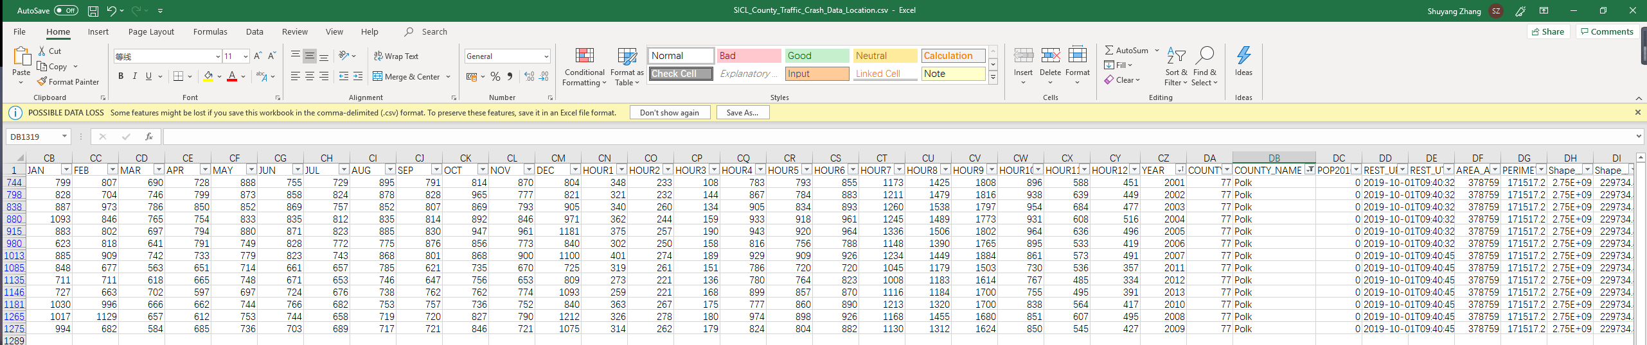
Status Report
Data collection and processing
SICL County Traffic Crash Data -- The Iowa DOT's Office of Traffic and Safety
(a)Study area (b)Crash data in excel file

Slide 4
Project overview
Outcomes:
Python code for SOM algorithm
Graphs that can help to illustrate temporal characteristics
Final draft of project proposal
Powerpoint draft for final presentation
Each member’s responsibility:
Data collection: Shuyang
Python Code: Everyone
Graphs: Shuyang,Luke
Powerpoint draft: Gabriel
Final presentation: Everyone
Project Proposal draft: Carlo, Arielle

Slide 5
Project overview
Timeline:
Week 5-6 Data collection and processing
Week 7-11 Python Code editing
Week 12 Graphs
Week 13 Powerpoint
Week 13-15 Proposal draft

Slide 6
Thank You!

