Slide 1
POLYNOMIAL REGRESSION
Sapna Jha(4769)

Slide 2
AGENDA
What is Polynomial Regression
Why do we use Polynomial Regression
When do we use Polynomial
Degree of Polynomial
Math intuition with Example
Cost Function
Gradient Descent
Conclusion
References

Slide 3
What is polynomial regression
Regression analysis that uses polynomials to the nth degree to model the connection between independent and dependent variables is known as polynomial regression.
The least squares fitting technique is typically used to fit polynomial regression models which reduces the variance of the coefficients.
Polynomial Regression is a special case of Linear Regression where we fit the polynomial equation on the data with a curvilinear relationship between the dependent and independent variables.

Slide 4
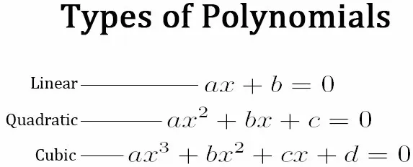

Slide 5
Why do we use polynomial regression?
If we try to use a simple linear regression in the above graph then the linear regression line won’t fit very well. It is very difficult to fit a linear regression line in the above graph with a low value of error. Hence we can try to use the polynomial regression to fit a polynomial line so that we can achieve a minimum error or minimum cost function. The equation of the polynomial regression for the above graph data would be:

Slide 6
When do we use Polynomial ?
When we build our model, we discover that it performs terribly. We compare the actual value to the best fit line, which we forecasted, and find that there appears to be some sort of curve in the graph for the actual value, and our line is nowhere close to cutting the mean of the points. This is where polynomial regression comes into action; it forecasts the best fit line that follows the pattern (curve) of the data.

Slide 7
Degree Of Polynomial
The General Equation of Polynomial Regression is:
Y=θo + θ₁X + θ₂X² + … + θₘXᵐ + residual error
How to find the right degree of the equation?
We can use the following methods to determine the ideal degree for the model to avoid over- or
under-fitting.
Forward Selection, the degree is raised until it becomes significant enough to designate the ideal model.
Backward Selection reduces the degree until it becomes important enough to determine the best model.

Slide 8
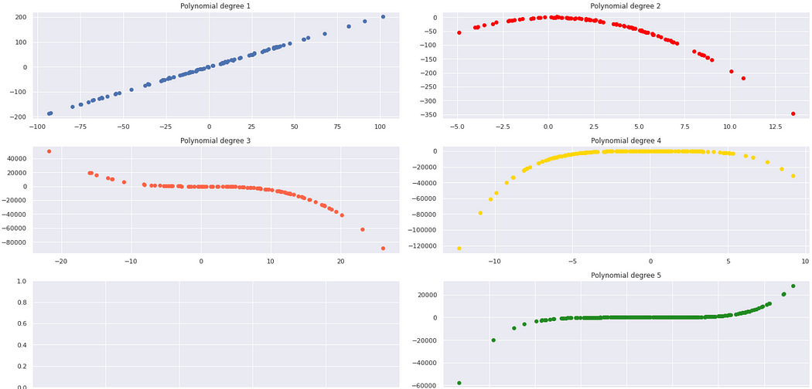
Let’s look at the shapes of polynomials of different degrees.

Slide 9
Algorithm Of Polynomial Regression
Step 1 : Input order of polynomial to be fit m.
Step 2 : Input number of data points n.
Step 3 : If n < m + 1, print out an error message that regression is impossible and terminate the process . If n>= m+1, continue.
Step 4 : Compute the elements of the normal equation of the form of an augmented matrix.
Step 5 : Solve the augmented matrix for the coefficients a0,a1,a2,…,an using an elimination method.
Step 6 : Print out the coefficients.

Slide 10
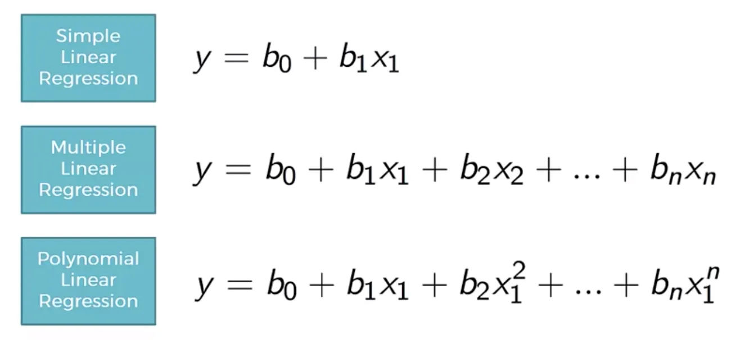
Math Behind Polynomial Regression!

Slide 11
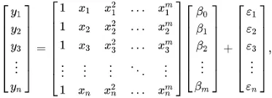
Now, the value of b is found out by matrix multiplication. For Multiple variable the matrix calculation is done by:

Slide 12
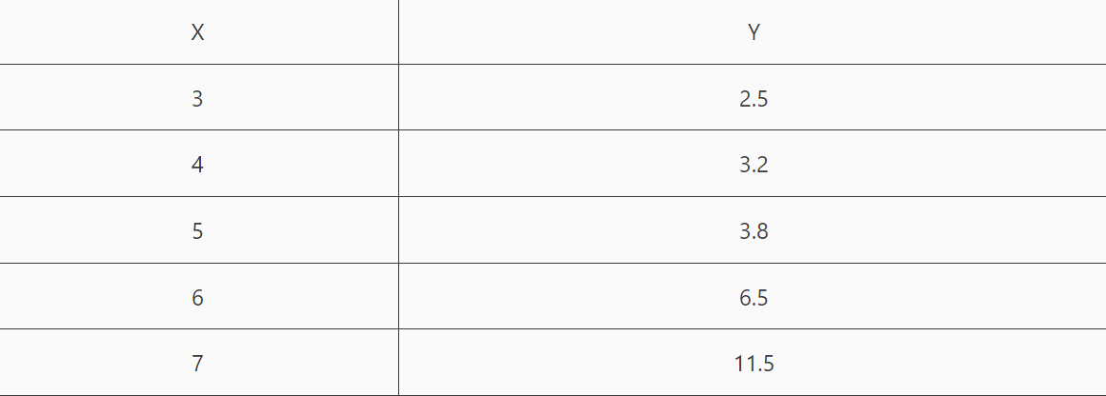
Example Of Polynomial regression
Problem Definition:
Find a quadratic regression model for the following data:

Slide 13
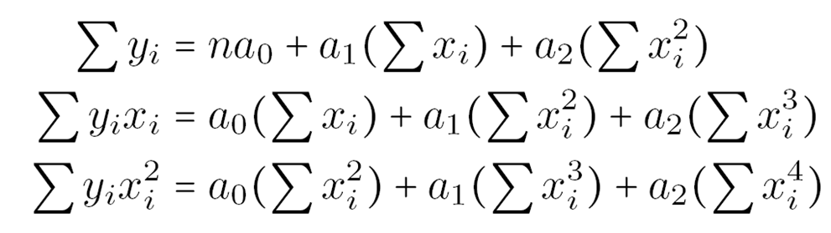
Solution
Let the quadratic polynomial regression model be
y=a₀+a₁*x+a₂*x²
The values of a₀, a₁, and a₂ are calculated using the following system of equations:

Slide 14
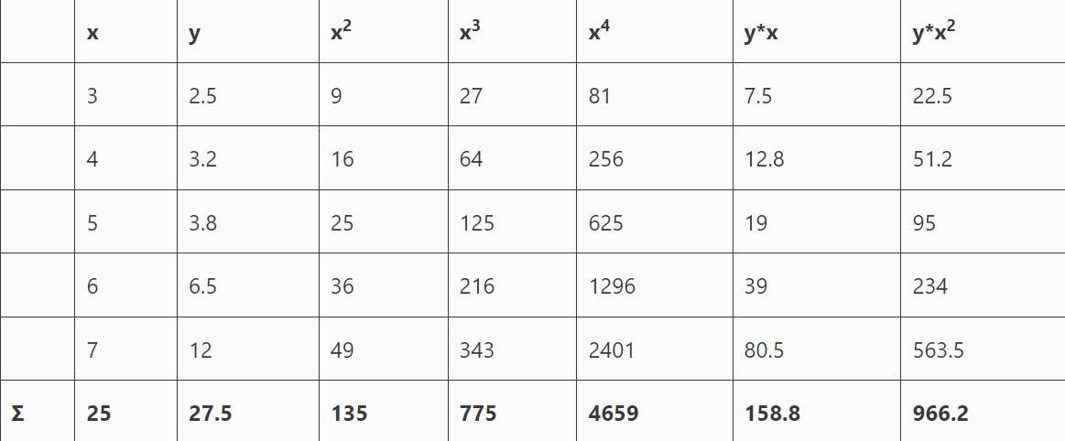
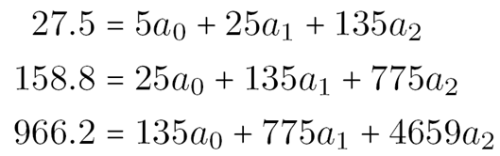
Using the given data we,
Solving this system of equations we get
a₀=12.4285714
a₁=-5.5128571
a₂=0.7642857
The required quadratic polynomial model is
y=12.4285714 -5.5128571 * x +0.7642857 * x²
Now, given the value of x (independent variable), we can calculate the value of y (dependent or output variable).

Slide 15

Cost Function of Polynomial Regression
Cost Function is a function that measures the performance of a Machine Learning model for given data.
Cost Function is the average of error of n-sample in the data.
Cost Function is the calculation of the error between predicted values and expected values and presents it in the form of a single real.

Slide 16
Gradient Descent for Polynomial Regression
Gradient descent is an optimization algorithm used to find the values of parameters (coefficients) of a function that minimizes a cost function (cost).
To update m and b values in order to reduce Cost function (minimizing MSE value) and achieving the best fit line you can use the Gradient Descent. The idea is to start with random m and b values and then iteratively updating the values, reaching minimum cost.
The process of updating the values of m and b continues until the cost function reaches the ideal value of 0 or close to 0. The values of m and b now will be the optimum value to describe the best fit line

Slide 18
ADVANTAGES
The relationship between the dependent and independent variables is best approximated by a polynomial.
In general, polynomial fits a large range of curvatures.
DISADVANTAGES
The presence of one or two outliers in the data can seriously affect the results of the nonlinear analysis.
There are unfortunately fewer model validation tools for the detection of outliers in nonlinear regression than there are for linear regression.

Slide 19
Conclusion
Polynomial Regression is a powerful and versatile machine learning technique that allows us to model complex non-linear relationships between input and output variables.
By adding polynomial terms to the linear regression model, we can capture non-linear trends and make better predictions on the target variable.

Slide 20
References
https://www.vtupulse.com/machine-learning/quadratic-polynomial-regression-model-solved-example/
https://medium.com/analytics-vidhya/understanding-polynomial-regression-5ac25b970e18
https://www.geeksforgeeks.org/polynomial-regression-from-scratch-using-python/?ref=lbp
https://www.analyticsvidhya.com/blog/2021/07/all-you-need-to-know-about-polynomial-reg
https://towardsdatascience.com/introduction-to-linear-regression-and-polynomial-regression-f8adc96f31cb

Slide 21
THANK YOU!

