Slide 1
DEPARTMENT OF COMPUTER SCIENCE AND ENGINEERING
Session: 2018-2022
Recommendation system based on Facial Expression Recognition
Submitted by :
SAPNA YADAV - 181112066
RISHITA JAIN - 181112088
GEETANJALI MARASKOLE - 181112042
MANASA - 181112093
Under the Guidance of
Prof. Vasudeo Dehalwar

Slide 2
OBJECTIVE
To classify human facial expressions into one of the categories (0=Angry,1=Disgust,2=Fear,3-Happy,4-Sad,5-Surprise,6=Neutral) and recommend some movies, food, songs etc.
Build a Convolution Neural Network(CNN) to recognize facial expressions.
Extract only expression specific features from a face image and explore the sample, apply some pre-processing techniques
Use data set FER2013 to train the model.

Slide 3
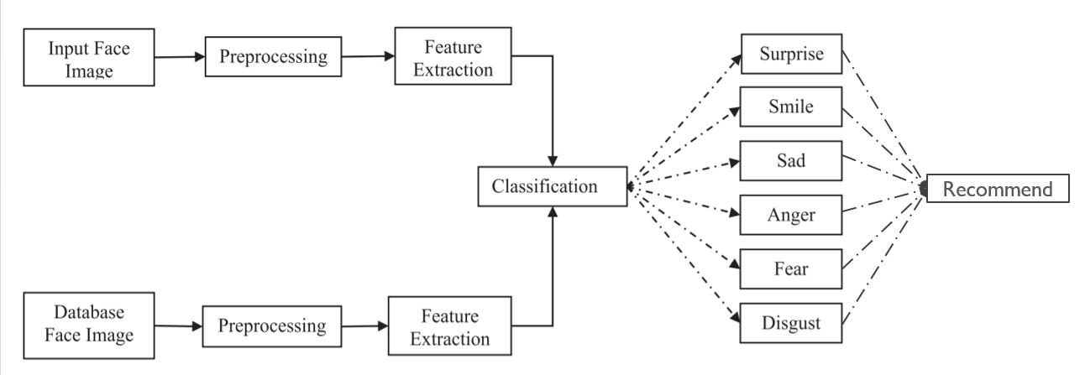
FACIAL EXPRESSION RECOGNITION

Slide 4
EXPRESSIONS
Smile - Eye with a curved shape.
Sad - Rising skewed eyebrows and frown.
Anger - Squeezed eyebrows, slender and stretched eyelids.
Disgust - Pull down eyebrows and creased nose.
Surprise - Eye-widening and mouth gaping.
Fear - Growing skewed eyebrows.

Slide 5
STAGES OF EXPRESSION RECOGNITION

Slide 6
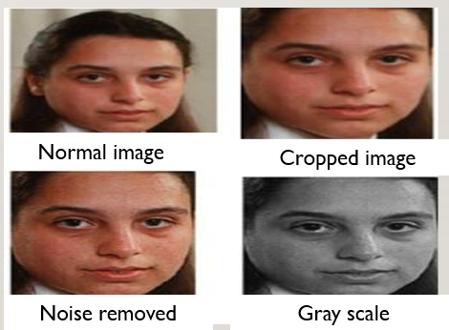
PREPROCESSING
Image preprocessing includes different types of processes such as image clarity and scaling, contrast adjustment, and additional enhancement processes to improve the expression frames.
Reduce the noise
Convert The Image To Binary/Grayscale.
Geometric Transformation.
Rotation, scaling and translation

Slide 7
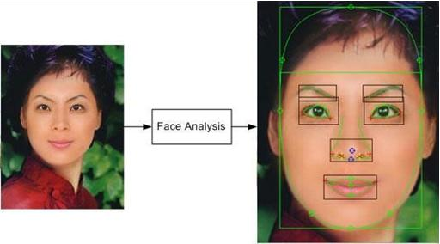
FEATURE EXTRACTION
Features extraction is the process of locating specific regions, points, landmarks, or curves/contours in a given image.
Common features that can be extracted are-
Lips
Eyes
Eyebrows
Nose tip

Slide 8
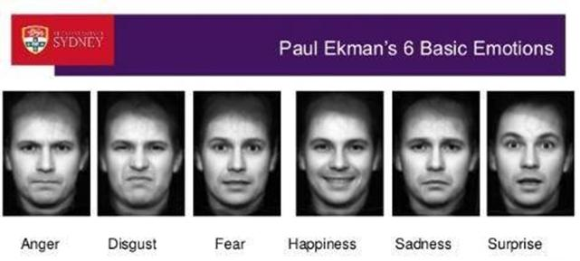
CLASSIFICATION
Classification is the final stage of FER system in which the classifier categorizes the expression such as smile, sad, surprise, anger, fear, disgust and neutral.
Euclidean distance metric is generally used for classification purpose which uses the normalized score and similarity score matrix for estimating Euclidean distance.

Slide 9
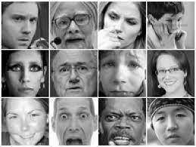
DATA DESCRIPTION
For the training purpose, we have used FER2013 data available on kaggle, which consists of 48x48 pixel grayscale images of faces.
The "emotion" column contains a numeric code ranging from 0 to 6, inclusive, for the emotion that is present in the image.
The "pixels" column contains a string surrounded in quotes for each image.
The training set consists of 28,709 examples and the test set consists of 3,589 examples
Sample images from FER2013 database

Slide 10
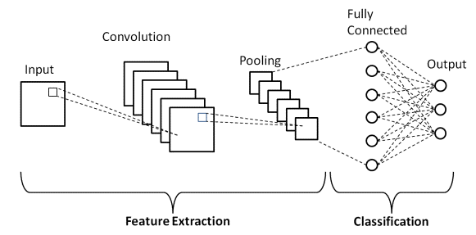
MODEL - OVERVIEW
Convolution Layer - This layer is the first layer that is used to extract the various features from the input images. In this layer, a filter of a particular size is present. By sliding the filter over the input image, the dot product is taken between the filter and the parts of the input image with respect to the size of the filter.
Pooling Layer - The primary aim of this layer is to decrease the size of the convolved feature map to reduce the computational costs. This is performed by decreasing the connections between layers and independently operates on each feature map.
Fully connected layer – This layer utilizes the output from the convolution process and predicts the class of the image based on the features extracted in previous stages.

Slide 11
MODEL - Overview
Our model consists of 4 convolution layers and 2 fully connected layers.
First convolutional layer, we had 64 3×3 filters.
Second convolutional layer, we had 128 5x5 filters.
Third convolutional layer, we had 512 3×3 filters.
Fourth convolutional layer, we had 512 3×3 filters.
All the layers consist of batch normalization and dropout and max-pooling with a filter size 2×2.
In the two FC layer, we had two hidden layers with 256 and 512 neurons respectively and relu function as a loss function.

Slide 12
ALGORITHM
FER2013 database of 35887 pre-cropped, 48-by-48-pixel grayscale images of faces each labeled with one of the 7 emotion classes is used.
Pre-processing of images.
Detection of a face from each image.
The cropped face is converted into grayscale images.
The pipeline ensures every image can be fed into the input layer as a (1, 48, 48) numpy array.
The numpy array gets passed into the Convolution2D layer.

Slide 13
ALGORITHM
Convolution generates feature maps.
Pooling method called MaxPooling2D that uses (2, 2) windows across the feature map only keeping the maximum pixel value.
The relu function presents itself as a probability for each emotion class.
The model is able to show the detail probability composition of the emotions in the face.

Slide 14
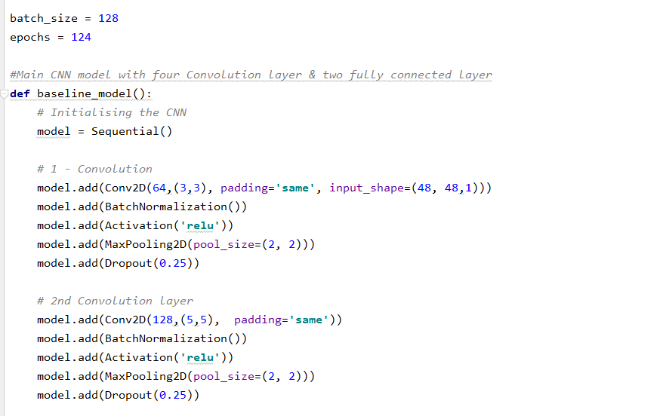
Model layers

Slide 15
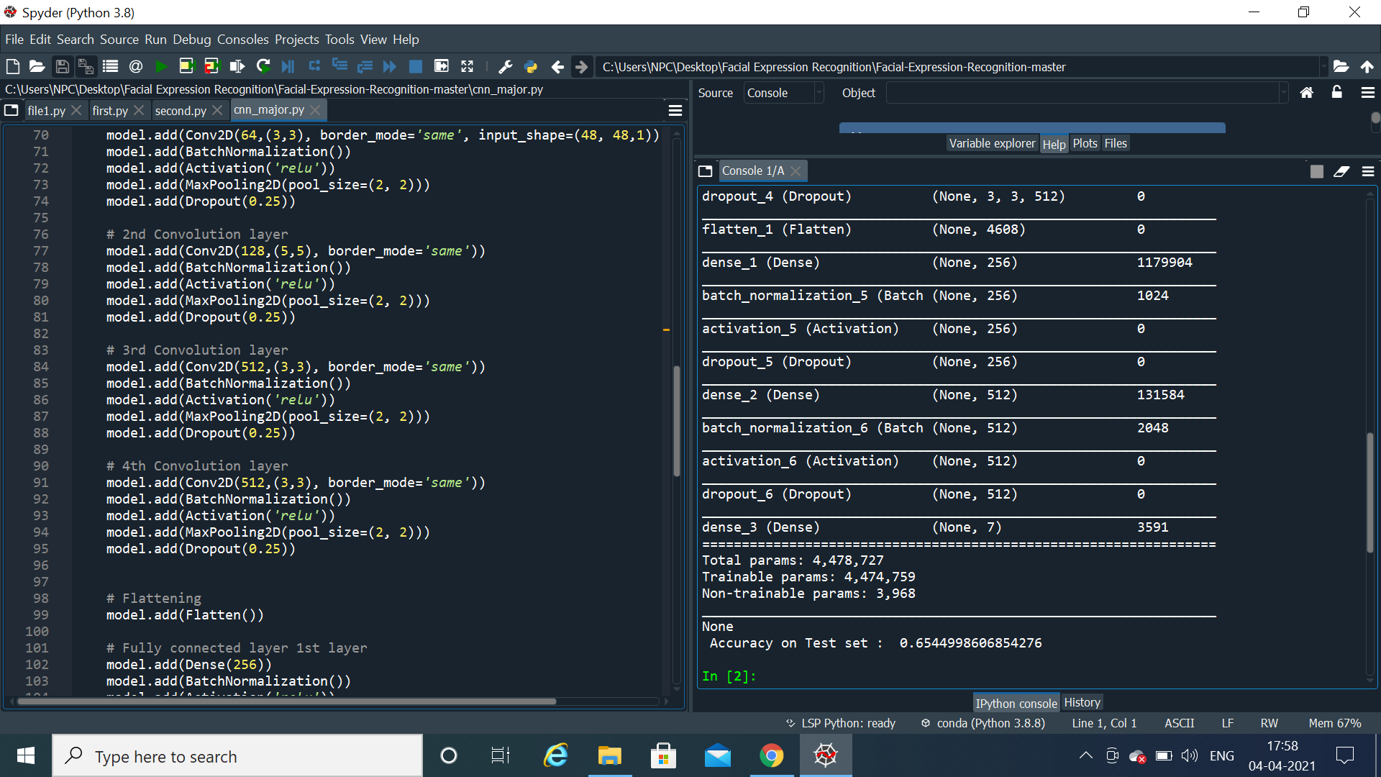
The model works at 65.44 % accuracy

Slide 16
IMPLEMENTATION
Libraries used : numpy, werkzeug and keras.
Developing web application: Flask web framework.
HTML, CSS and JS for the frontend.
UPLOAD→ PREDICT
Now you can choose whether you want to watch a movie, listen to a song or eat some food.

Slide 17
PROJECT WORKING

Slide 18
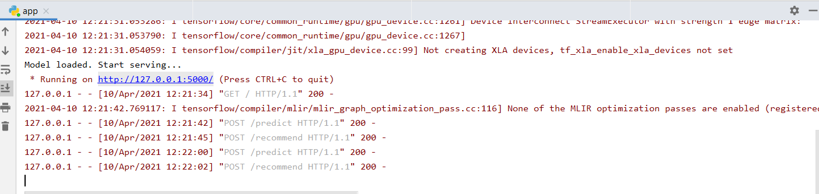
Step 1)
Run app. URL is generated

Slide 19

Step 2) Click on Upload to upload image

Slide 20

Step 3) Click on Predict to predict emotion

Slide 21
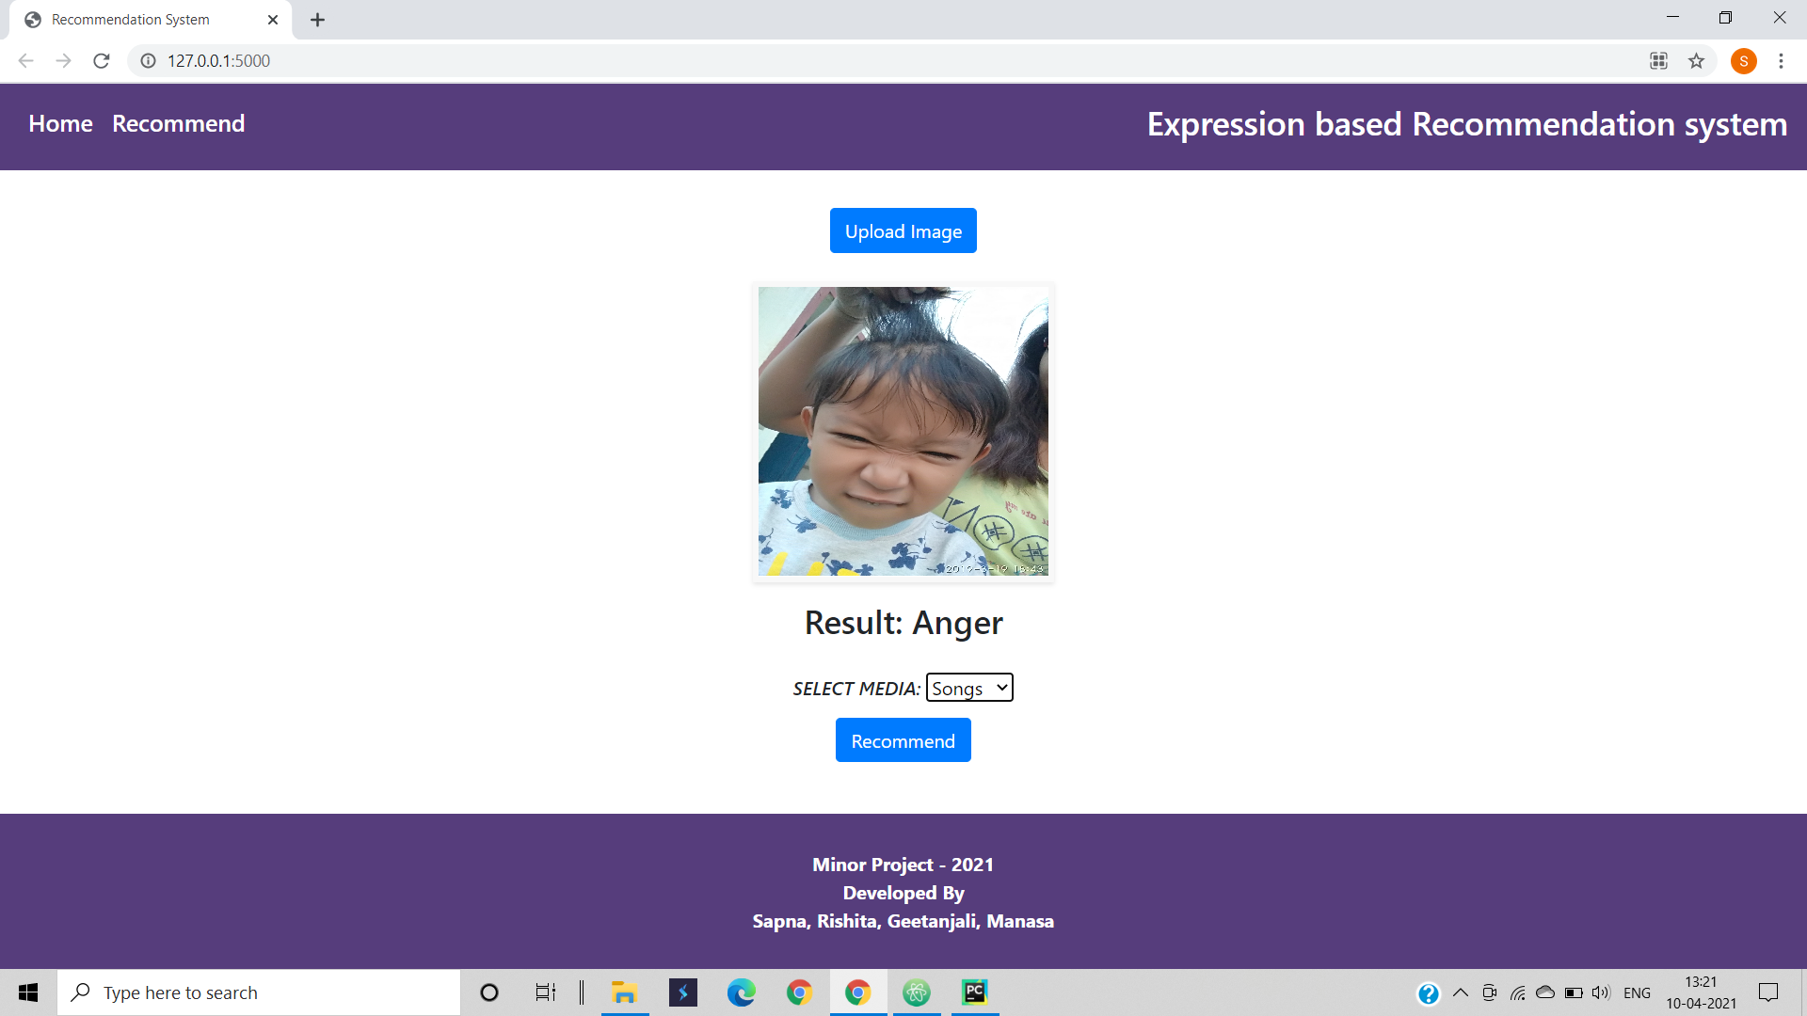
Step 4) Select media and click recommend

Slide 22

Step 5) Select home to go to home page

Slide 23
FLOW CHART

Slide 24
Home page opens(/ route)
(index.html)
Run app (app.run())
Load model
URL generated
Image upload
X
Stop
Returns emotion probability list
Max propability emotion returned to html page
Image saved to uploads folder (/predict route)
Model_predict() function called
Image preprocessed
Select media and recommend
/recommend route opens
Recommend.html page open
Home

Slide 25
Code For APP

Slide 26
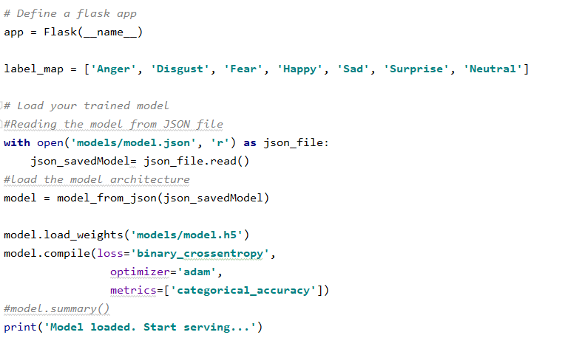
Load Model in app

Slide 27
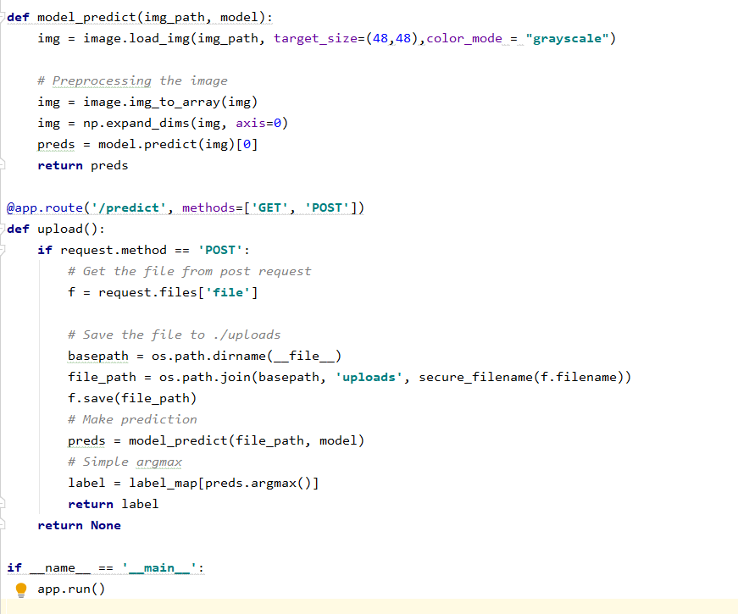
Predict route

Slide 28
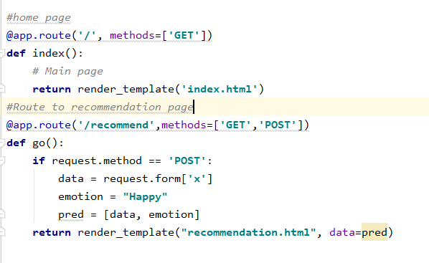
Recommend route

Slide 29
Web application code

Slide 30
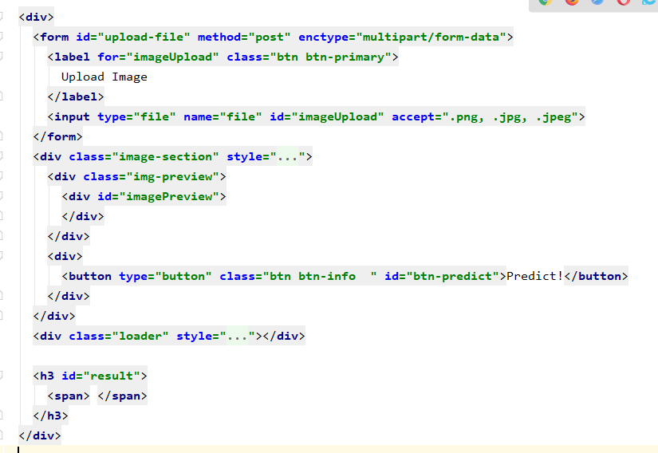
Predict form html

Slide 31
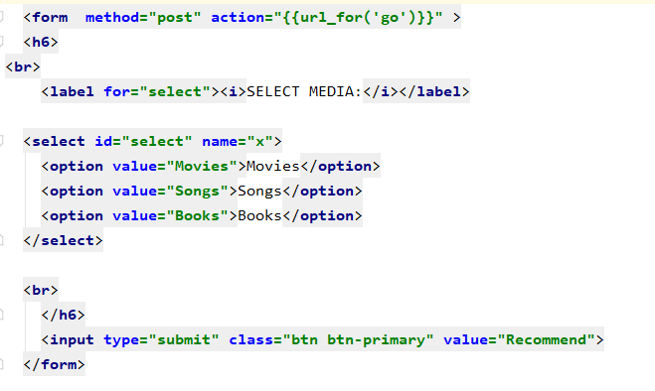
Recommend form html

Slide 32
Thank You!

