Slide 1
PHASES OF COMPILER
Lexical analysis:
It divides program as collection of words and verifies its validity.
Syntax analysis:
It checks validity of sentence in terms of grammar rule
Semantic analysis:
It consider program as a collection of sentences and verifies it’s validity.

Slide 2
Intermediate code generation:
The compiler generates an intermediate code of the source code for the target machines.
Code optimisation phase:
This phase does code optimisation of the intermediate code.
It removes unnecessary lines from code.
Target code generation:
In this phase the code generator takes the optimised code and maps it to the target machine language.

Slide 3
HOW TO DESIGN PARSING TABLE OF LR(1)
Step 1-Find first and follow set.
Step 2- Assign unique number to all the productions
of CFG.
Step 3-Augment the CFG by adding a production
S’->S

Slide 4
Step 4-Find canonical collection of LR(0) item sets.
Step 5- Create empty table where rows are item set number (state number) and columns
(i) in action table -terminals and ‘$’
(ii) in goto table – variables of CFG
Step 6-Fill the table.

Slide 5
INPUT FORMAT
→Store the grammar on a 2D character array
Assumptions :
Epsilon is represented by ‘#’.
Productions are of the form A=B, where ‘A’ is a single variable and ‘B’ can be any combination of Terminals and Non- Terminals.
L.H.S. of the first production rule is the start symbol.
Each NEW PRODUCTIOM IS ENTERED ON NEW LINE.
Only Upper Case letters are Non-Terminals and everything else is a terminal.
Do not use ‘$’ as they are reserved for special purposes.

Slide 6
IMPLEMENTATION OF FIRST SET
First() function is used to calculate the first of any variable
For every variable there are 2 cases:
If the first symbol in the R.H.S of the production is a Terminal then it can directly be included in the first set.
If the first symbol in the R.H.S of the production is a VAriable then call the first() function again on that variable. To handle these cases Recursion is the best possible solution. Here again, if the First of the new variable contains an epsilon then we have to move to the next symbol of the original production which can again be a Terminal or a variable.

Slide 7
IMPLEMENTATION OF FOLLOW SET
2 function are involved in calculation of follow set which are follow() and follow_first().
ADD ‘$’ symbol in follow set of start variable.
If a variable on the R.H.S. of any production is followed immediately by a Terminal then it can immediately be included in the Follow set of that variable.
If a variable on the R.H.S. of any production is followed immediately by a variable, then the First Set of that new variable gets included on the follow set of our original variable. In case encountered an epsilon i.e. ” # ” then, move on to the next symbol in the production. Note : “#” is never included in the Follow set of any variable.
If reached the end of a production while calculating follow, then the Follow set of that variable will include the Follow set of the variable on the L.H.S. of that production. This can easily be implemented by recursion.

Slide 8
Closure rule
If in any item set .(dot) is followed by a variable then include the production of that variable after converting it into an item .
This follows until no more productions can be added.

Slide 9
Add (.)dot before every production
For I0 state add production s’->.s
Check character after dot and store it in an array.
Traverse the array:
If(variable) then add it’s production containing dot.
Repeat above steps for every character until no new item can be added.

Slide 10
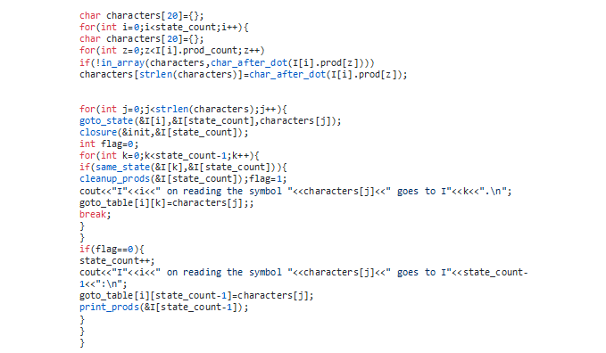

Slide 11
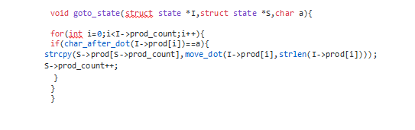

Slide 12
SHIFT REDUCE ACTION
For each state check entry in the goto table, if terminal then print ‘s’ with column number. If non-terminal print column number.
Create an array which stores the complete item number present in every state and -1 if there is no complete item.
Traverse this array for all states.
If there is entry other than -1
add ‘R’ followed by entry in follow set of lhs variable.

Slide 13
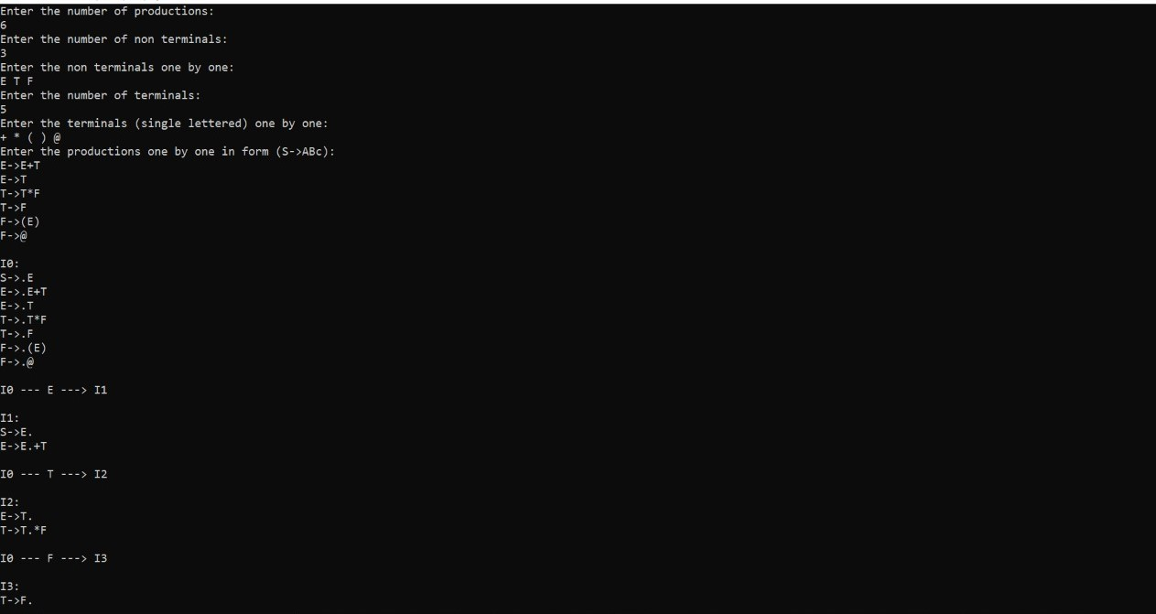

Slide 14
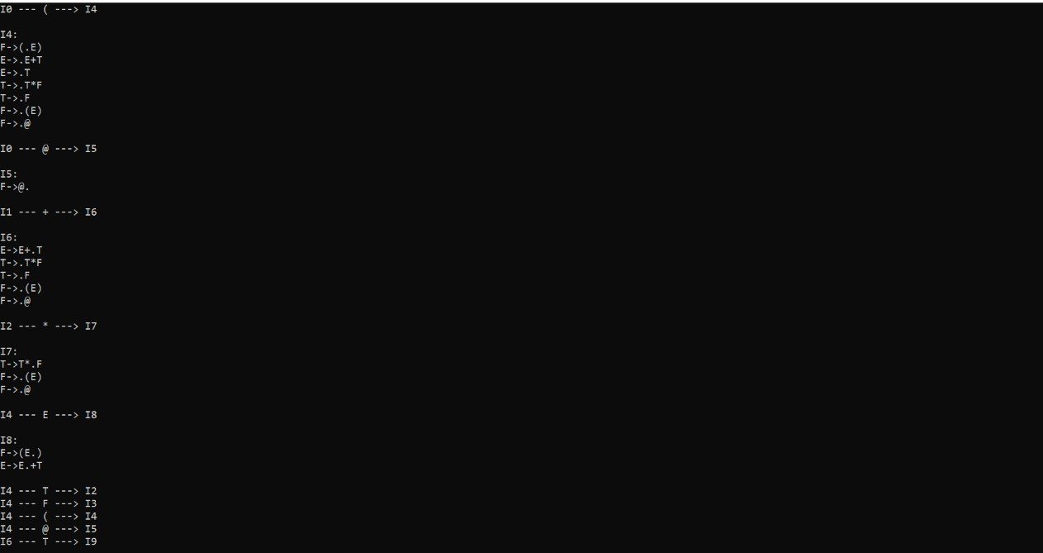

Slide 15
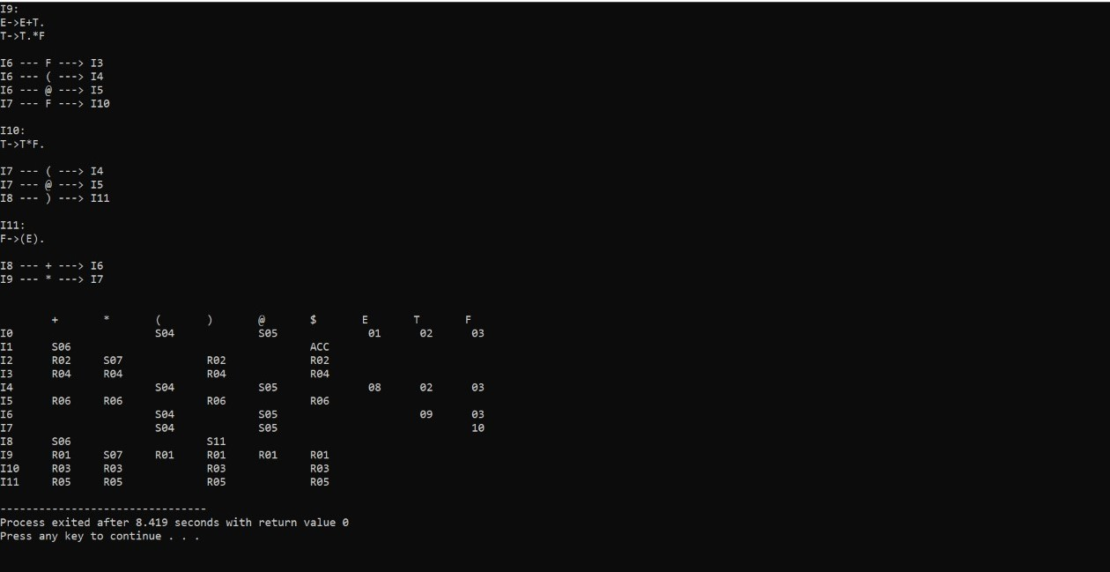

Slide 16
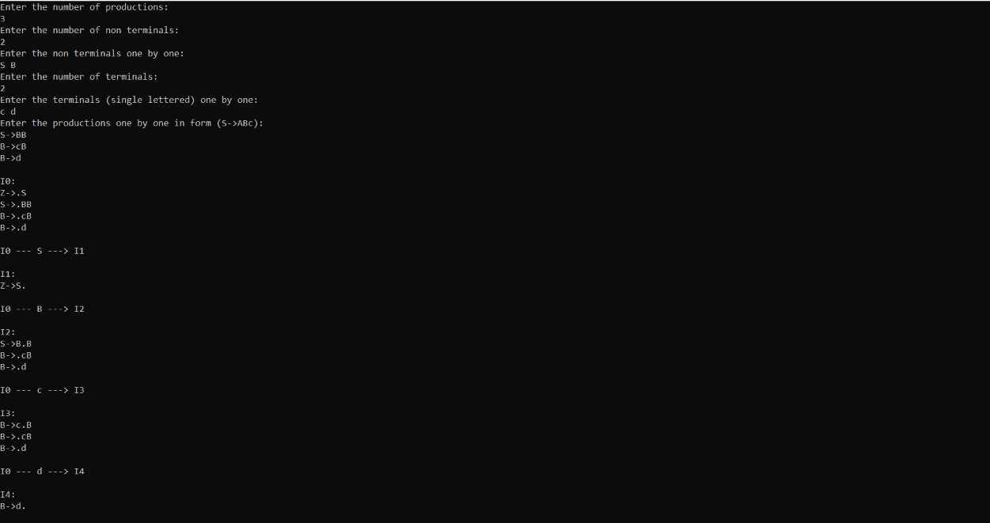

Slide 17
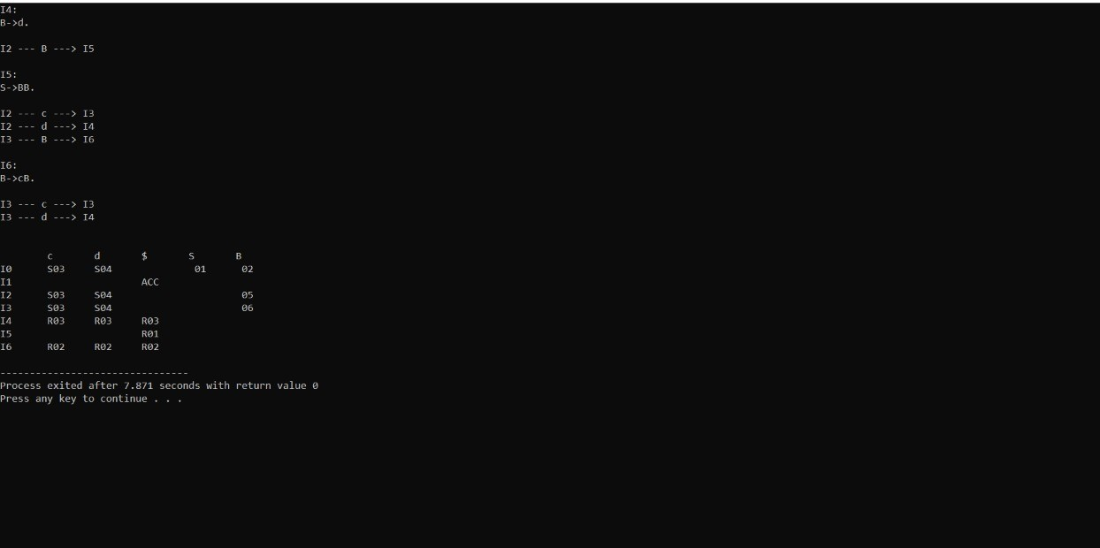

Slide 18
LALR
HOW TO DESIGN PARSING TABLE OF LALR
Step 1- Assign unique number to all the productions of CFG.
Step 2-Augment the CFG by adding a production
S’->S

Slide 19
Step 3-Find canonical collection of LR(1) item sets.
Step 4- Create empty table where rows are item set number (state number) and columns
(i) in action table -terminals and ‘$’
(ii) in goto table – variables of CFG
Step 5-Fill the table.

Slide 20
Lookahead symbol :
For augmented production , lookahead=‘$’
For s->.BB{$},B->.cB
for the second production lookahead is first(B{$})
For s->.B{c|d},B->.cB
for the second production lookahead is first(c|d),i.e ‘c|d’

Slide 21
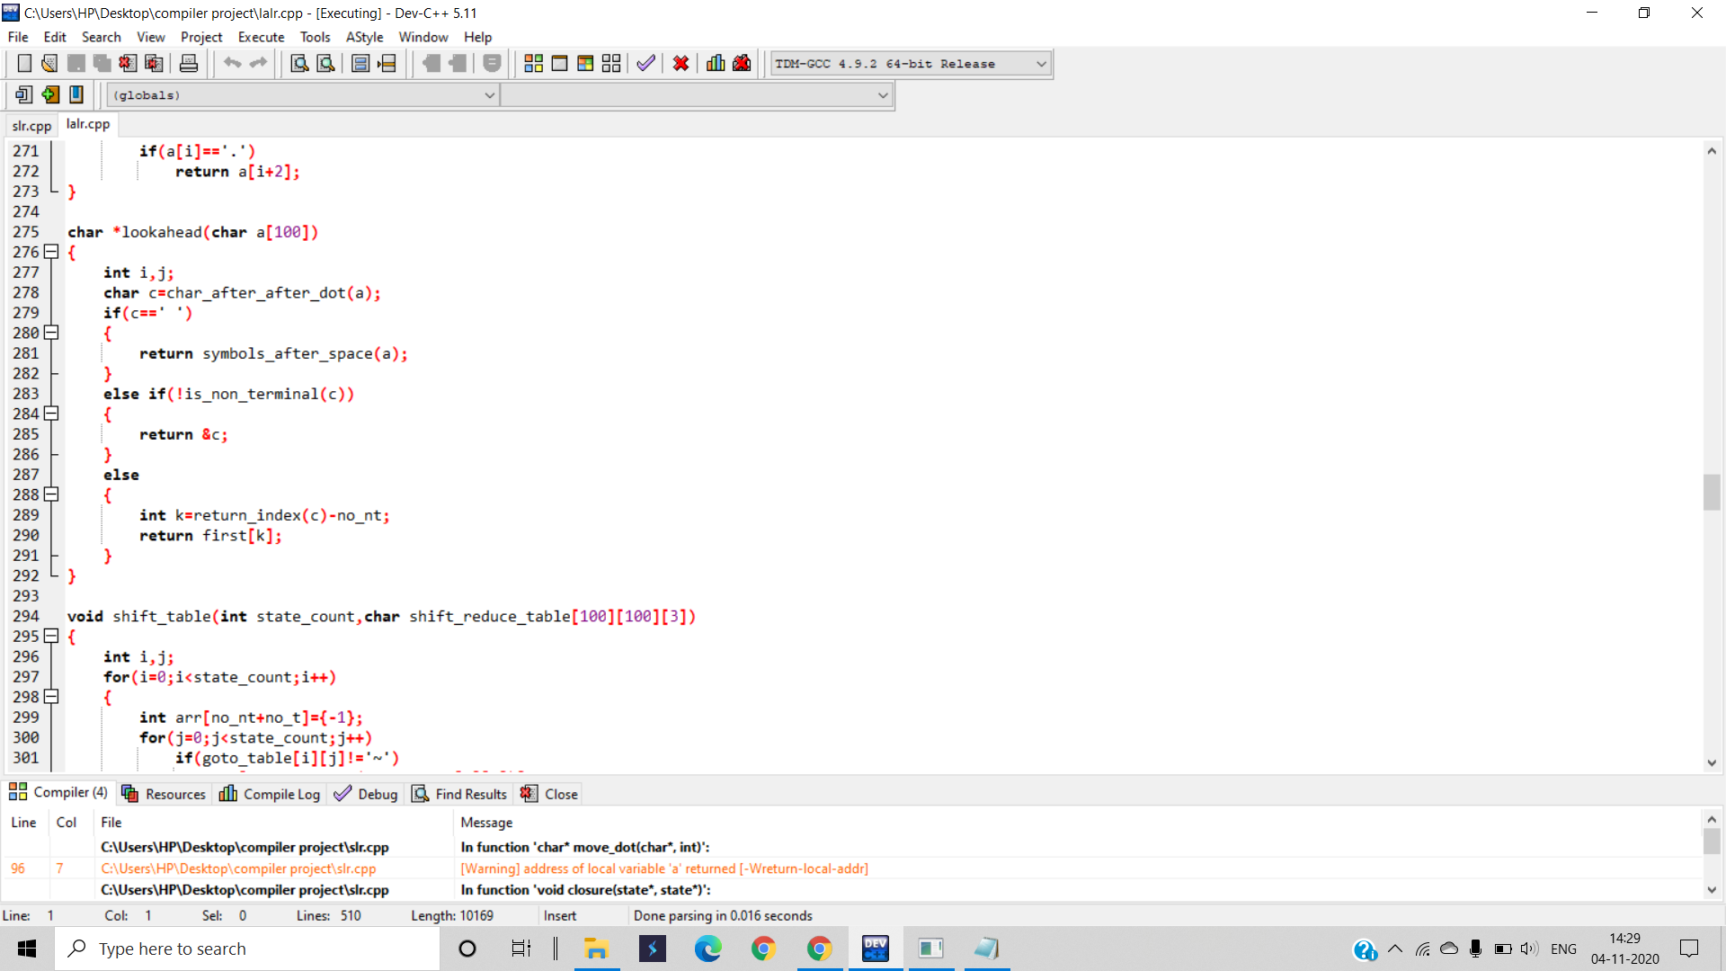

Slide 22
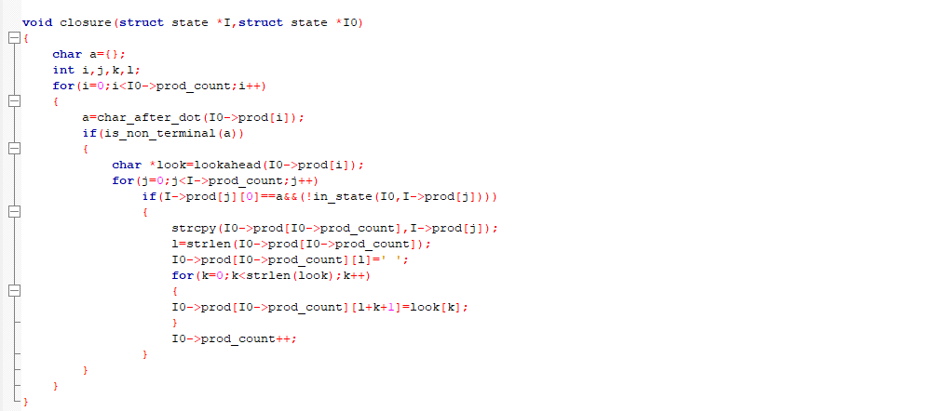

Slide 23
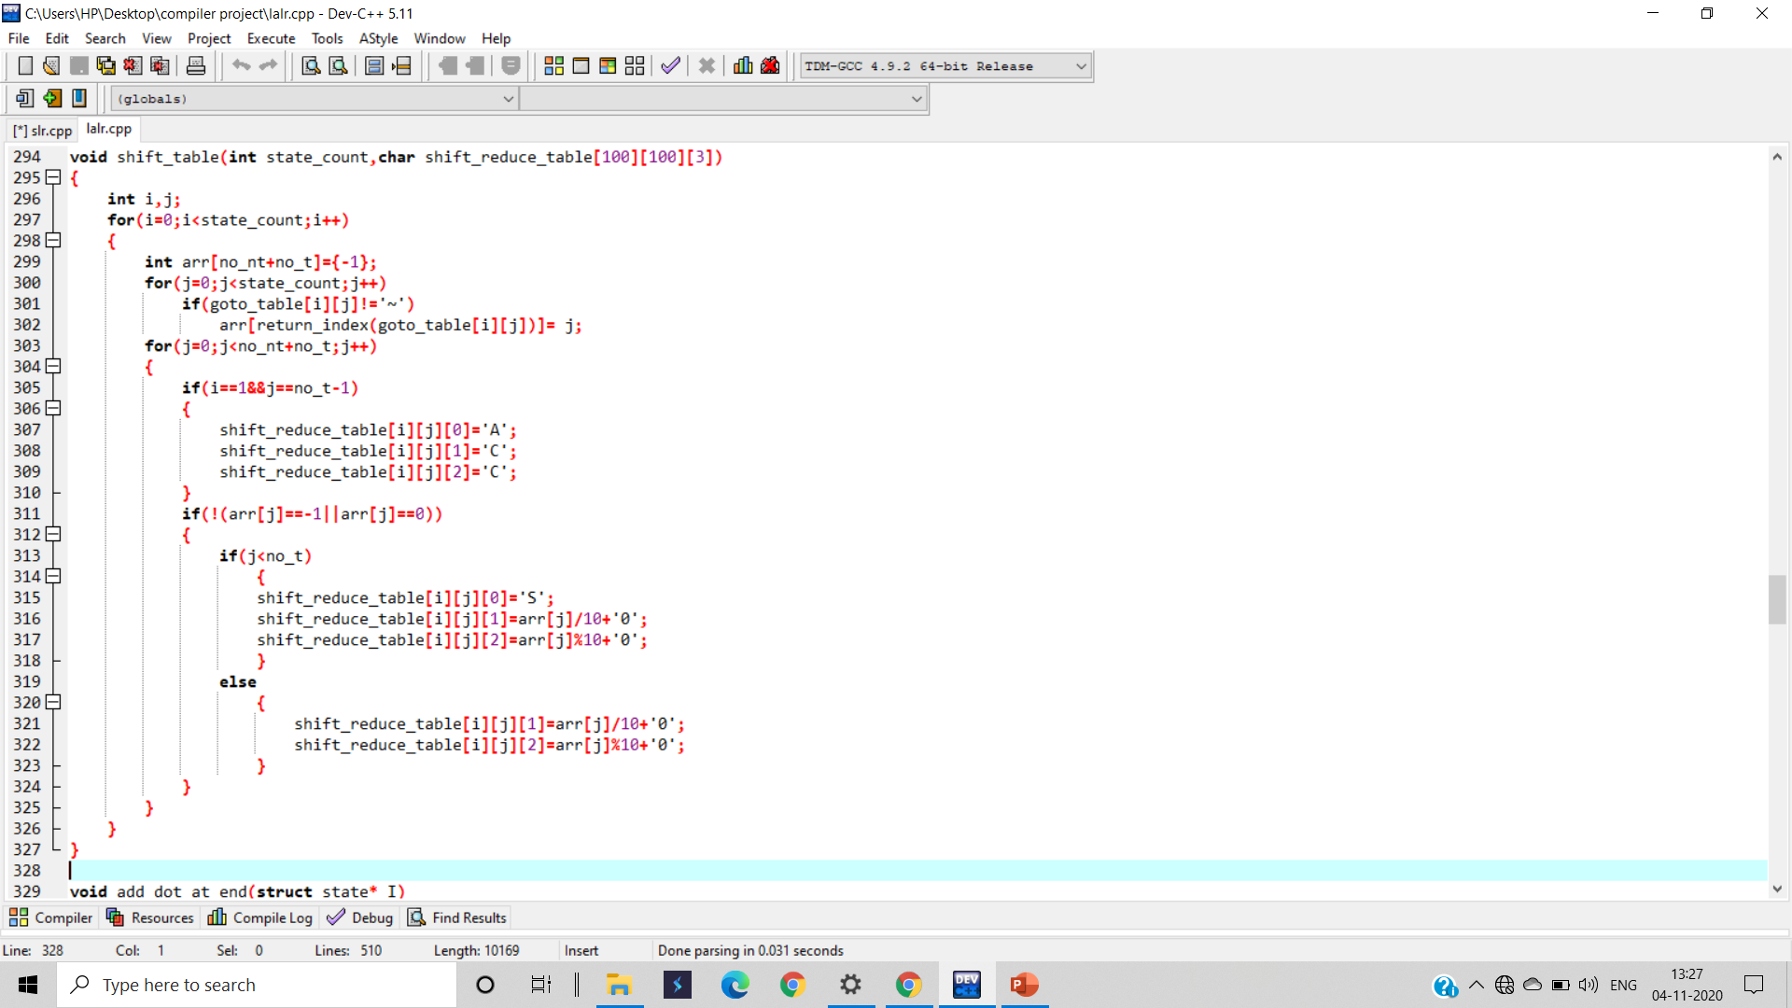

Slide 24
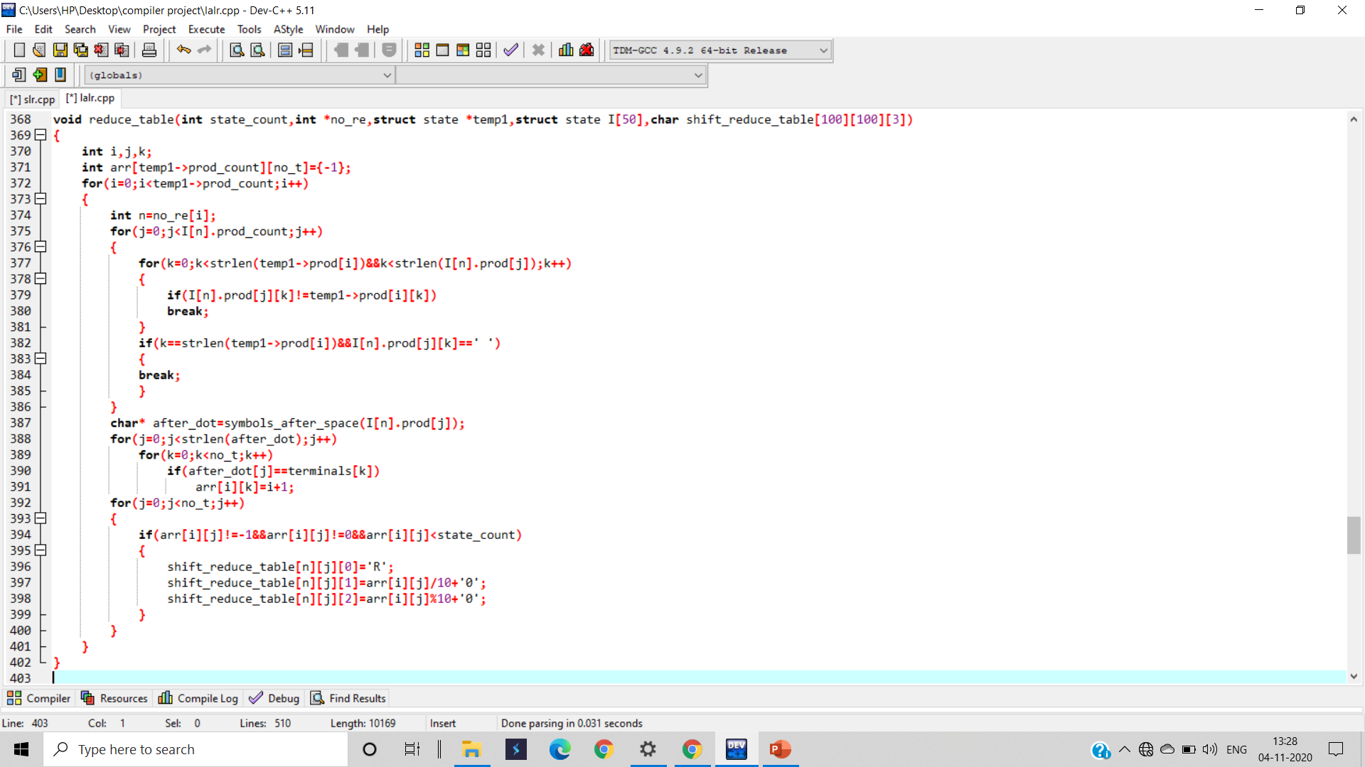

Slide 25
