Slide 1
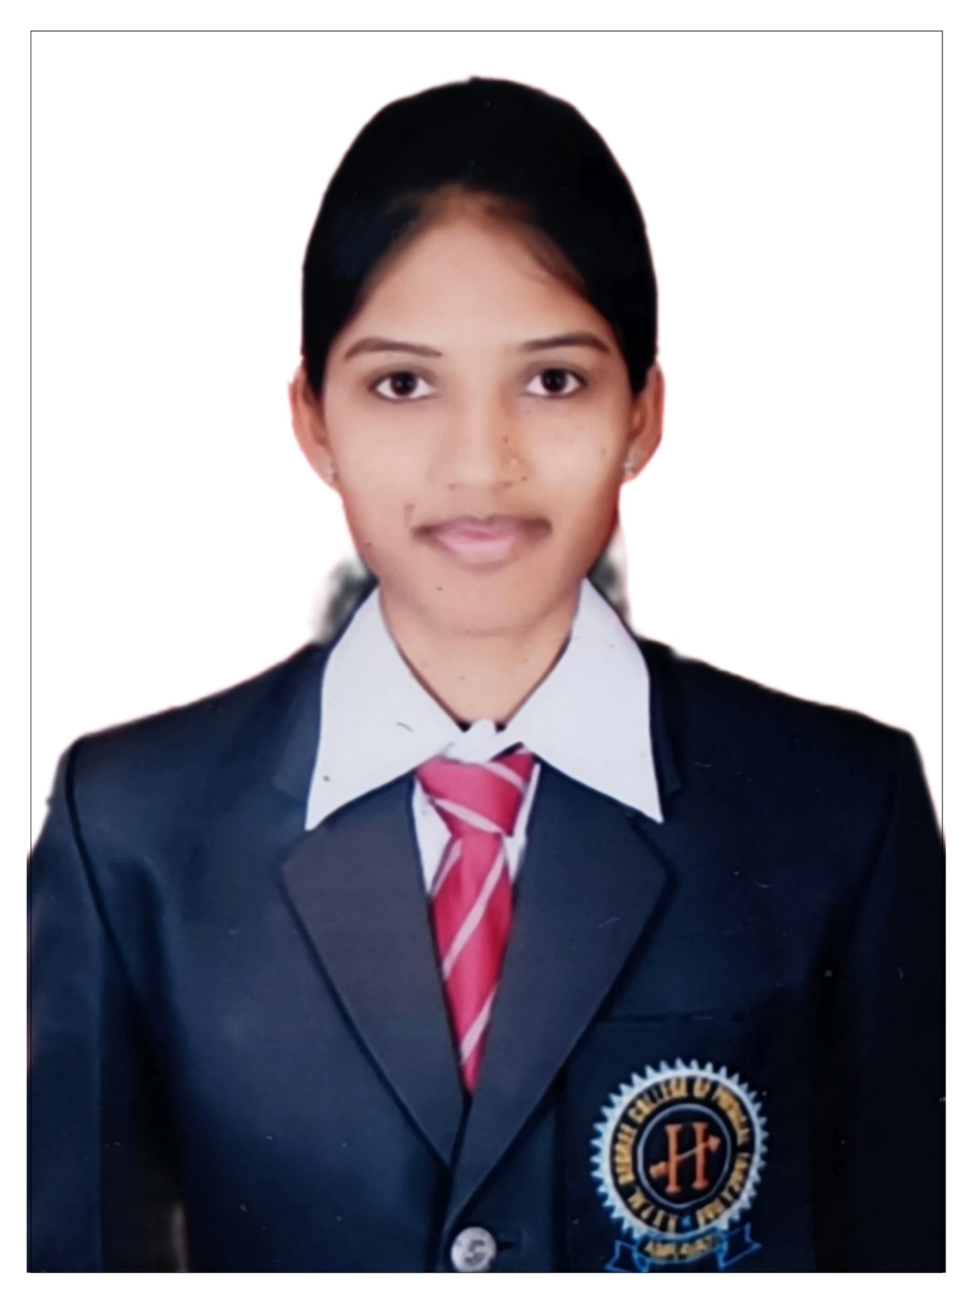
Sapna Agarkar
Analyst/Software Engineer
Master in Computer Application
Graduation: 2016-2019
Skills C#
ASP.NET Core MVC
ASP.NET Core Web API
ADO.NET
Database
SQL database – SQL Server
Web Technologies
HTML
CSS
Add-ons
GitHub
Swagger
Fiddler
Tools
Visual Studio 2019
SQL Server Management Studio
Additional Details
Excellent Communication Skills
Team Player
Leadership
Mumbai
sapna.sudhakar-agarkar@capgemini.com
+91 8412013010
A4
A self-driven learner with Front-End and Back End knowledge.
Eager to work in a team of dedicated people and serve a key role in the enhancement and development of the project.
A team player with good communication skill, always ready to work for the enrichment of knowledge.
Ready to learn new technology and implement them to further improve my knowledge.
Ability to learn, adapt and grow and has good time management.
Openly share ideas to help to improve the business process.
Online shopping
Completed end to end case study of Online shopping along with JWT authentication, Swagger testing using Core MVC, Core Web API and SQL Server.
Implemented Data Access Layer(DAL) to communicate with the database. Used Code-First approach provided by the entity framework. In the application there is a usage of Create, Read, Update, Delete(CRUD) operations using Web API.
Certifications
AZ-900: Microsoft Azure Fundamental

