Slide 1
Python History
DYPSOM
Python was developed by Guido van Rossum in the late eighties and early nineties at the National Research Institute for Mathematics and Computer Science in the Netherlands.
Python is derived from many other languages, including ABC, Modula- 3, C, C++, Algol-68, SmallTalk, and Unix shell and other scripting languages.
He was big fan of Monty Python's Flying Circus.
Python is copyrighted. Like Perl, Python source code is now available under the GNU General Public License (GPL).
Python 2.0 was released on 16 October 2000

Slide 2

Python History
DYPSOM
Guido van Rossum
Dutch programmer who is best known as the author of the Python programming language.
As of January 2013, I work for Dropbox.
From December 2005 till December 2012, He worked for Google.
He had a deal where He can spend up to 50% of his time on Python Development.

Slide 3
Python Introduction
DYPSOM
Python is a general-purpose interpreted, interactive, object-oriented, and high-level programming language.
It was created by Guido van Rossum during 1985- 1990.
Like Perl, Python source code is also available under the GNU General Public License (GPL).
It uses English keywords frequently where as other languages use punctuation, and it has fewer syntactical constructions than other languages.

Slide 4
Python Introduction
Python is Interpreted: Python is processed at runtime by the interpreter. You do not need to compile your program before executing it. This is similar to PERL and PHP.
Python is Interactive: You can actually sit at a Python prompt and interact with the interpreter directly to write your programs.
Python is Object-Oriented: Python supports Object-Oriented style or technique of programming that encapsulates code within objects.
Python is a Beginner's Language: Python is a great language for the beginner-level programmers and supports the development of a wide range of applications from simple text processing to WWW browsers to games

Slide 5
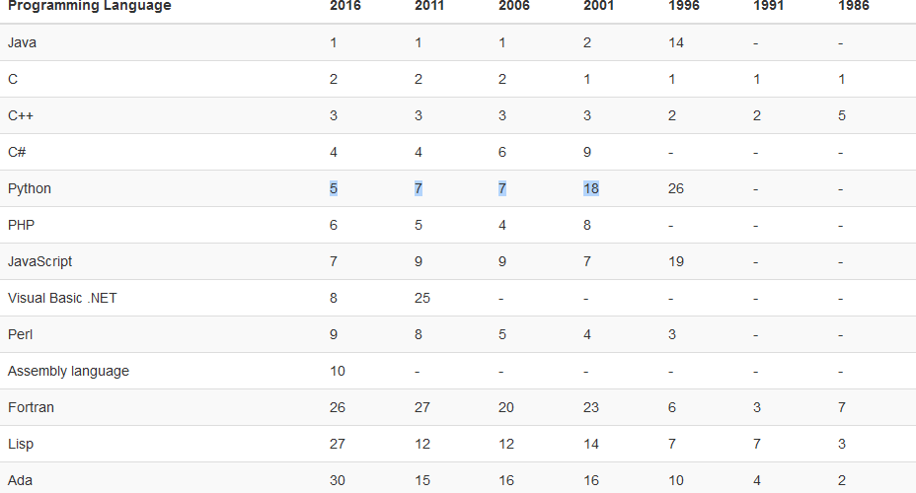
Python TIEBO Index
DYPSOM

Slide 6
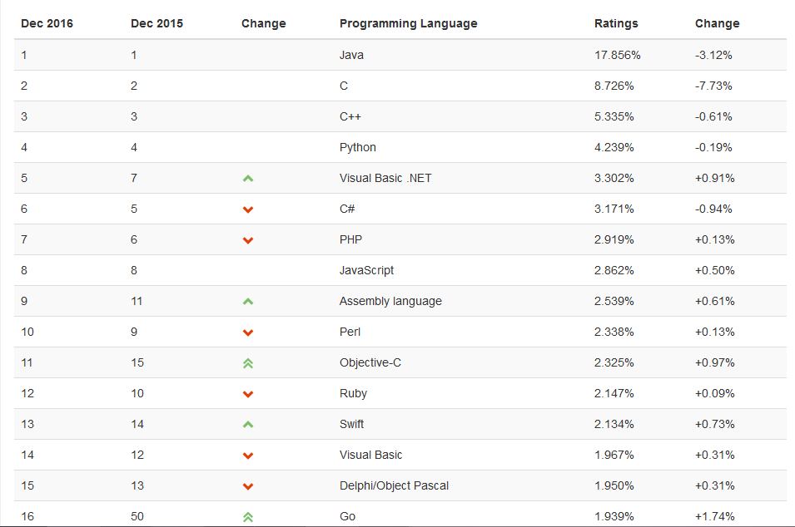
Python TIEBO Index
DYPSOM

Slide 7
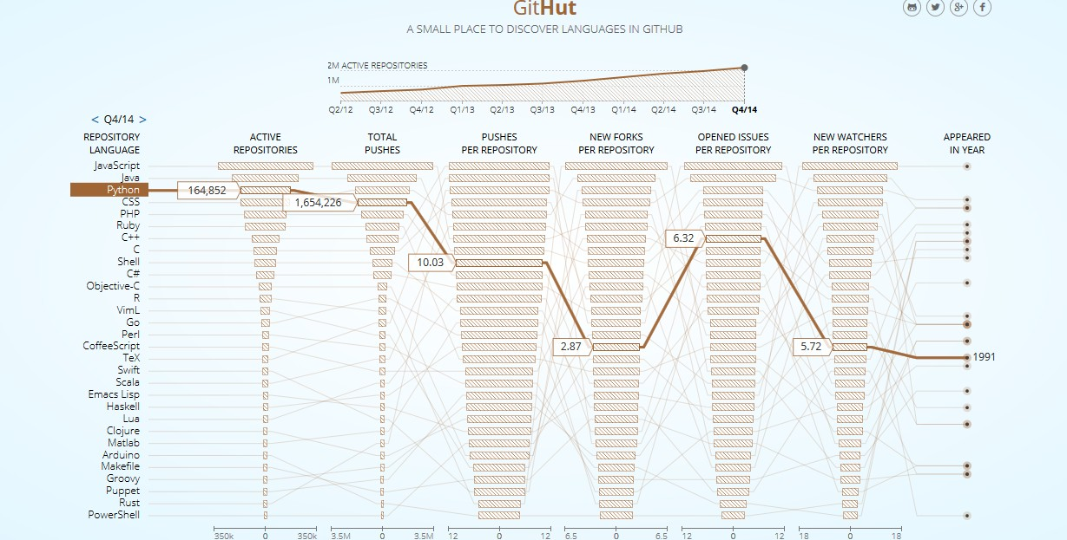
Python GITHUT Info.
DYPSOM

Slide 8
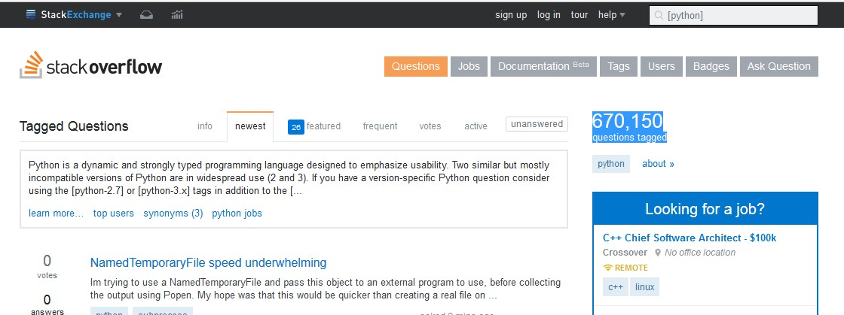
Python Stackoverflow data
DYPSOM

Slide 9
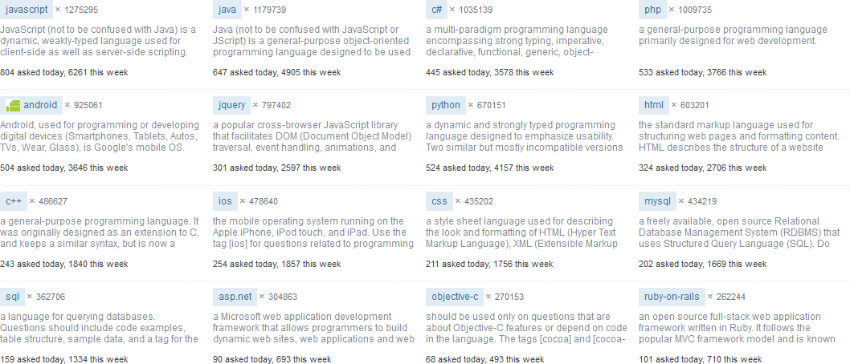
Python Stackoverflow data
DYPSOM

Slide 10
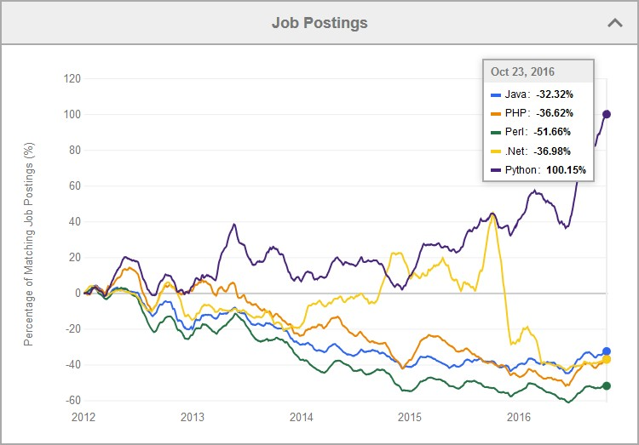
Python Indeed jobs trend
DYPSOM

Slide 11
Python Introduction
DYPSOM
Popular websites
-Instagram
-pinterest
-reddin.com
-dropbox
Bioinformatics
Raspberry bi
Python can be used in robotics
Nasa
You can use python for creating website
Framework for python website- pyramid, Django and flask
Python is leading language in data analysis
Machine Learning
Face Detection
Game Development using module Pygame
Web Scrapping
Writing Scripts
Browser Automation
GUI Development using Tkinter,PyQt module

Slide 12
Python Features
DYPSOM
Easy-to-learn: Python has few keywords, simple structure, and a clearly defined syntax. This allows the student to pick up the language quickly.
Easy-to-read: Python code is more clearly defined and visible to the eyes.
Easy-to-maintain: Python's source code is fairly easy-to-maintain.
A broad standard library: Python's bulk of the library is very portable and cross-platform compatible on UNIX, Windows, and Macintosh.
Interactive Mode: Python has support for an interactive mode which allows interactive testing and debugging of snippets of code.
Portable: Python can run on a wide variety of hardware platforms and
has the same interface on all platforms.

Slide 13
Python Features
DYPSOM
Extendable: You can add low-level modules to the Python interpreter. These modules enable programmers to add to or customize their tools to be more efficient.
Databases: Python provides interfaces to all major commercial databases.
GUI Programming: Python supports GUI applications that can be created and ported to many system calls, libraries and windows systems, such as Windows MFC, Macintosh, and the X Window system of Unix.
Scalable: Python provides a better structure and support for large programs than shell scripting.

Slide 14
Python Installation
DYPSOM
Unix and Linux Installation
Open a Web browser and go to http://www.python.org/downloads/
Follow the link to download zipped source code available for Unix/Linux.
Download and extract files.
Editing the Modules/Setup file if you want to customize some options.
run ./configure script
make
make install

Slide 15
Python Installation
DYPSOM
Windows Installation
Open a Web browser and go to http://www.python.org/downloads/
Follow the link for the Windows installer python-XYZ.msi file where XYZ is the version you need to install.
To use this installer python-XYZ.msi, the Windows system must support Microsoft Installer 2.0. Save the installer file to your local machine and then run it to find out if your machine supports MSI.
Run the downloaded file. This brings up the Python install wizard, which is really easy to use. Just accept the default settings, wait until the install is finished, and you are done.

Slide 16
Python Basic Syntax
DYPSOM
print ("Hello, Python!")
To Run program
$ python test.py

Slide 17
Python Reserved Words
DYPSOM
and | exec | not
assert | finally | or
break | for | pass
class | from | print
continue | global | raise
def | if | return
del | import | try
elif | in | while
else | is | with
except | lambda | yield

Slide 18
Python Multi-Line Statements
DYPSOM
Statements in Python typically end with a new line. Python does, however, allow the use of the line continuation character (\) to denote that the line should continue. For example −
total = item_one + \
item_two + \ item_three

Slide 19
Quotation in Python
DYPSOM
Python accepts single ('), double (") and triple (''' or """) quotes to denote string literals, as long as the same type of quote starts and ends the string.
The triple quotes are used to span the string across multiple lines. For example, all the following are legal −
word = 'word'
sentence = "This is a sentence." paragraph = """This is a paragraph. It is
made up of multiple lines and sentences."""

Slide 20
Comments in Python
DYPSOM
A hash sign (#) that is not inside a string literal begins a comment.
All characters after the # and up to the end of the physical line are part of the comment and the Python interpreter ignores them.
Multiple Statements on a Single Line
The semicolon ( ; ) allows multiple statements on the single line given that neither statement starts a new code block. Here is a sample snip using the semicolon.
import sys; x = 'foo'; sys.stdout.write(x + '\n')

Slide 21
Multiple Statement Groups as Suites
DYPSOM
A group of individual statements, which make a single code block are called suites in Python. Compound or complex statements, such as if, while, def, and class require a header line and a suite.
Header lines begin the statement (with the keyword) and terminate with a colon ( : ) and are followed by one or more lines which make up the suite. For example −
if expression : suite
elif expression :
suite
else : suite

Slide 22
Variable Declaration in Python
DYPSOM
Python variables do not need explicit declaration to reserve memory space. The declaration happens automatically when you assign a value to a variable. The equal sign (=) is used to assign values to variables.
Example
counter = 100
miles = 1000.0
name = "John"
print counter print miles print name
# An integer assignment
# A floating point
# A string

Slide 23
Standard Data Types
DYPSOM
Python has five standard data types −
Numbers
String
List
Tuple
Dictionary

Slide 24
Standard Data Types
DYPSOM
Python supports four different numerical types −
int (signed integers)
long (long integers, they can also be represented in octal and hexadecimal)
float (floating point real values)
complex (complex numbers)

Slide 25
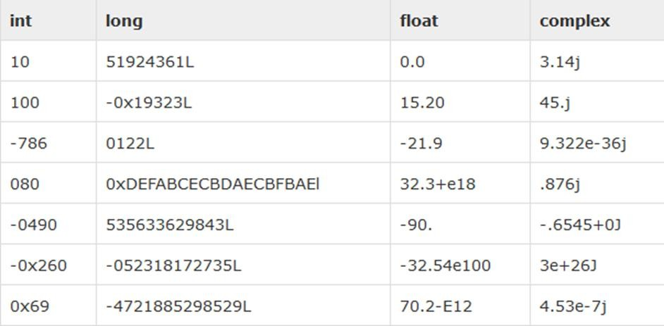
Standard Data Types
DYPSOM
Example ..
A complex number consists of an ordered pair of real floating-point numbers denoted by x + yj, where x and y are the real numbers and j is the imaginary unit

Slide 26
Python Strings
DYPSOM
str = 'Hello World!'
print (str) print (str[0])
print (str[2:5])
print (str[2:]) print (str * 3)
# Prints complete string
# Prints first character of the string
# Prints characters starting from 3rd to 5th # Prints string starting from 3rd character
# Prints string two times
print (str + "TEST") # Prints concatenated string

Slide 27
Python Lists
DYPSOM
Lists are the most versatile of Python's compound data types.
A list contains items separated by commas and enclosed within square
brackets ([]).
To some extent, lists are similar to arrays in C. One difference between them is that all the items belonging to a list can be of different data type.
The values stored in a list can be accessed using the slice operator ([ ] and [:]) with indexes starting at 0 in the beginning of the list and working their way to end -1.
The plus (+) sign is the list concatenation operator, and the asterisk (*) is the repetition operator.

Slide 28
Python Lists
DYPSOM
For Example -
list = [ 'abcd', 786 , 2.23, 'john', 70.2 ]
tinylist = [123, 'john']
print (list) print (list[0]) print (list[1:3])
print (list[2:])
# Prints complete list
# Prints first element of the list
# Prints elements starting from 2nd till 3rd # Prints elements starting from 3rd element
print (tinylist * 2) # Prints list two times
print (list + tinylist) # Prints concatenated lists

Slide 29
Python Tuples
DYPSOM
A tuple is another sequence data type that is similar to the list.
A tuple consists of a number of values separated by commas. Unlike
lists, however, tuples are enclosed within parentheses ( ).
What is the difference between lists and tuples ?
Ans :
Lists are enclosed in brackets ( [ ] ) and their elements and size can be changed.
While tuples are enclosed in parentheses ( ( ) ) and cannot be updated.
Tuples can be thought of as read-only lists.

Slide 30
Python Tuples
DYPSOM
For Example –
tuple = ( 'abcd', 786 , 2.23, 'john', 70.2 )
tinytuple = (123, 'john')
print (tuple) print (tuple[0]) print (tuple[1:3]) print (tuple[2:])
# Prints complete list
# Prints first element of the list
# Prints elements starting from 2nd till 3rd
# Prints elements starting from 3rd element
print (tinytuple * 2) # Prints list two times
print (tuple + tinytuple) # Prints concatenated lists
#tuple[2] = 1000
#list[2] = 1000
# Invalid syntax with tuple # Valid syntax with list

Slide 31
Python Dictionary
DYPSOM
Python's dictionaries are kind of hash table type.
They work like associative arrays or hashes found in Perl and
consist of key-value pairs.
A dictionary key can be almost any Python type, but are usually numbers or strings. Values, on the other hand, can be any arbitrary Python object.
Dictionaries are enclosed by curly braces ({ }) and values can be
assigned and accessed using square braces ([]).

Slide 32
Python Dictionary
DYPSOM
For Example - dict = {}
dict['one'] = "This is one"
dict[2] = "This is two"
tinydict = {'name': 'john','code':6734, 'dept': 'sales'}
print (dict['one']) print (dict[2]) print (tinydict)
# Prints value for 'one' key # Prints value for 2 key
# Prints complete dictionary
print (tinydict.keys()) # Prints all the keys print (tinydict.values()) # Prints all the values

Slide 33
Python Operators
DYPSOM
Python language supports the following types of operators.
Arithmetic Operators
Comparison (Relational) Operators
Assignment Operators
Logical Operators
Bitwise Operators
Membership Operators
Identity Operators

Slide 34
Python Arithmetic Operators
DYPSOM
Operator | Description | Example
+ Addition | Adds values on either side of the operator. | a + b = 30
- Subtraction | Subtracts right hand operand from left hand operand. | a – b = -10
* Multiplication | Multiplies values on either side of the operator | a * b = 200
/ Division | Divides left hand operand by right hand operand | b / a = 2
% Modulus | Divides left hand operand by right hand operand and returns remainder | b % a = 0

Slide 35
Python Arithmetic Operators
DYPSOM
Operator | Description | Example
** Exponent | Performs exponential (power) calculation on operators | a**b =10 to the power 20
// | Floor Division - The division of operands where the result is the quotient in which the digits after the decimal point are removed. But if one of the operands is negative, the result is floored, i.e., rounded away from zero (towards negative infinity) | 9//2 = 4 and 9.0//2.0 = 4.0, - 11//3 = -4, - 11.0//3 = -4.0

Slide 36
Python Comparison Operators
DYPSOM
Operator | Description | Example
== | If the values of two operands are equal, then the condition becomes true. | (a == b) is not true.
!= | If values of two operands are not equal, then condition becomes true.
> | If the value of left operand is greater than the value of right operand, then condition becomes true. | (a > b) is not true.
< | If the value of left operand is less than the value of right operand, then condition becomes true. | (a < b) is true.
>= | If the value of left operand is greater than or equal to the value of right operand, then condition becomes true. | (a >= b) is not true.
<= | If the value of left operand is less than or equal to the value of right operand, then condition becomes true. | (a <= b) is true.

Slide 37
Python Assignment Operators
DYPSOM
Operator | Description | Example
= | Assigns values from right side operands to left side operand | c = a + b assigns value of a + b into c
+= Add AND | It adds right operand to the left operand and assign the result to left operand | c += a is equivalent to c = c + a
-= Subtract AND | It subtracts right operand from the left operand and assign the result to left operand | c -= a is equivalent to c = c - a
*= Multiply AND | It multiplies right operand with the left operand and assign the result to left operand | c *= a is equivalent to c = c * a
/= Divide AND | It divides left operand with the right operand and assign the result to left operand | c /= a is equivalent to c = c / a c /= a is equivalent to c = c / a
%= Modulus AND | It takes modulus using two operands and assign the result to left operand | c %= a is equivalent to c = c % a
**= Exponent AND | Performs exponential (power) calculation on operators and assign value to the left operand | c **= a is equivalent to c = c ** a
//= Floor Division | It performs floor division on operators and assign value to the left operand | c //= a is equivalent to c = c // a

Slide 38
Python Bitwise Operators
DYPSOM
Operator | Description | Example a =60 and b = 13
& Binary AND | Operator copies a bit to the result if it exists in both operands | (a & b) (means 0000 1100)
| Binary OR | It copies a bit if it exists in either operand. | (a | b) = 61 (means 0011 1101)
^ Binary XOR | It copies the bit if it is set in one operand but not both. | (a ^ b) = 49 (means 0011 0001)
~ Binary Ones Complement | It is unary and has the effect of 'flipping' bits. | (~a ) = -61 (means 1100 0011 in 2's complement form due to a signed binary number.
<< Binary Left Shift | The left operands value is moved left by the number of bits specified by the right operand. | a << = 240 (means 1111 0000)
>> Binary Right Shift | The left operands value is moved right by the number of bits specified by the right operand. | a >> = 15 (means 0000 1111)

Slide 39
Python Logical Operators
DYPSOM
Operator | Description | Example a =60 and b = 13
and Logical AND | If both the operands are true then condition becomes true. | (a and b) is true.
or Logical OR | If any of the two operands are non-zero then condition becomes true. | (a or b) is true.
not Logical NOT | Used to reverse the logical state of its operand. | Not(a and b) is false.

Slide 40
Python Membership Operators
DYPSOM
Python’s membership operators test for membership in a sequence, such as strings, lists, or tuples.
Operator | Description | Example
in | Evaluates to true if it finds a variable in the specified sequence and false otherwise. | x in y, here in results in a 1 if x is a member of sequence y.
not in | Evaluates to true if it does not finds a variable in the specified sequence and false otherwise. | x not in y, here not in results in a 1 if x is not a member of sequence y.

Slide 41
Python Identity Operators
DYPSOM
Identity operators compare the memory locations of two objects. There are two Identity operators explained below:.
Operator | Description | Example
is | Evaluates to true if the variables on either side of the operator point to the same object and false otherwise. | x is y, here is results in 1 if id(x) equals id(y).
is not | Evaluates to false if the variables on either side of the operator point to the same object and true otherwise. | x is not y, here is not results in 1 if id(x) is not equal to id(y).

Slide 42
Python Decision Making Statements
DYPSOM
IF Statement is similar to that of other languages. The if statement contains a logical expression using which data is compared and a decision is made based on the result of the comparison.
if expression: statement(s)
var1 = 100 if var1:
print "1 - Got a true expression value" print var1
var2 = 0 if var2:
print "2 - Got a true expression value" print var2
print "Good bye!"

Slide 43
Python Decision Making Statements
DYPSOM
An else statement can be combined with an if statement. An else statement contains the block of code that executes if the conditional expression in the if statement resolves to 0 or a FALSE value.
if expression: statement(s)
else:
statement(s)
var1 = 100
if var1:
print "1 - Got a true expression value" print var1
else:
print "1 - Got a false expression value" print var1

Slide 44
Python Decision Making Statements
DYPSOM
An else statement can be combined with an if statement. An else statement contains the block of code that executes if the conditional expression in the if statement resolves to 0 or a FALSE value.
if expression: statement(s)
else:
statement(s)
var1 = 100
if var1:
print "1 - Got a true expression value" print var1
else:
print "1 - Got a false expression value" print var1

Slide 45
Python Decision Making Statements
DYPSOM
if...elif...else
There may be a situation when you want to check for another condition after a condition resolves to true. In such a situation, you can use the nested if construct.
if expression1: statement(s) if expression2:
statement(s)
elif expression3: statement(s)
else:
statement(s)
elif expression4:
statement(s) else:
statement(s)

Slide 46
Python Decision Making Statements
DYPSOM
if...elif...else
a = int(input("Enter Value of A: ")) b = int(input("Enter Value of B: "))
if a==b:
print("A == B") elif a>b:
print("A>B")
else:
print("A<B")

Slide 47
Python Decision Making Statements
DYPSOM
Exercise
Write a program to find out maximum of three numbers ?
a = int(input("Enter Value of A: ")) b = int(input("Enter Value of B: ")) c = int(input("Enter Value of C: ")) if a>b:
if a>c:
print("A is greater ") else:
print("C is Greater") elif b>c:
print("B is Greater") else:
print("C is Greater")

Slide 48
Python Loops
DYPSOM
While Loop
Repeats a statement or group of statements while a given condition is TRUE. It tests the condition before executing the loop body.
General Syntax
While (condition) : Statement 1
Statement 2
Exercise
Write a program to print the even numbers up to N?

Slide 49
Python Loops
DYPSOM
For Loop
Executes a sequence of statements multiple times and abbreviates the code that manages the loop variable.
for iterating_var in sequence: statements(s)
for letter in 'Python': # First Example print 'Current Letter :', letter
fruits = ['banana', 'apple', 'mango']
for fruit in fruits: # Second Example print 'Current fruit :', fruit

Slide 50
Python Loops
DYPSOMCA
Iterating by Sequence Index
An alternative way of iterating through each item is by index offset into the sequence itself. Following is a simple example
fruits = ['banana', 'apple', 'mango']
for index in range(len(fruits)): print 'Current fruit :', fruits[index]
print "Good bye!"

Slide 51
Python Loops
DYPSOMCA
Iterating by Sequence Index
Exercise :
Write a Python program to count the number of even and odd numbers from a
series of numbers. Sample numbers : numbers = (1, 2, 3, 4, 5, 6, 7, 8, 9)
numbers = (1, 2, 3, 4, 5, 6, 7, 8, 9) # Declaring the tuple
count_odd = 0
count_even = 0
for x in numbers:
if not x % 2:
count_even+=1
else:
count_odd+=1
print("Number of even numbers :",count_even)
print("Number of odd numbers :",count_odd)

Slide 52
Python Loops
DYPSOM
Iterating by Sequence Index
So far the increment of range() has been 1. We can specify a different increment with a third argument. The increment is called the "step". It can be both negative and positive, but not zero:
range(begin,end, step)
list(range(4,50,5))
[4, 9, 14, 19, 24, 29, 34, 39, 44, 49]
list(range(42,-12,-7))
[42, 35, 28, 21, 14, 7, 0, -7]

Slide 53
Python Loops
DYPSOM
Break Statement
It terminates the current loop and resumes execution at the next statement, just like the traditional break statement in C.
Exercise : Write a break statement at ‘h’ letter in “python” string and display the rest of string
Solution:
for letter in 'Python': if letter == 'h':
break
# First Example
print 'Current Letter :', letter

Slide 54
Python Loops
DYPSOM
Break Statement
Exercise : Write a program to display the numbers 10 to 6. if number = 5 then break the statement ( Using While Loop)
Solution:
var = 10 while var > 0:
print 'Current variable value :', var
var = var -1 if var == 5:
break
print "Good bye!"

Slide 55
Python Loops
DYPSOM
Continue Statement
The continue statement rejects all the remaining statements in the current iteration of the loop and moves the control back to the top of the loop.
The continue statement can be used in both while and for loops.
Exercise : Write a program to display the string “python” by excluding ‘h’ character.
for letter in 'Python': if letter == 'h':
continue
print 'Current Letter :', letter

Slide 56
Python Loops
DYPSOM
Continue Statement
Exercise : Write a program to display the Numbers from 10 to 1 by excluding ‘5’ Number.
var = 10 while var > 0:
var = var -1 if var == 5: continue
print 'Current variable value :', var print "Good bye!"

Slide 57
Python String Function
DYPSOM
Sr no | Methods with Description
1 | capitalize() Capitalizes first letter of string
2 | center(width, fillchar) Returns a space-padded string with the original string centered to a total of width columns.
3 | count(str, beg= 0,end=len(string)) Counts how many times str occurs in string or in a substring of string if starting index beg and ending index end are given.
4 | decode(encoding='UTF-8',errors='strict') Decodes the string using the codec registered for encoding. encoding defaults to the default string encoding.

Slide 58
Python String Function
DYPSOM
Python String center() Method
The method center() returns centered in a string of length width. Padding is done using the specified fillchar. Default filler is a space.
str.center(width[, fillchar])
str = "this is string example....wow!!!";
print "str.center(40, 'a') : ", str.center(40, 'a')

Slide 59
Python String Function
DYPSOM
Python String count() Method
The method count() returns the number of occurrences of substring sub in the range [start, end]. Optional arguments start and end are interpreted as in slice notation.
str.count(sub, start= 0,end=len(string)) str = "this is string example....wow!!!";
sub = "i";
print "str.count(sub, 4, 40) : ", str.count(sub, 4, 40) sub = "wow";
print "str.count(sub) : ", str.count(sub)

Slide 60
Python String Function
DYPSOM
decode() Method
The method decode() decodes the string using the codec registered for encoding. It defaults to the default string encoding.
Str.decode(encoding='UTF-8',errors='strict')
encoding -- This is the encodings to be used. For a list of all encoding schemes
please visit: Standard Encodings.
errors -- This may be given to set a different error handling scheme.
The default for errors is 'strict', meaning that encoding errors raise a UnicodeError.
Other possible values are 'ignore', 'replace', 'xmlcharrefreplace',

Slide 61
Python String Function
DYPSOM
decode() Method
Str = "this is string example....wow!!!"; Str = Str.encode('base64','strict');
print "Encoded String: " + Str
print "Decoded String: " + Str.decode('base64','strict')

Slide 62
Python String Function
DYPSOM
Python String find() Method
It determines if string str occurs in string, or in a substring of string if starting index beg
and ending index end are given.
str.find(str, beg=0, end=len(string)) str1 = "this is string example....wow!!!";
str2 = "wow";
print str1.find(str2) print str1.find(str2,0,40) print str1.find(str2,0)

Slide 63
Python String Function
DYPSOM
Python String isalnum() Method
The method isalnum() checks whether the string consists of alphanumeric
characters
str.isalnum()
str = "this2009"; # No space in this string print str.isalnum()
str = "this is string example....wow!!!"
print str.isalnum()

Slide 64
Python String Function
DYPSOM
Python String isalpha() Method
The method isalpha() checks whether the string consists of alphabetic
characters only.
str.isalpha()
str = "this"; # No space & digit in this string print str.isalpha()
str = "this is string example....wow!!!“ print str.isalpha()

Slide 65
Python String Function
DYPSOM
Python String isdigit() Method
The method isdigit() checks whether the string consists of digits only. str.isdigit()
str = "123456"; # Only digit in this string
print str.isdigit()
str = "this is string example....wow!!!"; print str.isdigit()

Slide 66
Python String Function
DYPSOM
Python String islower() Method
The method islower() checks whether all the case-based characters (letters) of
the string are lowercase
str.islower()
str = "THIS is string example....wow!!!"; print str.islower()
str = "this is string example....wow!!!"; print str.islower()

Slide 67
Python String Function
DYPSOM
Python String istitle() Method
The method istitle() checks whether all the case-based characters in the string following non-casebased letters are uppercase and all other case-based characters are lowercase.
str.istitle()
str = "This Is String Example...Wow!!!"; print str.istitle()
str = "This is string example....wow!!!";
print str.istitle()

Slide 68
Python String Function
DYPSOM
Python String isupper() Method
The method isupper() checks whether all the case-based characters (letters) of
the string are uppercase.
str.isupper()
str = "THIS IS STRING EXAMPLE....WOW!!!";
print str.isupper()
str = "THIS is string example....wow!!!";
print str.isupper()

Slide 69
Python String Function
DYPSOM
Python String join() Method
The method join() returns a string in which the string elements of sequence
have been joined by str separator.
str.join(sequence) s = "-";
seq = ["a", "b", "c"] # This is sequence of strings. print ('$'.join(seq))

Slide 70
Python String Function
DYPSOM
Python String lower() Method
The method lower() returns a copy of the string in which all case-based
characters have been lowercased
str.lower()
str = "THIS IS STRING EXAMPLE....WOW!!!";
print str.lower()

Slide 71
Python String Function
DYPSOM
Python String max() Method
The method max() returns the max alphabetical character from the string str. max(str)
1
str = "this is really a string example....wow!!!";
print "Max character: " + max(str)
str = "this is a string example....wow!!!"; print "Max character: " + max(str)

Slide 72
Python String Function
DYPSOM
Python String swapcase() Method
The method swapcase() returns a copy of the string in which all the case-based
characters have had their case swapped.
str.swapcase();
str = "this is string example....wow!!!"; print str.swapcase()
str = "THIS IS STRING EXAMPLE....WOW!!!";
print str.swapcase()

Slide 73
Python String Function
DYPSOM
Python String swapcase() Method
The method swapcase() returns a copy of the string in which all the case-based
characters have had their case swapped.
str.swapcase();
str = "this is string example....wow!!!"; print str.swapcase()
str = "THIS IS STRING EXAMPLE....WOW!!!";
print str.swapcase()

Slide 74
Python Lists
DYPSOM
Accessing Values in Lists
list1 = ['physics', 'chemistry', 1997, 2000];
list2 = [1, 2, 3, 4, 5, 6, 7 ];
print "list1[0]: ", list1[0]
print "list2[1:5]: ", list2[1:5]

Slide 75
Built-in List Functions & Methods
DYPSOM
Python List len() Method
The method len() returns the number of elements in the list.
list1, list2 = [123, 'xyz', 'zara'], [456, 'abc'] print "First list length : ", len(list1)
print "Second list length : ", len(list2)

Slide 76
Built-in List Functions & Methods
DYPSOM
Python List max() Method
The method max returns the elements from the list with maximum value.
list1, list2 = [123, 'xyz', 'zara', 'abc'], [456, 700, 200] print "Max value element : ", max(list1)
print "Max value element : ", max(list2)

Slide 77
Built-in List Functions & Methods
DYPSOM
Python List list() Method
The method list() takes sequence types and converts them to lists. This is used to convert a given tuple into list.
aTuple = (123, 'xyz', 'zara', 'abc'); aList = list(aTuple)
print "List elements : ", aList

Slide 78
Built-in List Functions & Methods
DYPSOM
Python List append() Method
The method append() appends a passed obj into the existing list.
aList = [123, 'xyz', 'zara', 'abc'] aList.append( 2009 )
print "Updated List : ", aList

Slide 79
Built-in List Functions & Methods
DYPSOM
Python List count() Method
The method count() returns count of how many times obj occurs in list.
aList = [123, 'xyz', 'zara', 'abc', 123];
print "Count for 123 : ", aList.count(123)
print "Count for zara : ", aList.count('zara')

Slide 80
Built-in List Functions & Methods
DYPSOM
Python List extend() Method
The method extend() appends the contents of seq to list.
aList = [123, 'xyz', 'zara', 'abc', 123];
bList = [2009, 'manni'];
aList.extend(bList)
print ("Extended List : ", aList)

Slide 81
Built-in List Functions & Methods
DYPSOM
Python List extend() Method
The method extend() Merge the contents of seq to list.
aList = [123, 'xyz', 'zara', 'abc', 123]; bList = [2009, 'manni']; aList.extend(bList)
print "Extended List : ", aList

Slide 82
Built-in List Functions & Methods
DYPSOM
Python List index() Method
The method index() returns the lowest index in list that obj appears.
aList = [123, 'xyz', 'zara', 'abc'];
print "Index for xyz : ", aList.index( 'xyz' ) print "Index for zara : ", aList.index( 'zara' )

Slide 83
Built-in List Functions & Methods
DYPSOM
Python List insert() Method
The method insert() inserts object obj into list at offset index.
aList = [123, 'xyz', 'zara', 'abc'] aList.insert( 3, 2009)
print "Final List : ", aList

Slide 84
Built-in List Functions & Methods
DYPSOM
Python List pop() Method
The method pop() removes and returns last object or obj from the list.
aList = [123, 'xyz', 'zara', 'abc']
print "A List : ", aList.pop() print "B List : ", aList.pop(2)

Slide 85
Built-in List Functions & Methods
DYPSOM
Python List remove() Method
This method does not return any value but removes the given object from the list.
aList = [123, 'xyz', 'zara', 'abc', 'xyz'] aList.remove('xyz')
print "List : ", aList aList.remove('abc') print "List : ", aList

Slide 86
Built-in List Functions & Methods
DYPSOM
Python List reverse() Method
The method reverse() reverses objects of list in place.
aList = [123, 'xyz', 'zara', 'abc', 'xyz']; aList.reverse();
print "List : ", aList

Slide 87
Built-in List Functions & Methods
DYPSOM
Python List sort() Method
The method sort() sorts objects of list, use compare func if given.
aList = [123, 'xyz', 'zara', 'abc', 'xyz']; aList.sort();
print "List : ", aList

Slide 88
Python Functions
DYPSOM
A function is a block of organized, reusable code that is used to perform a single, related action. Functions provide better modularity for your application and a high degree of code reusing.
Defining a Function :
Function blocks begin with the keyword def followed by the function name and parentheses ( ( ) ).
Any input parameters or arguments should be placed within these parentheses. You can also define parameters inside these parentheses.
The first statement of a function can be an optional statement - the documentation string of the function or docstring.
The code block within every function starts with a colon (:) and is indented.
The statement return [expression] exits a function, optionally passing back an expression to the caller. A return statement with no arguments is the same as return None.

Slide 89
Python Functions
DYPSOM
General Syntax :
def functionname( parameters ): "function_docstring" function_suite
return [expression]
EXAMPLE :
def printme( str ):
"This prints a passed string into this function"
print str return
Calling Function :
Printme(“Hello World “) Printme (“Welcome to IMCC”)

Slide 90
Python Functions
DYPSOM
Exercise :
Write a Python function to find the Max of three numbers.
Solution :
def max_of_three(x,y,z): if x > y and x > z :
print("X is maximum : ", x)
elif y > x and y > z :
print("Y is Maximum :",y) else :
print("Z is Maximum :",z)

Slide 91
Python Functions
DYPSOM
Alernate Solution :
def max_of_two( x, y ): if x > y:
return x
return y
def max_of_three( x, y, z ):
return max_of_two( x, max_of_two( y, z ) )
print(max_of_three(3, 6, -5))-5))

Slide 92
Python Functions
DYPSOM
Exercise :
Write a Python function to sum all the numbers in a list. Sample List : (8, 2, 3, 0, 7)
Expected Output : 20
Solution :
def sum(numbers): total = 0
for x in numbers:
total += x return total
print(sum((8, 2, 3, 0, 7)))

Slide 93
Python Functions
DYPSOM
Exercise :
Write a Python function to sum all the numbers in a list. Sample List : (8, 2, 3, 0, 7)
Expected Output : 20
Solution :
def sum(numbers): total = 0
for x in numbers:
total += x return total
print(sum((8, 2, 3, 0, 7)))

Slide 94
Python Functions
DYPSOM
Alternate Solution :
def sum(numbers): total = 0
for x in numbers:
total += x return total
def create_list(): l1 = (8, 2, 3,0, 7)
print(sum(l1))

Slide 95
Python Functions
DYPSOM
Exercise
Write a Python program to reverse a string without using reverse function.
Solution :
def string_reverse(str1):
rstr1 = ''
index = len(str1)
while index > 0:
rstr1 += str1[ index - 1 ] index = index - 1
return rstr1 print(string_reverse('1234abcd'))

Slide 96
Python Functions
DYPSOM
Exercise
Write a Python function to check whether a number is in a given range. For example : n must be in between 1 to 10
Solution :
def test_range(n):
if n in range(1,10):
print( " %d is in the range" %n)
else :
print("The number is outside the given range.") test_range(12)

Slide 97
Python Functions
DYPSOM
Exercise
Write a Python function that accepts a string and calculate the number of upper case letters and lower case letters
Solution :
def string_test(s): countU = 0
countL = 0 for c in s:
if c.isupper():
countU+=1 elif c.islower(): countL+=1 else:
pass
print ("Original String : ", s)
print ("No. of Upper case characters : ", countU) print ("No. of Lower case Characters : ", countL)

Slide 98
Python Functions
DYPSOM
Pass by reference vs value
All parameters (arguments) in the Python language are passed by reference.
It means if you change what a parameter refers to within a function, the change also reflects back in the calling function.
For example – def ref_demo(x):
print("x=",x," id=",id(x))
x=42
print("x=",x," id=",id(x))

Slide 99
Python Functions
DYPSOM
Pass by reference vs value
For Example –
# Function definition is here def changeme( mylist ):
"This changes a passed list into this function" mylist.append([1,2,3,4]);
#mylist = [1,2,3,4]
print ("Values inside the function: ", mylist) return
# Now you can call changeme function mylist = [10,20,30];
changeme( mylist );
print ("Values outside the function: ", mylist)

Slide 100
Python Functions
DYPSOM
Function Arguments
You can call a function by using the following types of formal arguments:
Required arguments
Keyword arguments
Default arguments
Variable-length arguments

Slide 101
Python Functions
DYPSOM
Function Arguments
Required arguments : Required arguments are the arguments passed to a function in correct positional order. Here, the number of arguments in the function call should match exactly with the function definition.
For Example:
def printme( str ):
"This prints a passed string into this function"
print str return;
# Now you can call printme function
printme()
#TypeError: printme() takes exactly 1 argument (0 given)

Slide 102
Python Functions
DYPSOM
Function Arguments
Keyword arguments : Keyword arguments are related to the function calls. When you use keyword arguments in a function call, the caller identifies the arguments by the parameter name. This allows you to skip arguments or place them out of order because the Python interpreter is able to use the keywords provided to match the values with parameters.
For Example:
def printme( str ):
"This prints a passed string into this function" print str
return;
# Now you can call printme function printme( str = "My string")

Slide 103
Python Functions
DYPSOM
Function Arguments
Default arguments : A default argument is an argument that assumes a default value if a value is not provided in the function call for that argument.
For Example :
# Function definition is here def printinfo( name, age = 35 ):
"This prints a passed info into this function"
print "Name: ", name print "Age ", age return;
# Now you can call printinfo function printinfo( age=50, name="miki" ) printinfo( name="miki" )

Slide 104
Python Functions
DYPSOM
Function Arguments
Variable-length arguments : You may need to process a function for more arguments than you specified while defining the function. These arguments are called variable-length arguments and are not named in the function definition, unlike required and default arguments.
General Syntax :
def functionname([formal_args,] *var_args_tuple ):
"function_docstring" function_suite return [expression]
An asterisk (*) is placed before the variable name that holds the values of
all nonkeyword variable arguments.

Slide 105
Python Functions
DYPSOM
Function Arguments
For Example :
# Function definition is here def printinfo( arg1, *vartuple ):
"This prints a variable passed arguments" print "Output is: "
print arg1
for var in vartuple: print var
return;
# Now you can call printinfo function printinfo( 10 )
printinfo( 70, 60, 50 )

Slide 106
The Anonymous Functions
DYPSOM
These functions are called anonymous because they are not declared in the standard manner by using the def keyword. You can use the lambda keyword to create small anonymous functions.
Lambda forms can take any number of arguments but return just one value in the form of an expression. They cannot contain commands or multiple expressions.
An anonymous function cannot be a direct call to print because lambda requires an expression.
Python anonymous functions are defined using the lambda keyword. Hence, anonymous functions are also called lambda functions.

Slide 107
The Anonymous Functions
DYPSOM
Lambda functions can have any number of arguments but only one expression. The expression is evaluated and returned.
General Syntax :
lambda [arg1 [,arg2,.....argn]]:expression
sum = lambda arg1, arg2: arg1 + arg2;
# Now you can call sum as a function print "Value of total : ", sum( 10, 20 ) print "Value of total : ", sum( 20, 20 )

Slide 108
The Anonymous Functions
DYPSOM
Exercise : Write a small anonymous input value.
Solution:
double = lambda x: x * 2 # Output: 10 print(double(5))
or lambda function that doubles the

Slide 109
Python Dictionary
DYPSOM
dict = {'Name': 'Zara', 'Age': 7, 'Class': 'First'}
print ("dict['Name']: ", dict['Name'])
print ("dict['Age']: ", dict['Age'])
# output dict['Name']: Zara dict['Age']: 7

Slide 110
Python Dictionary
DYPSOM
Updating Dictionary
You can update a dictionary by adding a new entry or a key-value pair, modifying an existing entry, or deleting an existing entry as shown below in the simple example −
dict = {'Name': 'Zara', 'Age': 7, 'Class': 'First'}
dict['Age'] = 8; # update existing entry dict['School'] = “BSM School"; # Add new entry
print "dict['Age']: ", dict['Age']
print "dict['School']: ", dict['School']

Slide 111
Python Dictionary
DYPSOM
Delete Dictionary Elements
You can either remove individual dictionary elements or clear the entire contents of a dictionary. You can also delete entire dictionary in a single operation.
To explicitly remove an entire dictionary, just use the del statement. Following is a simple example −
dict = {'Name': 'Zara', 'Age': 7, 'Class': 'First'}
#del dict['Name']; # remove entry with key 'Name' #dict.clear(); # remove all entries in dict
#del dict ; # delete entire dictionary
for x in dict: print (x)

Slide 112
Built-in Dictionary Functions & Methods
DYPSOM
Python dictionary cmp() Method
The method cmp() compares two dictionaries based on key and values.
General Syntax:
cmp(dict1, dict2)
This method returns 0 if both dictionaries are equal;
-1 if dict1 < dict2 ; 1 if dict1 > dic2.

Slide 113
Built-in Dictionary Functions & Methods
DYPSOM
Python dictionary cmp() Method
dict1 = {'Name': 'Zara', 'Age': 7};
dict2 = {'Name': 'Mahnaz', 'Age': 27};
dict3 = {'Name': 'Abid', 'Age': 27};
dict4 = {'Name': 'Zara', 'Age': 7};
print "Return Value : %d" % cmp (dict1, dict2) print "Return Value : %d" % cmp (dict2, dict3) print "Return Value : %d" % cmp (dict1, dict4)
Output
-1
1
0

Slide 114
Built-in Dictionary Functions & Methods
DYPSOM
Python dictionary len() Method
The method len() gives the total length of the dictionary. This would be equal to the number of items in the dictionary.
dict = {'Name': 'Zara', 'Age': 7}; print ("Length : %d" % len (dict))

Slide 115
Built-in Dictionary Functions & Methods
DYPSOM
Python dictionary str() Method
The method str() produces a printable string representation of a dictionary.
dict = {'Name': 'Zara', 'Age': 7};
print "Equivalent String : %s" % str (dict)

Slide 116
Built-in Dictionary Functions & Methods
DYPSOM
copy() Method
The method copy() returns a shallow copy of the dictionary.
dict1 = {'Name': 'Zara', 'Age': 7};
dict2 = dict1.copy()
print "New Dictinary : %s" % str(dict2)

Slide 117
Built-in Dictionary Functions & Methods
DYPSOM
get() Method
The method get() returns a value for the given key. If key is not available then returns default value None.
dict = {'Name': 'Zabra', 'Age': 7}
print ("Value : %s" % dict.get('Age',"No"))

Slide 118
Built-in Dictionary Functions & Methods
DYPSOM
has_key() Method
The method has_key() returns true if a given key is available in the dictionary, otherwise it returns a false.
dict = {'Name': 'Zabra', 'Age': 7}
print ("Value : %s" % dict.has_key('Age'))

Slide 119
Built-in Dictionary Functions & Methods
DYPSOM
items() Method
The method items() returns a list of dict's (key, value) tuple pairs.
dict = {'Name': 'Zara', 'Age': 7}
Print ( "Value : %s" % dict.items())

Slide 120
Built-in Dictionary Functions & Methods
DYPSOM
keys() Method
The method keys() returns a list of all the available keys in the dictionary.
dict = {'Name': 'Zara', 'Age': 7}
print ("Value : %s" % dict.keys())

Slide 121
Built-in Dictionary Functions & Methods
DYPSOM
values() Method
The method values() returns a list of all the values available in a given dictionary.
dict = {'Name': 'Zara', 'Age': 7}
print ("Value : %s" % dict.values())

Slide 122
Built-in Dictionary Functions & Methods
DYPSOM
update() Method
The method update() adds dictionary dict2's key-values pairs in to dict. This function does not return anything.
dict = {'Name': 'Zara', 'Age': 7} dict2 = {'Sex': 'female' }
dict.update(dict2)

Slide 123
Python Modules
DYPSOM
A module allows you to logically organize your Python code.
Grouping related code into a module makes the code easier to understand and use.
A module is a Python object with arbitrarily named attributes that you can bind and reference.
Modules in Python are simply Python files with the .py extension, which implement a set of functions.
Modules are imported from other modules using the import command.

Slide 124
Python Modules
DYPSOM
Example :
def str_disp(str ):
print ("Hello : ", str) #Module return
import strdisp
strdisp.str_disp("Hello World") # Import Module

Slide 125
Python Modules
DYPSOM
Exercise : Create a module basic_math which includes : add , sub ,mul and div function. Import basic_math module in demo.py file and give the demonstration of all the function.

Slide 126
Python Modules
DYPSOM
Import with renaming
# import module by renaming it
import math as m
print("The value of pi is", m.pi)

Slide 127
Python Modules
DYPSOM
Import with renaming
# import module by renaming it
import math as m
print("The value of pi is", m.pi)
We have renamed the math module as m. This can save us typing time in some
cases.
Note that the name math is not recognized in our scope. Hence, math.pi is invalid,
m.pi is the correct implementation.

Slide 128
Python Modules
DYPSOM
Python from...import statement
We can import specific names form a module without importing the module as a whole.
Here is an example.
# import only pi from math module
from math import pi
print("The value of pi is", pi)

Slide 129
Python Modules
DYPSOM
Python from...import statement
imported multiple attributes separated by ‘ , ’ operator
Here is an example. from math import pi, e
print("The value of pi is", pi)
print("The value of e is", e)

Slide 130
Python Modules
DYPSOM
Import all names
We can import all names(definitions) form a module using the following construct. from math import *
print("The value of pi is", pi) print("The value of e is", e)

Slide 131
Python Modules
DYPSOM
Locating Modules
When you import a module, the Python interpreter searches for the module in the following sequences −
The current directory.
If the module isn't found, Python then searches each directory in the shell
variable PYTHONPATH.
If all else fails, Python checks the default path.
On UNIX, this default path is normally /usr/local/lib/python/.

Slide 132
Python Modules
DYPSOM
The PYTHONPATH Variable:
The PYTHONPATH is an environment variable, consisting of a list of directories.
>>> import sys
>>> sys.path
set PYTHONPATH=c:\python20\lib; #for windows set PYTHONPATH=/usr/local/lib/python # for Unix

Slide 133
Python Modules
DYPSOM
Reloading a module
The Python interpreter imports a module only once during a session.
This makes things more efficient.
Here is an example to show how this works.
My_module
print("This code executed")
>>> import imp
>>> imp.reload(my_module)
>>> import my_module
This code got executed
>>> import my_module
>>> import my_module

Slide 134
Python Modules
DYPSOM
The dir( ) Function
The dir() built-in function returns a sorted list of strings containing the names defined by a module.
The list contains the names of all the modules, variables and functions that are defined in a module.
Following is a simple example − # Import built-in module math import math
content = dir(math) print content

Slide 135
Python Modules
DYPSOM
Exercise : Write a Python program to add a key to a dictionary
Sample Dictionary : {0: 10, 1: 20}
Expected Result : {0: 10, 1: 20, 2: 30}
Solution :
d = {0:10, 1:20}
print(d) d.update({2:30})
print(d)

Slide 136
Python Modules
DYPSOM
Exercise : Write a Python program to concatenate following dictionaries to create a new one.
Sample Dictionary :
dic1={1:10, 2:20} , dic2={3:30, 4:40}, dic3={5:50,6:60}
Expected Result dic4 = {1: 10, 2: 20, 3: 30, 4: 40, 5: 50, 6: 60}
Solution :
dic1={1:10, 2:20}
dic2={3:30, 4:40}
dic3={5:50,6:60}
dic4 = {}
for d in (dic1, dic2, dic3): dic4.update(d) print(dic4)

Slide 137
Python Modules
DYPSOM
Exercise : Write a function to check if a given key already exists in a dictionary .
Sample Dictionary :
d = {1: 10, 2: 20, 3: 30, 4: 40, 5: 50, 6: 60}
Solution :
d = {1: 10, 2: 20, 3: 30, 4: 40, 5: 50, 6: 60}
def is_key_present(x):
if x in d:
print('Key is present in the dictionary') else:
print('Key is not present in the dictionary') is_key_present(5)
is_key_present(9)

Slide 138
Python Modules
DYPSOM
Exercise : Write a Python script to generate and print a dictionary that contains a number (between 1 and n) in the form (x, x*x)
Sample Dictionary ( n = 5)
Expected Output : {1: 1, 2: 4, 3: 9, 4: 16, 5: 25}
Solution :
print("Enter your number") n=int(input())
d = {}
for x in range(1,n+1): d[x]=x*x
print(d)

Slide 139
Python Modules
DYPSOM
Exercise : Write a Python script to merge two Python dictionaries
Solution :
d1 = {'a': 100, 'b': 200}
d2 = {'x': 300, 'y': 200}
d = d1.copy() d.update(d2) print(d)

Slide 140
Python Modules
DYPSOM
Exercise : Write a Python program to sum all the items in a dictionary
Solution :
my_dict = {'data1':100,'data2':-54,'data3':247}
print(sum(my_dict.values()))

Slide 141
Python Modules
DYPSOM
Exercise : Write a Python program to multiply all the items in a dictionary
Solution :
my_dict = {'data1':100,'data2':-54,'data3':247}
result=1
for key in my_dict:
result=result * my_dict[key]
print(result)

Slide 142
Python Modules
DYPSOM
Exercise : Write a Python program to remove ‘a’ key from a dictionary.
Solution :
myDict = {'a':1,'b':2,'c':3,'d':4}
print(myDict) if 'a' in myDict:
del myDict['a']
print(myDict)

Slide 143
Python Modules
DYPSOM
Exercise : Write a Python program to sort a dictionary by key
Solution :
color_dict = {'red':'#FF0000', 'green':'#008000',
'black':'#000000',
'white':'#FFFFFF'}
for key in sorted(color_dict):
print("%s: %s" % (key, color_dict[key]))

Slide 144
Python Modules
DYPSOM
Exercise : Write a Python program to convert radian to degree.
Solution :
pi=22/7
radian = float(input("Input radians: ")) degree = radian*(180/pi) print(degree)

Slide 145
Python Modules
DYPSOM
Exercise : Write a Python program to convert degree to radian.
Solution :
pi=22/7
degree = float(input("Input degrees: ")) radian = degree*(pi/180)
print(radian)

Slide 146
Python Modules
DYPSOM
Exercise : Write a Python program to convert radian to degree.
Solution :
pi=22/7
radian = float(input("Input radians: ")) degree = radian*(180/pi) print(degree)

Slide 147
Iterators
.
Iterator in python is an object that is used to iterate over iterable objects like lists, tuples, dicts, and sets.
The iterator object is initialized using the iter() method. It uses the next() method for iteration.
The __iter__() method acts similar, you can do operations (initializing etc.), but must always return the iterator object itself.
The __next__() method also allows you to do operations, and must return the next item in the sequence

Slide 148
__iter(iterable)__ method that is called for the initialization of an iterator. This returns an iterator object
next ( __next__ in Python 3) The next method returns the next value for the iterable. When we use a for loop to traverse any iterable object, internally it uses the iter() method to get an iterator object which further uses next() method to iterate over. This method raises a StopIteration to signal the end of the iteration.

Slide 149
Example
num = [10,20,30,40]
It=iter(num)
print(it.__next__())
print(it.__next__())
# or
print(next(it))
print(next(it))

Slide 150
Example
class MyNumbers: def __iter__(self): self.a = 1 return self def __next__(self): x = self.a self.a += 1 return x myclass = MyNumbers() myiter = iter(myclass) print(next(myiter)) print(next(myiter)) print(next(myiter)) print(next(myiter)) print(next(myiter))

Slide 151
Generator
Generator in python are special routine that can be used to control the iteration behavior of a loop.
A generator is similar to a function returning an array.
A generator has parameter, which we can called and it generates a sequence of numbers

Slide 152
EXAMPLE
def simple():
for i in range(10):
if(i%2==0):
yield i
#Successive Function call using for loop
for i in simple():
print(i)

Slide 153
Yield
The yield statement is responsible for controlling the flow of the generator function.
It pauses the function execution by saving all states and yielded to the caller.
Later it resumes execution when a successive function is called. We can use the multiple yield statement in the generator function

Slide 154
Example
def multiple_yield():
str1 = "First String"
yield str1
str2 = "Second string"
yield str2
str3 = "Third String"
yield str3
obj = multiple_yield()
print(next(obj))
print(next(obj))
print(next(obj))

Slide 155
Example
list = [1,2,3,4,5,6]
z = (x**3 for x in list)
print(next(z))
print(next(z))
print(next(z))
print(next(z))

Slide 156
Q. Write a program to print the table of the given number using the generator.
def table(n):
for i in range(1,11):
yield n*i
i = i+1
for i in table(15):
print(i)

Slide 157
Decorator
Decorators are a very powerful and useful tool in Python since it allows programmers to modify the behavior of a function or class.
Decorators allow us to wrap another function in order to extend the behavior of the wrapped function, without permanently modifying it.
But before diving deep into decorators let us understand some concepts that will come in handy in learning the decorators.

Slide 158
Example
def div(a,b):
print(a/b)
def sdiv(func):
def inner(a,b):
if a<b:
a,b = b,a
return func(a,b)
return inner
div1 = sdiv(div)
div1(2,4)

Slide 159
Python Modules
DYPSOM
Exercise : Write a program which will find all such numbers which are divisible by 7 but are not a multiple of 5, between 2000 and 3200 (both included). The nubers obtained should be printed in a comma-separated sequence on a single line
Solution :
l=[]
for i in range(2000, 3201):
. if (i%7==0) and (i%5!=0):
l.append(str(i))
print (','.join(l))

Slide 160
Python Files I/O
DYPSOM
Reading Keyboard Input
Python provides two built-in functions to read a line of text from standard input, which by default comes from the keyboard. These functions are −
raw_input
input
raw_input :
The raw_input([prompt]) function reads one line from standard input and returns it as a string.
.
For Example :
str = raw_input("Enter your input: ");
print ("Received input is : ", str)

Slide 161
Python Files I/O
DYPSOM
The input Function
The input([prompt]) function is equivalent to raw_input, except that it assumes the input is a valid Python expression and returns the evaluated result to you.
For Example :
str = input("Enter your input: "); print ("Received input is : ", str)
.
Enter your input: [x*5 for x in range(2,10,2)]
Recieved input is : [10, 20, 30, 40]
Only work with version 2.7

Slide 162
Python Files I/O
DYPSOM
Opening and Closing Files
Python provides basic functions and methods necessary to manipulate files by
default. You can do most of the file manipulation using a file object.
The open Function
Python has a built-in function open() to open a file. This function returns a file object, also called a handle, as it is used to read or modify the file accordingly.
General Syntax :
. Open(“File name”, “Mode (optional)”)
fo = open("test.txt","w")

Slide 163
Python Files I/O
DYPSOM
Here is a list of the different modes of opening a file −
Modes | Description
r | Opens a file for reading only. The file pointer is placed at the beginning of the file. This is the default mode.
rb | Opens a file for reading only in binary format. The file pointer is placed at the beginning of the file. This is the default mode.
r+ | Opens a file for both reading and writing. The file pointer placed at the beginning of the file.
rb+ | Opens a file for both reading and writing in binary format. The file pointer placed at the beginning of the file.
w | Opens a file for writing only. Overwrites the file if the file exists. If the file does not exist, creates a new file for writing.
.

Slide 164
Python Files I/O
DYPSOM
Here is a list of the different modes of opening a file −
Modes | Description
wb | Opens a file for writing only in binary format. Overwrites the file if the file exists. If the file does not exist, creates a new file for writing.
a | Opens a file for appending. The file pointer is at the end of the file if the file exists. That is, the file is in the append mode. If the file does not exist, it creates a new file for writing.
ab | Opens a file for appending in binary format. The file pointer is at the end of the file if the file exists. That is, the file is in the append mode. If the file does not exist, it creates a new file for writing.
.

Slide 165
Python Files I/O
DYPSOM
The file Object Attributes
Attribute | Description
file.closed | Returns true if file is closed, false otherwise.
file.mode | Returns access mode with which file was opened.
file.name | Returns name of the file.
.

Slide 166
Python Files I/O
DYPSOM
The file Object Attributes Example :
# Open a file
fo = open("test.txt","w")
print ("Name of the file: ", fo.name) print ("Closed or not : ", fo.closed) print ("Opening mode : ", fo.mode)
.

Slide 167
Python Files I/O
DYPSOM
The close() Method
Python automatically closes a file when the reference object of a file is reassigned to another file. It is a good practice to use the close() method to close a file.
# Open a file
fo = open("foo.txt", "wb")
print ("Name of the file: ", fo.name)
# Close opend file fo.close()
.

Slide 168
Python Files I/O
DYPSOM
Reading and Writing Files
The write() Method :
The write() method writes any string to an open file. It is important to note that
Python strings can have binary data and not just text.
# Open a file
fo = open("foo.txt", "wb")
fo.write( “Welcome to IMCC.\n Python is great language\n");
#str = "Hello world" #f.write(str.encode('utf-8'))
For above 2.7 version
.
The read() Method :
The read() method reads a string from an open file. It is important to note that
Python strings can have binary data. apart from text data.

Slide 169
Python Files I/O
DYPSOM
Reading and Writing Files
The read() Method :
The read() method reads a string from an open file. It is important to note that Python strings can have binary data. apart from text data.
fo = open("foo.txt", "r+") str = fo.read(10);
print ("Read String is : ", str)
# Close opend file fo.close()
.

Slide 170
Python Files I/O
DYPSOM
The read() Method :
The read() method reads a string from an open file. It is important to note that Python strings can have binary data. apart from text data.
fo = open("foo.txt", "r+") str = fo.read(10);
print ("Read String is : ", str)
# Close opend file fo.close()
.
Readline : Read file line by line
str = fo.readline();

Slide 171
Python Files I/O
DYPSOM
Read file line by line with for loop
fo = open("test.txt", "r+")
for line in fo: print(line, end = '\n')
# Close opend file fo.close()
.

Slide 172
Python Files I/O
DYPSOM
Exercise
Write a Python program to append text to a file and display the text.
fo = open("test.txt", "a")
fo.write("Append the text") # Close opend file fo.close()
.

Slide 173
Python Files I/O
DYPSOM
Exercise :
Write a Python program to read a file line by line store it into a variable.
def file_read(fname):
with open (fname, "r") as myfile: data=myfile.readlines() print(data)
file_read('test.txt')
.

Slide 174
Python Files I/O
Exercise :
Write a Python program to copy the contents of a file to another file
from shutil import copyfile copyfile('test.txt', 'abc.txt')
.

Slide 175
Python Files I/O
DYPSOM
Exercise 1:
Write a Python program to assess if a file is closed or not.
f = open('abc.txt','r') print(f.closed) f.close() print(f.closed)
.

Slide 176
Python Files I/O
DYPSOM
File Positions
tell() method : Returns the current position within the file (in number of bytes.
seek(offset, from_what) method : offset means how many positions you will
move; from_what defines your point of reference:
.

Slide 177
Python Files I/O
DYPSOM
File Positions
# Open a file
fo = open("test.txt", "r+")
str = fo.read(10);
print ("Read String is : ", str)
# Check current position position = fo.tell();
print ("Current file position : ", position)
# Reposition pointer at the beginning once again position = fo.seek(0,0);
str = fo.read(5);
print ("Again read String is : ", str)
position = fo.tell();
print ("Current file position : ", position) # Close opend file
fo.close()
.

Slide 178
Python Files I/O
DYPSOM
Renaming and Deleting Files
Python os module provides methods that help you perform file-processing operations, such as renaming and deleting files.
To use this module you need to import it first and then you can call any related
functions.
The rename() Method :
The rename() method takes two arguments, the current filename and the new filename.
General Syntax : os.rename(current_file_name, new_file_name)
.
import os
# Rename a file from test1.txt to test2.txt
os.rename( "test.txt", "test1.txt" )

Slide 179
Python Files I/O
DYPSOM
Renaming and Deleting Files
The remove() Method : You can use the remove() method to delete files by supplying the name of the file to be deleted as the argument.
General Syntax : os.remove(file_name) import os
# Delete file test.txt os.remove("test.txt")
.

Slide 180
Python Files I/O
DYPSOM
Directories in Python
All files are contained within various directories, and Python has no problem handling these too. The os module has several methods that help you create, remove, and change directories.
The mkdir() Method : You can use the mkdir() method of the os module to create directories in the current directory.
Syntax : os.mkdir("newdir“)
The chdir() Method : You can use the chdir() method to change the current directory.
Syntax : os.chdir("/home/newdir")
.

Slide 181
Python Files I/O
DYPSOM
Directories in Python
The getcwd() Method : The getcwd() method displays the current working directory.
Syntax: os.getcwd()
The rmdir() Method : The rmdir() method deletes the directory, which is passed as an argument in the method. Before removing a directory, all the contents in it should be removed.
Syntax: os.rmdir('dirname')
.

Slide 182
Python Errors and Exceptions
DYPSOM
What is Exception?
An exception is an event, which occurs during the execution of a program that disrupts the normal flow of the program's instructions.
In general, when a Python script encounters a situation that it cannot cope
with, it raises an exception.
An exception is a Python object that represents an error.
When a Python script raises an exception, it must either handle the exception immediately otherwise it terminates and quits.
Handling an exception :
– If you have some suspicious code that may raise an exception, you can defend your program by placing the suspicious code in a try: block.
.
– After the try: block, include an except: statement, followed by a block of code which handles the problem as elegantly as possible.

Slide 183
Python Errors and Exceptions
DYPSOM
Exception Handling
General Syntax : try....except...else blocks
try:
You do your operations here;
......................
except ExceptionI:
If there is ExceptionI, then execute this block.
except ExceptionII:
If there is ExceptionII, then execute this block.
......................
else:
If there is no exception then execute this block.
.

Slide 184
Python Errors and Exceptions
DYPSOM
Description of above code
A single try statement can have multiple except statements. This is useful when the try block contains statements that may throw different types of exceptions.
You can also provide a generic except clause, which handles any exception.
After the except clause(s), you can include an else-clause. The code in the else- block executes if the code in the try: block does not raise an exception.
The else-block is a good place for code that does not need the try: block's protection.
.

Slide 185
Python Errors and Exceptions
DYPSOM
This example opens a file, writes content in the, if file is not present then generate the IOError smoothly
try:
fh = open("testfile,txt", "w")
fh.write("This is my test file for exception handling!!")
except IOError:
print ("Error: can\'t find file or read data“) else:
print ("Written content in the file successfully“) fh.close()
.

Slide 186
Python Errors and Exceptions
DYPSOM
The except Clause with No Exceptions
try:
fh = open("testfile1.txt", "r")
fh.write("This is my test file for exception handling!!") except :
#If there is any exception, then execute this block. print ("Error: can\'t find file or read data")
else:
#If there is no exception then execute this block. print ("Written content in the file successfully")
fh.close()
.

Slide 187
Python Errors and Exceptions
DYPSOM
The except Clause with Multiple Exceptions
You can also use the same except statement to handle multiple exceptions as follows −
try:
fh = open("testfile1.txt", "r")
fh.write("This is my test file for exception handling!!")
10/0
except IOError, ArithmeticError:
print ("Error: can\'t find file or read data",FileNotFoundError) else:
print ("Written content in the file successfully")
fh.close()
.

Slide 188
Python Errors and Exceptions
DYPSOM
Exercise
Write a program that ask for an integer number. Accepted number should be in between 1 to 10 and break the loop. if not then generate the exception and print an error message.
while True: try:
num=int(input("Enter an integer number:")) if num <= 10 and num >1:
break except:
print("That is not a valid number!Try again...")
.

Slide 189
Python Errors and Exceptions
DYPSOM
The try-finally Clause
The finally block is a place to put any code that must execute, whether the try- block raised an exception or not.
The syntax of the try-finally statement is this −
try:
fh = open("testfile", "w")
fh.write("This is my test file for exception handling!!")
finally:
print "Error: can\'t find file or read data"
.

Slide 190
Python Errors and Exceptions
DYPSOM
Argument of an Exception
An exception can have an argument, which is a value that gives additional information about the problem. The contents of the argument vary by exception.
try:
fh = open("testfile", "r")
fh.write("This is my test file for exception handling!!")
except IOError,argument:
print ("Error: can\'t find file or read data",argument) finally:
print ("Finally Executed !" )
.

Slide 191
Python Errors and Exceptions
DYPSOM
Raising an Exceptions
You can raise exceptions in several ways by using the raise statement. Following is the example of it.
try:
num=int(input("Enter an integer number:"))
if num<10:
raise ValueError("That is not a positive number!")
.
except ValueError as ve: print(ve)

Slide 192
Python Errors and Exceptions
DYPSOM
Exercise 2
Write a function to compute 5/0 and use try/except to catch the exceptions def throws():
return 5/0
try:
throws()
except ZeroDivisionError: print ("division by zero!")
.
finally:
print('In finally block for cleanup')

Slide 193
Python Errors and Exceptions
DYPSOM
Exercise 2
Write a function to compute 5/0 and use try/except to catch the exceptions def throws():
return 5/0
try:
throws()
except ZeroDivisionError: print ("division by zero!")
.
finally:
print('In finally block for cleanup')

Slide 194
Eg
def fun(a):
if a < 4:
# throws ZeroDivisionError fora = 3
b = a/(a-3)
# throws NameError if a >= 4
print("Value of b = ", b)
try:
fun(3)
fun(5)
# note that braces () are necessary here for
# multiple exceptions
except ZeroDivisionError:
print("ZeroDivisionError Occurred and Handled")
except NameError:
print("NameError Occurred and Handled")

Slide 195
Eg
try:
k = 5//0 # raises divide by zero exception.
print(k)
# handles zerodivision exception
except ZeroDivisionError:
print("Can't divide by zero")
finally:
# this block is always executed
# regardless of exception generation.
print('This is always executed')

Slide 196
eg
try:
raise NameError("Hi there")
# Raise Error
except NameError:
print ("An exception")
raise # To determine whether the exception was raised or not

Slide 197
Some of the common Exception Errors are :
IOError: if the file can’t be opened
KeyboardInterrupt: when an unrequired key is pressed by the user
ValueError: when built-in function receives a wrong argument
EOFError: if End-Of-File is hit without reading any data
ImportError: if it is unable to find the module

Slide 198
eg
# try for unsafe code
try:
amount = 1999
if amount < 2999:
# raise the ValueError
raise ValueError("please add money in your account")
else:
print("You are eligible to purchase DSA Self Paced course")
# if false then raise the value error
except ValueError as e:
print(e)

Slide 199
User defined Exception
class Error(Exception):
pass
class zerodivision(Error):
pass
try:
i_num = int(input("Enter a number: "))
if i_num ==0:
raise zerodivision
else:
print("No is: ", i_num)
except zerodivision:
print("Input value is zero, try again!")
print()

Slide 200
# class Error is derived from super class Exception
class Error(Exception):
# Error is derived class for Exception, but
# Base class for exceptions in this module
pass
class TransitionError(Error):
# Raised when an operation attempts a state
# transition that's not allowed.
def __init__(self, prev, nex, msg):
self.prev = prev
self.next = nex
# Error message thrown is saved in msg
self.msg = msg
try:
raise(TransitionError(2,3*2,"Not Allowed"))
# Value of Exception is stored in error
except TransitionError as error:
print('Exception occurred: ',error.msg)

Slide 201
Thread
In computing, a process is an instance of a computer program that is being executed. Any process has 3 basic components:
An executable program.
The associated data needed by the program (variables, work space, buffers, etc.)
The execution context of the program (State of process)

Slide 202
A thread is an entity within a process that can be scheduled for execution. Also, it is the smallest unit of processing that can be performed in an OS (Operating System).
In simple words, a thread is a sequence of such instructions within a program that can be executed independently of other code. For simplicity, you can assume that a thread is simply a subset of a process!

Slide 203
A thread contains all this information in a Thread Control Block (TCB):
Thread Identifier: Unique id (TID) is assigned to every new thread
Stack pointer: Points to thread’s stack in the process. Stack contains the local variables under thread’s scope.
Program counter: a register which stores the address of the instruction currently being executed by thread.
Thread state: can be running, ready, waiting, start or done.
Thread’s register set: registers assigned to thread for computations.
Parent process Pointer: A pointer to the Process control block (PCB) of the process that the thread lives on.

Slide 204
Multithreading
Multiple threads can exist within one process where:
Each thread contains its own register set and local variables (stored in stack).
All thread of a process share global variables (stored in heap) and the program code.

Slide 205
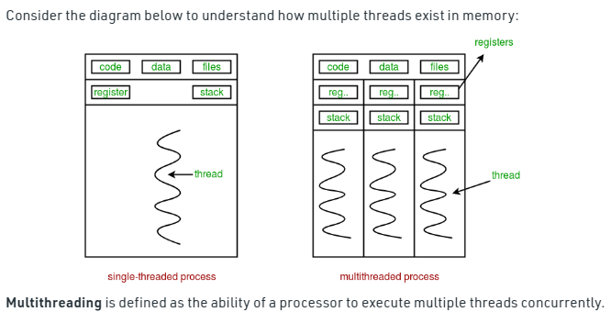

Slide 206
Eg
import threading
def print_cube(num):
"""
function to print cube of given num
"""
print("Cube:”, num * num * num))
def print_square(num):
"""
function to print square of given num
"""
print("Square:”, format(num * num))
if __name__ == "__main__":
# creating thread
t1 = threading.Thread(target=print_square, args=(10,))
t2 = threading.Thread(target=print_cube, args=(10,))
# starting thread 1
t1.start()
# starting thread 2
t2.start()
# wait until thread 1 is completely executed
t1.join()
# wait until thread 2 is completely executed
t2.join()
# both threads completely executed
print("Done!")

Slide 207
eg
import threading
import os
def task1():
print("Task 1 assigned to thread: “,(threading.current_thread().name))
print("ID of process running task 1: “, (os.getpid()))
def task2():
print("Task 2 assigned to thread: “,(threading.current_thread().name))
print("ID of process running task 2: “,(os.getpid()))

Slide 208
if __name__ == "__main__":
# print ID of current process
print("ID of process running main program:“,(os.getpid()))
# print name of main thread
print("Main thread name:”, (threading.current_thread().name))
# creating threads
t1 = threading.Thread(target=task1, name='t1')
t2 = threading.Thread(target=task2, name='t2')
# starting threads
t1.start()
t2.start()
# wait until all threads finish
t1.join()
t2.join()

Slide 209
Synchronization between threads
Thread synchronization is defined as a mechanism which ensures that two or more concurrent threads do not simultaneously execute some particular program segment known as critical section.
Critical section refers to the parts of the program where the shared resource is accessed.

Slide 210
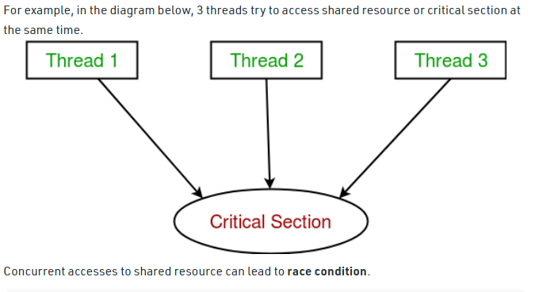

Slide 211
A race condition occurs when two or more threads can access shared data and they try to change it at the same time. As a result, the values of variables may be unpredictable and vary depending on the timings of context switches of the processes.

Slide 212
eg
import threading
# global variable x
x = 0
def increment():
"""
function to increment global variable x
"""
global x
x += 1
def thread_task():
"""
task for thread
calls increment function 100000 times.
"""
for _ in range(100000):
increment()

Slide 213
def main_task():
global x
# setting global variable x as 0
x = 0
# creating threads
t1 = threading.Thread(target=thread_task)
t2 = threading.Thread(target=thread_task)
# start threads
t1.start()
t2.start()
# wait until threads finish their job
t1.join()
t2.join()
if __name__ == "__main__":
for i in range(10):
main_task()
print("Iteration {0}: x = {1}".format(i,x))

Slide 214
Python Object Oriented
DYPSOM
Overview of OOP Terminology
Class: A user-defined prototype for an object that defines a set of attributes that characterize any object of the class. The attributes are data members (class variables and instance variables) and methods, accessed via dot notation.
Data member: A class variable or instance variable that holds data associated with a class and its objects.
Function overloading: The assignment of more than one behavior to a particular function. The operation performed varies by the types of objects or arguments involved.
.
Member Function or Method : A special kind of function that is defined in a class definition.
Instance variable: A variable that is defined inside a method and belongs only to the current instance of a class.

Slide 215
Python Object Oriented
DYPSOM
Overview of OOP Terminology
Inheritance: The transfer of the characteristics of a class to other classes that are derived from it.
Operator overloading: The assignment of more than one function to a particular operator.
Object: A unique instance of a data structure that's defined by its class. An object comprises both data members (class variables and instance variables) and methods.
.

Slide 216
Python Object Oriented
DYPSOM
Creating Classes
The class statement creates a new class definition. The name of the class immediately follows the keyword class followed by a colon as follows −variables and methods.
class ClassName:
'Optional class documentation string' class_suite…..
The class has a documentation ClassName. doc .
string,
which
can be accessed via
.
The class_suite consists of all the
members, data attributes and functions.
component
statements
defining
class

Slide 217
Python Object Oriented
DYPSOM
Example
class Employee:
'Common base class for all employees' empCount = 0
def init (self, name, salary): self.name = name
self.salary = salary
Employee.empCount += 1
.
def displayCount(self):
print "Total Employee %d" % Employee.empCount
def displayEmployee(self):
print "Name : ", self.name, ", Salary: ", self.salary

Slide 218
Python Object Oriented
DYPSOM
Description of Example
The variable empCount is a class variable whose value is shared among all instances of a this class. This can be accessed as Employee.empCount from inside the class or outside the class.
The first method init () is a special method, which is called class constructor or initialization method that Python calls when you create a new instance of this class.
You declare other class methods like normal functions with the exception that the first argument to each method is self. Python adds the self argument to the list for you; you do not need to include it when you call the methods.
.

Slide 219
Python Object Oriented
DYPSOM
Creating Instance Objects
#"This would create first object of Employee class" emp1 = Employee(“Amit", 2000)
#"This would create second object of Employee class" emp2 = Employee(“Sumit", 5000)
Accessing Attributes
emp1.displayEmployee() emp2.displayEmployee()
print ("Total Employee %d" % Employee.empCount)
.

Slide 220
Python Object Oriented
DYPSOM
class Employee:
'Common base class for all employees' empCount = 0
def init (self, name, salary):
self.name = name self.salary = salary Employee.empCount += 1
def displayCount(self):
print ("Total Employee %d" % Employee.empCount)
def displayEmployee(self):
print ("Name : ", self.name, ", Salary: ", self.salary)
.
emp1 = Employee("Amit", 2000)
"This would create second object of Employee class" emp2 = Employee("Sumit", 5000) emp1.displayEmployee()
emp2.displayEmployee()
print ("Total Employee %d" % Employee.empCount)

Slide 221
Python Object Oriented
DYPSOM
The getattr(obj, name[, default]) : to access the attribute of object.
The hasattr(obj,name) : to check if an attribute exists or not.
The setattr(obj,name,value) : to set an attribute. If attribute does not exist, then it would be created.
The delattr(obj, name) : to delete an attribute.
print(hasattr(emp1, 'name')) # Returns true if 'Name' attribute exists print(getattr(emp1, 'name')) # Returns value of 'Name' attribute setattr(emp1, 'salary',6000) # Set attribute 'Salary' at 6000
.print(getattr(emp1, 'salary'))
delattr(empl, 'salary') # Delete attribute 'salary' print(getattr(emp1, 'salary'))

Slide 222
Python Object Oriented
DYPSOM
Built-In Class Attributes
Every Python class keeps following built-in attributes and they can be accessed using dot operator like any other attribute −
dict : Dictionary containing the class's namespace.
doc : Class documentation string or none, if undefined.
name : Class name.
module : Module name in which the class is defined. This attribute is
. " main " in interactive mode.
bases : A possibly empty tuple containing the base classes, in the order of
their occurrence in the base class list.

Slide 223
Python Object Oriented
DYPSOM
class Employee:
'Common base class for all employees' empCount = 0
def init (self, name, salary):
self.name = name self.salary = salary Employee.empCount += 1
def displayCount(self):
print "Total Employee %d" % Employee.empCount
def displayEmployee(self):
print "Name : ", self.name, ", Salary: ", self.salary
.
print "Employee. doc :", Employee. doc
print "Employee. name :", Employee. name print "Employee. module :", Employee. module print "Employee. bases :", Employee. bases print "Employee. dict :", Employee. dict

Slide 224
Python Object Oriented
DYPSOM
Destroying Objects (Garbage Collection)
Python deletes unneeded objects (built-in types or class instances) automatically to free the memory space.
The process by which Python periodically reclaims blocks of memory that no longer are in use is termed Garbage Collection.
A class can implement the special method del (), called a destructor, that is
invoked when the instance is about to be destroyed.
.

Slide 225
Python Object Oriented
DYPSOM
Destroying Objects (Garbage Collection)
Example
This del () destructor prints the instance name that is about to be destroyed −
class Point:
def init( self, x=0, y=0): self.x = x
self.y = y
def del (self):
class_name = self. class . name
print (class_name, "destroyed")
pt1 = Point()
. pt2 = pt1 pt3 = pt1
print(id(pt1), id(pt2), id(pt3)) # prints the ids of the obejcts
del pt1 del pt2 del pt3
print (id(pt1), id(pt2), id(pt3)) # Generate Error

Slide 226
Python Object Oriented
DYPSOM
Class Inheritance
The child class inherits the attributes of its parent class, and you can use those
attributes as if they were defined in the child class.
A child class can also override data members and methods from the parent.
.

Slide 227
Python Object Oriented
DYPSOM
Class Inheritance Example
class Person: def __init__(self, first, last): self.firstname = first self.lastname = last def Name(self): return self.firstname + " " + self.lastname
 | class Employee(Person): def __init__(self, first, last, staffnum): Person.__init__(self,first, last) self.staffnumber = staffnum def GetEmployee(self): return self.Name() + ", " + self.staffnumber x = Person(“Akshay", “Kumar") y = Employee(“Rohit", “Roy", "1007") print(x.Name()) print(y.GetEmployee())
.

Slide 228
class Person(object):
# Constructor
def __init__(self, name):
self.name = name
# To get name
def getName(self):
return self.name
# To check if this person is an employee
def isEmployee(self):
return False
# Inherited or Subclass (Note Person in bracket)
class Employee(Person):
# Here we return true
def isEmployee(self):
return True
# Driver code
emp = Person("Geek1") # An Object of Person
print(emp.getName(), emp.isEmployee())
emp = Employee("Geek2") # An Object of Employee
print(emp.getName(), emp.isEmployee())

Slide 229
class Person( object ):
# __init__ is known as the constructor
def __init__(self, name, idnumber):
self.name = name
self.idnumber = idnumber
def display(self):
print(self.name)
print(self.idnumber)
# child class
class Employee( Person ):
def __init__(self, name, idnumber, salary, post):
self.salary = salary
self.post = post
# invoking the __init__ of the parent class
Person.__init__(self, name, idnumber)
# creation of an object variable or an instance
a = Employee('Rahul', 886012, 200000, "Intern")
# calling a function of the class Person using its instance
a.display()

Slide 230
Types of Inheritance
Different forms of Inheritance: 1. Single inheritance: When a child class inherits from only one parent class, it is called single inheritance. We saw an example above. 2. Multiple inheritance: When a child class inherits from multiple parent classes, it is called multiple inheritance.
Unlike java, python shows multiple inheritance

Slide 231
3. Multilevel inheritance: When we have a child and grandchild relationship.
4. Hierarchical inheritance More than one derived classes are created from a single base. 5. Hybrid inheritance: This form combines more than one form of inheritance. Basically, it is a blend of more than one type of inheritance.
Private members of parent class We don’t always want the instance variables of the parent class to be inherited by the child class i.e. we can make some of the instance variables of the parent class private, which won’t be available to the child class. We can make an instance variable private by adding double underscores before its name.

Slide 232
#Multiple Inheritance
class Base1(object):
def __init__(self):
self.str1 = “Dypm1"
print("Base1")
class Base2(object):
def __init__(self):
self.str2 = “DYPM2"
print("Base2")
class Derived(Base1, Base2):
def __init__(self):
# Calling constructors of Base1
# and Base2 classes
Base1.__init__(self)
Base2.__init__(self)
print("Derived")
def printStrs(self):
print(self.str1, self.str2)
ob = Derived()
ob.printStrs()

Slide 233
#Multiple Level
class Base(object):
# Constructor
def __init__(self, name):
self.name = name
# To get name
def getName(self):
return self.name
# Inherited or Sub class (Note Person in bracket)
class Child(Base):
# Constructor
def __init__(self, name, age):
Base.__init__(self, name)
self.age = age
# To get name
def getAge(self):
return self.age

Slide 234
# Inherited or Sub class (Note Person in bracket)
class GrandChild(Child):
# Constructor
def __init__(self, name, age, address):
Child.__init__(self, name, age)
self.address = address
# To get address
def getAddress(self):
return self.address
# Driver code
g = GrandChild("Geek1", 23, "Noida")
print(g.getName(), g.getAge(), g.getAddress())

Slide 235
#Hierarchical Inheritance
class Parent:
def func1(self):
print("This function is in parent class.")
# Derived class1
class Child1(Parent):
def func2(self):
print("This function is in child 1.")
# Derivied class2
class Child2(Parent):
def func3(self):
print("This function is in child 2.")
# Driver's code
object1 = Child1()
object2 = Child2()
object1.func1()
object1.func2()
object2.func1()
object2.func3()

Slide 236
#Hybrid Inheritance
class School:
def func1(self):
print("This function is in school.")
class Student1(School):
def func2(self):
print("This function is in student 1. ")
class Student2(School):
def func3(self):
print("This function is in student 2.")
class Student3(Student1, School):
def func4(self):
print("This function is in student 3.")
# Driver's code
object = Student3()
object.func1()
object.func2()

Slide 237
super()
When a class inherits some or all of the behaviors from another class is known as Inheritance.
In such a case, the inherited class is the subclass and the latter class is the parent class.
In an inherited subclass, a parent class can be referred to with the use of the super() function.
The super function returns a temporary object of the superclass that allows access to all of its methods to its child class.

Slide 238
Furthermore, The benefits of using a super function are:-
Need not remember or specify the parent class name to access its methods. This function can be used both in single and multiple inheritances.
This implements modularity (isolating changes) and code reusability as there is no need to rewrite the entire function.
Super function in Python is called dynamically because Python is a dynamic language unlike other languages.

Slide 239
There are 3 constraints to use the super function:-
The class and its methods which are referred by the super function
The arguments of the super function and the called function should match.
Every occurrence of the method must include super() after you use it.

Slide 240
# super function
class Animals:
# Initializing constructor
def __init__(self):
self.legs = 4
self.domestic = True
self.tail = True
self.mammals = True
def isMammal(self):
if self.mammals:
print("It is a mammal.")
def isDomestic(self):
if self.domestic:
print("It is a domestic animal.")
class Dogs(Animals):
def __init__(self):
super().__init__()
def isMammal(self):
super().isMammal()

Slide 241
class Horses(Animals):
def __init__(self):
super().__init__()
def hasTailandLegs(self):
if self.tail and self.legs == 4:
print("Has legs and tail")
# Driver code
Tom = Dogs()
Tom.isMammal()
Bruno = Horses()
Bruno.hasTailandLegs()

Slide 242
Overloading operators
Operator Overloading means giving extended meaning beyond their predefined operational meaning.
For example operator + is used to add two integers as well as join two strings and merge two lists.
It is achievable because ‘+’ operator is overloaded by int class and str class.
You might have noticed that the same built-in operator or function shows different behavior for objects of different classes, this is called Operator Overloading.

Slide 243
Changing the behavior of operator is as simple as changing the behavior of method or function.
You define methods in your class and operators work according to that behavior defined in methods.
When we use + operator, the magic method __add__ is automatically invoked in which the operation for + operator is defined.
There by changing this magic method’s code, we can give extra meaning to the + operator.

Slide 244
class A:
def __init__(self, a):
self.a = a
# adding two objects
def __add__(self, o):
return self.a + o.a
ob1 = A(1)
ob2 = A(2)
ob3 = A(“Hello")
ob4 = A(“python")
print(ob1 + ob2)
print(ob3 + ob4)

Slide 245
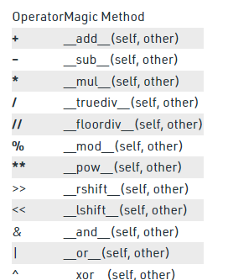
Binary operators

Slide 246
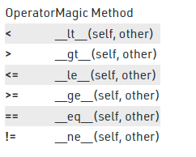
Comparison Operators :

Slide 247
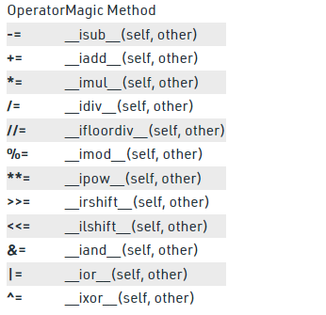
Assignment Operators :

Slide 248
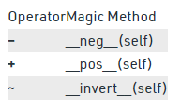
Unary Operator

Slide 249
Encapsulation in Python
It describes the idea of wrapping data and the methods that work on data within one unit.
This puts restrictions on accessing variables and methods directly and can prevent the accidental modification of data.
To prevent accidental change, an object’s variable can only be changed by an object’s method.
Those types of variables are known as private variables.

Slide 250
Protected members
Protected members (in C++ and JAVA) are those members of the class that cannot be accessed outside the class but can be accessed from within the class and its subclasses.
To accomplish this in Python, just follow the convention by prefixing the name of the member by a single underscore “_”.

Slide 251
class Base:
def __init__(self):
# Protected member
self._a = 2
# Creating a derived class
class Derived(Base):
def __init__(self):
# Calling constructor of
# Base class
Base.__init__(self)
print("Calling protected member of base class: ",
self._a)
# Modify the protected variable:
self._a = 3
print("Calling modified protected member outside class: ",
self._a)

Slide 252
obj1 = Derived()
obj2 = Base()
# Calling protected member
# Can be accessed but should not be done due to convention
print("Accessing protected member of obj1: ", obj1._a)
# Accessing the protected variable outside
print("Accessing protected member of obj2: ", obj2._a)

Slide 253
Private members
Private members are similar to protected members, the difference is that the class members declared private should neither be accessed outside the class nor by any base class.
In Python, there is no existence of Private instance variables that cannot be accessed except inside a class.
However, to define a private member prefix the member name with double underscore “__”.

Slide 254
class Base:
def __init__(self):
self.a = “Hello Python"
self.__c = " Hello Python "
# Creating a derived class
class Derived(Base):
def __init__(self):
# Calling constructor of
# Base class
Base.__init__(self)
print("Calling private member of base class: ")
print(self.__c)
# Driver code
obj1 = Base()
print(obj1.a)
# Uncommenting print(obj1.c) will
# raise an AttributeError
# Uncommenting obj2 = Derived() will
# also raise an AtrributeError as
# private member of base class
# is called inside derived class

Slide 255
Class Method
The @classmethod decorator is a built-in function decorator that is an expression that gets evaluated after your function is defined.
The result of that evaluation shadows your function definition.
class C(object):
@classmethod
def fun(cls, arg1, arg2, ...):

Slide 256
Static Method
A static method does not receive an implicit first argument.
A static method is also a method that is bound to the class and not the object of the class.
A static method can’t access or modify the class state.
class C(object):
@staticmethod
def fun(arg1, arg2, ...):

Slide 257
Class method vs Static Method
A class method takes cls as the first parameter while a static method needs no specific parameters.
A class method can access or modify the class state while a static method can’t access or modify it.
In general, static methods know nothing about the class state. They are utility-type methods that take some parameters and work upon those parameters. On the other hand class methods must have class as a parameter.
We use @classmethod decorator in python to create a class method and we use @staticmethod decorator to create a static method in python.

Slide 258
from datetime import date
class Person:
def __init__(self, name, age):
self.name = name
self.age = age
# a class method to create a Person object by birth year.
@classmethod
def fromBirthYear(cls, name, year):
return cls(name, date.today().year - year)
# a static method to check if a Person is adult or not.
@staticmethod
def isAdult(age):
return age > 18
person1 = Person('mayank', 21)
person2 = Person.fromBirthYear('mayank', 1996)
print (person1.age)
print (person2.age)
# print the result
print (Person.isAdult(22))

Slide 259
Dynamic attributes of classes
Dynamic attributes in Python are terminologies for attributes that are defined at runtime, after creating the objects or instances.
In Python we call all functions, methods also as an object.
So you can define a dynamic instance attribute for nearly anything in Python.
Consider the example for better understanding about the topic.

Slide 260
class GFG:
None
def value():
return 10
# Driver Code
g = GFG()
# Dynamic attribute of a
# class object
g.d1 = value
# Dynamic attribute of a
# function
value.d1 = “hello"
print(value.d1)
print(g.d1() == value())

Slide 261
Python Regular Expression
Why Regular Expressions?
Let’s take a moment to understand why we should use Regular expression.
Data Mining: Regular expression is the best tool for data mining. It efficiently identifies a text in a heap of text by checking with a pre-defined pattern. Some common scenarios are identifying an email, URL, or phone from a pile of text.
Data Validation: Regular expression can perfectly validate data. It can include a wide array of validation processes by defining different sets of patterns. A few examples are validating phone numbers, emails, etc.

Slide 262
Basic Regular Expressions
Let’s understand some of the basic regular expressions. They are as follows:
Character Classes
Rangers
Negation
Shortcuts
Beginning and End of String
Any Character

Slide 263
Character Classes
Character classes allow you to match a single set of characters with a possible set of characters.
You can mention a character class within the square brackets.
Let’s consider an example of case sensitive words.

Slide 264
import re
print(re.findall(r'[Gg]eeks', 'GeeksforGeeks:A computer science portal for geeks'))

Slide 265
Ranges
The range provides the flexibility to match a text with the help of a range pattern such as a range of numbers(0 to 9), a range of characters (A to Z), and so on.
The hyphen character within the character class represents a range.

Slide 266
import re
print('Range',re.search(r'[a-zA-Z]', 'x'))

Slide 267
Negation
Negation inverts a character class. It will look for a match except for the inverted character or range of inverted characters mentioned in the character class.

Slide 268
import re
print(re.search(r'[^a-z]', '0'))
Ex: 2
import re
print(re.search(r'G[^e]', 'Geeks'))

Slide 269
Shortcuts
Let’s discuss some of the shortcuts provided by the regular expression engine.
\w – matches a word character
\d – matches digit character
\s – matches whitespace character (space, tab, newline, etc.)
\b – matches a zero-length character

Slide 270
import re
print('Geeks:', re.search(r'\bGeeks\b', 'Geeks'))
print('GeeksforGeeks:', re.search(r'\bGeeks\b', 'GeeksforGeeks'))

Slide 271
Beginning and End of String
The ^ character chooses the beginning of a string and the $ character chooses the end of a string.

Slide 272
import re
# Beginning of String
match = re.search(r'^Geek', 'Campus Geek of the month')
print('Beg. of String:', match)
match = re.search(r'^Geeks', 'Geeks of the month')
print('Beg. of String:', match)
# End of String
match = re.search(r'Geeks$', 'Compute science portal-GeeksforGeeks')
print('End of String:', match)

Slide 273
Any Character
The . character represents any single character outside a bracketed character class.
import re
print('Any Character', re.search(r'p.th.n', 'python 3'))

Slide 274
Pattern matching in Python with Regex
You may be familiar with searching for text by pressing ctrl-F and typing in the words you’re looking for.
Regular expressions go one step further: They allow you to specify a pattern of text to search for.
Regular expressions, called regexes for short, are descriptions for a pattern of text.
For example, a \d in a regex stands for a digit character — that is, any single numeral 0 to 9.

Slide 275
Following regex is used in Python to match a string of three numbers, a hyphen, three more numbers, another hyphen, and four numbers.Any other string would not match the pattern. \d\d\d-\d\d\d-\d\d\d\d
Regular expressions can be much more sophisticated. For example, adding a 3 in curly brackets ({3}) after a pattern is like saying, “ Match this pattern three times.” So the slightly shorter regex\d{3}-\d{3}-\d{4}

Slide 276
import re
phoneNumRegex = re.compile(r'\d\d\d-\d\d\d-\d\d\d\d')
mo = phoneNumRegex.search('My number is 415-555-4242.')
print('Phone number found: ' + mo.group())

Slide 277
Steps of Regular Expression Matching
While there are several steps to using regular expressions in Python, each step is fairly simple.
Import the regex module with import re.
Create a Regex object with the re.compile() function. (Remember to use a raw string.)
Pass the string you want to search into the Regex object’s search() method. This returns a Match object.
Call the Match object’s group() method to return a string of the actual matched text.

Slide 278
Grouping with parentheses
Matching objects:
Say you want to separate the area code from the rest of the phone number.
Adding parentheses will create groups in the regex: (\d\d\d)-(\d\d\d-\d\d\d\d).
Then you can use the group() match object method to grab the matching text from just one group.

Slide 279
import re
phoneNumRegex = re.compile(r'(\d\d\d)-(\d\d\d-\d\d\d\d)')
mo = phoneNumRegex.search('My number is 415-555-4242.')
print(mo.group(1))

Slide 280
2. Retrieve all the groups at once :
If you would like to retrieve all the groups at once, use the groups(), method—note the plural form for the name.
import re
phoneNumRegex = re.compile(r'(\d\d\d)-(\d\d\d-\d\d\d\d)')
mo = phoneNumRegex.search('My number is 415-555-4242.')
print(mo.groups())

Slide 281
3. Using mo.groups : mo.groups() will return a tuple of multiple values, you can use the multiple-assignment trick to assign each value to a separate variable, as in the following areaCode, mainNumber = mo.groups() line.
import re
phoneNumRegex = re.compile(r'(\d\d\d)-(\d\d\d-\d\d\d\d)')
mo = phoneNumRegex.search('My number is 415-555-4242.')
areaCode, mainNumber = mo.groups()
print(mainNumber)

Slide 282
Match a parenthesis :
Parentheses have a special meaning in regular expressions, but what do you do if you need to match a parenthesis in your text.
For instance, maybe the phone numbers you are trying to match have the area code set in parentheses.
In this case, you need to escape the ( and ) characters with a backslash.
Enter the following into the interactive shell:

Slide 283
import re
phoneNumRegex = re.compile(r'(\(\d\d\d\)) (\d\d\d-\d\d\d\d)')
mo = phoneNumRegex.search('My phone number is (415) 555-4242.')
print(mo.group(1))

Slide 284
Matching Multiple Groups with the Pipe
The | character is called a pipe. You can use it anywhere you want to match one of many expressions. For example, the regular expression r’Batman|Tina Fey’ will match either ‘Batman’ or ‘Tina Fey’.
When both Batman and Tina Fey occur in the searched string, the first occurrence of matching text will be returned as the Match object. Enter the following into the interactive shell:

Slide 285
import re
heroRegex = re.compile (r'Batman|Tina Fey')
mo1 = heroRegex.search('Batman and Tina Fey.')
print(mo1.group())

Slide 286
Matching Specific Repetitions with Curly Brackets
If you have a group that you want to repeat a specific number of times, follow the group in your regex with a number in curly brackets. For example, the regex (Ha){3} will match the string ‘HaHaHa’, but it will not match ‘HaHa’, since the latter has only two repeats of the (Ha) group.
Instead of one number, you can specify a range by writing a minimum, a comma, and a maximum in between the curly brackets. For example, the regex (Ha){3, 5} will match ‘HaHaHa’, ‘HaHaHaHa’, and ‘HaHaHaHaHa’.
You can also leave out the first or second number in the curly brackets to leave the minimum or maximum unbounded. For example, (Ha){3, } will match three or more instances of the (Ha) group, while (Ha){, 5} will match zero to five instances. Curly brackets can help make your regular expressions shorter.

Slide 287
These two regular expressions match identical patterns:
(Ha){3} (Ha)(Ha)(Ha)
And these two regular expressions also match identical patterns:
(Ha){3, 5} ((Ha)(Ha)(Ha))|((Ha)(Ha)(Ha)(Ha))|((Ha)(Ha)(Ha)(Ha)(Ha))

Slide 288
import re
haRegex = re.compile(r'(Ha){3}')
mo1 = haRegex.search('HaHaHa')
print(mo1.group())
import re
haRegex = re.compile(r'(Ha){3}')
mo2 = haRegex.search('Ha')== None
print(mo2)

Slide 289
Optional Matching with the Question Mark
Sometimes there is a pattern that you want to match only optionally.
That is, the regex should find a match whether or not that bit of text is there.
The ? character flags the group that precedes it as an optional part of the pattern.
For example, enter the following into the interactive shell:

Slide 290
import re
batRegex = re.compile(r'Bat(wo)?man')
mo1 = batRegex.search('The Adventures of Batman')
print(mo1.group())
import re
batRegex = re.compile(r'Bat(wo)?man')
mo2 = batRegex.search('The Adventures of Batwoman')
print(mo2.group())

Slide 291
Matching Zero or More with the Star
The * (called the star or asterisk) means “match zero or more”—the group that precedes the star can occur any number of times in the text.
It can be completely absent or repeated over and over again. Let’s look at the Batman example again.

Slide 292
import re
batRegex = re.compile(r'Bat(wo)*man')
mo1 = batRegex.search('The Adventures of Batman')
print(mo1.group())
import re
batRegex = re.compile(r'Bat(wo)*man')
mo2 = batRegex.search('The Adventures of Batwoman')
print(mo2.group())

Slide 293
Matching One or More with the Plus
While * means “match zero or more, ” the + (or plus) means “match one or more.” Unlike the star, which does not require its group to appear in the matched string, the group preceding a plus must appear at least once.
It is not optional. Enter the following into the interactive shell, and compare it with the star regexes in the previous section:

Slide 294
import re
batRegex = re.compile(r'Bat(wo)+man')
mo1 = batRegex.search('The Adventures of Batwoman')
print(mo1.group())
import re
batRegex = re.compile(r'Bat(wo)+man')
mo2 = batRegex.search('The Adventures of Batwowowowoman')
print(mo2.group())

Slide 295
Password validation in Python
def password_check(passwd):
SpecialSym =['$', '@', '#', '%']
val = True
if len(passwd) < 6:
print('length should be at least 6')
val = False
if len(passwd) > 20:
print('length should be not be greater than 8')
val = False
if not any(char.isdigit() for char in passwd):
print('Password should have at least one numeral')
val = False
if not any(char.isupper() for char in passwd):
print('Password should have at least one uppercase letter')
val = False

Slide 296
if not any(char.islower() for char in passwd):
print('Password should have at least one lowercase letter')
val = False
if not any(char in SpecialSym for char in passwd):
print('Password should have at least one of the symbols $@#')
val = False
if val:
return val
# Main method
def main():
passwd = 'Geek12@'
if (password_check(passwd)):
print("Password is valid")
else:
print("Invalid Password !!")
# Driver Code
if __name__ == '__main__':
main()

Slide 297
if not any(char.islower() for char in passwd):
print('Password should have at least one lowercase letter')
val = False
if not any(char in SpecialSym for char in passwd):
print('Password should have at least one of the symbols $@#')
val = False
if val:
return val
# Main method
def main():
passwd = 'Geek12@'
if (password_check(passwd)):
print("Password is valid")
else:
print("Invalid Password !!")
# Driver Code
if __name__ == '__main__':
main()

Slide 298
if not any(char.islower() for char in passwd):
print('Password should have at least one lowercase letter')
val = False
if not any(char in SpecialSym for char in passwd):
print('Password should have at least one of the symbols $@#')
val = False
if val:
return val
# Main method
def main():
passwd = 'Geek12@'
if (password_check(passwd)):
print("Password is valid")
else:
print("Invalid Password !!")
# Driver Code
if __name__ == '__main__':
main()

Slide 299
EX 2
# importing re library
import re
def main():
passwd = 'Geek12@'
reg = "^(?=.*[a-z])(?=.*[A-Z])(?=.*\d)(?=.*[@$!%*#?&])[A-Za-z\d@$!#%*?&]{6,20}$"
# compiling regex
pat = re.compile(reg)
# searching regex
mat = re.search(pat, passwd)
# validating conditions
if mat:
print("Password is valid.")
else:
print("Password invalid !!")
# Driver Code
if __name__ == '__main__':
main()

Slide 300
Email
import re
s = 'manogna.neelam@gmail.com‘
match = re.search(r'\b[A-Z0-9._%+-]+@[A-Z0-9.-]+\.[A-Z]{2,}\b', s, re.I)
print(match.group())

Slide 301
import re
# Function to validate URL
# using regular expression
def isValidURL(str):
# Regex to check valid URL
regex = ("((http|https)://)(www.)?" +
"[a-zA-Z0-9@:%._\\+~#?&//=]" +
"{2,256}\\.[a-z]" +
"{2,6}\\b([-a-zA-Z0-9@:%" +
"._\\+~#?&//=]*)")
# Compile the ReGex
p = re.compile(regex)
# If the string is empty
# return false
if (str == None):
return False
# Return if the string
# matched the ReGex
if(re.search(p, str)):
return True
else:
return False
# Driver code
# Test Case 1:
url = "https://www.geeksforgeeks.org"
if(isValidURL(url) == True):
print("Yes")
else:
print("No")
# This code is contributed by avanitrachhadiya2155

Slide 302
URL
import re
# Function to validate URL
# using regular expression
def isValidURL(str):
# Regex to check valid URL
regex = ("((http|https)://)(www.)?" +
"[a-zA-Z0-9@:%._\\+~#?&//=]" +
"{2,256}\\.[a-z]" +
"{2,6}\\b([-a-zA-Z0-9@:%" +
"._\\+~#?&//=]*)")
# Compile the ReGex
p = re.compile(regex)
# If the string is empty
# return false
if (str == None):
return False

Slide 303
# Return if the string
# matched the ReGex
if(re.search(p, str)):
return True
else:
return False
# Driver code
# Test Case 1:
url = "https://www.geeksforgeeks.org"
if(isValidURL(url) == True):
print("Yes")
else:
print("No")
# This code is contributed by avanitrachhadiya2155

