Slide 1

SIMBA Technology
Dave Auwen
Jonathan Crocker
Kessia Eugene
Rohan Kulkarni
Shweta Zutshi

Slide 2
Overview
Review Over the Project
  Requirements
  Design
  Implementation
  Testing
What Happened during the project
  Problems that we encountered and our solutions
  Deviations from our specifications
  Known problems remaining in our system
What we Would’ve done
  If we had more time
  If we had it to do all over again
  What we learnt
Summary
DEMO
Questions

Slide 3
Requirements
Record-Keeper is an accounting software product used to keeping the church’s financial records up to date in user friendly manner.
Stand-alone application.
Makes it easier to edit, update, access, delete and verify the information about each fund, donor and donation.
Generates numerous reports.
Our client is Professor Cerise Wuthrich.

Slide 4
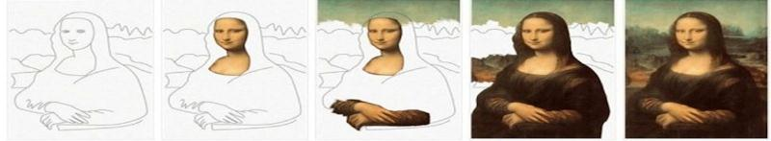

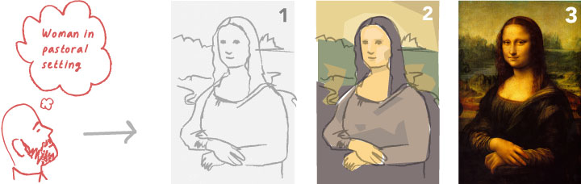
Iterative Process Model

Slide 5
Iterative Process Model
Advantages
Disadvantages
Less time is spent on documentation and more time is spent on design.
Gets user feed back when presenting sketches.
Builds project step by step, so we can find defects at early stages.
Each phase of an iteration is rigid with no overlaps.
Costly system architecture or design issues may arise because not all requirements are gathered up front for the entire lifecycle.

Slide 6
Implementation
Tools
  Visual Studio, SQL Sever 2008 CE, ADO.net
Languages
  C#, SQL
Interaction
  Windows application, interacts with the database using classes in the ADO.net library.

Slide 7
Test Report
3-Iterations Testing
  Coding
  Unit Testing
  Integration Testing
  System Testing
Unit Tester
  Rohan
Integration/SytemTesters
  Kessia
  Shweta

Slide 8
Problems that we Encountered
Updating multiple tables at once. Data Adapter can ONLY update one at a time. Had to use SQL Transaction Object.
Getting everyone to be able to meet at the same time. Creating backup plans for just in case.
Getting Visual Studio and SQL Sever working together.
Reports and a backup system.

Slide 9
Deviations from Specifications
The major deviation was just tweaks to the UI design.
  Email
  Import/Export to Excel
  How to restore the Backup

Slide 10
Known Problems Remaining in the System
The reporting works correctly but the design of the reports is still not satisfactory.
Have duplicate details in the database.
Member name corresponding to the selected envelope number doesn't appear in the donations form.
In the donations form, we need to read fund id and envelope number in the dropdown, it's being read in the textbox.

Slide 11
If we had more Time
We would have
Gone with a Web base, because we would have more control on the looks.
Added more Functionalities, like sending emails of the reports.
Improved the UI looks.
Fixed more bugs.

Slide 12
If We Could Do it All Over
We would
Learn about as many components Visual studio toolbox offers and use them wisely while designing UI.
Improve the UI.
Organize our work a little better, better time and task management.
Research more languages to see which one would have been best to use for this project.

Slide 13
What We Learnt
Learnt to work in a team and manage a team.
Team work and delegating task is very important to deadline.
Learn C#, ADO.net, some SQL.
Software development from the scratch.

Slide 14
DEMO TIME

Slide 15
Summary
3rd iteration of testing.
Fix the report page.
Write the final report.
Create the deliverable CD.

Slide 16

QUESTIONS?

