Slide 1
MindSprint
Sapoliya Dhruv
Vavaliya Dvarkesh
Prajapati Krunal

Slide 2
1. Introduction

Slide 3
1.1 Existing System
The existing system for student placement preparation and technical skill learning primarily relies on physical textbooks, static offline notes, and scattered web platforms. Students currently use separate applications or websites for practicing quantitative aptitude, watching video lectures, reading technical documentation, and tracking their study habits.
Key drawbacks of the existing system include:
Disjointed platforms for exam preparation, skill learning, and progress tracking.
Lack of real-time performance evaluation and weak spot identification.
Inability to practice company-specific interview patterns in a single mobile interface.
Manual tracking of daily study consistency without automated retention tools like flashcards or streak counters.

Slide 4
1.2 Need for the New System
With the rapid increase in competitive campus placement drives (TCS, Infosys, Wipro, Accenture, Amazon, Google), students require a unified, mobile-first learning management system.
The new system, MindSprint, addresses this need by combining:
Practice questions categorized by Quantitative Aptitude, Logical Reasoning, and IT Technical topics.
Company-specific question filters.
Real-time exam simulation with live timers and scratchpad tools.
Intelligent analytics to identify weak topics based on past test attempts.
Integrated video learning modules and interactive flashcards.

Slide 5
1.3 Objective of the New System
The primary objectives of MindSprint are:-
To provide a consolidated mobile platform for aptitude practice, technical courses, and academic revision.
To enable company-wise filter options for focused campus drive preparation.
To deliver real-time exam evaluation with automated score calculation and topic-level weak spot detection.
To improve daily student engagement through streak tracking and swipeable flashcards.
To offer a robust full-stack architecture with backend database persistence and offline dataset fallback.

Slide 6
1.4 Problem Definition
Students preparing for IT job placements face difficulty in identifying their specific technical and quantitative weak areas due to a lack of detailed test analysis. Furthermore, switching between multiple apps for learning, practicing, and reviewing formulas leads to reduced focus and study fragmentation.
MindSprint solves this problem by integrating test execution, video learning, weak topic analysis, and formula flashcards into a single application supported by a Node.js/MongoDB REST API backend.

Slide 7
1.5 Core Components
MindSprint is architected into five core software layers and modules:
1. Mobile Client App: React Native frontend built with Expo v54/v57, TypeScript, and Expo Router, delivering cross-platform performance across Android, iOS, and Web.
2. REST API Backend: Node.js and Express server delivering secure JWT authentication, rate limiting, academic data APIs, and AI proxy routing.
3. Scalable Database Layer: MongoDB database with Mongoose schemas for User accounts, Question banks, Courses, ExamResults, DuelRooms, and SamplePapers.
4. Offline Resilience Layer: Service-level fallback mechanism (ApiService) that automatically loads verified local datasets when network connectivity drops.
5. Interactive Learning Engines: Real-time timed mock exam engine with question palette, 1v1 Quiz Duel battles, Voice Viva player, and AI Doubt Solver with photo OCR.

Slide 8
1.6 Project Profile
Project Title :- MindSprint - Placement Preparation & Skill Learning App
Front-End Technology :- React Native, Expo v54, TypeScript, Expo Router
Back-End Technology :- Node.js, Express.js REST API
Database :- MongoDB / Mongoose ODM
Target OS :- Android, iOS, Web
IDE / Environment :- VS Code, Node.js v20+, Expo CLI

Slide 9
1.7 Assumptions and Constraints
Assumptions:
Users possess an active Android/iOS mobile device or modern web browser.
Network connectivity is available for user registration, live backend sync, and course video streaming.
Constraints:
Offline mode relies on static local datasets for practice questions.
Video playback requires active internet bandwidth.
Backend API authentication uses JWT/hashed passwords for secure user access.

Slide 10
1.8 Advantages and Limitations of the Proposed System
Advantages :-
Single unified platform for aptitude practice, course videos, and flashcards.
Real-time weak spot detection helping students target problem areas.
Automated score calculation and test analytics.
Cross-platform compatibility (Android, iOS, Web).
Graceful offline fallback mechanism.
Limitations :-
Initial database setup requires internet connectivity for syncing recent exam results.
Advanced AI recommendations depend on the volume of test data recorded over time.

Slide 11
2. Requirement Determination & Analysis

Slide 12
2.1 Requirement Determination
Functional Requirements :
1. User Authentication: Secure registration, login, and guest mode protected by bcrypt password hashing and JWT tokens.
2. Multi-Board Track Selection: Dynamic curriculum switching between GTU Engineering and Gujarat School (GSEB) syllabi.
3. Company-Wise Question Bank: Practice questions filtered by company recruitment pattern (TCS, Infosys, Amazon, etc.).
4. Timed Mock Exam Engine: Real-time countdown timer, color-coded question palette navigation, and in-exam scratchpad.
5. Automated Weak Spot Detection: Automated score calculation flagging topics with <60% accuracy for targeted revision.
6. AI Doubt Solver & OCR: Instant question clearing via camera photo OCR and Gemini-powered step-by-step verified explanations.
7. Course Catalog & Video Masterclasses: Organized chapter navigator, official e-textbooks, and curated YouTube video lectures.
8. Engagement & 1v1 PvP Battles: Swipeable flashcards, daily study streaks, campus leaderboard, and live Quiz Duel matchmaking.

Slide 13
2.1 Requirement Determination
Non-Functional Requirements :-
1. Performance: Screen load times under 2 seconds; instant local exam evaluation with zero latency score calculation.
2. Reliability: Seamless offline fallback using local verified static datasets when backend REST API is unreachable.
3. Usability: Clean, accessible Material Design 3 interface with dynamic dark/light mode and intuitive student workflows.
4. Security: Encrypted user passwords (bcryptjs, salt rounds: 10) and protected REST API endpoints with JWT bearer authentication.

Slide 14
2.2 Targeted Users
Targeted User Roles & Personas :-
1. College / Placement Aspirant (Engineering Student): Focuses on aptitude practice, company-specific test filters (TCS, Infosys, Amazon), weak spot analytics, and countdown exam timers.
2. Job Seeker / IT Skill Learner: Focuses on technical course catalog, streaming video masterclasses, DSA & full-stack development, and flashcard revision.
3. School & Academic Student (GSEB 9-12): Focuses on foundational science, mathematics chapters, GSEB/NCERT textbooks, and doubt solving.

Slide 15
3. System Design

Slide 16
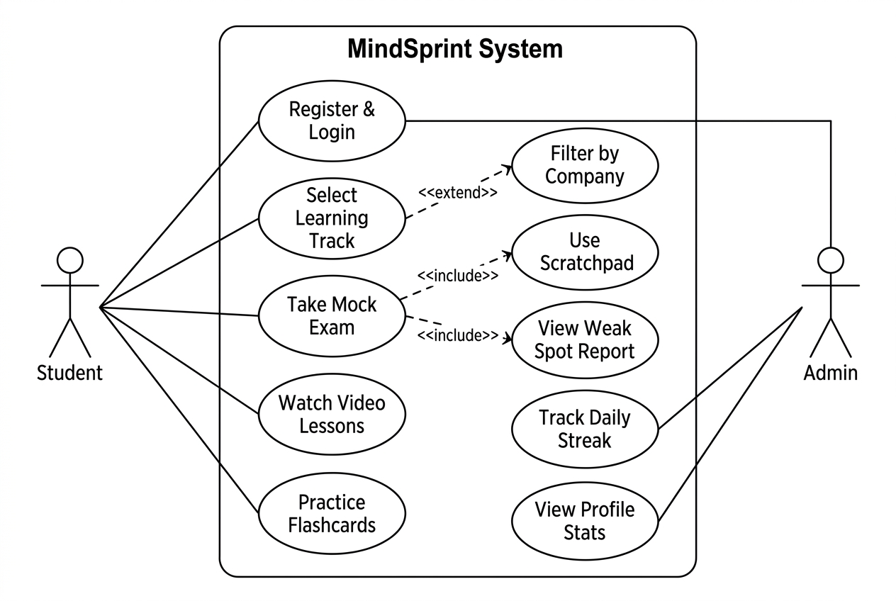
3.1 Use Case Diagram
The following UML Use Case
Diagram illustrates the interaction
between each User Role and the
MindSprint System :-

Slide 17
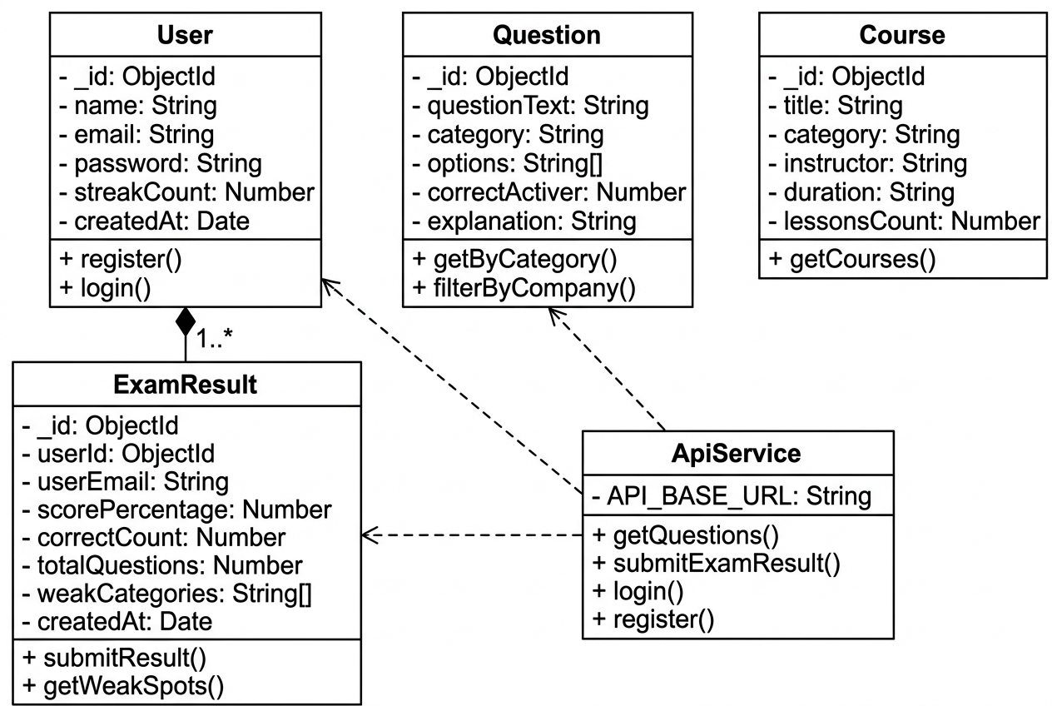
3.2 Class Diagram

Slide 18
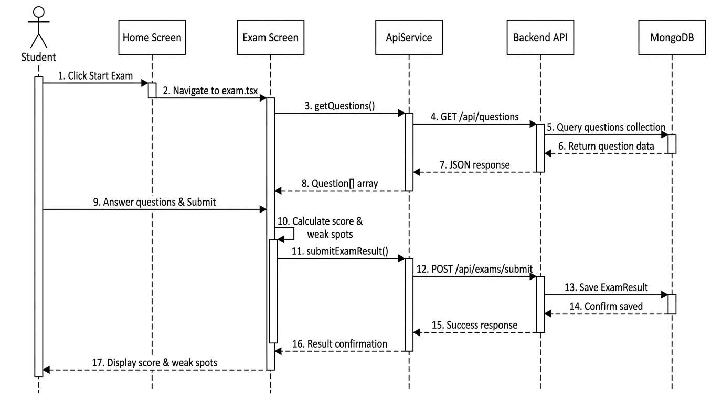
3.3 Interaction Diagram (Sequence Diagram)

Slide 19
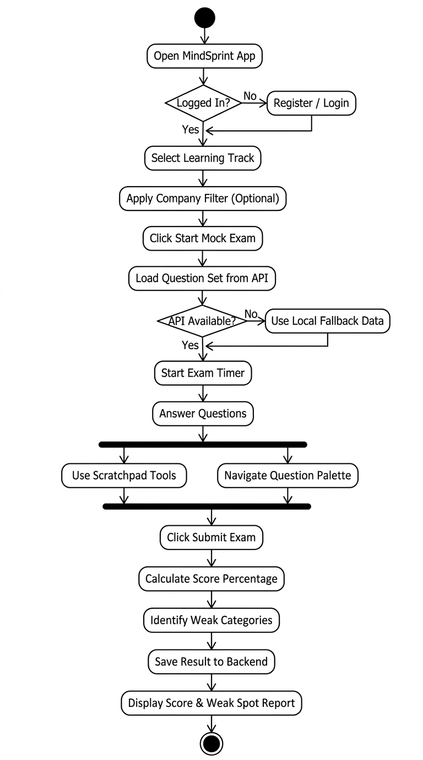
3.4 Activity Diagram

Slide 20
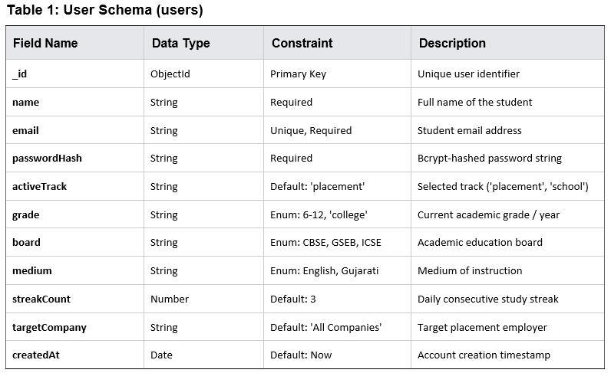
3.5 Data Dictionary

Slide 21
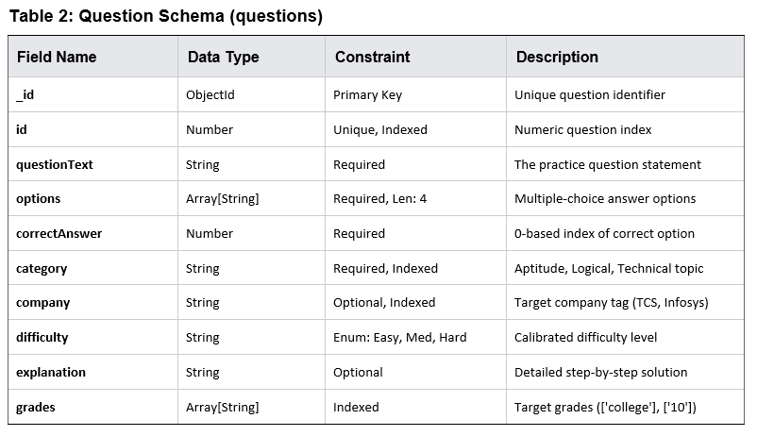
3.5 Data Dictionary

Slide 22
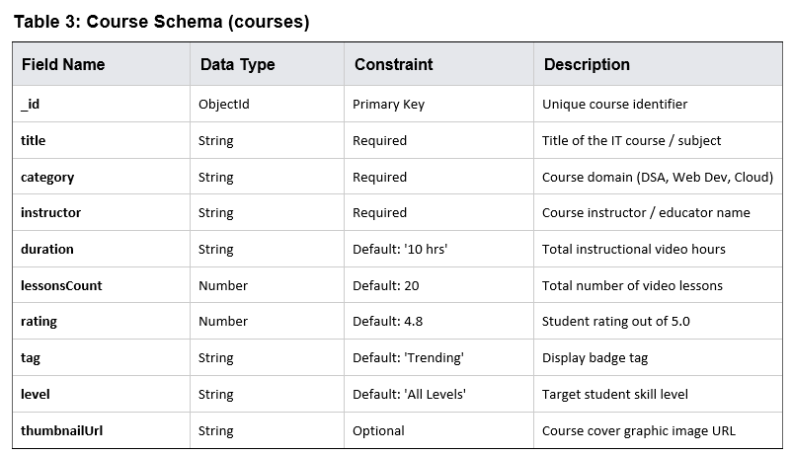
3.5 Data Dictionary

Slide 23
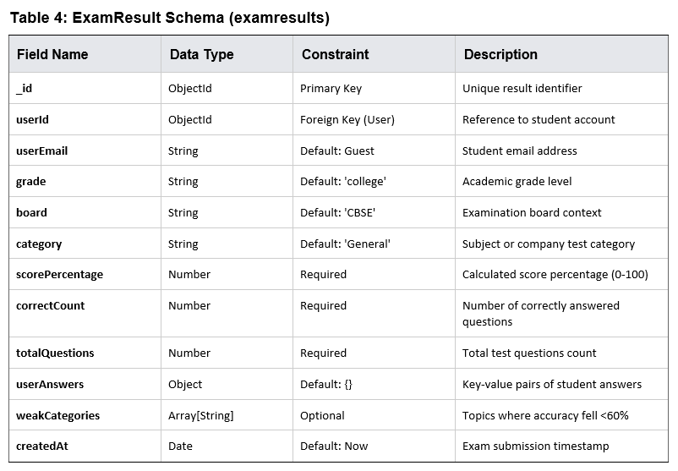
3.5 Data Dictionary

Slide 24
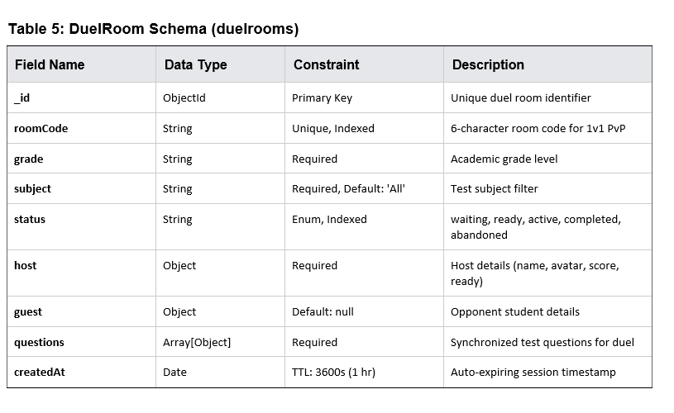
3.5 Data Dictionary

Slide 25
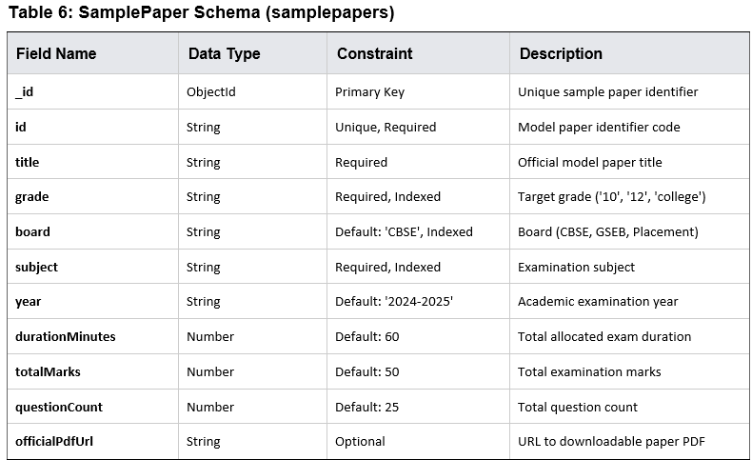
3.5 Data Dictionary

Slide 26
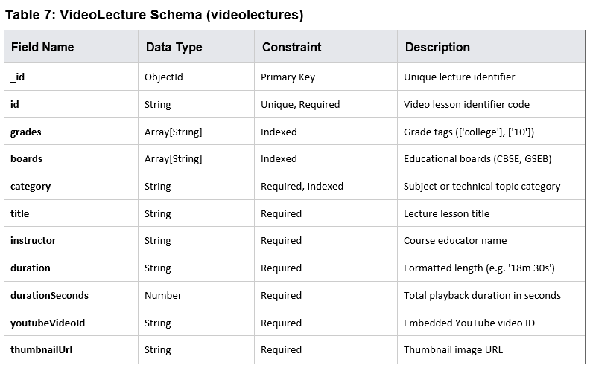
3.5 Data Dictionary

Slide 27
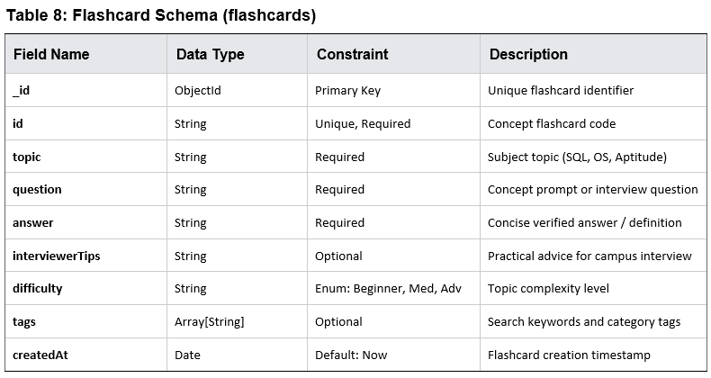
3.5 Data Dictionary

Slide 28
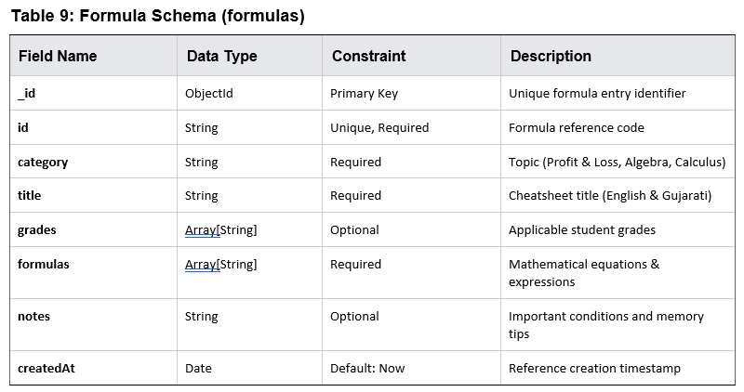
3.5 Data Dictionary

Slide 29
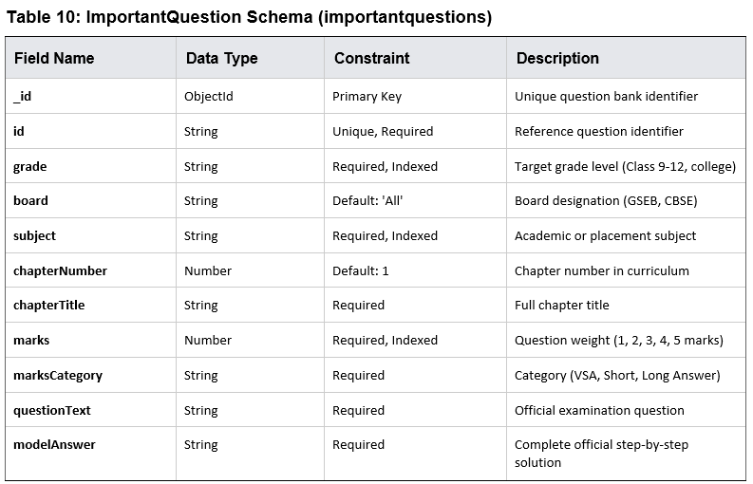
3.5 Data Dictionary

Slide 30
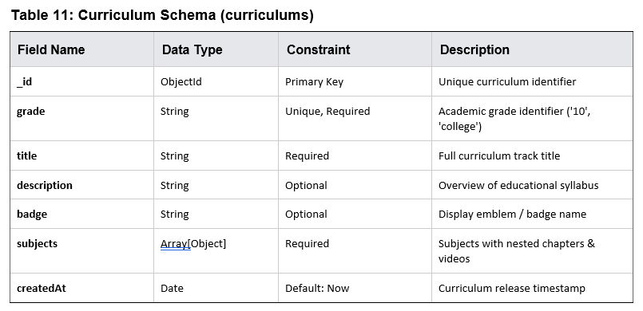
3.5 Data Dictionary

Slide 31
4. Development

Slide 32
4.1 Coding Standards
4.1.1 Architectural & Structural Principles :-
Component-Driven Development (CDD): Modular, reusable UI components in /components (e.g., QuestionPalette, WeakSpotAnalyzer).
File-Based Routing: Follows Expo Router conventions in /app for declarative, stack-based routing.
Service Layer Abstraction: Centralized REST communication in /services/api.ts; presentation components never call fetch directly.
Backend MVC Architecture: Separation of concerns between Mongoose models (/backend/models), routes, and business controllers.
4.1.2 Naming Conventions :-
Component Files & Interfaces: PascalCase is strictly enforced (e.g., WeakSpotAnalyzer.tsx, Question.ts).
Functions, Methods & Hooks: camelCase is used for handlers, utilities, and custom React hooks (e.g., useAuth, getQuestions).
Constants & Environment Keys: UPPER_SNAKE_CASE is reserved for constants and env keys (e.g., EXPO_PUBLIC_API_URL).
Route Files: kebab-case is utilized for Expo Router paths (e.g., doubt-solver.tsx, quiz-duel.tsx).

Slide 33
4.1 Coding Standards
4.1.3 Static Typing & Code Formatting :-
TypeScript Strict Mode: Configured with strict: true, eliminating implicit 'any' and catching nullability issues at compile-time.
Explicit Interfaces & Root Aliasing: Dedicated models for all API payloads and component props; path alias (@/*) removes relative paths.
ESLint Flat Config: Code style validated via eslint.config.js extending eslint-config-expo (2-space indent, strict semicolons).
4.1.4 State Management, Offline Resilience & Security :-
Global State via Context API: ThemeContext (Dark/Light mode) and AuthContext (session persistence) avoid prop drilling.
Transparent Offline Resilience: ApiService intercepts network connectivity dropouts and transparently serves verified local datasets.
Error Boundary Protection: React Error Boundaries encapsulate root layout to prevent fatal app crashes from UI exceptions.
Backend Security Standards: Passwords encrypted via bcryptjs (10 salt rounds); REST APIs protected with JWT bearer tokens.

Slide 34

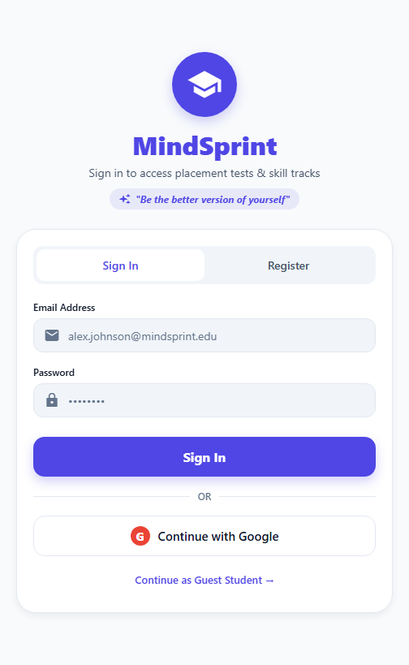
4.2 Screen Shots: Onboarding & Authentication

Slide 35
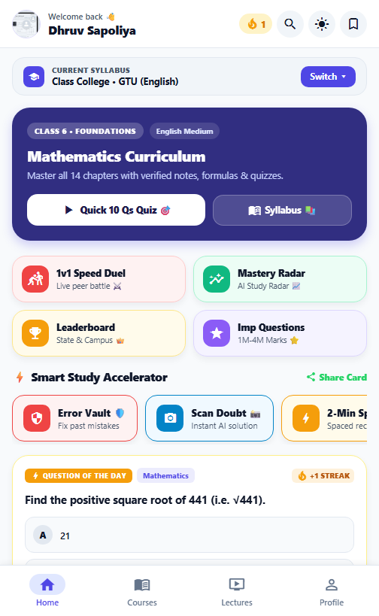
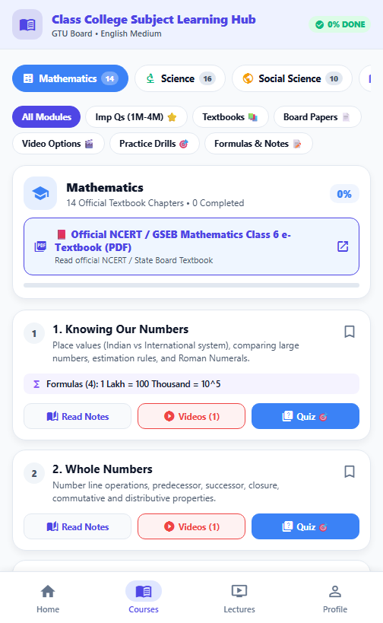
4.2 Screen Shots: Student Dashboard & Course Catalog

Slide 36
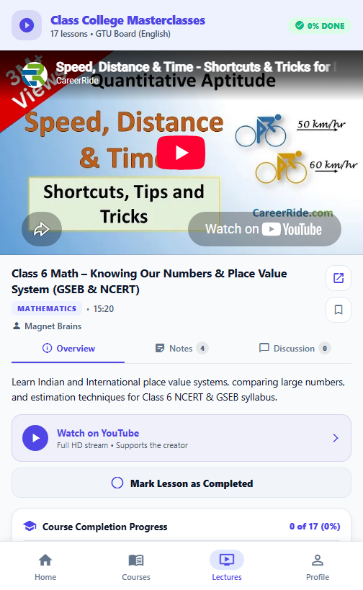
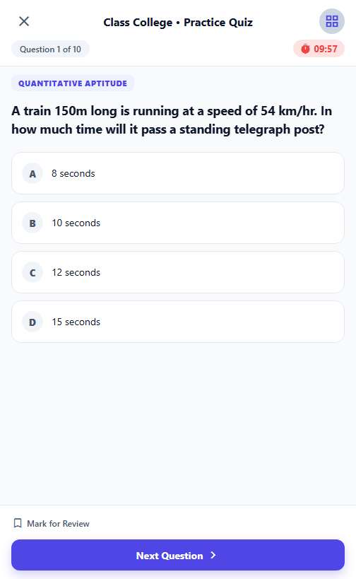
4.2 Screen Shots: Video Learning & Timed Mock Exam

Slide 37

4.2 Screen Shots: Spaced Repetition Flashcards & AI Doubt Solver

Slide 38

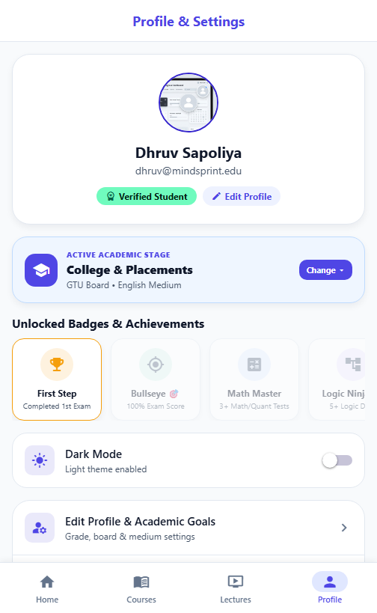
4.2 Screen Shots: Campus Leaderboard & Student Profile

Slide 39
5. Agile Documentation

Slide 40
5.1 Agile Project Charter

Slide 41
5.2 Agile Roadmap / Schedule

Slide 42
5.3 Agile Project Plan

Slide 43
5.4 Agile User Stories (Minimum 3 Tasks)

Slide 44
5.5 Agile Release Plan

Slide 45
5.6 Agile Product Backlog & Sprint Backlog

Slide 46
5.7 Agile Test Plan

Slide 47
5.8 Earned-Value and Burn Charts

Slide 48
6. Proposed Enhancements

Slide 49
6. Proposed Enhancements
1. Adaptive AI Difficulty Engine: Dynamically adjusts mock exam question difficulty in real time based on individual student performance history, accuracy streaks, and time spent per question.
2. Real-Time Multiplayer Quiz Battles: Expands the 1v1 Quiz Duel into live classroom multiplayer tournaments and collaborative study groups with live voice viva discussion rooms.
3. Placement Cell & Faculty Analytics Portal: Web-based administration portal enabling college placement officers to monitor cohort preparedness, track weak subject patterns across student batches, and schedule targeted mock drives.
4. Background Exam Sync & Smart Push Alerts: Automatic offline-to-online test score syncing upon reconnection, paired with intelligent push notifications to maintain daily study streak retention.
5. Regional Vernacular Language Support: Adding bilingual Gujarati and Hindi audio and explanations for academic school syllabi and technical definitions alongside standard English.

Slide 50
7. Conclusion

Slide 51
7. Conclusion
• Unified Learning Solution: MindSprint successfully eliminates the fragmentation of student preparation by integrating aptitude mock tests, technical video masterclasses, formula flashcards, and AI doubt resolution into a single responsive mobile application.
• Production-Grade Full-Stack Architecture: Built with React Native, Expo, TypeScript, Node.js REST APIs, and MongoDB, supported by an intelligent offline fallback layer that guarantees zero downtime and uninterrupted learning during network drops.
• Proven Agile Execution: Developed iteratively across six sprints using the Scrum framework, incorporating sprint backlogs, burn-down velocity tracking, and comprehensive quality assurance testing across Android and Web environments.
• Direct Academic & Placement Impact: Automated weak-spot diagnostics (<60% accuracy flagging) and bite-sized flashcards empower college students to pinpoint critical improvement areas and excel in campus placement drives.

Slide 52
8. Bibliography

Slide 53
8. Bibliography
1. Expo & React Native Framework Documentation: Official architecture guides, Expo SDK v54/v57 APIs, Expo Router file-based routing, and React Native component lifecycle. https://docs.expo.dev
2. Node.js & Express.js Developer Guides: RESTful API design principles, Express middleware pipelines, JWT bearer token authentication, and bcryptjs password security. https://expressjs.com
3. MongoDB & Mongoose Object Data Modeling: NoSQL document schema design, indexing strategies, and MongoDB Atlas database connection pooling. https://mongoosejs.com
4. Google Gemini API Documentation: Multimodal generative AI integration, prompt engineering, and image OCR doubt solving. https://ai.google.dev
5. Gujarat Technological University (GTU) & GSEB Curriculum Manuals: Official engineering syllabus structures, academic exam blueprints, and subject textbooks.
6. The Scrum Guide (Ken Schwaber & Jeff Sutherland): The definitive rules and guidelines of the Scrum framework for Agile software development and sprint planning.

Slide 54
Thank You

