Slide 1
MindSprint
Sapoliya Dhruv
Vavaliya Dvarkesh
Prajapati Krunal

Slide 2
1. Introduction

Slide 3
1.1 Existing System
The existing system for student placement preparation and technical skill learning primarily relies on physical textbooks, static offline notes, and scattered web platforms. Students currently use separate applications or websites for practicing quantitative aptitude, watching video lectures, reading technical documentation, and tracking their study habits.
Key drawbacks of the existing system include:
Disjointed platforms for exam preparation, skill learning, and progress tracking.
Lack of real-time performance evaluation and weak spot identification.
Inability to practice company-specific interview patterns in a single mobile interface.
Manual tracking of daily study consistency without automated retention tools like flashcards or streak counters.

Slide 4
1.2 Need for the New System
With the rapid increase in competitive campus placement drives (TCS, Infosys, Wipro, Accenture, Amazon, Google), students require a unified, mobile-first learning management system.
The new system, MindSprint, addresses this need by combining:
Practice questions categorized by Quantitative Aptitude, Logical Reasoning, and IT Technical topics.
Company-specific question filters.
Real-time exam simulation with live timers and scratchpad tools.
Intelligent analytics to identify weak topics based on past test attempts.
Integrated video learning modules and interactive flashcards.

Slide 5
1.3 Objective of the New System
The primary objectives of MindSprint are:-
To provide a consolidated mobile platform for aptitude practice, technical courses, and academic revision.
To enable company-wise filter options for focused campus drive preparation.
To deliver real-time exam evaluation with automated score calculation and topic-level weak spot detection.
To improve daily student engagement through streak tracking and swipeable flashcards.
5To offer a robust full-stack architecture with backend database persistence and offline dataset fallback.

Slide 6
1.4 Problem Definition
Students preparing for IT job placements face difficulty in identifying their specific technical and quantitative weak areas due to a lack of detailed test analysis. Furthermore, switching between multiple apps for learning, practicing, and reviewing formulas leads to reduced focus and study fragmentation.
MindSprint solves this problem by integrating test execution, video learning, weak topic analysis, and formula flashcards into a single application supported by a Node.js/MongoDB REST API backend.

Slide 7
1.5 Core Components
MindSprint consists of four primary software components :-
1. Mobile Client App: React Native frontend built with Expo v54, TypeScript, and Expo Router.
2. REST API Backend: Node.js and Express server delivering authentication, question banks, course data, and exam result processing.
3. Database Layer: MongoDB database storing User accounts, Question banks, Courses, and Exam Results.
4. Offline Resilience Layer: Fallback service layer (ApiService) ensuring continuous app functionality using local datasets when network connectivity is lost.

Slide 8
1.6 Project Profile
Project Title :- MindSprint - Placement Preparation & Skill Learning App
Front-End Technology :- React Native, Expo v54, TypeScript, Expo Router
Back-End Technology :- Node.js, Express.js REST API
Database :- MongoDB / Mongoose ODM
Target OS :- Android, iOS, Web
IDE / Environment :- VS Code, Node.js v20+, Expo CLI

Slide 9
1.7 Assumptions and Constraints
Assumptions:
Users possess an active Android/iOS mobile device or modern web browser.
Network connectivity is available for user registration, live backend sync, and course video streaming.
Constraints:
Offline mode relies on static local datasets for practice questions.
Video playback requires active internet bandwidth.
Backend API authentication uses JWT/hashed passwords for secure user access.

Slide 10
1.8 Advantages and Limitations of the Proposed System
Advantages :-
Single unified platform for aptitude practice, course videos, and flashcards.
Real-time weak spot detection helping students target problem areas.
Automated score calculation and test analytics.
Cross-platform compatibility (Android, iOS, Web).
Graceful offline fallback mechanism.
Limitations :-
Initial database setup requires internet connectivity for syncing recent exam results.
Advanced AI recommendations depend on the volume of test data recorded over time.

Slide 11
2. Requirement Determination & Analysis

Slide 12
2.1 Requirement Determination
Functional Requirements :-
1. User Authentication: Secure user registration and login using email/password.
2. Track Selection: Ability to switch between Placement Prep, IT Skills, and School tracks.
3. Company Filter: Filter exam questions by company tag (TCS, Infosys, Amazon, etc.).
4. Exam Engine: Conduct timed mock tests, navigate via Question Palette, record user answers, calculate score percentages, and identify weak categories.
5. Course Learning: View IT skill course catalog and play instructional video lessons.
6. Revision & Engagement: Interactive flashcard flip deck and daily streak counter.

Slide 13
2.1 Requirement Determination
Non-Functional Requirements :-
1. Performance: Screen load times under 2 seconds; instant local exam evaluation with zero latency score calculation.
2. Reliability: Seamless offline fallback using local verified static datasets when backend REST API is unreachable.
3. Usability: Clean, accessible Material Design 3 interface with dynamic dark/light mode and intuitive student workflows.
4. Security: Encrypted user passwords (bcryptjs, salt rounds: 10) and protected REST API endpoints with JWT bearer authentication.

Slide 14
2.2 Targeted Users
Targeted User Roles & Personas :-
1. College / Placement Aspirant (Engineering Student): Focuses on aptitude practice, company-specific test filters (TCS, Infosys, Amazon), weak spot analytics, and countdown exam timers.
2. Job Seeker / IT Skill Learner: Focuses on technical course catalog, streaming video masterclasses, DSA & full-stack development, and flashcard revision.
3. School & Academic Student (GSEB 9-12): Focuses on foundational science, mathematics chapters, GSEB/NCERT textbooks, and doubt solving.

Slide 15
3. System Design

Slide 16
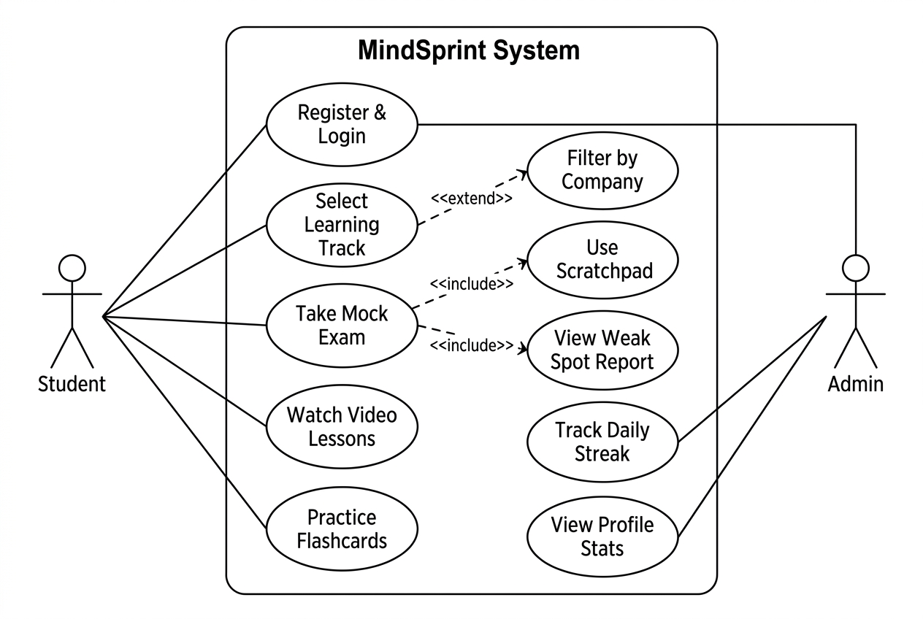
3.1 Use Case Diagram
The following UML Use Case
Diagram illustrates the interaction
between each User Role and the
MindSprint System :-

Slide 17
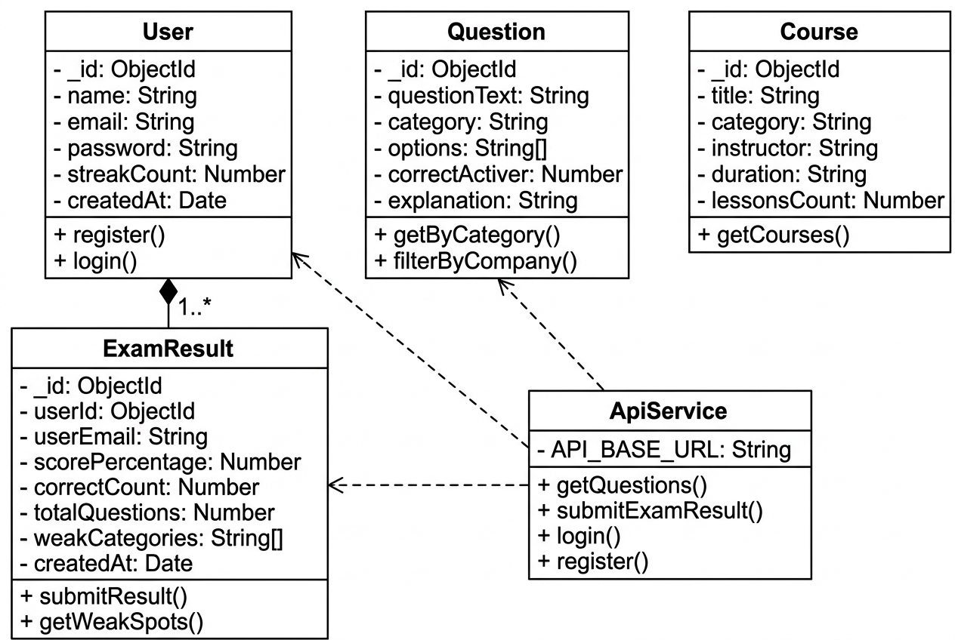
3.2 Class Diagram

Slide 18
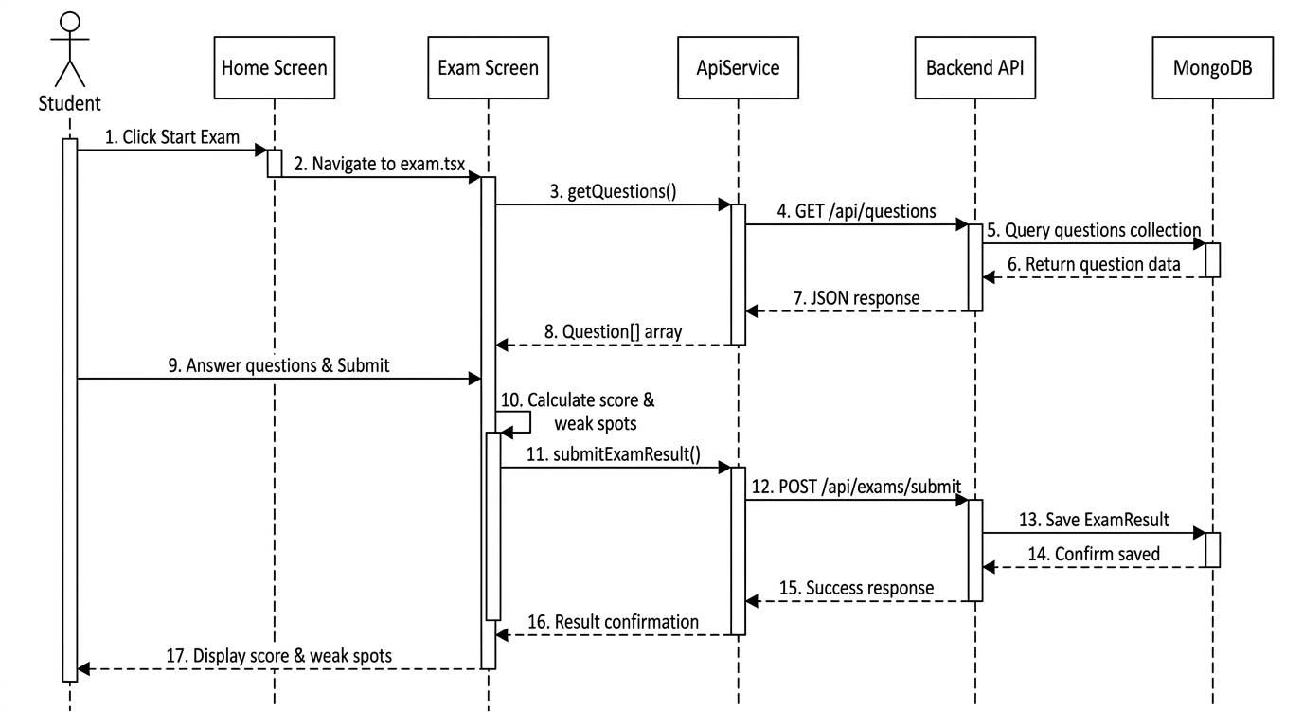
3.3 Interaction Diagram (Sequence Diagram)

Slide 19
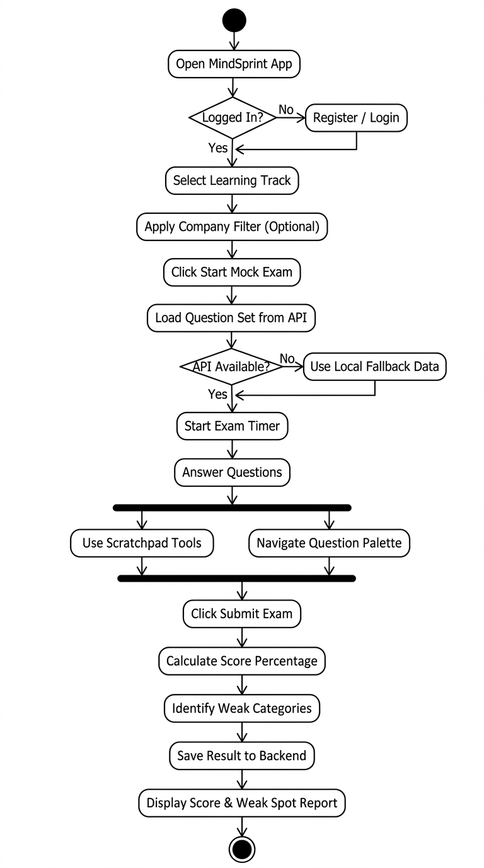
3.4 Activity Diagram

Slide 20
3.5 Data Dictionary
Table 1: User Schema (users)
Field Name | Data Type | Constraint | Description
_id | ObjectId | Primary Key | Unique user identifier
name | String | Required | Full name of user
email | String | Unique, Required | User email address
password | String | Required | Encrypted password
streakCount | Number | Default: 1 | Consecutive study days
createdAt | Date | Default: Now | Account creation timestamp

Slide 21
3.5 Data Dictionary
Table 2: Question Schema (questions)
Field Name | Data Type | Constraint | Description
_id | ObjectId | Primary Key | Unique question identifier
questionText | String | Required | The question statement
category | String | Required | Topic (Aptitude/DSA/React)
options | Array[String] | Required | 4 multiple choice options
correctAnswer | Number | Required | 0-based index of correct option
explanation | String | Optional | Detailed solution text

Slide 22
3.5 Data Dictionary
Table 3: Course Schema (courses)
Field Name | Data Type | Constraint | Description
_id | ObjectId | Primary Key | Unique course identifier
title | String | Required | Title of the IT course
category | String | Required | Course domain
instructor | String | Required | Instructor name
duration | String | Required | Total course hours
lessonsCount | Number | Required | Number of video lessons

Slide 23
3.5 Data Dictionary
Table 4: ExamResult Schema (examresults)
Field Name | Data Type | Constraint | Description
_id | ObjectId | Primary Key | Unique result identifier
userId | ObjectId | Foreign Key (User) | Reference to user account
userEmail | String | Default: Guest | User email
scorePercentage | Number | Required | Calculated score %
correctCount | Number | Required | Number of correct answers
totalQuestions | Number | Required | Total test questions count
userAnswers | Object | Required | Key-value pairs of answers
weakCategories | Array[String] | Optional | Topics where errors occurred
createdAt | Date | Default: Now | Exam submission timestamp

Slide 24
4. Development

Slide 25
4.1 Coding Standards
4.1.1 Architectural & Structural Principles :-
Component-Driven Development (CDD): Modular, reusable UI components in /components (e.g., QuestionPalette, WeakSpotAnalyzer).
File-Based Routing: Follows Expo Router conventions in /app for declarative, stack-based routing.
Service Layer Abstraction: Centralized REST communication in /services/api.ts; presentation components never call fetch directly.
Backend MVC Architecture: Separation of concerns between Mongoose models (/backend/models), routes, and business controllers.
4.1.2 Naming Conventions :-
Component Files & Interfaces: PascalCase is strictly enforced (e.g., WeakSpotAnalyzer.tsx, Question.ts).
Functions, Methods & Hooks: camelCase is used for handlers, utilities, and custom React hooks (e.g., useAuth, getQuestions).
Constants & Environment Keys: UPPER_SNAKE_CASE is reserved for constants and env keys (e.g., EXPO_PUBLIC_API_URL).
Route Files: kebab-case is utilized for Expo Router paths (e.g., doubt-solver.tsx, quiz-duel.tsx).

Slide 26
4.1 Coding Standards
4.1.3 Static Typing & Code Formatting :-
TypeScript Strict Mode: Configured with strict: true, eliminating implicit 'any' and catching nullability issues at compile-time.
Explicit Interfaces & Root Aliasing: Dedicated models for all API payloads and component props; path alias (@/*) removes relative paths.
ESLint Flat Config: Code style validated via eslint.config.js extending eslint-config-expo (2-space indent, strict semicolons).
4.1.4 State Management, Offline Resilience & Security :-
Global State via Context API: ThemeContext (Dark/Light mode) and AuthContext (session persistence) avoid prop drilling.
Transparent Offline Resilience: ApiService intercepts network connectivity dropouts and transparently serves verified local datasets.
Error Boundary Protection: React Error Boundaries encapsulate root layout to prevent fatal app crashes from UI exceptions.
Backend Security Standards: Passwords encrypted via bcryptjs (10 salt rounds); REST APIs protected with JWT bearer tokens.

Slide 27
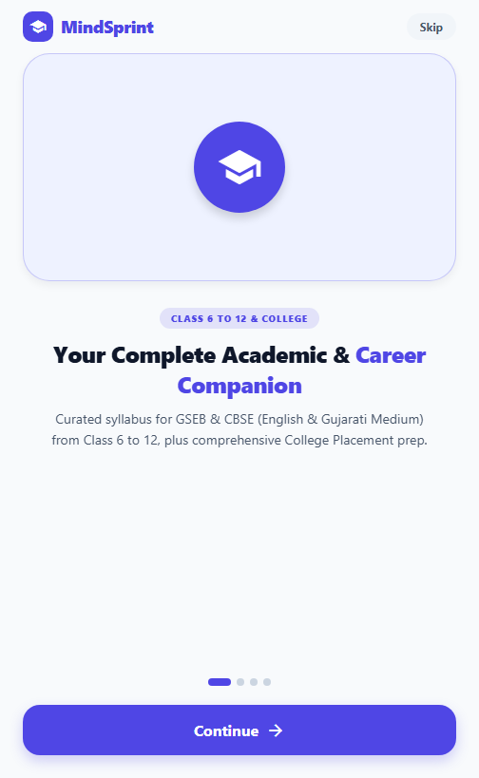
4.2.1 Welcome and Onboarding Screen
Welcome & Onboarding Experience :-
Platform Introduction: Introduces students to the unified academic & career companion covering Gujarat Board (GSEB 9-12) and GTU Engineering.
Feature Highlights: Showcases core capabilities: real-time timed mock tests, chapter-aligned learning, and video lectures.
Streamlined Journey: Offers direct 'Get Started' action leading students into personalized study track selection.
Modern Design: Vibrant hero graphics, fluid typography, and clean Material Design 3 aesthetic.

Slide 28
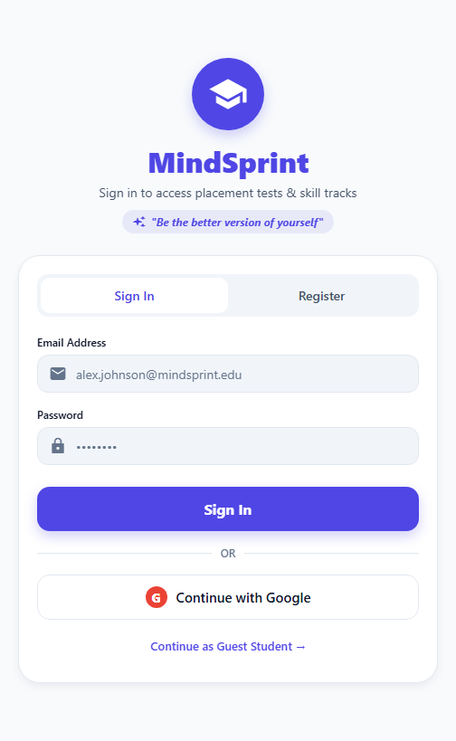
4.2.2 User Authentication and Sign-in Screen
Secure User Authentication :-
Dual-Mode Authentication: Intuitive tabbed switching between User Login and New Account Registration.
Google OAuth SSO: One-tap Google Sign-In integration for frictionless, passwordless student access.
Client-Side Validation: Live email regex checking and real-time password constraint feedback with visibility toggle.
Backend Security: Credentials verified against bcrypt-hashed passwords in MongoDB with secure JWT token issuance.

Slide 29
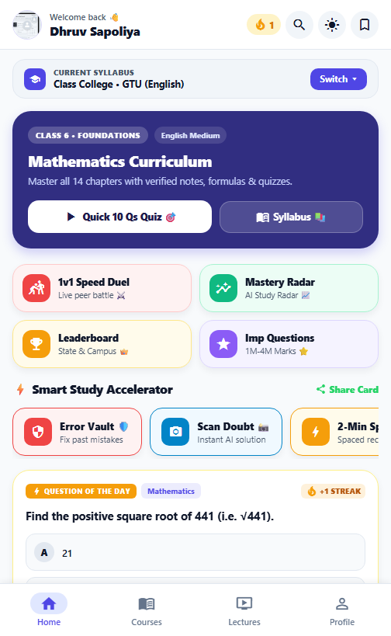
4.2.3 Student Dashboard & Learning Hub
Central Student Learning Hub :-
Dynamic Stage Selector: Enables seamless switching between GTU Engineering and Gujarat School (GSEB) curriculum stages.
Daily Streak & Readiness: Gamified streak counter tracking daily study habits and overall exam readiness score.
Quick Action Grid: Direct one-tap tiles to Timed Mock Exams, AI Doubt Solver, Video Classes, and Flashcards.
Weak Spot Alert Banner: Proactive warning highlighting topics where accuracy fell below 60% for immediate revision.

Slide 30
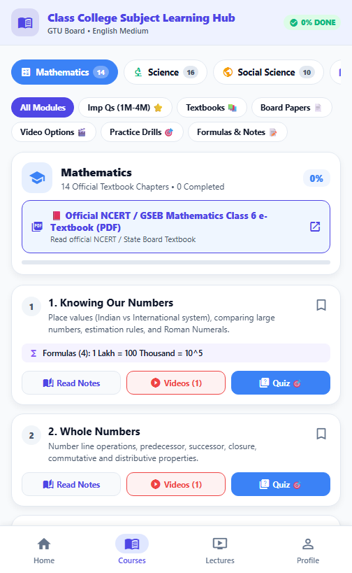
4.2.4 Course Catalog & Chapter Navigator
Curriculum Catalog & Digital Textbooks :-
Subject-Wise Tabs: Organized course browsing across Mathematics, Science, Social Science, and Engineering modules.
Official e-Textbooks: Direct digital links to official NCERT and GSEB Gujarat State textbooks.
Chapter Progression: Visual completion progress bars for each chapter and topic submodule.
Integrated Resources: Quick access to chapter formula sheets, summary notes, and foundational MCQs.

Slide 31
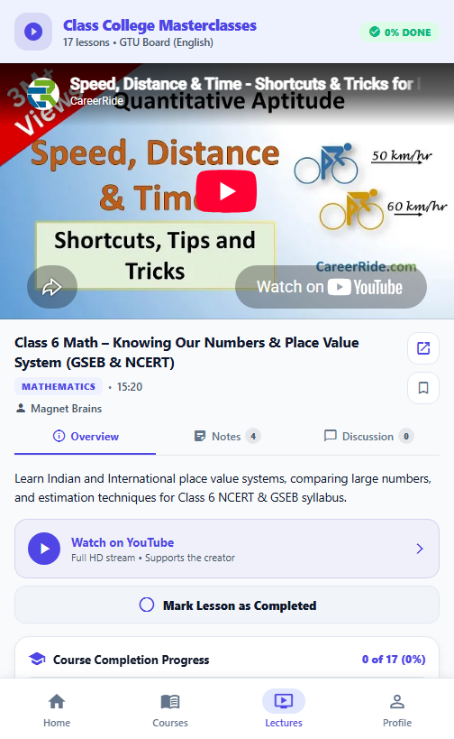
4.2.5 Interactive Video Lecture Player
High-Definition Video Masterclasses :-
Curated Video Lessons: Embedded YouTube video lectures aligned with specific syllabus chapters and topic goals.
Instructor Credentials: Displays educator profile, lesson objectives, and lecture duration timestamps.
Advanced Controls: Supports variable playback speed (0.75x to 2x), landscape full-screen, and quick rewind/fast-forward.
Topic Bookmarking: Allows students to bookmark critical video segments and view synchronized topic notes.

Slide 32
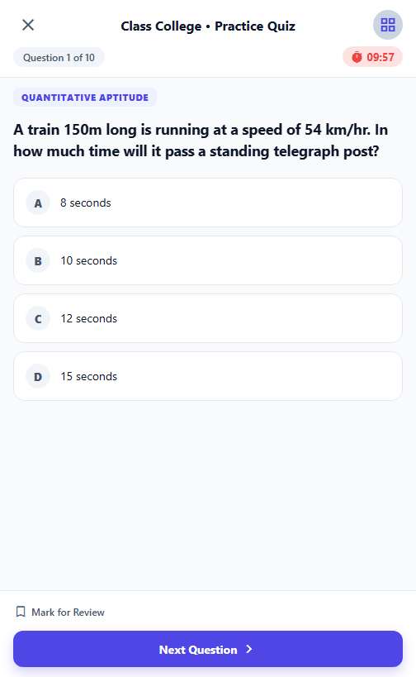
4.2.6 Real-Time Timed Mock Exam Engine
Recruitment & Competitive Exam Simulation :-
Real-World Simulation: Timed test engine mirroring TCS, Infosys, and Amazon campus recruitment patterns.
Live Countdown Timer: Visible countdown header with automatic submission when time expires.
Interactive Question Palette: Color-coded drawer indicating Attempted (Green), Marked for Review (Yellow), and Unvisited (Gray).
In-Exam Scratchpad: Built-in scratchpad tool for calculations and rough work directly inside the mobile app.

Slide 33
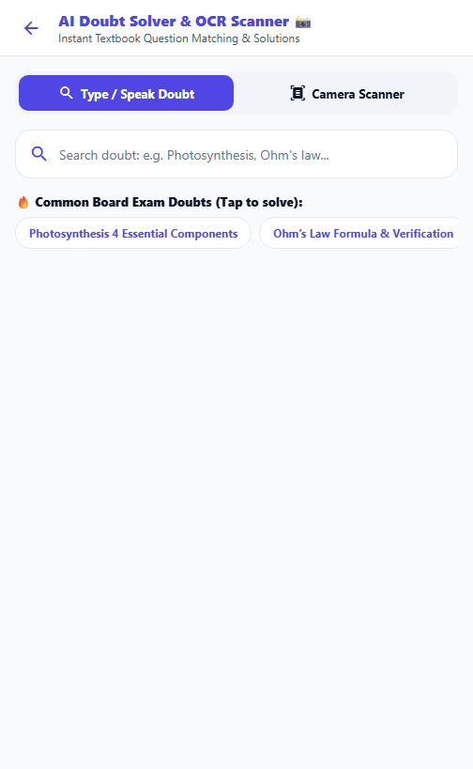
4.2.7 AI Doubt Solver & Camera Scanner
AI-Powered Doubt Clearing & OCR :-
Multi-Modal Query Input: Ask academic doubts via typed text, voice recognition, or camera snapshot.
Camera OCR Extraction: Extracts textbook questions from photos and matches them against verified question database.
Step-by-Step Solutions: Returns structured mathematical proofs, reasoning steps, and conceptual explanations.
Related Practice Problems: Automatically suggests similar difficulty practice MCQs to solidify the concept.

Slide 34
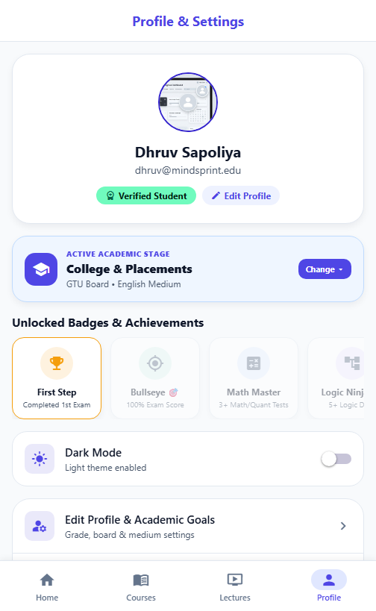
4.2.8 Student Profile, Badges & Theme Configuration
Student Profile & Gamification :-
Academic Credentials: Displays student verification status, current syllabus stage, and overall exam percentile.
Milestone Badges: Gamification trophies recognizing study streaks, test completions, and category mastery.
Theme Personalization: One-tap toggle between sleek Dark Mode and high-contrast Light Mode.
Session & Offline Sync: Shows local cache synchronization status and provides secure account logout.

Slide 35
5. Agile Documentation

Slide 36
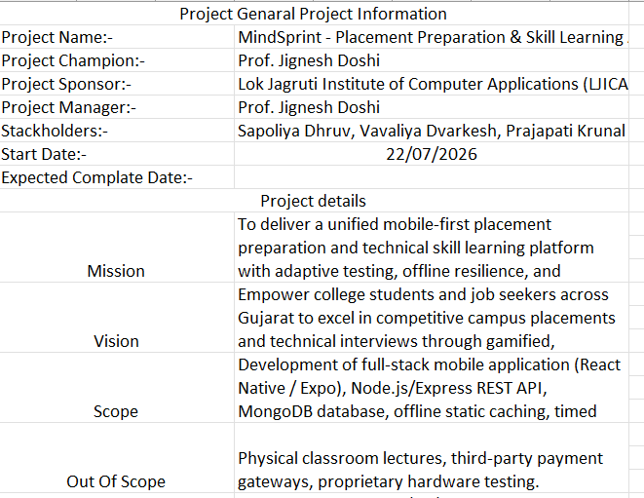
5.1 Agile Project Charter

Slide 37
5.2 Agile Roadmap / Schedule

Slide 38
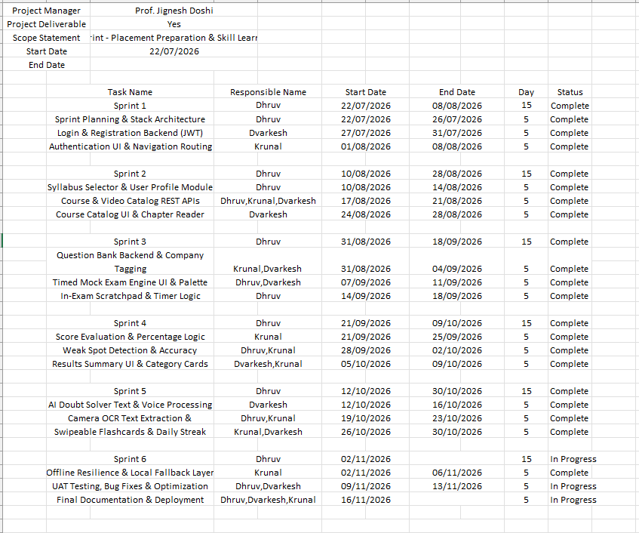
5.3 Agile Project Plan

Slide 39
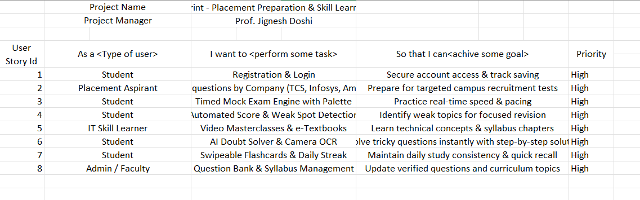
5.4 User Stories

Slide 40
5.5 Release Plan

Slide 41
5.6 Product Backlog & Sprint Backlog

Slide 42
5.7 Test Plan

Slide 43
5.8 Burndown Chart

Slide 44
Thank You!

