Slide 1
MindSprint
Placement Preparation & Technical Skill Development Platform
Academic Project Presentation | React Native & Node.js REST API

Slide 2
MINDSPRINT PROJECT PRESENTATION
Project Overview & Problem Statement
Current Challenges in Placement Prep
• Scattered platforms for aptitude practice, video learning, and notes.
• Lack of real-time weak spot diagnosis to highlight mistake areas.
• No single interface for company-specific test pattern practice.
• Manual tracking of study habits leading to low consistency.
The MindSprint Solution
• Unified mobile-first app combining tests, courses, and flashcards.
• Targeted company filters (TCS, Infosys, Wipro, Amazon, Google).
• Real-time exam engine with timed tests and interactive scratchpad.
• Automated Weak Spot Analyzer mapping user score metrics.
• Full-stack architecture with offline fallback dataset support.

Slide 3
MINDSPRINT PROJECT PRESENTATION
Core Project Objectives
1. Consolidated Learning
• Provide quantitative aptitude, logical reasoning, and tech courses in one place.
• Eliminate fragmentation across multiple websites and physical notes.
2. Targeted Evaluation
• Deliver company-wise practice filters for placement drives.
• Instantly compute test accuracy and aggregate weak topic categories.
3. Student Retention
• Drive daily consistency using active streak tracking and XP rewards.
• Offer interactive memory flashcards for rapid formula revision.

Slide 4
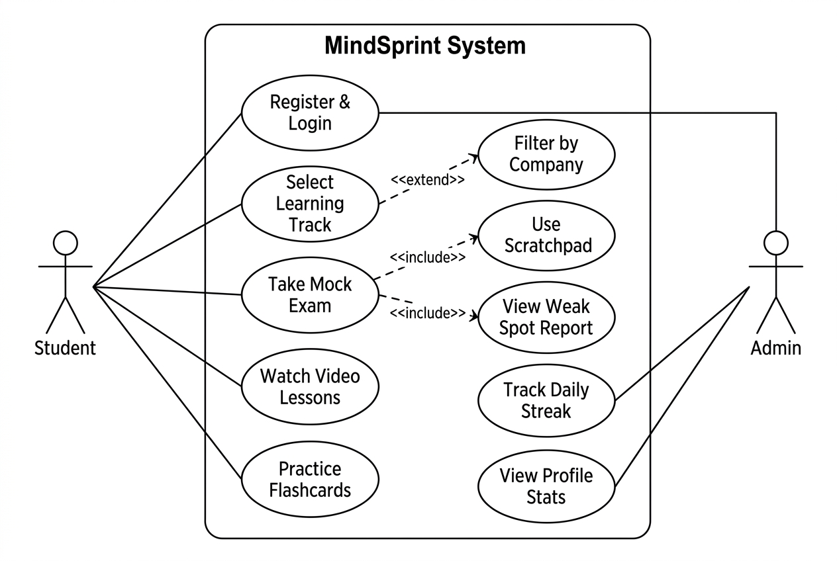
MINDSPRINT PROJECT PRESENTATION
3.1 Use Case Diagram

Slide 5
MINDSPRINT PROJECT PRESENTATION
Use Case Diagram (User-by-User Breakdown)
Placement Aspirant
• UC-1.1: Register / Login account.
• UC-1.2: Select Placement Track.
• UC-1.3: Apply Company Filters.
• UC-1.4: Launch Timed Mock Test.
• UC-1.5: Use Palette & Scratchpad.
• UC-1.6: View Weak Spot Analytics.
• UC-1.7: Maintain Daily Streak.
IT Skill & School Learner
• UC-2.1: Select IT Skills Track.
• UC-2.2: Browse Tech Course Catalog.
• UC-2.3: Watch Video Lessons.
• UC-2.4: Practice Concept Flashcards.
• UC-3.1: Select School Track.
• UC-3.2: Solve Subject Math/Science MCQs.
Backend & Admin Roles
• UC-4.1: Authenticate User JWT Tokens.
• UC-4.2: Serve Questions & Courses.
• UC-4.3: Provide Offline Local Fallback.
• UC-4.4: Store Exam Results in MongoDB.
• UC-5.1: Manage Question Bank.
• UC-5.2: Update Course Syllabus.

Slide 6
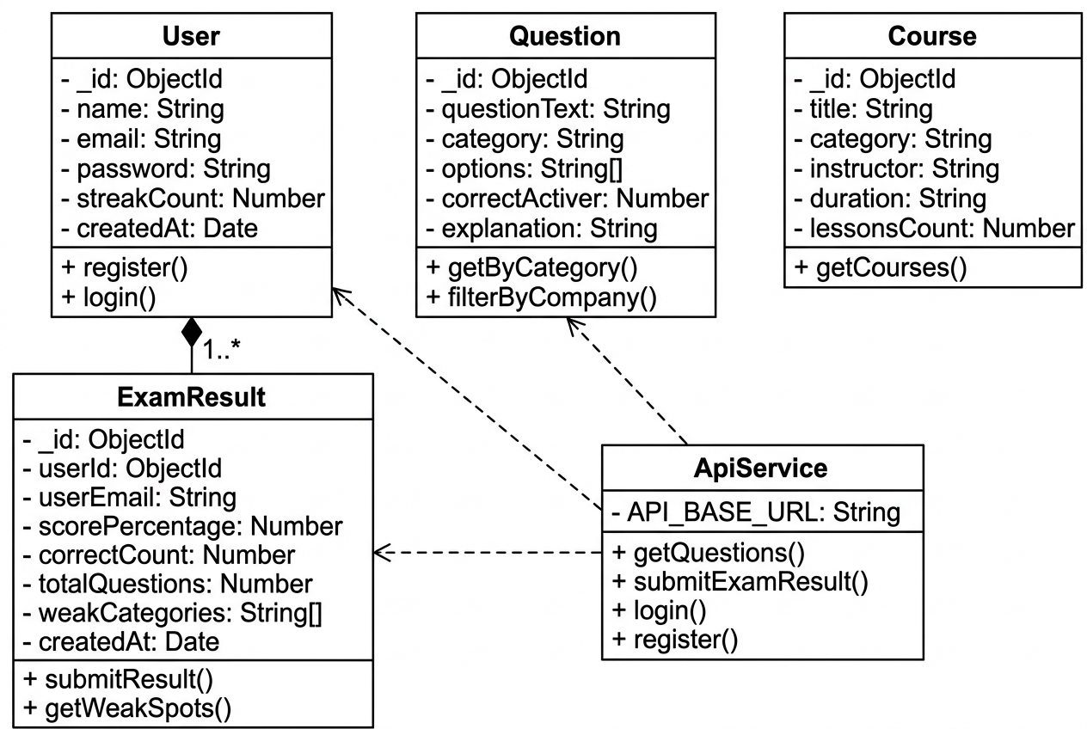
MINDSPRINT PROJECT PRESENTATION
3.2 Class Diagram - Data Models & ApiService

Slide 7
MINDSPRINT PROJECT PRESENTATION
Full-Stack Technology Architecture
Frontend Mobile App
• Framework: React Native with Expo v54.
• Language: TypeScript & ES6+.
• Routing: Expo Router v6 (File-based).
• UI Layer: Material Design 3, ThemeContext, Reanimated animations.
Backend REST API
• Environment: Node.js & Express.js.
• Authentication: JWT & Bcrypt password hashing.
• Middleware: Express JSON, CORS handling.
• Deploy Target: Node Server / Cloud API.
Database & Resilience
• Database: MongoDB Atlas with Mongoose ODM.
• Schemas: User, Question, Course, ExamResult.
• Offline Layer: ApiService graceful fallback to local datasets.

Slide 8
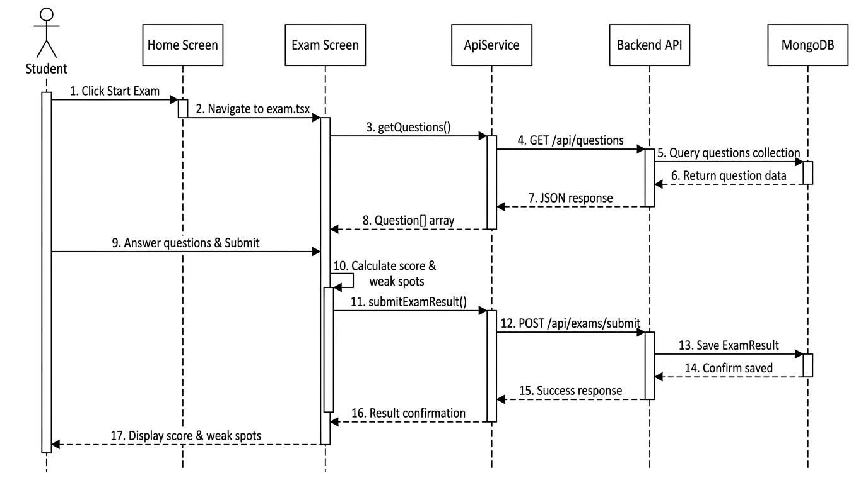
MINDSPRINT PROJECT PRESENTATION
3.3 Interaction Diagram - Mock Exam Sequence Flow

Slide 9
MINDSPRINT PROJECT PRESENTATION
App Tracks & Feature Breakdown
Placement Track
• Quant & Aptitude practice.
• Logical Reasoning MCQs.
• Company-specific filters.
• Interactive exam timer.
IT Skills Track
• React & React Native dev.
• Node.js & Microservices.
• Python AI/ML fundamentals.
• DSA & System Design.
Revision Tools
• Swipeable Flashcard deck.
• Weak Spot Analyzer.
• In-exam Text Scratchpad.
• Grid Question Palette.
Engagement
• Daily Streak Counter.
• Performance graphs.
• Profile stats dashboard.
• Dark / Light theme mode.

Slide 10
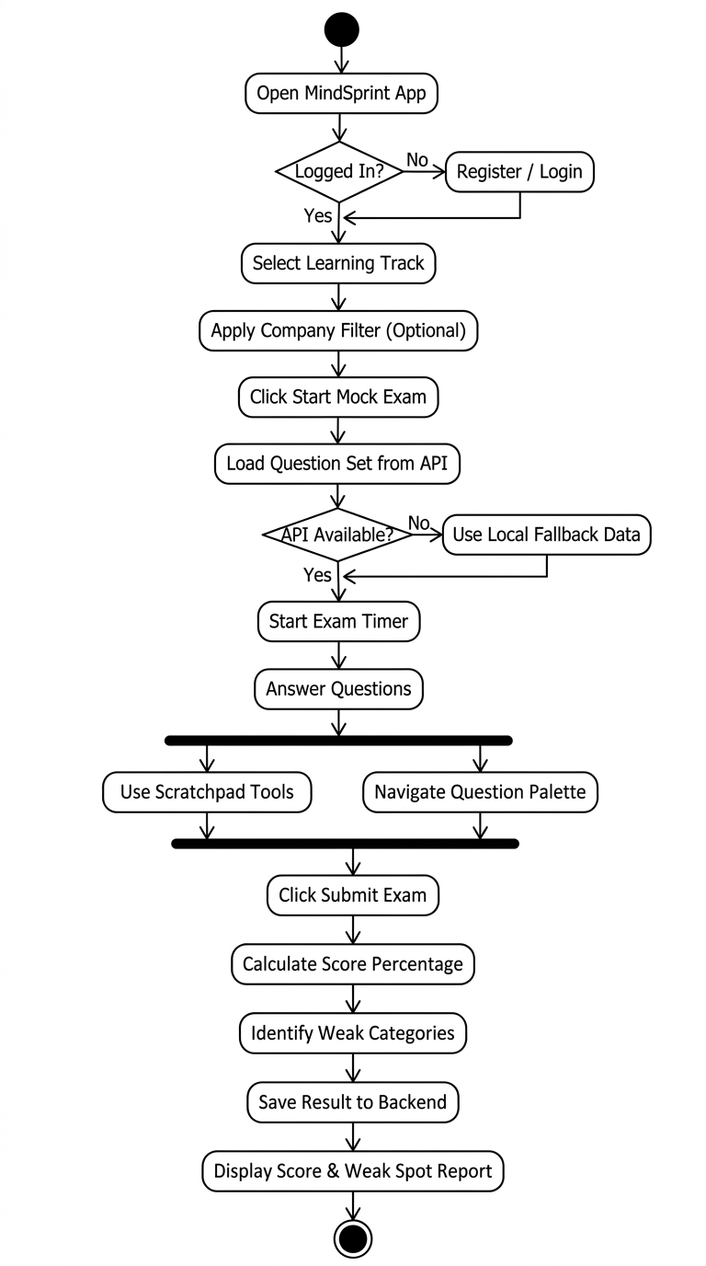
MINDSPRINT PROJECT PRESENTATION
3.4 Activity Diagram - Mock Exam Process Flow

Slide 11
MINDSPRINT PROJECT PRESENTATION
3.5 Database Schemas (MongoDB / Mongoose)
User Schema
• _id: ObjectId (PK)
• name: String
• email: String (Unique)
• password: String
• streakCount: Number
• createdAt: Date
Question Schema
• _id: ObjectId (PK)
• questionText: String
• category: String
• options: Array[String]
• correctAnswer: Number
• explanation: String
Course Schema
• _id: ObjectId (PK)
• title: String
• category: String
• instructor: String
• duration: String
• lessonsCount: Number
ExamResult Schema
• _id: ObjectId (PK)
• userId: Ref (User)
• scorePercentage: Number
• correctCount: Number
• totalQuestions: Number
• weakCategories: Array

Slide 12
MINDSPRINT PROJECT PRESENTATION
Key Advantages & Conclusion
System Advantages
• All-in-one ecosystem for placement preparation and skill development.
• Real-time diagnostic analytics identifying student weak spots.
• Offline resilient architecture ensuring zero learning interruption.
• Production-grade mobile UX built with React Native and Expo Router.
Future Scope & Conclusion
• AI-powered question recommendation based on weak topics.
• Peer-to-peer live mock interview rooms.
• Automated resume parsing and skill matching.
• Successfully achieved a functional, full-stack learning platform.

Slide 13
Thank You!
MindSprint - Placement Preparation & Skill Development Platform

