Slide 1
Topics
Basics of Jenkins
Basics of Terraform
Basics Of Aws

Slide 2
Jenkins
Jenkins is an open-source automation tool written in Java with plugins built for continuous integration. Jenkins is used to build and test your software projects continuously making it easier for developers to integrate changes to then project, and making it easier for users to obtain a fresh build.
Jenkins is an open source continuous integration/continuous delivery and deployment (CI/CD) automation software DevOps tool. It is used to implement CI/CD workflows, called pipelines.

Slide 3
CI-CD
Continuous Integration (CI) is a development practice in which the developers are needs to commit changes to the source code in a shared repository at regular intervals. Every commit made in the repository is then built. This allows the development teams to detect the problems early.
Continuous integration requires the developers to have regular builds. The general practice is that whenever a code commit occurs, a build should be triggered.
Continuous Delivery is the automation of steps to safely get changes into production. Where Continuous Deployment focuses on the actual deployment, Continuous Delivery focuses on the release and release strategy.

Slide 4
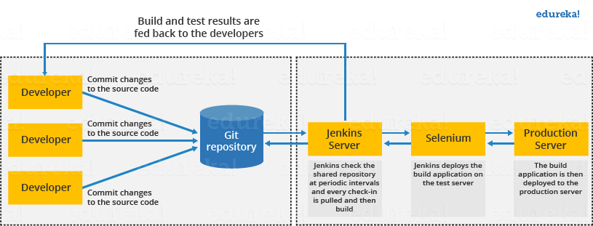
Jenkins CI Flow

Slide 5
Advantages and Disadvantages of using Jenkins
Advantages-It is an open source tool,It is free of cost.
It does not require additional installations or components. Means it is easy to install. Easily configurable.
It supports 1000 or more plugins to ease your work. If a plugin does not exist, you can write the script for it and share with community.It is built in java and hence it is portable.
Disadvantages-Its interface is out dated and not user friendly compared to current user interface trends.
Not easy to maintain it because it runs on a server and requires some skills as server administrator to monitor its activity.
CI regularly breaks due to some small setting changes. CI will be paused and therefore requires some developer's team attention.

Slide 6
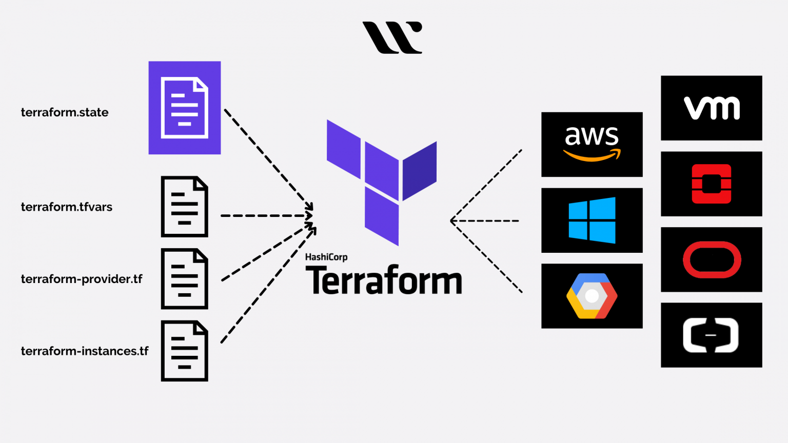
Terraform

Slide 7
Terraform Basic Commands
Terraform INIT= initilize a working directory containig terra config file
create new terra config file or clone existing file
Terraform Plan= creates and execution plan, preview the changes that terraform plans to make to your infra.
Terraform Apply- executes the actions proposed in a terraform plan . It is used to deploy your infrastructure. Typically apply should be run after terraform init and terraform plan
Terraform Destroy- terminates resources managed by your Terraform project.

Slide 8

Basics Of AWS

