Slide 1

Agile Project Management Tool
Date：2024-11-28

Slide 3
Introduction
Background
Project management tools ensure efficient and organized achievement of goals by centralizing resources, promoting collaboration, and tracking progress.
Motivation
Project Management Tools
The existing tools are either complex and expensive, or lack customization. Developing an efficient, economical, and easy-to-use agile Scrum management tool is an urgent need for small and medium-sized teams.
Our idea
Our solution focuses on simplicity and ease of use, targeting smaller teams and projects that want essential functionalities without clutter, based on Python Flask, SQLite, and Vue.js.

Slide 5
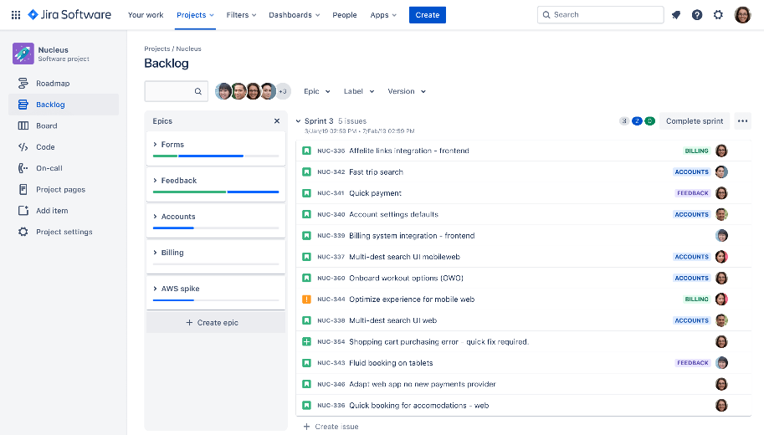
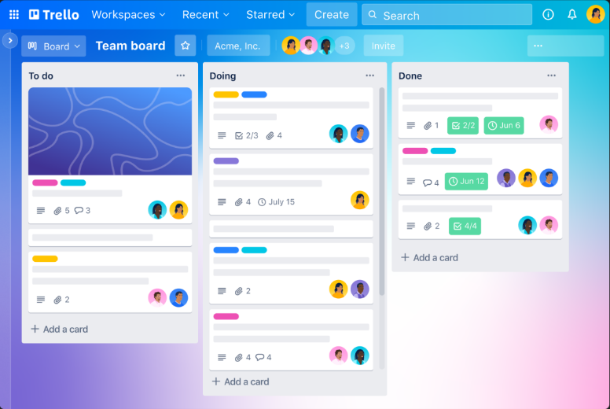
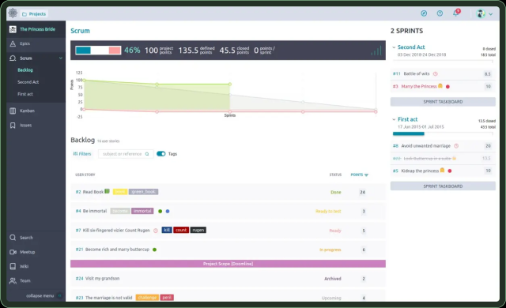
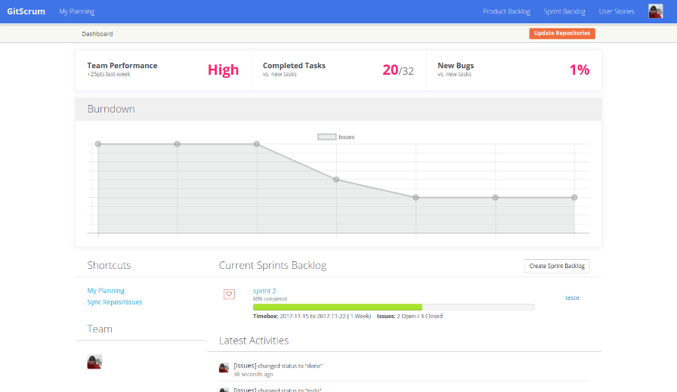
Related work
Powerful but
High cost
complex
Lightweight
but
Lacks robustness
limited reporting capabilities
JIRA
Trello
open-source
Easy
but
Require technical maintenance
Convenient
but
Steep learning curve
Taiga
GitScrum

Slide 7
Preliminaries
Requirement Elicitation
R1: New users must be able to create accounts.
R2: User accounts are required for login.
R3: All users can create projects; the creator assumes the role of project owner.
R4: Users can invite other users to join projects as members.
R5: Users can view their own projects and those they participate in.
R6: Members can create and manage tasks, including details such as priority and responsibility.
R7: Task progress is displayed on a Kanban board.
R8: Task information can be edited at any time on relevant pages.
R9: Tasks can be assigned to team members, with avatars indicating assignment.
R10: Task Detail page must show task priority and descriptions.
R11: Users can comment on tasks for collaboration.
R12: The tool should be maintainable and expandable.
Priority of Requirements
Priority | Requirements
Must Have | R1, R2, R3, R4, R5
Should Have | R6, R7, R8
Could Have | R9, R10, R11, R12
Selected Technology Stack
 | Technology
Frontend | Vue.js
Backend | Python, Flask
Database | SQLite

Slide 9
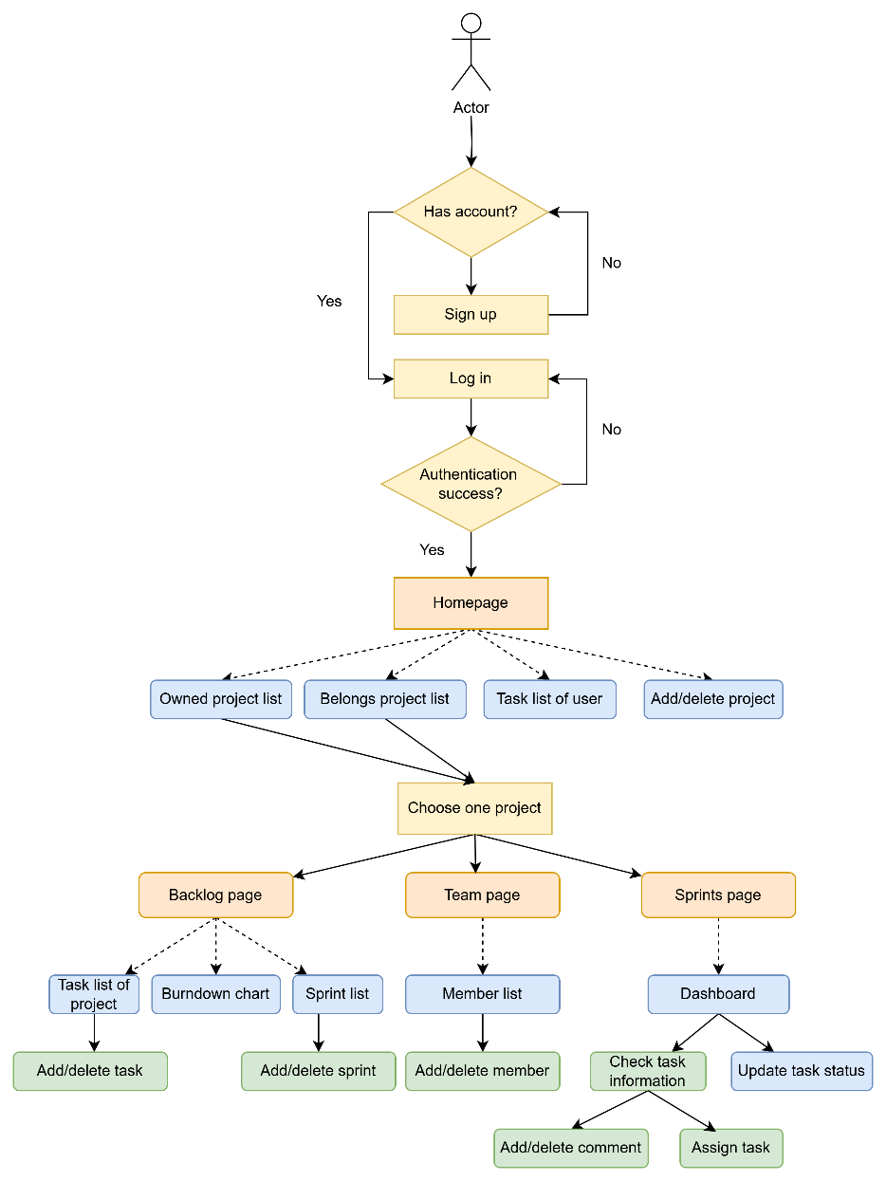
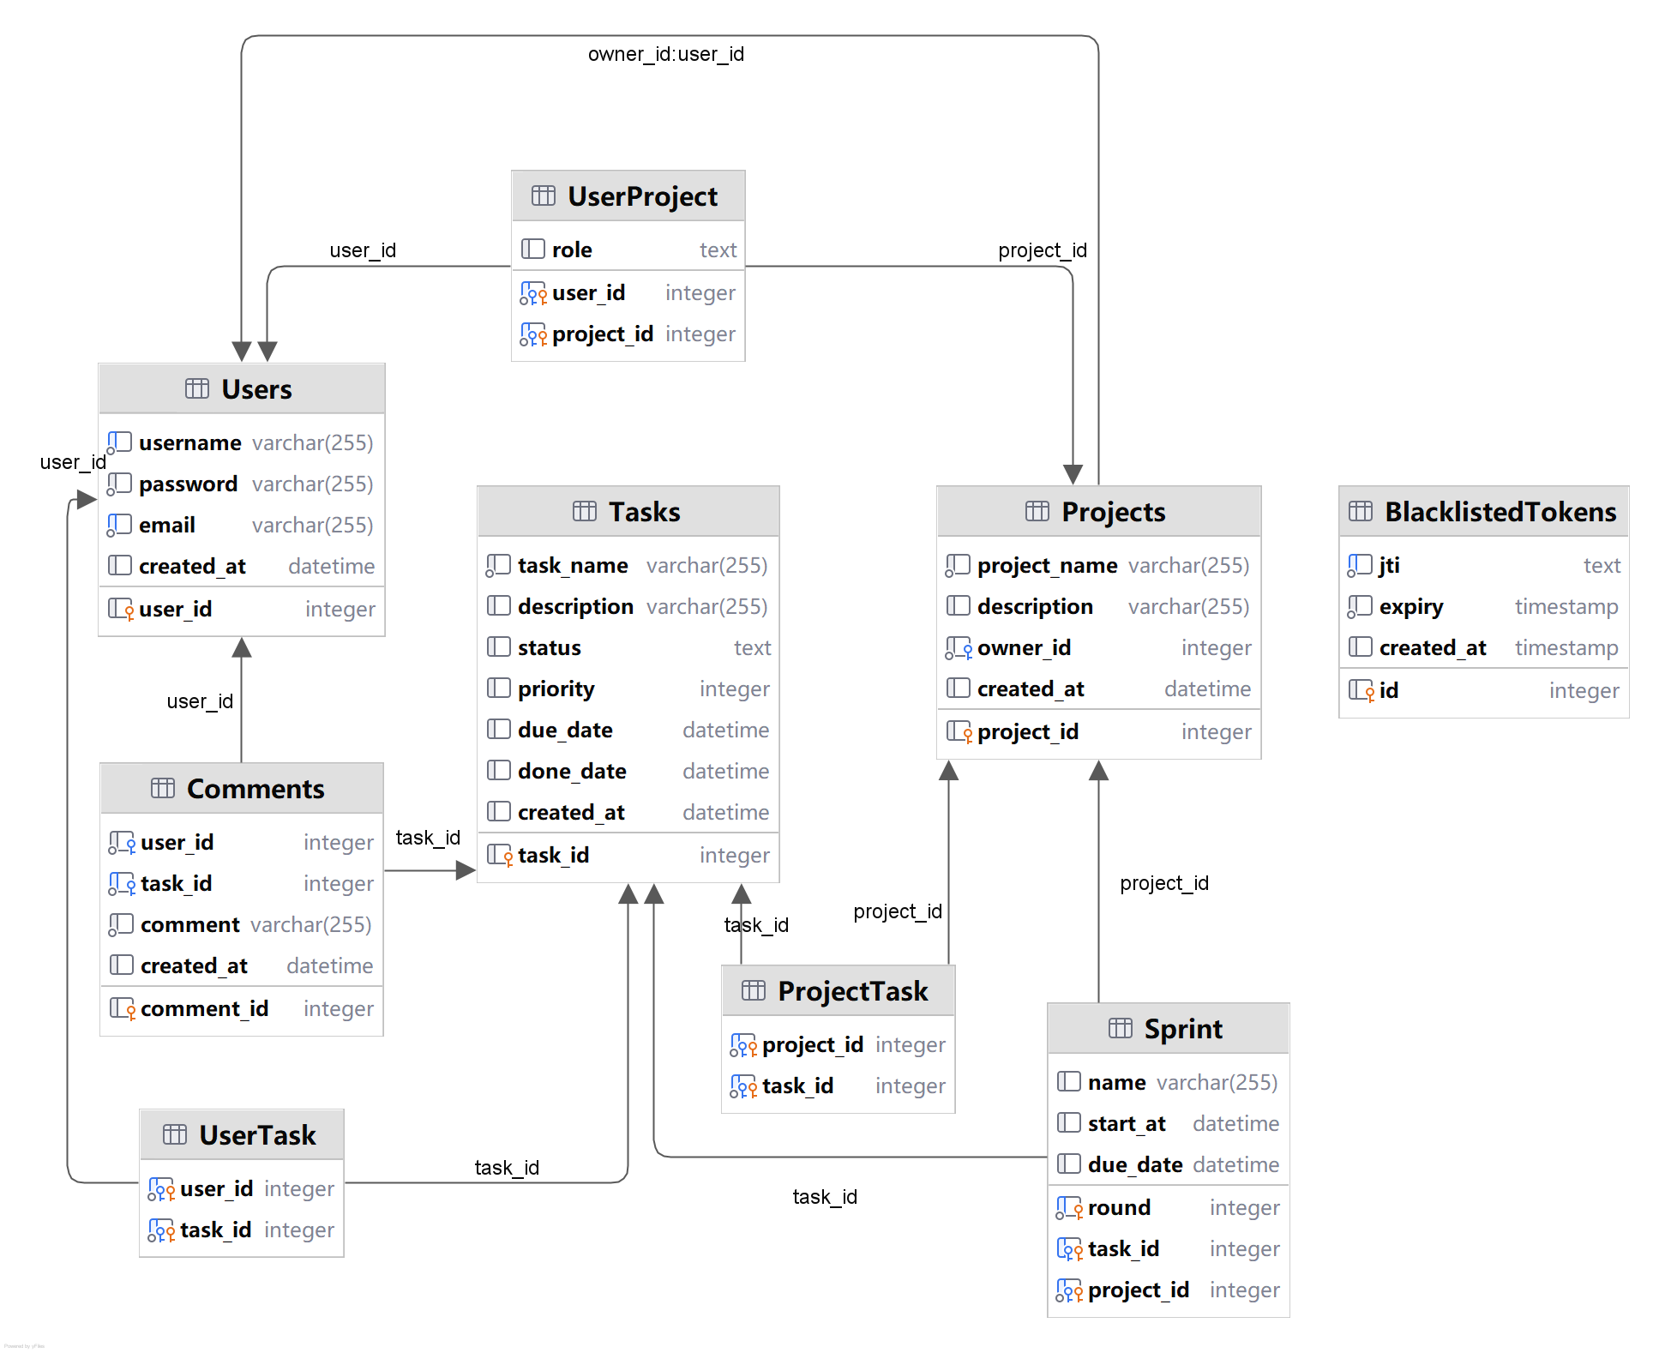
Solution
Walkthrough of our solution
Database Structure Design

Slide 10
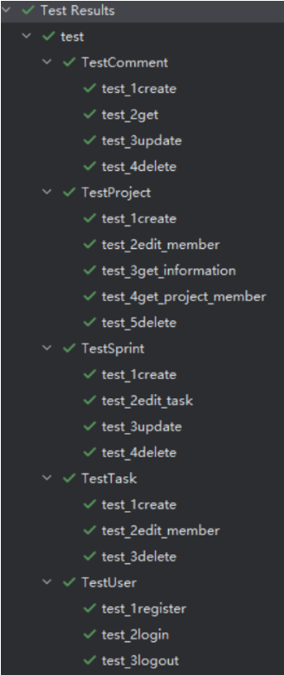
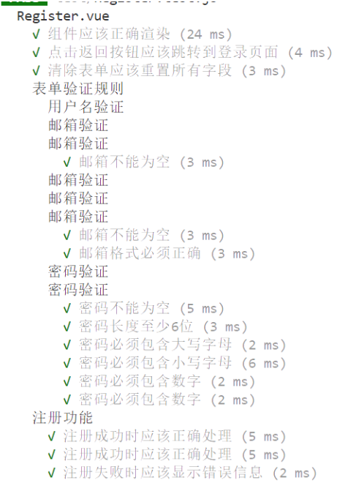
Solution
Code With Quality
Single Responsibility Principle
Open/Closed Principle
Dependency Inversion Principle
Interface Segregation Principle
Testing
Unit Testing
Integration Testing
Functional Testing
UI Testing
Regression Testing
End-to-End Testing
Results of backend unit test
Results of frontend unit test

Slide 12
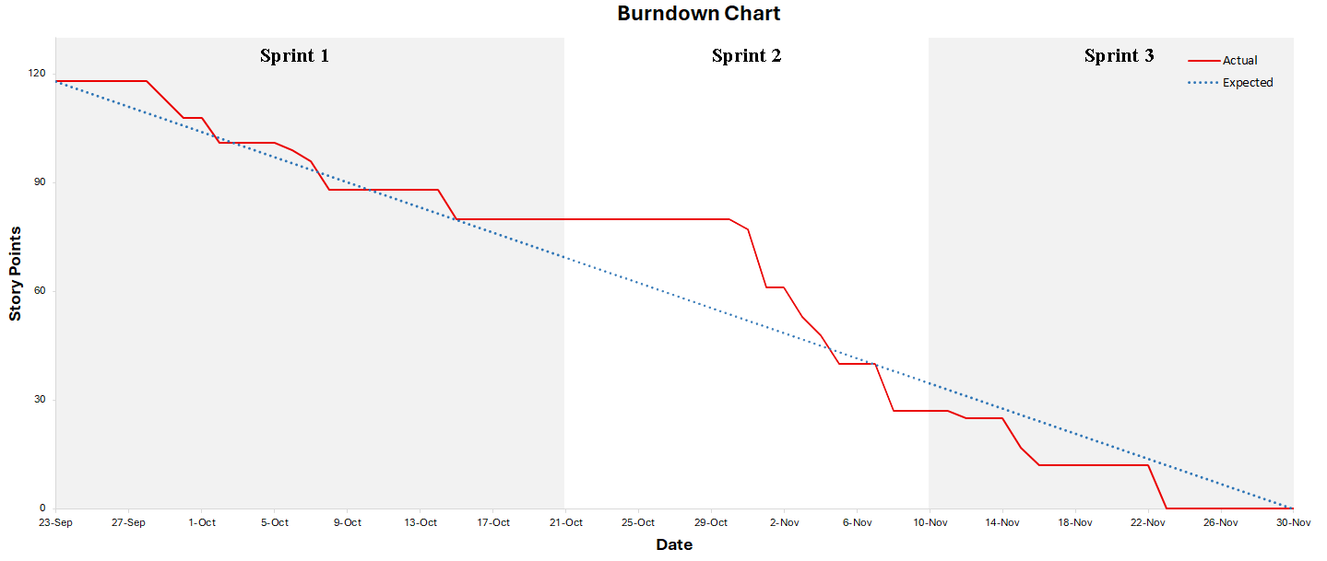
Software process
Burndown chart of whole project
Notes:
这里我说一下我们的sprint周期、为什么有个平台期

Slide 13
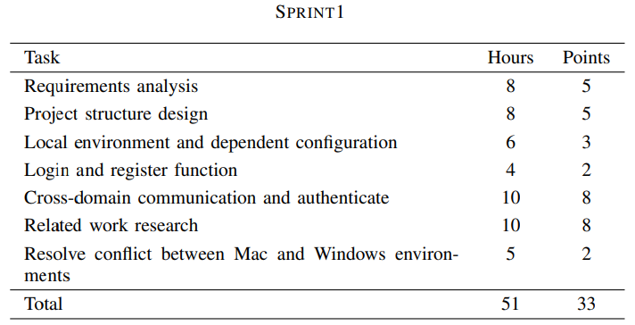
Software process-Sprint 1
In this sprint, We focused on project preparation, including background research, technical analysis, tool selection, task distribution, overall design and basic function.
Tasks, expected spend time and their points
Notes:
这里总结一下sprint1干了什么，有什么任务，上面那个文字等报告改了贴报告里的

Slide 14
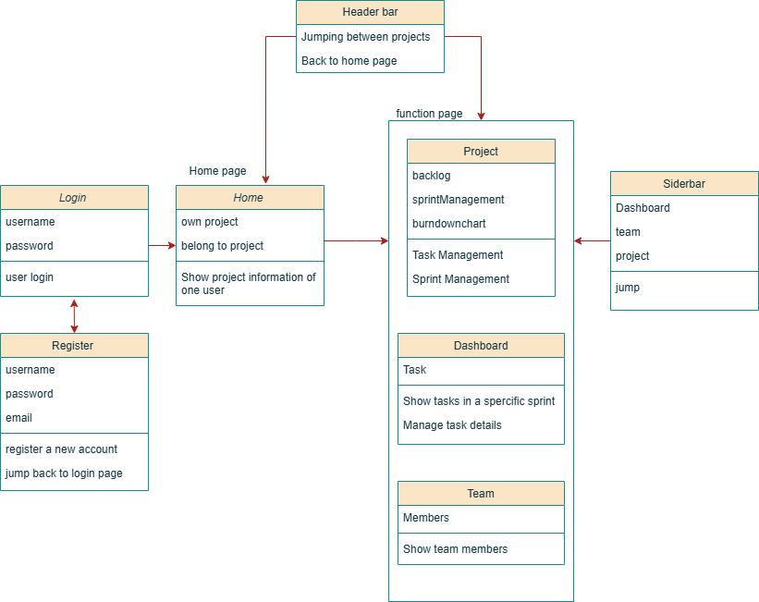
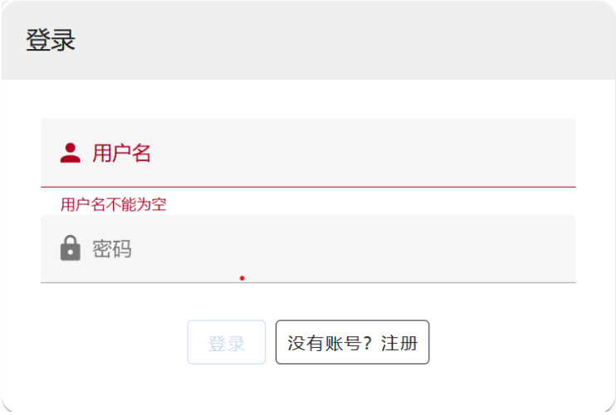
Software process-Sprint 1
First version of login
Main Function Classification
Notes:
这里讲一下结构和用户登录的初次实现

Slide 15
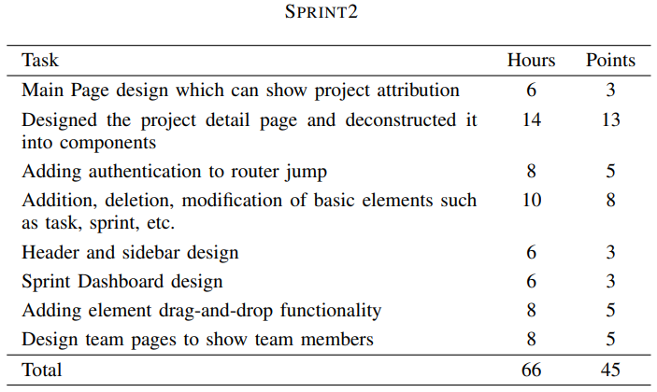
Software process-Sprint 2
In this sprint, We following the plans laid out in Sprint 1, we continued development and successfully completed the project prototype.
Tasks, expected spend time and their points
Notes:
这里总结一下sprint2干了什么，有什么任务，上面那个文字等报告改了贴报告里的

Slide 16
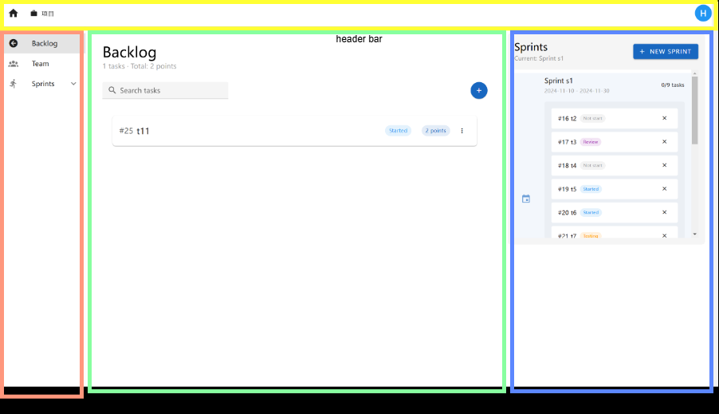
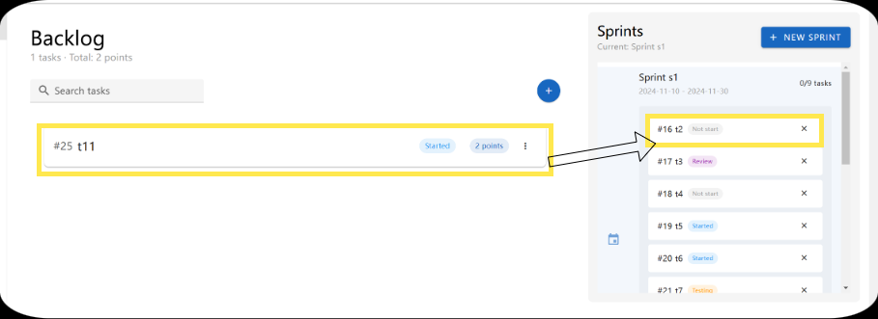
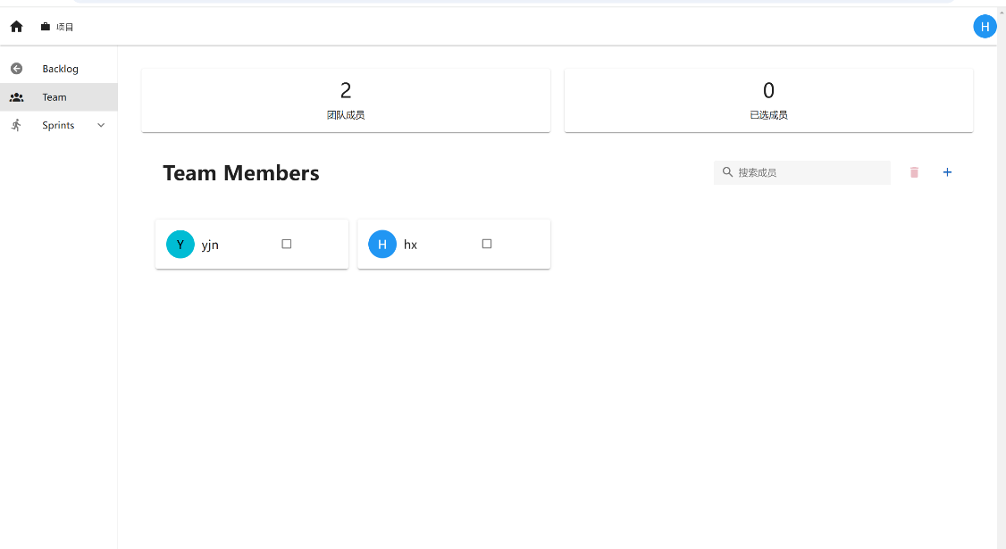
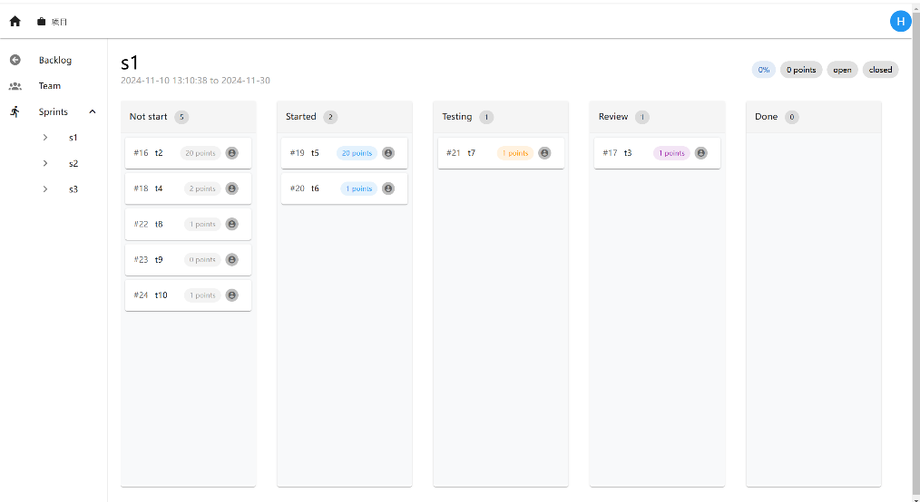
Software process-Sprint 2
Drag-and-drop functionality
Project Page
Dashboard Page
Team Page
Notes:
讲一下这个周期我们完成了这些页面，每个页面的作用

Slide 17
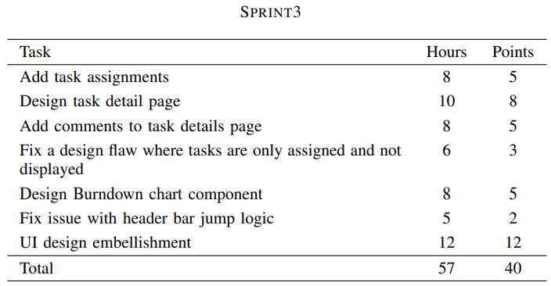
Software process-Sprint 3
In this sprint, building on the prototype, we optimized the UI design, refined the code, finalized the project, and reflected on our work, culminating in the final report.
Tasks, expected spend time and their points
Notes:
这里总结一下sprint3干了什么，有什么任务，上面那个文字等报告改了贴报告里的

Slide 18
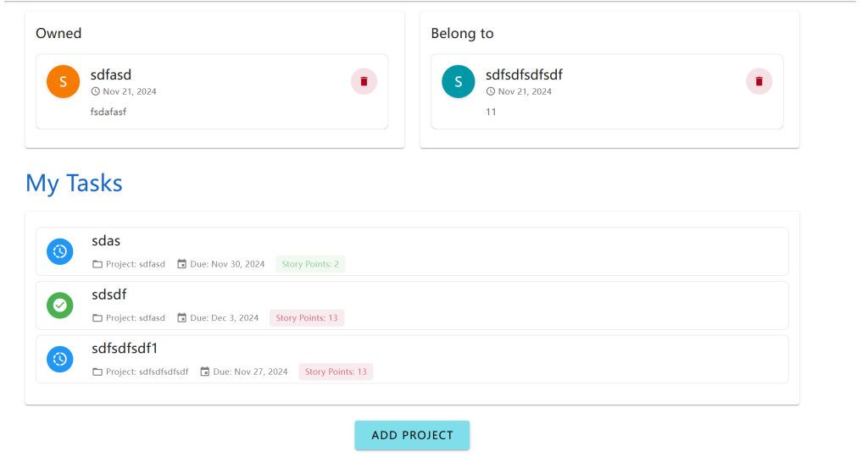
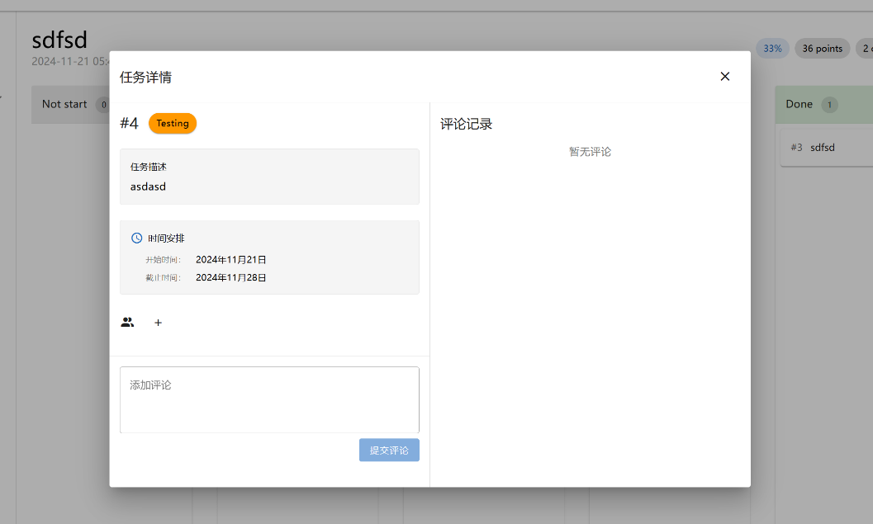
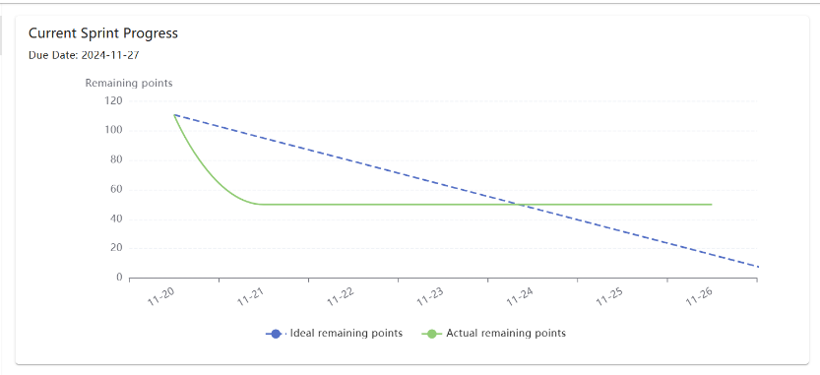
Software process-Sprint 3
Refined Home page
Task detail
Burndown Chart
Notes:
讲一下主界面fix了展示任务功能，添加了task detail以及作用，添加了实时更新的burndown chart

Slide 19
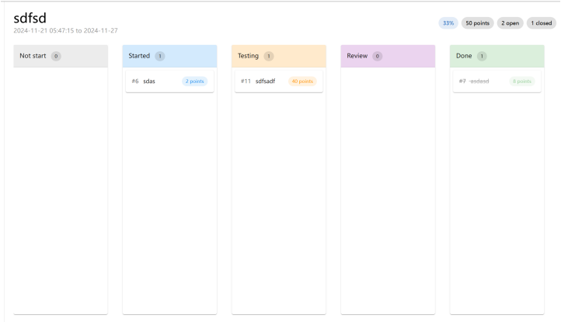
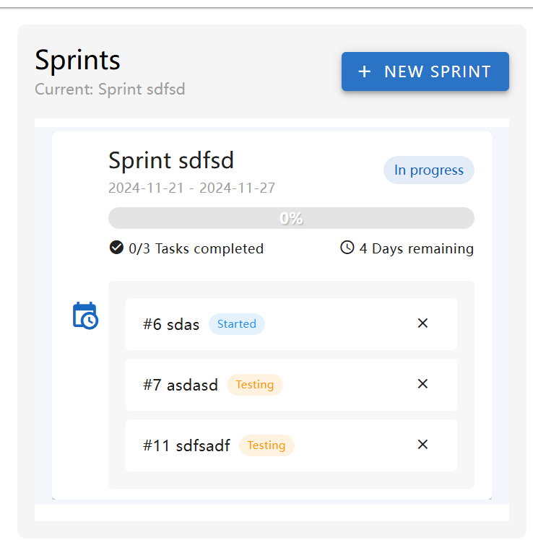
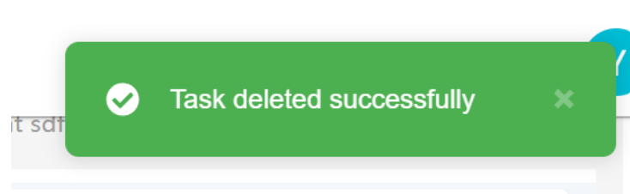
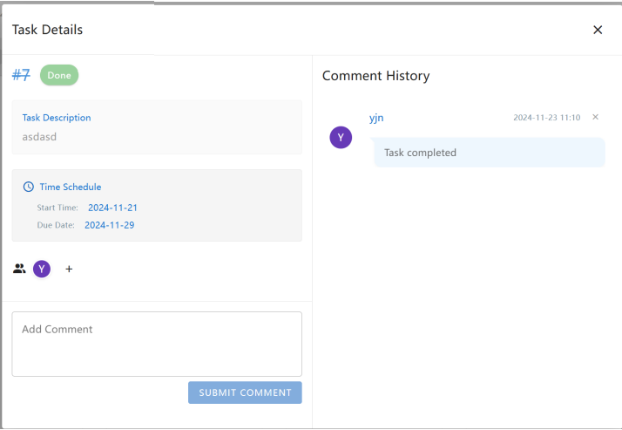
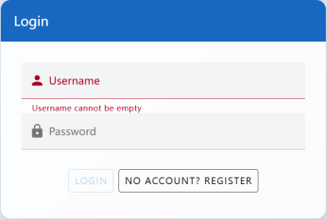
Software process-Sprint 3
Alerts
Refined task board
Refined Sprint Management
Refined Task Detail Card
Refined Login Page
Notes:
讲一下我们更新UI

Slide 20
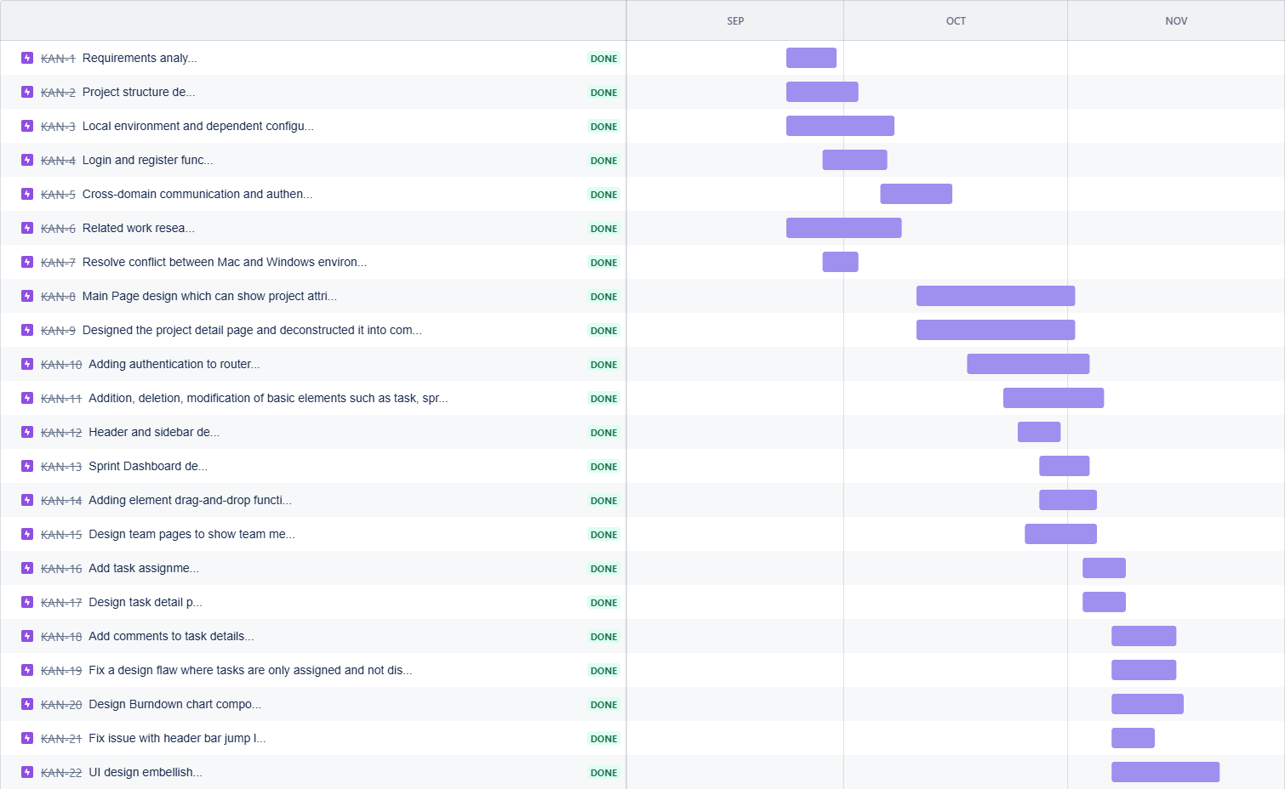
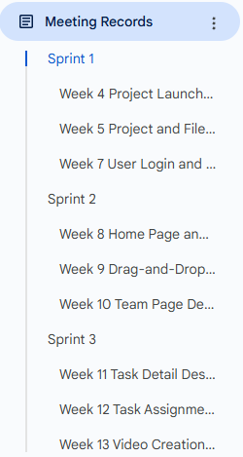
Software process-Weekly evidence
Timeline
Index of meeting records
Notes:
提一下evidence

Slide 22
Evaluation
User-Friendliness and Lightweight Design
Ease of Navigation
Task Collaboration
Emphasizing local environments
Data Organization
Data Integrity
Lightweight Deployment
Dynamic Visualization
Kanban Interaction
Burndown Chart Integration
Data Security
Token Authentication
Data Isolation

Slide 23
Conclusion
In summary, this agile project management tool provides a simplified yet robust solution for small teams, focusing on essential features like task management, sprint planning, and dynamic visualization. With secure authentication, live Kanban updates, and a structured SQLite database, it bridges the gap between overly complex enterprise tools and overly simple alternatives.

Slide 25
Thanks for Your Attention!

