Slide 1




MediTrack
Oracle SQL + PL/SQL
Python · oracledb
Diagnostic Clinic Management System
Streamlit + CLI
Review III · Integrated application and final build
BCSE302L Database Systems · School of Computer Science Engineering and Information Systems, VIT
Faculty: Thanga Marriapan · [Student name(s) – Register number(s)]
Notes:
MediTrack is our Oracle database for a single diagnostic clinic. Review I designed it, Review II built the SQL and PL/SQL; this review shows the integrated application: a new three-portal Streamlit front end and the final, re-runnable build.

Slide 2




The clinic's rules now live in the database
Problem at the clinic → what enforces the fix
7
85
Double booking
trg_no_double_booking rejects a clash (ORA-20003)
tables in BCNF,
7 PK + 7 FK
named constraints,
all VALID
Lost or delayed samples
9
15
SAMPLE status + Q2 lists samples past turnaround
PL/SQL units: 4 procs,
2 functions, 3 triggers
queries, each mapped
to a requirement
Missed abnormal values
trg_flag_result sets LOW / NORMAL / HIGH itself
7
17
Billing errors and untraced dues
generate_bill, ck_bill_total_amt, patient_total_due
transactions T1–T7
in the app
pages across
3 portals
Notes:
Review I listed four problems. Each one is now enforced by a database object, not by the screen. If someone bypasses the app and types SQL, double booking, overpayment and wrong result flags are still impossible.

Slide 3



Architecture: two front ends, one service layer
Front ends
Service layer
Driver
Oracle database
Streamlit site: Patient, Doctor, Administration portals
CLI menu (app/main.py)
Both call the same functions
services.py: one function per T1–T7
Bind variables only, one COMMIT per unit
explain.py: ORA code → reason
python-oracledb, thin mode
callproc for procedures
callfunc for functions
7 tables, 85 constraints, 1 view
4 procedures, 2 functions, 3 triggers
Business rules enforced here
Why this split matters: the UI only collects input and shows results. Every rule (no double booking, bill totals, payment status, result flags) is a constraint, trigger or procedure, so it holds for the CLI, the website and raw SQL alike.
Notes:
Request path: a page or menu item calls a function in services.py. That function runs SQL or PL/SQL through oracledb with bind variables, commits once, and returns a TxResult with the operation, tables, components, statements and rows affected. Both front ends render the same TxResult.

Slide 4
The new frontend
A clinic website with three portals, built in Streamlit over the same service layer

Slide 5
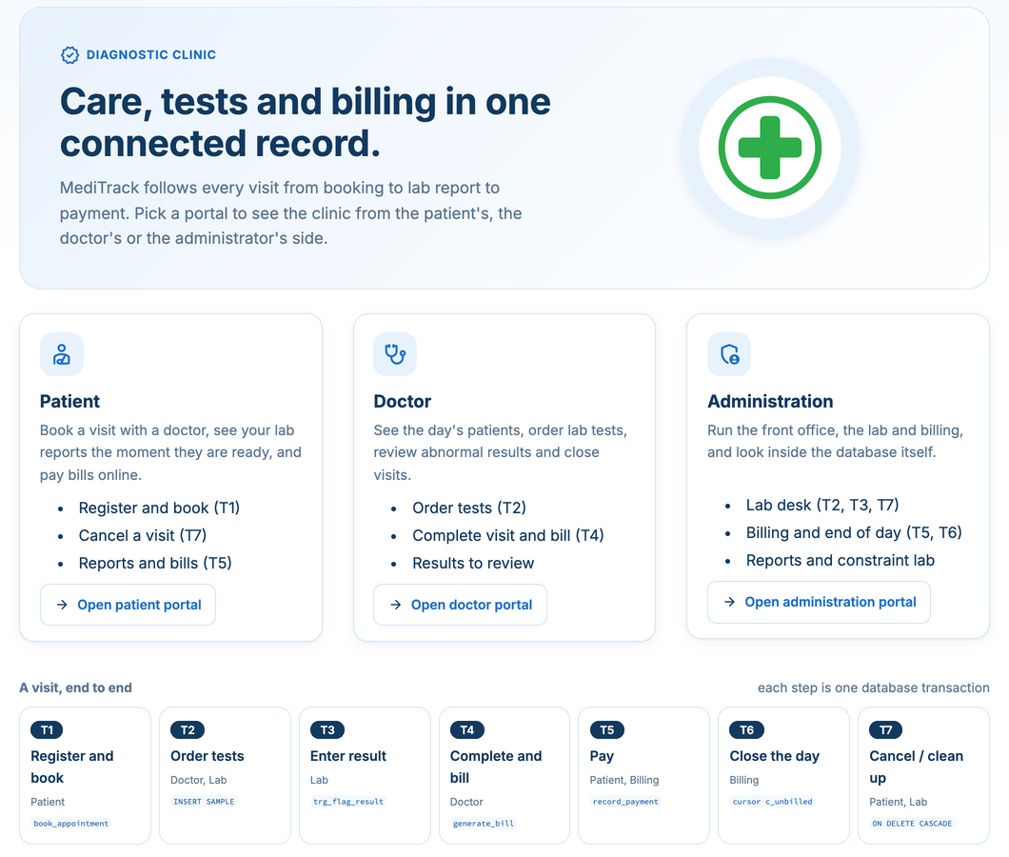



Three portals, one connected record
Patient
My health · Book a visit · My visits · Lab reports · Bills · New patient
T1 register + book · T5 pay · T7a cancel
Doctor
My day · Order tests · Complete visit · Patient results
T2a order tests · T4 complete + bill
Administration
Dashboard · Lab desk · Billing · Reports · Database · Activity log
T2b · T3 · T5 · T6 · T7b
Demo only: a 'Signed in as' picker replaces login. Every visit runs T1 → T7, one transaction per step.
Notes:
The home page explains the whole visit as seven steps, T1 to T7, each one a single database transaction. Each portal shows the clinic from one role's side. Patient and doctor portals use a 'Signed in as' picker for the demo; there is no login.

Slide 6
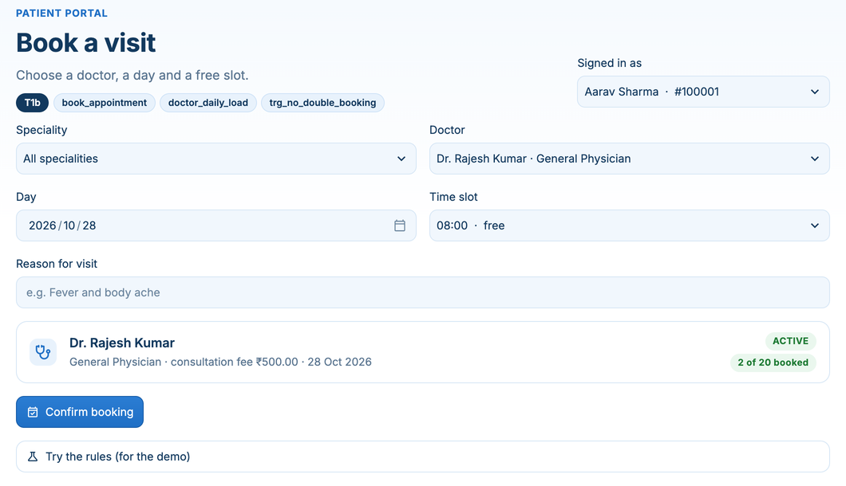
Patient portal: booking checks the rules before and after
1
Slot list is live
Slots held by this doctor or this patient are marked taken (read from APPOINTMENT).
2
“2 of 20 booked”
Comes from doctor_daily_load() against the doctor's max_daily_appts.
3
Confirm booking
Calls book_appointment; the INSERT fires trg_no_double_booking.
4
Lab reports and bills
Flags come from trg_flag_result; the amount due from patient_total_due().
T1b
book_appointment
doctor_daily_load
trg_no_double_booking
Each page header lists the transaction and the database objects it exercises.
Notes:
Demo: pick Dr. Rajesh Kumar today and the 10:00 slot marked taken, then confirm. The trigger raises ORA-20003. Dr. Ramesh Patel is INACTIVE (-20001); Dr. Sanjay Gupta is full today (-20002); a past date gives -20004.

Slide 7
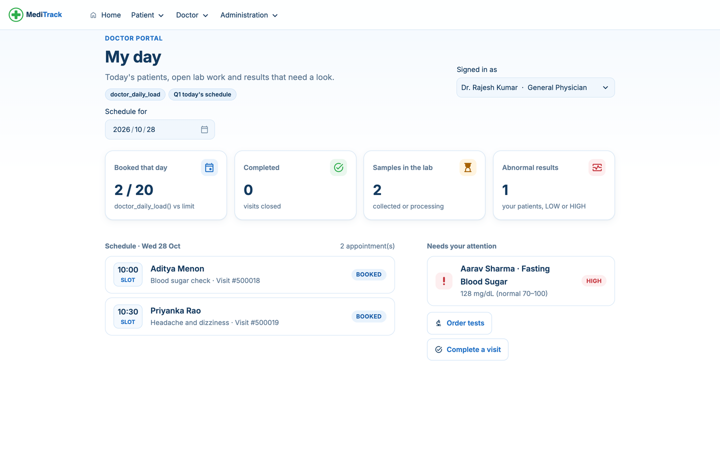
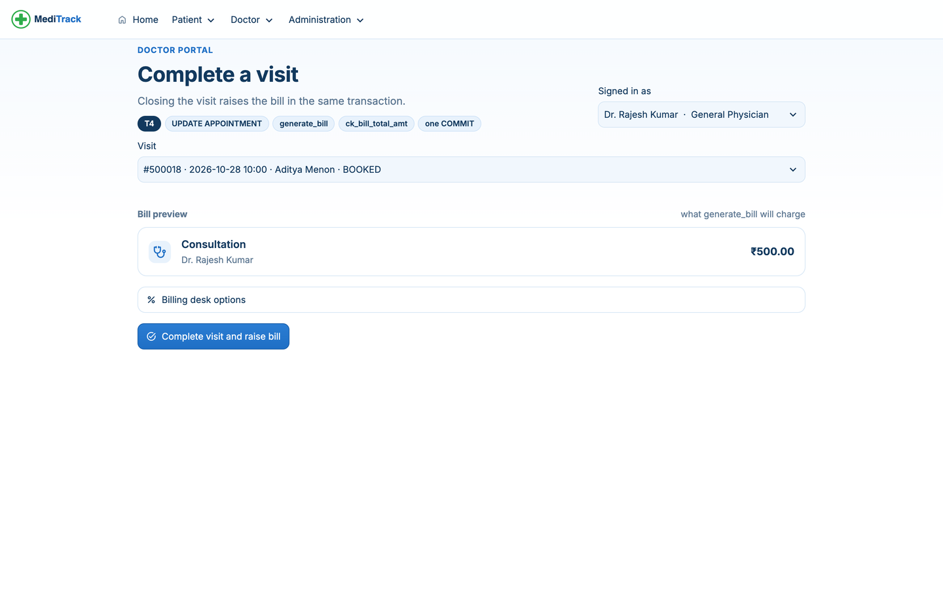
Doctor portal: closing a visit raises the bill
My day
Complete visit (T4)
Today's schedule (Q1), load vs limit from doctor_daily_load(), and LOW / HIGH results that need a look.
UPDATE APPOINTMENT to COMPLETED and generate_bill run in one unit of work with a single COMMIT; the preview shows exactly what the procedure will charge.
Notes:
Order tests (T2a) inserts one SAMPLE row per test; ordering the same test twice is refused by the composite UNIQUE uq_sample_appt_test. Complete visit (T4) is the key unit of work: if generate_bill fails, the status update is rolled back too.

Slide 8
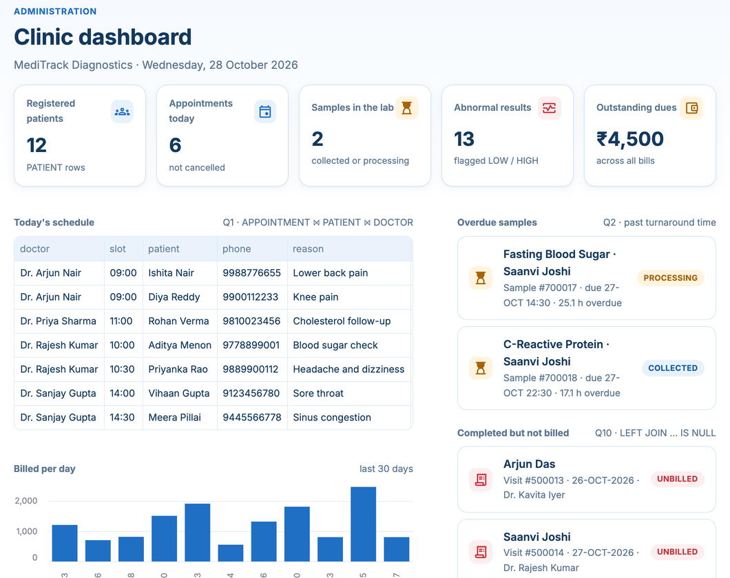





Administration: the clinic dashboard runs our queries
Dashboard
KPIs + Q1 today's schedule, Q2 overdue samples, Q10 unbilled visits
Lab desk
T2b sample status, T3 enter result, T7b delete a REJECTED sample
Billing
T5 record payment, T6 end-of-day billing (cursor)
Reports
All 15 queries, read live from sql/03_queries.sql
Database
Columns, constraints and PL/SQL source from the data dictionary; constraint lab
Notes:
The dashboard is not a separate reporting layer: each panel is one of the 15 queries. The Reports page parses the header comments in 03_queries.sql, so what the examiner reads in the file is exactly what runs. The Database page reads USER_TAB_COLUMNS, USER_CONSTRAINTS and USER_SOURCE.

Slide 9
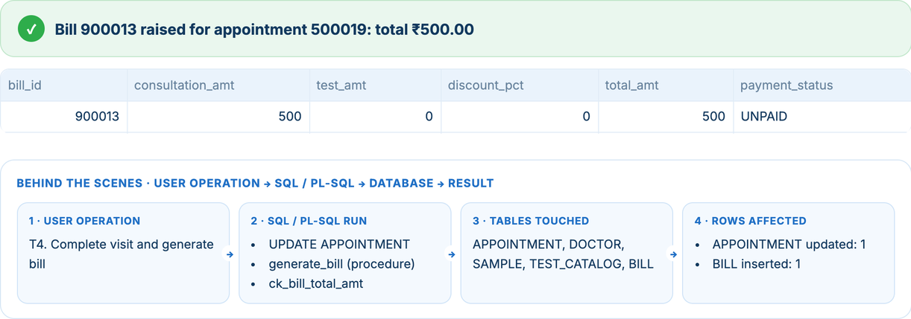
Every action shows its SQL: operation → database → result
TxResult (services.py)
operation
e.g. T4. Complete visit and bill
tables
APPOINTMENT, DOCTOR, SAMPLE, …
components
generate_bill, ck_bill_total_amt
statements
User operation
SQL / PL-SQL run
Tables touched
Rows affected
the SQL actually executed
rows_affected
APPOINTMENT updated: 1, BILL inserted: 1
This is the “User Operation → SQL/PL-SQL → Database → Result” flow the evaluators ask about, printed after every transaction in both front ends.
result / error_code
outcome, or the ORA code
Notes:
Every service function returns a TxResult. The Streamlit 'Behind the scenes' strip and the CLI print the same fields, so in the viva we can point at any action and say exactly which table and which PL/SQL object it touched. The Activity log page keeps the session's history.

Slide 10
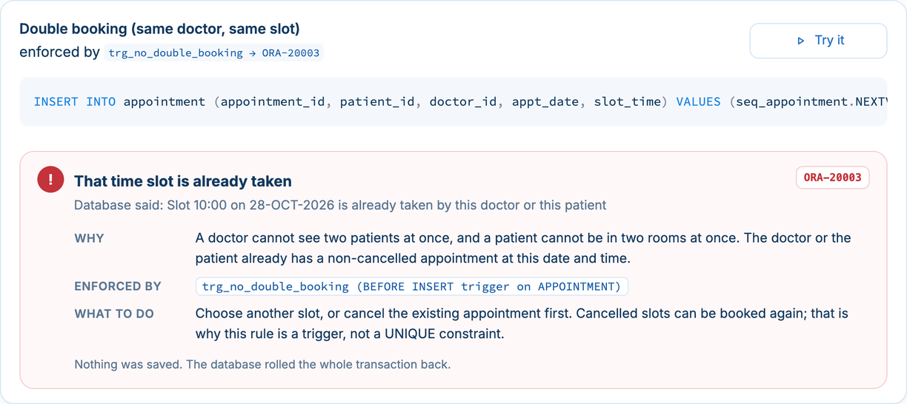
When the database says no, the screen says why
1
Catch
oracledb.DatabaseError; the whole unit is rolled back
2
Extract
ORA-200xx business code, or the constraint name for ORA-00001 / 02290 / 02291 / 02292
3
Explain
explain.py: title, why the rule exists, what enforced it, what to do next
-20001 doctor INACTIVE
-20002 doctor's day full
Constraint lab: 10 statements that each break one rule. All 10 are refused and rolled back.
-20003 slot clash (trigger)
-20004 date in the past
-20010 visit not COMPLETED
-20011 already billed
-20020 bad / over payment
-20030 REJECTED sample
Notes:
Twelve business-rule codes are in use, -20001 to -20031, one per rule, documented at the top of 05_procedures.sql and 06_triggers.sql. Every new code or constraint has an entry in explain.py, so the user never sees a raw stack trace.

Slide 11

The final build
Seven transactions, nine PL/SQL units, fifteen queries: one re-runnable script set

Slide 12
Seven transactions, each traceable to SQL and PL/SQL
# | Operation | Where in the app | SQL / PL-SQL run
T1 | Register patient + book | Patient › New patient, Book a visit | INSERT PATIENT, book_appointment, doctor_daily_load, trg_no_double_booking
T2 | Order tests, collect samples | Doctor › Order tests; Admin › Lab desk | INSERT SAMPLE, UPDATE SAMPLE status, uq_sample_appt_test
T3 | Enter test result | Admin › Lab desk | INSERT TEST_RESULT, trg_flag_result (sets flag + sample COMPLETED)
T4 | Complete visit + bill | Doctor › Complete visit | UPDATE APPOINTMENT + generate_bill, one COMMIT
T5 | Payment + dues check | Patient › Bills; Admin › Billing | record_payment (FOR UPDATE), trg_payment_status, patient_total_due
T6 | End-of-day billing | Admin › Billing | end_of_day_billing: explicit cursor c_unbilled → generate_bill
T7 | Cancel visit, delete rejected sample | Patient › My visits; Admin › Lab desk | UPDATE APPOINTMENT; DELETE SAMPLE → ON DELETE CASCADE
Review III asks for at least 5 transactions; T1–T7 together cover INSERT, UPDATE, DELETE, procedures, functions, a cursor and all three triggers.
Notes:
Read this table as the map from a click to the database. Procedures never commit; the caller owns the unit of work. The only exception is the batch job end_of_day_billing, which commits once after the loop and rolls back everything if any visit fails.

Slide 13



PL/SQL: where each rule is enforced
Procedures
Functions
Triggers
book_appointment
doctor_daily_load
trg_no_double_booking
ACTIVE doctor, room in the day, not in the past
non-cancelled appointments on a date
BEFORE INSERT on APPOINTMENT
generate_bill
patient_total_due
trg_flag_result
fee + non-REJECTED tests, snapshot into BILL
SUM(total − paid), 0 if none
LOW / NORMAL / HIGH + sample COMPLETED
record_payment
trg_payment_status
locks the bill, rejects overpayment
UNPAID / PARTIAL / PAID
end_of_day_billing
explicit cursor, one COMMIT
Notes:
trg_no_double_booking is BEFORE INSERT only: a row trigger cannot query its own table during UPDATE (ORA-04091 mutating table), so rescheduling is cancel + rebook. trg_flag_result reads the normal range through SAMPLE and TEST_CATALOG, so the technician never types the flag.

Slide 14

One command rebuilds and verifies everything
99
drop all
01
DDL
04
functions
05
procedures
06
triggers
02
seed data
03
queries + view
Triggers run before the seed, so every seeded flag, sample status and payment status is set by a trigger, never typed by hand. python app/setup_db.py (or 00_build_all.sql in SQL*Plus).
16 / 16
objects VALID (procs, functions, triggers, view, sequences)
10 / 10
constraint-lab violations refused
15 / 15
queries return non-empty output on seed data
T1–T7
07_dml_demo.sql: success and failure cases
Notes:
Run on a clean Oracle Free 23ai schema on 28 Oct 2026. Seed dates are relative to SYSDATE, so 'today's schedule' always has data on demo day. Every SQL file is re-runnable because the build starts with 99_drop_all.sql.

Slide 15
Fifteen queries, each answering a clinic question
Q1
Q2
Q3
Q4
Q5
Today's schedule
Overdue samples
Abnormal results
Revenue by day, mode
Busiest doctors
3-table JOIN
date arithmetic
5-table + LEFT JOIN
GROUP BY 2 cols
HAVING
Q6
Q7
Q8
Q9
Q10
Dues above average
Never-ordered tests
Top test per category
Patients, >1 doctor
Completed, not billed
nested subquery
NOT EXISTS
RANK() OVER
COUNT DISTINCT, LISTAGG
LEFT JOIN … IS NULL
Q11
Q12
Q13
Q14
Q15
Average vs normal range
Doctor revenue share
Both HIGH and LOW
Registrations / month
v_bill_summary
AVG + CASE
scalar subquery
INTERSECT
GROUP BY derived
CREATE VIEW
Each query's header (purpose, FR, concept, output) is parsed by the Reports page, so the file and the app never drift apart.
Notes:
Coverage: simple retrieval, INNER and LEFT joins over 3+ tables, GROUP BY + HAVING, aggregates, correlated and non-correlated subqueries, NOT EXISTS, INTERSECT, RANK(), and a view. On the seed data, Q7 returns Vitamin B12 and Q10 returns visits 500013 and 500014, which T6 then bills.

Slide 16
Design decisions we defend in the viva
Trigger, not UNIQUE, for double booking
BILL keeps a price snapshot
A UNIQUE (doctor, date, slot) would also block rebooking a cancelled slot, and could not check the patient's own clash.
A bill is a record of what was charged that day; ck_bill_total_amt keeps total = parts.
Doctors are deactivated, never deleted
Procedures never COMMIT
Visit history must stay; verified_by uses ON DELETE SET NULL.
T4 = UPDATE + generate_bill succeed or fail together; only the batch job commits.
SAMPLE resolves APPOINTMENT ⟷ TEST_CATALOG
“Today” comes from the database
The M:N becomes an entity with its own type, collector and status.
Oracle in Docker runs in UTC; the UI uses TRUNC(SYSDATE) so screens and procedures agree.
Notes:
These are the questions most likely to come up. Each answer points at a concrete object in the code: the trigger, the CHECK constraint, the FK delete rule, the commit placement, the SAMPLE table, and services.db_today.

Slide 17
Thank you
Questions? · Live demo: streamlit run app/streamlit_app.py
What's next, within scope
Real sign-in with Oracle roles and GRANTs per portal
Reschedule in one step via a compound trigger
Printable bill and lab-report PDFs
Notes:
Close with the live demo if time allows: book a taken slot to show -20003, enter a HIGH result, complete and bill a visit, take a partial payment, and run end-of-day billing.

