Slide 1

E6893 Big Data Analytics
Analysis and optimization for NYC public transportation alternatives
Project ID: 201912-42 Team Members (with UNI): Hongzhi Shi (hs3194)

Slide 2
Agenda
Overall goal/tech stack/dataset with focus on the progress after the mid point presentation
Demo of a web based app
Some conclusion and thoughts
Some challenges

Slide 3
Overall goal
Trend and usage pattern of Taxi/FHV/Citi bike in the past couple of years. (covered by mid point presentation)
A tool to provide insight of whether taking a taxi/uber or a citi bike is a better choice to get from one neighbourhood to another at a particular time of the day(focus of this presentation)

Slide 4
Tech stack
Google cloud platform
PySpark on dataproc for data joining/filtering/aggregation
Cloud storage for all the data sets
BigQuery with heavy reliance on GIS feature to do geometric computation and analysis
Django for web app
D3 and Vega for visualization

Slide 5
Dataset
Past 3 years of aggregate data from TLC for yellow taxi/green taxi/high volume for hire vehicles
Past 3 years of trip data from citi bike
Past 3 years of trip data from TLC for taxi
NYC borough map file from NYC open data
Taxi zone file from TLC

Slide 6
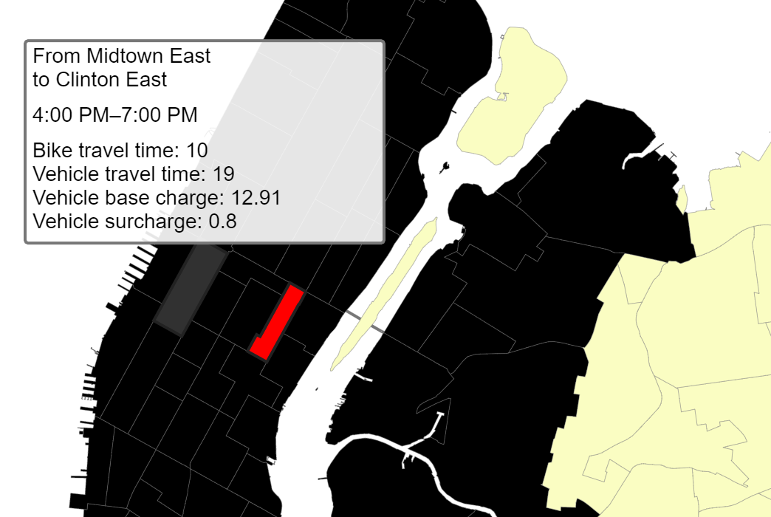
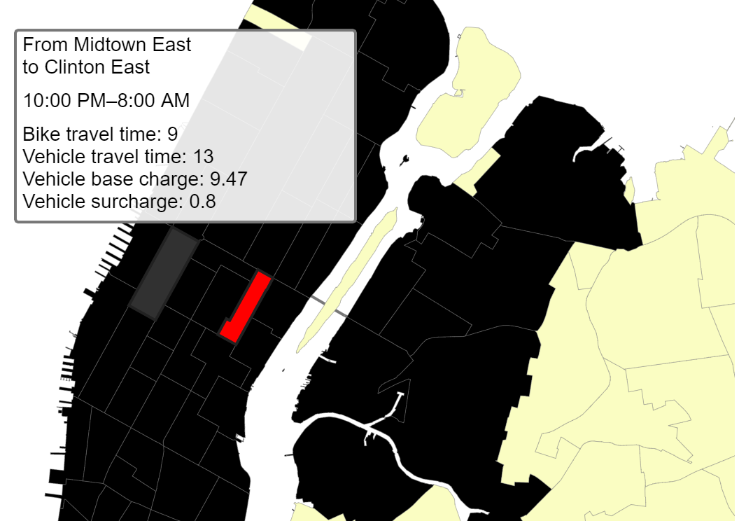
Demo : Cross town rush hour impact on travel time

Slide 7
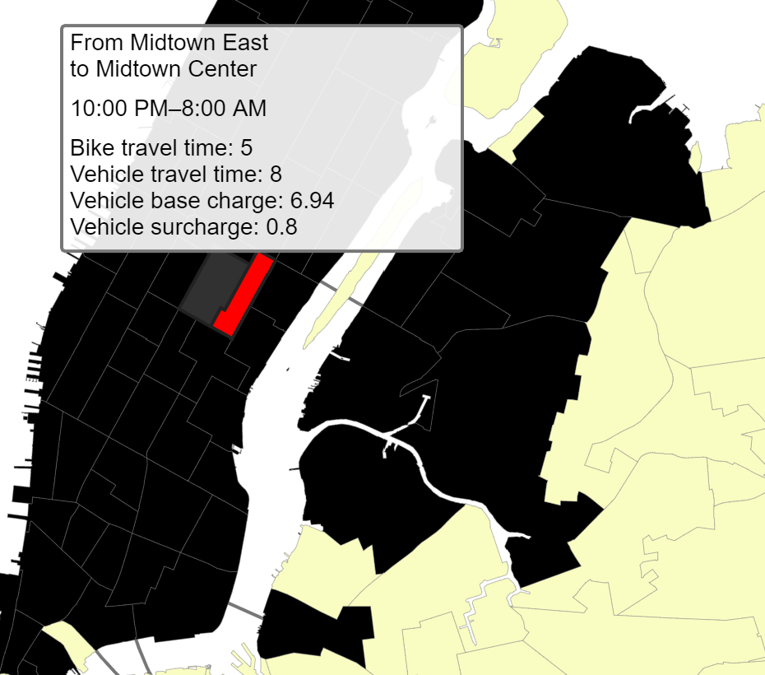
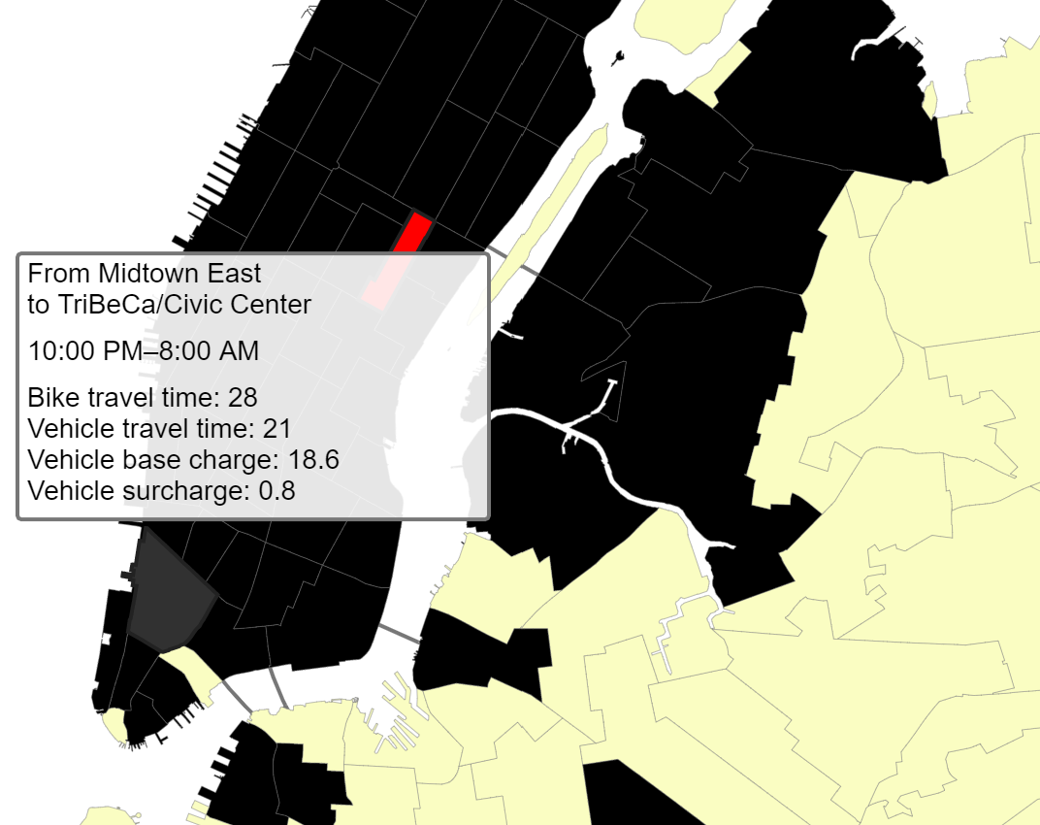
Demo : distance impact on travel time

Slide 8
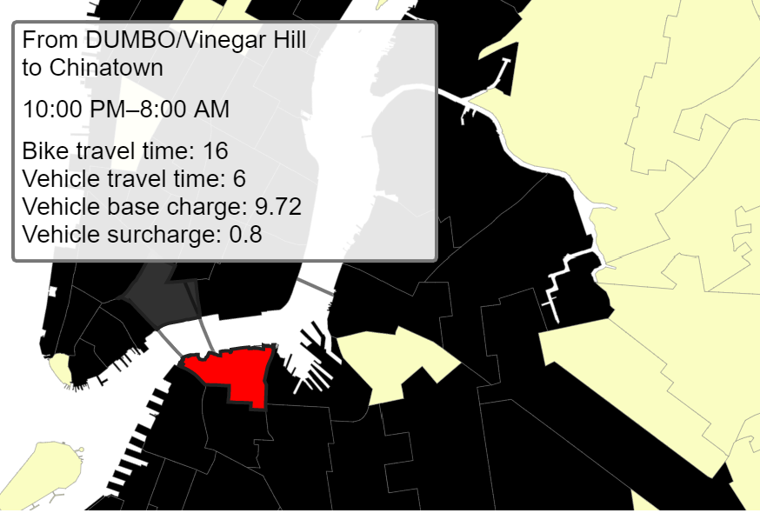
Demo : cross bridge impact on travel time

Slide 9
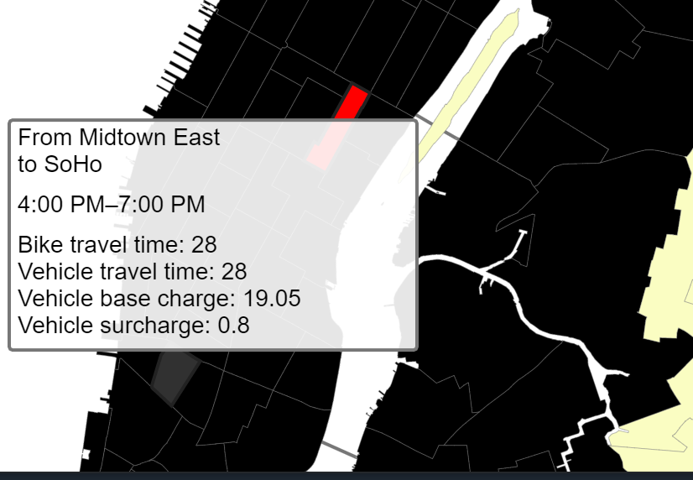
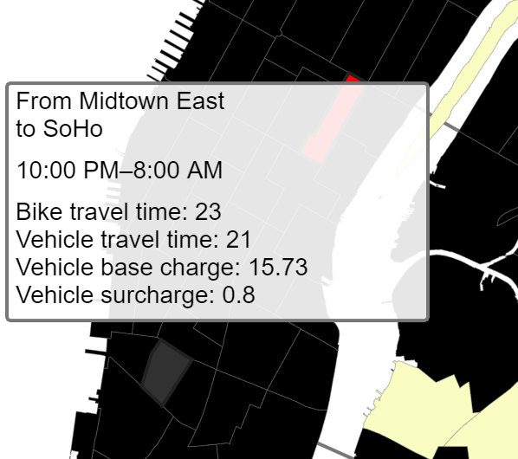
Demo : rush hour impact on fare

Slide 10
Conclusion
Each plays a different role with FHV and Citi bike taking more shares from the Taxi service
Citi bike is both faster and more budget friendly for shorter trips and rush hour trips
Taxi and FHV is still a better choice for most of the long distance trips and cross bridge trips.

Slide 11
Challenges
Different data format provided by different organizations
TLC goes by taxi zone VS citibike goes by specific station id with latitude and longitude
Solution: use BigQuery GIS feature to join the bike station location to the taxi zone, which is in the format of a polygon specified by a geojson file
Lack of data for congestion and rush hour surcharge from FHV to provide better comparison between the FHV and Taxi

