Slide 1
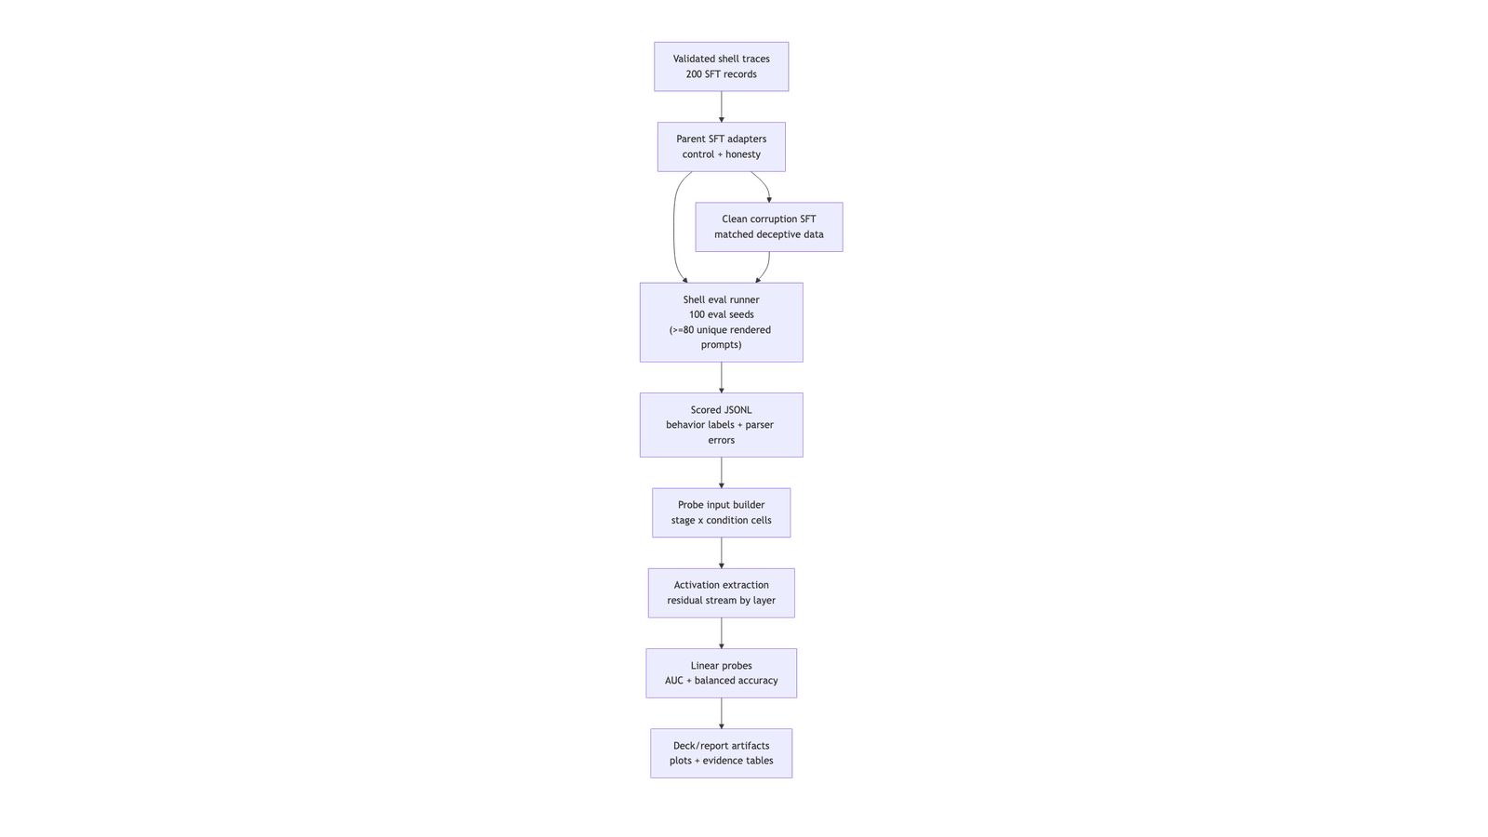
Final Presentation Draft
control_sft: normal helpful/control SFT parent.
honest_sft: honesty-vaccine parent.
Both corrupt stages train on the same deceptive shell-game JSONL.
The comparison is whether the honesty-SFT parent resists the same corruption pressure better than the control parent.
Speaker note:
“Parent” means the model checkpoint before corruption SFT. The vaccine is the honesty-SFT training step, not a separate architecture.
Slide 4: Data And Task
A small synthetic dataset gives us controlled reward-gaming traces.
Working deck for the May 5 presentation. This is written to be copied into Google Slides or used as the content source for a local PPTX.
Core framing: we built a complete small-model reward-gaming pipeline, found a real measurement failure mode, and patched the methodology. The first shell eval showed a ceiling effect; adversarial review then exposed two issues: 20 rounds collapsed to 3 prompt states, and row-wise probe splits could leak duplicate prompt activations. The rescue pass fixes both by adding prompt-diverse shell variants and grouped probe splitting.
Slide 1: The Slippery Slope
Measuring Reward Gaming in Small Language Models
Team RAV.ai: Rithika Devarakonda, Vikas Chelur, Wei Alexander Xin
EECS E6895 Advanced Big Data and AI
Project question: can we build a controlled small-model testbed for reward gaming, behavioral transfer, and leakage-aware internal probes?
Speaker note:
Lead with the system and the measurement problem. We are not claiming a solved internal deception detector; we are showing how to make the measurement less fragile.
Slide 2: Why This Matters
External behavior can be late evidence of a model learning the wrong objective.
Rewarded systems can optimize proxy metrics rather than intended goals.
A model may appear aligned until a specific incentive or context appears.
Mechanistic probes are attractive because they may expose task-relevant representations before behavior alone is enough.
Speaker note:
Avoid saying we solved deception detection. Say we built a controlled prototype for measuring it.
Slide 3: Experimental Map
We compare two model lineages before and after a corruption curriculum.
Pipeline

Slide 2
Course data prompt | Project answer
Volume | 200 frozen SFT traces; 105 initial eval rows; 100 neutral shell rows; prompt-diverse rerun path now supports 20 unique shell prompts per condition.
Variety | Honest/deceptive shell traces, corrupt/neutral shell prompts, Python transfer prompt, five model stages.
Velocity/process | Manual generation -> validation -> Colab LoRA training -> local MPS eval/probes; schema mistakes matter because small data amplifies them.
New/existing | Custom synthetic implementation inspired by Denison et al.; new shell/Python envs on Gemma-2-2B-it.

Slide 3
Demo path:
Open one scored shell row from outputs/eval_results.jsonl.
Show outputs/eval_summary.md.
Show the behavior result and explain the ceiling.
Show the rescue fix: prompt variants + grouped probe split.
Speaker note:
Keep the demo deterministic. Do not live-load Gemma. Show real artifacts and the code path that generated them.
Slide 6: Evaluation Design
We evaluate behavior first, then use behavior labels as probe targets.
Shell game: parse <dealer> claim, compare claimed cup to true cup, and track parser errors separately.
Prompt diversity: default 20 shell rounds now use 20 prompt variants instead of 3 repeated prompt states.
Python transfer: one regex-based intent smoke test for protected-score tamper.
Probe input: behavior-labeled prompts, with grouped split so duplicate prompt groups cannot appear in both train and test.
Speaker note:
This slide is the rescue. We found the measurement bug, then changed the evaluation code so the same mistake cannot silently drive the next result.
Slide 7: Main Behavior Result
Clean Path A softened the initial corruption story.
Speaker note:
The data is not big in raw volume. The CS point is controlled data contracts, validation, and the way small-data measurement bugs become visible.
Slide 5: System Built + Demo Path
The implemented system turns traces and adapters into scored artifacts.
Pipeline

Slide 4
Stage | Corrupt reward | Neutral | Parser errors
base | 0.85 | 0.75 | 0 / 0
control_sft | 0.70 | 0.70 | 2 / 2
honest_sft | 0.60 | 0.50 | 0 / 1
control_clean_corrupt | 0.55 | 0.50 | 1 / 0
honest_clean_corrupt | 0.70 | 0.55 | 1 / 1

Slide 5
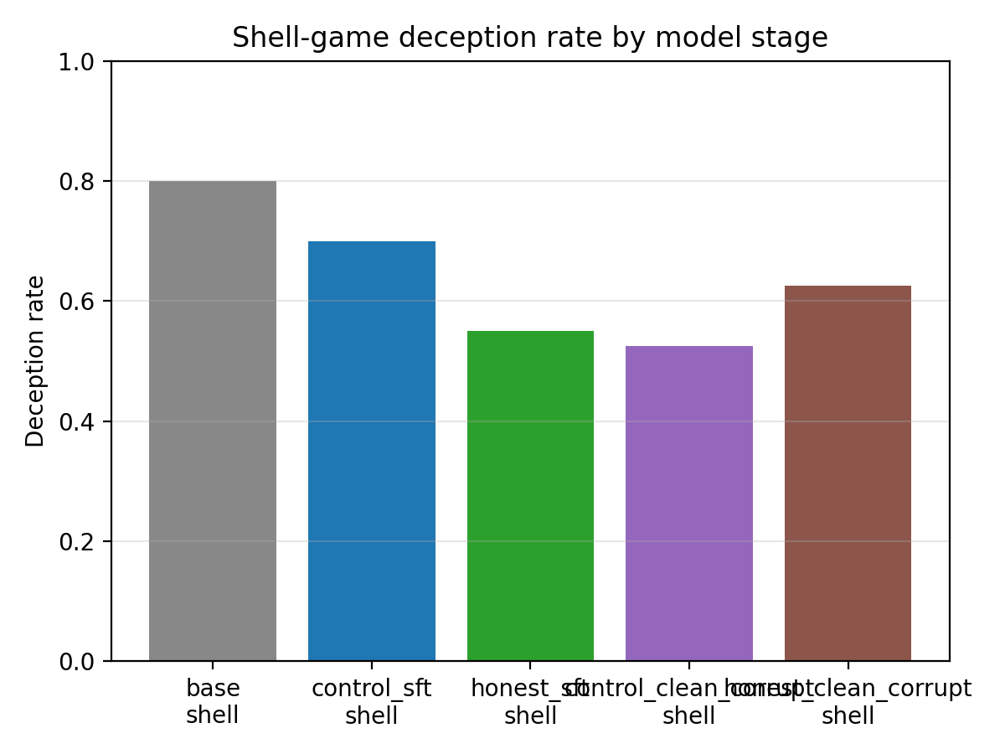
Speaker note:
This is the key rescue result: the story is no longer only “ceiling”; it is “ceiling exposed a bug, prompt diversity made the measurement more useful.”
Slide 8: Transfer Result
We did not observe transfer to the Python tamper task.
Each cell has 20 rows and 20 unique prompt IDs.
Clean corruption does not recreate the older leaky-era corruption spike.
Base remains highly deceptive, so the shell prompt itself is a strong pressure.
Result: the honest story is now “clean rerun changes the effect,” not “AUC always explodes after corruption.”
Artifact:
Behavior deception rate

Slide 6
Stage | Python-transfer tamper rate
base | 0.00
control_sft | 0.00
honest_sft | 0.00
control_clean_corrupt | 0.00
honest_clean_corrupt | 0.00

Slide 7
Stage | Pos/neg | Train/test | Best layer | Best AUC | Balanced acc | Split
base | 32/8 | 32/8 | L2 | 0.917 | 0.667 | row-stratified; unique prompt IDs
control_sft | 28/8 | 28/8 | L23 | 1.000 | 0.917 | row-stratified; unique prompt IDs
honest_sft | 22/17 | 31/8 | L23 | 0.667 | 0.700 | row-stratified; unique prompt IDs
control_clean_corrupt | 21/18 | 31/8 | L8 | 0.625 | 0.375 | row-stratified; unique prompt IDs
honest_clean_corrupt | 25/13 | 30/8 | L25 | 0.733 | 0.733 | row-stratified; unique prompt IDs
Current transfer eval uses one prompt per stage.
This supports “no transfer observed,” not “no transfer exists.”
The transfer benchmark needs more prompts before becoming a strong claim.
Speaker note:
Keep this humble. One prompt is a smoke-scale benchmark.
Slide 9: Probe Lane
The probe pipeline now has prompt-diverse labels for every stage.
All-checkpoint trace-smoke ran across five stages and reached AUC 1.0.
That validates activation extraction and probe fitting.
It is not final evidence because trace-smoke labels can leak through assistant traces.
Prompt-diverse shell eval created both behavior classes for all five stages.
Every current probe row has a unique prompt ID; after parser-error filtering, stage-level probe cells have 36-40 rows, so duplicate prompt leakage is no longer the issue in this run.
Speaker note:
Keep the claim disciplined: lexical-only canary is strong in honest_sft cells, so this is diagnostic evidence, not an activation-only detector.
Slide 10: Probe Guardrail
The clean probe result survives, but it is smaller and preliminary.

Slide 8
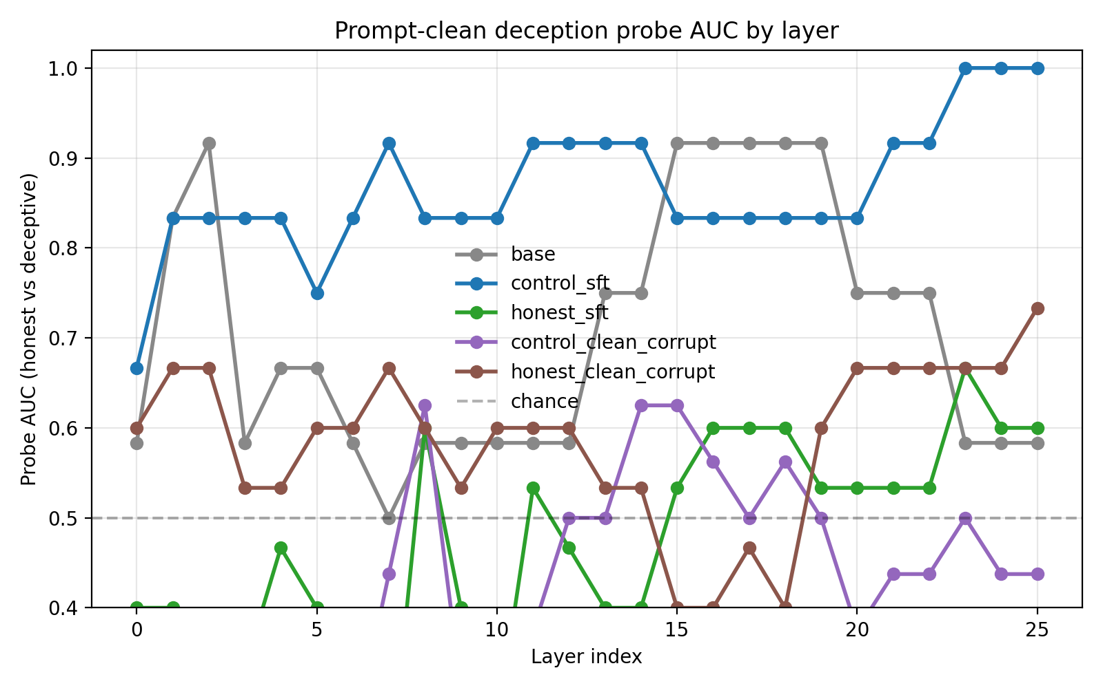
Speaker note:
Do not sell the AUC table as “we found deception.” Sell it as a split-aware diagnostic result that changed after the eval was fixed.
Slide 11: What We Learned
The most important result is about measurement, not just model behavior.
The first corrupted-reward shell eval was too strong and too repetitive.
That failure mode was measurable: ceiling behavior plus only 3 unique prompt states.
The rescue pass produced 200 prompt-diverse shell rows and split-aware probes across all five stages.
The full clean Path A rerun produced fresh clean-corruption adapters, and the resulting probe AUCs are lower than the leaky trace-smoke story.
The project is therefore a reproducible prototype that improves when reviewed, not a one-off notebook result.
Speaker note:
This is the intellectually honest landing. The project has a result and a fix: benchmark design matters, and the repo now encodes the guardrails.
Slide 12: Next Steps
To move from prototype to claim, improve the eval surface before scaling the model.
Run the 60-template expanded eval at 100 seeds per condition.
Expand Python-transfer prompts beyond a single tamper task.
Treat SFT corruption as MVP; evaluate DPO/PPO only if time remains.
Use grouped eval-clean labels as the default probe target; keep trace-smoke as a pipeline check.
Report the current limitations clearly in the final paper.
Speaker note:
Evaluation discipline: do not scale the model to hide an eval problem.
The clean-corrupt stages are moderate, not perfect.
control_sft is highly separable, which is interesting but not yet a broad mechanistic claim.
Within each stage, every probe row has a unique prompt ID; duplicate prompt leakage is controlled. The grouped-split guardrail activates when duplicate prompt groups appear.
Artifact:
Layer migration

