Slide 1

E6895 Advanced Big Data Analytics:
Ask Ubuntu - Data Analytics
Team Member:
Andre Cunha (adc2171)
April 9, 2015

Slide 2
Outline
Motivation
Overview
Methods and Analyses
  Data Analyses
  Data Processing
  Model
Results
Demo

Slide 3
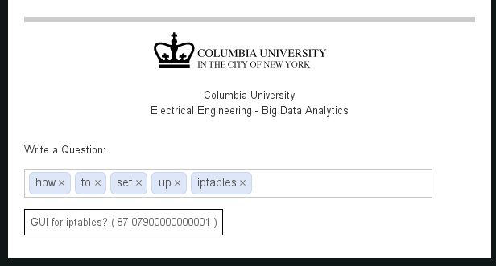
Motivation
AskUbuntu is a question and answer site for Ubuntu
users and developers.
Free
Great Resources
Big Community
Clean and Organized dataset

Slide 4
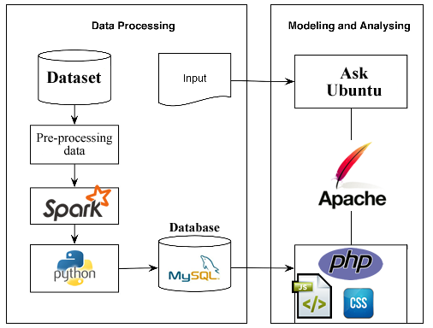
Overview

Slide 5
Overview
Dataset Free Available at StackExchange
https://data.stackexchange.com/
(5 GB)
AskUbuntu.com.7z
Posts.xml Users.xml Tags.xml

Slide 6
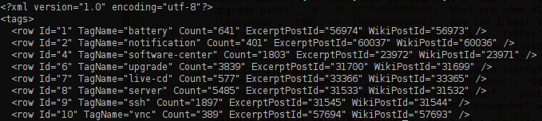
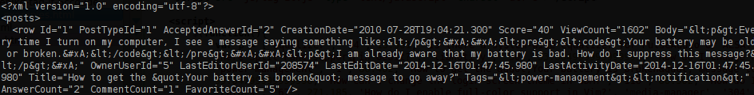
Overview
Spark / Python and XML
Regular Expression
Tags.xml
Posts.xml

Slide 7
Methods and Analyses
Data Parser / Cleaning
Spark RDD Actions and Transformation
  Map() / FlatMap()
  Filter()
  GroupBYKey()
It was not necessary a train process
Map / Reduce (Key, Value)
('upgrade', [[u'221', 75.997, u'How to force installation of kernel updates when using apt-get upgrade?'], [u'283', 38.891999999999996, u'Does installing packages manually with dpkg prevent a future upgrade path?'], [u'5', 36.82299999999999, u'What are some alternatives to upgrading without using the standard upgrade system?']])

Slide 8
Recommendation System
ViewCount
FavoriteCount
Score
Posts.xml
Tags
CommentCount
AnswerCount

Slide 9


Front-End
JavaScript
Tag-it (Jquery)
Mysql
Html
Apache

Slide 10
Conclusion
What were my key achievements?
  Spark
  Python
  Open Source Community
  Map / Reduce Strategies
Next Steps?
  Better Performance
  Security
  Expand the Platform
  Multiple User

