Slide 1

E6893 Big Data Analytics:
Dota 2: Win Probability Prediction
Team Members: Tianhong Ding, Chi Li
Group #90
December 15, 2016

Slide 2
Outline
Technologies used
Dataset overview
Challenges
Findings
Business Values
Demos
Next Steps

Slide 3





Technologies Used
TensorFlow neural net Library
Item-based Recommendation Technique
Mahout and Hadoop
Multinomial Naïve Bayes model and Logistic regression model in R and Python

Slide 4
Dataset Overview
Dota 2 is played by two teams, called Radiant and Dire
Each team has five players. Each of the players choose one hero from a pool of 113 heroes
Uncompressed dataset:
  Matches.jsonlines
  Size: 2.94 GB
After data extraction, it has records
  97230 matches (rows)
  1125 variables (columns)
    Radiant1_hero, Rdaint1_money, … Radiant2_hero, ...
    Dire1_hero, Dire1_money,… Dire2_hero, …

Slide 5
Challenges
Prediction model building
“Hero” variable is neither categorical nor numerical
  Cannot used directly
  Our Solution: Use neural net to “learn”
Prediction Model comparison
Identify factors that will increase win probability
Which heroes to select to increase winning probability?
  Assume that winners have similarities in choosing heroes
  Our Solution: Recommendation system
How to win?

Slide 6
Findings
Logistic Regression model has highest accuracy: 68%
  By looking at the the coefficients, Money and Experience are crucial factors in winning the game
Multinomial Naïve Bayes model accuracy: 65%
TensorFlow model has accuracy rate of 58%.
  It’s hard to predict who will win by hero information
Some heroes are recommend more often than others

Slide 7
Business Value
  Dota2 eSports Competitors
    Win up to 1 million prize
  Game Development company
    Make game unpredictable to attract more customers
    Discover bugs in the game

Slide 8



Demos: TensorFlow Neural Net
Data preparation: 0-1 matrix
Radiant choices
| Dire choices
 | 1 | 2 | … | 113 | 114 | … | 225 | 226 | y
1 | 0 | 1 |  | 0 | 0 |  | 0 | 1 | 1
2 | 1 | 1 |  | 0 | 0 |  | 1 | 0 | 0
…

Slide 9
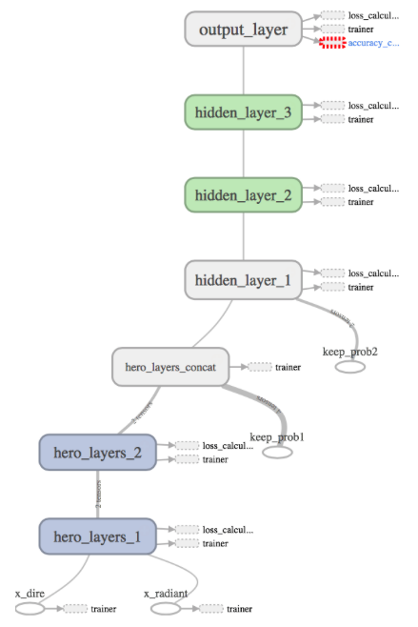
Demos: TensorFlow Neural Net
Net Structure:
base model

Slide 10
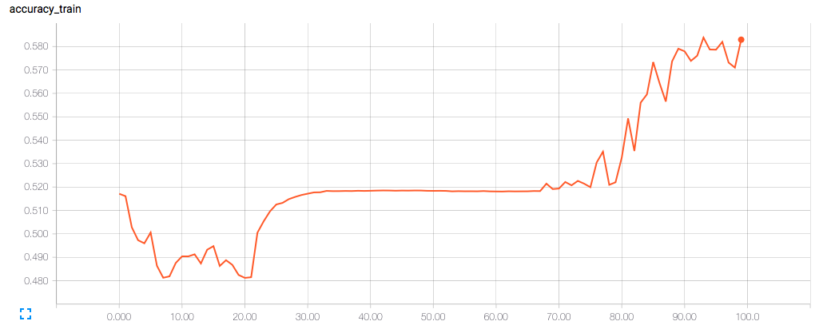
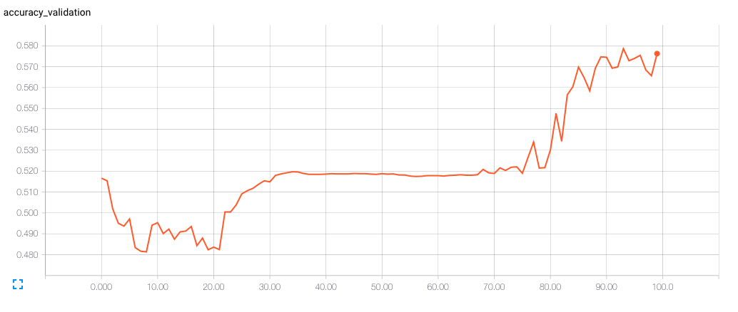
Demos: TensorFlow Neural Net
Test accuracy: 0.585

Slide 11
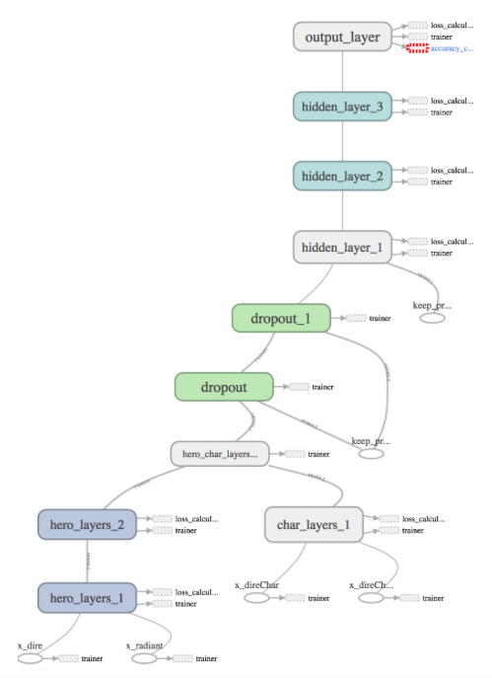
Demos: TensorFlow Neural Net
Net Structure: new model
  Add more factors such as Gold and Experience into the model as a new node
  Result is not satisfying, test accuracy is only 0.520
  Other factors may interfere with the “learning process” of neural network

Slide 12
Demos: Recommendation System Technique
If the winner choose a hero with ID i, then he “buys” that hero. So item i is given rating “1”
  For example, winner_1 choose hero with ID “2” and “113”, then the Ratings of these heroes will be 1.
Winner | Hero | Rating
1 | 1 | 0
1 | 2 | 1
1 | 3 | 0
…
1 | 113 | 1

Slide 13
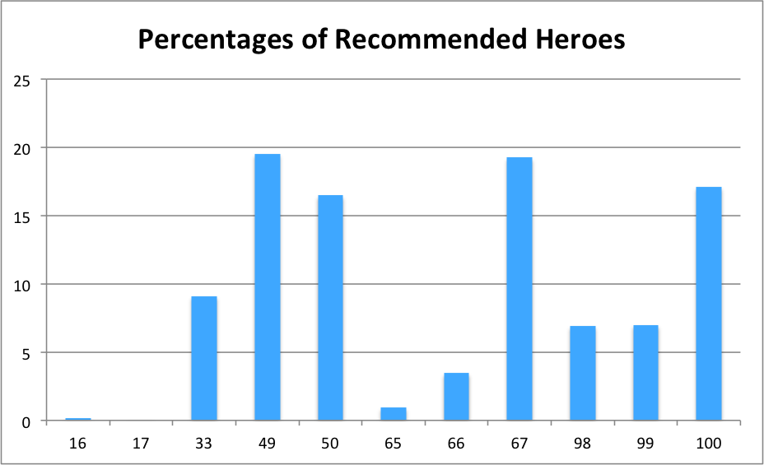
Demos: Recommendation System Technique
From the recommended result, Hero with ID 33,49,50,67,100 are recommended high more often other heroes

Slide 14
Next Step
Adjust Neural net model to find better accuracy rate
Use categorical similarities measures in the recommendation system
Gain more matches to train model

Slide 15
Appendixes
http://markdunne.github.io/2016/02/07/TensorFlow-Dota-Model/
https://inclass.kaggle.com/c/dota-2-win-probability-prediction
Conley, K., & Perry, D. (2013). How does he saw me? A Recommendation Engine for Picking Heroes in Dota 2. Np, nd Web, 7.

