Slide 1

E6895 Advanced Big Data Analytics Final Project:
Market Intelligence Analysis
<Jia Ji, Tianrui Peng>
February 2nd, 2017

Slide 2
Final Project Overview
Machine learning
Dataset
features
Models
Dynamic learning system
Work with other groups
Sentiment analysis model from group b3
Provided web API to group b9 for optimizing user portfolio

Slide 3
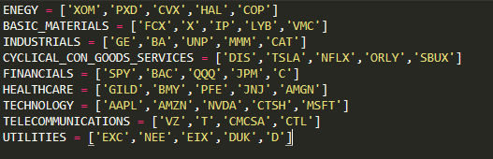
Training Dataset
Historical data of 2015
44 stocks from different fields
10736 data points

Slide 4
Machine Learning Features
Features | Example
Total likes | 698
Total reshares | 10
Total post user | 441
Total followers | 2437826
Total subscribers | 5815
Watchlist count | 91084
Trending score | 0.58
Total number of messages | 1601
Total number of bullish messages | 346
Total number of bearish messages | 135
date | 2015-01-02'

Slide 5
Machine Learning Models
Naive Bayes
a classification technique based on Bayes’ theorem
useful for very large data set
naturally gives a probability for prediction
Average Accuracy: 0.55
Symbol | Accuracy | Symbol | Accuray
FCX | 0.7 | DIS | 0.62
GE | 0.6 | DUK | 0.6
GILD | 0.62 | EIX | 0.61
HAL | 0.6 | EXC | 0.57
IP | 0.45 | GE | 0.6
JNJ | 0.46 | GILD | 0.62

Slide 6
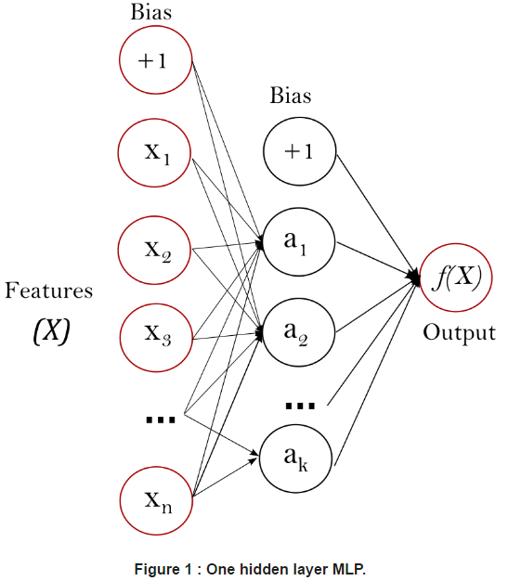
Neural Networks
Multi-layer Perceptron (MLP)
a supervised learning algorithm
Average Accuracy: 0.53
Symbol | Accuracy | Symbol | Accuray
FCX | 0.7 | DIS | 0.38
GE | 0.58 | DUK | 0.44
GILD | 0.42 | EIX | 0.34
HAL | 0.52 | EXC | 0.57
IP | 0.5 | GE | 0.58
JNJ | 0.54 | GILD | 0.42

Slide 7
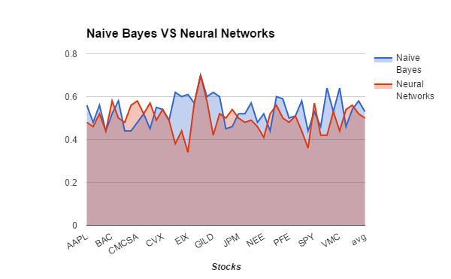
Accuracies

Slide 8
Dynamic Learning System
Automatically learning new data and improve itself everyday
dataset:
historical data from 2015
newest data from 2017
model: Naive Bayes
Incorporated into our web interface

Slide 9
Dynamic Learning System
Run once everyday
Result Visualization (Web)
Retrain the machine learning model
Use the new model to make prediction
StockTwits
Daily Analysis Features
Collect Data (Python Script)
Get previous day analysis result
Data Analysis (Statistical Methods)
Public API for query data (Python)
Mongo DB
Data Query Interface (Python)

Slide 10
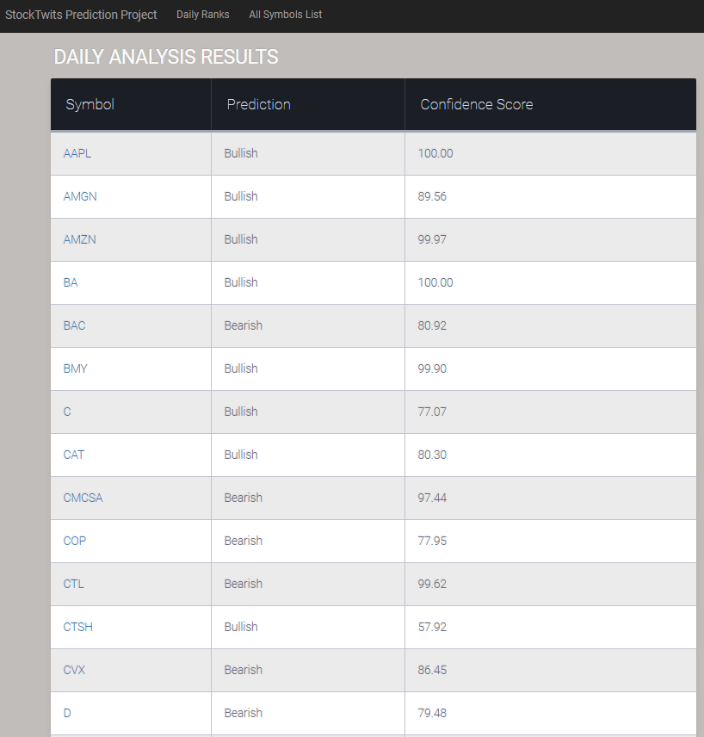
Incorporate Into our website
show symbols, predictions, and confidence score.

Slide 11
Demo
http://45.33.45.39:8000/stock

Slide 12
Future Plan
Continually hosting the website
Combining with other information source
news
Twitter

Slide 13
Questions?

