Slide 1

=
$$×$$
Review
User
Business

Slide 2
User
Eating Mates
Others

Slide 3
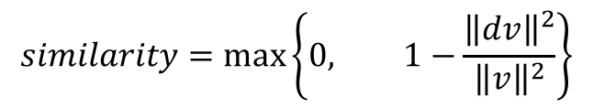
dv
v
u
$$similarity=\max\left\{0, 1−\frac{{\left\|dv\right\|}^{2}}{{\left\|v\right\|}^{2}}\right\}$$

Slide 4
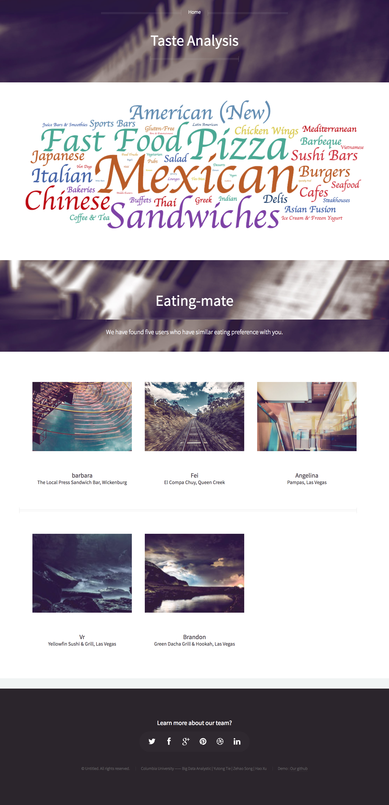
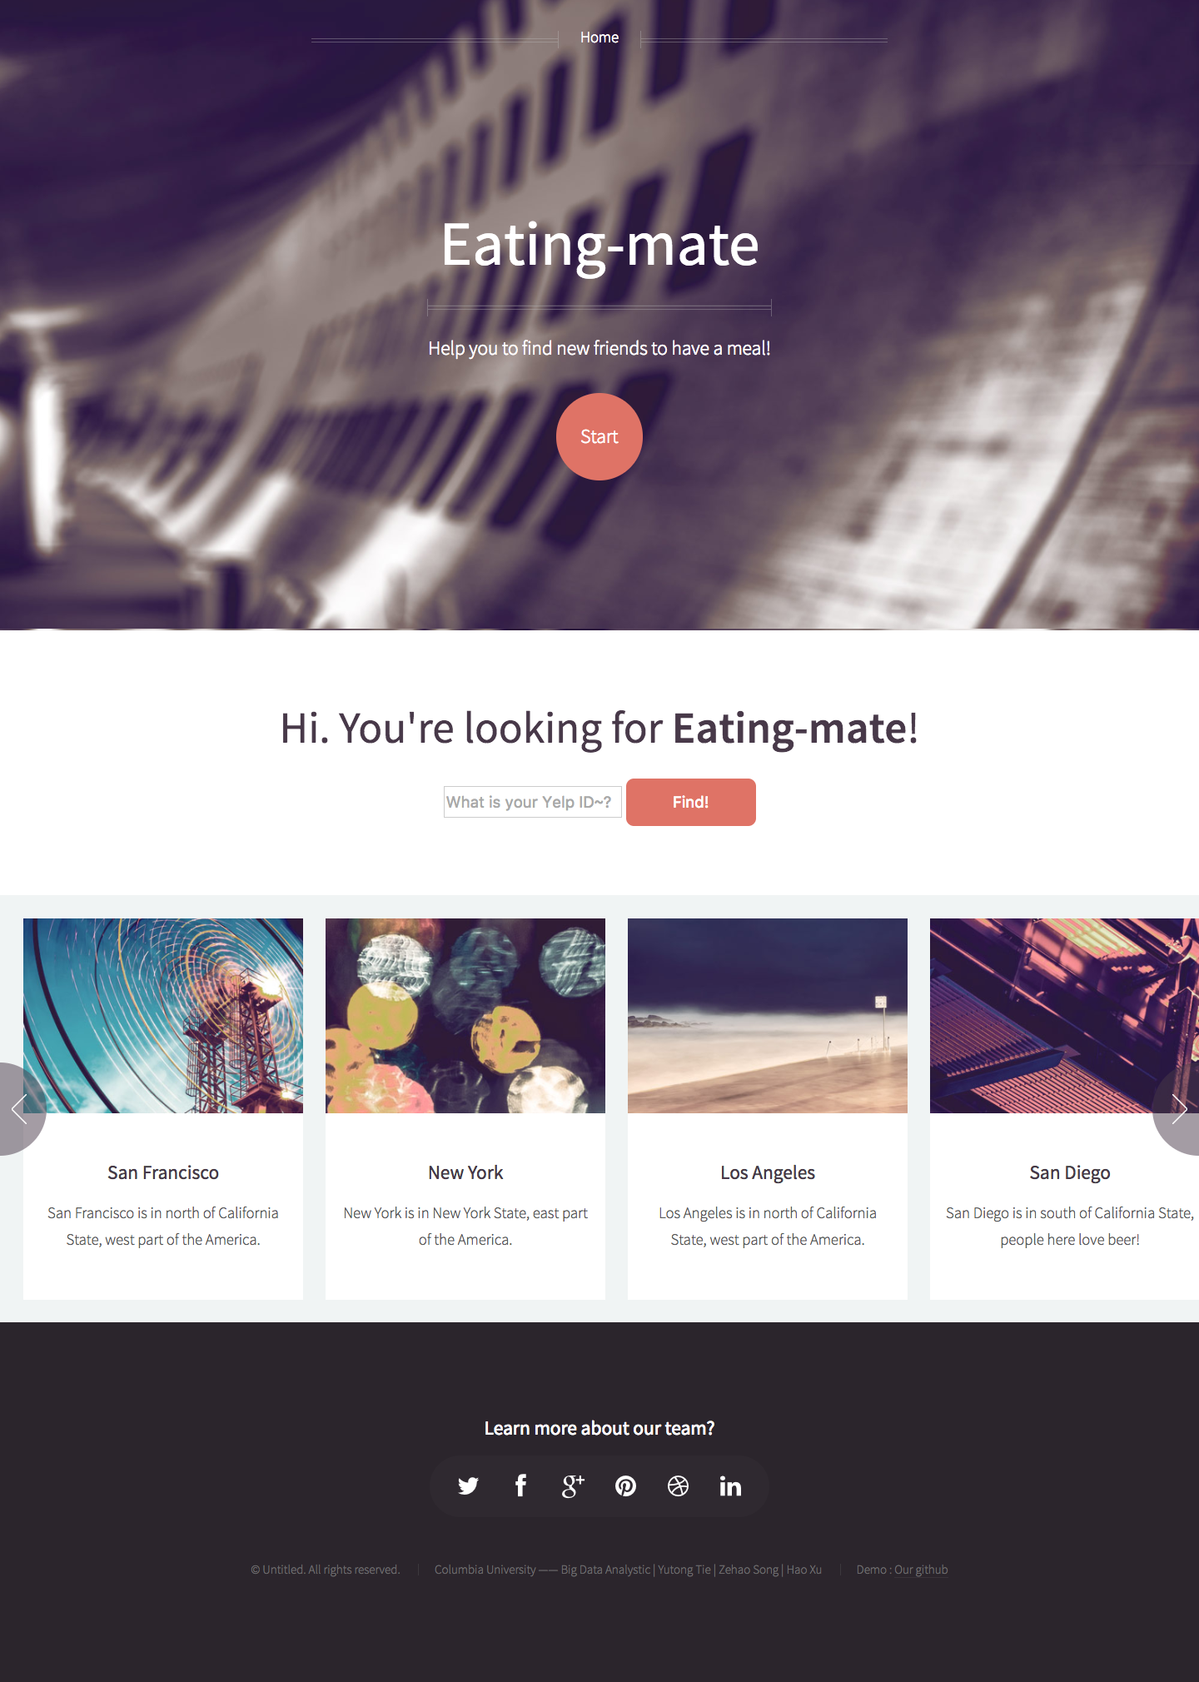
1. Input User Id
2. Click Find

