Slide 1
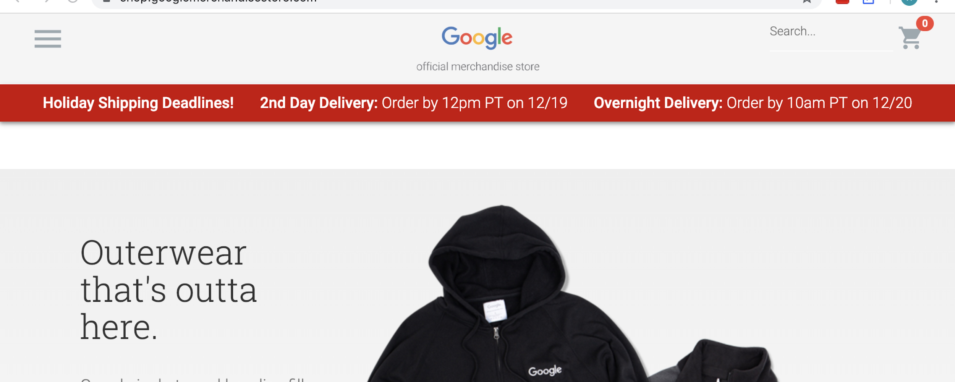
E6893 Big Data Analytics:
Google Merchandise Store Data Analysis
-- Google Analytics Customer Revenue Prediction
Team Members:
Ziyu Gu (zg2305)
Jingwei Han (jh4021)
Xiaoshu Cao (xc2418)

Slide 2
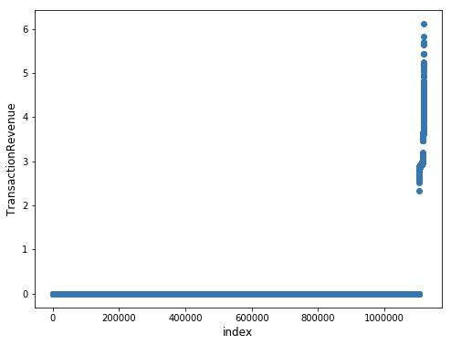
Motivation
For many businesses, only a small percentage of customers produce the most of the revenue. As such, making appropriate promotional strategies can help companies make more profits with less money. Also, appropriate promotional strategies will reduce the unnecessary harassment to customers. In this way, making the customer revenue prediction is quite important for companies.
In the Google Merchandise Store, the 80/20 rule still works.
We can see that in GStore, the ratio is even more extreme: about
2% of customers produce all of the revenue.
In our project, we are going to analyze the GStore customer dataset,
and predict revenue per customer.
Our main goal is to provide more actionable operational changes and
a better use of marketing budgets for those companies who choose to
use data analysis on top of GStore data.

Slide 3
Dataset and Data Cleaning
Dataset:
Our dataset is 24GB, the original version has 12 columns (like: fullVisitorId, channelGrouping , date, device, geoNetwork, etc) with about 1.7 million rows in total. Also, there are multiple columns containing JSON blobs of varying depth, which will create several sub-columns when flattened (If we flatten them totally, it will create more than 200 columns).
Data Cleaning:
Since our data is quite large, we need to split them into 9 pieces, flatten them separately and then concat them.
We delete the constant columns and almost constant columns in the first place.
Also, we explored the correlations between features to help us determine the importance of features.

Slide 4
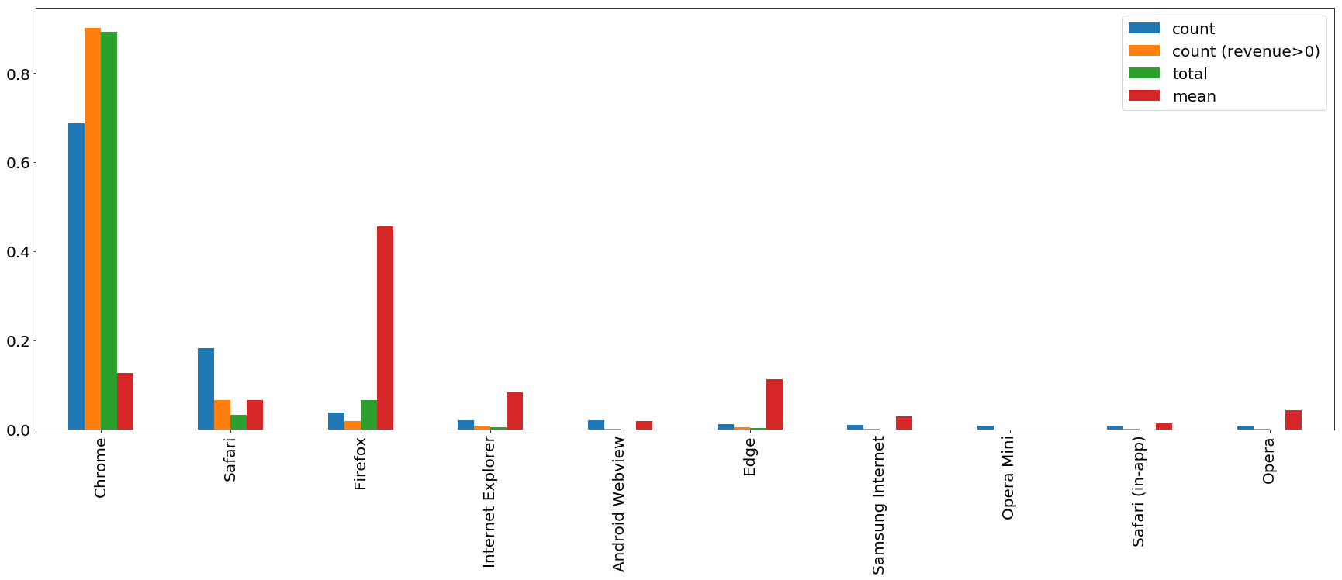
Data Exploring -- ‘device_browser’
For an important feature, we want to explore its relationship to our target variable('totals_transactionRevenue'). So we defined several functions to show: the count of how many times a category show up in a certain feature; many times a category show up when revenue > 0; the total and mean revenue of a category make in a certain feature. (in %)
Like in the feature ‘device_browser’, even though most of the traffic and total revenue comes from Chrome users, the Firefox users always purchase more one time. It seems that GStore should pay more attention to Firefox users to gain more. Also, we can treat all the less used browsers as one type(others) in modeling.

Slide 5
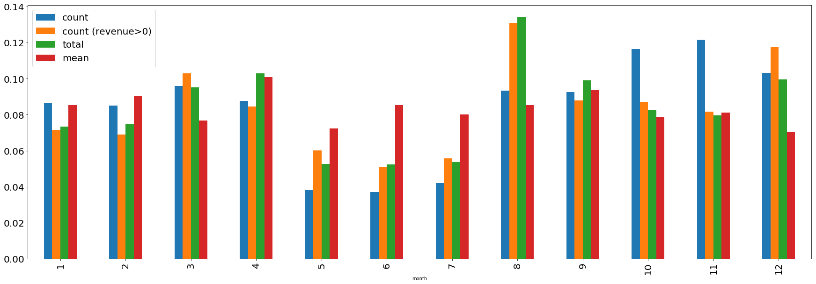
Data Exploring -- ‘date’
In order to make full use of ‘date’ column, we derived 4 new columns from it: ‘year’, ‘month’, ‘week’, ‘weekday’, which is the year, month, specific week during the year(from 1 to 52), and the day of the week(from 0 to 6).
Like the feature ‘month’, we can see that while the mean purchase seems don’t change much, the total revenue in Aug. and Dec. is higher than other months. This may result from the back to college days and Christmas. So we may suggest GStore to do some promotions in Aug. and Dec. to gain more profits.

Slide 6
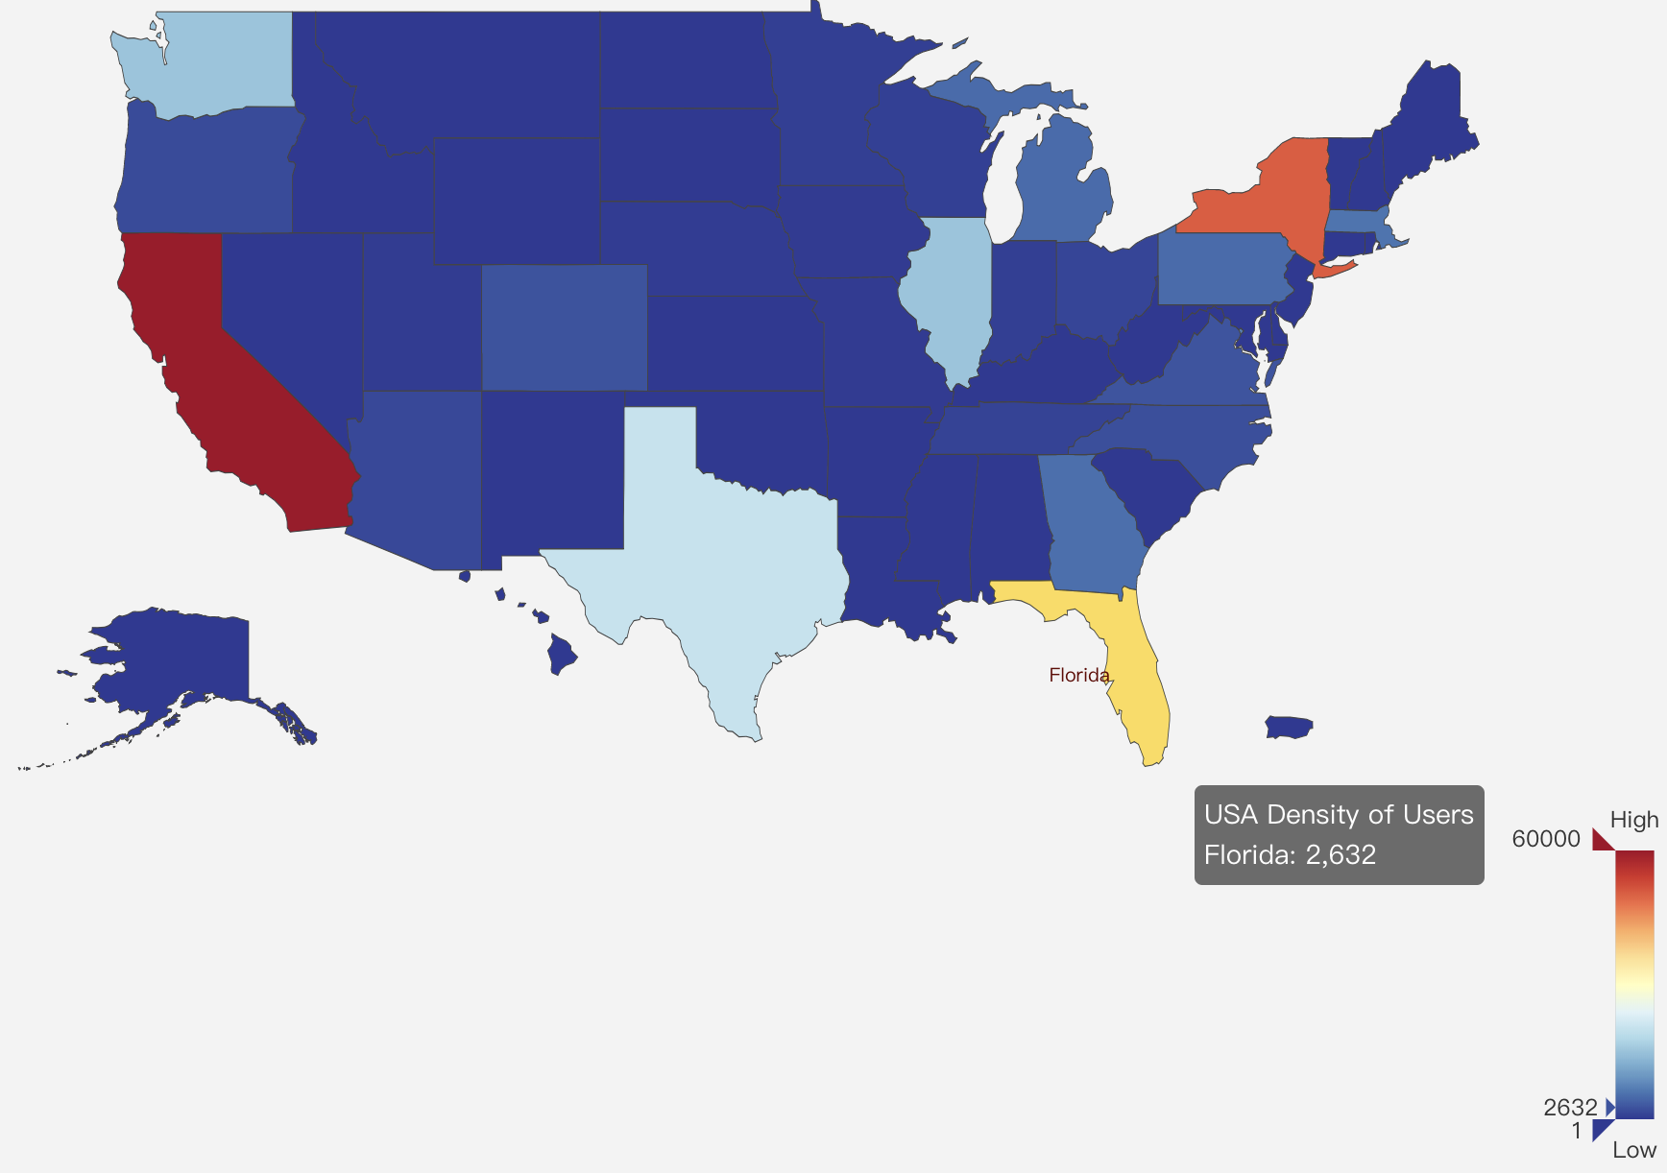
Data visualization:
Density of users in different states in USA:

Slide 7
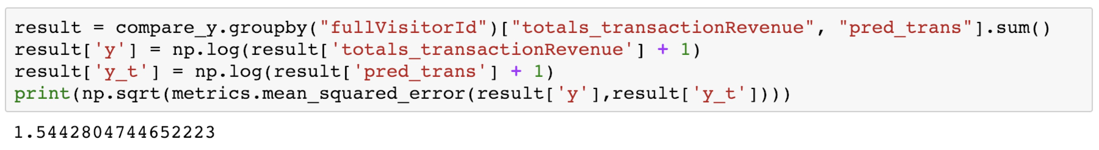
Modeling
Dataset: since our data contains user transactions from August 1st 2016 to April 30th 2018, we use the data before Jan 1st 2018 as training data, and the data after Jan 1st 2018 as test data.
Models: We used linear regression, then implementing LGBM, MLP and CNN model, to achieve better performance
Linear Regression: we imported ‘sklearn’ in python to do linear regression, and here is the results:
the rmse is:

Slide 8
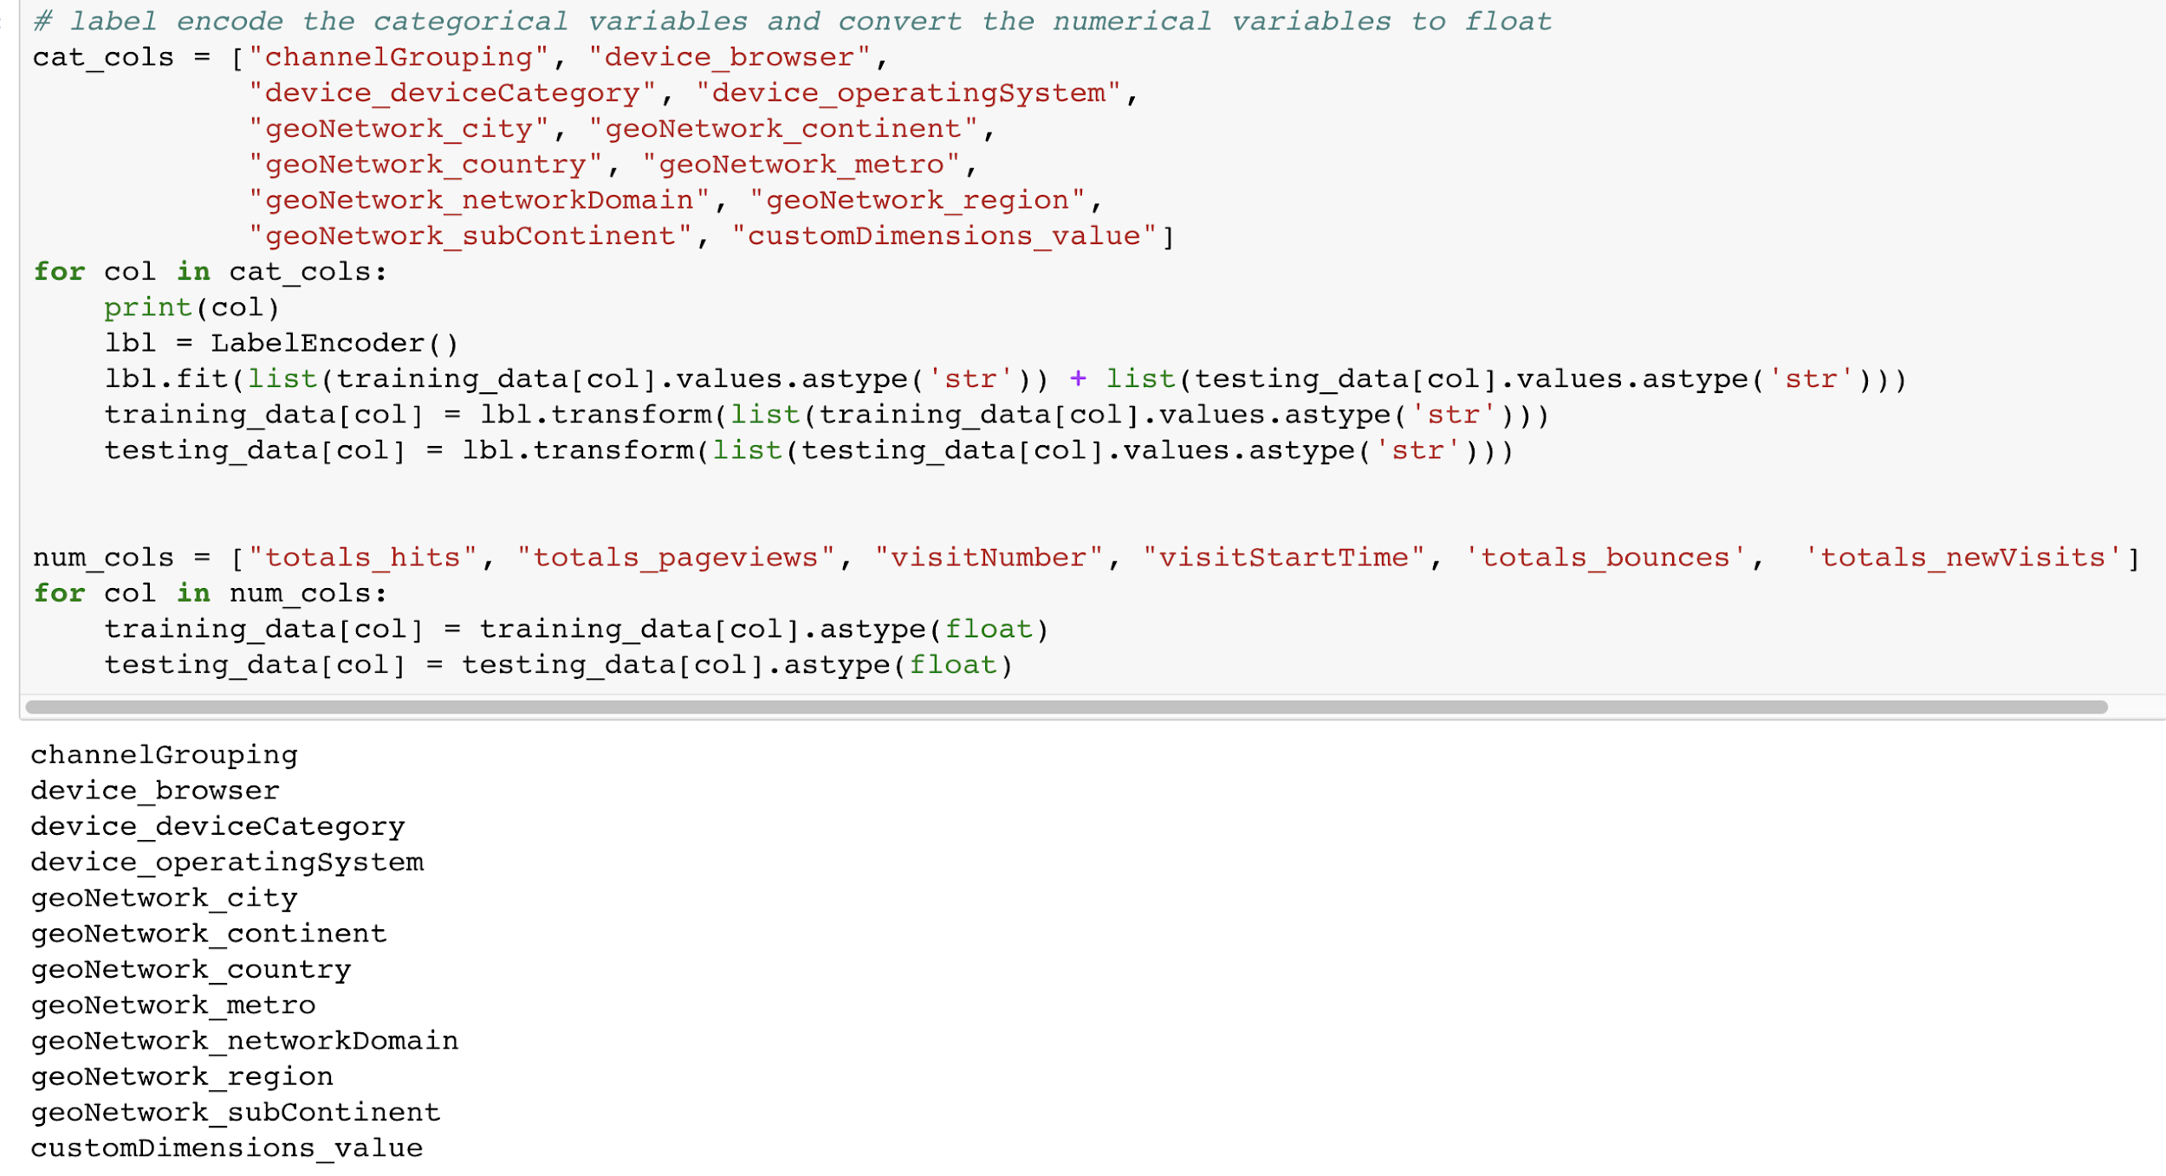
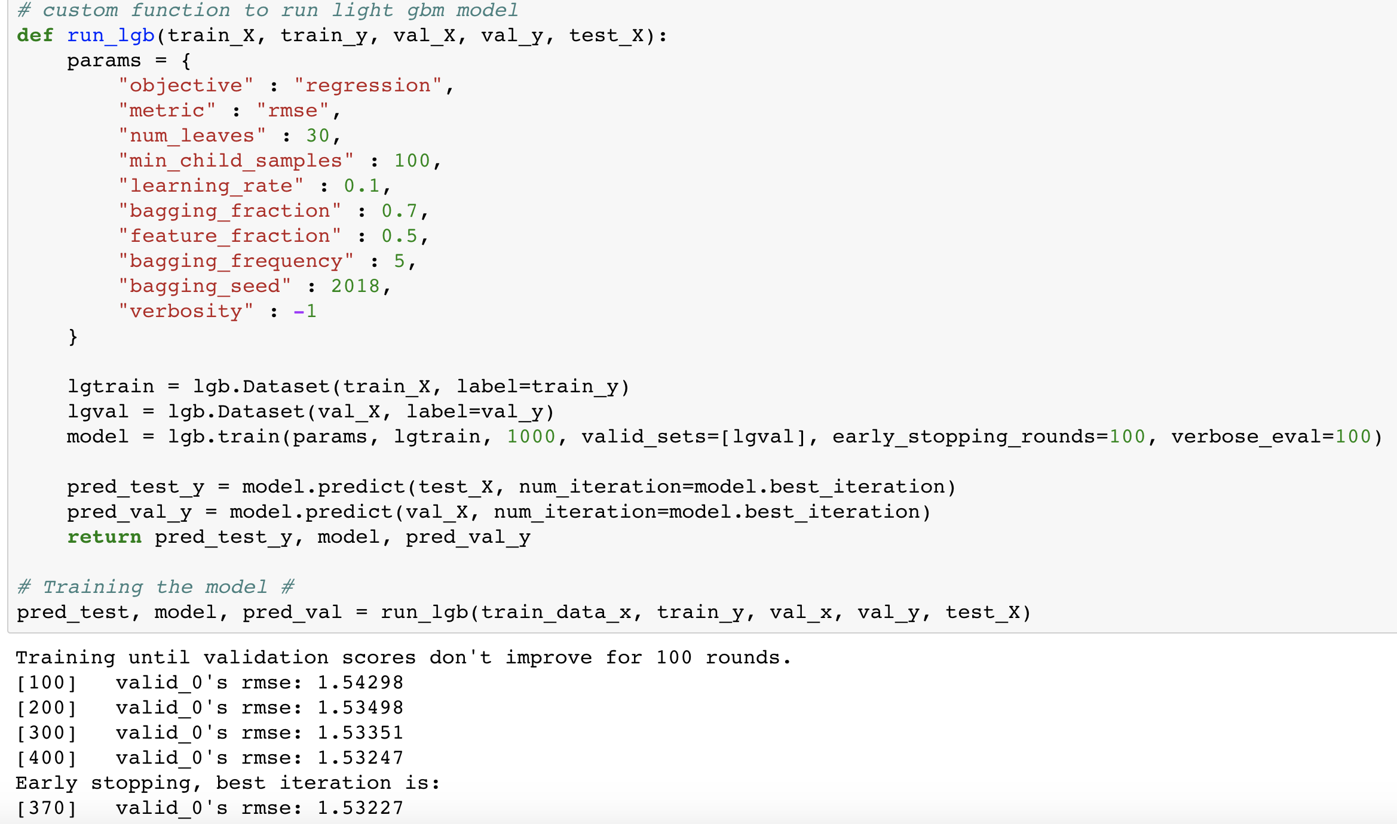
LGBM model:
We apply LGBM model to our dataset to see its performance. We firstly identify category features, encode their values into number and combine them with numeric features to generate training set and run the model.

Slide 9
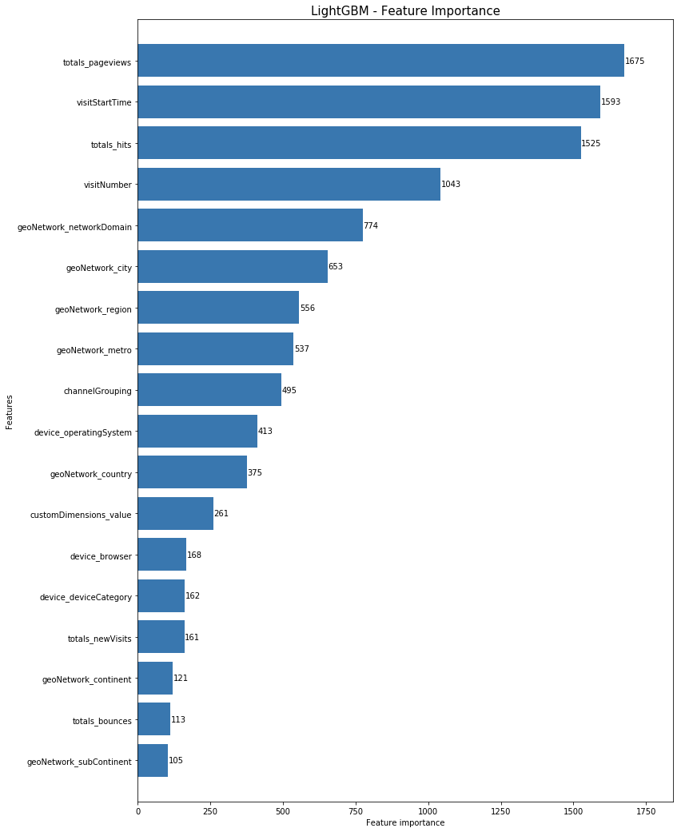
According to LGBM’s feature importance, we can conclude that totals_pageviews, visitStartTime and totals_hits are the top 3 important features influencing on the final revenue.
LGBM model:

Slide 10
MLP and CNN model
Implement MLP and then CNN using Pytorch
Use 80% of the whole data as training set, leaving the rest 20% as testing set.
The aim is to use CNN to extract high-dimensional features, since each column might be related to each other to some degree.
Use label encoder to transform data of string types into numeric types .

Slide 11
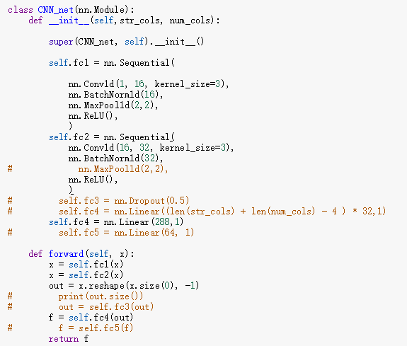
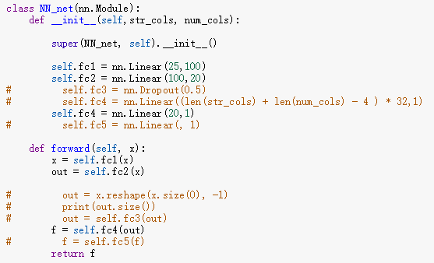
Model Structures:

Slide 12
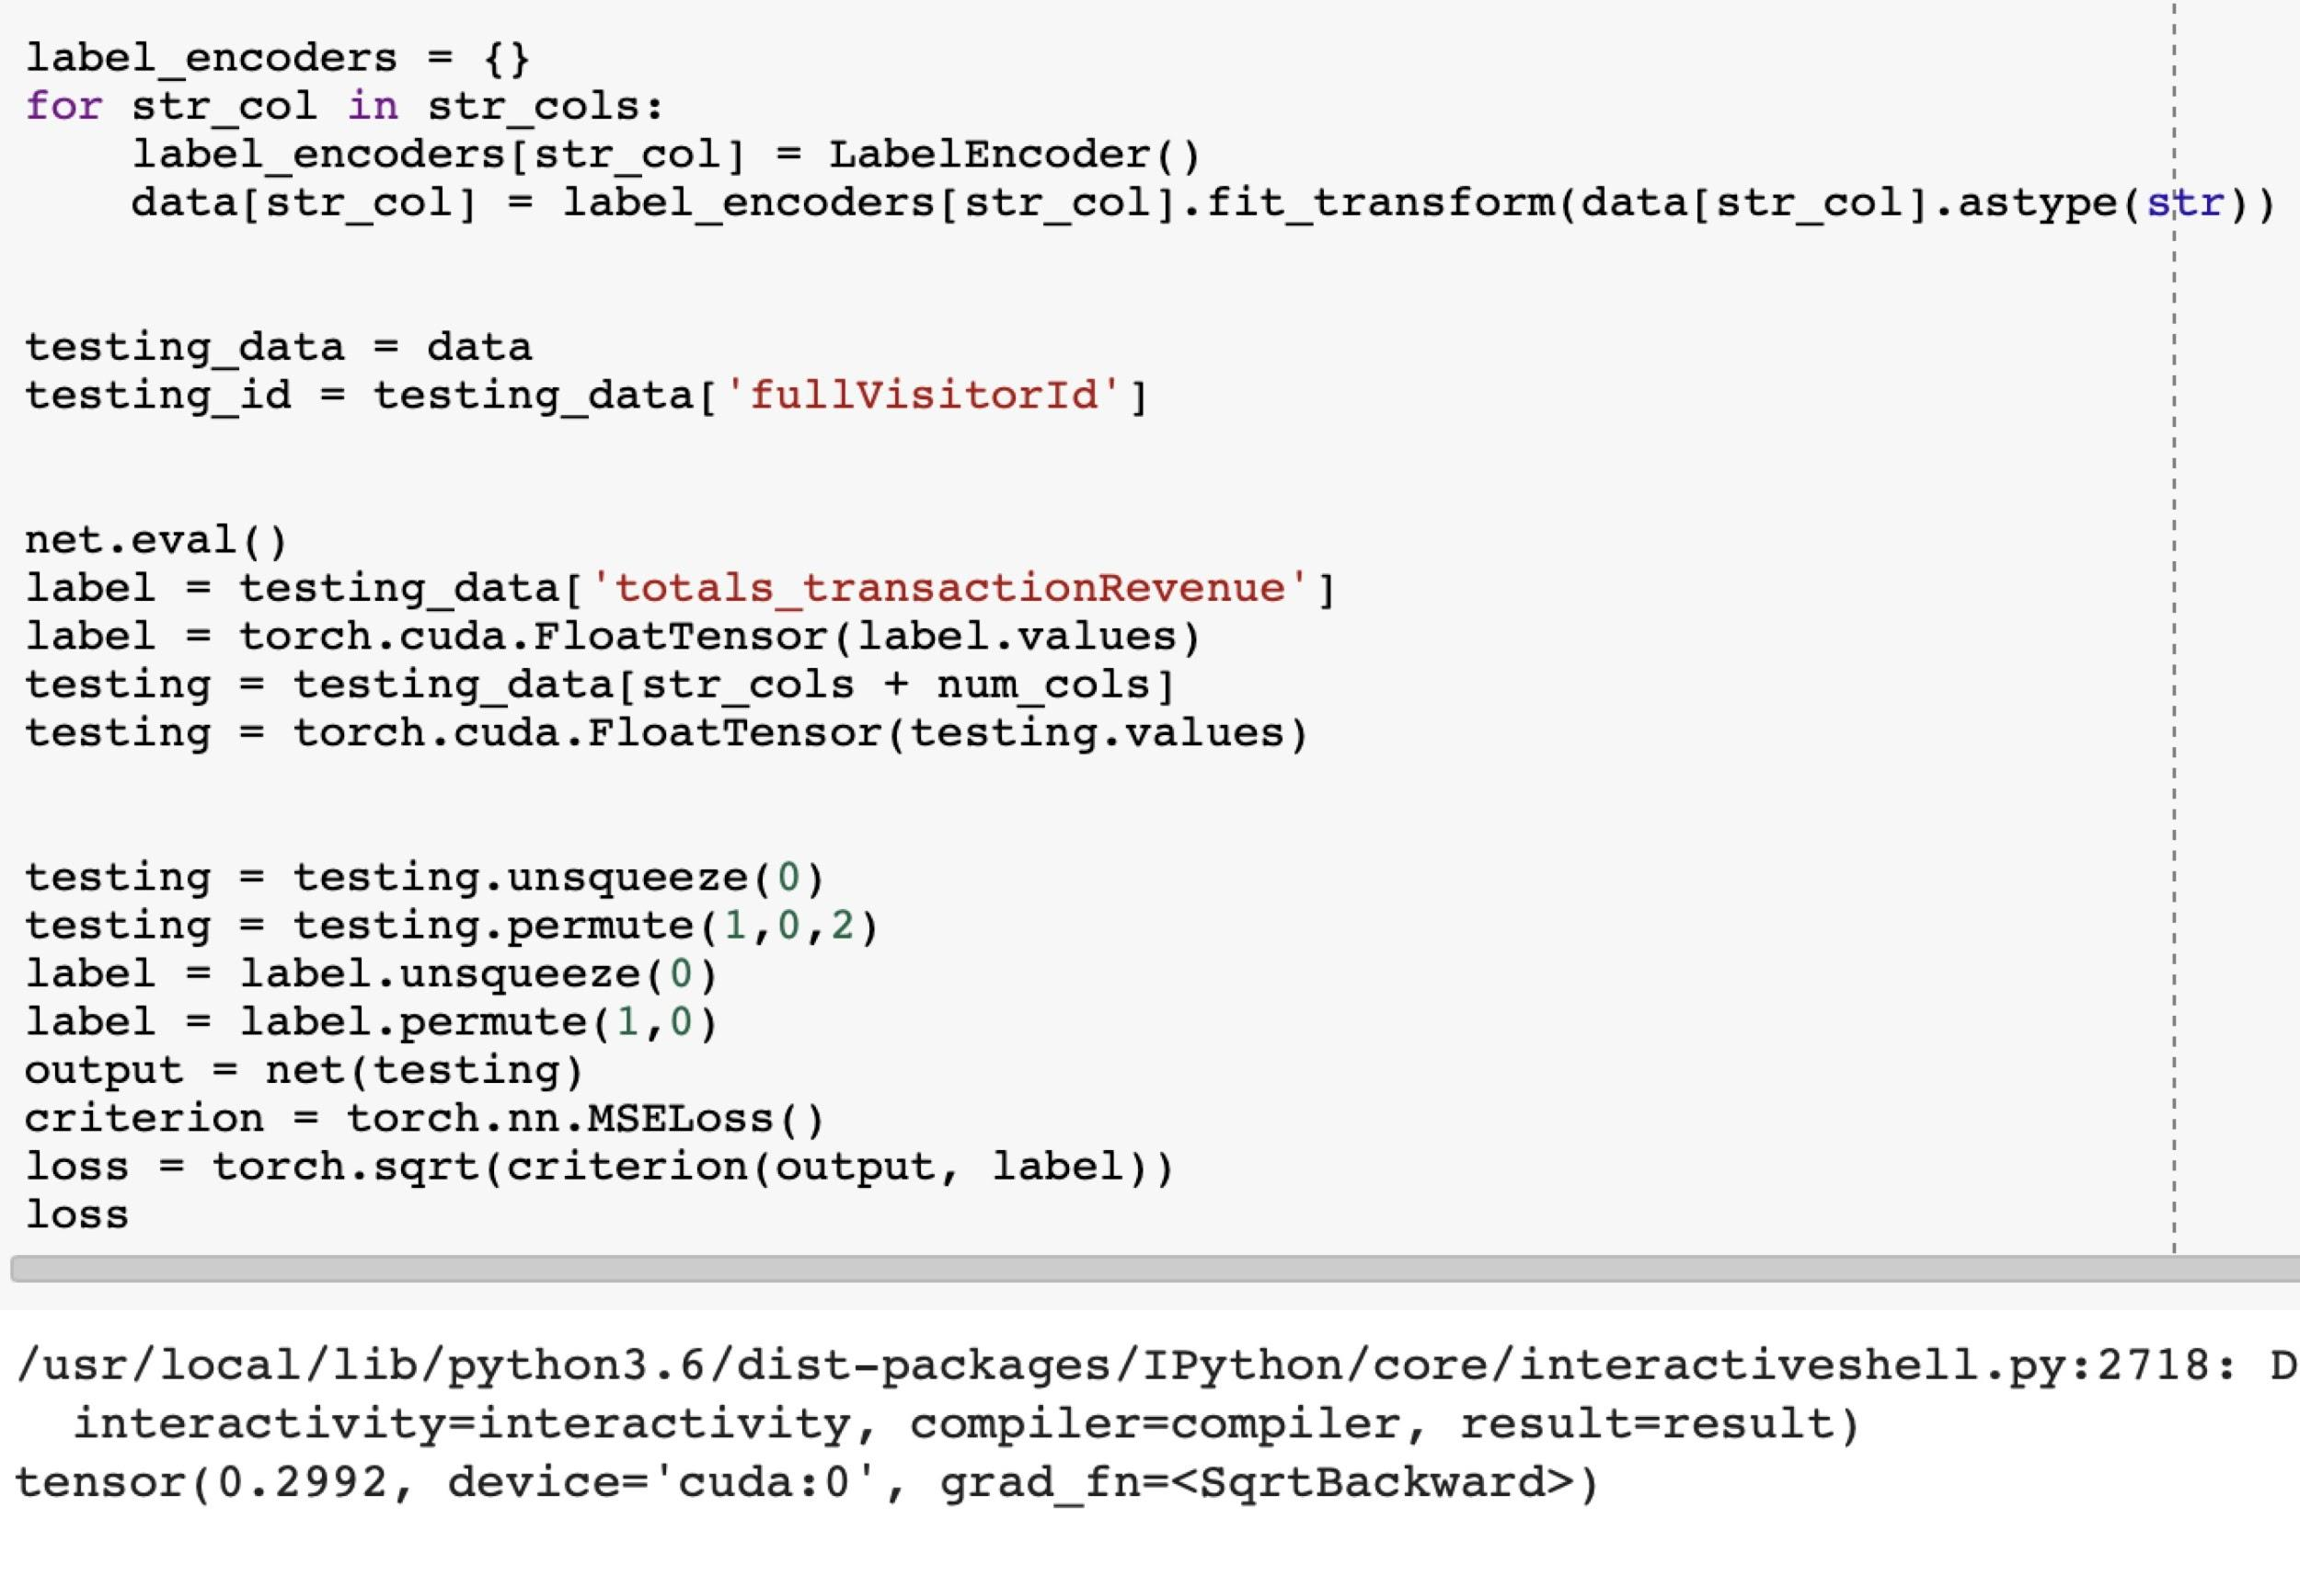
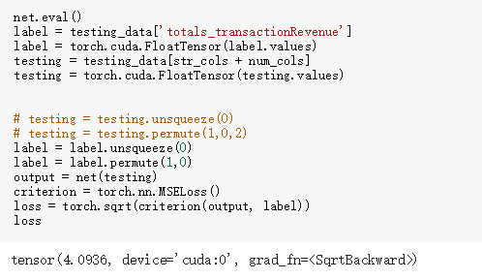
Model Result in RMSE:
CNN : 0.30
NN: 4.0936

Slide 13
Comparison of our models(RMSE):
Models | RMSE
Linear Regression | 1.54
LGBM | 1.53
MLP | 4.09
CNN | 0.30 (can not be tested by the whole dataset due to GPU memory limitation, only tested by 1,000,000 random samples of given dataset)

Slide 14
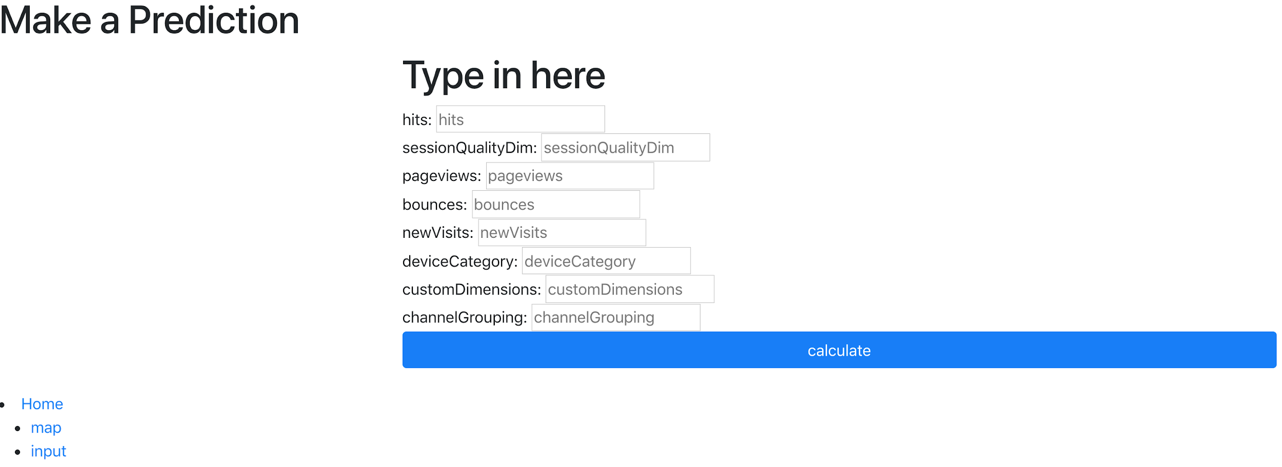
Screenshot: see our prediction system with model:

Slide 15
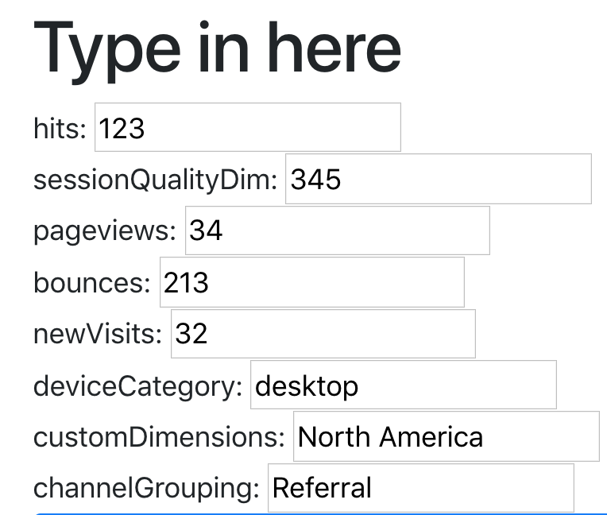
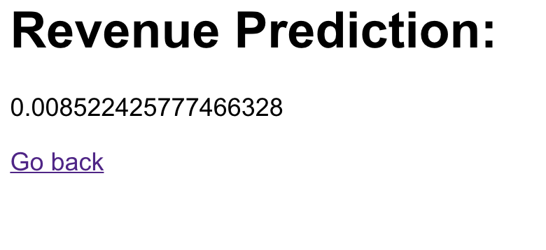
Values typed in and final result (you can try it out following our readme on github!):

