Slide 1

Concurrent Control Using
2-Phase Locking
CS157BLecture 20
Prof. Sin-Min Lee
Department of Computer Science

Slide 2
Locks
The most common way in which access to items is controlled is by “locks.” Lock manager is the part of a DBMS that records, for each item I, whether one or more transactions are reading or writing any part of I. If so, the manager will forbid another transaction from gaining access to I, provided the type of access (read or write) could cause a conflict, such as the duplicate selling of an airline seat.

Slide 3
Locks
As it is typical for only a small subset of the
items to have locks on them at any one time,
the lock manager can store the current locks in
a lock table which consists of records
(<item>,<lock type>,<transaction> The
meaning of record (I,L,T) is that transaction T
has a lock of type L on item I.

Slide 4
Example of locks
Lets consider two transaction T1 and T2. Each accesses an item A, which we assume has an integer value, and adds one to A.
Read A;A:=A+1;Write A;
-----------------------------------------------------------
T1: Read A A:=A+1 Write A
T2: Read A A:=A+1 Write A
-----------------------------------------------------------

Slide 5
Example of locks (cont…)
The most common solution to this problem is to provide a lock on A. Before reading A, a transaction T must lock A, which prevents another transaction from accessing A until T is finished with A. Furthermore, the need for T to set a lock on A prevents T from accessing A if some other transaction is already using A. T must wait until the other transaction unlocks A, which it should do only after finishing with A.

Slide 6
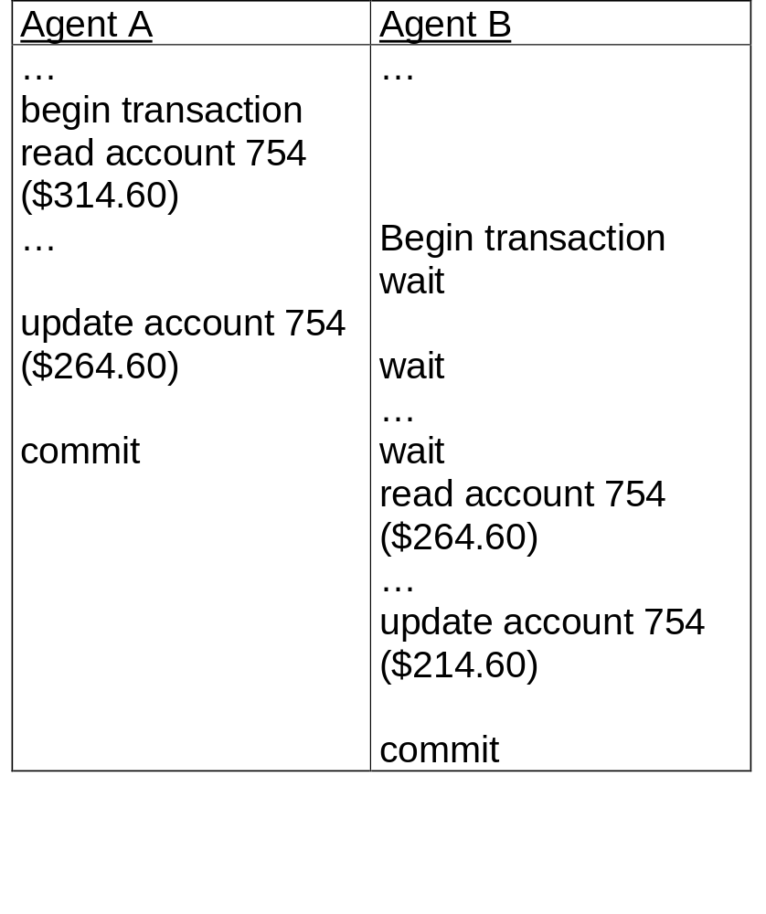
Concurrent access with transaction

Slide 7
Transaction Management with SQL
Transaction support is provided by two SQL statements: COMMIT and ROLLBACK.
A COMMIT statement is reached, in which case all changes are permanently recorded within the database. The COMMIT statement automatically ends the SQL transaction.
A ROLLBACK statement is reached in which case all changes are aborted and the database is rolled back to its previous consistent state.

Slide 8

Serializable schedules
A serializable schedule is a linear arrangement of the database calls from several transactions with the property: the final database state obtained by executing the calls in schedule order is the same as that obtained by running the transactions in some unspecified serial order.

Slide 9
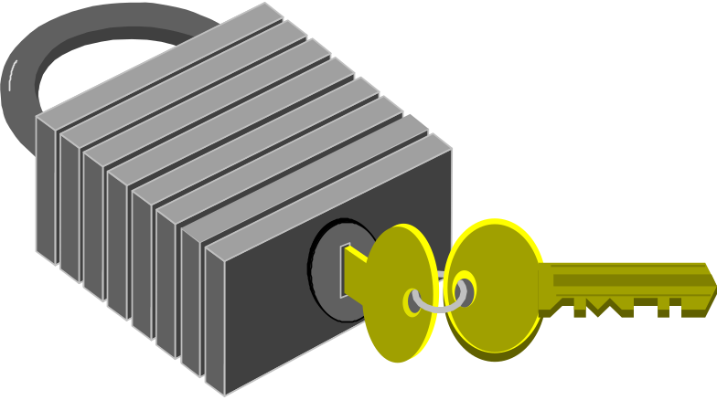
Serializability through lock
A lock is an access priviledge on a database object, which the DBMS grant to a particular transaction.

Slide 10

Shared locks permit reads but no updates
Exclusive locks prevent any current access. A shared lock lets you read an object, but you need an exclusive lock to update it.

Slide 11

Deadlocks
A deadlocks involves a chain of transactions that are cyclically waiting for each other to release a lock. The DBMS detects deadlock with a transaction dependency graph. It resolves the impasse by sacrificing one of the transactions in cycle.

Slide 12
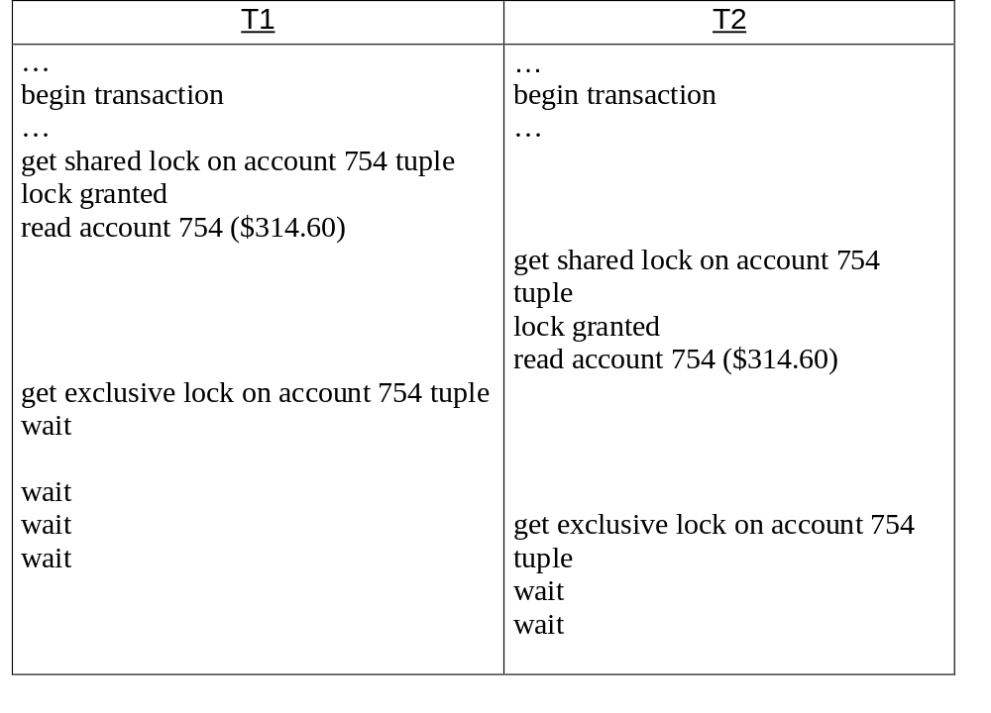
Deadlock and the transaction dependency graph

Slide 13

Dirty-read
The Dirty-read, unrepeatable read, and phantom scenarios, represent inference among competing transactions that can jeopardize serializability. The strict two-phase locking protocol resolves these problems.

Slide 14

Serializability through timestamps
A timestamp is a centrally dispensed number assigned to each transaction in strictly increasing order. The DBMS guarantees that the final result from competing transactions will appear as if the transactions had executed serially in timestamp order.

Slide 15
The log files role in rollbacks and failure recovery
A log file maintains a record of all changes to the database, including the ID of the perpetrating transaction, a before-image of each modified object.
The log file enables recovery from a failure that loses the memory buffer’s contents but doesn’t corrupt the database. You scan the log backward and reverse transactions by rewriting their before-images. You then scan it forward and reverse transactions by rewriting their after-images.

Slide 16

A checkpoint
A checkpoint is a synchronization record placed in the log to note a point when all concluded transactions are safely on disk. It limits the log segment needed to recover from a failure.

Slide 17

Recovery from a backup copy of the database
If a failure corrupts the database, you can reinstate a previous state from a backup copy. If some portion of the log remains intact, you can recover certain transactions that committed subsequent to the backup.

Slide 18

Summary
Database concurrency. More than one agents can access the database.
Database transaction. Database access is serialized by transaction.
Database consistency is maintained by applying locking and timestamping.
Database failure recovery is discussed.

Slide 19
Schedules
Each transaction must specify as its final action either
commit (i.e., complete successfully) or abort (i.e., terminate
and undo all the actions carried out thus far).
Definition: a schedule is a list of actions (reading, writing,
aborting or committing) from a set of transactions, and the
order in which two actions of a transaction T appear in a
schedule must be the same as the order in which they appear
in T.

Slide 20
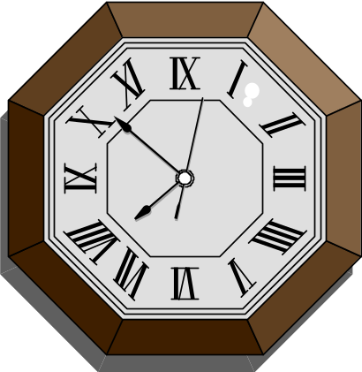
Notation: RT(O) means the action of a transaction T reading
an object O; WT(O) means writing O.
An execution order for transactions T1 and T2:
T1 T2 Intuitively, a schedule
R(A) represents an actual
W(A) R(B) or potential execution
W(B) sequence.
R(C)
W(C)
Figure 1

Slide 21
Consistency
We assume that the database designer has defined some
notion of a consistent database state. After each transaction,
the consistent state of the database should be preserved.
Consistency in three different situations:
1. Serial schedule (no aborted transactions involved)
2. Interleaved execution
3. Schedules involving aborted
transactions

Slide 22
Serializability
Definition: If the actions of different transactions are not
interleaved--that is, transactions are executed from start to
finish, one by one -- we call the schedule a serial schedule.
A serializable schedule over a set S of committed transactions
is a schedule whose effect on any consistent database instance
is guaranteed to be identical to that of some complete serial
schedule over S.
When a complete serial schedule is executed against a
consistent database, the result is also a consistent database

Slide 23
Interleaved Execution
Two actions on the same data object conflict if at least one of
them is a write. Three anomalous situations can occur when
the actions of two transactions T1 and T2 conflict with each
other.
Reading uncommitted data (WR Conflicts):
A transaction T2 could read a database object A that has been modified by another
transaction T1, which has not yet committed.
Unrepeatable reads (RW Conflicts):
A transaction T2 could change the value of an object A that has been read by a
transaction T1, while T1 is still is progress.
Overwriting uncommitted data (WW Conflict):
A transaction T2 could overwrite the value of an object A, which has already been
modified by a transaction T1, while T1 is still in progress.

Slide 24
Schedules Involving Aborted Transactions
To ensure consistency, all actions of aborted transactions are
to be undone.
In a schedule, if we cannot undo all the actions of an aborted
transaction, we say such a schedule is unrecoverable.
A recoverable schedule is one in which transactions commit
only after all transactions whose changes they read commit.
Recoverable schedules are allowed in a DBMS.

Slide 25
Concurrency Control
Strict Two-Phase is the most widely used locking protocol in
concurrency control. This protocol has two rules:
(1) If a transaction T wants to read (respectively, modify) an
object, it first requests a shared (respectively exclusive)
lock on the object.
(2) All locks held by a transaction are released when the
transaction is completed.
Denotation: the action of a transaction T requesting a shared
(respectively, exclusive) lock on object O is
denoted as ST(O) (respectively, XT(O) ).

Slide 26
T1 T2
X(A)
R(A)
W(A)
Figure 2 Schedule Illustrating Strict 2PL
T1 T2 T1 T2
X(A) X(A)
R(A) R(A)
W(A) W(A)
X(B) X(B)
R(B) R(B)
Commit W(B)
X(A) Commit
R(A) X(C)
W(A) R(C)
X(B) W(C)
R(B) Commit
W(B)
Commit Figure 4 Strict 2PL with Interleaved Actions
Figure 3 Strict 2PL with Serial Execution

Slide 27
Precedence Graph
The precedence graph for a schedule S contains:
A node for each committed transaction in S.
A arc from Ti to Tj if an action of Ti precedes and conflicts
with one of Tj’s actions.
The precedence graphs for schedules corresponding to
Figure 2, Figure 3, and Figure 4(respectively (i),(ii), (iii) ):
(i) (ii)
(iii)
T1
T2
T1
T2
T1
T2
T3

Slide 28
(…cont’d) Precedence Graph
A schedule is conflict serializable if and only if its
precedence graph is acyclic.
Strict 2PL ensures that the precedence for any schedule that it allows is acyclic.

Slide 29
Lock Management
The part of the DBMS that keeps track of the locks issued to transactions is call the lock manager. The lock manager
maintains a lock table which is a hash table with data object identifier as the key. The DBMS also maintains a descriptive entry for each transaction in a transaction table. The entry contains a pointer to a list of locks held by transaction.
A lock table entry for an object -- which can be a page,
a record, and so on, depending on the DBMS --
contains the number of transactions currently
holding a lock on the object, the nature of the lock,
and a pointer to a queue of lock requests.

Slide 30
Lock and Unlock Requests
When a transaction needs a lock on an object, it issues a
lock request to the lock manager.
When a transaction aborts or commits, it releases all its
locks.
The implementation of lock and unlock commands must ensure that these are atomic operations.
A transaction holding a heavily used lock may be suspended by the operating system.

Slide 31
Deadlock
Deadlock is a cycle of transactions that are all waiting for another transaction in the cycle to release a lock.
The DBMS must either prevent or detect (and resolve) deadlock situations.
We can prevent deadlock by giving each transaction a priority ( e.g., assign timestamp) and ensuring that lower priority transactions are not allowed to wait for higher priority transactions (or vice-versa).
Detecting and resolving deadlocks as they arise has advantage over taking measures to prevent deadlock, because deadlocks tend to be rare. The lock manager maintains a waits-for graph to detect deadlock cycles.

Slide 32
Performance of Lock-Based Concurrency Control
In prevention-based schemes, the abort mechanism is used preemptively in order to avoid deadlocks. On the other hand, detection-based schemes reduces system throughput.
Deadlocks are relatively infrequent, and detection-based schemes work well in practice. However, if there is a high level of contention for locks, and therefore and increased likelihood of deadlocks, prevention-based schemes could perform better.
Criteria to choose deadlock victim: the one with the fewest locks, the one has done the least work, the one that is farthest from completion, and so on.

Slide 33

Specialized Locking Techniques
Dynamic Database:
The collection of database object is not fixed, but can grow and shrink through the insertion and deletion of objects.
Locking pages at a given time does not prevent new “phantom” records from being added to other pages. If new items are added to the database, conflict serialization does not guarantee serialization.

Slide 34

Concurrency Control in Tree Index
1. The higher levels of the tree only serve to direct searches, and all the ‘real’ data is in the leaf levels.
2. For inserts, a node must be locked (in exclusive mode, of course) only if a split can propagate up to it from the modified leaf. (A 2-3 tree is used here.)

Slide 35
Locks on Objects Containing Other Objects
A database contains a set of files, each file contains a set of
pages, and each page contains a set of records. The ‘contain’
relationship is hierarchical. It can be thought of as a tree of
objects, where each node contains all its children. A locks on
a node locks that node and all its descendants.

Slide 36
Concurrency Control Without Locking
Optimistic Concurrency Control
Timestamp-Based Concurrency Control
Multi-version Concurrency Control

Slide 37
Why is concurrency control needed?
Without it, update anomalies can occur that corrupt the database and give apps incorrect results.
E.g.
  1. W(T1,x)
  2. W(T2,x)
  3. R(T1,x) (problem: T1 should see same value
  of x it wrote in step 1, but it doesn't)

Slide 38
Concurrency Control Goals
Goals of a concurrency control algorithm are to:
  make sure that the actual sequence of database R, W operations is equivalent to some serial schedule of operations
  allow a lot of concurrency so higher throughput and better average response time is achieved
    e.g. "run transactions serially" is a dumb but correct CC algorithm.

Slide 39
Introduction
Every record must be locked by a XACT before the XACT touches it
Lock modes: R, W
HELD
Requested R W
mode
R OK Wait
W Wait Wait

Slide 40
Terminology
Read (R) mode sometimes called Share (S) mode
Write (W) mode sometimes called Exclusive (X) mode

Slide 41
2-phase locking protocol
lock every item you touch
once you release your first lock, you can’t acquire any more locks

Slide 42
2-Phase Locking Provides Serializability
Theorem: 2Φ locking implies transactions are serializable
problem with 2Φ locking: can require cascaded rollback (impossible to do in practice)
T1 T2
Φ1 Φ2 T1 rolled back- would
# of require T2 to roll back
locks held too!!
T1: release X lock on Q T2 gets X lock on Q here, then updates
Q & commits

Slide 43
Solution to Cascaded Rollbacks Problem
Modify 2 Φ locking protocol so that transactions hold all their locks until after they commit.
Φ2
# locks Φ1
held
begin trans acquire hold all commit trans release all locks
locks locks
time

Slide 44
Testing a schedule for serializability
for each operation o from first to last do:
  make a node for the transaction of o if one doesn't exist yet
  label transaction of o with name of o and the mode it touched o (R, W)
  When labeling a transaction T with a new object/mode for o, make an edge pointing from T to every other transaction that must come before T based on R/W, W/R, or W/W conflicts on o.
when done, if graph contains cycles, then schedule is not serializable

Slide 45
Sample schedules
R(T1,x), R(T1,y), W(T2,y), R(T1,y)
Exercise:
R(T1,x), R(T2,x), W(T1,y), R(T2,y)

Slide 46
Graph based protocols
Non 2 Φ locking but still yields serializability
idea: impose a partial order (directed acyclic graph) on data items
transactions access items from the root of this partial order.
X
Y
Z
Q
R
S
T
U

Slide 47
Graph based protocols
Rules:
must access data starting from the root
1st lock for Ti may be on any data item
subsequently, a data item X can only be locked by Ti if Ti has locked the parent of X
Ti can release a lock any time
Ti cannot relock an item once it has unlocked it.
Main application:
used for locking in B+trees, to allow high-concurrency update access; otherwise, root page lock is a bottleneck

Slide 48
Deadlock
2 Φ locking can cause deadlock
solutions:
  periodically
    build wait for graph
    while (cycles in wait-for graph) begin
      pitch a victim
      roll it back
    end
  or timeout XACTS if they wait too long

Slide 49
Deadlocks(cntd)
Deadlock doesn’t waste resources
deadlock should be rare (or else, you have to redesign apps)
eg.: T1 T2 wait-for
R(X) graph
R(X)
W(X) suspended
W(X) deadlock!
T1
T2
time

Slide 50
Summary
Why use CC?
  prevent DB from becoming alphabet soup
  but still allow high throughput and good response time
Two phase locking concurrency control
Real world: only release locks after commit
Graph-based locking protocols (tree or DAG locking); application: B+trees
Deadlock

