Slide 1
Concurrency Control
Amol Deshpande
CMSC424

Slide 2
Approach, Assumptions etc..
Approach
  Guarantee conflict-serializability by allowing certain types of concurrency
    Lock-based
Assumptions:
  Durability is not a problem
    So no crashes
    Though transactions may still abort
Goal:
  Serializability
  Minimize the bad effect of aborts (cascade-less schedules only)

Slide 3
Lock-based Protocols
A transaction must get a lock before operating on the data
Two types of locks:
  Shared (S) locks (also called read locks)
    Obtained if we want to only read an item
  Exclusive (X) locks (also called write locks)
    Obtained for updating a data item

Slide 4
Lock instructions
New instructions
  - lock-S: shared lock request
  - lock-X: exclusive lock request
  - unlock: release previously held lock
Example schedule:
T1
T2
read(B)
B ←B-50
write(B)
read(A)
A ←A + 50
write(A)
read(A)
read(B)
display(A+B)

Slide 5
Lock instructions
New instructions
  - lock-S: shared lock request
  - lock-X: exclusive lock request
  - unlock: release previously held lock
Example schedule:
T1
T2
lock-X(B)
read(B)
B ←B-50
write(B)
unlock(B)
lock-X(A)
read(A)
A ←A + 50
write(A)
unlock(A)
lock-S(A)
read(A)
unlock(A)
lock-S(B)
read(B)
unlock(B)
display(A+B)

Slide 6
Lock-based Protocols
Lock requests are made to the concurrency control manager
  It decides whether to grant a lock request
T1 asks for a lock on data item A, and T2 currently has a lock on it ?
  Depends
If compatible, grant the lock, otherwise T1 waits in a queue.
T2 lock type | T1 lock type | Should allow ?
Shared | Shared | YES
Shared | Exclusive | NO
Exclusive | - | NO

Slide 7
Lock-based Protocols
How do we actually use this to guarantee serializability/recoverability ?
  Not enough just to take locks when you need to read/write something
T1
lock-X(B)
read(B)
B ←B-50
write(B)
unlock(B)
lock-X(A)
read(A)
A ←A + 50
write(A)
unlock(A)
lock-X(A), lock-X(B)
A = A-50
B = B+50
unlock(A), unlock(B)

Slide 8
2-Phase Locking Protocol (2PL)
Phase 1: Growing phase
  Transaction may obtain locks
  But may not release them
Phase 2: Shrinking phase
  Transaction may only release locks
Can be shown that this achieves conflict-serializability
  lock-point: the time at which a transaction acquired last lock
  if lock-point(T1) < lock-point(T2), there can’t be an edge from T2 to T1 in the precedence graph
T1
lock-X(B)
read(B)
B ←B-50
write(B)
unlock(B)
lock-X(A)
read(A)
A ←A + 50
write(A)
unlock(A)

Slide 9

2 Phase Locking
Example: T1 in 2PL
T1
lock-X(B) read(B) B ← B - 50 write(B) lock-X(A) read(A) A ← A - 50 write(A) unlock(B) unlock(A)
Growing phase
Shrinking phase

Slide 10
2 Phase Locking
Guarantees conflict-serializability, but not cascade-less recoverability
T1 | T2 | T3
lock-X(A), lock-S(B) read(A) read(B) write(A) unlock(A), unlock(B) <xction fails> | lock-X(A) read(A) write(A) unlock(A) Commit | lock-S(A) read(A) Commit

Slide 11
2 Phase Locking
Guarantees conflict-serializability, but not cascade-less recoverability
Guaranteeing just recoverability:
  If T2 reads a dirty data of T1 (ie, T1 has not committed), then T2 can’t commit unless T1 either commits or aborts
  If T1 commits, T2 can proceed with committing
  If T1 aborts, T2 must abort
    So cascades still happen

Slide 12
Strict 2PL
Release exclusive locks only at the very end, just before commit or abort
T1 | T2 | T3
lock-X(A), lock-S(B) read(A) read(B) write(A) unlock(A), unlock(B) <xction fails> | lock-X(A) read(A) write(A) unlock(A) Commit | lock-S(A) read(A) Commit
Strict 2PL
will not
allow that
Works. Guarantees cascade-less and recoverable schedules.

Slide 13
Strict 2PL
Release exclusive locks only at the very end, just before commit or abort
  Read locks are not important
Rigorous 2PL: Release both exclusive and read locks only at the very end
  The serializability order === the commit order
  More intuitive behavior for the users
    No difference for the system

Slide 14
Strict 2PL
Lock conversion:
  Transaction might not be sure what it needs a write lock on
  Start with a S lock
  Upgrade to an X lock later if needed
  Doesn’t change any of the other properties of the protocol

Slide 15
Implementation of Locking
A separate process, or a separate module
Uses a lock table to keep track of currently assigned locks and the requests for locks
  Read up in the book

Slide 16
Recap
Concurrency Control Scheme
  A way to guarantee serializability, recoverability etc
Lock-based protocols
  Use locks to prevent multiple transactions accessing the same data items
2 Phase Locking
  Locks acquired during growing phase, released during shrinking phase
Strict 2PL, Rigorous 2PL

Slide 17
More Locking Issues: Deadlocks
No xction proceeds:
Deadlock
- T1 waits for T2 to unlock A
- T2 waits for T1 to unlock B
T1 | T2
lock-X(B) read(B) B ← B-50 write(B) lock-X(A) | lock-S(A) read(A) lock-S(B)
Rollback transactions
Can be costly...

Slide 18
2PL and Deadlocks
2PL does not prevent deadlock
  Strict doesn’t either
> 2 xctions involved?
- Rollbacks expensive
T1 | T2
lock-X(B) read(B) B ← B-50 write(B) lock-X(A) | lock-S(A) read(A) lock-S(B)

Slide 19
Preventing deadlocks
Solution 1: A transaction must acquire all locks before it begins
  Not acceptable in most cases
Solution 2: A transaction must acquire locks in a particular order over the data items
  Also called graph-based protocols
Solution 3: Use time-stamps; say T1 is older than T2
  wait-die scheme: T1 will wait for T2. T2 will not wait for T1; instead it will abort and restart
  wound-wait scheme: T1 will wound T2 (force it to abort) if it needs a lock that T2 currently has; T2 will wait for T1.
Solution 4: Timeout based
  Transaction waits a certain time for a lock; aborts if it doesn’t get it by then

Slide 20
Deadlock detection and recovery
Instead of trying to prevent deadlocks, let them happen and deal with them if they happen
How do you detect a deadlock?
  Wait-for graph
  Directed edge from Ti to Tj
    Ti waiting for Tj
T2
T4
T1
T1 | T2 | T3 | T4
S(V) | X(V) S(W) | X(Z) S(V) | X(W)
T3
Suppose T4 requests lock-S(Z)....

Slide 21
Dealing with Deadlocks
Deadlock detected, now what ?
  Will need to abort some transaction
  Prefer to abort the one with the minimum work done so far
  Possibility of starvation
    If a transaction is aborted too many times, it may be given priority in continueing

Slide 22
Locking granularity
Locking granularity
  What are we taking locks on ? Tables, tuples, attributes ?
Coarse granularity
  e.g. take locks on tables
  less overhead (the number of tables is not that high)
  very low concurrency
Fine granularity
  e.g. take locks on tuples
  much higher overhead
  much higher concurrency
  What if I want to lock 90% of the tuples of a table ?
    Prefer to lock the whole table in that case

Slide 23
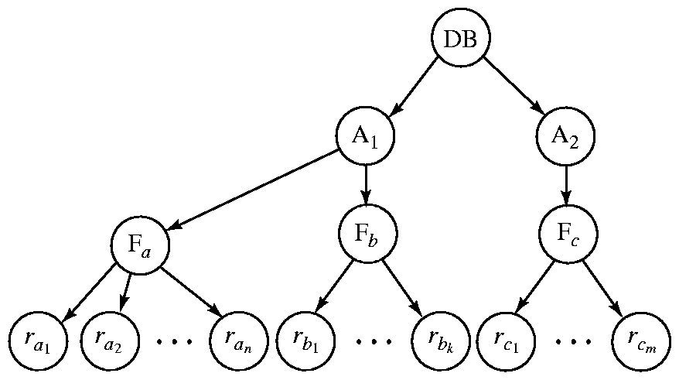
Granularity Hierarchy
The highest level in the example hierarchy is the entire database.
The levels below are of type area, file or relation and record in that order.
Can lock at any level in the hierarchy

Slide 24
Granularity Hierarchy
New lock mode, called intentional locks
  Declare an intention to lock parts of the subtree below a node
  IS: intention shared
    The lower levels below may be locked in the shared mode
  IX: intention exclusive
  SIX: shared and intention-exclusive
    The entire subtree is locked in the shared mode, but I might also want to get exclusive locks on the nodes below
Protocol:
  If you want to acquire a lock on a data item, all the ancestors must be locked as well, at least in the intentional mode
  So you always start at the top root node

Slide 25
Granularity Hierarchy
(1) Want to lock F_a in shared mode, DB and A1 must be locked in at least IS mode (but IX, SIX, S, X are okay too)
(2) Want to lock rc1 in exclusive mode, DB, A2,Fc must be locked in at least IX mode (SIX, X are okay too)

Slide 26
Granularity Hierarchy
Parent Child can be
locked in locked in
IS
IX
S
SIX
X
P
IS, S
IS, S, IX, X, SIX
[S, IS] not necessary
X, IX, [SIX]
none
C

Slide 27
Compatibility Matrix with
Intention Lock Modes
The compatibility matrix (which locks can be present simultaneously on the same data item) for all lock modes is:
requestor
IS
IX
S
S IX
X
IS
✓
✓
✓
✓
×
IX
✓
✓
×
×
×
S
✓
×
✓
×
×
holder
S IX
✓
×
×
×
×
X
×
×
×
×
×

Slide 28
Example
T1(IS)
, T2(IX)
R1
t1
t4
t2
t3
T1(S)
T2(X)

Slide 29
Examples
T1(IX)
R
T1(IS)
R
T1(IX)
t1
t2
t3
t4
T1(S)
t1
t2
t3
t4
T1(X)
f2.1
f2.2
f4.2
f4.2
f2.1
f2.2
f4.2
f4.2
T1(SIX)
Can T2 access object f2.2 in X mode?
What locks will T2 get?
R
T1(IX)
t1
t2
t3
t4
T1(X)
f2.1
f2.2
f4.2
f4.2

Slide 30
Examples
T1 scans R, and updates a few tuples:
  T1 gets an SIX lock on R, then repeatedly gets an S lock on tuples of R, and occasionally upgrades to X on the tuples.
T2 uses an index to read only part of R:
  T2 gets an IS lock on R, and repeatedly gets an S lock on tuples of R.
T3 reads all of R:
  T3 gets an S lock on R.
  OR, T3 could behave like T2; can
  use lock escalation to decide which.
--
IS
IX
S
X
--
√
√
√
√
√
IS
√
√
√
√
IX
√
√
√
S
√
√
√
X
√

Slide 31
Recap, Next….
Deadlocks
  Detection, prevention, recovery
Locking granularity
  Arranged in a hierarchy
  Intentional locks
Next…
  Brief discussion of some other concurrency schemes

Slide 32
Other CC Schemes
Time-stamp based
  Transactions are issued time-stamps when they enter the system
  The time-stamps determine the serializability order
  So if T1 entered before T2, then T1 should be before T2 in the serializability order
  Say timestamp(T1) < timestamp(T2)
  If T1 wants to read data item A
    If any transaction with larger time-stamp wrote that data item, then this operation is not permitted, and T1 is aborted
  If T1 wants to write data item A
    If a transaction with larger time-stamp already read that data item or written it, then the write is rejected and T1 is aborted
  Aborted transaction are restarted with a new timestamp
    Possibility of starvation

Slide 33
Other CC Schemes
Time-stamp based
  Example
T₁
T₂
T₃
T₄
T₅
read(X)
read(Y)
read(Y)
write(Y)
write(Z)
read(Z)
read(X)
abort
read(X)
write(Z)
abort
write(Y)
write(Z)

Slide 34
Other CC Schemes
Time-stamp based
  As discussed here, has too many problems
    Starvation
    Non-recoverable
    Cascading rollbacks required
  Most can be solved fairly easily
    Read up
  Remember: We can always put more and more restrictions on what the transactions can do to ensure these things
    The goal is to find the minimal set of restrictions to as to not hinder concurrency

Slide 35
Other CC Schemes
Optimistic concurrency control
  Also called validation-based
  Intuition
    Let the transactions execute as they wish
    At the very end when they are about to commit, check if there might be any problems/conflicts etc
      If no, let it commit
      If yes, abort and restart
  Optimistic: The hope is that there won’t be too many problems/aborts
Rarely used any more

Slide 36
The “Phantom” problem
An interesting problem that comes up for dynamic databases
Schema: accounts(branchname, acct_no, balance, …)
Transaction 1: Find the maximum balance in each branch
Transaction 2: Insert <“branch1”, acctX, $10000000>, and delete <“branch2”, acctY, $100000000>.
  Both maximum entries in the corresponding branches
Execution sequence:
  T1 locks all tuples corresponding to “branch1”, finds the maximum balance and releases the locks
  T2 does its two insert/deletes
  T1 locks all tuples corresponding to “branch2”, finds the maximum balance and releases the locks
Not serializable

