Slide 1

E6895 Advanced Big Data Analytics:
Gene and Protein Analysis for Cancer Research: Pathway and Network Analysis
Team Members: Ziyi Liu (zl2690), Boyan Rong (br2566)
EECS6895 Advanced Big Data Analytics

Slide 2
Outline
Data Loading & Preprocessing
General Analysis & Visualization
K-means Clustering & t-SNE
Random Forests
Correlation Matrix (Interactive)
General undirected Graph
Positive force-directed graph
EECS6895 Advanced Big Data Analytics
Notes:
This is the outline of our presentation.
As our visualization are realized through webpage, i.e. html files which are linked to google platform, our results of visualization parts may not be presented in this ppt file.

Slide 3
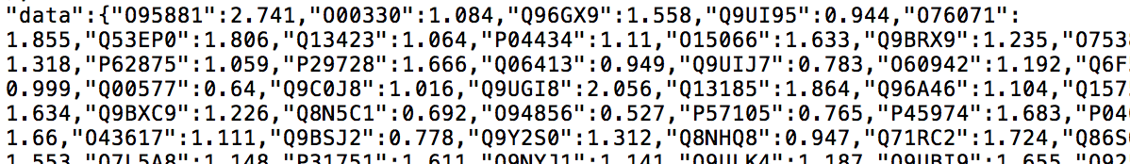
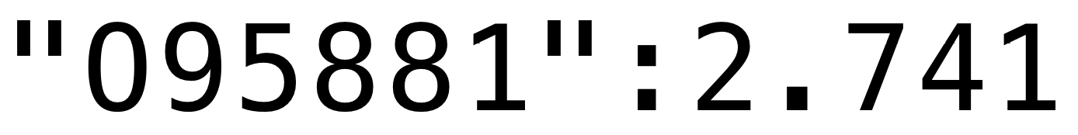
Data Preprocessing
96 lung cancer patients
(gender, age, cancer stage, etc.)
10000 protein content ratios
Protein code
Content ratio
EECS6895 Advanced Big Data Analytics

Slide 4
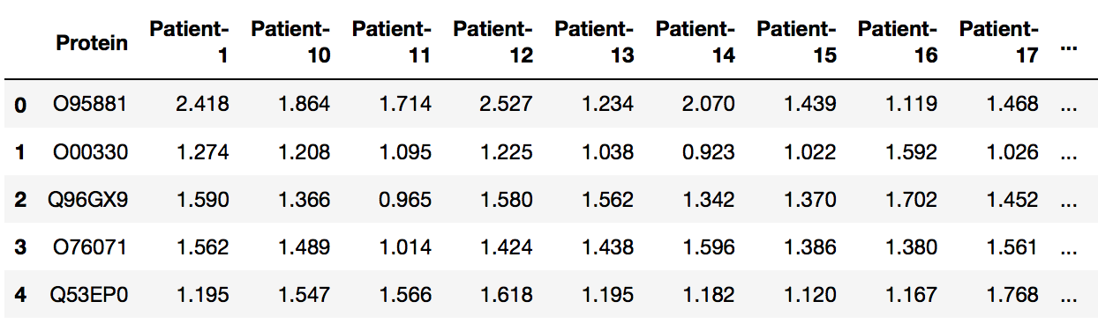
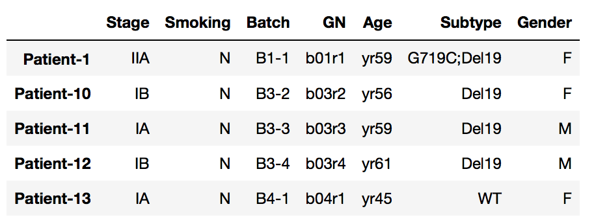
Data Preprocessing
EECS6895 Advanced Big Data Analytics
Notes:
Data frames containing information

Slide 5
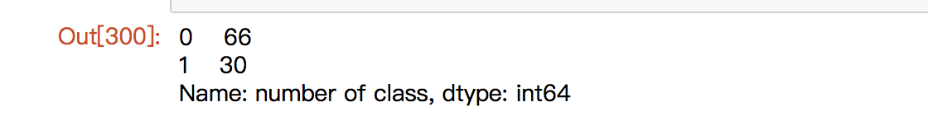
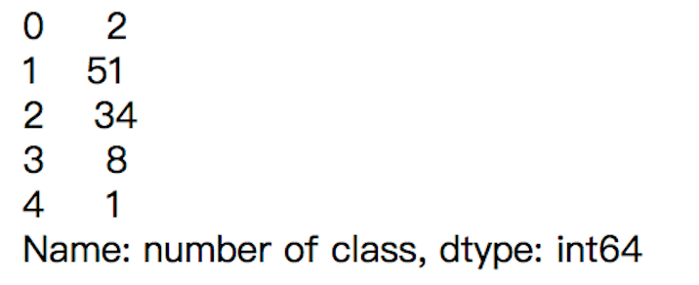
General Analysis & Visualization
K-means Clustering
EECS6895 Advanced Big Data Analytics
Notes:
The aim of k-means clustering is to discover whether there are similarities in the patients’ profiles of same class. The first figure shows the clustering result on two-class condition.
As we increase the number of classes and redo the clustering, the result shows that the number of major classes remain 2. The second figure is the result of five classes. We can see that class 1 and 2 are the majority. So we reckon that the major difference appears in two parts of patients.

Slide 6
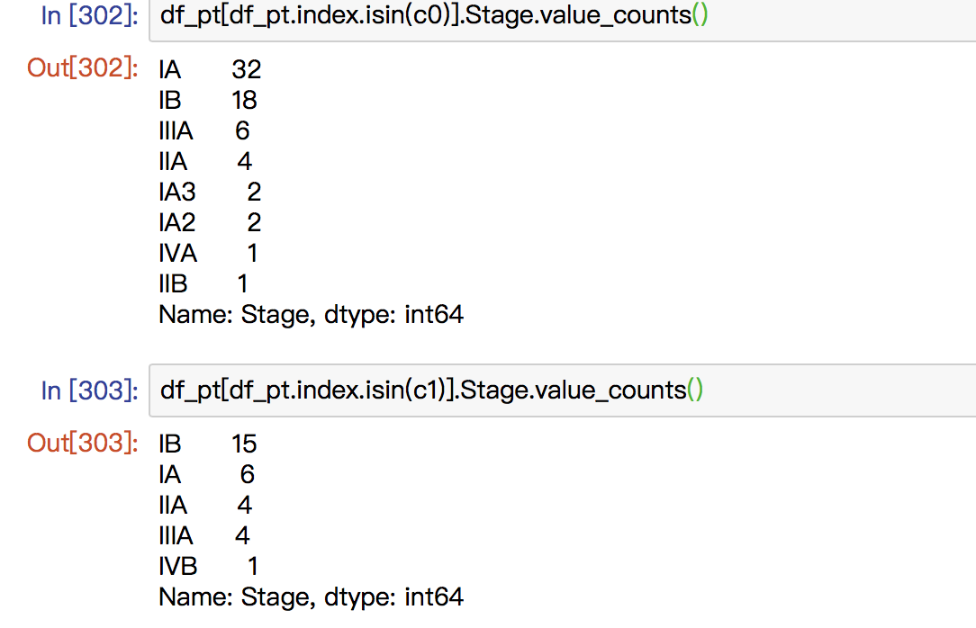
General Analysis & Visualization
K-means Clustering
EECS6895 Advanced Big Data Analytics
Notes:
We count the stages/genders/subtypes in two classes. We can see there are much more patients of IA in class 1 than class 2.

Slide 7
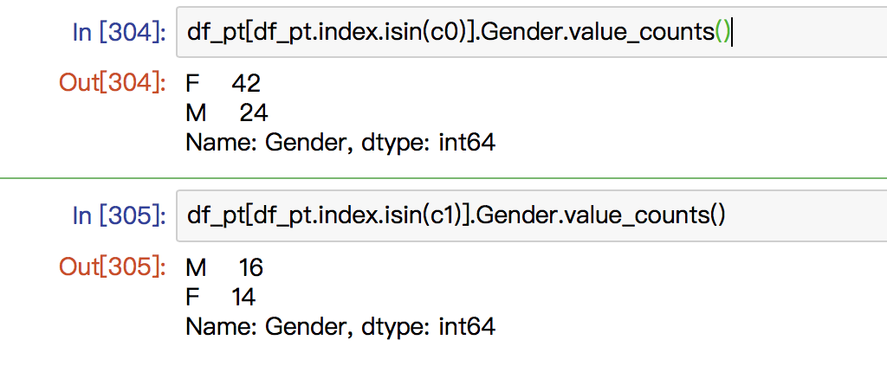
General Analysis & Visualization
K-means Clustering
EECS6895 Advanced Big Data Analytics
Notes:
There are much more female patients in class 1 than class 2.

Slide 8
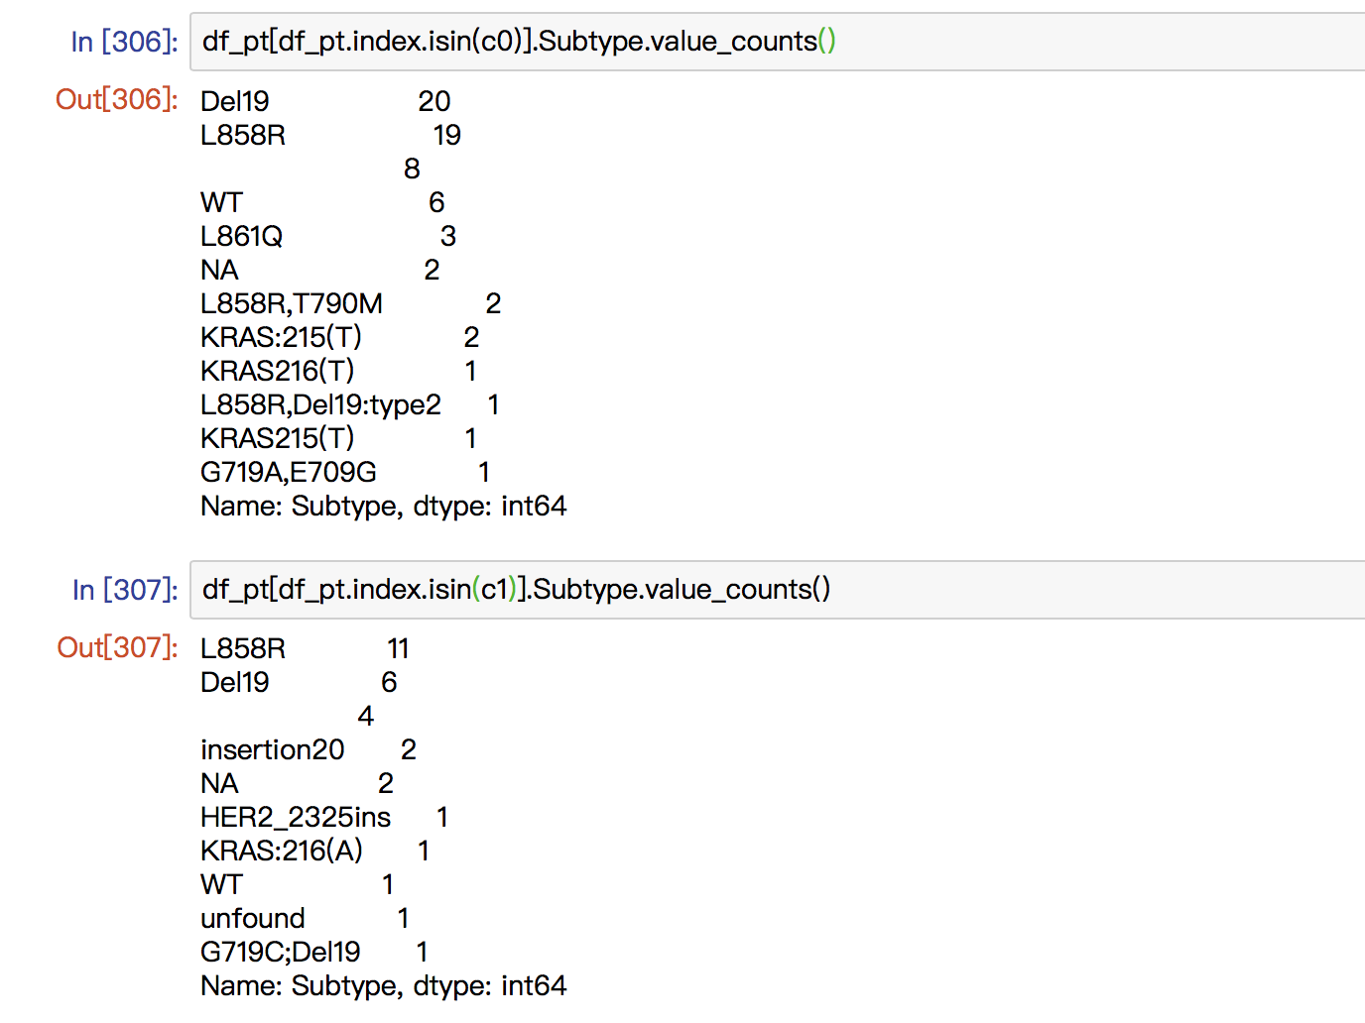
General Analysis & Visualization
K-means Clustering
EECS6895 Advanced Big Data Analytics
Notes:
There are much more patients of Del9 and L858R in class 1 than class 2.
So we conclude that patient of different stages ,different gender and different subtype may have different distributions in some proteins.

Slide 9
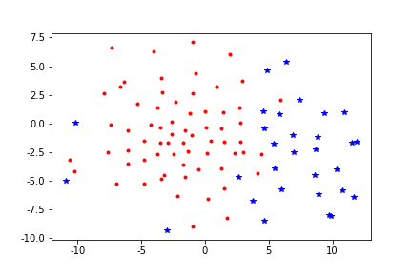
General Analysis & Visualization
t-SNE for dimension reduction
EECS6895 Advanced Big Data Analytics
Notes:
We use t-SNE to reduce the dimension from about 8000 to 2 and 3 in order to better visualize the difference between classes. This is the 2D version.

Slide 10
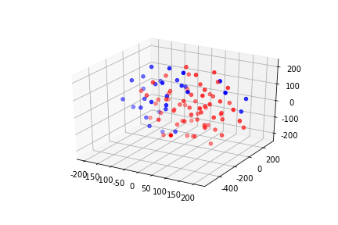
General Analysis & Visualization
t-SNE for dimension reduction
EECS6895 Advanced Big Data Analytics
Notes:
This is the 3D version

Slide 11
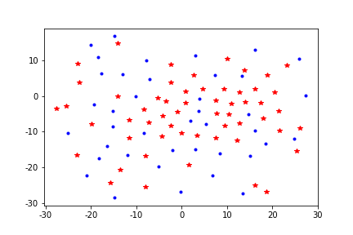
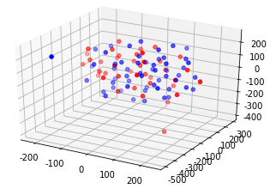
General Analysis & Visualization
t-SNE for dimension reduction
EECS6895 Advanced Big Data Analytics
Notes:
However, if we just classify the patient based on one information like gender or age range instead of the k-mean results, the performances is not satisfied. This is the classification based on gender

Slide 12
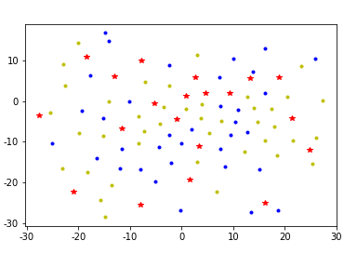
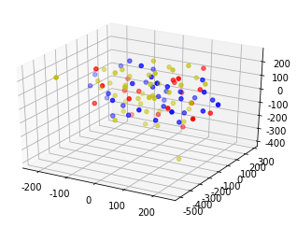
General Analysis & Visualization
t-SNE for dimension reduction
EECS6895 Advanced Big Data Analytics
Notes:
This is the classification based on age range (below 55 , above 66 and in the middle). In our opinion, the bad performance is due to the diversity of variables in patients’profiles and the relatively small sample size.

Slide 13
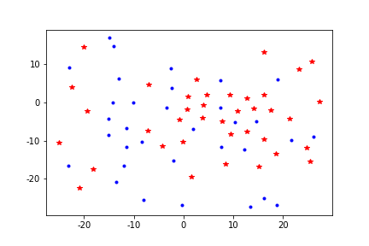
General Analysis & Visualization
t-SNE for dimension reduction
EECS6895 Advanced Big Data Analytics
Notes:
Patient of stage IA and IB

Slide 14
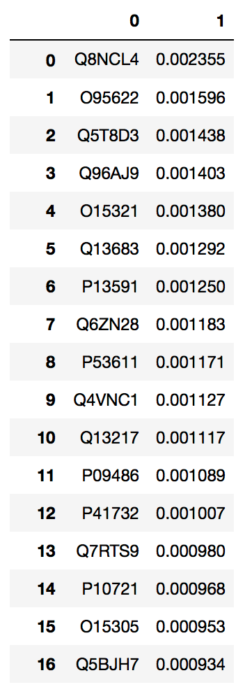
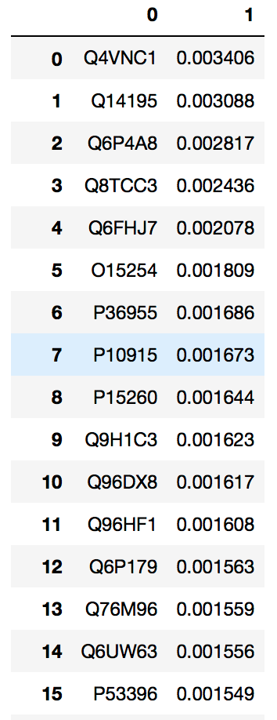
General Analysis & Visualization
Random forests for feature extraction
Original stages
4 stages
EECS6895 Advanced Big Data Analytics
Notes:
Then we use the random forest to extract features from different information in the patient profile which we assume relevant with protein ratio based on our k-mean clustering analysis.
Firstly, we analyze the stage information.
We use the ratio of proteins as inputs and the stages information as outputs and train on the random forest models. In this process, we can obtain the importance values of every protein contributing to the different stages.
This is the results obtained based on original stages. However, there is no much difference in the values. So we look back to the profile of patients, there are totally 4 levels of stages from 1 to 4 and each level has different types like IA, IA2,IB. So the total number of different stages are more than 10.
To simply this, we replace the information by assume all types in the same level as one stage.(Assume there are more difference between stage levels than between types)
For instance, we assign IIA, IIB as stage two and IIIA,IIIB as stage three. Then, we did the RF again and this time the values show much more differences. We can see the top 6 proteins have much higher importance value than the rest. According to this, we can assume that those proteins have some potential relations to the stage levels.

Slide 15
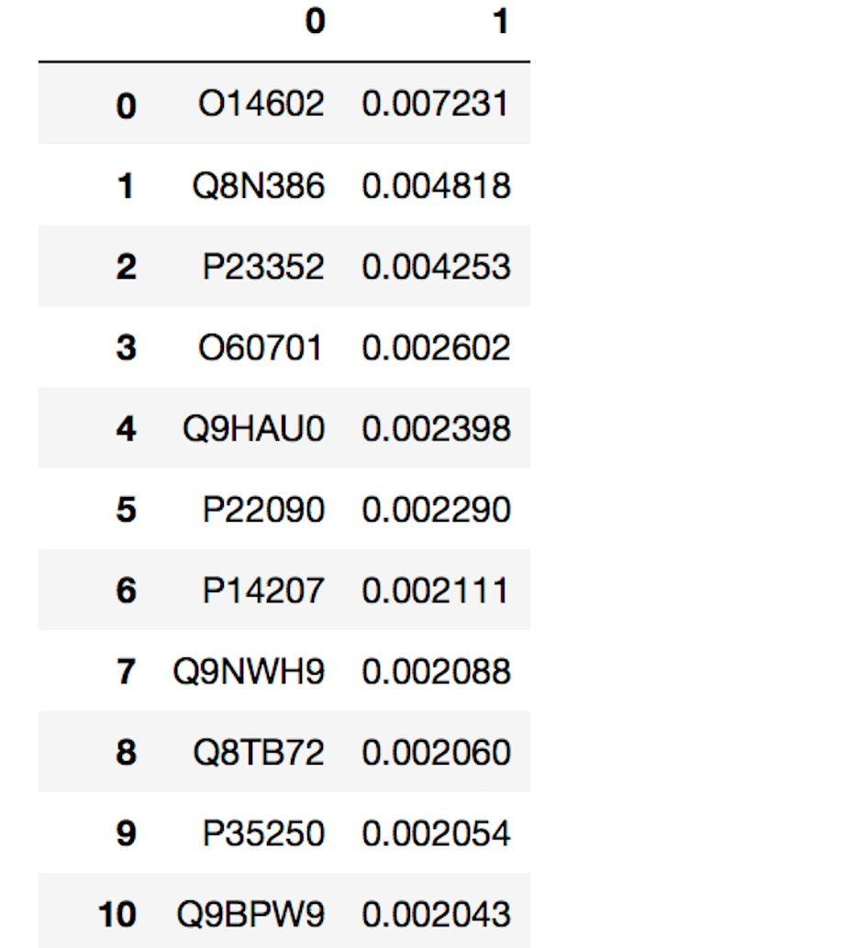
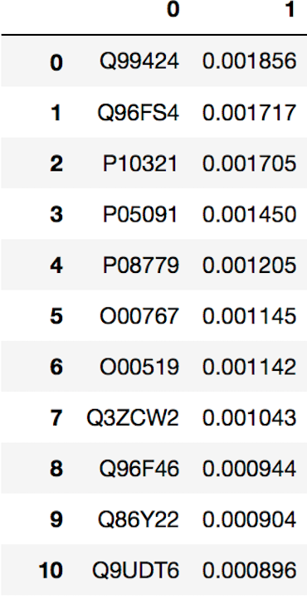
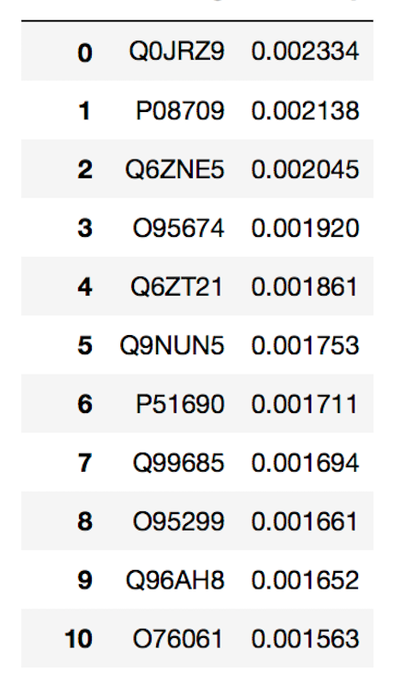
General Analysis & Visualization
Random forests for feature extraction
gender
age
subtype
EECS6895 Advanced Big Data Analytics
Notes:
Then, we use the same methods to analyze gender. The results is surprising. The top 3 especially the top 1 proteins which is about 0.007231, has the distinctively high values.
The results on ages and subtypes is not so convincing since the difference between the importance values is not as much as that on stage and gender. However, the difference do exists so we can do some further research on them.
In the next milestone, we will look deeper into those proteins with high values and study whether ,why and how they influence the certain aspects.

Slide 16
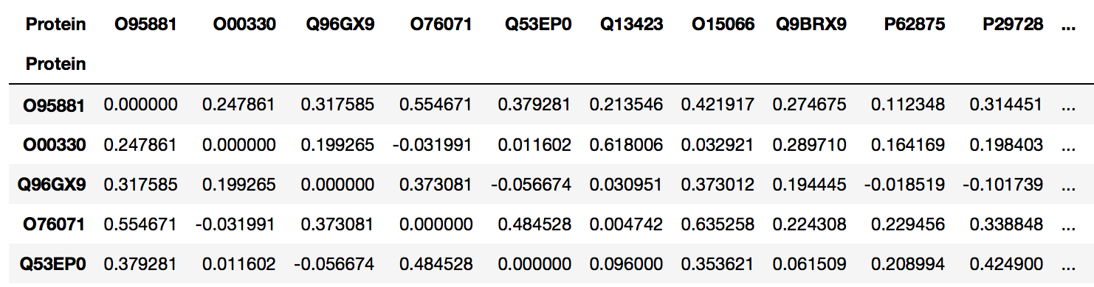
General Analysis & Visualization
General correlation matrix
EECS6895 Advanced Big Data Analytics
Notes:
We calculated the correlation coefficients between these proteins according to the protein content ratios of each patients, and made a correlation matrix.
We changed the elements in the diagonal to zero, which can help us find the most highly correlated proteins afterwards. And the correlation coefficients here between -1 and 1 shows whether two proteins are positively or negatively correlated.

Slide 17
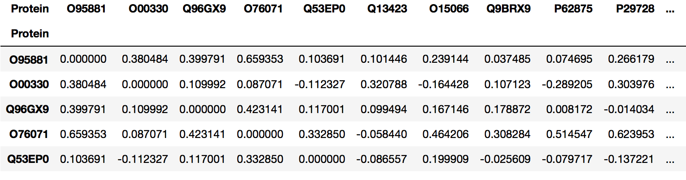
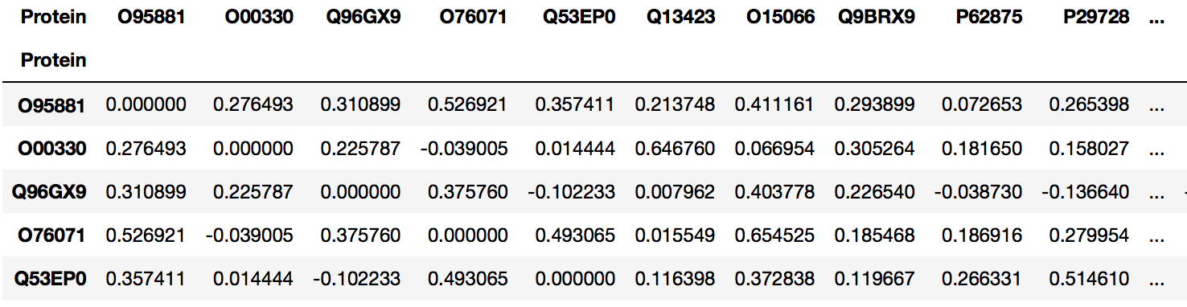
General Analysis & Visualization
Conditional correlation matrix
Correlation affected by smoking factors
Smoking patients
Non-smoking patients
EECS6895 Advanced Big Data Analytics
Notes:
The conditional correlation matrices are designed to illustrate the correlation between proteins for some certain groups of patients, based on their age, gender, cancer stage, smoking or not, etc.
For example, here shows a pair of conditional matrices based on smoking factors. The correlation between the first two proteins in our dataset can be considered as significantly related to smoking factors, and there are even correlations of two lung cancer proteins turning from negative to positive when patients start to smoke.

Slide 18
General Analysis & Visualization
Interactive correlation matrix
Notes:
And to have a better overview of those correlation coefficients and a more user-friendly visualization, we made an interactive correlation matrix. As the users move their pointers to some certain blocks in the matrix, they see the correlation coefficients of the corresponding pair of proteins. Comparing to the traditional non-interactive style which use only a color bar to show the correlation, we believe this can help users get more precise and focused results they may want.

Slide 19
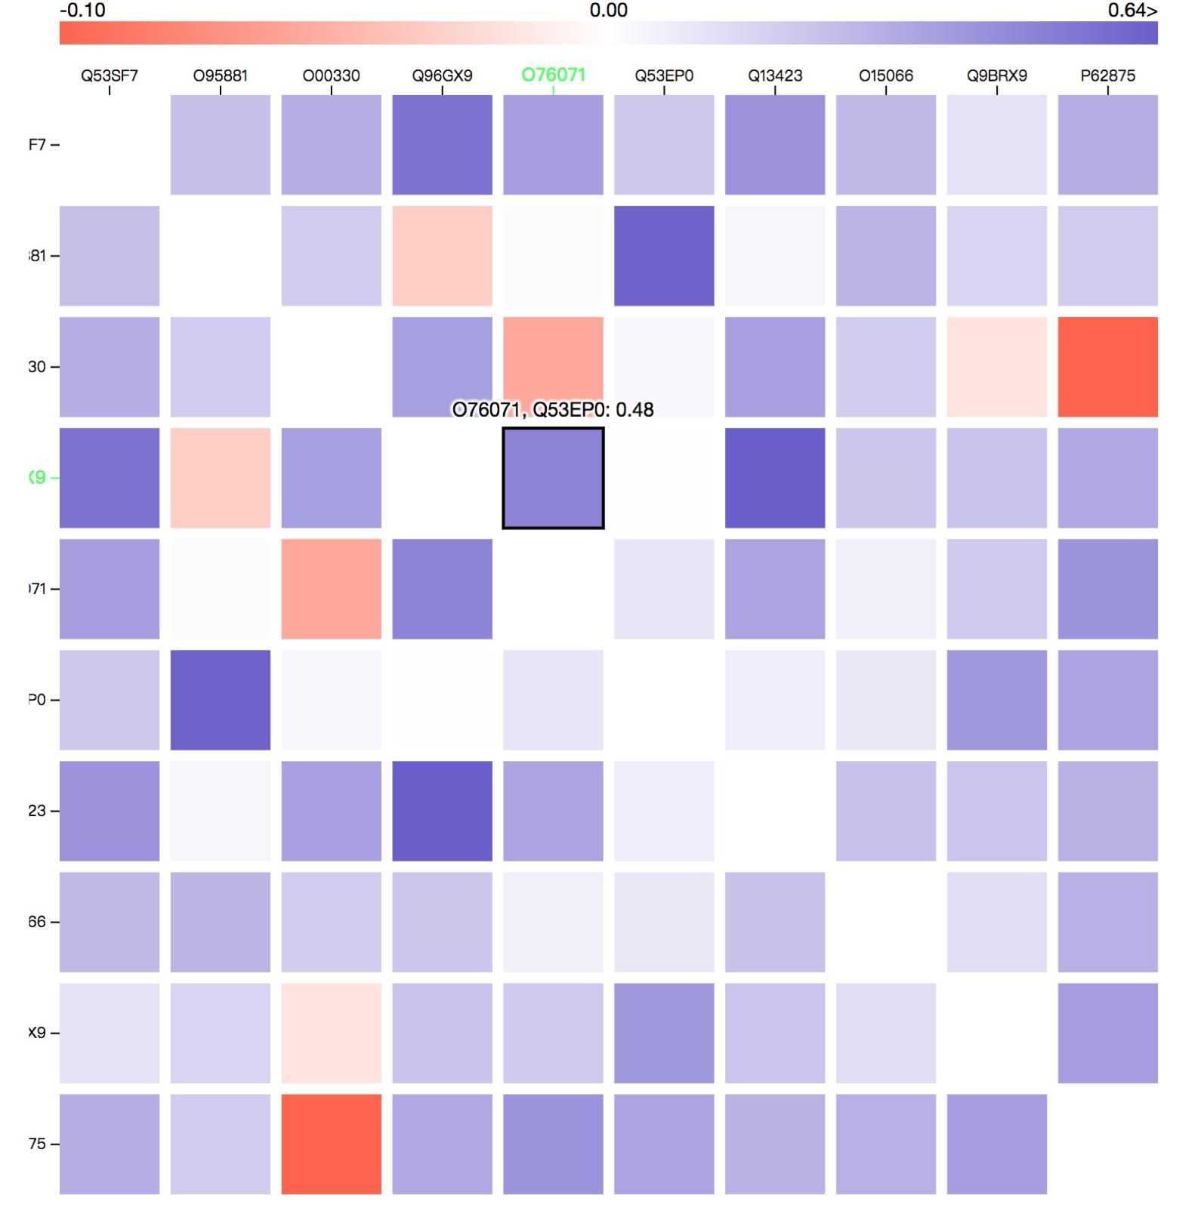
Notes:
Example
Names of protein and their correlation value are shown when choose the small squares.

Slide 20
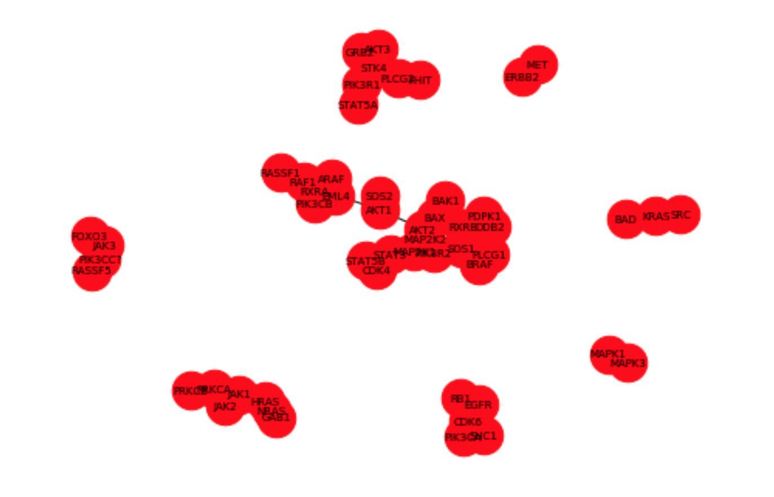
General Analysis & Visualization
Undirected Graph
☑️Explicit and interpretable
☑️Easy to determine protein clusters
✖️Overlapping nodes, hard to read
✖️Noninteractive and inflexible
✖️incapable of illustrating directed
relationships
EECS6895 Advanced Big Data Analytics
Notes:
Then we want to further make our visualization more comprehensible, in a form which better shows the correlation between proteins than numbers or colors.
So here we use an undirected graph to explicitly show the correlation in the form of distances between those proteins. As the graph shows, the closer two proteins stay, the more they are correlated with each other.
And also, this kind of graph help us easily split those proteins into groups, or clusters. When we want to focus on a certain group of them, we don’t need to care about others.
But there are still many problems, like there are so many overlapping nodes in the graph, which are really hard to read. And if we want to adjust the position of these nodes to have a less messy view, we cannot do that because the graph is inflexible and non-interactive. Also, we know that some of those nodes are negatively related while others are positively related, however, this kind of graph is not capable of showing the direction of correlations between nodes as well.

Slide 21
General Analysis & Visualization
Positive Force-directed Graph
- positive correlations between nodes
- no overlapping nodes
- as few crossing edges as possible
- interactive, flexible and user-friendly
EECS6895 Advanced Big Data Analytics
Notes:
So we want a tidy visualization style with hopefully no overlapping nodes and as few crossing edges as possible. And we also want it to be flexible and user-friendly, showing only the positive correlations between nodes. So here comes positive force-directed graph. As mentioned before, we don’t want our nodes to overlap each other, while we also need them to have connections to show how they are correlated.

Slide 22
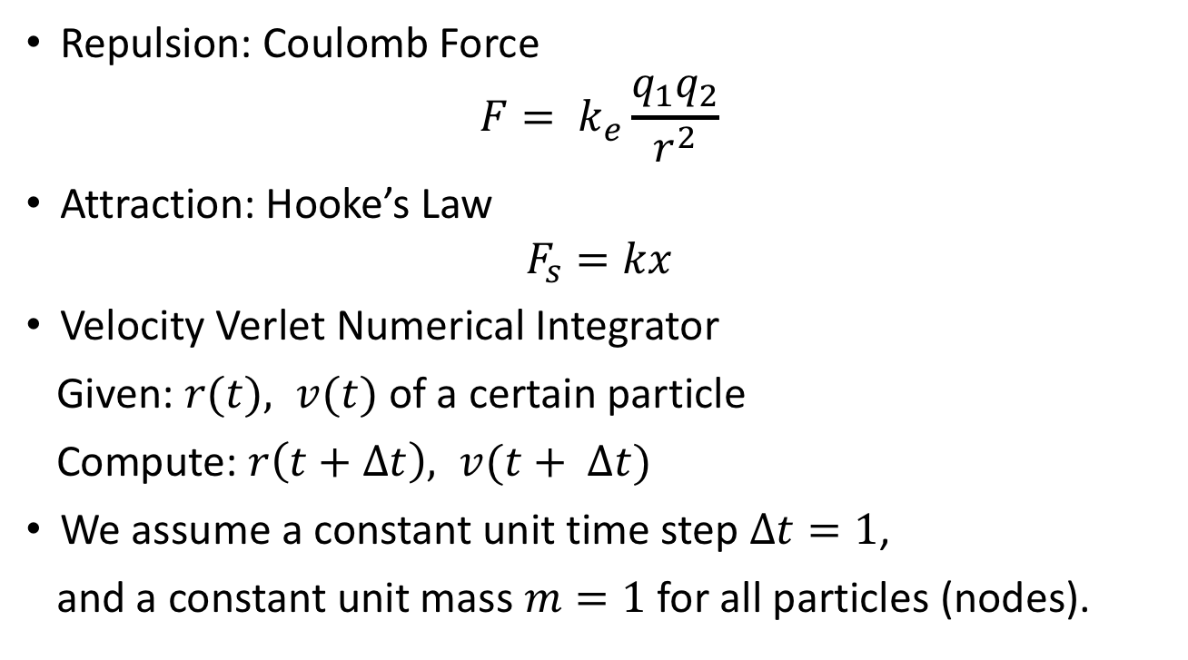
General Analysis & Visualization
Repulsion: Coulomb Force
$$F= k_{e}\frac{q_{1}q_{2}}{r^{2}}$$
Attraction: Hooke’s Law
$$F_{s}=kx$$
Velocity Verlet Numerical Integrator
Given: $r(t), v(t)$ of a certain particle
Compute: $r\left(t+∆t\right), v(t+ Δt)$
We assume a constant unit time step $∆t=1$,
and a constant unit mass $m=1$ for all particles (nodes).
Notes:
Therefore, we draw the idea of particles like electrons with attracting as well as repulsing forces between each other. This is the basic idea of force-directed algorithm, where we try to simulate the Coulomb Force and Hooke’s law as the attraction and repulsion between our nodes and predict the position and velocity of them according to their previous status and Newton’s Law. To simplify out algorithm model, we assume a constant unit time step delta t which equals to 1 and a constant unit mass m which also equals to 1.

Slide 23
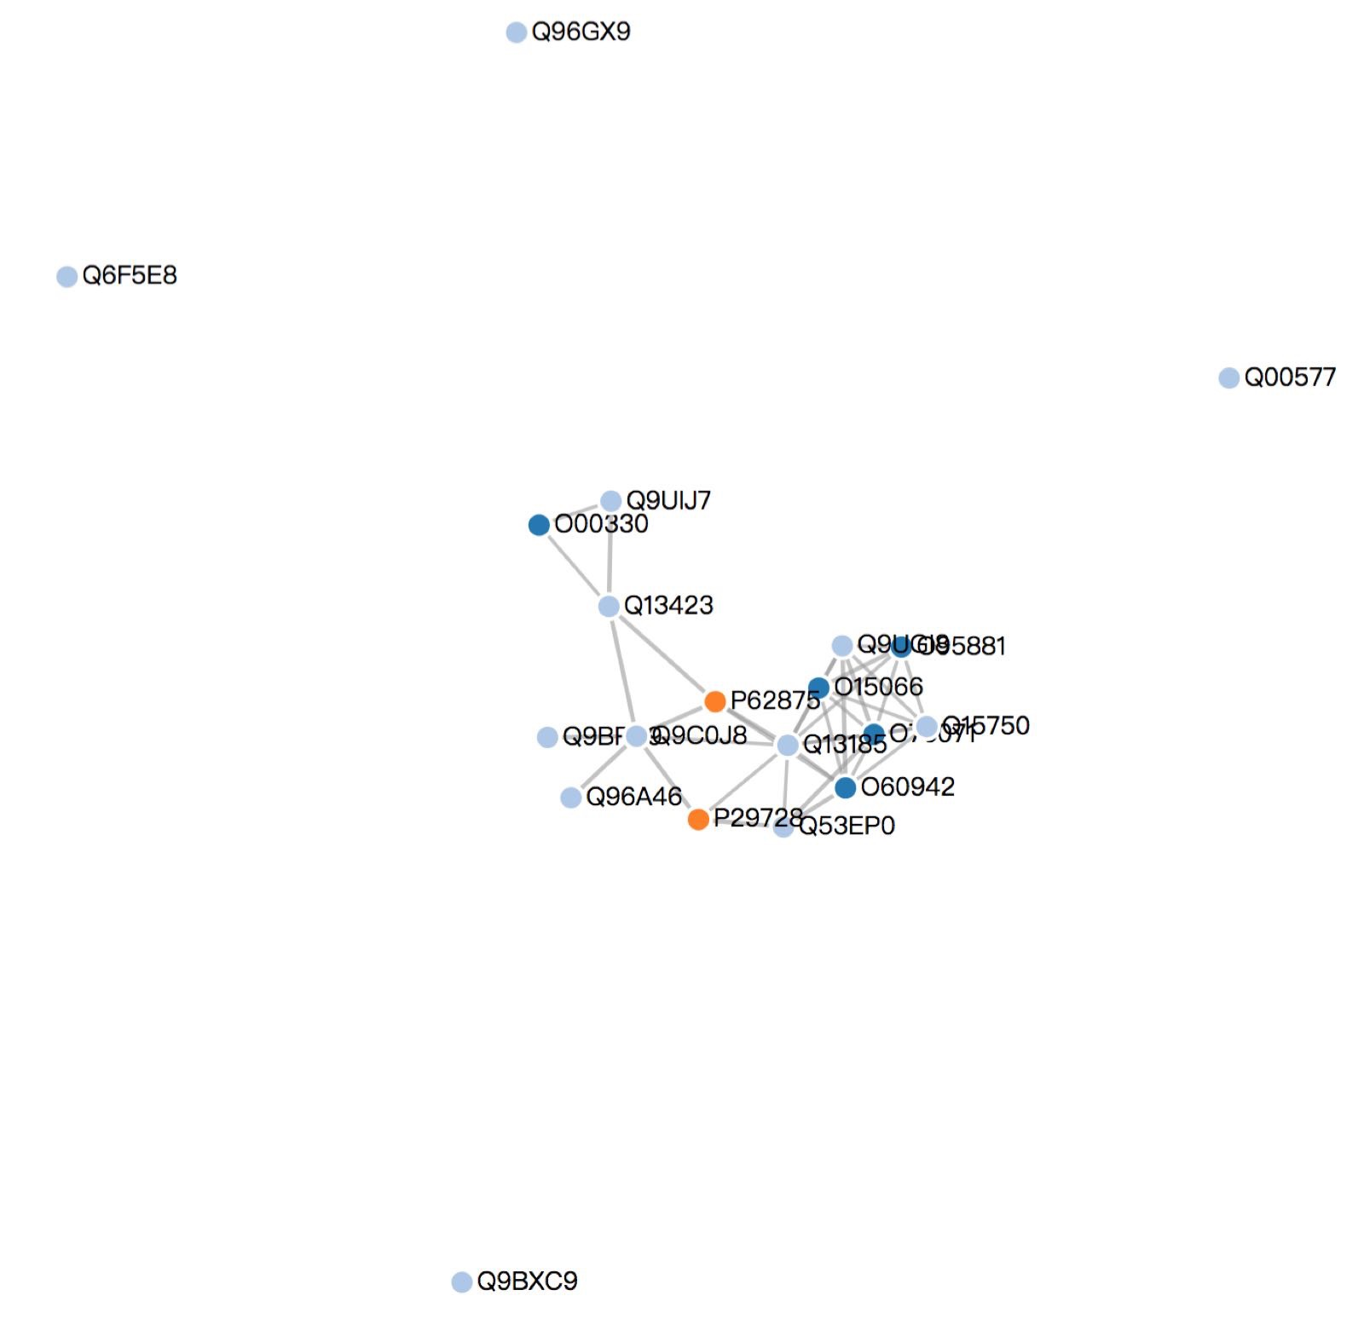
Notes:
Examples

Slide 24
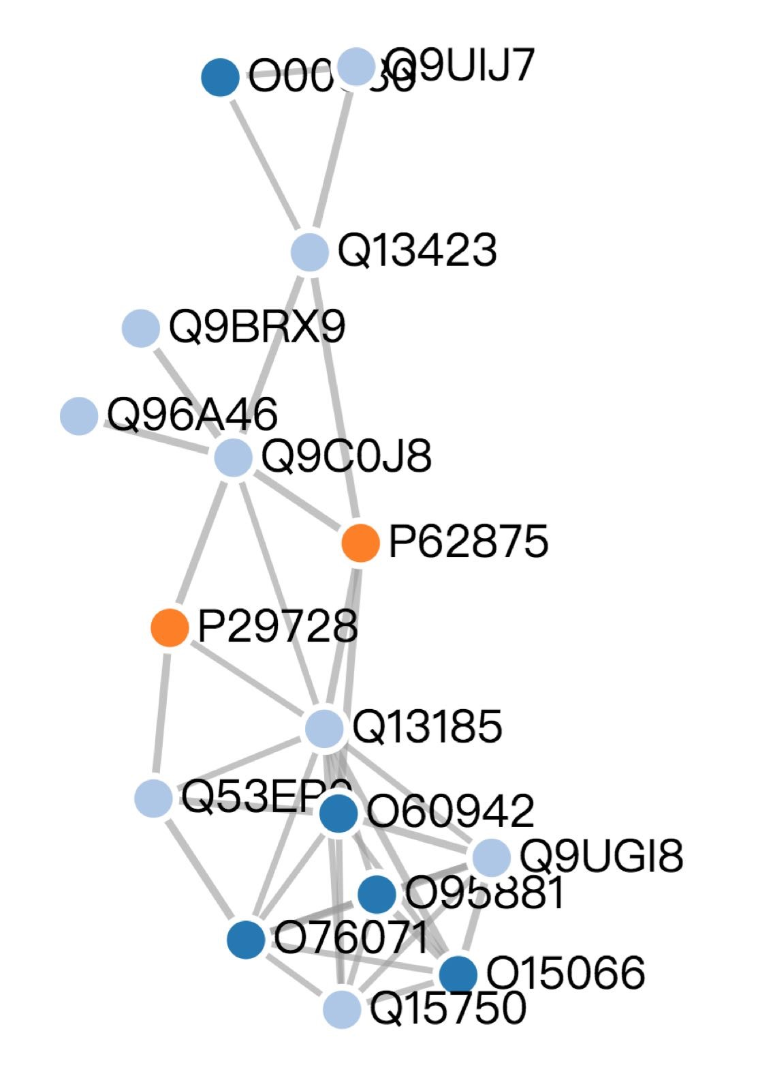
Notes:
We can drag any node out to see its connections

Slide 25
Next Step
Information search of proteins based on importance value
Data matching with STRING DB
Further improvement of visualization
EECS6895 Advanced Big Data Analytics
Notes:
In terms of our work for the next milestone, we intend to search more protein information based on the importance value we calculated out in the previous work.
And we want to match our data with the STRING Database to have a deeper view of our protein analysis.
Additionally, we need to improve our visualization by adapting conditional correlation analysis to it in order to have a more specific and focused perspective of our data.

