Slide 1

E6893 Big Data Analytics:
Recommendation Engine on Google Cloud platform
Team Members: Li Zishuo, Zheng Deming, Fu Yuxin
Team: 666

Slide 2
Outline
Motivation
Setup
Data set preparation
Algorithms
Results
Conclusions

Slide 3
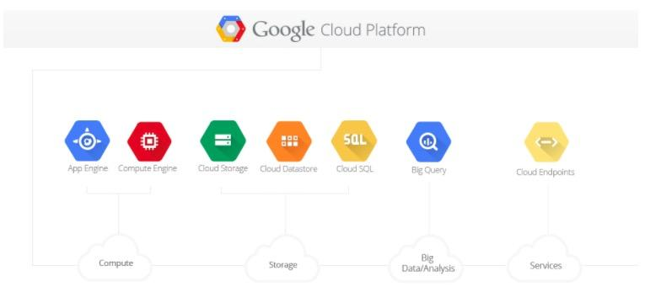
Motivation
Can Work from Anywhere
Fast and professional
Less Disruption
More Productivity Through Innovation
Notes:
Can Work from Anywhere
Technically with Google, We can gain complete access to the Google cloud platform from any device anywhere in the world, and it’s all completely powered by the Google cloud.
Fast and Professional
Google Cloud is a cloud services, for sure it will be much faster than local virtual machine and more closer to industry level
More Productivity Through Innovation
Google is by far the fastest company at distributing the latest updates and innovations. They often send updates on a weekly basis, and sometimes they are even faster.
Less Disruption
Whenever introducing new updates, in general, there’s a lot of disruptions come along. Google manages this through delivering small updates continuously, so users only have to deal with minor changes.
Therefore, this project presents a way to build a recommendation engine on Google Cloud platform combined four different machine learning algorithms.

Slide 4
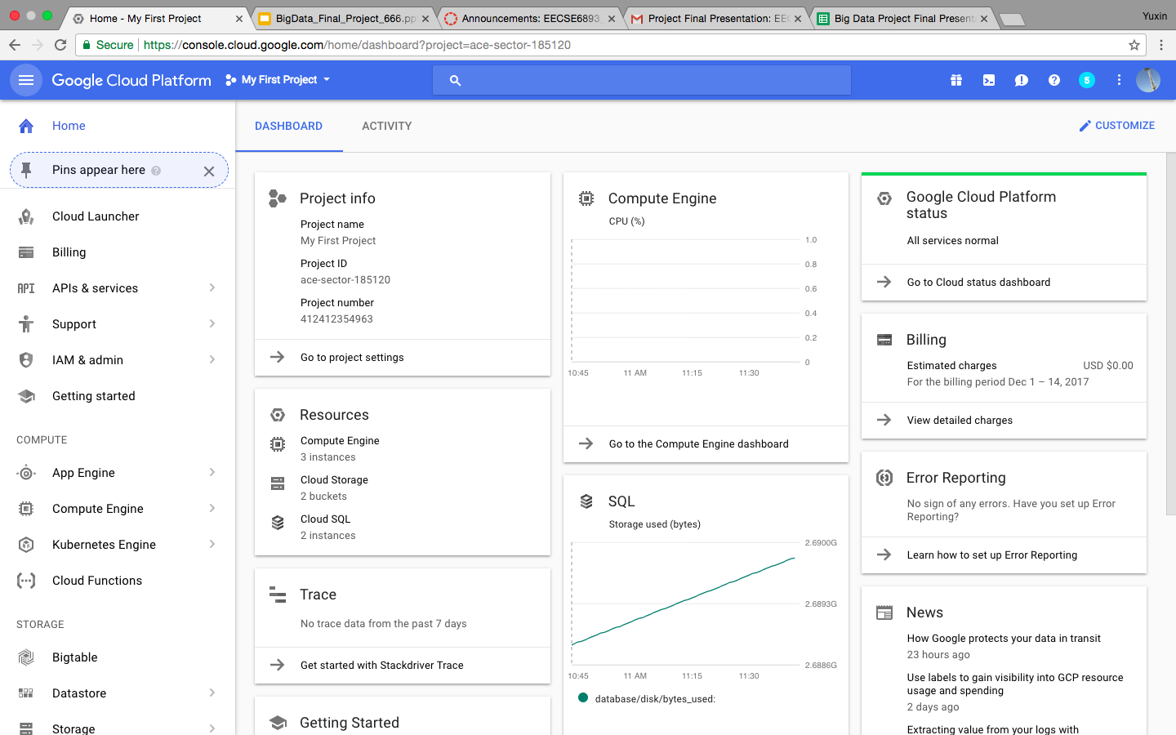
Final set up
Notes:
This is the fully set up of Google cloud platform. Various modules including Cloud SQL modules

Slide 5

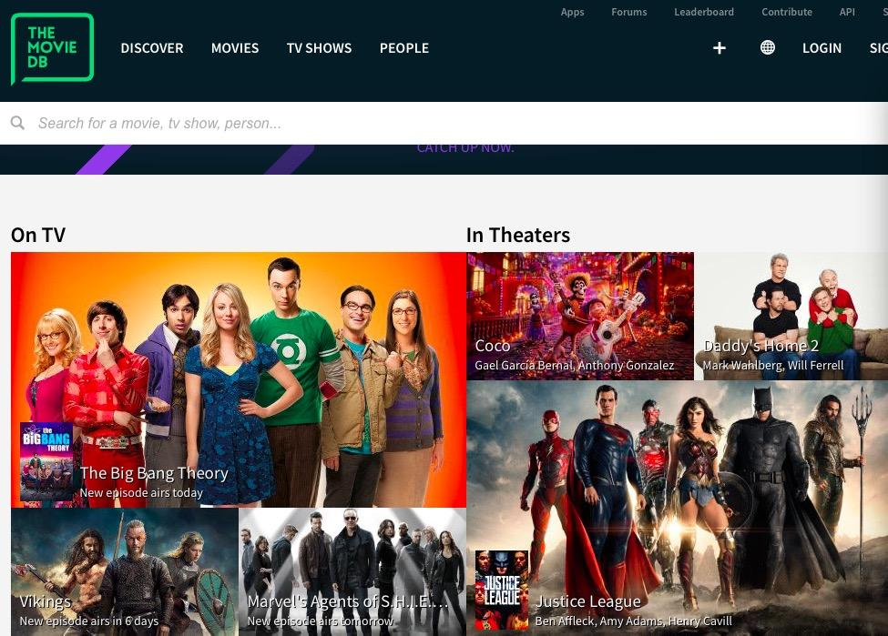
Data set preparation
MovieLens
data set
IMDB id
The Movie Database
Posters
Notes:
Specially, this system designed for movie recommendation. Therefore, we grap the data set from MovieLens. In the data set, there is a "ratings.csv" contains user id, movie id, rating, and time information, and "link.csv" contains movie id, IMDB id, and TMDB id. We combine these two tables since the IMDB id information is required for each movie to get the movie poster from The Movie Database website using its API.

Slide 6

Algorithms
Spark ALS
SVD
Cosine similarity
item-item
user-user
Deep learning
Tensorflow
VGG16 in Keras
Notes:
For sure we have spark ALS, however just ALS is not enough, we decide to combine more different algorithms.
When the number of users and/or items is not so huge, the computation can be done using directly a SVD (Singular Value Decomposition) algorithm. Given that, besides Spark ALS, this projects also implemented SVD algorithm based on Tensorflow for recommendation engine while the number of users and/or items is small.
As for cosine similarity algorithms, one of them is item-item collaborative filtering. Item-item models resolve these problems in systems that have more users than items. With more users than items, each item tends to have more ratings than each user, so an item's average rating usually doesn't change quickly. This leads to more stable rating distributions in the model, so the model doesn't have to be rebuilt as often.
Another one is user-user collaborative filtering. This system uses the given profile of given user and provide recommendation system completely based on that preference and liking.
In order to further improve precision, the project tries to use deep learning to recommend movies to users. VGG16 in Keras is used to train this neural network. There is no target in the data set, therefore only the fourth-to-last layer as a feature vector has been considered. The project uses this feature vector to characterize each movie in data set. In the codes, similar as before first step is to get the movie posters from TMDB website using its API with IMDB id, then these posters are fed to VGG16 and are used to train the neural networks, finally, cosine similarity can be obtained using the features learned by VGG16. After getting the movie similarity, movies with the highest similarity will be recommended to similar users.

Slide 7
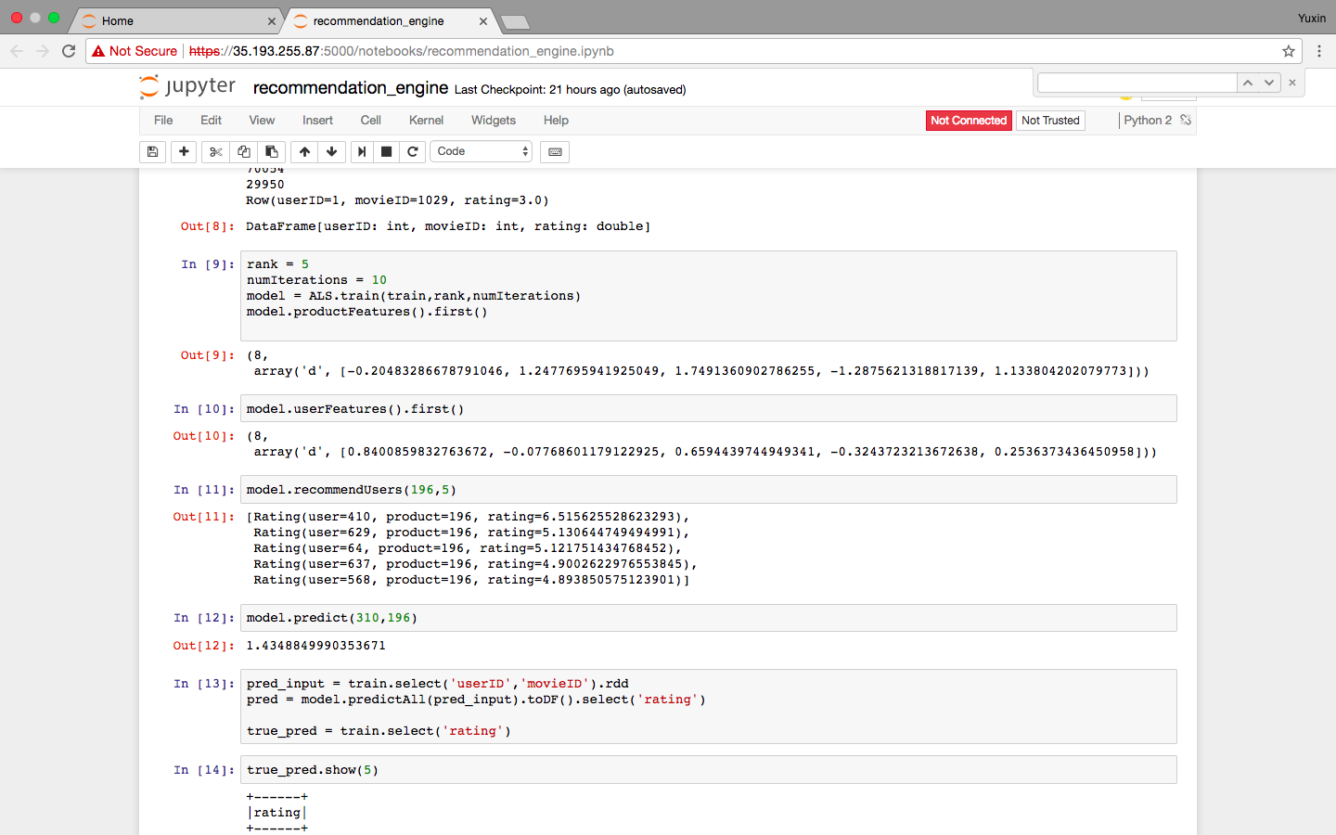
Results
Spark ALS

Slide 8
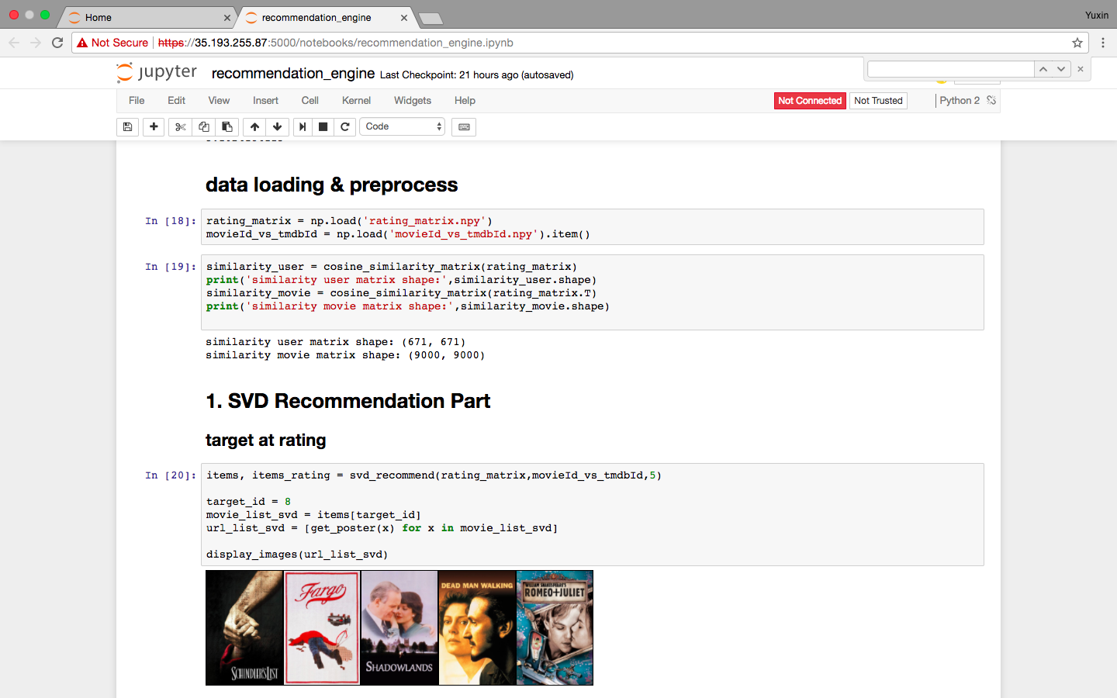
Results
SVD

Slide 9
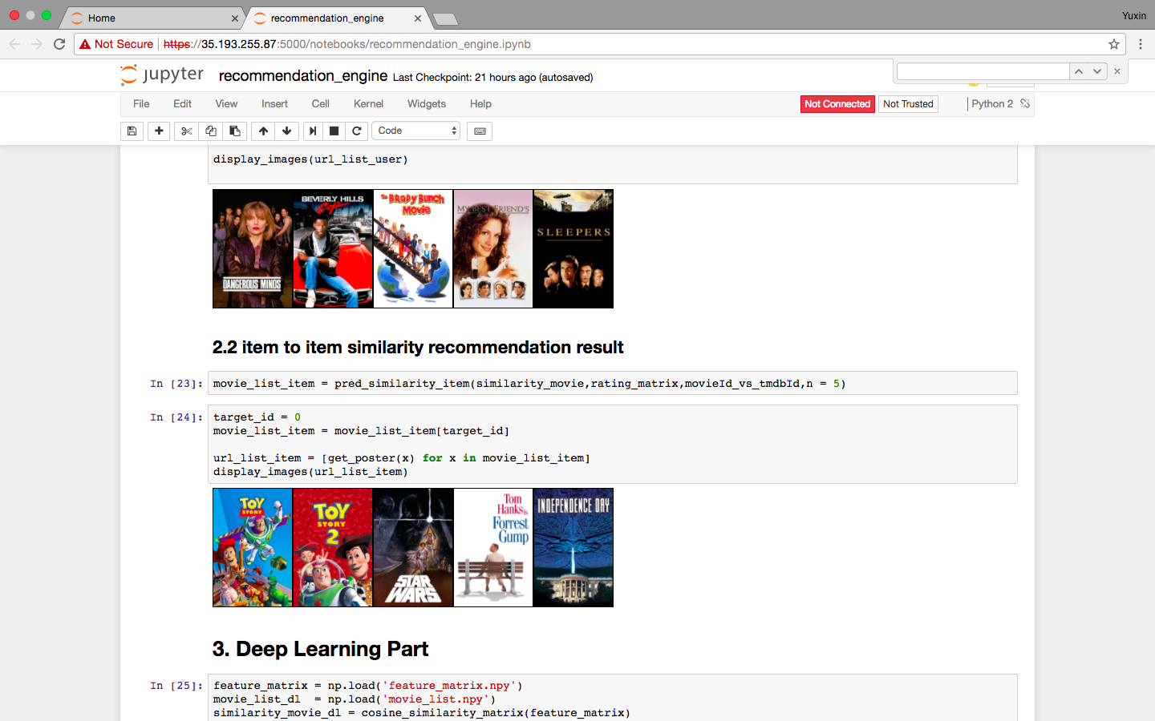
Results
Item-item

Slide 10
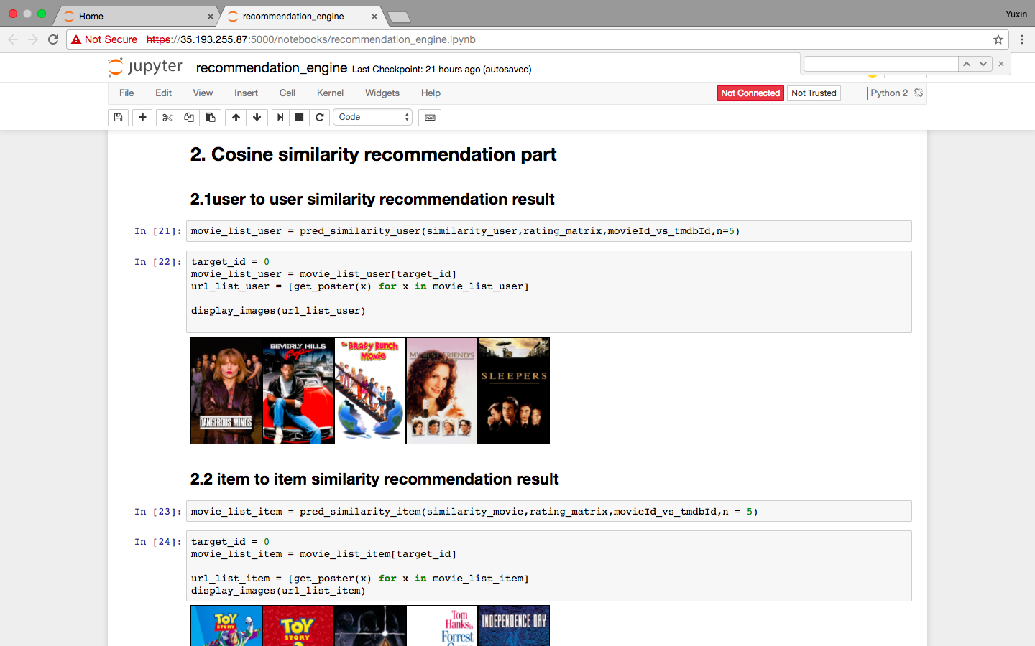
Results
User-user

Slide 11
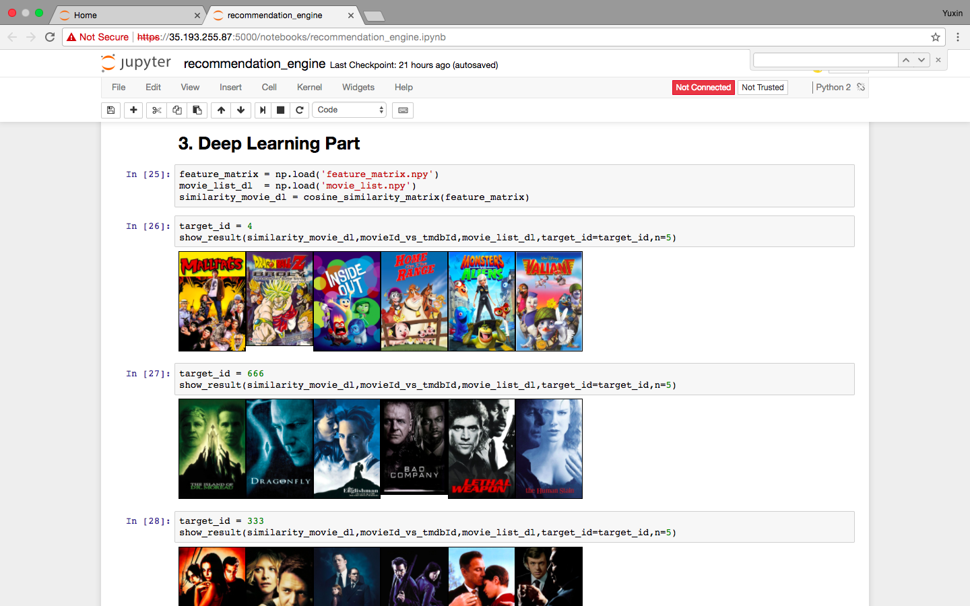
Results
Deep learning

Slide 12
Conclusions
This project uses Spark ALS, SVD, cosine similarity, and deep learning as unsupervised learning approaches to learn the similarity of movies by processing movie posters to build a recommendation engine. Precise results of this project have proved its validity.

Slide 13
Thank you

