Slide 1

E6893 Big Data Analytics:
Efficient prediction of payments in hospitals and other medical organizations
Team Members:
Dhruv Motwani
Harshit Saxena
Abhinav Iyappan
December 15, 2016
‹#›

Slide 2

Outline
Healthcare comprises 17.5% of US GDP
19 major drug companies had atleast one board member who also held leadership role at atleast one academic medical center

Slide 3

Dataset
Open payments datasets
A public dataset highlighting the financila relationship between recipients like phyicians and hospitals for service such as:
Consulting fees
Speaker fees
Gifts
Entertainmain
Food and Beverage
Travel
Education and Research
Charitable contribution
Grants
Rental Fees in teaching hospitals
http://openpayments.cms.gov/about

Slide 4
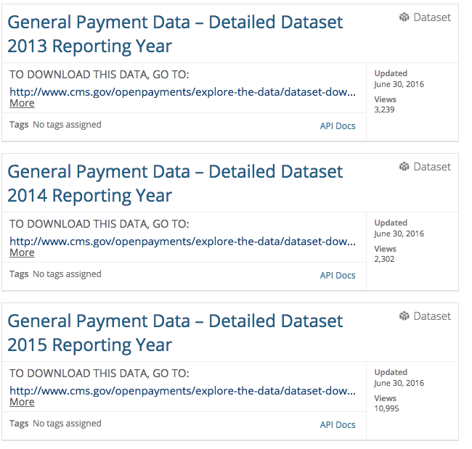
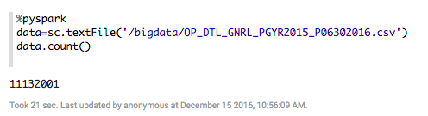
Dataset
Data contains demographic information about the patient, doctor and hospital details drug prescribed and cost covered by the insurance companies
28 million insurance claims
618,000 physical records
1,100 hospitals in the US
2000 companies
Dataset size: over 15 GB

Slide 5
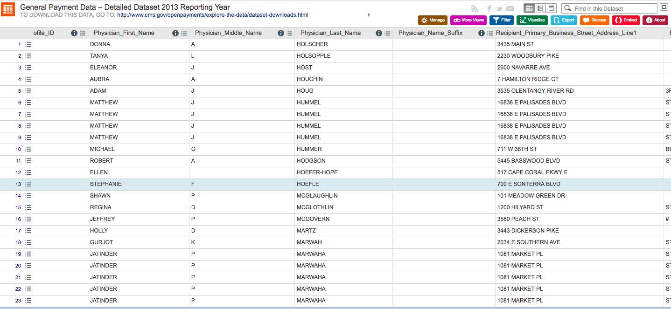
Data set
‹#›

Slide 6
Technical details
Tools used:
1. Hadoop for data storage
2. Spark
3. Docker
4. Zeppelin: for visualization

Slide 7
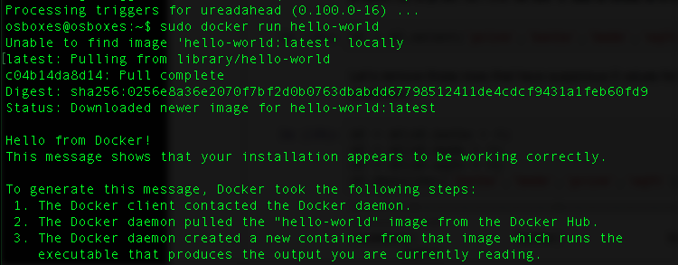
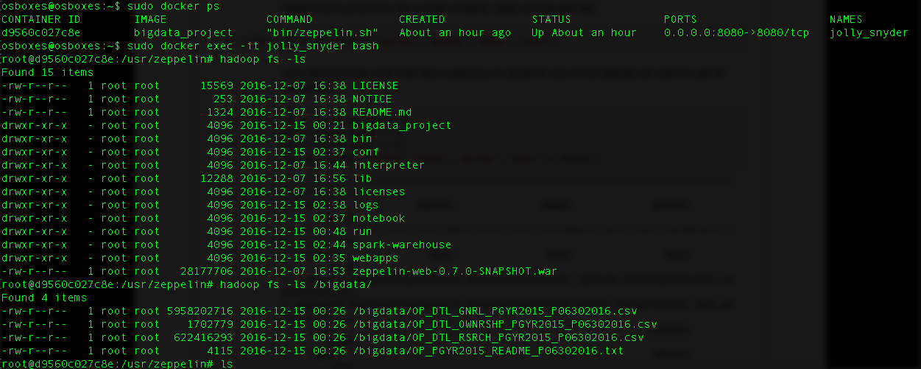
Docker

Slide 8
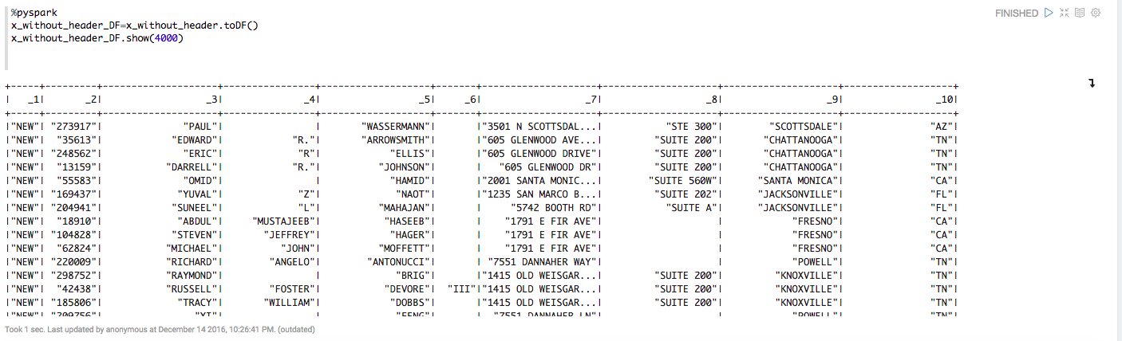
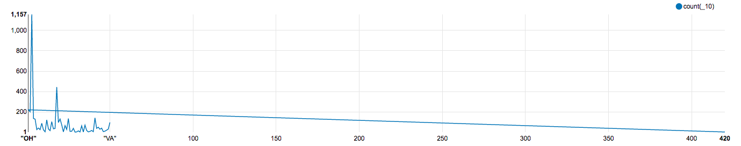
Pyspark and Zeppelin
The data has noisy values.
Long time in understanding all the technologies used.

Slide 9
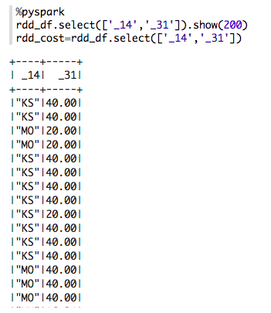
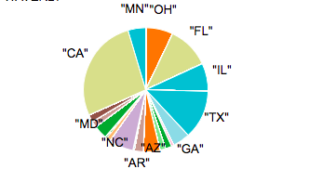
Results and conclusion
California and Florida had most counts of payments by medical companies.
Live changes and changes in companies can be compared to find trends.
Most payments are <$1000 to doctors.

Slide 10
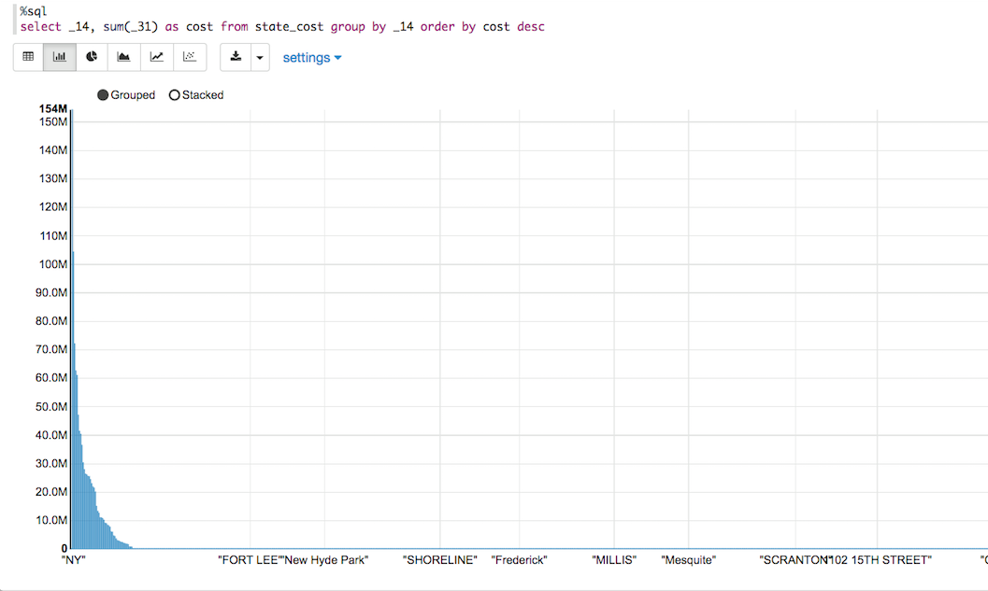
Conclusion
The data has noisy values.
Long time in understanding all the technologies used.

Slide 11
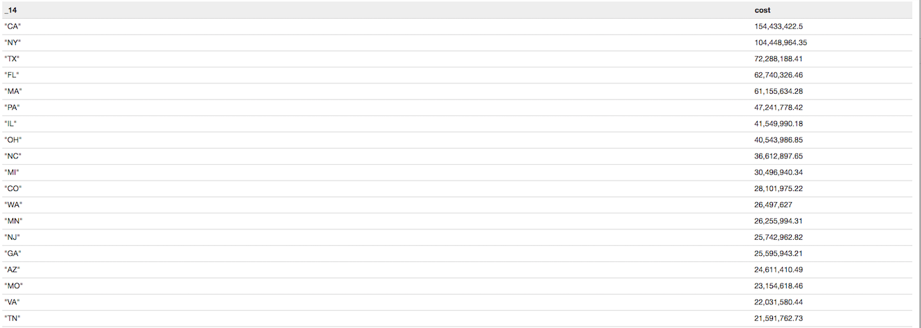
Results
The data has noisy values.
Long time in understanding all the technologies used.

Slide 12
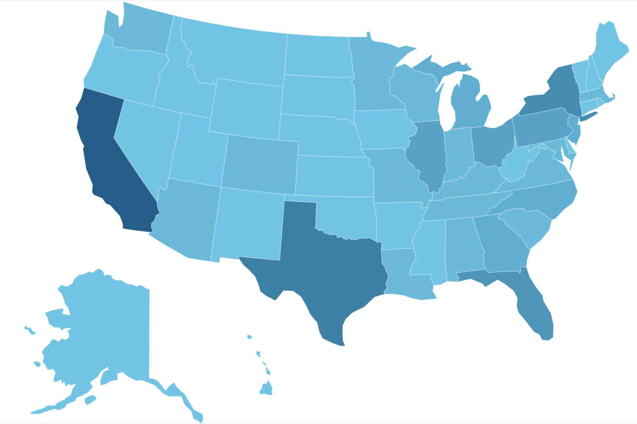
Results
The data has noisy values.
Long time in understanding all the technologies used.

Slide 13
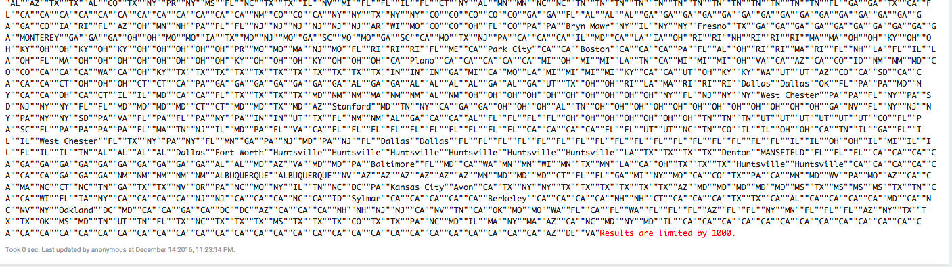
Challenges and Issues
The data has noisy values.
Long time in understanding all the technologies used.

Slide 14
Thank you

