Slide 1

E6895 Advanced Big Data Analytics:
Roommates and Apartments Recommend System
Team Members:
Zhicheng Xu(zx2170), YuzhongJi(yj2345)
December 9, 2014
1

Slide 2
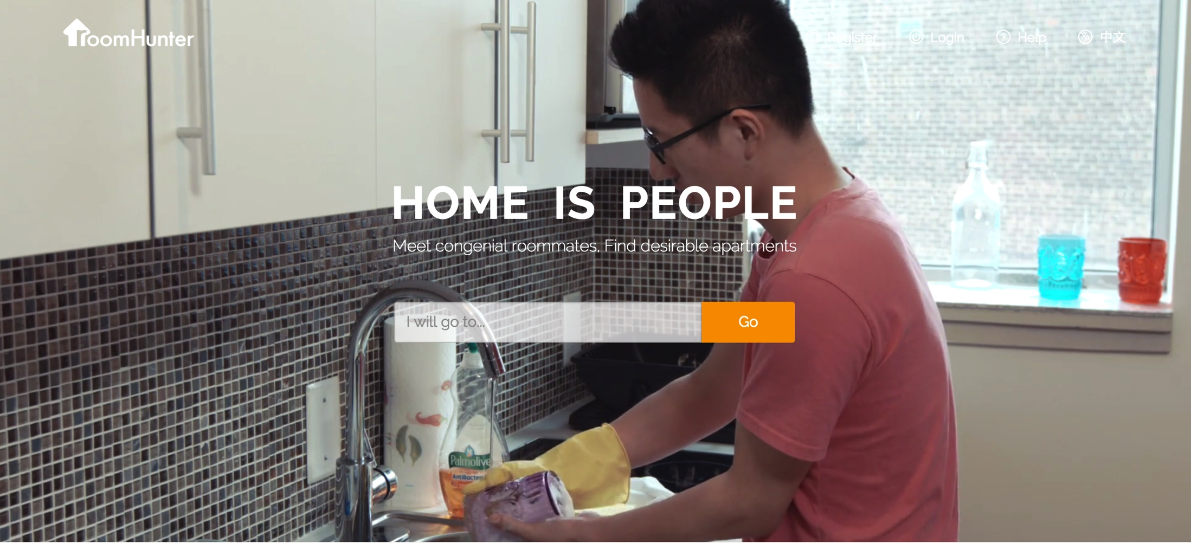
Motivation
To build a system that recommend suitable apartments and roommates for users who want to rent houses.
2

Slide 3
Steps: Overview
Frontend
Clustering
Amazon Web Server
Web Interface
Start

Slide 4




Tools
C++
JAVA
Mongo
AWS
Neo4j
Node.js
express
4

Slide 5
Data Collection
What about data?
Sources : Meetup.com
Java and Meetup API
Data Format
Data Size
18212 Groups
1294827 Users
User ID
Group ID …
Event ID …
User
Appartments
…
Houses
…

Slide 6
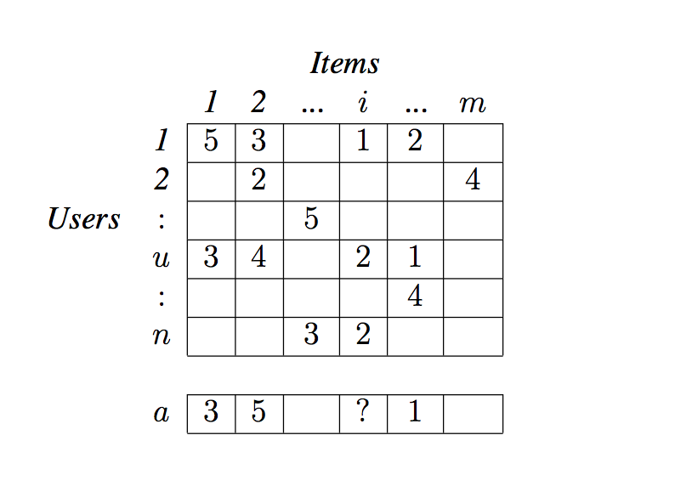
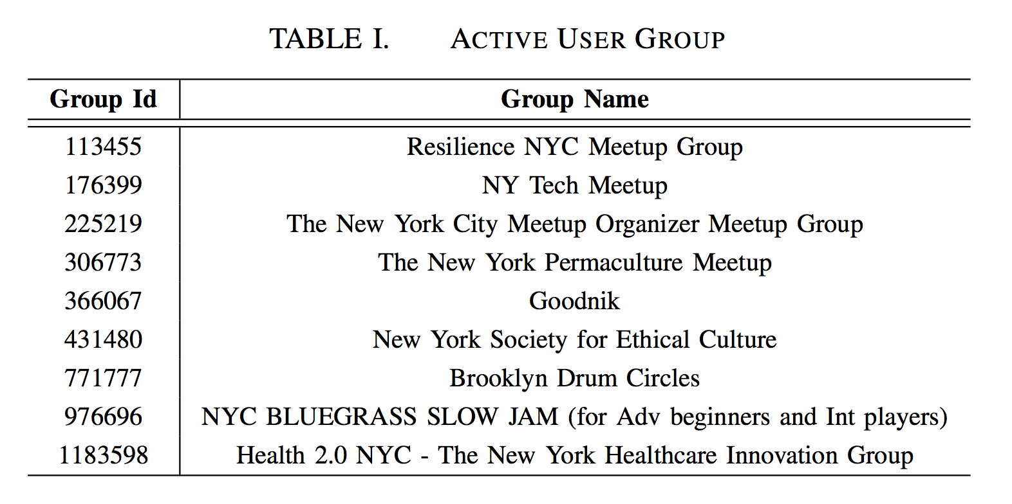
Collaborative Filtering
Collaborative Filtering algorithm
Neighborhood-based Collaborative Filtering
Item-based Collaborative Filtering
Similarity Computation
Cosine-Based
Pearson’s Correlation
Apartment
Recommendation
Roommate
Matching
6

Slide 7
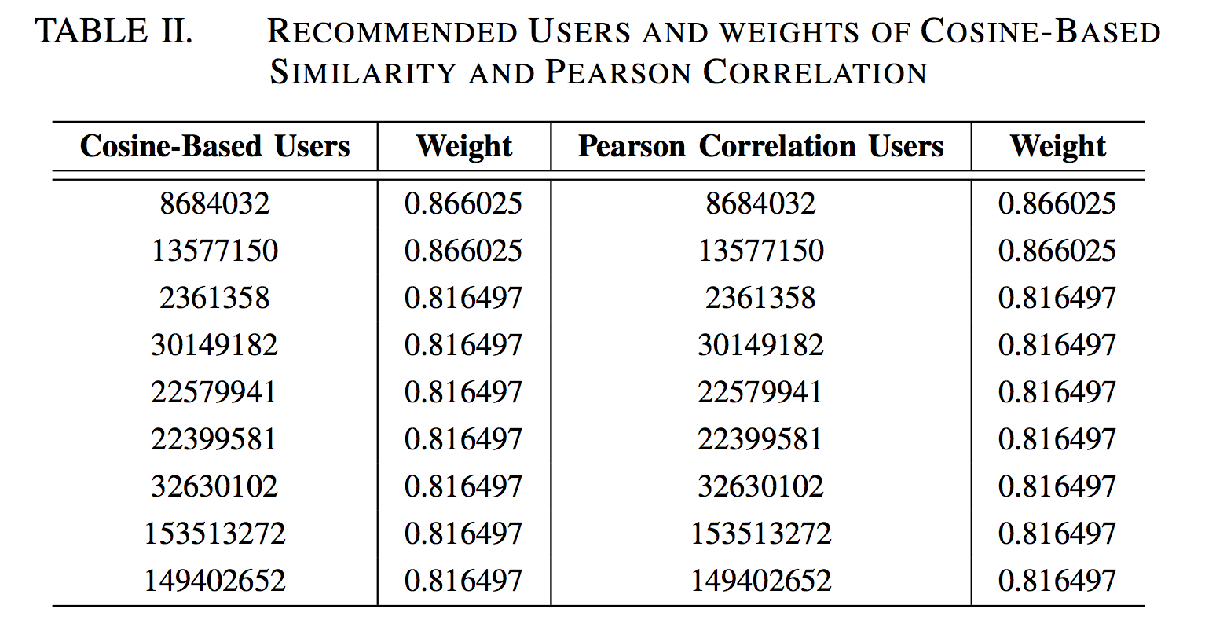
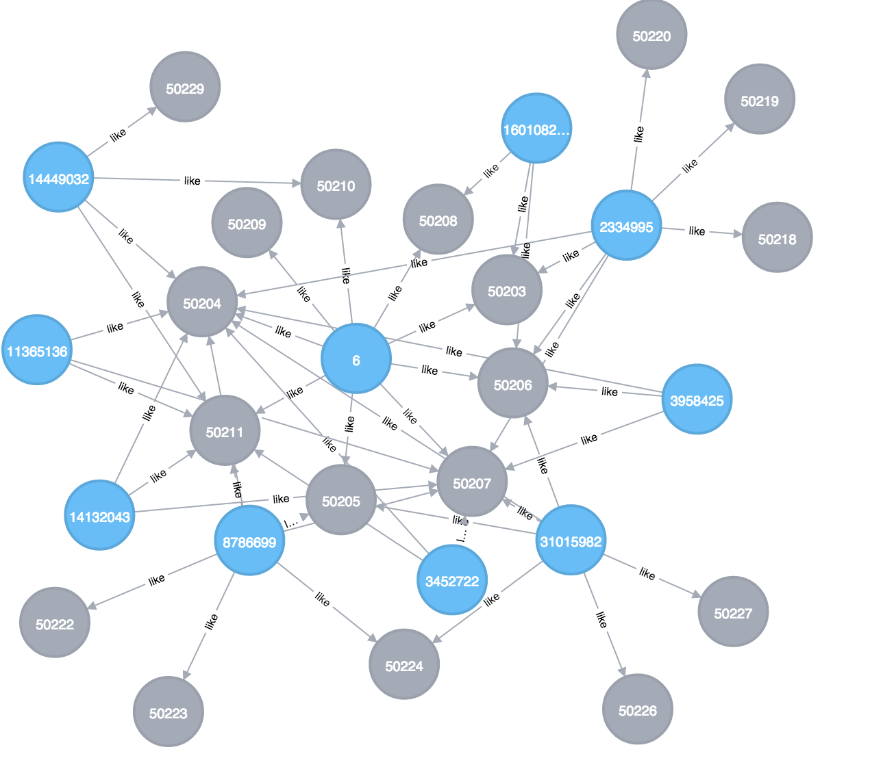
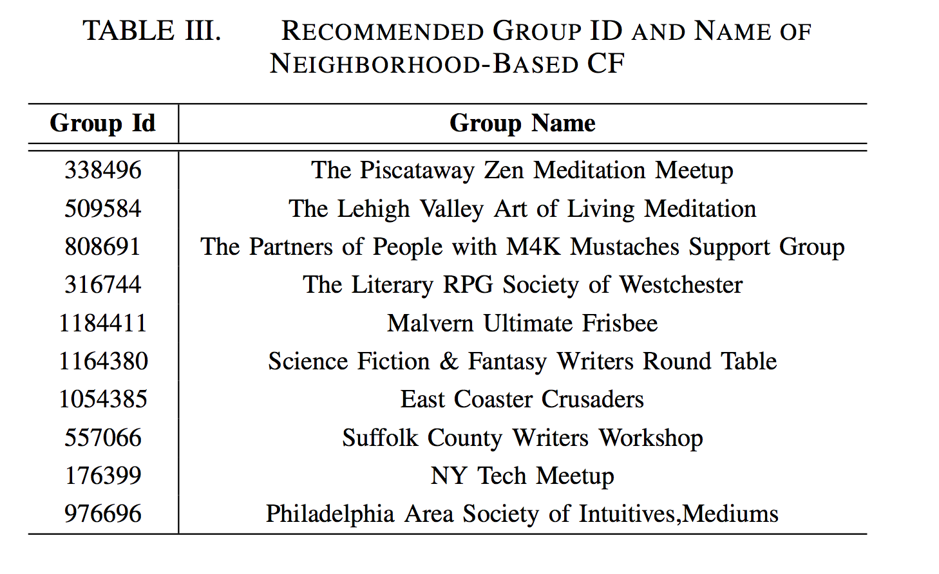
Simulated Results Analytics
User and Group Network
Neighborhood CF 93.882164 s
Item CF 4.41963 s
7

Slide 8
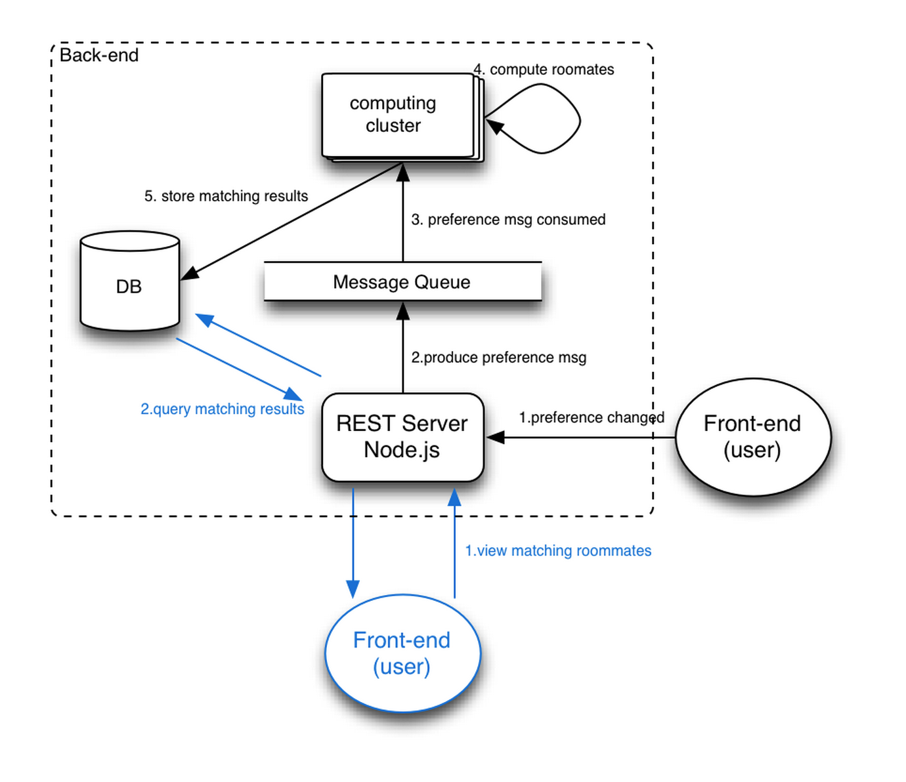
Web architecture
Node.js and mongo
8

Slide 9
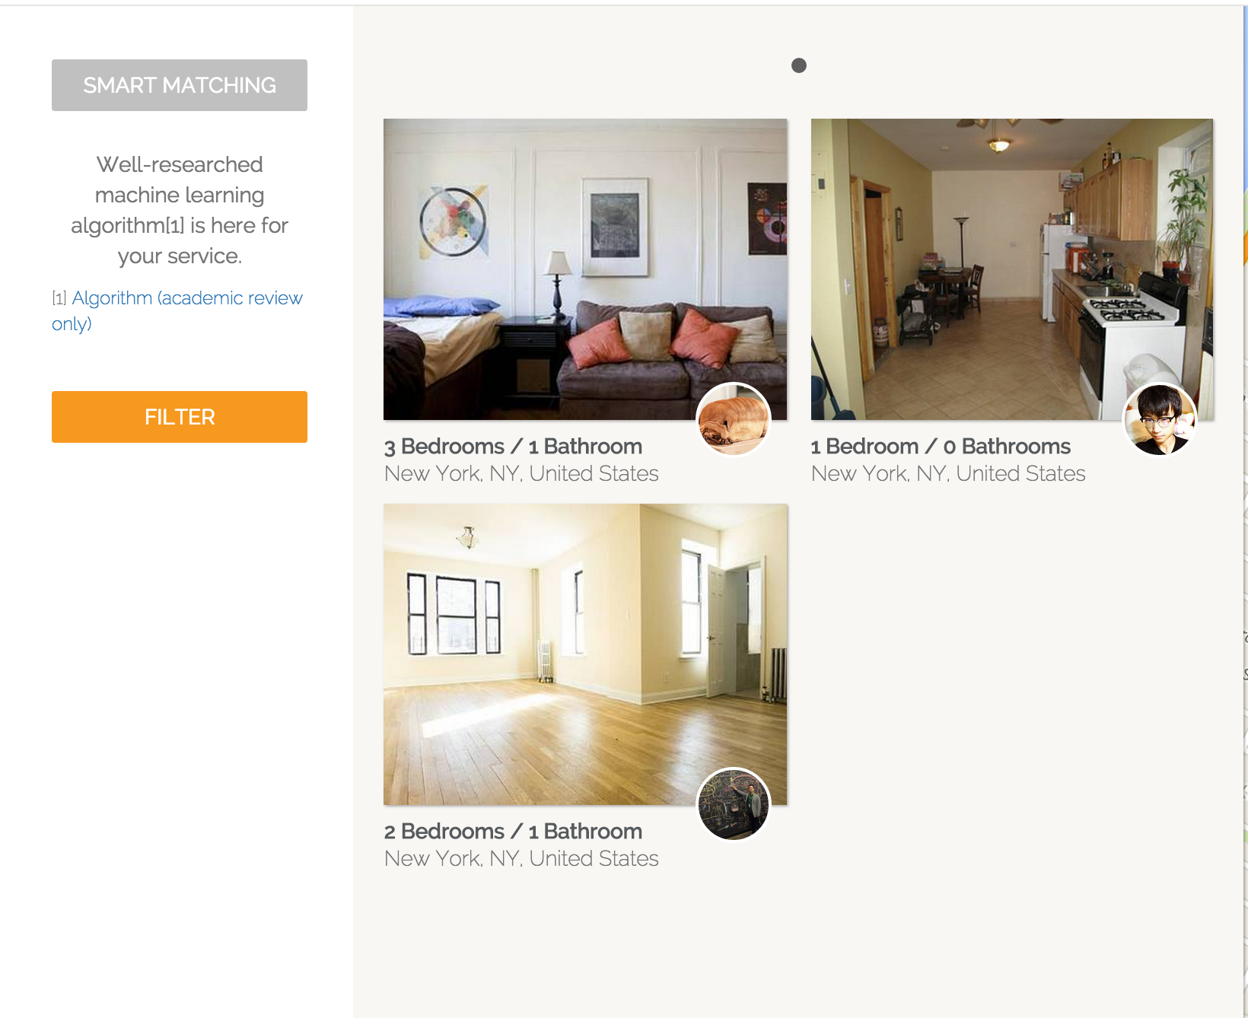
User Interface
https://test.roomhunter.us

