Slide 1

E6893 Big Data Analytics:
Your Project Name
Team Members:

Slide 2




Test Data – Good picture

Slide 3
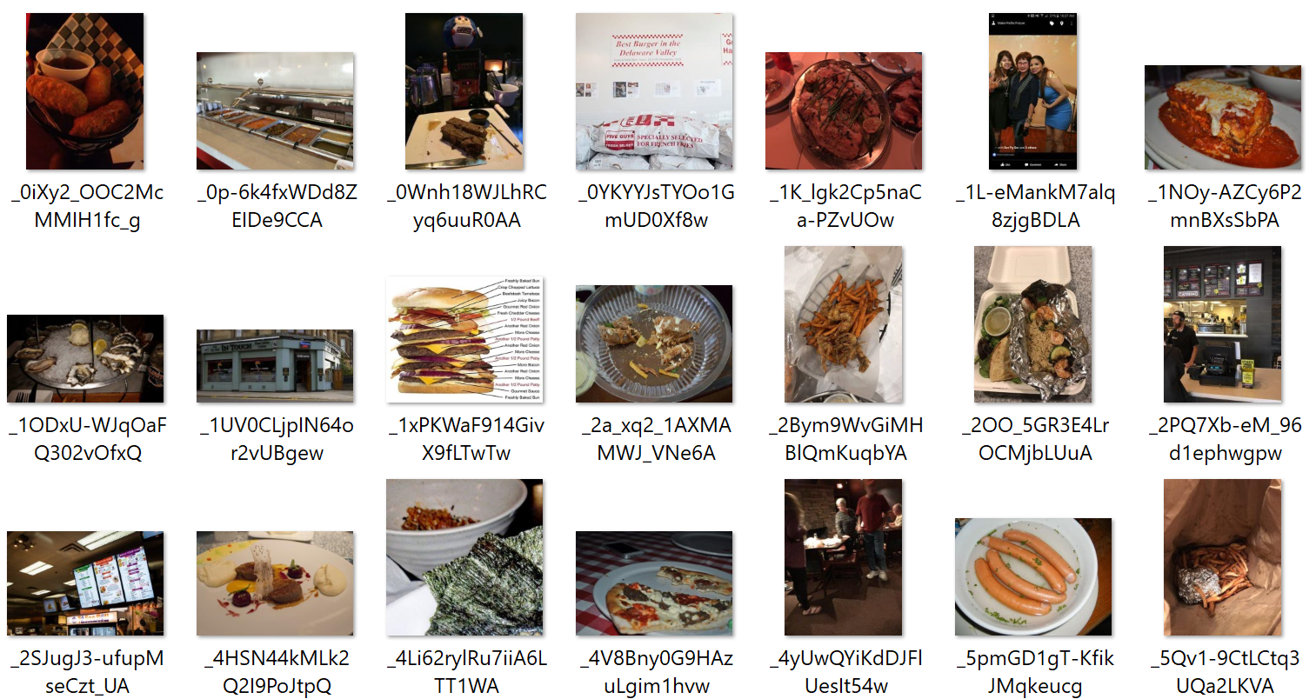



Test Data – Normal Picture

Slide 4
Expected Contributions and Timeline

