Slide 1
Stock Prediction
Base on financial statement
Group Member: Suyang Xu Jiahao Li Yue Zhang

Slide 2
Progress
1
Data collection
2
Data Processing
3
Model establishment
4
Training and Testing

Slide 3
PART ONE Data Collection
Target:
ShangHai Stock
ShenZhen Stock
Data sourse:
Financial Statement
Methods:
Requests and bs4 package
Website:
http://quotes.money.163.com
01
02
03
04

Slide 4
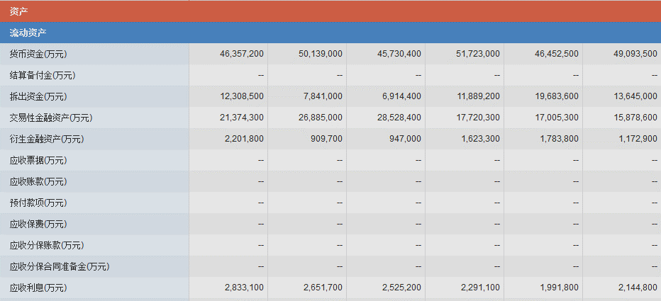
PART ONE Data Collection
This is a part of the balance sheet of YongHui Supermarket (ShangHai Stock Market 601933). We use the package mentioned in python to gather those data from the website

Slide 5
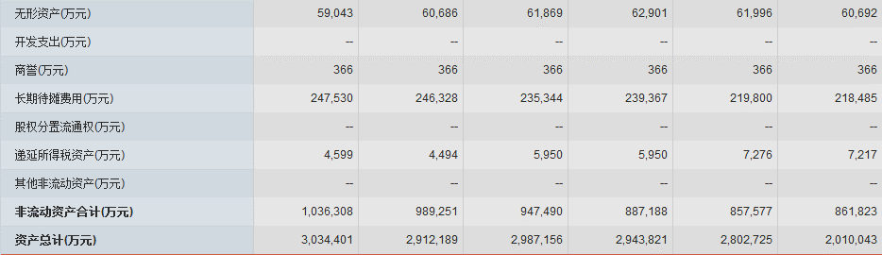
PART TWO Data Processing
2.1 Normalize
Obviously, after collecting those data, we couldn’t put them into the model directly, because there are large difference between the magnitude of different features
In our project, we choose debt and profits per share as our key feature. But we could notice in the figure that they have large difference in magnitude 3034401 vs 0.15, so we need to normalize them approprately

Slide 6
PART TWO Data Processing
2.1 Normalize
We could use the data in Every year to divide the data in the first year so that the data will be rescaled, for example, in the figure below
The data will be rescaled like this 3034401/2010043, 2912189/2010043, 2987156/ 2010043, 2943821/2010043, 2802725/2010043. But, if you process data like this, some information will lose. The real scale of the total asset of a company. Different company has different total asset, we still need a feature to describe this. So we introduce a special feature to report this. For example, if the total asset of a company is between 10000 and 100000, we report 0.2, if it is between 100000 and 1000000, we report 0.4, etc.

Slide 7
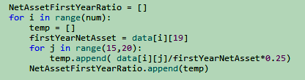
PART TWO Data Processing
2.1 Normalize
Coding implementation

Slide 8
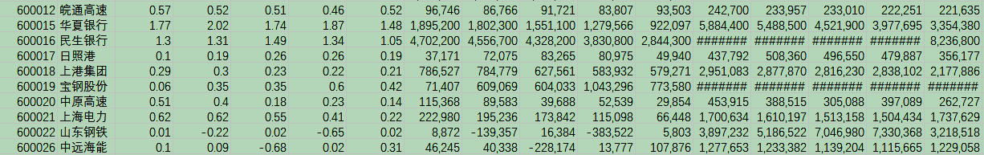
PART TWO Data Processing
2.2 Feature selection
From the book Security Analysis by Benjamin Graham, We understand that there are relevantly strong connection between some feature in financial statement and the quality of that stock. We use these knowledge and choose those features below.
Profits per share, Net Profits, Operating Profits, Net Assets, Debts, Price. Each feature was sampled between 2011 to 2015

Slide 9
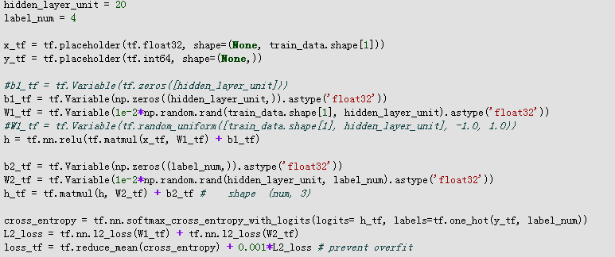
PART Three Model Establishment
3.1 model introduction
We use python as programming language and tensorflow as the machine learning framework. The shape of the input data is (1224, 48), that’s 1224 datas and 48 features for one data(stock). We build a 2 layer MLP and the hidden units are 20. We use L2 regularization to prevent Over-fitting.
A section of our Model

Slide 10
PART Three Model Establishment
3.2 label defination
We define 4 type of stock, Excellent stock, with label 3, good stock, with label 2, fair stock, with label 1 and no good stock , label 0.
We define p5,p4,p3,p2,p1 as the stock price of 2015-2011. and p_max = max{p5,p4,p3,p2,p1}, p_min = max{p5,p4,p3,p2,p1}, p_avg = mean{p5,p4,p3,p2,p1}. if p6 > (p_max-p_min)/4 + p_max, then it is the Excellent stock, if p6 > p_max and p6< (p_max-p_min)/4 + p_max, then it is the good stock, if p6>p_avg and p6<p_max, then it is the fair stock. Others are no good stock.

Slide 11
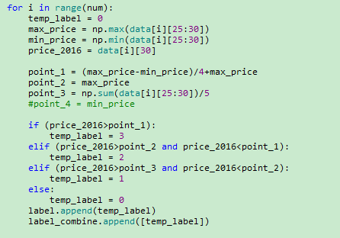
PART Three Model Establishment
3.2 label defination
Coding implementation

Slide 12
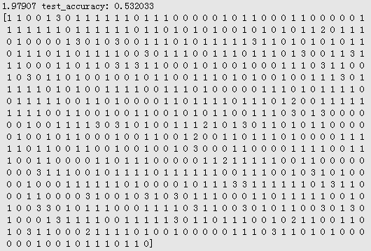
PART Four Training and Testing
Test Accuracy
Our Test Accuracy could reach 53.2033%, In some cases, it could reach 55%. Because there are 4 type of labels, the random classification accuracy should be 25%, so our model has 30% higher than that. So we could conclude that our model has reference value

Slide 13
Questions

Slide 14
THANK YOU
FOR
WATCHING
感谢聆听

