Slide 1

E6893 Big Data Analytics:
Relationship between population flow and criminal rate in Manhattan
Team Members (with UNI): Yunan Lu (yl4021)
Zhicheng Ding (zd2212)
Lin Bai (lb3161)

Slide 2
Motivation
Every day, large amount of people would rush to the school or work place in the morning and go back home in the evening through public transportation, e.g. taxi, subway. At the same time, crimes happens at everywhere. But whether it exists any pattern between the population density and the frequency of crimes? In a specific area, will it has more or less crimes when it is crowed? Besides, using the sentiment analysis of twitter we can describe the people’s attitude towards the traffic situation during the day.
With this prediction, we could do better in police resource distribution and give some suggestions to the public.
Crimes and Transportation Map
Crimes Map
Transportation trajectory of taxi and subway to represent the population flow and calculate the population density in each place in certain period
Regression Analysis
Visualize relationship between the population density and crime’s frequency
Sentiment Analysis
Sentiment analysis of Twitter based on the time to describe people’s mood or attitude towards the traffic situation

Slide 3
Dataset, Algorithm, and Tools
Dataset
New York City Crime
Taxi; Subway
Tweet Context (traffic)
Tools
d3.js
dimple.js
nodejs
html
javascript
css
Natural Language Processing
Algorithm
Data Preprocessing
Backend - Modeling
Frontend - Visualization
Data Mining
Data Aggregation
Data Cleanup
Data Visualization
Natural Language Processing
Feature Extraction

Slide 4
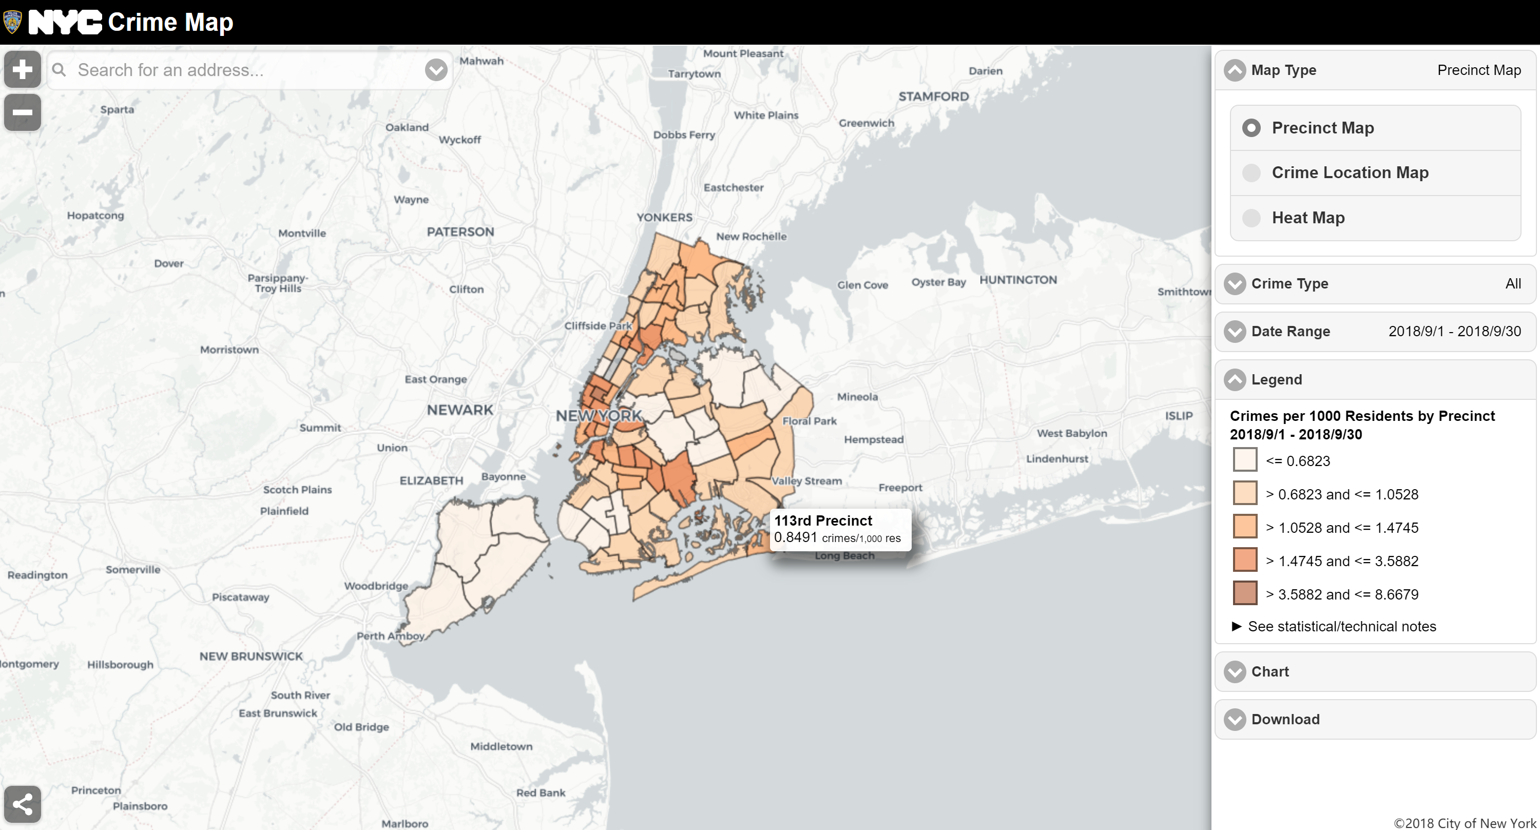
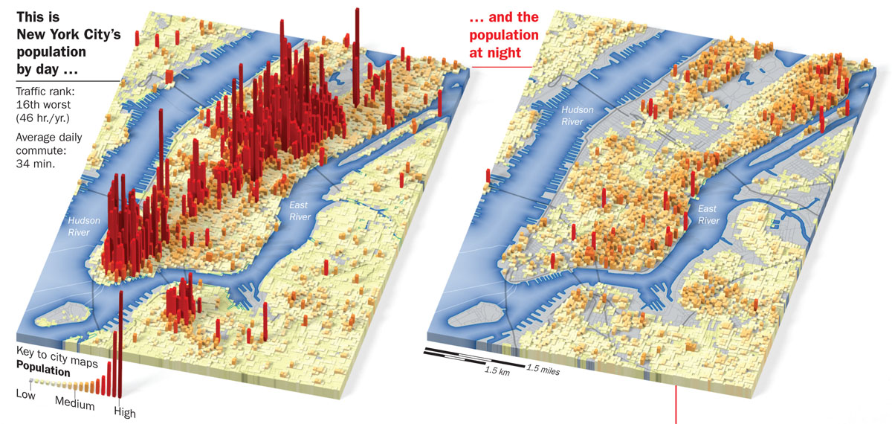
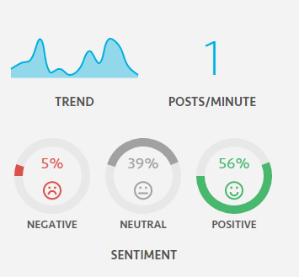
Crime Map [1]
Transportation Map [2]
Sentiment Analysis of Twitter [3]
Reference:[1] https://maps.nyc.gov/crime/
[2] https://imgs.6sqft.com/wp-content/uploads/2015/07/20212442/New-york-city-population-day-versus-night.jpg
[3] https://pbs.twimg.com/media/B09cXdeCIAAS9zf.png

Slide 5
Expected Contributions and Timeline
Contribution
Yunan LU
Crimes Map
Draw the crimes flow hour by hour using histogram and combine with the transportation
Zhicheng Ding
Transportation Map
Draw the transportation trajectory of bus, taxi and subway
Regression analysis
The relationship between population flow and criminal rate
Lin Bai
Sentiment Analysis
Sentiment analysis of Twitter based on the time
Proposal
Deadline: Nov. 1st
Content:
Milestone
Deadline: Nov. 22nd
Content:
Final
Deadline: Dec. 13rd
Content:
Sentiment analysis of twitter for specific time period
General ideas
Search for Dataset
Confirm algorithms and tools
Create crimes map
Regression analysis of crime frequency and population density
Create transportation map
Create a website

Slide 6
Youtube link: public
https://youtu.be/vOyisfkSr_E

