Slide 1

E6893 Big Data Analytics:
Food recognition and recommendation web app
Team Members :
Kehan Yang ky2398
Boyu Yang by2267

Slide 2
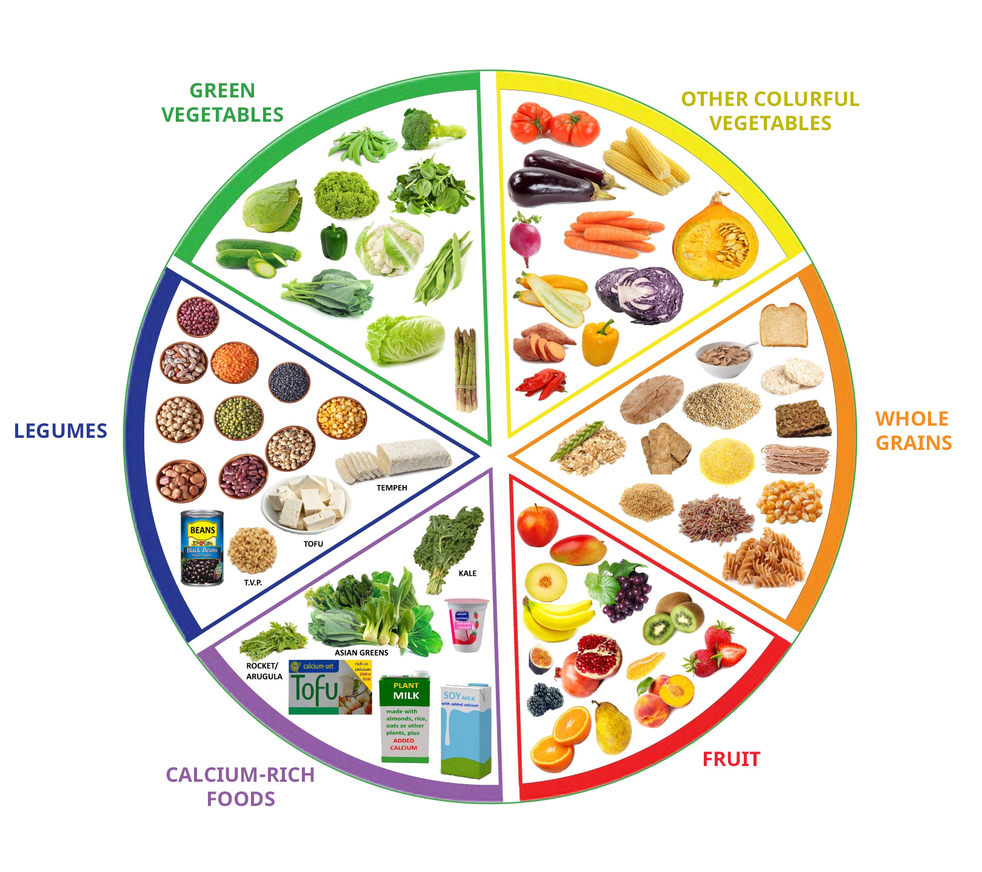
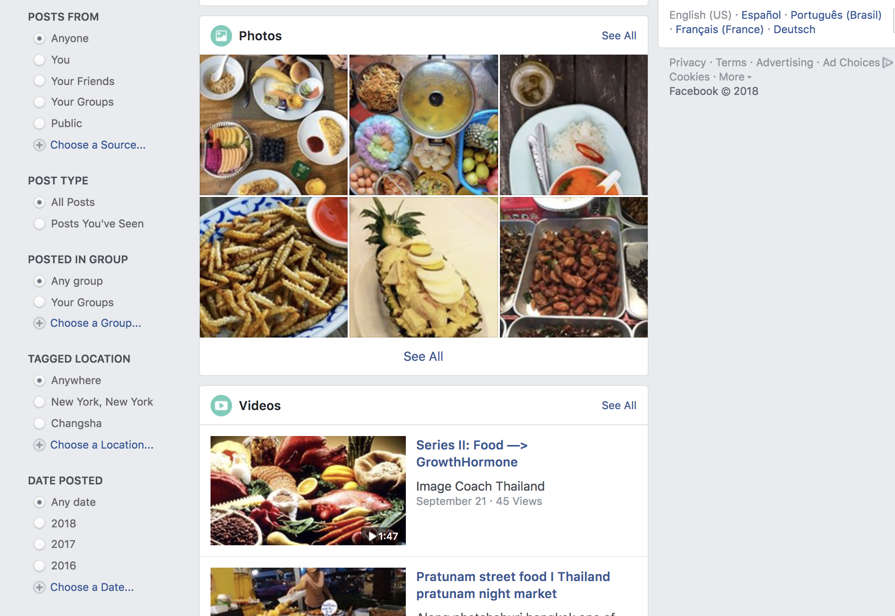
Motivation
Sharing eating everyday
Sharing eating everywhere
What we want to eat?
How can we eat healthy?
?

Slide 3
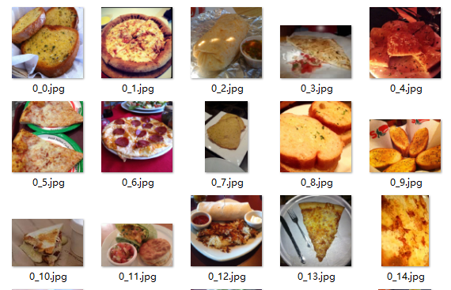
Dataset, Algorithm, and Tools
Dataset:
Food-11 dataset
Food-11 dataset consists of 16643 food images grouped in 11 major food categories.
There are 9866 training images, 3430 validation images and 3347 test images.

Slide 4
Dataset, Algorithm, and Tools
Flowchart:
Dataset classification
Classification model
Users upload images
Images classification
Table search by results
Nutrition facts presentation
Food recommendation

Slide 5
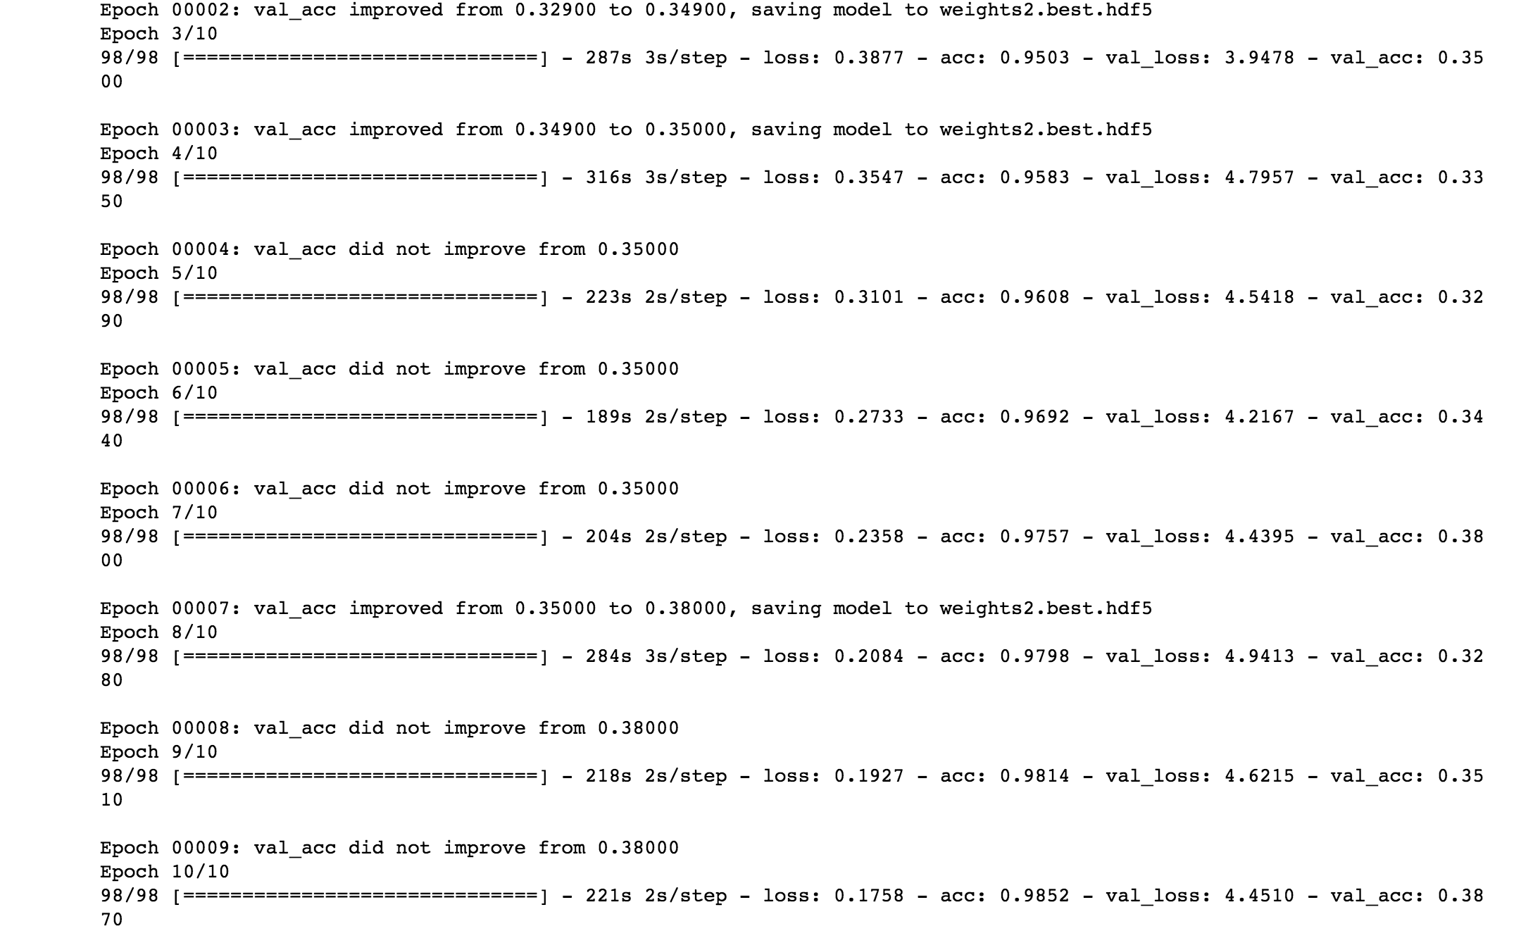
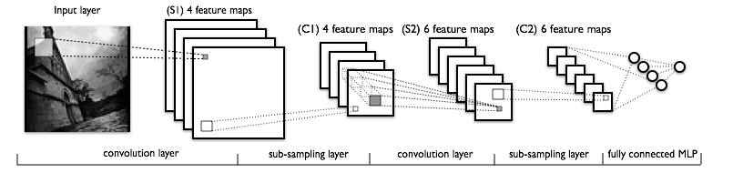
Dataset, Algorithm, and Tools
Classification Algorithm:
Keras CNN: LeNet
Add Batch Normalization layer to decrease overfitting
Tool: TensorFlow Keras

Slide 6
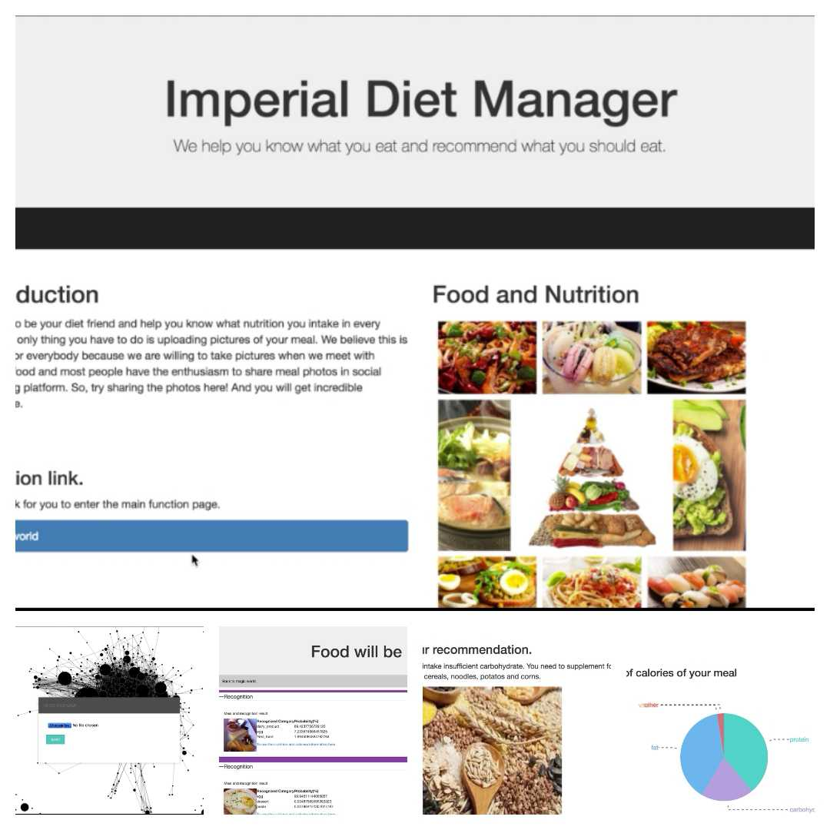
Web and Demo
Tool: python, html, flask, D3.js, CSS
Model loading
Backend runs
Homepage
web design
Storing image
Upload page
Recognize based on nn model and compute nutrition
result page
nutrition page
Demo Youtube link:
https://youtu.be/tm7K8XxK4vU

Slide 7
Contributions and Timeline
Contributions:
Finished classification of food-11 dataset
Built a webpage to help utilize the classification model
Food recommendation and nutrition analysis according to classification results
Timeline:
date | completed
11/02~ 11/15 | Dataset preparation and classification
11/15 ~ 11/22 | Web page and nutrition table building
11/22 ~ 11/29 | Image classification and food recommendation function testing
11/29 ~ 12/13 | Model and web optimization
12/13 ~ 12/20 | Final report and video

