Slide 1
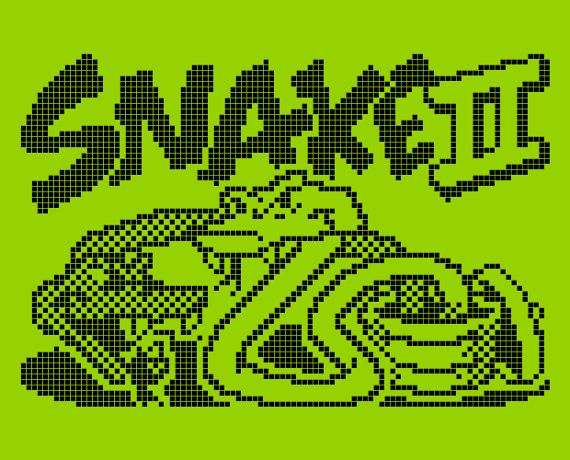
Retro snake Game
ARYAN MITTAL (2010110154)
MAYANK PRATAP (2010110391)
SAPTADWEEPA DUTTA(2010110894)
VAIBHAV PRASAD (2010110696)
GitHub Link : https://github.com/Saptadweepa-Dutta/FPGA_PROJECT
Notes:
NOTE:
To change the image on this slide, select the picture and delete it. Then click the Pictures icon in the placeholder to insert your own image.

Slide 2
CONTENT
Introduction
Theory
Equipment and electronics
Project flowchart
FSM
Demo

Slide 3
Introduction
"Snake" is a simple game where the user controls a snake to eat items generated at random locations in the play area. The snake gets longer and harder to control the more items it consumes. You lose if the head of the snake collides with its own body.
The game has appeared in many different forms over the decade but its first appearance originated from the 1976 arcade game Blockade, and variations on the game are still around today.
By 1997, it had found its way into peoples pocket, onto their Nokia phone and created the craze of mobile gaming among teenagers.

Slide 4
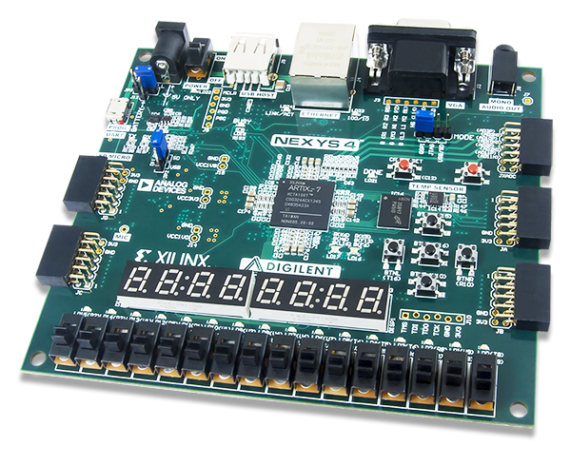
Equipment and electronics used:
- Nexys 4 board
- VGA cable & monitor
- USB cable
- Power cable for board
- Xilinx Vivado

Slide 5
Functionality
The design is supposed to get input from switches on the Nexys 4 board which is the direction in which you want the snake to go. Then it will be processed by the movement module to output the next position of the snake, which will be displayed on the screen through the VGA.
The objects for the snake to eat will appear at random positions on the screen. For the snake to get longer, the snake must pass over and “eat” the objects (apples). And if the snake run into itself the game will end.
We used VGA for visuals, so we needed to abide by the 640x480 pixel requirements for our graphics. We decided that each square in the game board should take up a 20x20 pixel area, giving us 32x25 spaces to work with.
We also decided that, while the VGA would require a 25MHz clock, we would update the game pieces 4 times a second (4 Hz) so that it would take 8 seconds for the snake to move all the way from the left side of the screen to the right side.

Slide 6
Modules
Snake top
Snake core
Display controller
Snake controller

Slide 7
Blockade Variant Game Design
Module: VGA Display
Module: Objective Generator
Module: Lose Condition
Module: Body & Head Module
VGA Refresher
H-Sync & V-Sync are outputs
Head hits body
Generates an objective in a random position within display
Keyboard inputs; Up, Right, Down, Left using OP code
Resets the score and the body segments obtained
RGB to illustrate “snake”, objective, and border
Generates a new objective after old objective has been obtained
As score goes up, new segments of the body are illustrated
Resets head back to the starting position with a new objective
Maintains a score of how many objectives were maintain
Clock Divider Module -Input
4 Hz

Slide 8
FSM for our snake game
Qi
INIT
Qm
MOVE
Qh
HOLD
Qe
EAT
Qu
UNKN
Qc
CHECK
Qw
WIN
Ql
LOSE
Sets up initial snake positions and length.
Updates the snake's position based on the current direction.
A default case for unknown states.
A state for maintaining consistent game speed.
Increases the snake's length and generates a new food location.
Checks for conditions like eating food or colliding with the snake's body.
Colliding with the snake's body.
If the score reaches 15

Slide 9
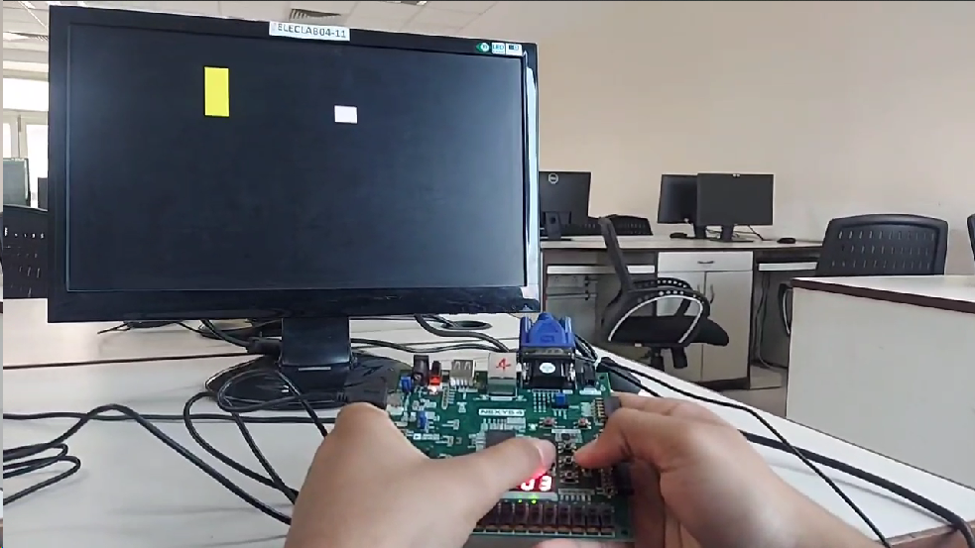
Some photo-stills

Slide 10
DEMONSTRATION
Nexys 4 Board

Slide 11
ALGORITHM FOR RANDOM NUMBER GENERATOR
Incremental Food Location Update: On each positive clock edge, the rand_loc variable is updated by incrementing its current value.
Dynamic Food Location: The Food variable, representing the current food location, is assigned the value of rand_loc. As rand_loc is continuously incremented, the Food location dynamically changes.
Collision Check: In the CHECK state, the algorithm checks if the head of the snake has reached the current food location: if (locations[0] == Food) begin... If a collision occurs, the game transitions to the EAT state.
New Food Location on Collision: In the EAT state, the Food variable is updated with a new value, ensuring a change in the food location. This change in the food location contributes to the dynamic nature of the game.
Usage in Game Logic: The dynamically changing Food location adds variability to the gameplay, influencing the snake's movement strategy.

Slide 12
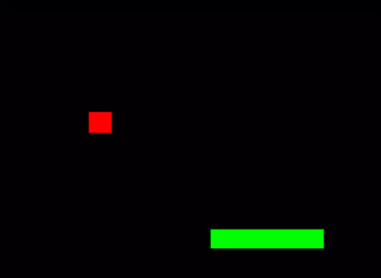
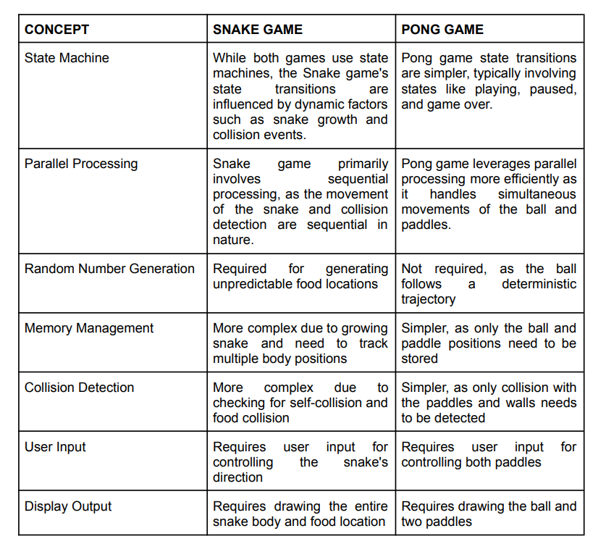
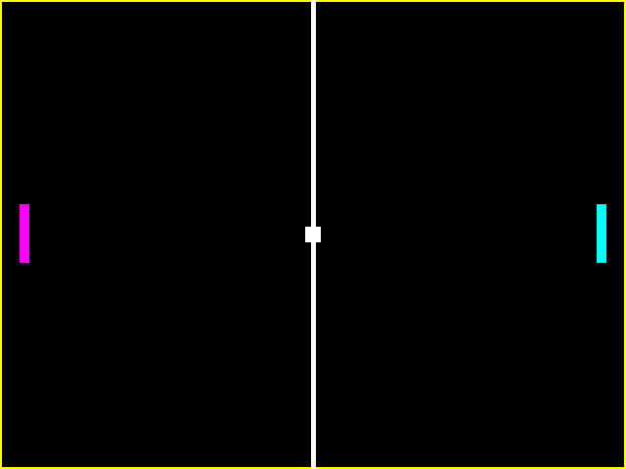
COMPARISON BETWEEN SNAKE GAME AND PONG GAME

