Slide 1

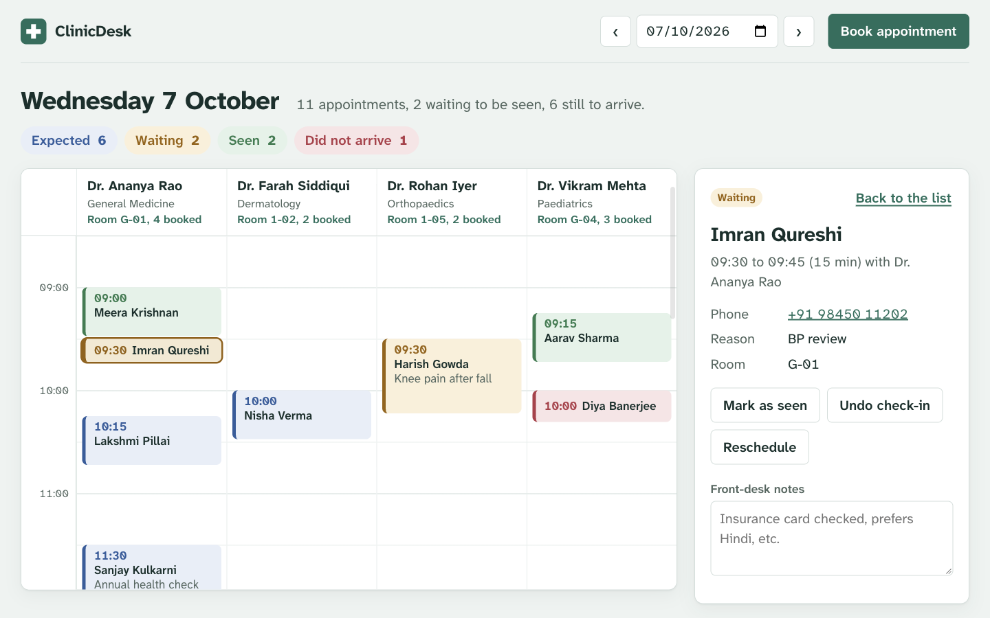
From commit to cluster: shipping a clinic front-desk app with DevSecOps
ClinicDesk
Session 21 final capstone · SST DevOps & Cloud [SWE]
Saptak Banerjee · October 2026
FastAPI · React · PostgreSQL · Docker · GitHub Actions · Trivy · Terraform · EKS · Helm · Argo CD · Prometheus · Grafana
Notes:
Introduce yourself and the project. ClinicDesk is my own application, a front-desk system for a small clinic, and I took it all the way from source code to a production-style deployment on AWS EKS with a security-gated CI/CD pipeline and GitOps.

Slide 2




ClinicDesk runs a clinic's whole day on one board
Day board
One column per doctor on a time grid; colour shows each visit's state.
Safe booking
New or returning patients. The API returns 409 when a doctor would be double-booked.
Visit flow
Check in, mark seen or did-not-arrive, reschedule, cancel, add notes.
Daily stats
Totals per state, per-doctor load and the next 7 days of bookings.
Real UI served by nginx in front of the FastAPI backend
Notes:
The domain is my own, not the TaskBoard reference. Three related tables (doctors, patients, appointments), booking rules with overlap detection, and a timezone-aware stats endpoint. Point at the day board: columns are doctors, colours are visit states.

Slide 3








The stack, layer by layer
Frontend
Backend
Data
Testing
React 19 + Vite 8, served by nginx-unprivileged on :8080
FastAPI, Uvicorn, Pydantic; /health, /ready, /metrics
PostgreSQL 18, SQLAlchemy 2.1, Alembic migrations
pytest 9.1 with SQLite in memory, never the real DB
Containers
CI/CD + security
Infrastructure
Platform
Multi-stage Alpine images, non-root, Docker Compose
GitHub Actions, Trivy, Bandit, Semgrep, pip-audit, gitleaks
Terraform: VPC, NAT, EKS 1.36 in ap-south-1
Helm, ingress-nginx, Argo CD, Prometheus, Grafana
Notes:
Every version is pinned in the repo. The frontend and backend run as non-root users; PostgreSQL runs as a StatefulSet with an EBS volume on EKS.

Slide 4
Architecture: CI writes to Git, the cluster pulls
Developer
git push to main
GitHub repo
app, chart, Terraform
GitHub Actions
test · scan · build · gate
GHCR
clinicdesk-*:<commit SHA>
Receptionist
browser
gitops/values-eks.yaml
bot commit bumps the tag
Terraform
VPC · subnets · NAT · EKS
AWS EKS 1.36 · ap-south-1 · namespace clinicdesk (restricted Pod Security)
frontend × 2
nginx :8080
Argo CD
syncs the Helm chart
Pull, not push
GitHub never holds a kubeconfig or AWS key. The pipeline's last step is a Git commit; Argo CD inside the cluster pulls it.
Ingress (NLB)
/ and /api
backend × 2–5
FastAPI :8000, HPA
PostgreSQL
StatefulSet + EBS PVC
Prometheus
scrapes /metrics
Grafana
8-panel dashboard
Notes:
Walk the arrows. A push triggers GitHub Actions: tests, five kinds of security scan, image build, a security gate, then images are pushed to GHCR tagged with the commit SHA. The last job commits the new tag into gitops/values-eks.yaml. Argo CD in the cluster sees that commit and syncs the Helm chart. Terraform built the VPC and EKS cluster. Users come in through ingress-nginx on an AWS NLB: slash goes to the frontend, /api to the backend.

Slide 5
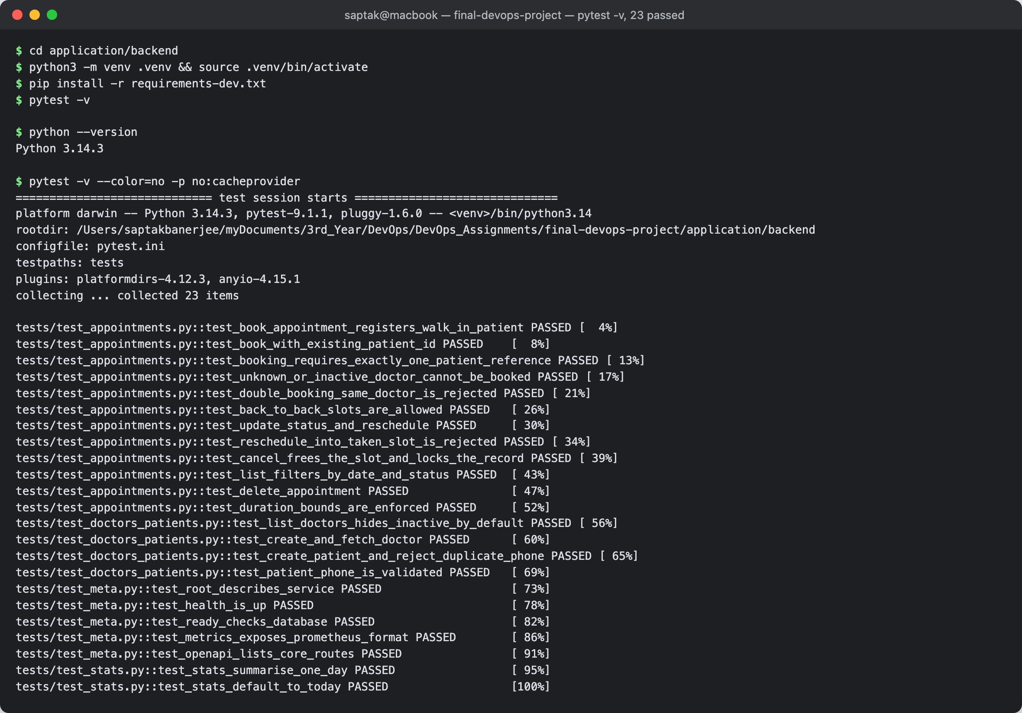
Application and tests: 23 checks gate every build
23
pytest tests pass in 0.64 s, on SQLite in memory, never the real database
3
tables (doctors, patients, appointments) managed by 2 Alembic migrations
409
returned when a booking would clash with a doctor's existing slot
REST API: GET / POST / PUT / DELETE on appointments, plus doctors, patients, stats, /health, /ready, /metrics
Notes:
Tests run against SQLite in memory through conftest.py, so they never touch the production database. They cover doctors, patients, appointments including the clash rule, stats, health and metrics. If any test fails, the pipeline stops before anything is built.

Slide 6
Containers: small, non-root, zero HIGH or CRITICAL CVEs
Backend image
Frontend image
docker compose up --build
Multi-stage on python:3.14-alpine
Runs as uid 10001, read-only root filesystem
Migrates with Alembic, then starts Uvicorn
Stage 1: node:24-alpine runs vite build
Stage 2: nginx-unprivileged serves dist/
Proxies /api to the backend
frontend on localhost:3000
backend on :8000 with health checks
PostgreSQL 18 with a named volume
44 → 0
HIGH CVEs in the backend image after moving from a Debian-slim base, where none had a fix, to Alpine. Ignoring unfixed CVEs would have turned the scan green while shipping all 44.
Notes:
Both Dockerfiles are multi-stage and both images run as non-root users; the pipeline fails if an image would run as root. The 44 to 0 story is the clearest security win in the project.

Slide 7
CI/CD: ten jobs from a push to a promoted release
1
2
3
4
5
Test: pytest + vite build
SAST: Bandit, Semgrep
SCA + IaC: pip-audit, npm audit, Trivy
Secrets: gitleaks
Docker build (both images)
6
7
8
9
10
Image scan: Trivy
Security gate
Push to GHCR as :<SHA>
Helm install on kind
GitOps promote
A real run on GitHub Actions, commit dbbdd49, 4 min 26 s end to end
Triggers: every push to main that touches the project, plus pull requests. Tags: ghcr.io/saptak-cyber/clinicdesk-{backend,frontend}:<commit SHA>, never latest.
Notes:
Ten jobs. Tests come first and any failure stops the run. Scanners write reports; the security gate reads all nine and blocks the push if any policy fails. Only the exact image tarballs that were scanned get pushed to GHCR, tagged with the commit SHA. Job 9 proves the chart installs on a throwaway kind cluster; job 10 commits the new tag for Argo CD.

Slide 8






DevSecOps: nine reports, one gate that fails closed
SAST Bandit, Semgrep
What Trivy found
Security gate
security_gate.py applies gate-policy.toml to every report. A missing report fails.
Trivy scanned both images' OS packages and their Python and npm libraries. The final run had 0 HIGH and 0 CRITICAL, so the gate passed.
Findings fixed on the way: 44 unfixable HIGH CVEs in Debian-slim (removed by moving to Alpine), Bandit B608 f-string SQL in a migration, and a writable root filesystem on PostgreSQL.
SCA pip-audit, npm audit, Trivy fs
IaC Trivy config on K8s, Helm, Terraform
Secrets gitleaks, full history
Images Trivy on both images
Gate verdict on the live-demo run: all nine checks PASS, SECURITY GATE: PASSED. Any HIGH or CRITICAL finding fails the build before an image is pushed.
Notes:
This is where you explain the Trivy result for M6. Trivy scanned the operating-system packages and language dependencies in both images; HIGH and CRITICAL are configured to fail. The final scan was clean. Earlier, the Debian base had 44 HIGH CVEs with no fix available, which is why I switched to Alpine.

Slide 9
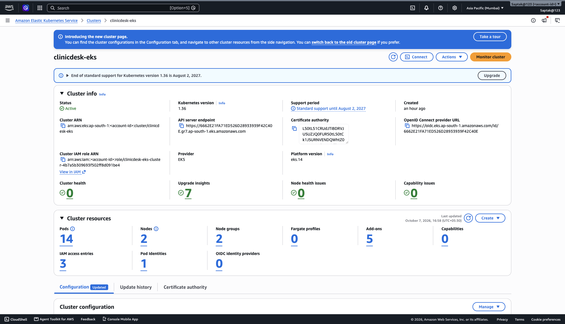
Terraform builds the AWS foundation in one apply
61
14 min
0
resources created
apply, 9 of it the EKS control plane
resources left after destroy
VPC 10.42.0.0/16: 2 public + 2 private subnets across ap-south-1a and 1b, one NAT gateway
EKS 1.36, managed node group of t3.medium (min 1, desired 2, max 3) in private subnets
Add-ons: VPC CNI, CoreDNS, kube-proxy, metrics-server, EBS CSI via Pod Identity
Only terraform.tfvars.example is committed; no credentials in Git
clinicdesk-eks Active in Asia Pacific (Mumbai): 2 nodes, 5 add-ons
Notes:
Show terraform plan in the demo. It uses the community VPC and EKS modules. One NAT gateway keeps cost down for a classroom; production would use one per zone. Everything is destroyed after the demo, and the AWS CLI sweep shows nothing billable left.

Slide 10
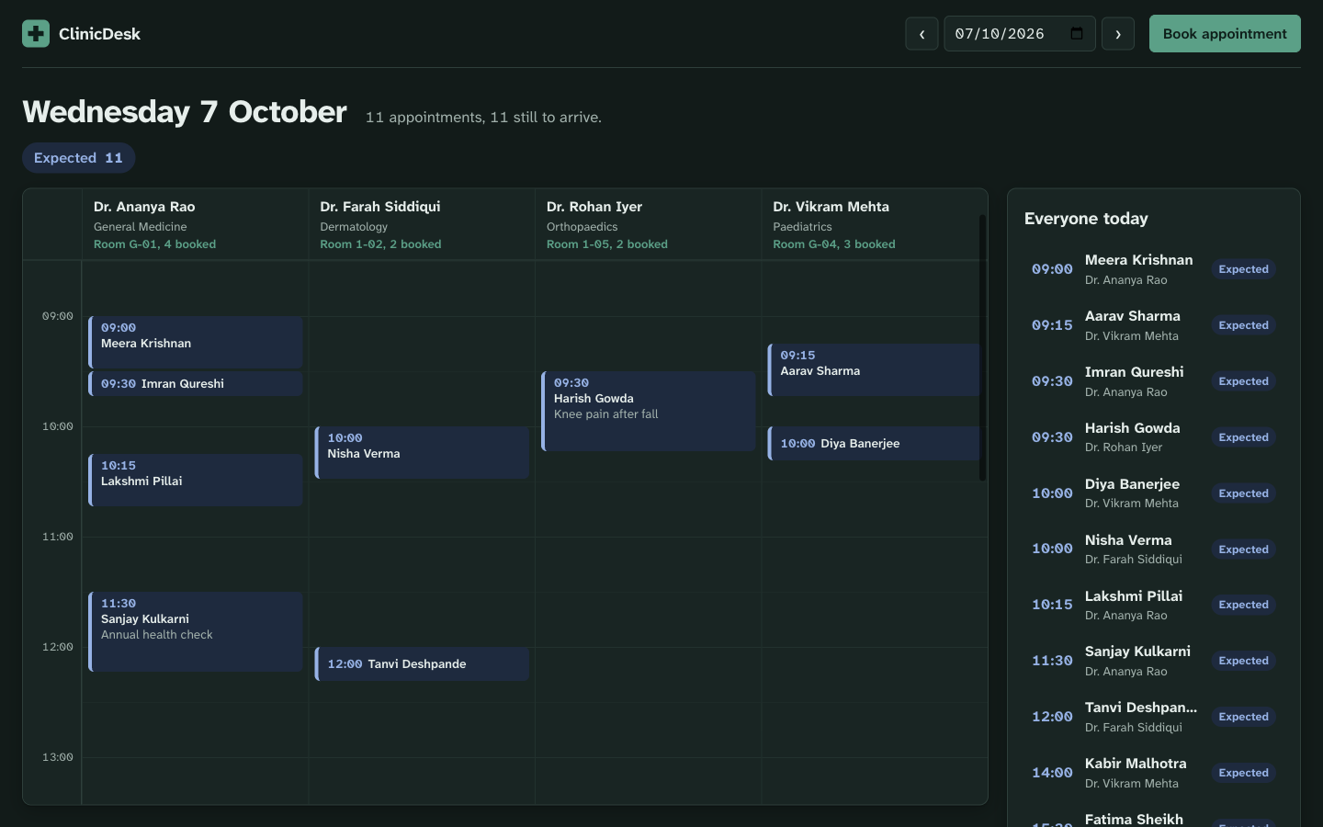





Kubernetes and Helm: one chart for dev, prod and EKS
Namespace
clinicdesk with restricted Pod Security
Deployments
frontend and backend, 2 replicas each; backend HPA 2–5 at 60% CPU
Services + Ingress
ClusterIP Services; Ingress sends / to frontend, /api to backend
PostgreSQL
StatefulSet with a 5 GiB gp3 PVC on EBS
Helm values
values-dev, values-prod, gitops/values-eks
The app on EKS, reached through the ingress-nginx NLB
Notes:
In the demo: kubectl get pods, svc, ingress in the clinicdesk namespace, and helm list. Probes are split: /health for liveness never touches the database, /ready for readiness does, so a database outage takes pods out of rotation without restart loops.

Slide 11
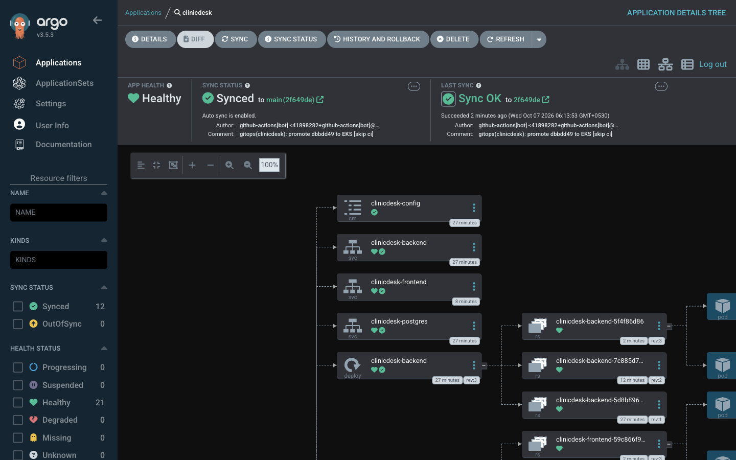
GitOps: Argo CD keeps the cluster equal to Git
1
Commit
ClinicDesk 1.1.0 adds opening hours to the footer
2
Pipeline
Tests, scans, gate, push dbbdd49 images to GHCR
3
Promote
Bot commit sets both tags in values-eks.yaml [skip ci]
4
Sync
Argo CD polls every 60 s and rolls out the new SHA
6 s
for self-heal to undo a manual ConfigMap edit and a deleted Service
Argo CD: clinicdesk Synced and Healthy at the bot's promotion commit
Notes:
This is the commit, pipeline, deployment-update loop the rubric asks for. Show the Argo CD app, the revision it is on, then push a small change and watch the revision and the image tags change.

Slide 12
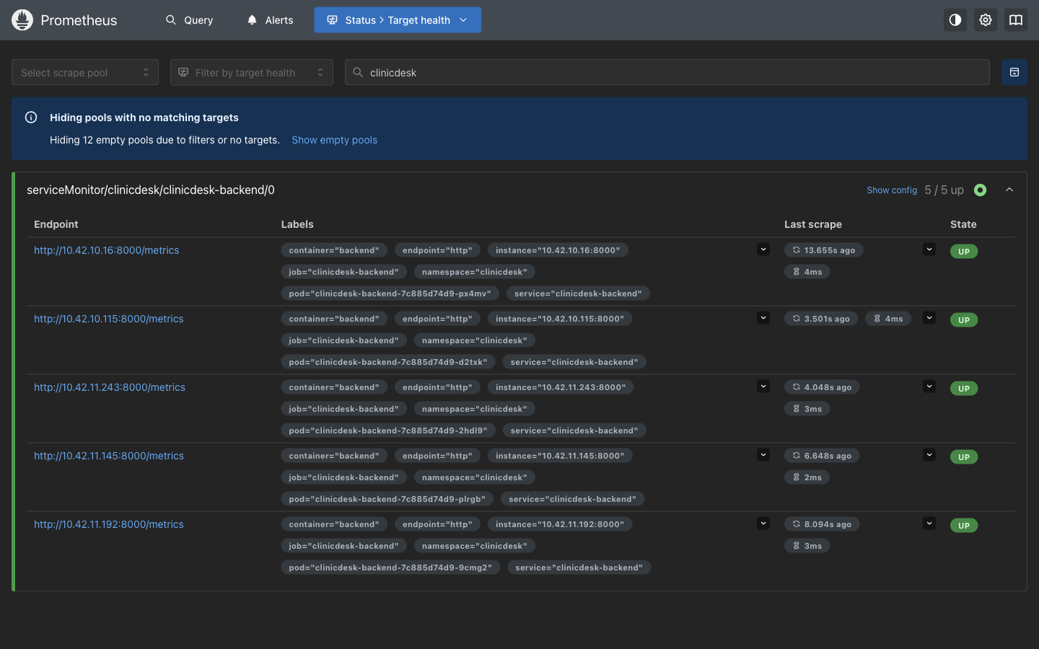
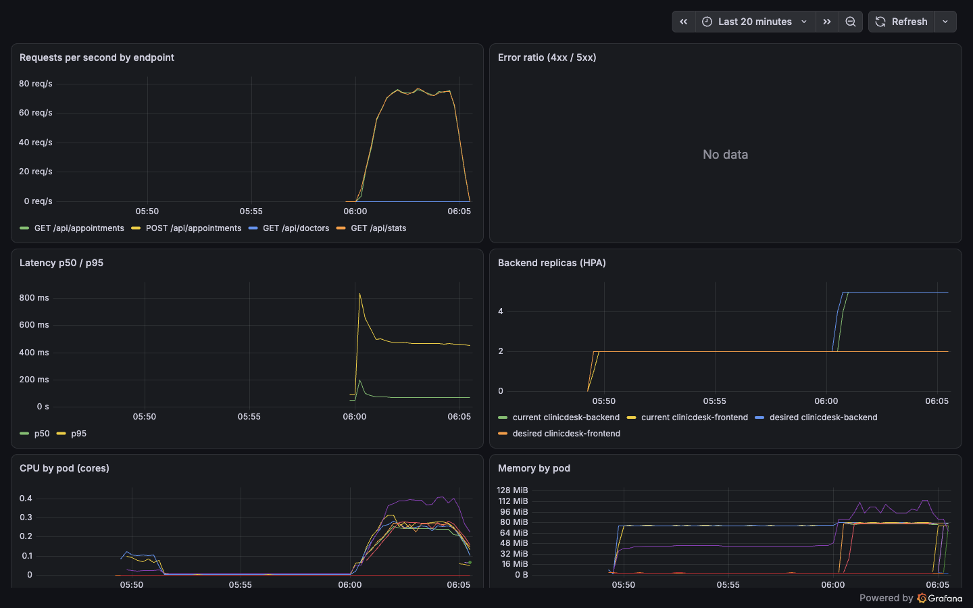
Observability: every pod scraped, every request graphed
Prometheus: a ServiceMonitor scrapes /metrics every 15 s; 5 of 5 backend pods UP during load.
Grafana: 8 panels (request rate, error ratio, p50/p95 latency, HPA replicas, CPU, memory) plus 3 alert rules.
Notes:
kube-prometheus-stack installs Prometheus and Grafana. The dashboard is provisioned from a ConfigMap. During the load test the request rate climbs to about 75 requests per second and the HPA scales the backend from 2 to 5 pods.

Slide 13
Key learnings
01
02
03
No fixable vulnerabilities is not no vulnerabilities
Pods, not cores, filled the cluster
Liveness and readiness answer different questions
Changing the base image removed 44 HIGH CVEs that ignore-unfixed would have hidden.
With the VPC CNI a t3.medium holds 17 pods; an autoscale plus rollout hit that limit.
Database down made pods unready without a single restart, and they recovered by themselves.
04
05
06
GitOps changes how you fix things
The API server's defaults are part of the diff
Pull-based delivery removes a secret
Self-heal undid manual changes in seconds, so the fix has to go into Git.
A StatefulSet stayed OutOfSync until the chart spelled out the defaulted fields.
GitHub never held a kubeconfig or AWS key; deployment is a Git commit.
Notes:
Pick two or three of these to talk about. Each one came from something that actually went wrong or nearly went wrong on the real cluster.

Slide 14
Next: the live walkthrough
ClinicDesk
Repository
github.com/Saptak-cyber/DevOps_Assignments
/tree/main/final-devops-project
Full technical write-up
final-devops-project/README.md
1. Codebase and folder structure
2. CI/CD: push and watch the pipeline
3. Terraform plan and the AWS console
4. Argo CD: synced app and GitOps flow
5. Kubernetes: pods, services, ingress
6. Prometheus targets UP
7. Grafana live dashboard
Notes:
Switch from the slides to the terminal and browser for the live walkthrough, in the order: codebase, CI/CD, Terraform, Argo CD, Kubernetes, Prometheus, Grafana.

