Slide 1
Pre-Release Movie Success Analysis
Kumar Sai Jonnala (kumar.jonnala@ovgu.de)
Saptak Chakraborty (saptak.chakraborty@st.ovgu.de)

Slide 2
Motivation:
The film industry is a high-risk, capital-intensive market:
Studios invest $65–100 million per film on average
Only 40% of theatrical releases are profitable
Industry losses: billions annually due to box office failures
Better prediction = Better decisions = Reduced financial risk

Slide 3
Methodology:
To predict movie success before release with the help of machine learning, enabling:
Data-driven greenlighting decisions
Optimized marketing spend and release timing
Early identification of high-risk projects
Understanding which factors drive box office success

Slide 4
Questions:
Can we predict movie success (Hit vs Flop) using pre-release features?
Which features are most important for predicting box office success?
How do different machine learning algorithms compare for this classification task?

Slide 5
Datasets
The Numbers database: 6,000+ movies with budgets, revenues, release data, other features
IMDB database: Cast & Crew data
Google Trends: Movie popularity and search interest

Slide 6
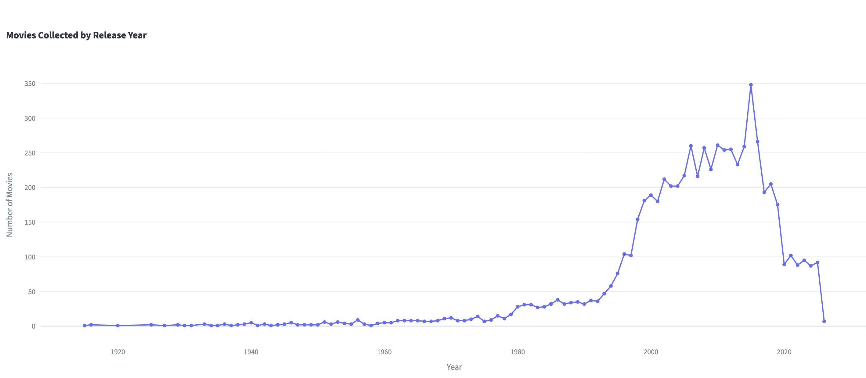
Market and Data Insights: Data
Movies collected by release year

Slide 7
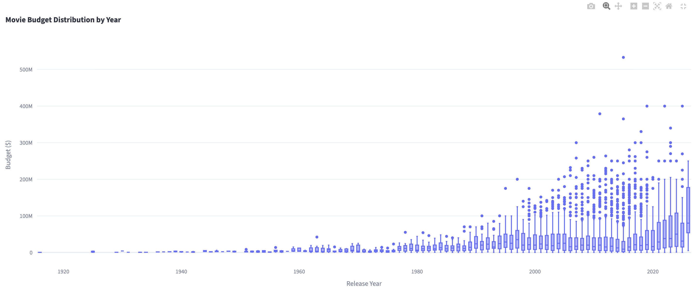
Market and Data Insights: Data
Budgets increased with time

Slide 8
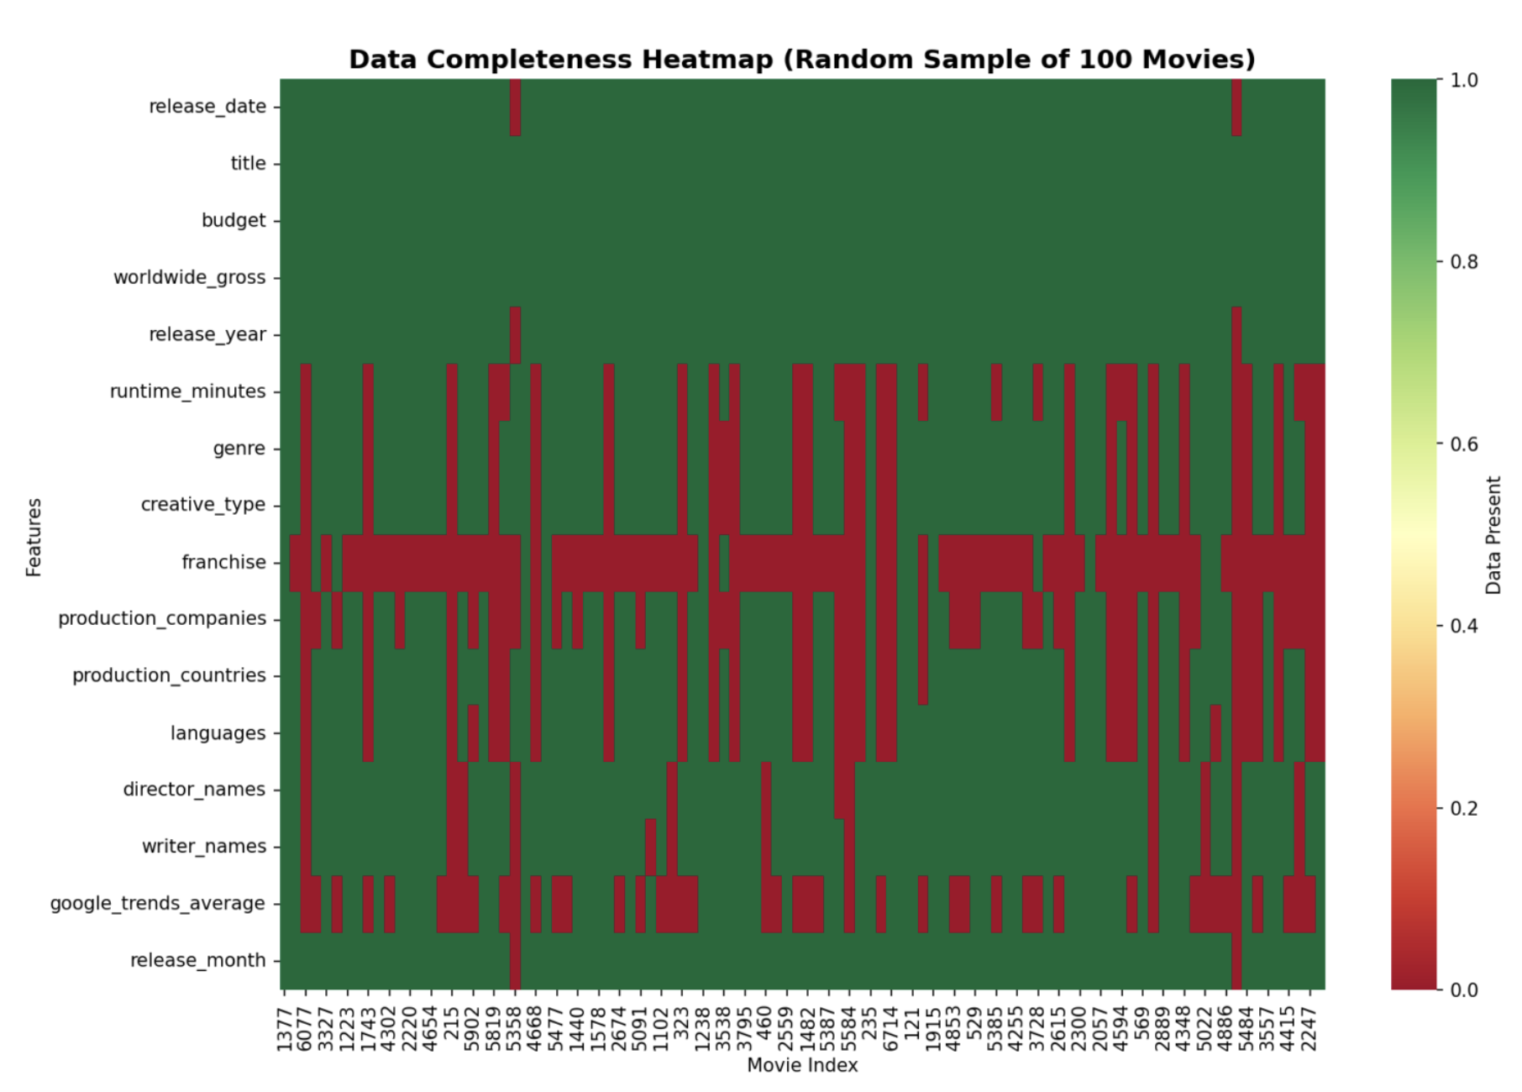
Data Completeness & Quality
Observed higher missing values in some columns

Slide 9
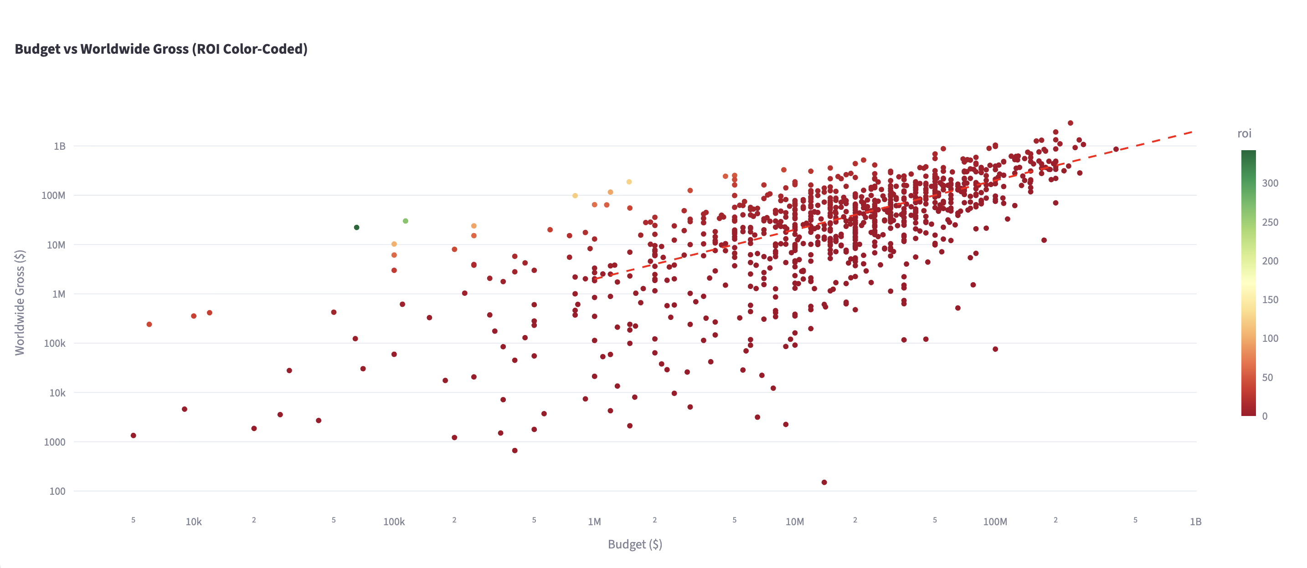
Budget vs Revenue & ROI
Higher budget generally generates more revenue but not necessarily success

Slide 10
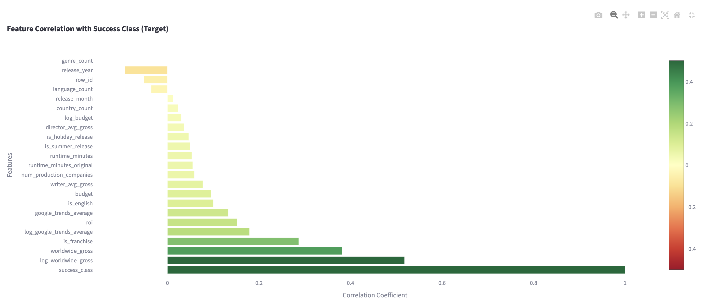
Feature Correlation with Target
Correlation with Target

Slide 11
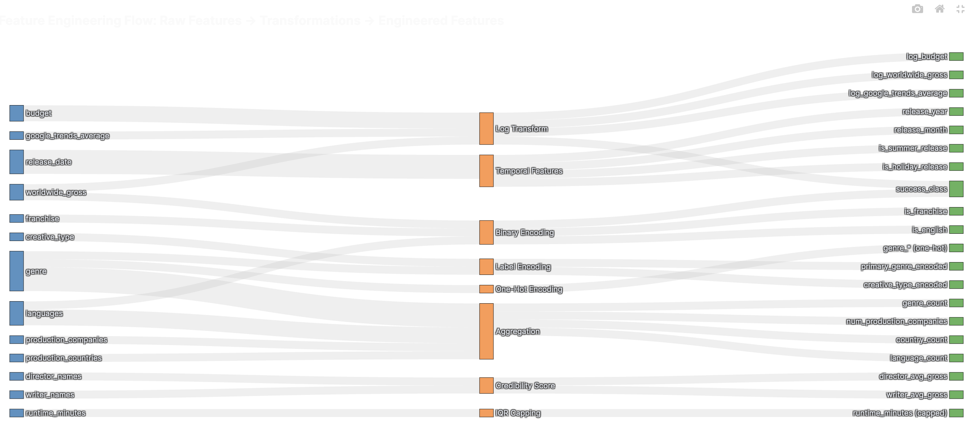
Feature Engineering
Raw features -> Transformations -> Engineered Features

Slide 12
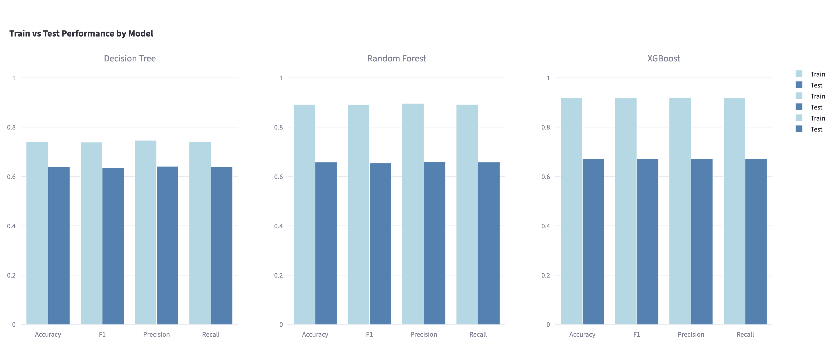
Model Performance Comparison
Decision Tree vs Random Forest vs XG Boost

Slide 13
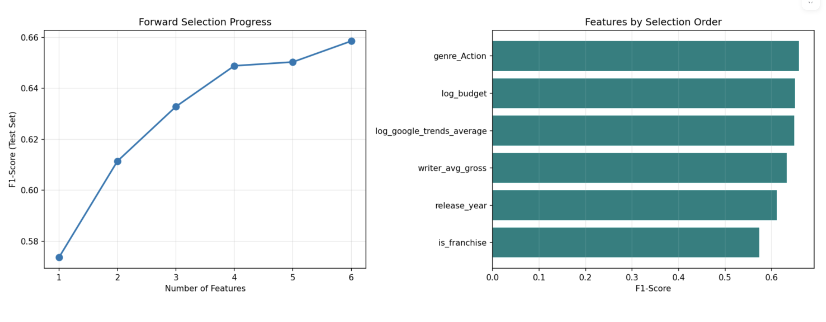
Forward Feature selection
Forward feature selection with XG Boost

Slide 14
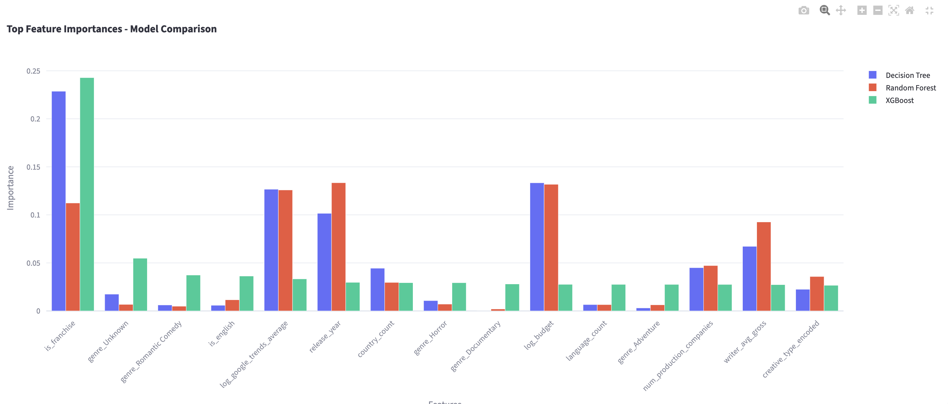
Feature Importance by Model
XG boost gave higher importance to franchise
Random forest is more distributed

Slide 15
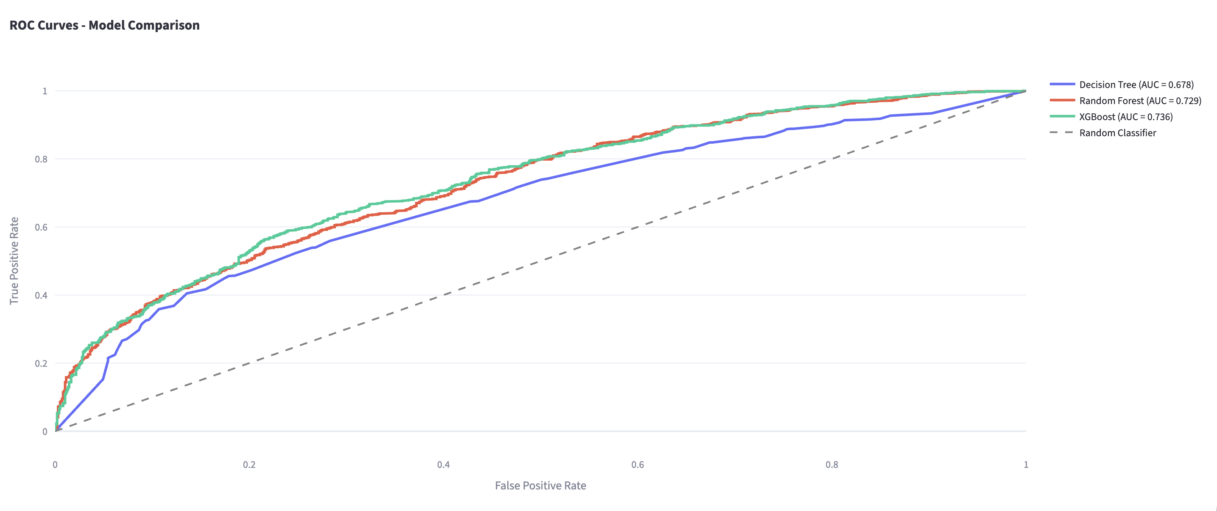
ROC Curves
XG Boost has higher AUC score

Slide 16
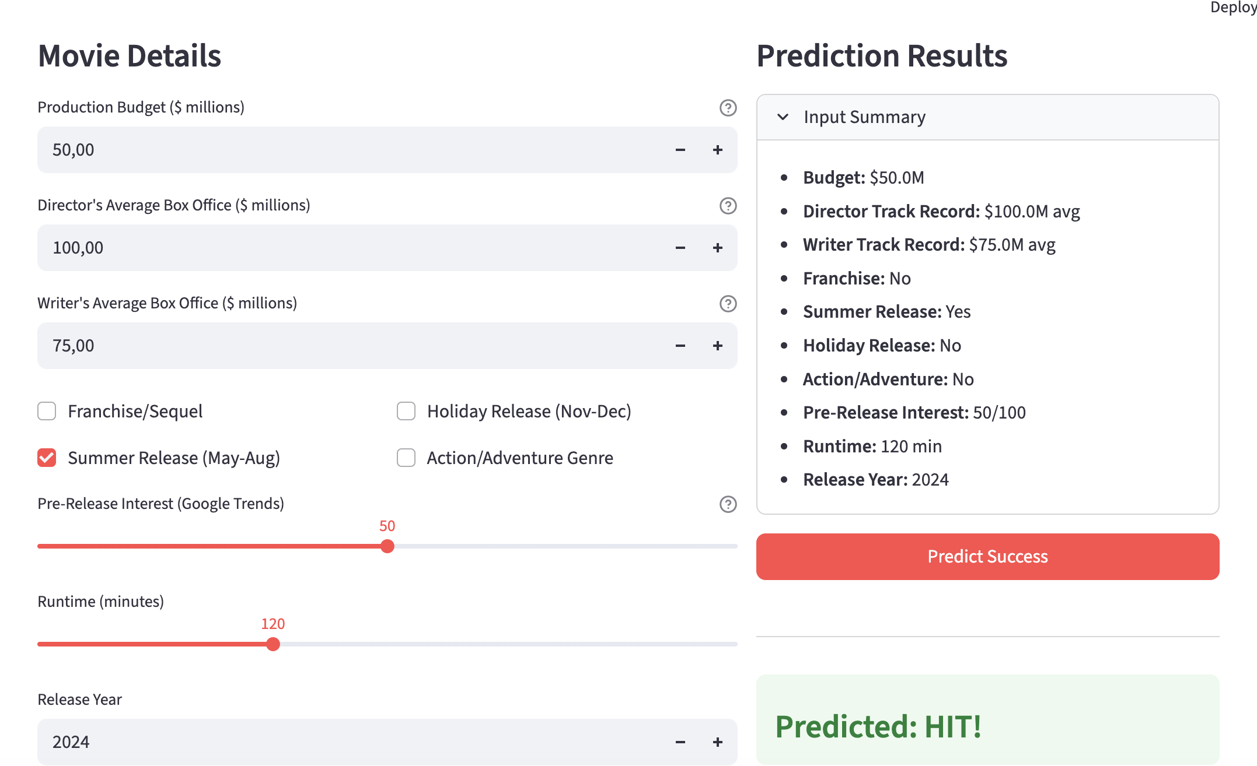
Movie Success Simulator

Slide 17
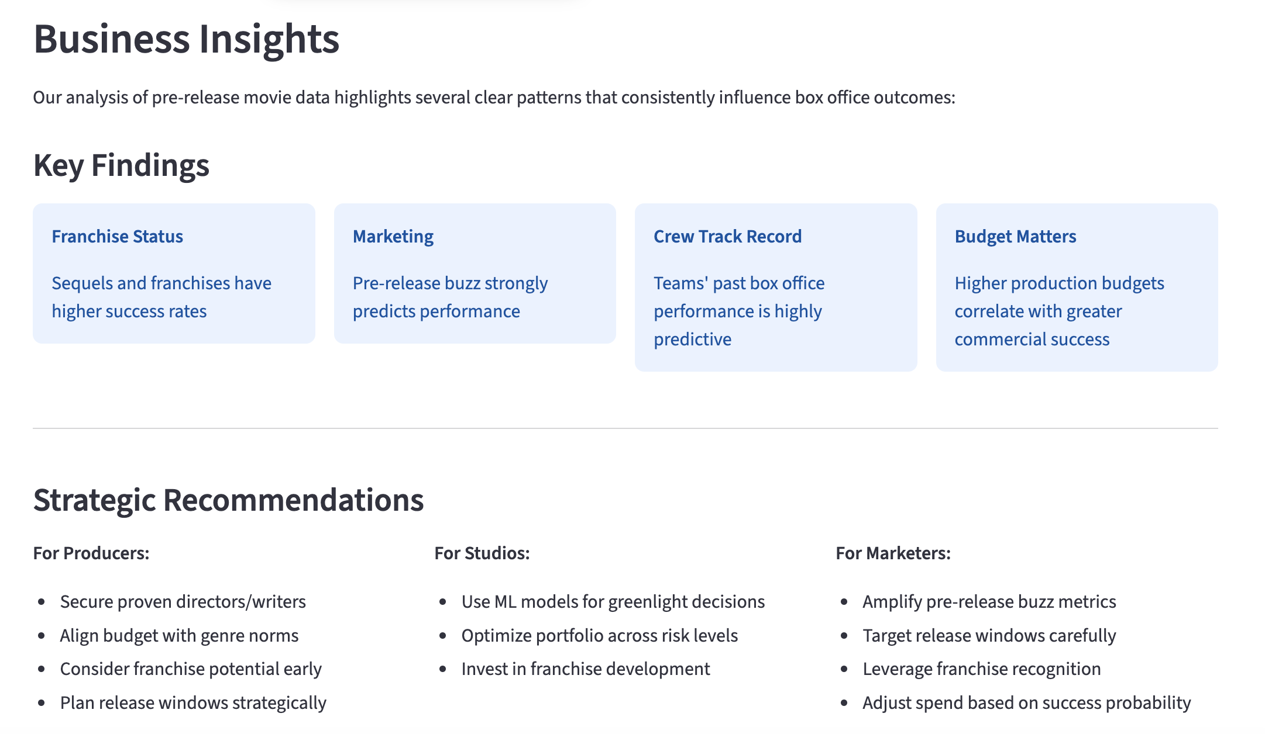
Key Takeaways

Slide 18
Limitations & Future Work
Data Scope: Limited to The Numbers dataset; may miss niche markets and may not be representative globally
Feature Set: Only pre-release features; excludes social media sentiment
Model Generalizability: Performance may vary across genres/markets
Dynamic Market Factors: Unpredictable events like pandemics not modelled

Slide 19
Dataset: References
https://www.the-numbers.com
https://www.imdb.com
https://trends.google.com/trends/

