Slide 1
E-Commerce website using PHP Project Report Submitted for the Approval of
Minor Project and Seminar (MCAN-381) In
Master of Computer Applications
Saptangshu Ghosh (14871022041)
Roop Paul (14871022036)
Pritam Sarkar (14871022057)
Abhijit Haldar (14871022039)
Abhijit Das (14871022047)
Under the guidance of
Prof. Shreyasi Bhattacharya
FUTURE INSTITUTE OF ENGINEERING AND MANAGEMENT
(Affiliated to Maulana Abul Kalam Azad University of Technology, West Bengal
Formerly known as West Bengal University of Technology)
KOLKATA 700 150 2022

Slide 2
Contents
Introductions
Advantages of Ecommerce
Features Of Ecommerce Sites
Objective of E-commerce website
DFD(0 Level , Level 1)
DFD (Level 2)
ERD
Use case Diagram
Our Web Pages
Future Scopes
Conclusion

Slide 3

Introduction
An e-commerce shopping website is an online platform that allows users to browse, select, and purchase products or services from the comfort of their own devices. These websites serve as virtual marketplaces where businesses showcase their offerings, allowing consumers to explore various items, compare prices, read reviews, and make secure transactions.
A successful e-commerce site offers a user-friendly interface, intuitive navigation, and a seamless shopping experience. It often incorporates features such as personalized recommendations, secure payment gateways, customer reviews, and efficient logistics for timely delivery. These platforms cater to a wide range of products, from electronics, apparel, and groceries to digital services, making shopping convenient and accessible for a global audience.

Slide 4

Advantages Of E-commerce
Faster buying process
Store and product listing creation
Cost reduction
Affordable advertising and marketing
Flexibility for customers
No reach limitations
Product and price comparison
Faster response to buyer/market demands
Several payment modes
Enables easy exports

Slide 5
Advantages of E-commerce
Faster buying process
Shoppers can find what they want more quickly and simply by browsing a range of things rapidly and buying what they want at once. Customers can shop online for things that are unavailable locally or are only available in distant physical stores.
E-business benefits include making it easier to choose from a variety of products and to get the order delivered. Finding an item, reading the description, and adding it to your cart all take very little time. Having the thing and not having to drive far makes the buyer happy in the end.
Cost reduction
Cost reduction is one of the main benefits of eCommerce for businesses that keeps sellers engaged in online selling. Many vendors spend a lot on upkeep for their physical business. They may need to pay more upfront expenditures like rent, repairs, store design, inventory, etc. In many circumstances, merchants don’t get the required earnings and ROI even after spending on services, stock, maintenance, and labor.
Several payment methods
eCommerce marketplaces accept a variety of payment methods, including UPI, pay later credit, cash on delivery, card on delivery, net banking, and EMIs on credit or debit cards. Sometimes a customer proceeds to the checkout page without completing the transaction. Here, you can call or email consumers to remind them to complete their purchases.

Slide 6
Features For E-commerce Sites
1. User-Friendly Design
A user-friendly website makes it easy for users to look for information using any device. Because your website is easy to use, users spend more time interacting with your website, eventually resulting in conversions.
Characteristics of a User-Friendly Website
Quick page load time. A slow-loading website is one of the top reasons why visitors leave a website without engaging. Users are accustomed to getting information quickly. A slow-loading website would drive them towards competitors.
Easy to navigate. Users and search engines should be able to find information quickly. The layout of the page should be intuitive and not hide information.
Accessible to all people and devices. More than half of the global population accesses the internet through their mobile phones. Additionally, one in four people in the United States has some form of disability. A user-friendly website can reach all audiences using different kinds of devices and follows accessibility guidelines.

Slide 7
2. Mobile-Friendly Features
Easy Accessibility
A mobile ecommerce website is easier to access than those that do not take advantage of modern web design techniques. You no longer need to worry about loading issues, slow websites, and popups while browsing. If you are using a mobile device or tablet, you simply open the URL provided by your phone or tablet browser, tap the link, and surf freely.
Better Search Engine Optimization (SEO)
A mobile-friendly website is more likely to rank higher and appear at the top of search results on Google and other search engines. Because mobile users tend to type keywords rather than navigate links, a mobile-friendly site can generate more traffic and sales. Since mobile searches are already a big deal, having a mobile-friendly website increases the likelihood your company will appear in relevant searches.
Better User Experience
Mobile websites give users a much better user experience than desktop versions. Users often search online for products or services using their phones. When they find the product or service they were looking for, they want to buy it without having to navigate away from the mobile screen. Having a mobile version gives them a seamless transition between devices while browsing the website.
Increased Conversion Rate
In addition, smartphone users are much more likely to purchase items compared to those using laptops or desktops. A well-designed mobile site will increase conversions.

Slide 8
3. Multiple Payment Options
In today’s fast-paced and digitally-driven world, businesses need to adapt to changing consumer preferences and expectations. One key aspect of customer satisfaction is the availability of multiple payment options. Gone are the days when cash or checks were the only accepted forms of payment.
Benefits of Offering Multiple Payment Options
Improves Conversion Rates
One of the main benefits of offering multiple payment options is improving your conversion rates. This means more customers will complete their purchases on your site.
Consumers abandon their carts if they have issues completing their purchase with their preferred payment method. For example, a customer might not have a credit or debit card or has an issue with their account.
You can reduce the risk of losing clients and increase conversion rates by giving customers multiple payment options. Not only will this improve your sales figures, but it will also improve your business’s overall profit margin.
Enhances User Experience
Having different payment options on your website will enhance the user experience. This is because it makes it quicker and easier for customers to complete their purchases.
Shoppers often have a preferred payment method. You'll speed up their checkout experience and help them complete their purchases more quickly by allowing them to pay with their preferred method.
Convenience is a key concern for many modern shoppers. They need an eCommerce site that can complete their purchases quickly and ship their products soon.
Offering different types of payment methods speeds up the checkout process and gives your customers a more streamlined experience. It will help reduce cart abandonment risk and increase customer satisfaction.
Customers Feel Safe
Multiple payment options on your online store will make customers feel more confident about giving their account data.
This is particularly a concern among customers who prefer to pay with cash, as they may be less inclined to share their account information. By offering multiple payment options, you build trust and make it easier for customers to make their purchases.
Customers like to feel safe when they’re shopping online. Having different payment options will make your brand appear trustworthy and transparent. Therefore, ensure your multiple payment methods offer a mix of security and ease of use.
You’ll Make More Money Internationally
Offering multiple payment methods will make it easier for your business to collect payments from international shoppers. The types of payment methods vary by region, nation, and accepted currencies.
For example, the most used payment method in China is Alipay; if your website supports it, you will have access to the enormous Chinese market. Multiple payment methods will help you handle different currencies and expand into foreign markets.
It Decreases Cart Abandonment
One of the biggest concerns for online retailers is cart abandonment. This is when shoppers add products to their cart but don't check out. Shoppers often leave their carts because of limited types of payment methods.
Multiple payment methods will help reduce the risk of customers abandoning their carts and increase your conversions. Not only will this boost your sales figures, but it will also make it easier for you to collect payment.
.

Slide 9
Objectives of E-Commerce Website
Increase Sales: This can be achieved by providing a user-friendly shopping experience, offering competitive prices, showcasing products effectively, and providing excellent customer service.
Expand Market Reach: E-commerce websites allow businesses to reach customers beyond their local market, providing them with the opportunity to expand their customer base and grow their business beyond geographical boundaries.
Build Brand Awareness: By creating a visually appealing and user-friendly website, businesses can establish themselves as a trusted and credible brand in the minds of their customers.
Improve Customer Engagement: Features such as customer reviews, chatbots, and personalized recommendations can help to build customer engagement, loyalty and trust.
Increase Efficiency: By automating processes such as order fulfillment, inventory management, and payment processing, businesses can improve their efficiency and profitability.

Slide 10
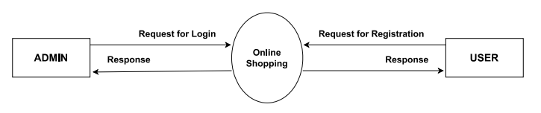
DFD Level 0

Slide 11
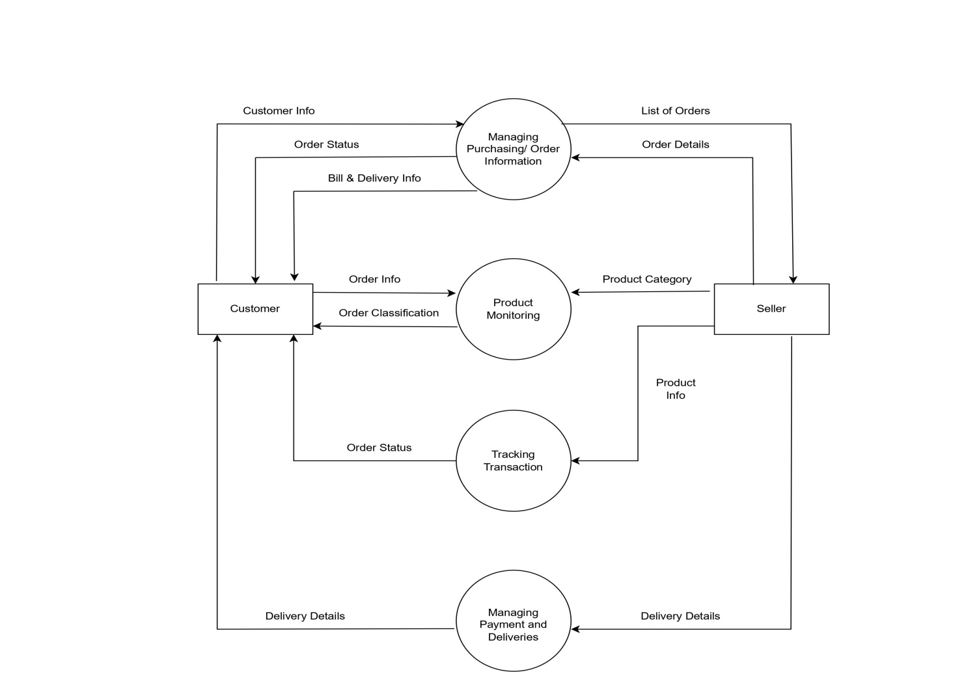
DFD Level 1

Slide 12
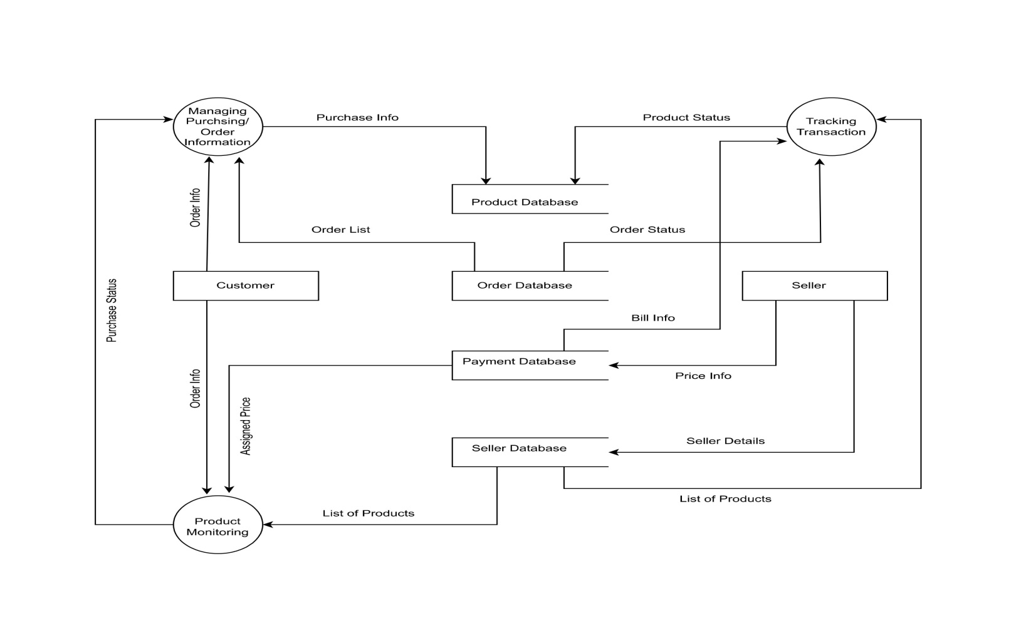
DFD Level 2

Slide 13
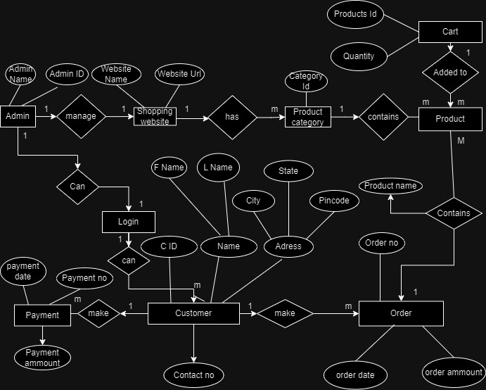
ERD

Slide 14
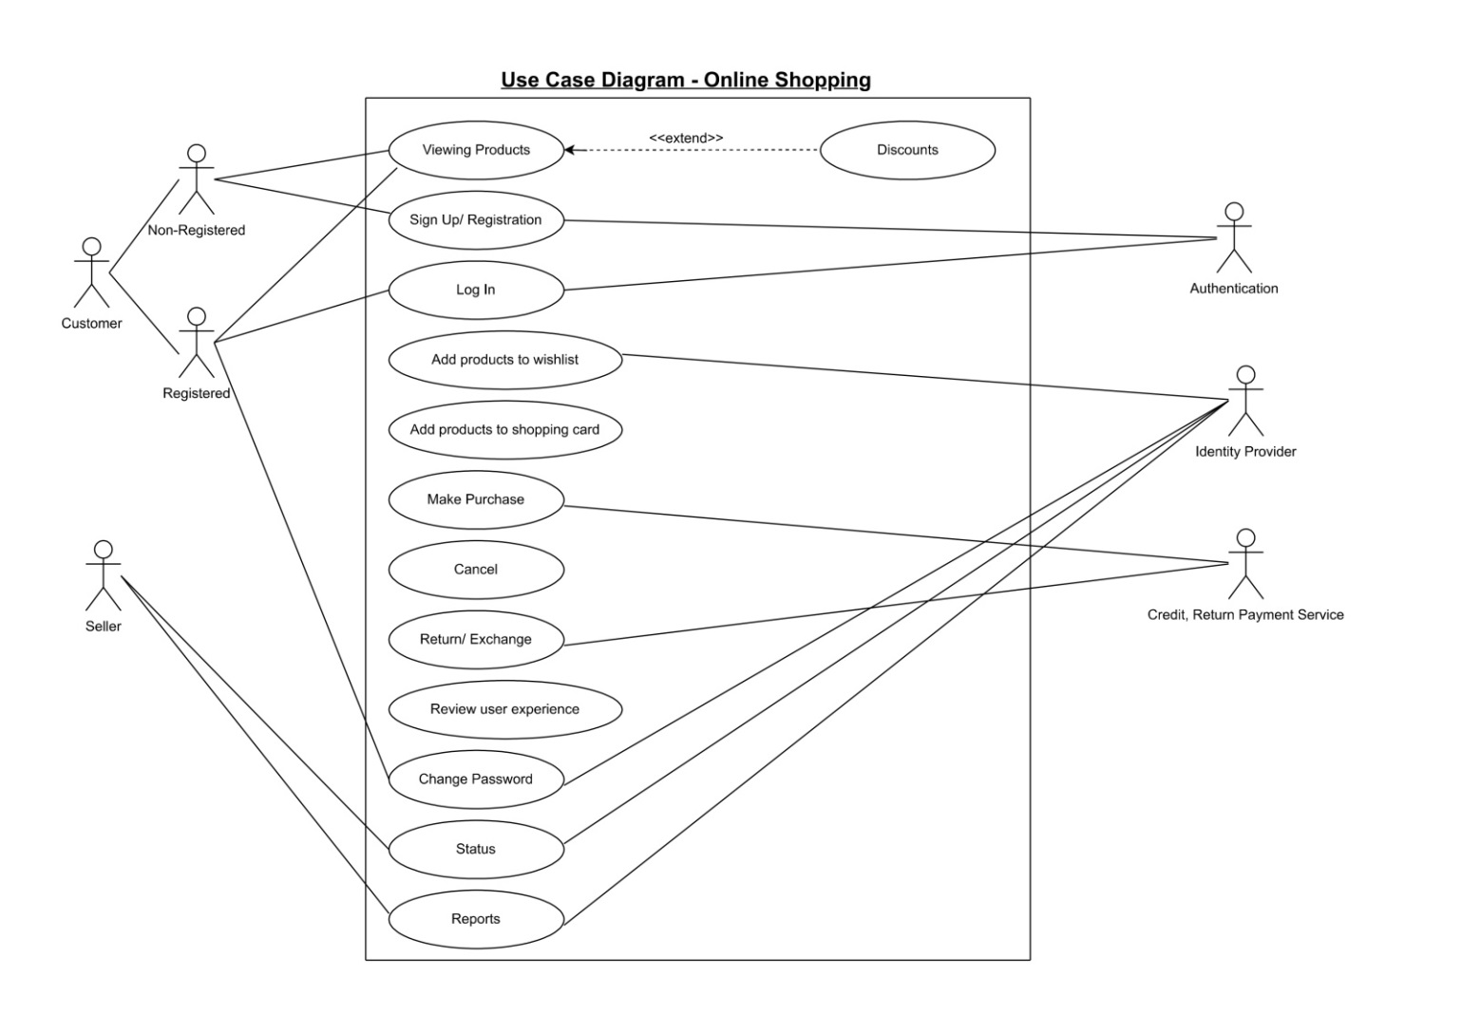
Use Case Diagram

Slide 15
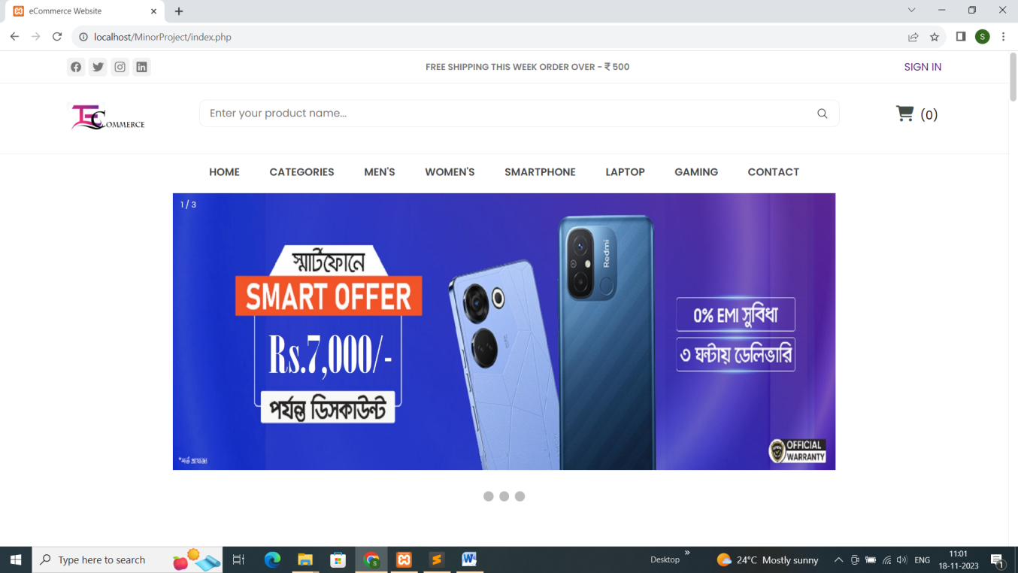
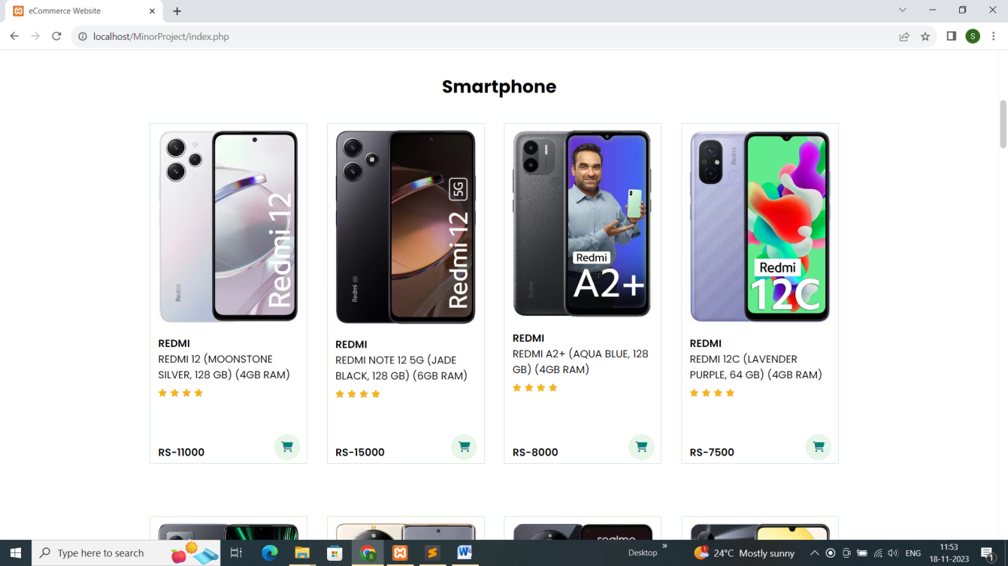

Slide 16
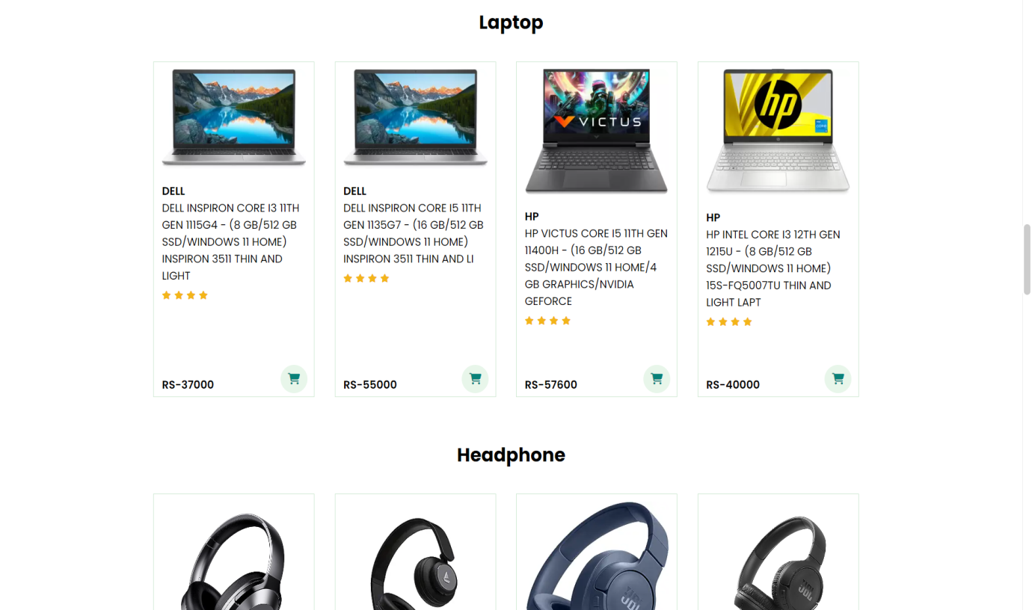
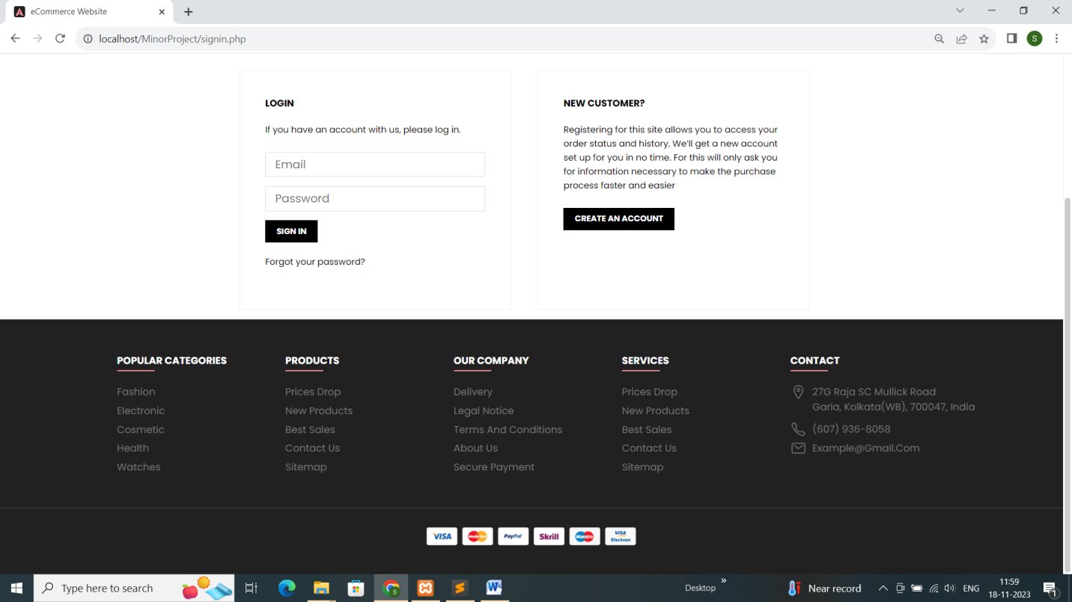

Slide 17
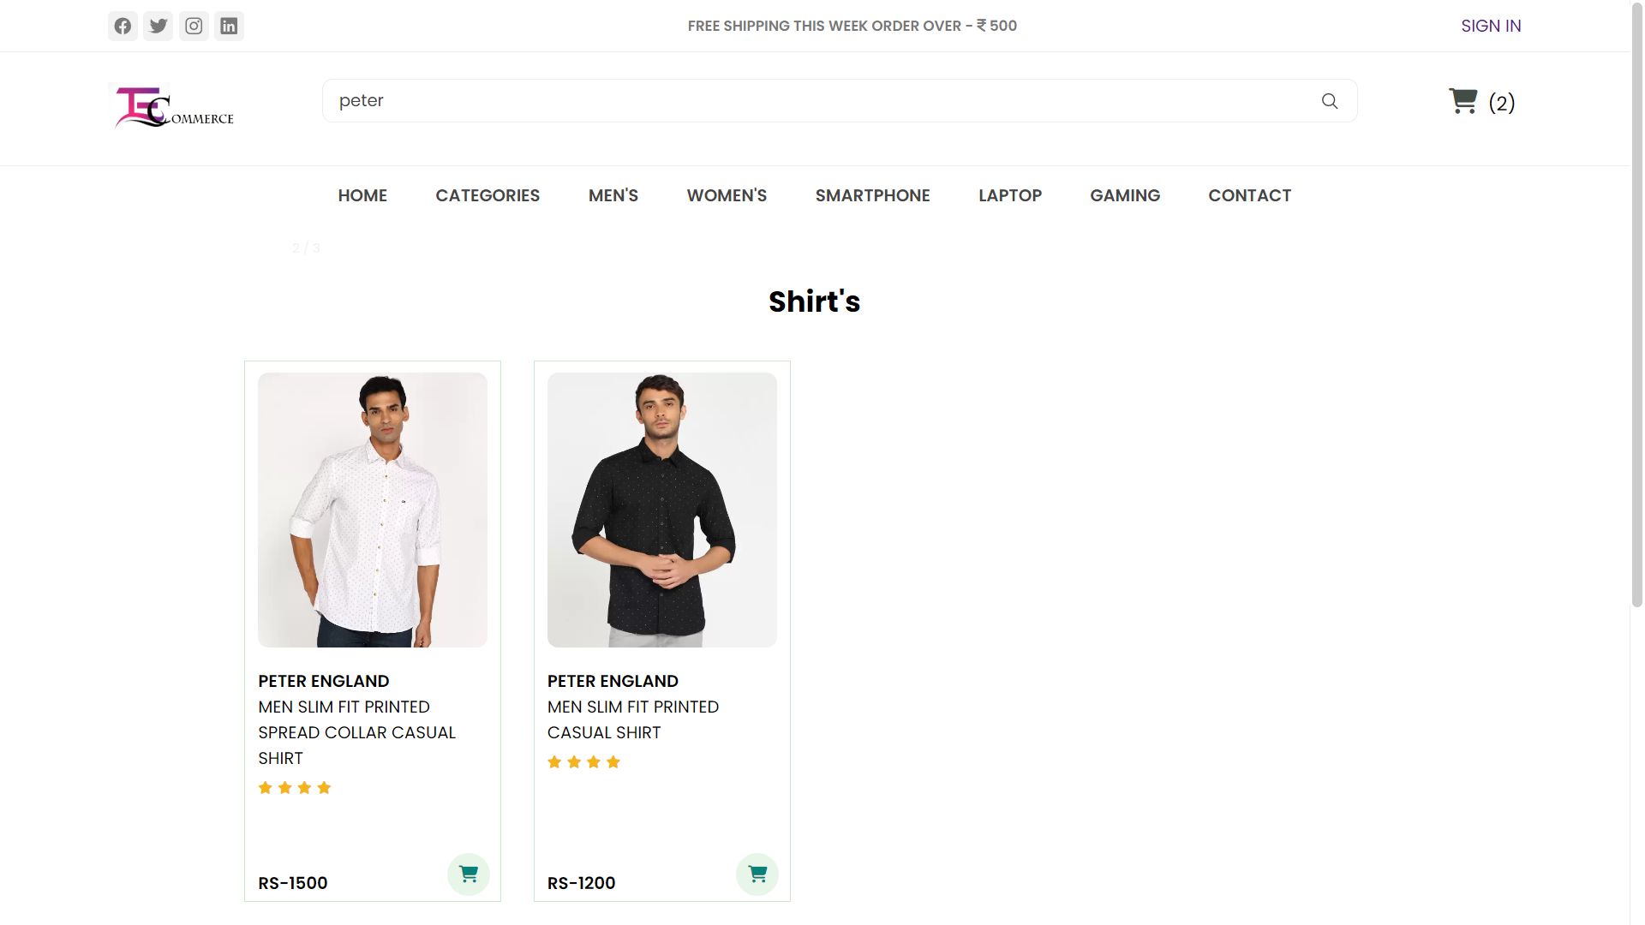

Slide 18
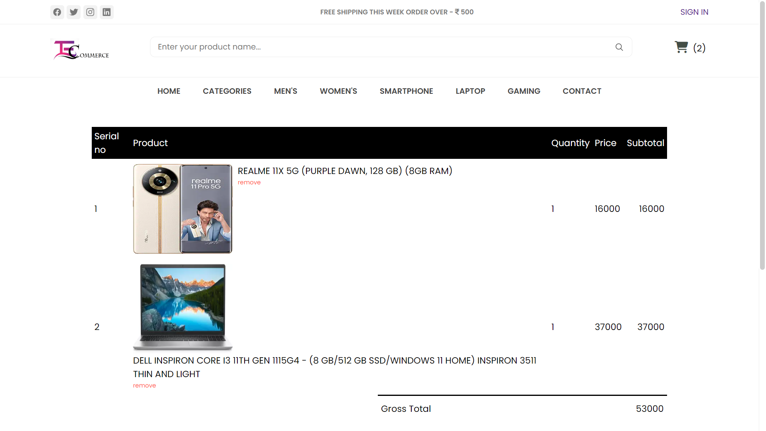

Slide 19
