Slide 1
FUNCTIONAL PROGRAMMING CS-IS-2010-1 Final PROJECT Presentation
Haskell Scraper & Code-Text Separator Saptarishi Dhanuka
Advisor: Dr. Partha Pratim Das

Slide 2
Introduction
Separate text and code from text source
Useful for software development information & knowledge extraction
Implement Naïve Bayes classifier from scratch
Learnt Haskell starting from no experience
Got idea of software specifications and development

Slide 3
Motivation

Slide 4
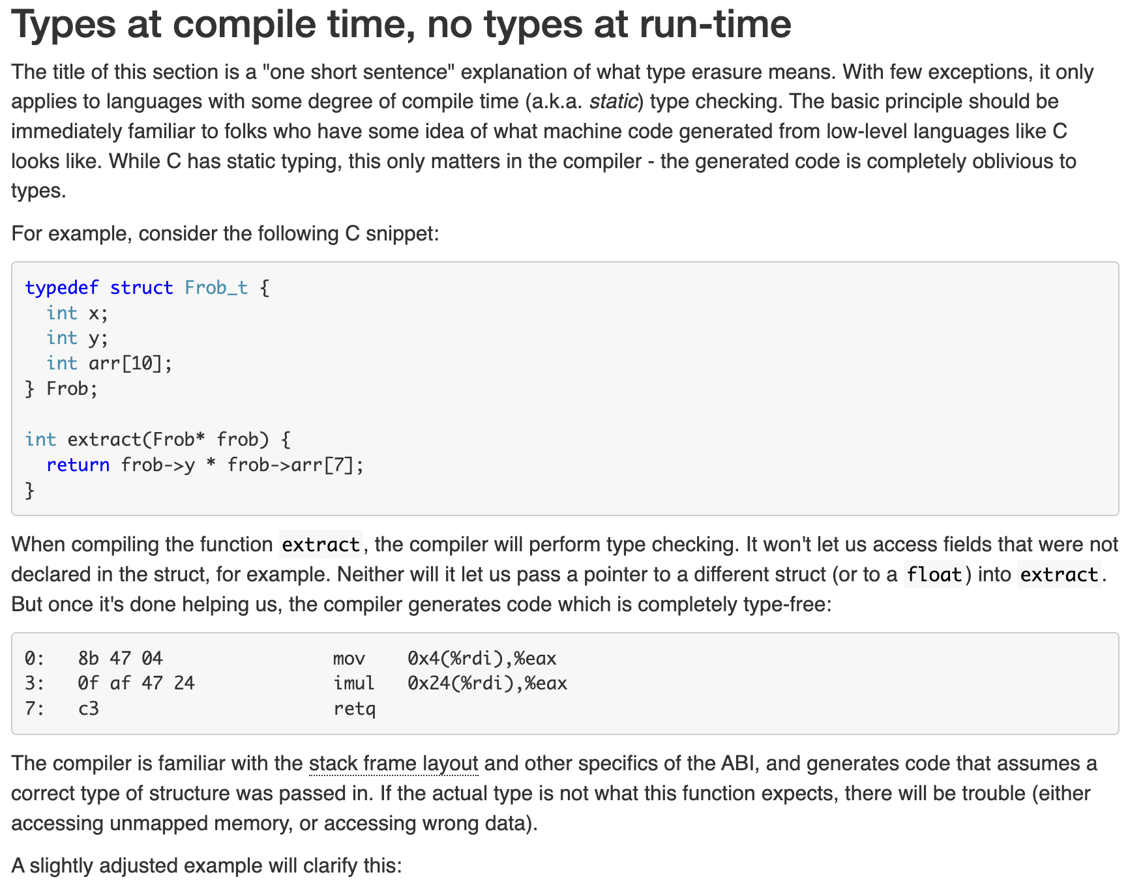

Slide 5
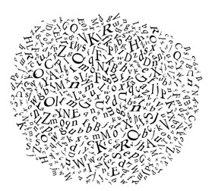
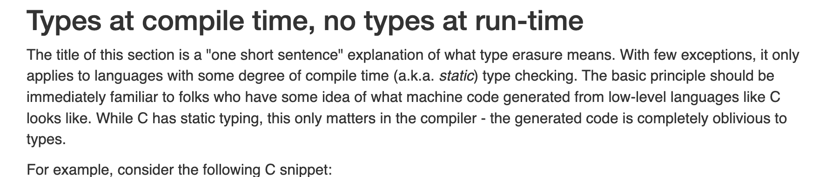

Slide 6
Some other use cases
Developer Emails at company
StackOverflow Q & A
Training Language Models
Any area where language and code are together

Slide 7
Literature Survey
Papers
Regex and programming language specific
Naive Bayes with bigrams & island parsers (specific to Java)
Variety of heuristics & island parsing
Hidden Markov Models

Slide 8
Literature Survey
Pre-existing libraries
HMM library : hmm
NaiveBayes
Decided to implement lightweight algorithm from scratch instead of heavyweight ML methods

Slide 9
Problem Statement & Requirements

Slide 10
Assigned Problem Statement
Develop a scraper using Haskell to extract text and code snippets separately.
1. Input: Scrape the text and code snippets from the given text source
2. Output: A Word document containing the text and .txt file containing the code.
3. Method: Write the algorithm to scrape (you can use the tagsoup library) and all the input-output facilities using Haskell. Do not use any other language.

Slide 11
Requirements
The user shall be able to give any text source as input.
The scraper shall get all the code snippets of the source and write it into a Plaintext file.
The scraper shall get all non-code text of the source and write it into a Word Document.

Slide 12
Specifications
The user will be able to enter a text source as input, whose code and non-code parts they wish to be separated.
The scraper will parse the contents of the text and separate the code snippets from the rest of the text.
The scraper will output a .docx file containing the textual content.
The scraper will output a .txt file containing the code snippets.

Slide 13
Analysis
Various ways to solve the problem
Boils down to classification of every line as text or code
Reasonably restrict ourselves to text sources with newlines
Don’t consider completely unstructured data
Don’t go more granular than a line
Consider text as natural language

Slide 14
Scope & Methodology

Slide 15
Scope
Fairly broad range of inputs that are structured with newlines
Classify each line as code or text without classifying within each line
Consider text as natural English language, not as some other non-code or non-English textual content

Slide 16
Methodology
Overview
Build and train Naïve Bayes classifier on custom data
Use calculated probabilities to classify each line in the text source
Combine all code and natural language separately

Slide 17
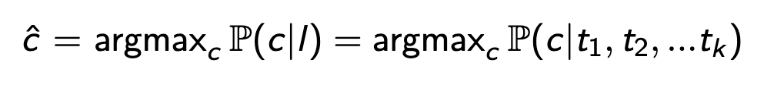
Methodology
Naïve Bayes Classification
Goal: For each line, find the best class
Vocabulary: All words in training data
Classes: Code and Text
Instead of just the terms, consider all words with indicator

Slide 18
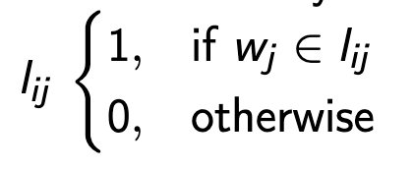
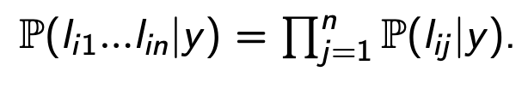
For each line i in text source, have binary feature vector for presence of vocabulary word j
Bag of Words approach
Make Naïve Bayes assumption of independence of words

Slide 19
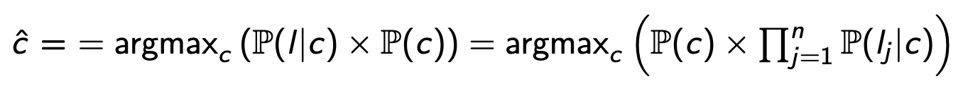
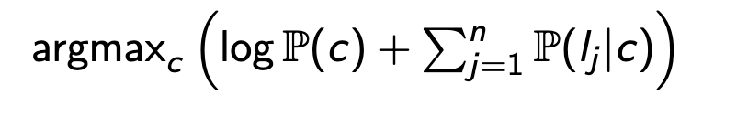
Work in logspace due to numerical precision and underflow

Slide 20
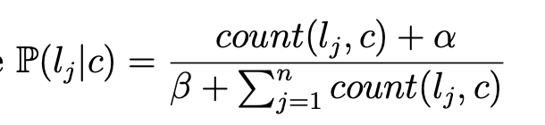
Calculate probabilities
Avoid 0 probabilities with Laplace Smoothing
Count occurrences of j-th word in line l in class c and count all words in class c
Prior probability of each class is simply it’s percentage of the training data

Slide 21
Architecture

Slide 22
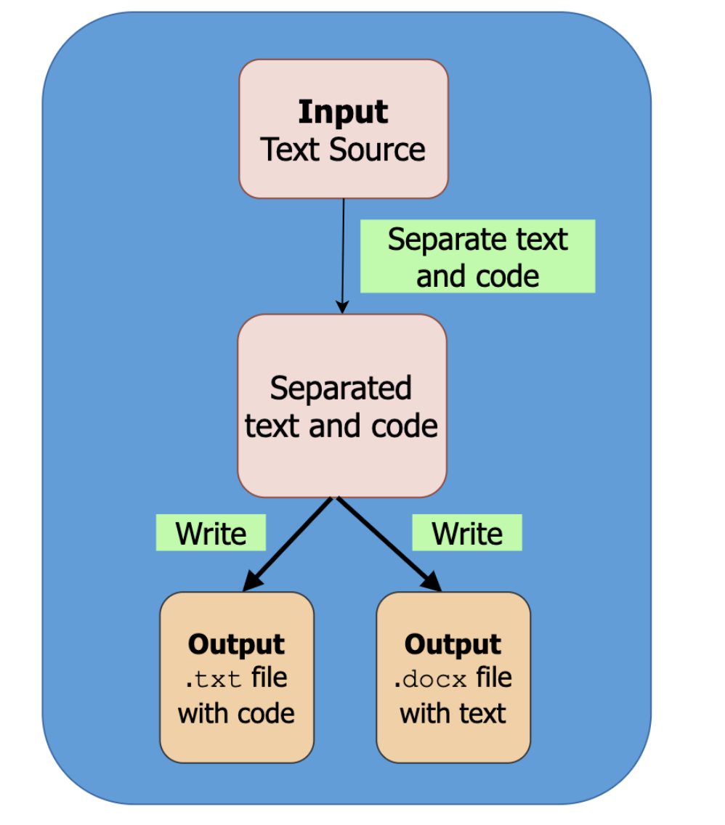
Code-Text Separation Pipeline

Slide 23
Design

Slide 24
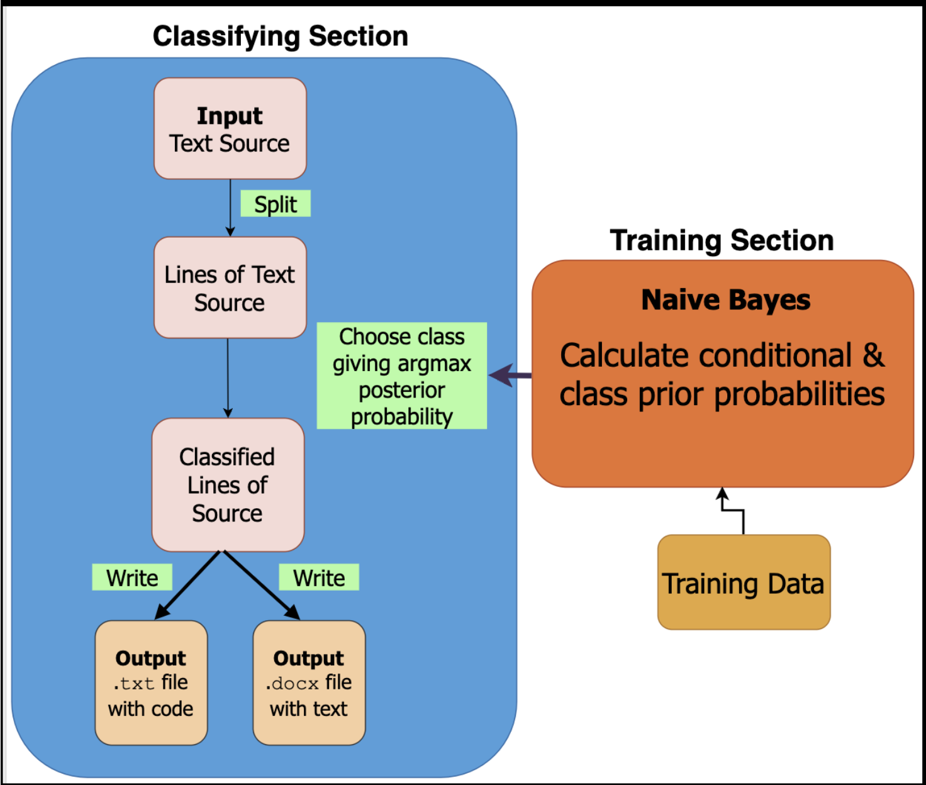
Classifying Pipeline and Training Section

Slide 25
Work Done

Slide 26
Implementation Details

Slide 27
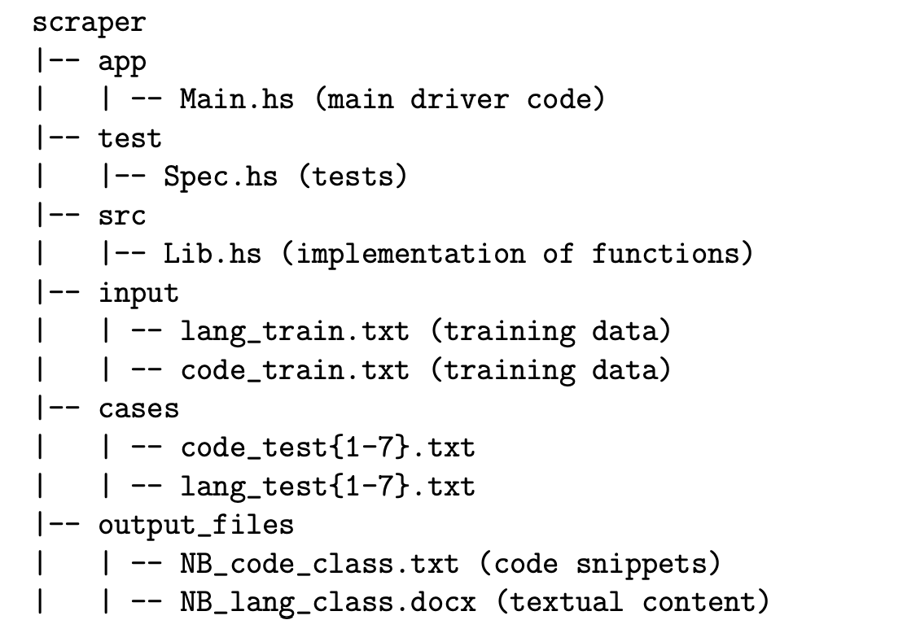
File Structure

Slide 28
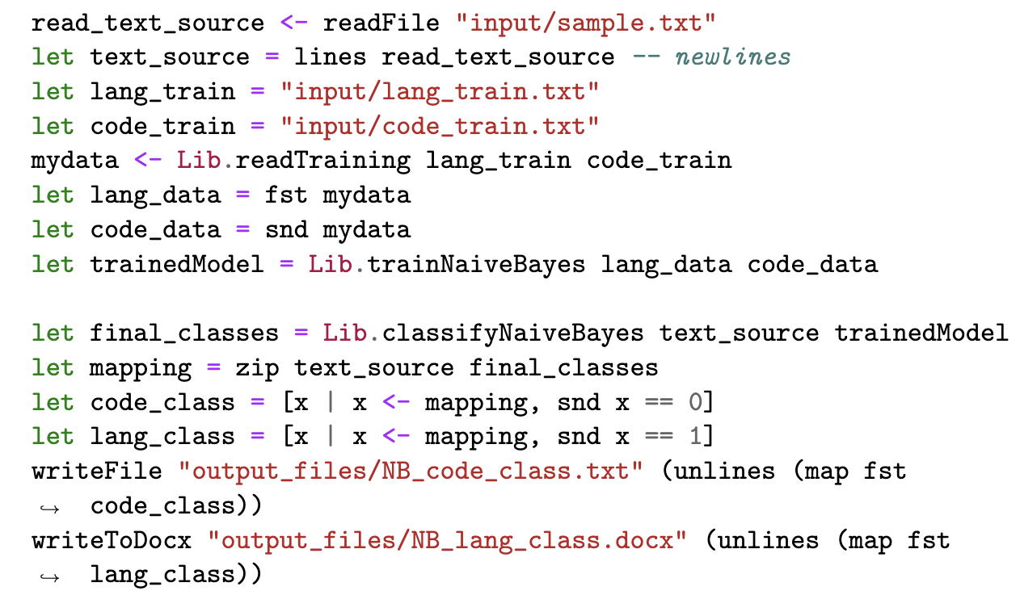
Main.hs
Classification and training pipeline

Slide 29
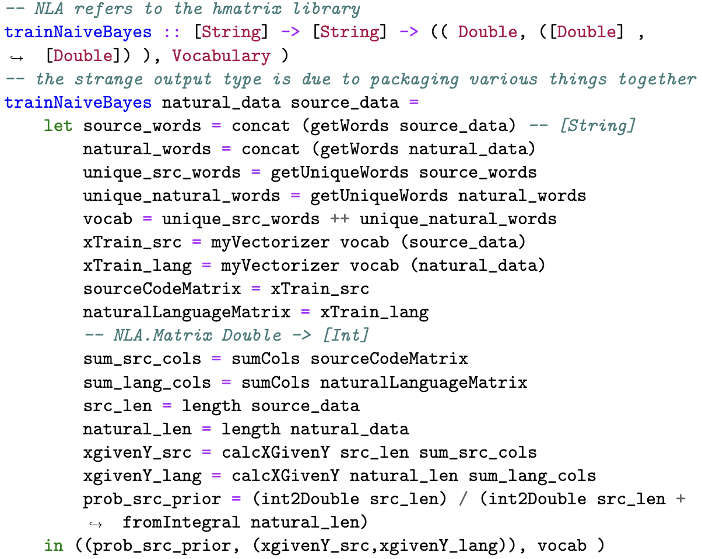
Lib.hs : trainNaiveBayes

Slide 30
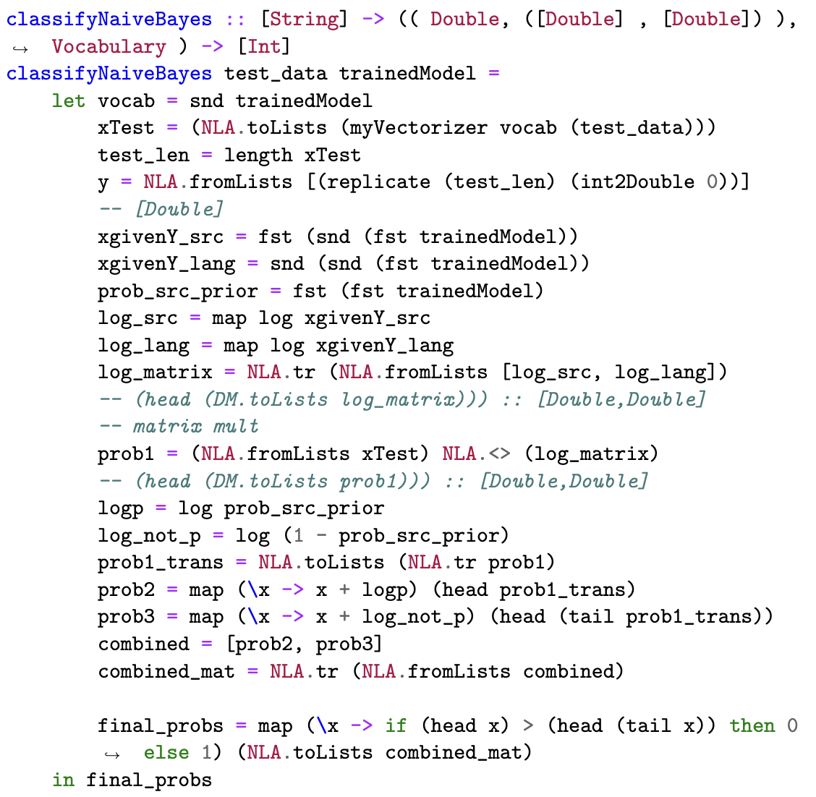
Lib.hs : classifyNaiveBayes

Slide 31
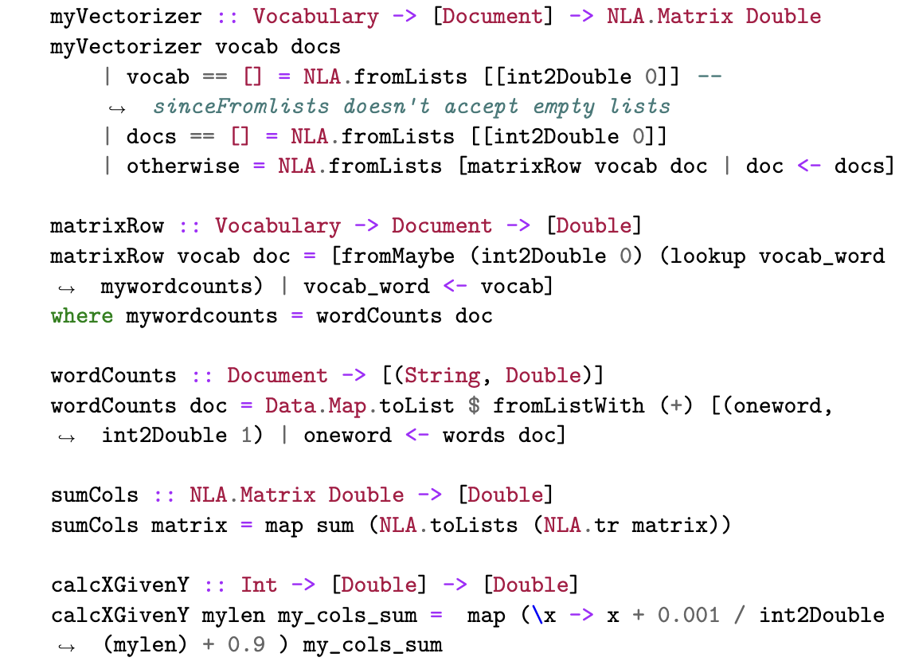
Lib.hs : Important Helpers

Slide 32
Training Data
Language | LoC | Source
C | 1171 | Andrej Karpathy's Github
Python | 461 | Sklearn's Github
Java | 201 | Jenkins Github
Description | Words & Lines | Source
CS50 Lec1 | 780 and 37 | CS50 Lec1
CS50 Lec6 | 229 and 11 | CS50 Lec6
Python 4 Everybody Text | 4910 and 589 | Python 4 Everybody Text

Slide 33
Challenges and Mitigations
After midterm eval, redid project to change from HTML to general text
Tried implementing HMM but decided on Naïve Bayes
Poor library support : Started from scratch
Inefficient matrix library : Found efficient hmatrix, reducing time from 2.5 min to 2.5 sec in one case

Slide 34
Challenges and Mitigations
Paucity of appropriately sized training data : created custom small dataset
Changing libraries and refactoring code

Slide 35
Tooling
Haskell
Stack build tool
Notable Libraries
hmatrix
hUnit
pandoc

Slide 36
Testing
Unit Testing
myVectorizer
matrixRow
wordCounts
getWords
getUniqueWords

Slide 37
Testing
End-to-end testing
Tested by the evaluation tests
Performance Testing
Time usage
Functional Testing

Slide 38
Results & Discussions

Slide 39
Results : Evaluation on Test Set
Case | Details of Code Portion
1 | Supplied Web Page containing C, Python, Java
2 | Assembly Code from the Apollo Guidance Computer
3 | SQL Code from this blog
4 | Haskell Code from ShellCheck
5 | Mix of Python and C Code
6 | Java Code
7 | Python Code

Slide 40
Results : Evaluation
Case | Precision (Code) | Recall (Code) | Precision (Text) | Recall (Text)
1 | 0.918 | 0.975 | 0.956 | 0.86
2 | 0.997 | 1.0 | 1.0 | 0.889
3 | 0.979 | 0.92 | 0.667 | 0.889
4 | 0.967 | 0.93 | 0.474 | 0.667
5 | 0.992 | 0.89 | 0.383 | 0.9
6 | 0.978 | 0.986 | 0.882 | 0.833
7 | 0.956 | 0.869 | 0.435 | 0.714

Slide 41
Results : Tests
Unit Tests : All passed successfully
Performance Testing
On given source : 1.32 seconds
Text of Frankenstein comprising 75,000 words and 1665 lines : 3.74 seconds
Functional Testing
By nature, can’t achieve 100 % accuracy, but has good performance in meeting requirements and specifications

Slide 42
Discussions
Surprisingly good performance
Lightweight in terms of training data and time
Code metrics better than text metrics
Output is simply classified, not formatted or parsed
High accuracy despite small and skewed dataset
Quality of training and testing datasets need to be analyzed further

Slide 43
Test Case 5 Text Misclassification Example
# Predict the class for a given row
def predict(summaries, row):
probabilities = calculate_class_probabilities(summaries, row)
best_label, best_prob = None, -1
for class_value, probability in probabilities.items():
if best_label is None or probability > best_prob:
best_prob = probability
best_label = class_value
return best_label
Predict Text Predict Code

Slide 44
Limitations
Granular upto line-level and not token level
Needs new-line separation
Will likely have inferior performance compared to heavyweight models
Comments classified as text and not code

Slide 45
Limitations
Doesn’t take into account context
Naïve independence assumption & Bag of Words approach
Hyperparameters and training size not tuned or optimized
Datasets Quality

Slide 46
Conclusions
Developed classifier that
Is Lightweight, Interpretable & Simple
Has strong results despite assumptions and improper training data
Can be used in a unified manner with more complex models, which needs to be further investigated
Analysis of classified results needed to understand why it’s correctly or incorrectly classifying lines

Slide 47
Extensions and Future Work
Add context and wider window with n-grams
Semantic approach to induce newlines or,
Semantic approach to classify within lines
Extract knowledge from classifier output

Slide 48
Extensions and Future Work
Tune hyperparameters like Laplacian constants
Increase training data size and quality
Write to Word doc without going through pandoc.readHTML
User Interface
More testing and profiling

Slide 49
Demo

Slide 50
References
A. Bacchelli, M. D’Ambros, and M. Lanza, “Extracting source code from e-mails,” in Program Comprehension (ICPC), 2010 IEEE 18th International Conference on, June 2010, pp. 24–33.
A. Bacchelli, T. Dal Sasso, M. D’Ambros and M. Lanza, ”Content classification of development emails,” 2012 34th International Conference on Software Engineering (ICSE), Zurich, Switzerland, 2012, pp. 375-385, doi: 10.1109/ICSE.2012.6227177
Chatterjee, Preetha & Gause, Benjamin & Hedinger, Hunter & Pollock, Lori. (2017). Extracting Code Segments and Their Descriptions from Research Articles. 10.1109/MSR.2017.10.
L. Cerulo, M. Ceccarelli, M. Di Penta, and G. Canfora, “A hidden markov model to detect coded information islands in free text,” in Source Code Analysis and Manipulation (SCAM), 2013 IEEE 13th International Working Conference on, Sept 2013, pp. 157–166.
https://github.com/Magalame/fastest-matrices
D. Jurafsky and J. H. Martin. Speech and Language Processing: An Introduction to Natural Language Processing, Computational Linguistics and Speech Recognition. Prentice Hall, 2nd edition, 2009.

Slide 51
Thank you!

