Slide 1
AI HR / HACKATHON PITCH
HR work is fragmented.
Important decisions cannot be.
DATA
CONTEXT
Employee history lives across files, messages, and memory. Routine preparation is slow, while high-impact actions need evidence and accountable review.
ACTION
AI HR
01
Notes:
[Sources]
- Problem framing supplied in the AI HR hackathon brief.

Slide 2
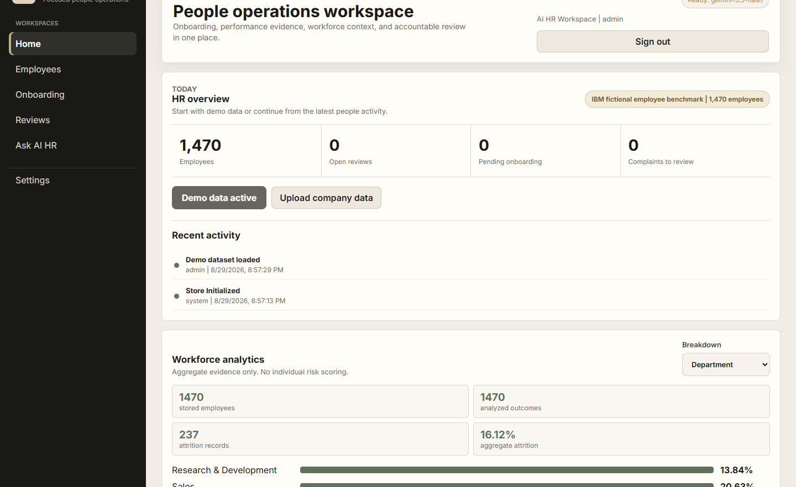
SOLUTION
One copilot turns records into accountable HR work
AI HR organizes employee information, prepares onboarding and reviews, explains company data, and keeps sensitive decisions under human control.
HOME
EMPLOYEES
ONBOARDING
REVIEWS
ASK AI HR
02
Notes:
[Sources]
- AI HR local product screenshot captured 2026-08-29 with fictional IBM demo data.
- Solution description supplied in the hackathon brief and implemented product.

Slide 3
LIVE WORKFLOW
A complete story in three minutes
One employee record moves from import to accountable action.
01
02
03
04
05
06
07
Upload
CSV
Open
profile
Record
a win
Add a
concern
Ask AI to
summarize
Review next
action
Approve +
audit
The demo proves ingestion, storage, AI preparation, employee context, human approval, and traceable audit history in one flow.
03
Notes:
[Sources]
- Demo sequence supplied in the AI HR hackathon brief and mapped to implemented screens.

Slide 4
ARCHITECTURE
A simple stack with control at the decision point
Data stays structured; Gemini prepares work; a person remains accountable.
Frontend
Node API
Database
Gemini
Human review
Five focused
workspaces
Validation +
role access
Employee records +
audit history
Drafts +
summaries
Approve, reject,
or request evidence
AUDIT TRAIL / every import, review, recommendation, and approval is recorded
Frontend -> Node API -> database -> Gemini -> human review
04
Notes:
[Sources]
- Architecture derived from local server.js, storage.js, and README.md.

Slide 5
SAFETY
AI drafts. HR decides.
01
Evidence beside the recommendation
Facts, wins, concerns, support, and warnings stay visible.
Promotion, compensation, demotion, discipline, and termination never execute automatically. The system prepares evidence and a recommendation for an accountable reviewer.
02
Complaints remain allegations
Counts provide context; they are not behavior scores or guilt.
03
Sensitive actions need confirmation
HUMAN APPROVAL REQUIRED
The UI explains that a brief does not apply an employment change.
Approve / Reject / Request more evidence
04
Every decision leaves a record
Review outcomes and responsible actors are written to the audit trail.
05
Notes:
[Sources]
- Safety boundary supplied in the hackathon brief and implemented in decision routes and UI confirmations.

Slide 6
FUTURE
Start focused. Grow into the HR stack.
The hackathon version proves the core workflow. The market version adds enterprise connection and scale.
01
HRIS integrations
02
SSO
Sync employee records and approved actions.
Enterprise identity, access, and recovery.
03
PostgreSQL
04
Multi-company support
Managed persistence, backup, and recovery.
Tenant isolation and organization-level controls.
Today: hackathon-ready copilot. Next: deployable people-operations platform.
06
Notes:
[Sources]
- Future roadmap supplied in the hackathon brief and aligned with README production guidance.

