Slide 1

SYSML Final Project
Severe Weather & Tsunami Detection (SMSWTD)
Mission
To minimize harm to lives, property, and infrastructure from severe weather events and tsunamis.
What this deck covers
TRIZ 9-box outlook (past → present → future)
Contradiction matrix + design trade-offs
System context, use cases, and requirements
Logical architecture, implemented pipeline, and statecharts
Notes:
[Sources] - SYSML Final Project Documentation.docx (uploaded by user) [/Sources]

Slide 2

TRIZ 9-box: Past / Present / Future
Past (5 years)
Present
Future (5 years)
Super-system
Fragmented infrastructure; siloed agencies; manual coordination; one‑way comms; delayed warnings; limited real‑time access.
Integrated preparedness ecosystem; coordinated agencies; real‑time sharing; multi‑channel alerts; ML‑enhanced prediction; public actionable insights.
AI‑driven global resilience network; autonomous prediction & response; smart‑city integration; community risk profiling; global collaboration; planning influence.
System
functionality
Detect basic met/ocean conditions; identify large seismic activity; broad forecasts using historical patterns; delayed general warnings.
Higher‑frequency sensing; early signs detection; moderate‑confidence impact/timing prediction; tailored alerts; dynamic risk based on severity & exposure.
Continuous fine‑scale sensing; anticipate compound triggers; high‑confidence cascading/compound hazard prediction; context‑aware horizons (minutes→days).
Sub-system
requirements
Standalone sensors; low‑res satellites; manual logging; separate compute platforms; sirens/radio; threshold logic; no centralized fusion.
Satellite/aircraft/underwater sensors; data fusion; ML analytics; SMS/app + gov APIs; cloud storage; health/diagnostics; dashboards; redundancy.
Self‑calibrating sensor mesh; edge compute; autonomous decision engine; automated alert generation & personalization; self‑optimizing comms; enhanced accelerators.
Summary based on the project documentation TRIZ table.
Notes:
[Sources] - SYSML Final Project Documentation.docx (TRIZ 9-box section) [/Sources]

Slide 3

TRIZ Contradiction Matrix
Parameter selection rationale
Improving: speed, reliability, accuracy, and automation (to reduce delay + human error).
Worsening constraints: energy loss, ease of operation, device complexity, and detect/measure difficulty.
Improve ↓ / Worsens →
22 Loss of Energy
33 Ease of operation
36 Device complexity
37 Difficulty of detecting/measuring
9 Speed
14, 20, 19, 35
32, 28, 13, 12
10, 28, 4, 34
3, 34, 27, 16
27 Reliability
10, 11, 35
27, 17, 40
13, 35, 1
27, 40, 28
28 Measurement accuracy
26, 32, 27
1, 13, 17, 34
27, 35, 10, 34
26, 24, 32, 28
38 Extent of automation
23, 28
1, 12, 34, 3
15, 24, 10
34, 27, 25
Notes:
[Sources] - SYSML Final Project Documentation.docx (Contradiction Matrix section) [/Sources]

Slide 4
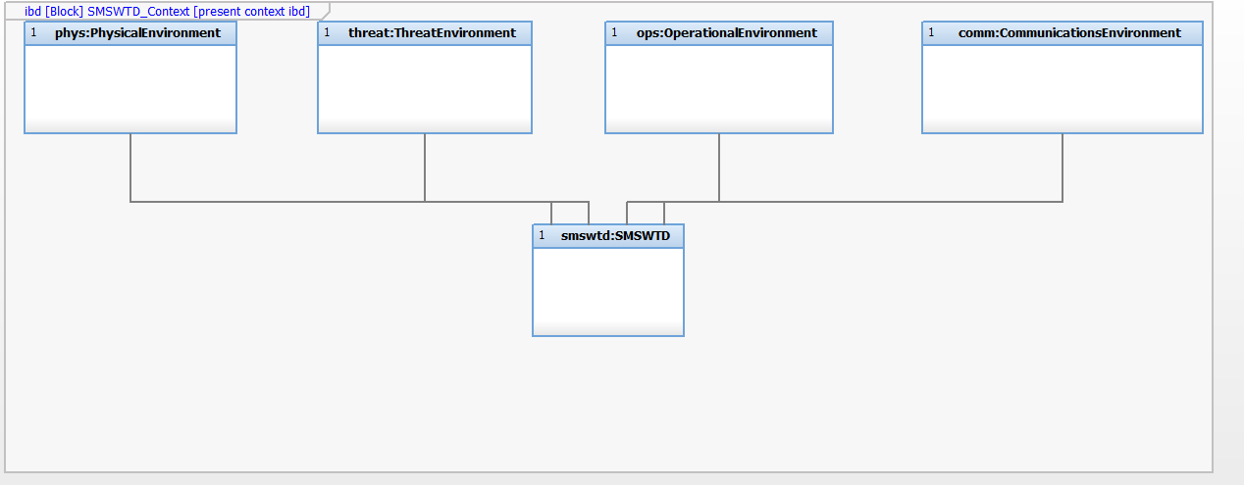
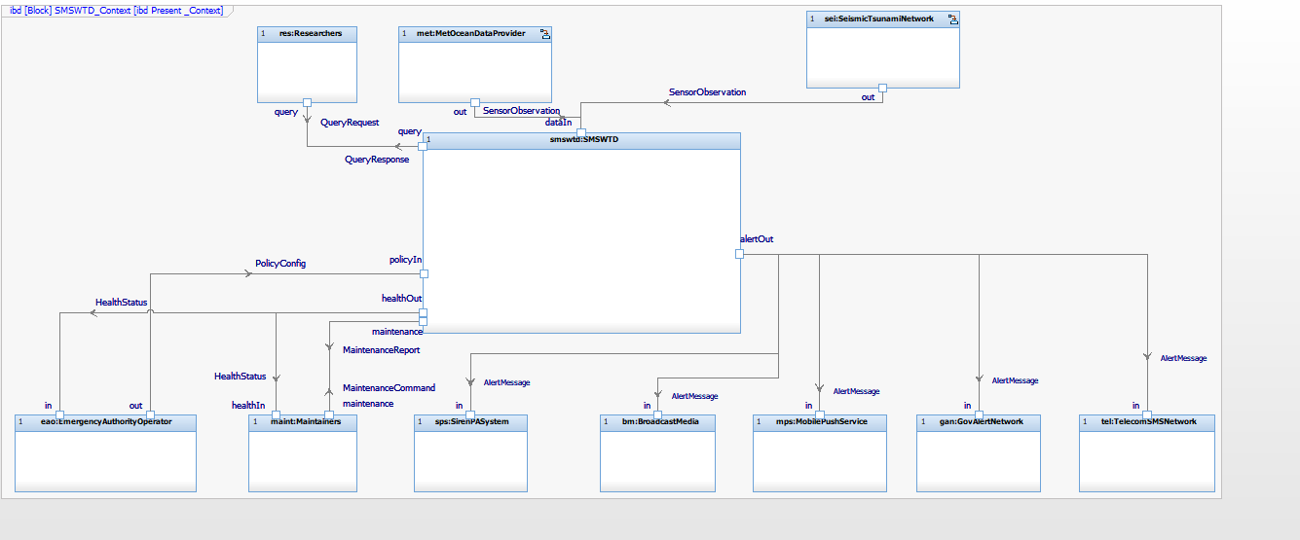
System Context & Operating Environment
Context
SMSWTD interacts with physical, threat, operational, and communications environments and exchanges data/alerts with multiple external stakeholders.
Operating environments
External entities & interfaces
Notes:
[Sources] - SYSML Final Project Documentation.docx (System Context and Operating Environment diagrams) [/Sources]

Slide 5
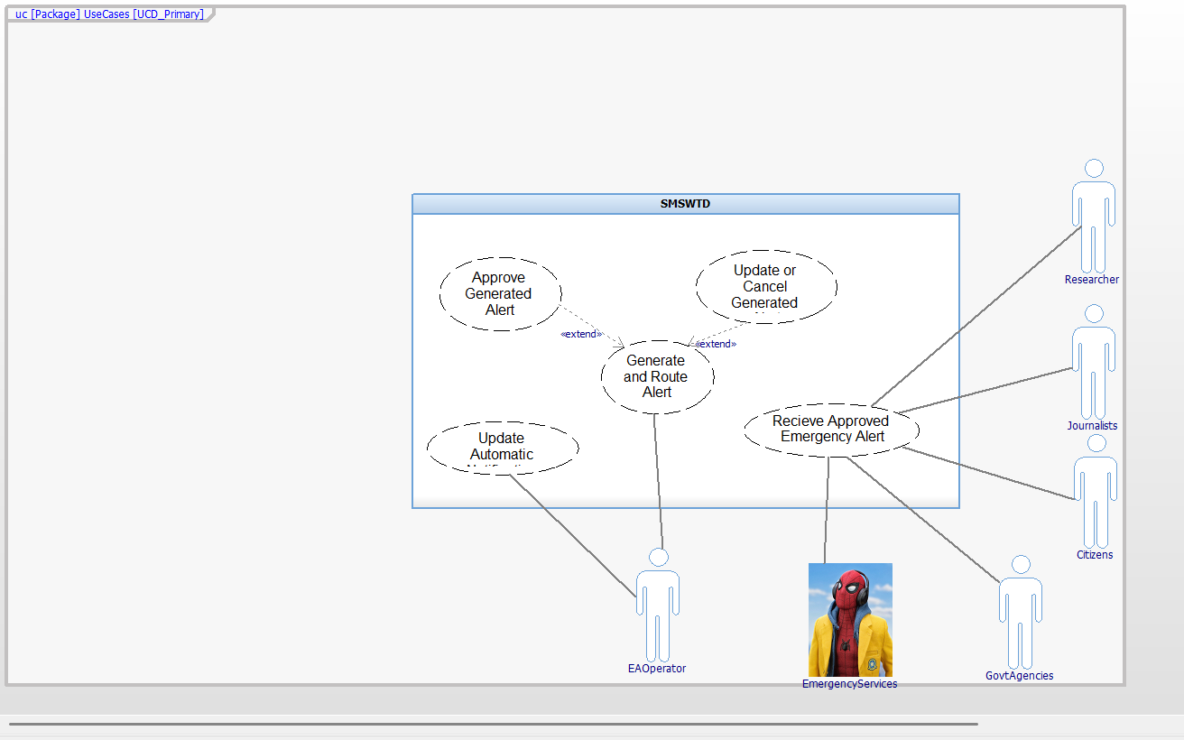
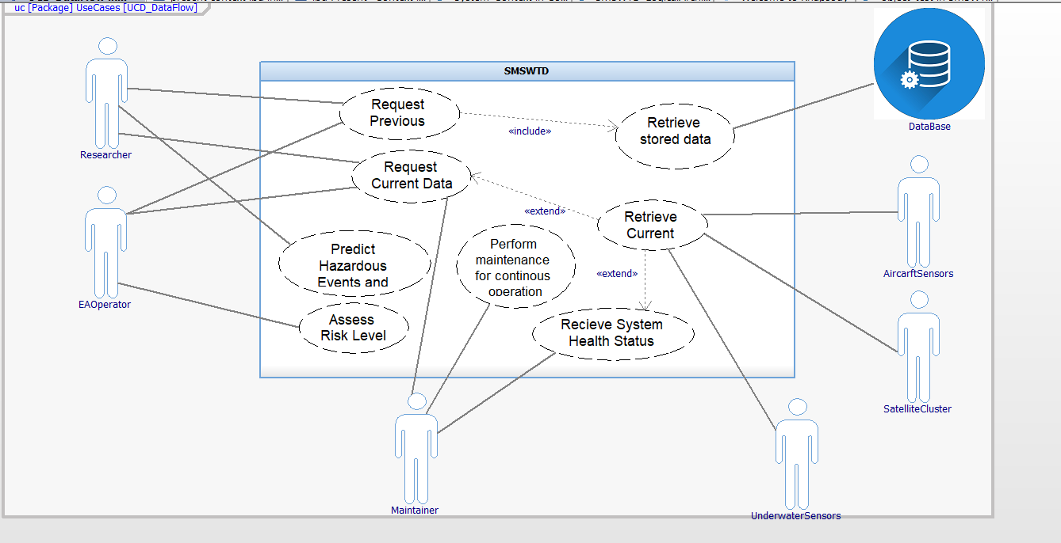
Use Cases
Primary alerting use cases
Data flow / stakeholder interaction
Notes:
[Sources] - SYSML Final Project Documentation.docx (Use Case diagrams) [/Sources]

Slide 6
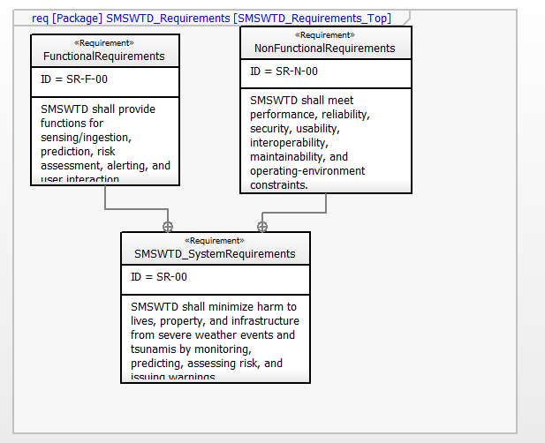
Requirements Overview
System requirement
To minimize harm to lives, property, and infrastructure from severe weather events and tsunamis.
Breakdown
Functional requirements: sensing/ingestion, fusion, detection, prediction, risk assessment, and alert routing.
Non-functional requirements: performance, reliability, security, usability, interoperability, maintainability, and operating constraints.
Implementation focus (time-boxed): raw data → risk analysis → alert generation pipeline.
Notes:
[Sources] - SYSML Final Project Documentation.docx (Requirements diagrams + requirement text) [/Sources]

Slide 7
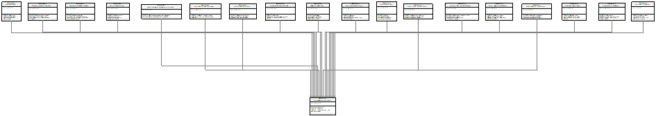
Functional Requirements (Highlights)
Core pipeline
FR trace / diagram
Overview trace diagram from the model (zoom in when presenting).
FR-01/02
Ingest met/ocean + seismic/tsunami observations
FR-03/04
Timestamp, validate, and fuse multi-source data
FR-05/06
Detect hazards; predict impact zones & timing
FR-07/08
Compute risk and provide confidence/rationale
FR-09/10
Generate actionable messages; route multi-channel
FR-11/12/17
Update/cancel alerts; track delivery; log events
FR-14/15/16
Dashboards for authorities; researcher queries; maintainer diagnostics
Notes:
[Sources] - SYSML Final Project Documentation.docx (Functional requirements table + diagram) [/Sources]

Slide 8
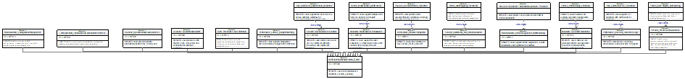
Non-Functional Requirements (Highlights)
Key qualities
NFR trace / diagram
Overview trace diagram from the model (zoom in when presenting).
Performance
Latency budgets; near-real-time processing
Reliability
Graceful degradation; channel redundancy; partial-outage continuity
Security
RBAC; secure comms; auditability/non-repudiation; anti-spoofing
Usability
Clear actionable alerts; operator situational awareness
Interoperability
Standardized data/alert interfaces
Maintainability/Ops
Remote diagnostics; config management; 24/7 operation
Notes:
[Sources] - SYSML Final Project Documentation.docx (Non-functional requirements table + diagram) [/Sources]

Slide 9
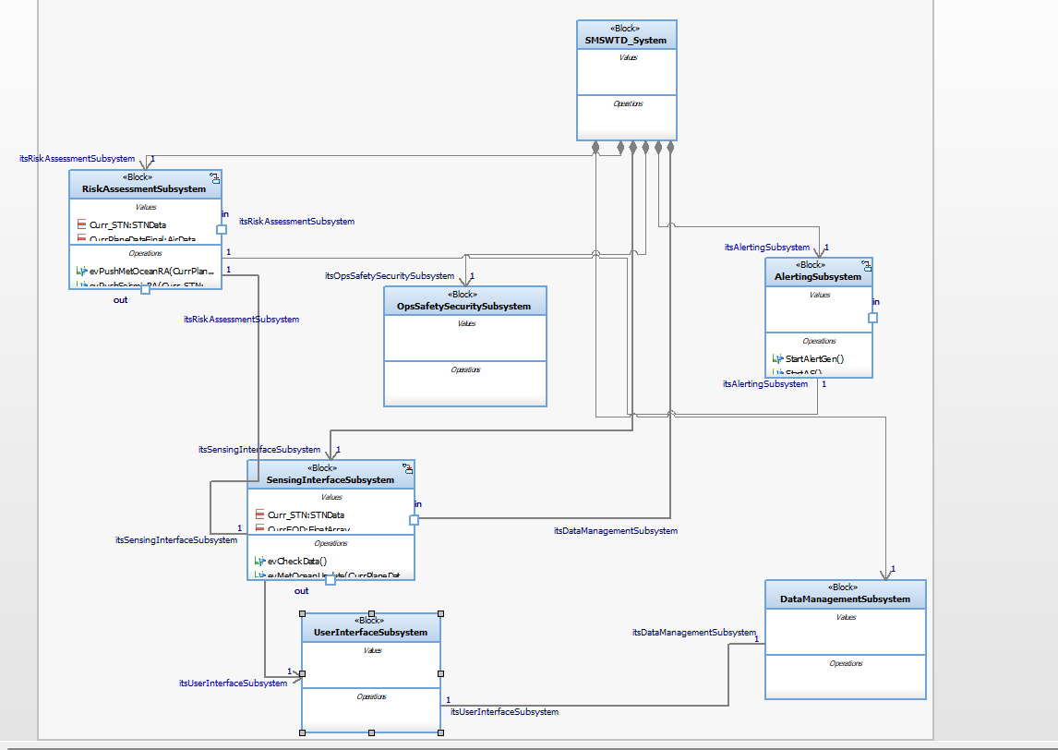
System Logical Architecture
Subsystem roles
SensingInterfaceSubsystem
Ingests provider data, checks certainty/quality, forwards best available data.
RiskAssessmentSubsystem
Analyzes fused data; determines risk; selects alert content & recipients.
AlertGenerationSubsystem
Creates and routes messages to external channels.
DataManagementSubsystem
Stores raw and generated data for traceability & reuse.
UserInterfaceSubsystem
Interfaces with authorities, researchers, maintainers for queries/config/diagnostics.
Notes:
[Sources] - SYSML Final Project Documentation.docx (System logical architecture section + diagram) [/Sources]

Slide 10
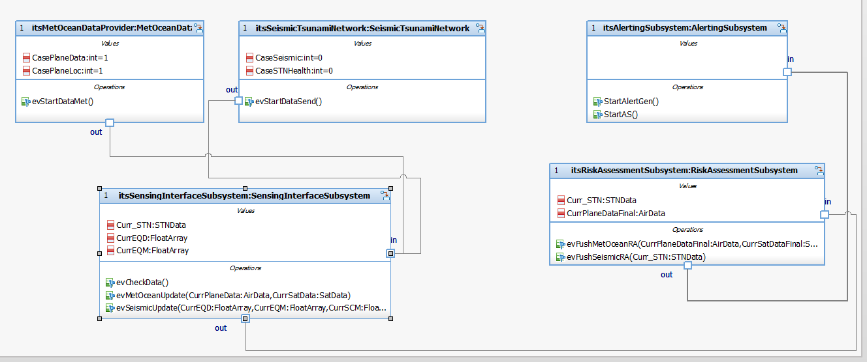
Implemented Scope: Data → Risk → Alert Pipeline
Scope decision
Due to time constraints, the implementation focuses on a streamlined pipeline: ingest raw sensor data, assess risk, and generate alerts.
Design choices to handle latency
Subsystems loop quickly back to collection states (reduced delay timers).
Providers generate data at a slower cadence to avoid overwriting while processing.
Collection gates require both data types before advancing to functional states.
Notes:
[Sources] - SYSML Final Project Documentation.docx (Implementation scope + pipeline diagram + narrative) [/Sources]

Slide 11
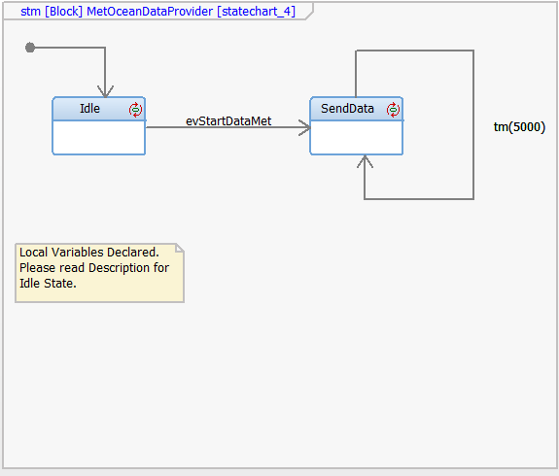
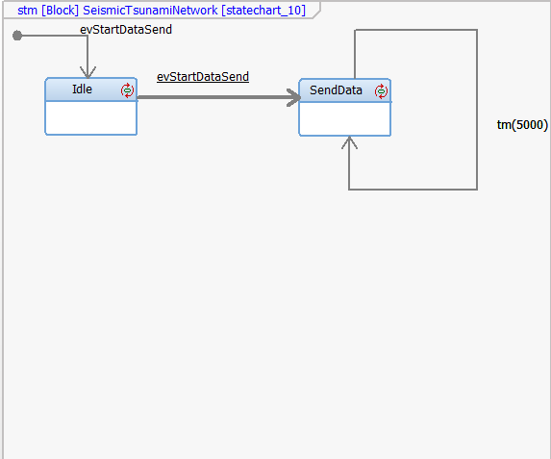
Behavior: Data Providers (Statecharts)
Key idea
Providers continuously loop between idle and “send data” states to simulate periodic data generation.
MetOceanDataProvider
SeismicTsunamiNetwork
Notes:
[Sources] - SYSML Final Project Documentation.docx (Provider statecharts) [/Sources]

Slide 12
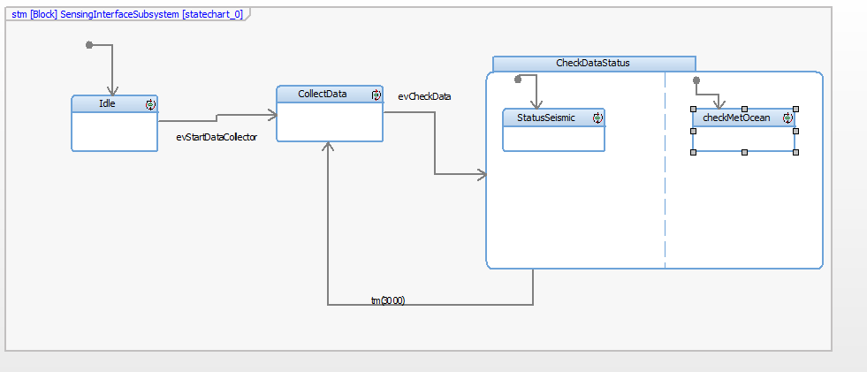
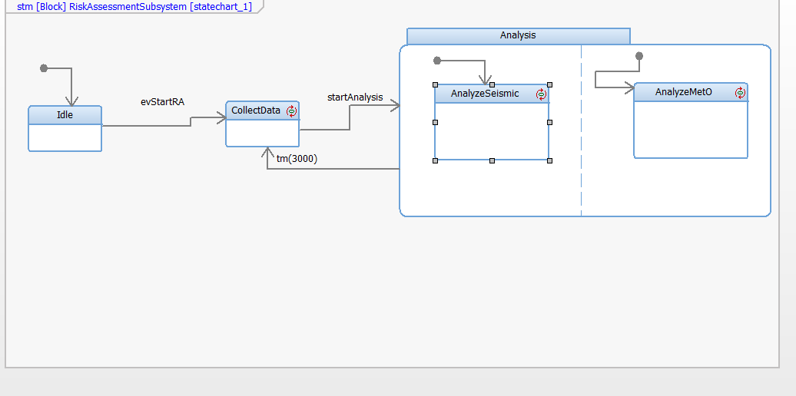
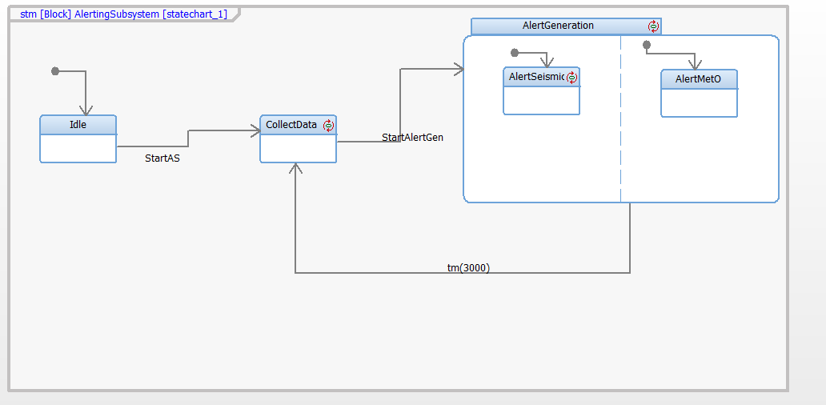
Behavior: Core Subsystems (Statecharts)
Common pattern
Idle → CollectData → Functional state (with separate substates for seismic vs met/ocean).
Subsystem advances only after receiving both data types to avoid race conditions.
SensingInterfaceSubsystem
RiskAssessmentSubsystem
AlertingSubsystem
Notes:
[Sources] - SYSML Final Project Documentation.docx (Subsystem statecharts + narrative) [/Sources]

Slide 13
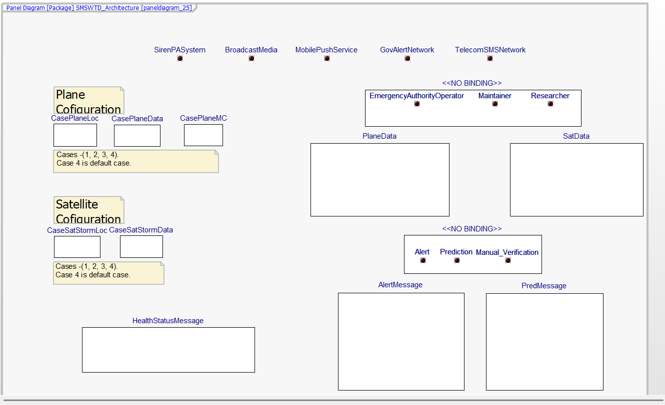
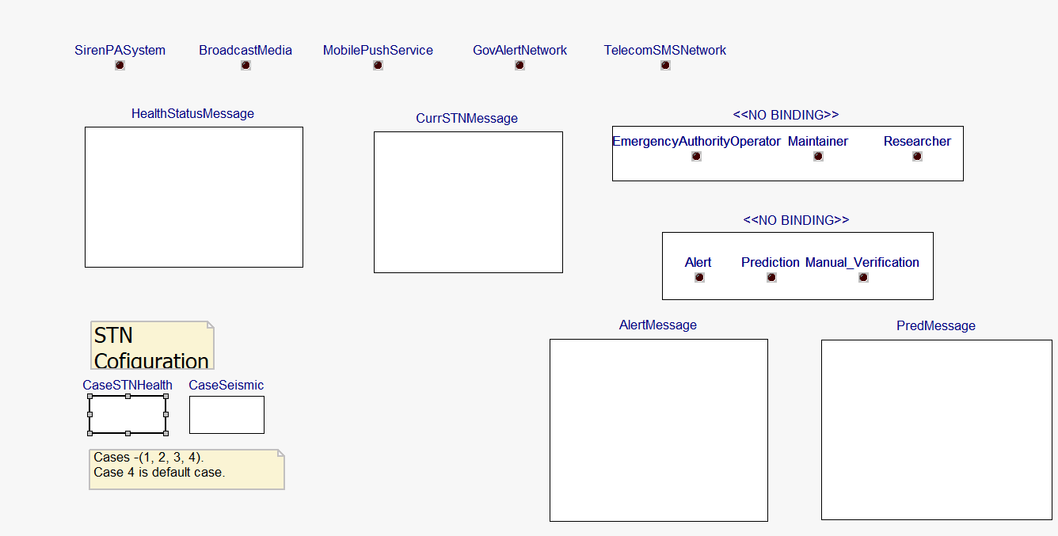
Panel Diagrams: Inputs & Outputs
What the panels show
Controls for selecting test cases (normal/prediction/alert) plus simulated delivery indicators and message outputs.
Notes:
[Sources] - SYSML Final Project Documentation.docx (Panel diagrams) [/Sources]

Slide 14
Video Folder Link
SYSML Video
Notes:
[Sources] - SYSML Final Project Documentation.docx (Panel diagrams) [/Sources]

Slide 15
Thank you
Questions / Discussion
Notes:
[Sources] - SYSML Final Project Documentation.docx [/Sources]

