Slide 1
Bibliometric analysis on Microgravity and Muscular atrophy and selection of plants to mitigate it

Slide 2
Query for PubMed Search
((("Muscular Atrophy"[MeSH] OR "muscle atrophy" OR "skeletal muscle atrophy" OR "muscle wasting" OR "muscle loss")) AND (("Space Flight"[MeSH] OR spaceflight OR microgravity OR weightlessness OR "bed rest" OR immobilization OR "hindlimb unloading" OR "hindlimb suspension"))) AND ((mTOR OR FOXO OR autophagy OR ubiquitin OR MuRF1 OR Atrogin-1 OR AMPK OR mitochondria))

Slide 3
Working pipeline
PubMed Query (428 results)
Export to *.nbib
Conversion to *.RIS
Data cleaning and trimming with python
Title and Abstract analysis
Clustering technique (K means)
Export of the most important clusters
Wordcloud design for most common words

Slide 4
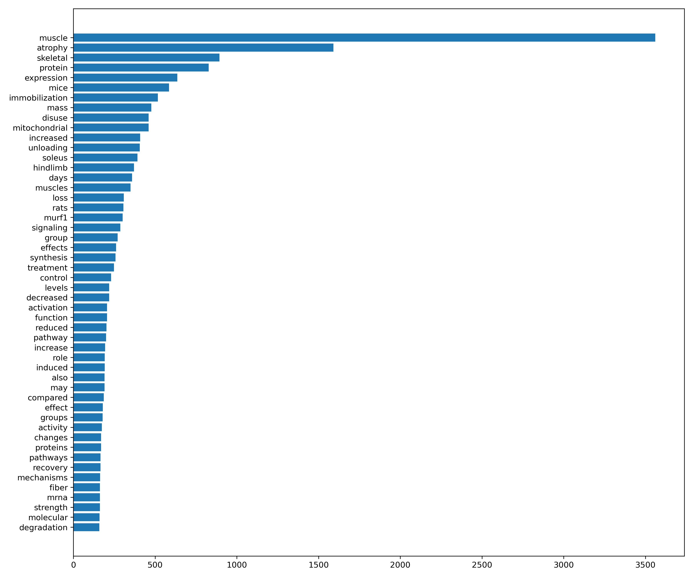

Slide 5
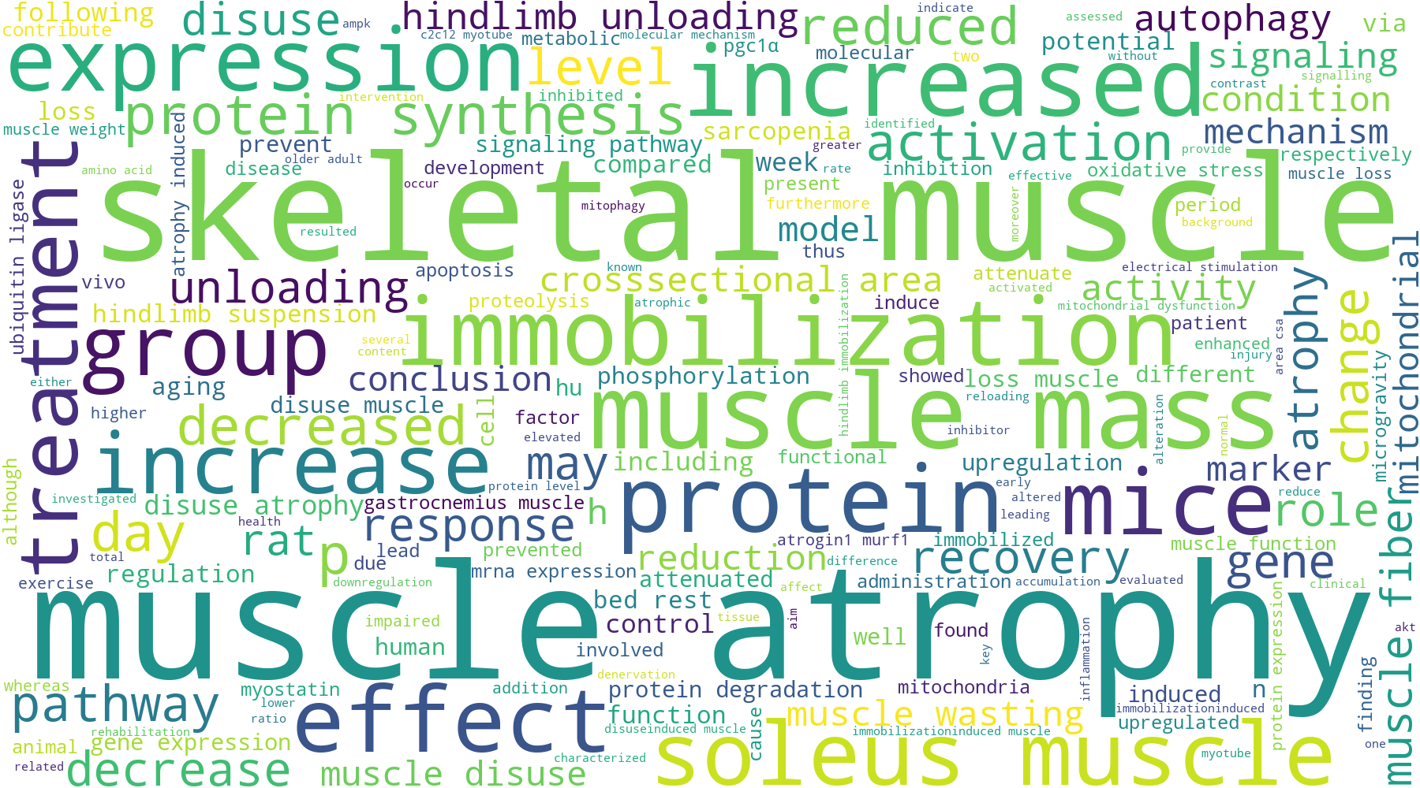

Slide 6
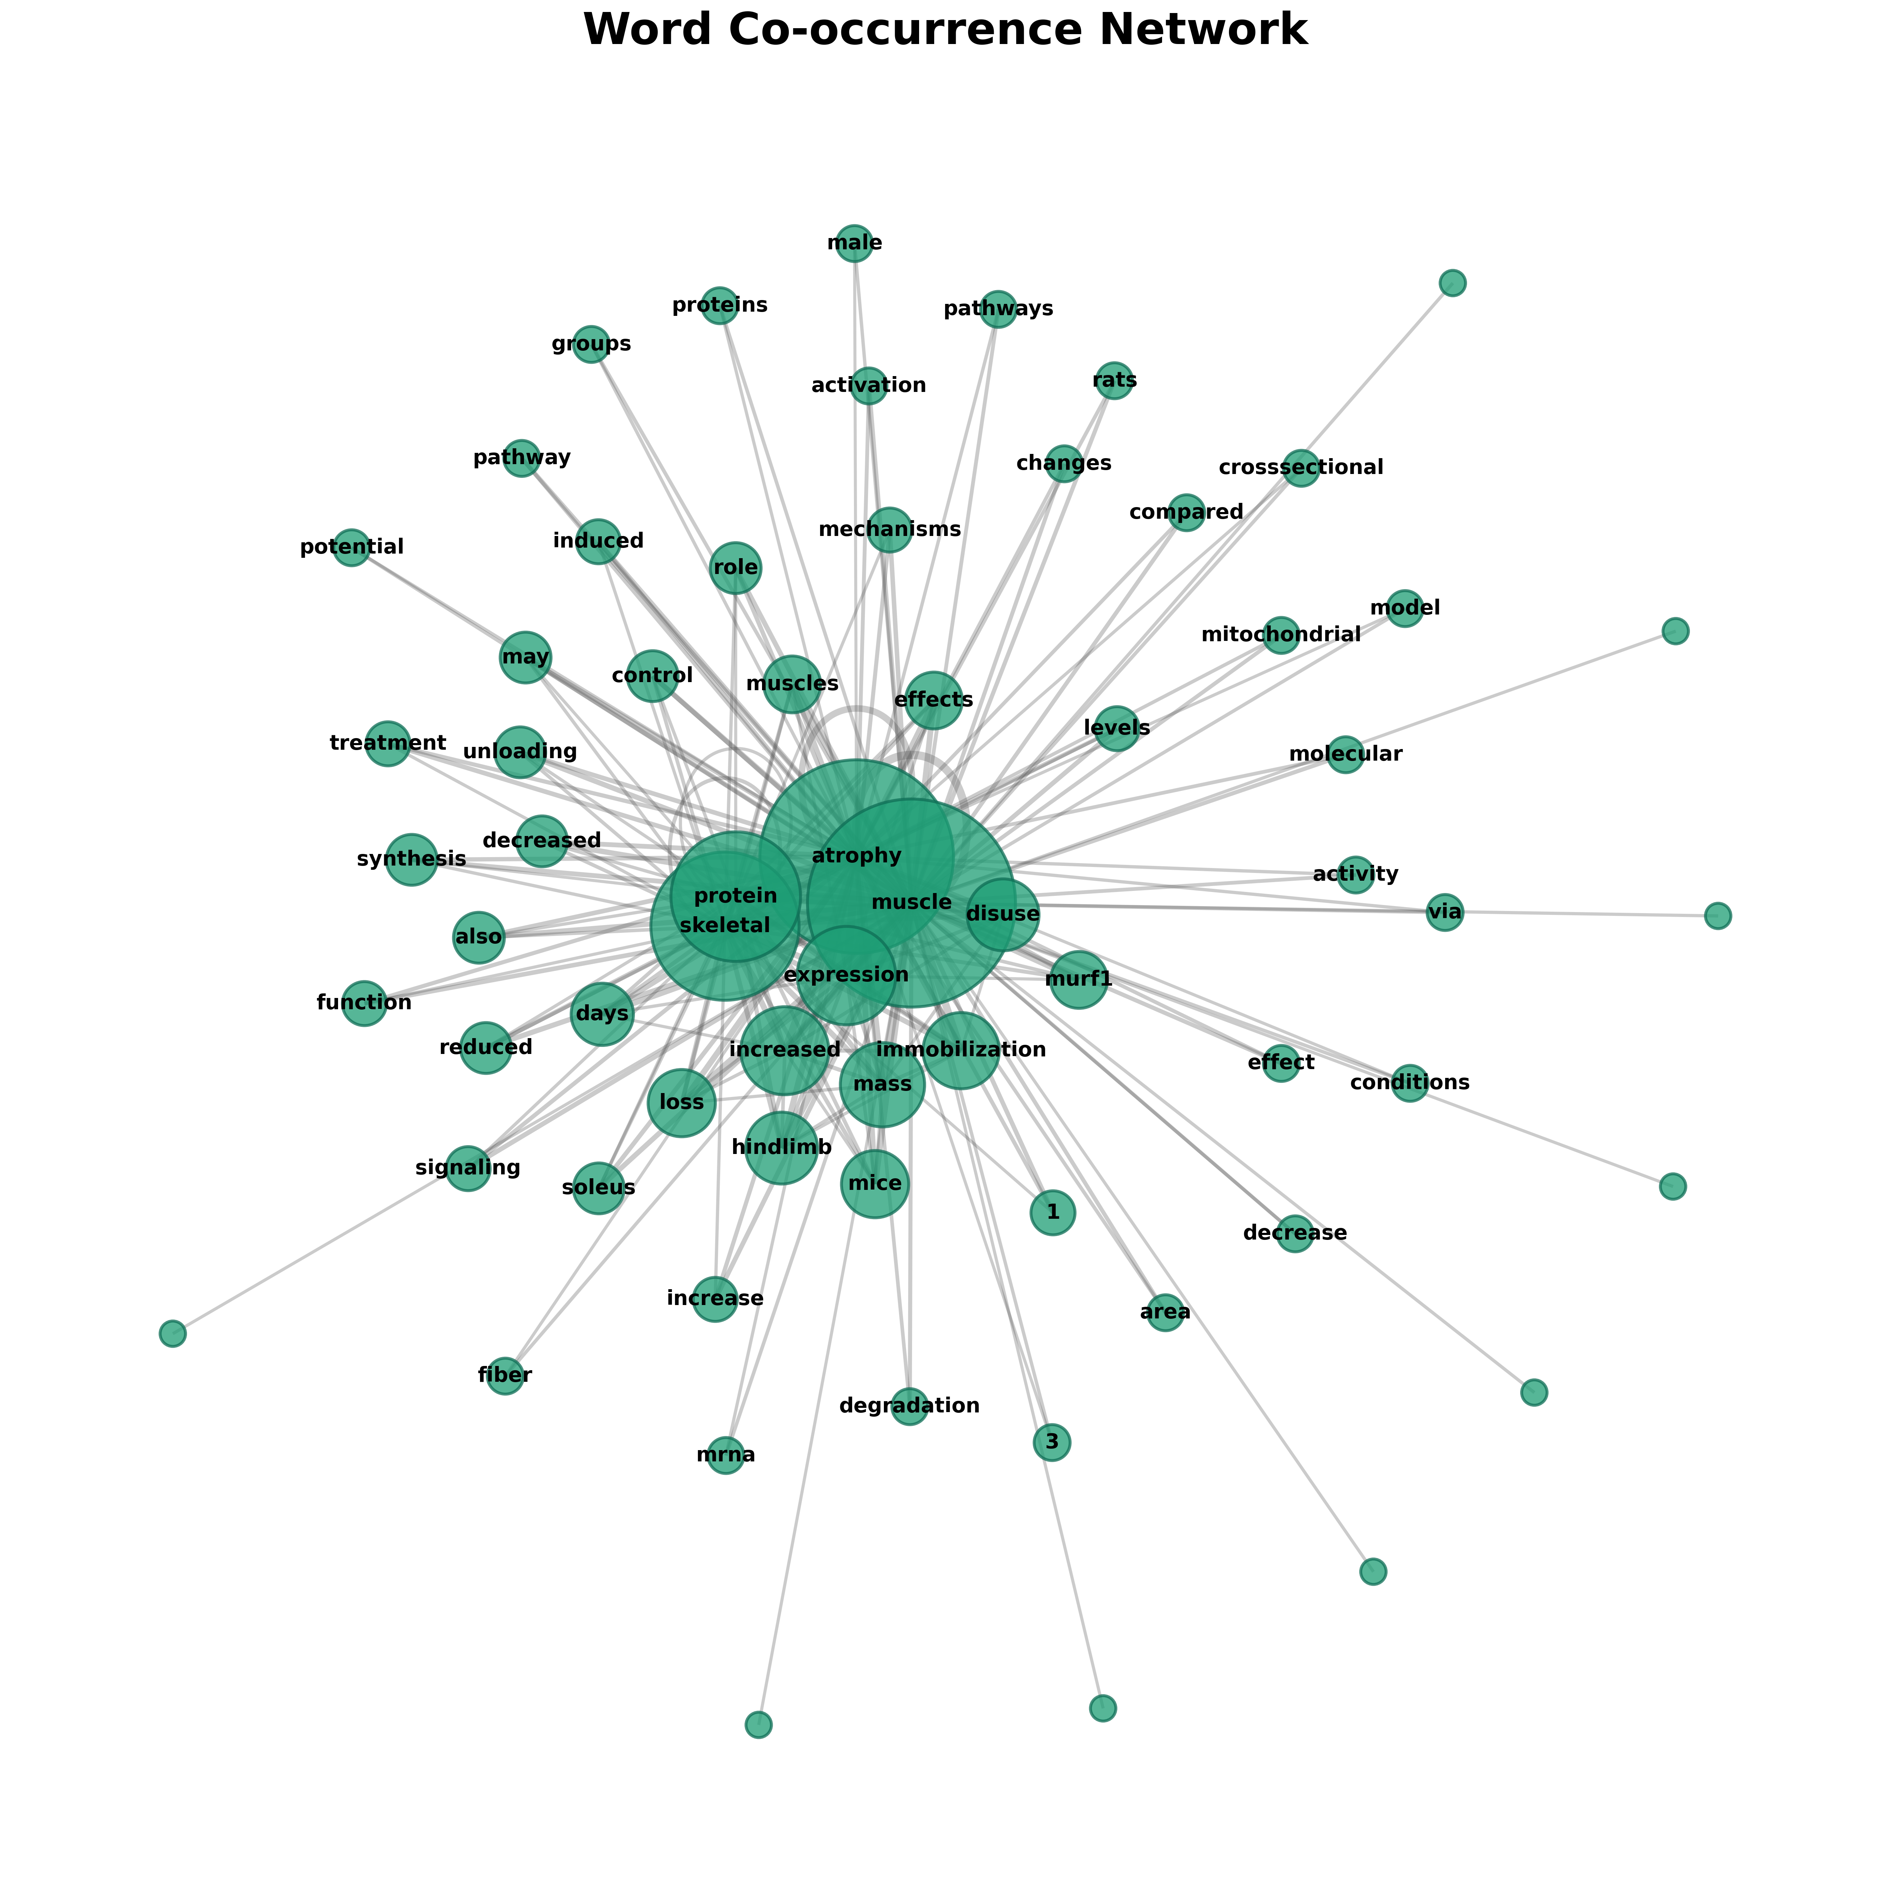

Slide 7
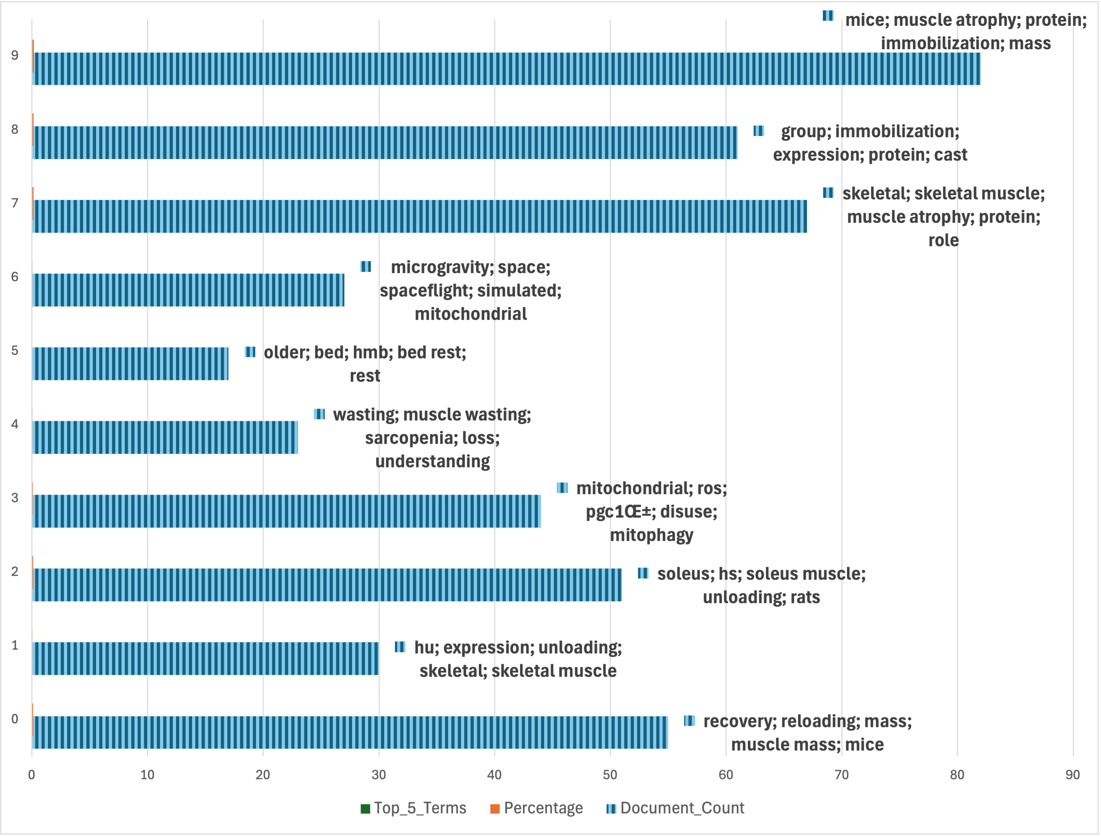
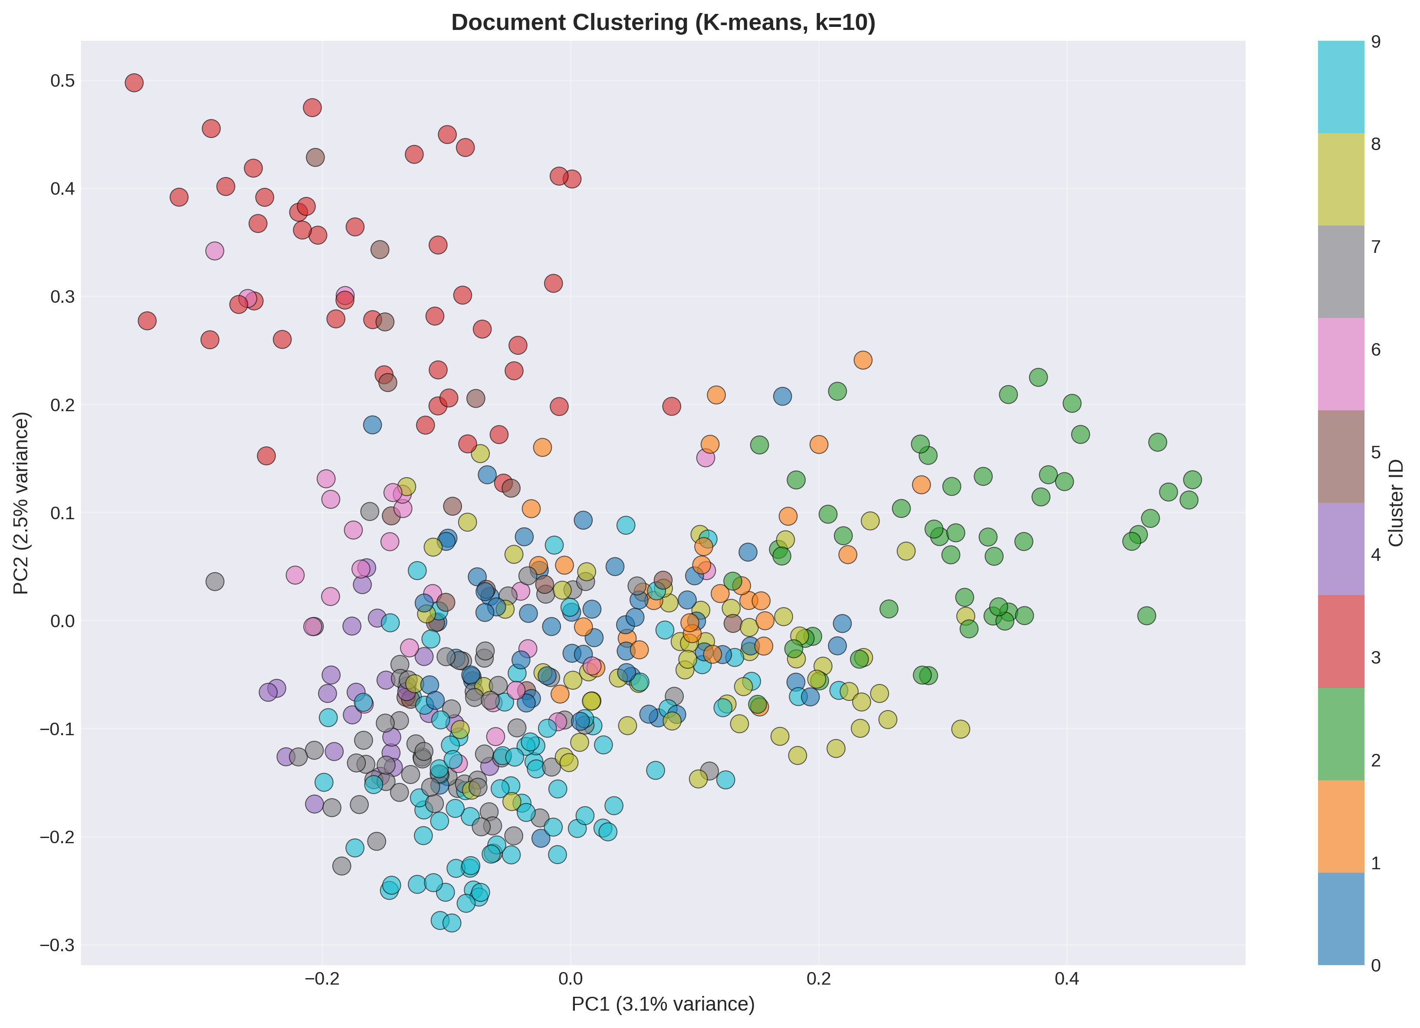
Microgravity and muscular atrophy: Pipeline and results
PubMed Query (428 results)
Export to *.nbib
Conversion to *.RIS
Data cleaning and trimming with python
Title and Abstract analysis
Clustering technique (K means)
Export of the most important clusters
Wordcloud design for most common words
Final selection of papers: 24
Future plan:
  Manual study of sorted papers
  Systematic Review based on the final selection of papers

Slide 10
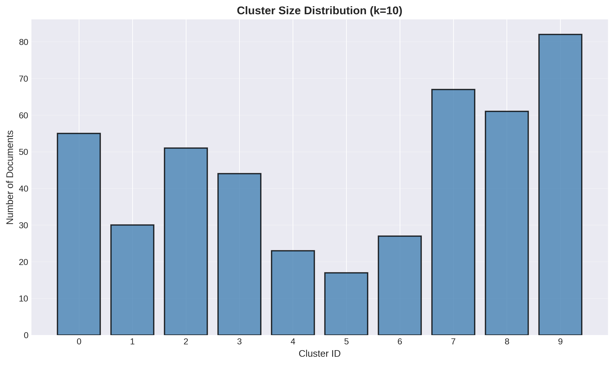

Slide 11
Final selection of papers: 24
Future plan:
  Manual study of sorted papers
  Systematic Review based on the final selection of papers

Slide 12
Plant selection
((indian AND (herbal OR ethnopharmacological OR traditional) OR Ayurveda) AND (muscle OR myofibre OR myopathy OR atrophy OR wasting) AND (atrophy OR degradation OR unuse OR unloading)) NOT ( Review[pt] OR Systematic NOT Review[pt] OR Meta-Analysis[pt] OR Guideline[pt] OR Practice Guideline[pt] OR Editorial[pt] OR Letter[pt] OR Comment[pt] OR News[pt])

Slide 13
Working pipeline
PubMed Query (133 results)
Export to *.nbib
Conversion to RIS
Visualisation with VOSviewer
Data cleaning and trimming with python
Title and Abstract analysis
TF IDF based Clustering technique (K means)
Export of the most important clusters

Slide 14
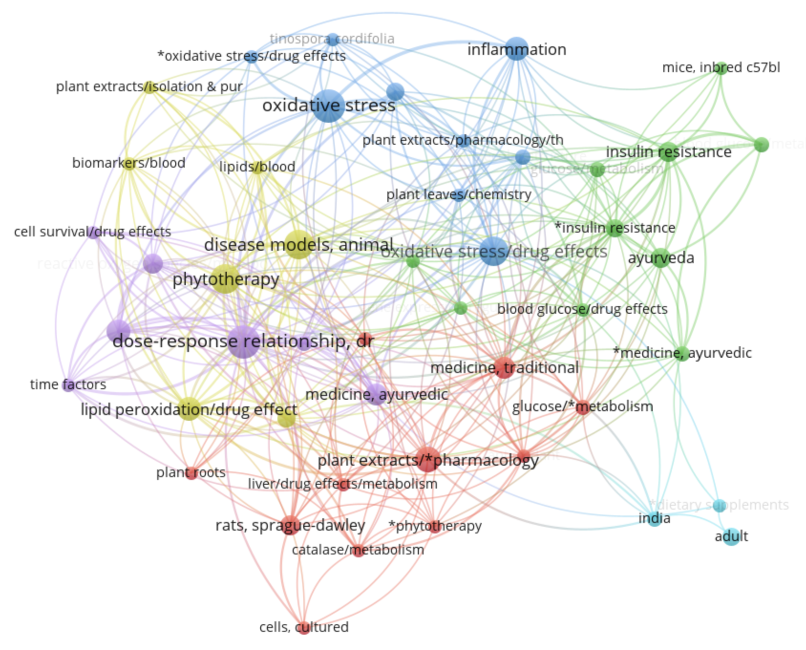
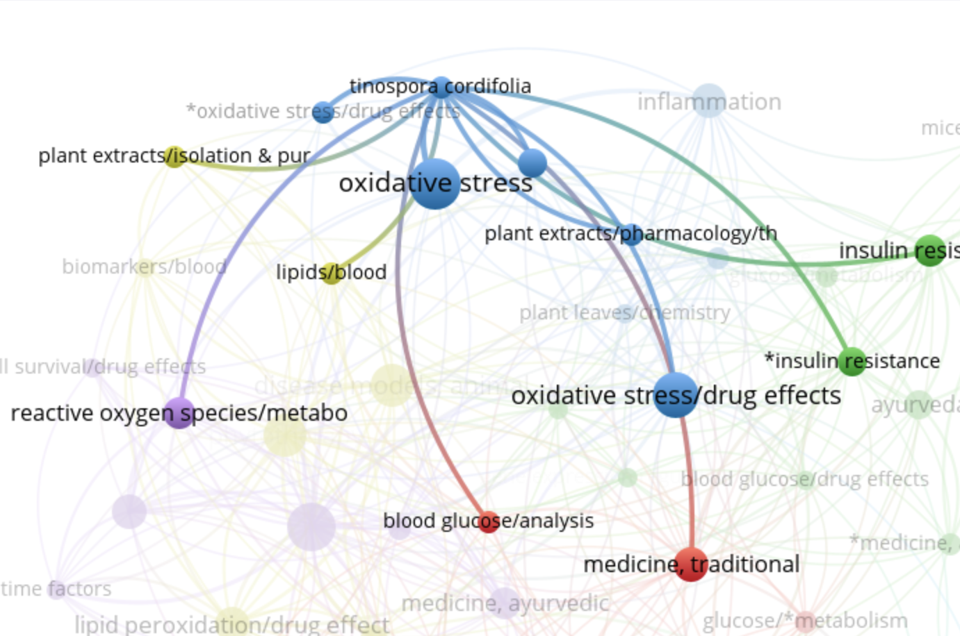
Title based co-occurrence search

Slide 15
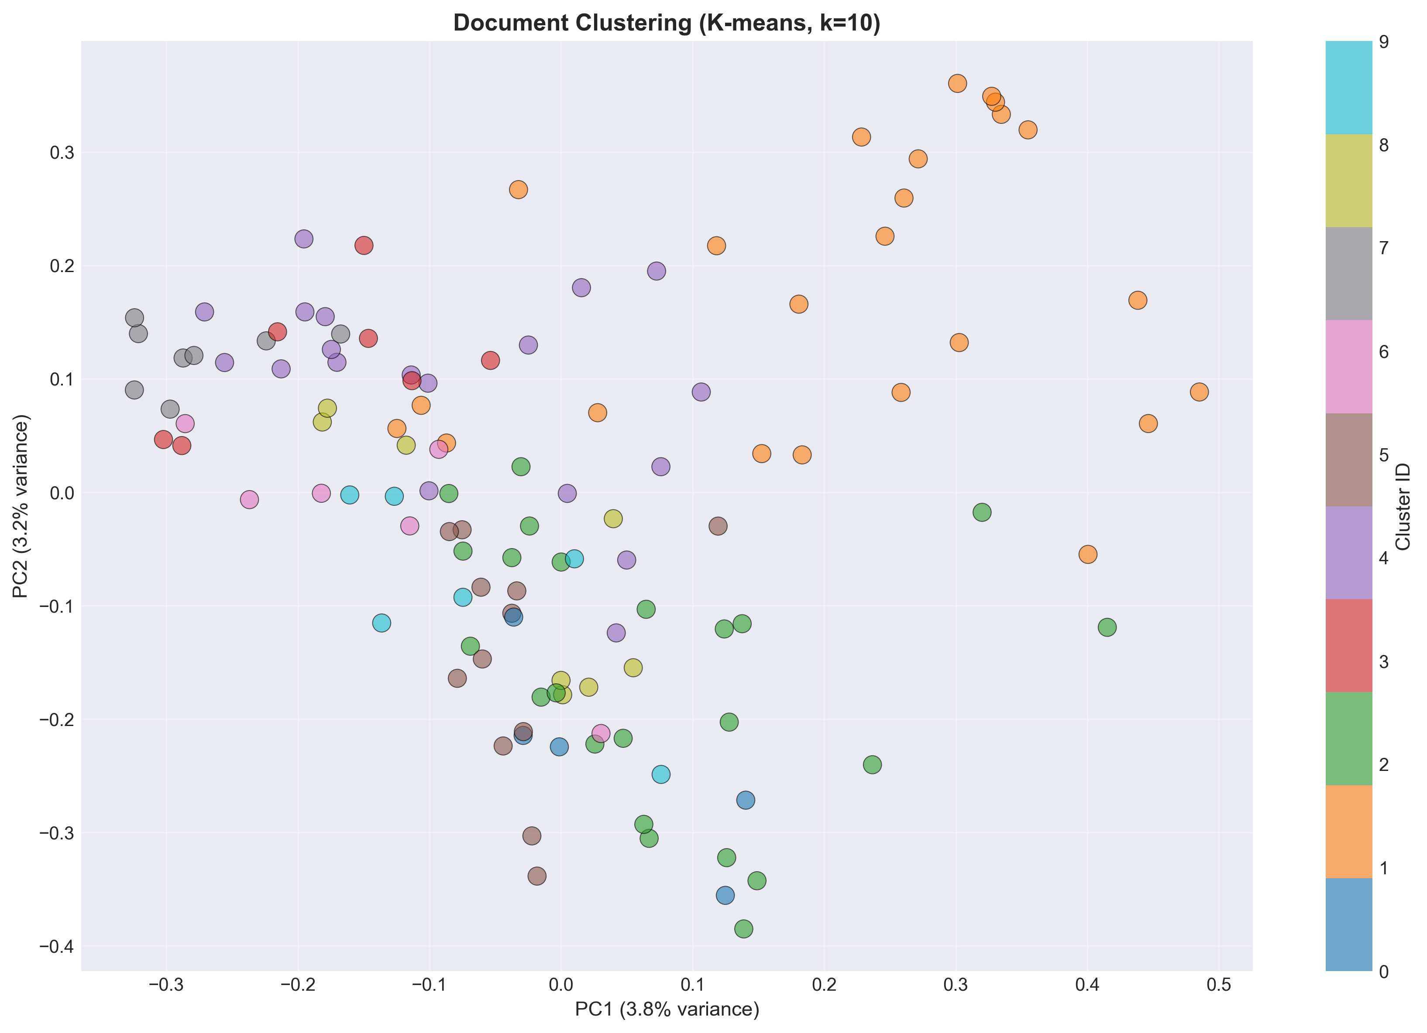
Plant selection: Pipeline and results
PubMed Query (133 results)
Export to *.nbib
Conversion to RIS
Visualisation with VOSviewer
Data cleaning and trimming with python
Title and Abstract analysis
TF IDF based Clustering technique (K means)
Export of the most important clusters
Result
Final paper selection: 45
No of plants/phytoconstituent identified: 4
  Curcumin (#2, Green Cluster)
  Ayurvedic formulation (#7, Grey Cluster
  Arjuna (#8, Yellow cluster)
  Ashwagandha (#9, Indigo cluster)
Future plan of action:
  Manual study of sorted papers
  Systematic review
  Formulation using identified plants

Slide 16
Cluster closeness

Slide 18
Query
( ("Space Flight"[Mesh] OR "Weightlessness"[Mesh] OR spaceflight[tiab] OR microgravity[tiab] OR weightlessness[tiab] OR "simulated microgravity"[tiab] OR "hindlimb unloading"[tiab]) AND ( neuro*[tiab] OR brain[tiab] OR CNS[tiab] OR cognition[tiab] OR cognitive[tiab] OR memory[tiab] OR learning[tiab] OR behavior*[tiab] OR psychological[tiab] OR anxiety[tiab] OR depression[tiab] OR stress[tiab] OR neuroplasticity[tiab] OR neuroinflammation[tiab] OR neurotransmitter*[tiab] ) AND ( Humans[Mesh] OR Animals[Mesh] OR Mouse[Mesh] OR Rat[Mesh] OR mice[tiab] OR rats[tiab] OR rodent*[tiab] ) ) AND ( Journal Article[pt] OR Review[pt] OR Systematic Review[pt] OR Meta-Analysis[pt] ) NOT ( Editorial[pt] OR Letter[pt] OR Comment[pt] OR News[pt] OR Biography[pt] OR Case Reports[pt] OR Interview[pt] )

Slide 19
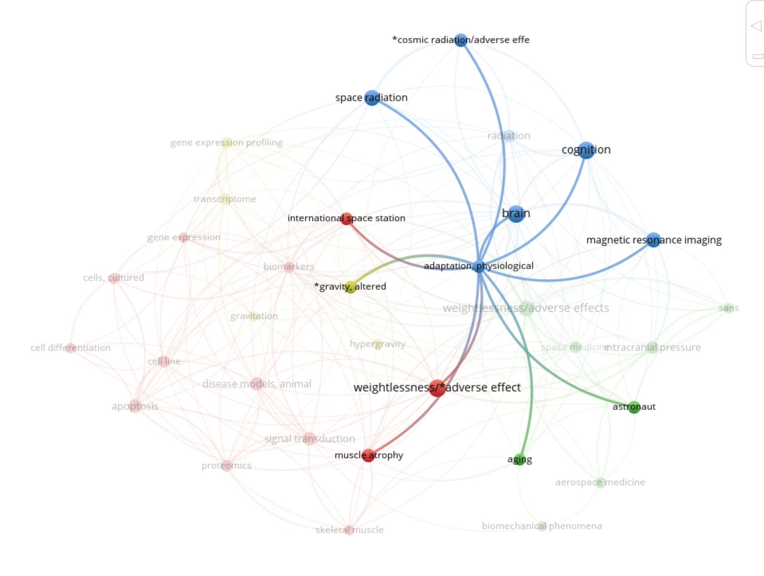
VOS plotting

Slide 21
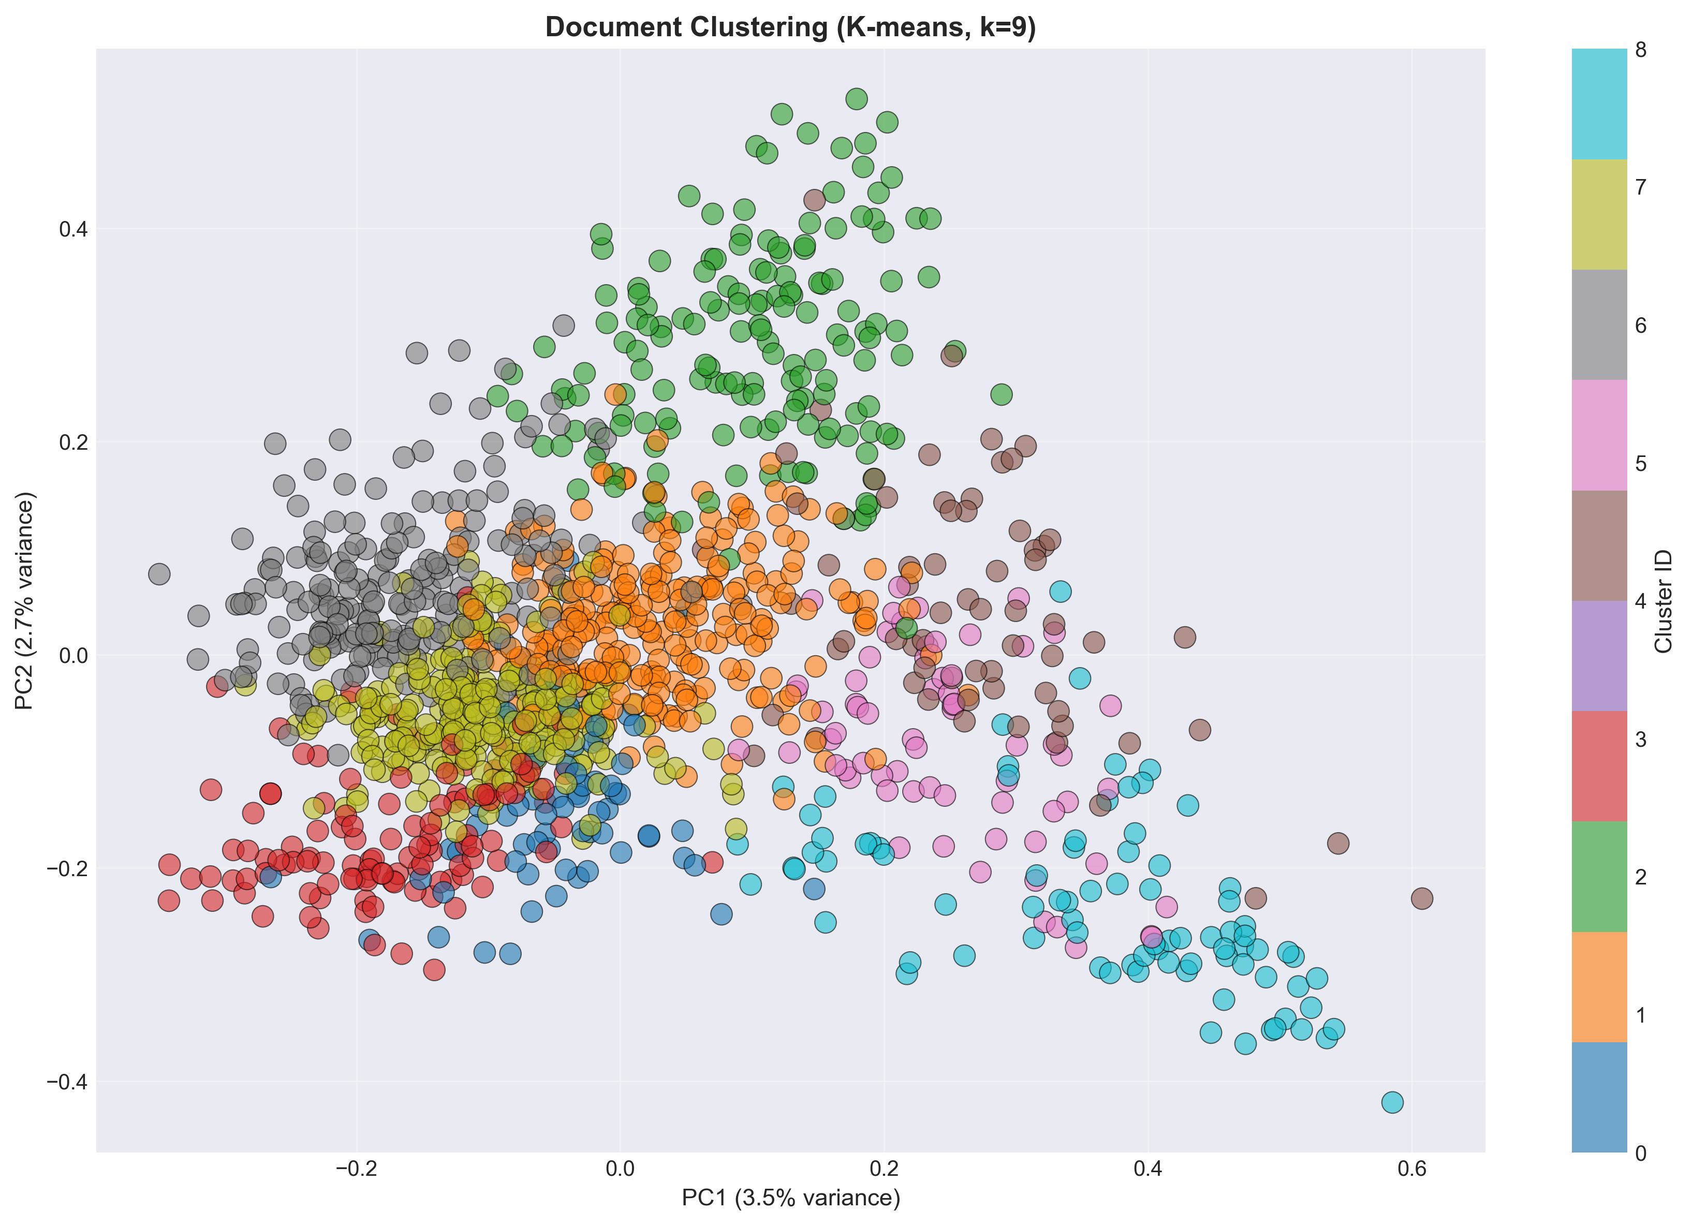
Bibliometric analysis pipeline
PubMed Query (1320 results)
Export to *.nbib
Conversion to RIS
Visualisation with VOSviewer
Data cleaning and trimming with python
Title and Abstract analysis
TF IDF based Clustering technique (K means)
Export of the most important clusters
Result:
Final paper selection: 515
No of diseases identified: 3
  Radiation sickness (#6, Grey Cluster)
  Spaceflight-Associated Neuro-Ocular Syndrome (#3, Red Cluster)
  Sleep deprivation (#7, Green Cluster)
Plan of action:
  Further sorting and curing of data to identify more diseases
  Manual study of final sorted papers
  Systematic review
  Formulation using identified plants

