Slide 1
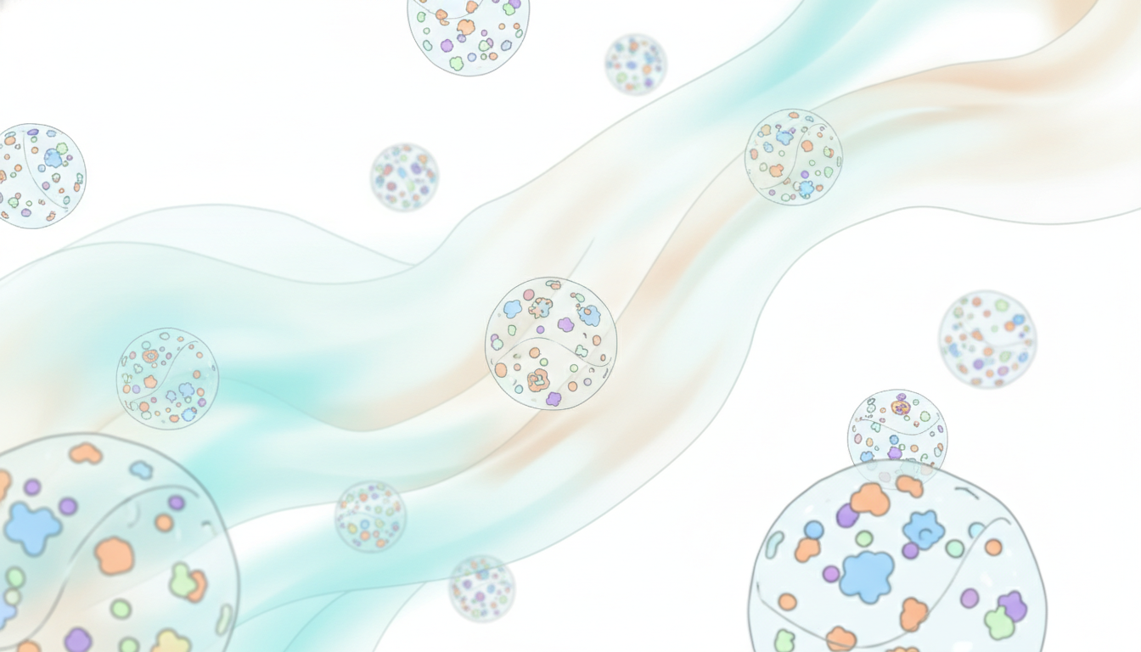
Biological fluid environment
Surface proteins
Lipid bilayer membrane
Exosome vesicle

