Slide 1
FILLET- PLATFORM FOR INTELLIGENT NUTRITION
SAPTHAMY P.O
PTA19CS041

Slide 2
INTRODUCTION
Nowadays there exist may food recommendation systems or meal recommendation systems , restaurant recommendation systems and online shopping assistance system etc.
The data sources relevant for such system are complex and diverse.
This paper introducing a platform FILLET which will collect and integrating data from multiple , complex sources and also provide tools for data preparation.

Slide 3
LITERATURE SURVEY
1.“A Food Recommender Systems Considering Nutritional Information and User Preferences”-Raciel Yera, Ahmad Toledo, A. Alzahrani and Luis Martínez-2019
This paper presents recommendation systems which recommend food based on data which is in structured form(nutrition database)
The nutrient content estimation is performed by checking only the nutrients present in each ingredient only.
Fillet overcome these disadvantages as it contain modules that will extract information from multiple sources such as food blogs, recipe website(unstructured form)and nutrition database(structured form).

Slide 4
This platform also contain modules that will estimate the nutritional content of a dish based on the nutrients present on the each ingredients, cooking method and also the quantity of each ingredient used in a particular dish.
2.Converting In-N-Out Orders into Structured Form-Michael Gummelt and David Brody-2009
This paper uses MEMM for tagging the labels.
Tagging is done in Fillet using CRF and n-gram model which overcome the disadvantage of label bias which is present in the MEMM model
When comparing MEMM and CRF,MEMM has the advantage of automatic spell checking, automatic competition etc but fillet uses n-grams which will provide all these functionalities.
This paper also uses In-N-Out orders as input.so its tagging is not accurate.

Slide 5
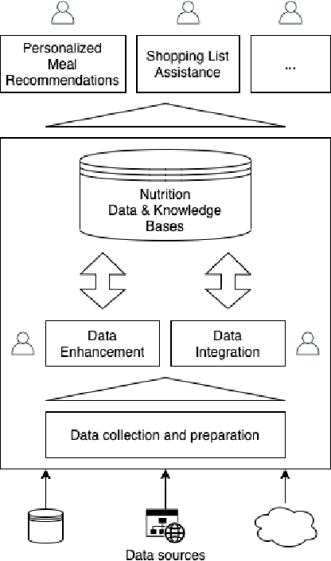
ARCHITECTURE
Fillet mainly contains three layers:
Data Preparation-Collecting data using different methods including web services, database queries, scrapers.
Data Enhancement-to discover additional knowledge about data being integrated.
Data Integration-uses information collected in the previous layers to associate information between different sources.

Slide 6
Modules
Recipe Scraper belonging to the data collection and preparation layer.
Ingredient Line Parser belonging to the data enhancement layer.
Nutrition Content Estimation and Food Product matching modules belongs to data integration layer.
Recipe Scraper
The web is a source of a lot of widely available information that is relevant for nutrition.
This includes recipes, food blogs, reviews etc.
This module uses a technique called web scraping which is widely used technique to extract information from multiple sources.

Slide 7
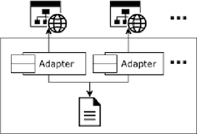
The main challenge related to scraping recipe from websites are related to the different structures used by websites and the different information contained in it.
An adapter is present in each website which will extract information from the website and normalize it into a common form.

Slide 8
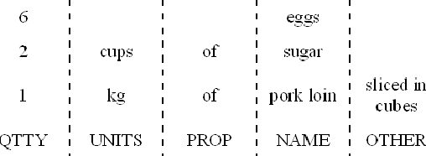
2.Ingredient Line Parser
This module divides ingredient lines into quantities, units, name and other informations.
It collects the ingredients that will be used in a recipe.
This module uses a model Linear CRF(Conditional Random Field)that can predict the tag sequence of any ingredient phrase.

Slide 9
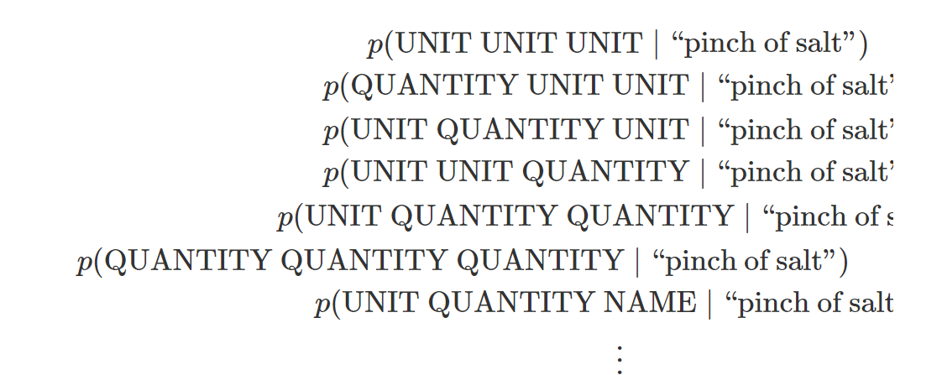
Problem Description:
Let{x1,x2,x3…xn} be the set of ingredient phrases
Eg:{“1/2 cup whole wheat flour", "pinch of salt”,..}where each xi is an ordered list of words associated with a list of tags, Yi.
If xi=[“pinch”,”of”,”salt”] then yi=[Unit,Unit, Name]
Tag is either a name,unit,quantity,comment or other.
Computationally unpleasant to score all tags^words

Slide 10
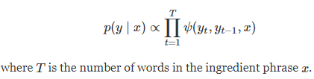

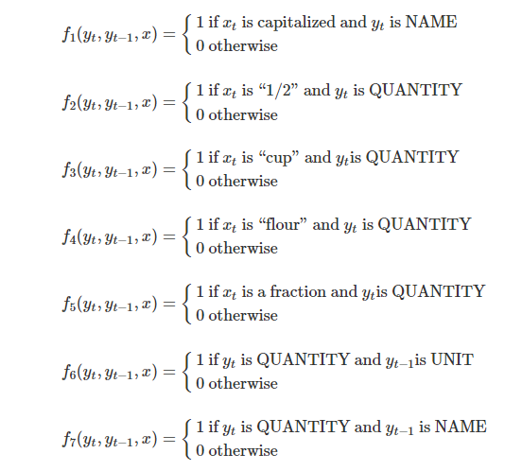
The Linear CRF model predict the best sequence of labels for an ingredient phrase-sequence of labels with highest probability in a time |tags|^2*|words|
Linear chain CRF models this probability in following way:

Slide 11
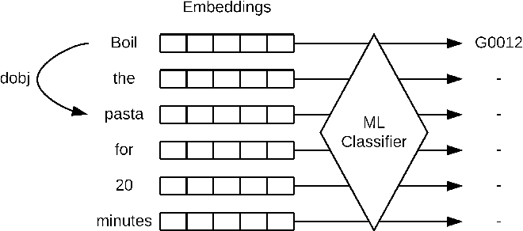
3.Nutritional Estimator
This module extracts informations like ingredients present in the recipe,how they are cooked.
These are associating to already established FCDBs-eg:TCA.
To identify how each ingredient is cooked this module analyses the preparation steps of a recipe
Extracting cooking related verbs with a trained ML classifier.
Associating direct/indirect objects of said verb that contain ingredient name with a LanguaL™ code.

Slide 12
LanguaL™ is an automated method for describing, capturing and retrieving data about food.
Principle Behind LanguaL™
Any food(or food products)can be systematically described by a combination of characteristics.
These characteristics can to categorized into viewpoints and coded for computer processing.
The resulting viewpoint/characteristic code can be used to retrieve data about the food from external databases.

Slide 13
Identification of a verb’s direct/indirect object is obtained by predicting the dependency tree of each sentence.
The classifier was trained with many words extracted from the instruction steps of many Portuguese recipe.
words were classified independently to identify which of them pertrain to cooking method.
4.Food product matching
Aims at associating ingredients identified in recipes with suitable food products from retailers.
Neo4j graph database stores all the information of the system.
The product information from the retailers, ingredients identified in recipes and the AGROVOC thesaurus loaded to the database.

Slide 14
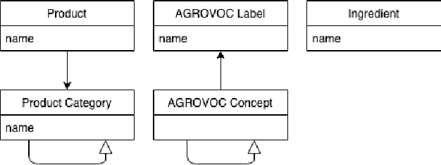
Each ingredients and products are associated with similar AGROVOC concept.
For matching ingredients and products candidates consisting of pairs of candidate are created.
SVM Binary classifiers are used to determine if each pair is a positive match
Bidirectional-candidates for new product or for new ingredients

Slide 15
conclusion
FILLET is considering as a generic platform to support the development of different services related to food and nutrition
FILLET facilitate the extraction, structuring and integration of information from heterogeneous sources of food domain

Slide 16
REFERENCES
Thi Ngoc Trang et al.”An overview of recommendation systems in the healthy food domain”[2]
Raciel Yera, Ahmad Toledo, A. Alzahrani and Luis Martínez, "A Food Recommender System Considering Nutritional Information and User Preferences“[3]
Michael Gummelt and David Brody.Converting In-N-Out Orders into a structured form[6]
Erica Greene.Extracting Structured Data from Recipes using Conditional Random Fields[9]
Anders Moller and Jyne Ireland Langual alimentaria thesaurus[5]

Slide 17
THANK YOU

