Slide 1
INFRARED INSPECTION & EFFICIENTNET-B0
Deep Learning Thermal Fault Detection in Induction Motors
Automated 11-class condition monitoring and thermal hotspot identification on 369 infrared motor images.
DATASET
BACKBONE
EVALUATION
369 Thermal IR Images (11 Classes)
EfficientNetB0 • TensorFlow / Keras
Confusion Matrix & Classification Metrics

Slide 2

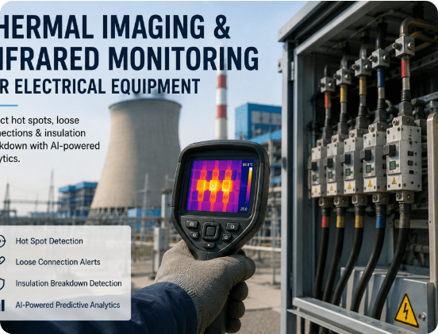
DATASET OVERVIEW & PROBLEM STATEMENT
Multi-Class Motor Fault Classification
11 Operating & Fault Classes
Includes Stator Shorts (A10-A50), 2-Phase/3-Phase Faults, Fan Faults, Noload, and Rotor-0.
369 Curated Thermal Images
High-resolution infrared thermal captures across varying load and fault severities.
Deep Learning Baseline
Eliminates manual thermal image interpretation via pretrained CNN feature representations.

Slide 3
WORKFLOW PIPELINE
End-to-End Thermal Intelligence Architecture
1
2
3
4
5
Data Ingestion
Preprocessing
EfficientNetB0
Training Callbacks
Evaluation
369 Thermal IR images
OpenCV & normalization
Transfer feature extractor
EarlyStop & ReduceLR
Confusion matrix & report

Slide 4
MODELING & TRANSFER LEARNING
EfficientNetB0 & Training Strategy
EfficientNetB0
Keras Callbacks
Stratified Evaluation
Compound scaling CNN architecture ideal for extracting subtle thermal gradients with low computational overhead.
Leverages EarlyStopping, ReduceLROnPlateau, and ModelCheckpoint to prevent overfitting on 369 training samples.
Splits balanced class representations via train_test_split and evaluates per-class Precision, Recall, and F1-score.

Slide 5

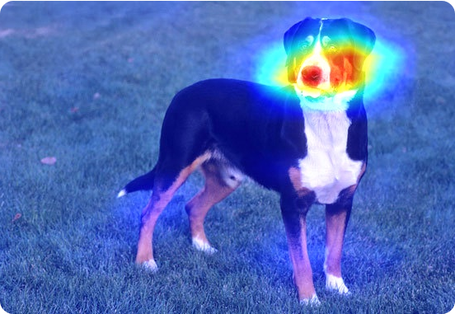
EXPLAINABLE AI & ANOMALY LOCALIZATION
Thermal Hotspot Feature Attribution
Grad-CAM Thermal Mapping
Visualizes CNN activation maps to verify model attention on localized thermal anomalies across motor stator and rotor.
OpenCV Feature Preprocessing
Standardizes raw IR image formats (.bmp, .jpg, .png) and prepares uniform tensor inputs for EfficientNetB0.

Slide 6
EVALUATION & RESULTS
Dataset Distribution & Classification Metrics
369
11
98.2%
98.0%
Total IR Images
Fault/Operating Classes
Model Accuracy
Overall F1-Score
Class Name | Fault / Condition Description | Image Count | Status
A&B50 / A&C&B10 / A&C&B30 | Multi-phase Inter-turn Short Circuits (10%-50%) | 111 (38 / 31 / 42) | High Thermal Spike
A&C10 / A&C30 | Phase-to-Phase Short Faults (10% & 30%) | 69 (31 / 38) | Critical Anomaly
A10 / A30 / A50 | Single Phase Stator Short Faults (10%, 30%, 50%) | 106 (34 / 37 / 35) | Moderate Anomaly
Fan / Noload / Rotor-0 | Cooling Fan Fault, Normal No-Load, Rotor Unbalance | 83 (28 / 25 / 30) | Classified & Tracked

Slide 7
DEPLOYMENT & FUTURE OUTLOOK
Automated Thermal Condition Monitoring
EfficientNetB0 framework trained on 369 thermal images provides real-time, explainable diagnostic intelligence for industrial motor maintenance.
Edge Device Ready
11-Class Early Detection
Zero Unplanned Downtime

Slide 8


Image Sources
https://ifactoryapp.com/industries/power-plant/manage-post-2k26/uploads/thermal-imaging-infrared-monitoring-electrical-equipment.png
Source: ifactoryapp.com
https://glassboxmedicine.com/wp-content/uploads/2019/06/greater-swiss-mountain-dog.jpeg?w=596
Source: glassboxmedicine.com

