Slide 1

AgentForge Local AI
A Privacy Focused Offline AI Agent Powered by Small Language Models
Run locally. Use tools intelligently. Keep your data under your control.
Saqib Ahmad Bhat
Student Developer · B.E. Computer Science and Engineering · Government College of Engineering, Tirunelveli
AI/ML EWB internship course, under the supervision of the EWB Courses programme
Overview
Architecture
Pipeline
Security
Results
Contact
Notes:
Introduce yourself and the project: an AI agent that runs a small language model on your own computer through Ollama and uses validated, deterministic tools. It was undertaken as part of the AI/ML EWB internship course. The buttons at the bottom jump to each section.

Slide 2





Problem statement and motivation
Cost
Privacy
Connectivity
Opacity
Most agent demos depend on paid cloud APIs and an API key.
Prompts, notes and documents are sent to a third-party server.
No network, no agent: cloud-only demos stop working offline.
Frameworks hide the loop, so it is hard to see how agents work.
Opportunity: small open-weight language models (about 1–4 billion parameters) now run on a laptop and support structured tool calling, so the whole agent can run, be inspected and be tested on one machine.
Home · Architecture · Pipeline · Security · Results · Contact
Notes:
Cloud agents cost money, send private data away, need a connection, and hide the agent loop. Small local models make a fully local, inspectable agent possible.

Slide 3






Objectives and scope
O1 Local inference only
O2 Safe tool execution
Out of scope
No paid API, no cloud fallback.
Model proposes; validated, allow-listed code executes.
Training or fine-tuning models
Multi-user or cloud deployment
Document retrieval beyond notes
Model benchmarks (future work)
O3 Bounded execution
O4 Explicit failures
Iteration, repeat and size limits.
Service down, missing model, timeouts, storage errors.
O5 Usable interfaces
O6 Evidence
Terminal and local web UI with tool traces.
Tests without a model; docs match the code.
Home · Architecture · Pipeline · Security · Results · Contact
Notes:
Six objectives, O1 to O6, and what is deliberately out of scope.

Slide 4
System overview and architecture
Terminal UI
cli.py
User
types a request
Agent loop
agent.py · bounded
Ollama (local)
qwen3:4b · 127.0.0.1:11434
Web UI
web.py · 127.0.0.1
messages + tool schemas →
← text or structured tool call
config.py
settings + offline guards
ToolRegistry
tools.py · validate → run
calculator.py
AST, size limits
notes.py
data/notes/*.txt
datetime · word count · help
deterministic
The model only proposes. The registry checks every call against the allow-list and validates its arguments before anything runs.
Home · Architecture · Pipeline · Security · Results · Contact
Notes:
Build the diagram step by step: two interfaces share one agent loop; only llm.py talks to the model; every action goes through the ToolRegistry; config.py enforces the offline rules.

Slide 5
Offline inference pipeline and data flow
Your computer — all traffic stays on 127.0.0.1
You
prompt
AgentForge
Python · validates
HTTP to 127.0.0.1:11434
no proxy, no redirects
Ollama
runs the model
Model weights
on disk, pulled once
1
2
3
4
5
6
Receive
Ask the model
Decide
Validate
Execute
Observe & stop
Reject empty or over-long input
Conversation + 8 tool schemas
No tool call → final answer
Allow-list, names, types, lengths
Deterministic Python tool
Answer, 6 calls, or repeats
Home · Architecture · Pipeline · Security · Results · Contact
Notes:
Data flow: the prompt never leaves the computer. AgentForge talks to Ollama over the loopback address, ignoring proxy settings and redirects. Then walk through the six steps of Agent.run.

Slide 6
Model integration: what the code actually does
Low-level failure | AgentForge error | User hint
ConnectionError / transport | LLMUnavailableError | Start Ollama
httpx timeout | LLMTimeoutError | Retry / raise timeout
HTTP 404 model not found | ModelNotFoundError | ollama pull <model>
“does not support tools” | ModelCapabilityError | Use a tool-capable model
Bad JSON / schema mismatch | LLMResponseError | Malformed reply reported
Ollama client (llm.py)
host 127.0.0.1:11434 · timeout 180 s
trust_env=False (proxies ignored), follow_redirects=False
chat(model, messages, tools=8 schemas, think, num_predict=2048)
Health check: /api/version (≥ 0.9.0) and /api/show capabilities (tools, thinking)
Model list from /api/tags, cloud models excluded
{"type": "function", "function": {
"name": "calculator",
"parameters": {"type": "object",
"properties": {"expression": {"type": "string"}},
"required": ["expression"]}}}
No fallback: every failure becomes a specific error with a hint; nothing is ever sent to another service.
Tool calling is native (structured tool_calls from Ollama). Whether a model uses tools reliably must be checked with that model; --check reports its advertised capabilities.
Home · Architecture · Pipeline · Security · Results · Contact
Notes:
Everything on this slide is taken from llm.py and tools.py. Mention that real-model tool reliability has not yet been measured in this project.

Slide 7

Privacy and security boundaries
Your computer
Blocked at the boundary
Browser
web UI on 127.0.0.1
Remote Ollama URL refused unless explicitly allowed
AgentForge
agent + tools
Ollama
local model
Terminal
agentforge
*-cloud models refused
data/notes
plain text
Proxy variables ignored for model traffic
Tool boundary
8 allow-listed tools; no code or shell execution
Calculator walks an AST, never eval; size limits
Note names cannot escape data/notes; no overwrite
Cloud fallback none exists
Web UI requests foreign Host / Origin → 403; JSON ≤ 64 KB; strict CSP
Home · Architecture · Pipeline · Security · Results · Contact
Notes:
Everything inside the dashed box runs on the user's computer. The right column lists what the code blocks, each covered by an automated test. Notes are not encrypted, which is listed as a limitation.

Slide 8
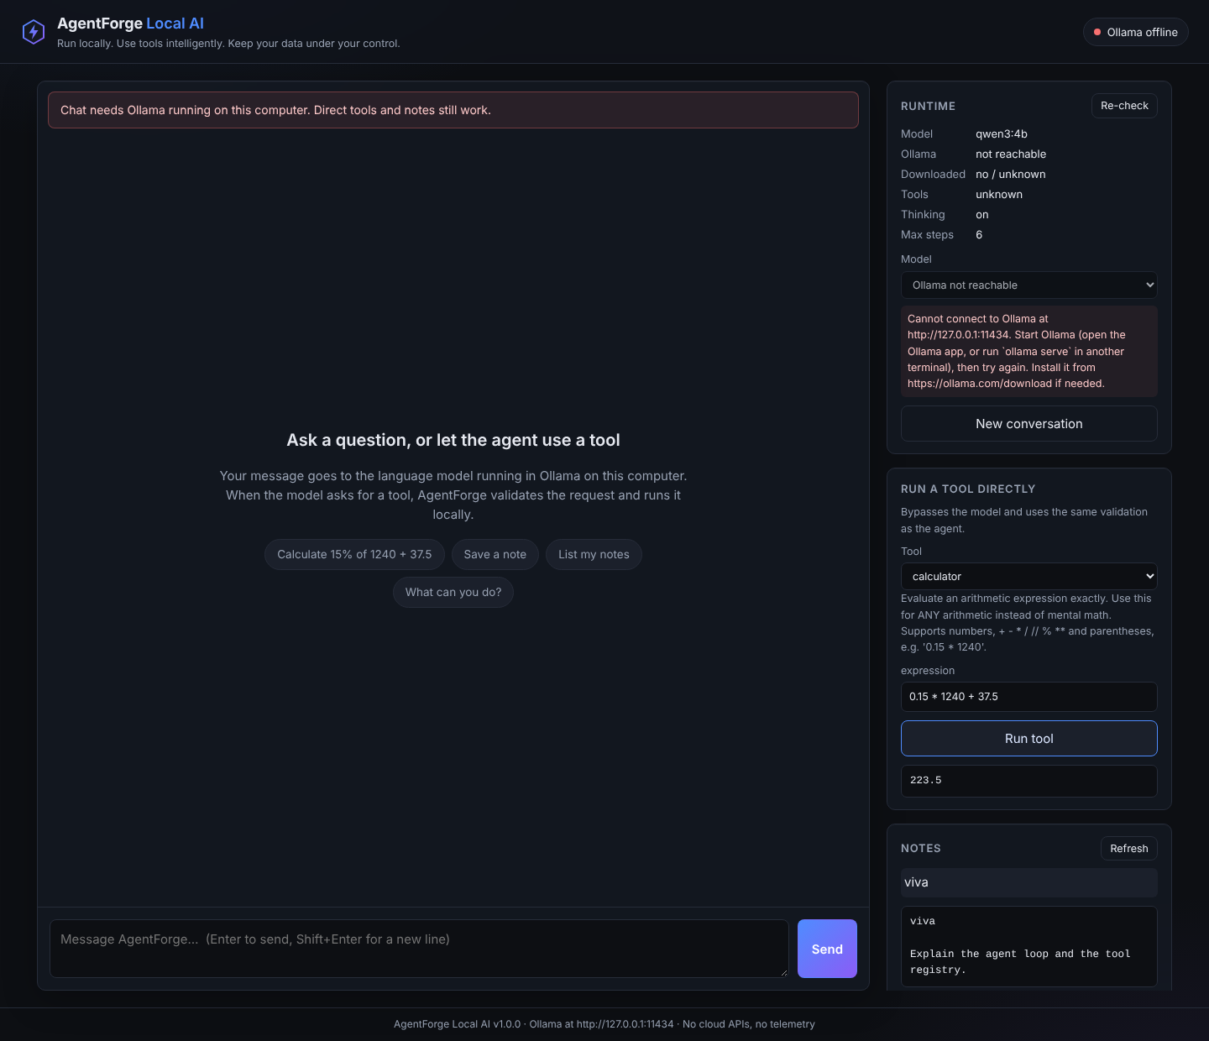
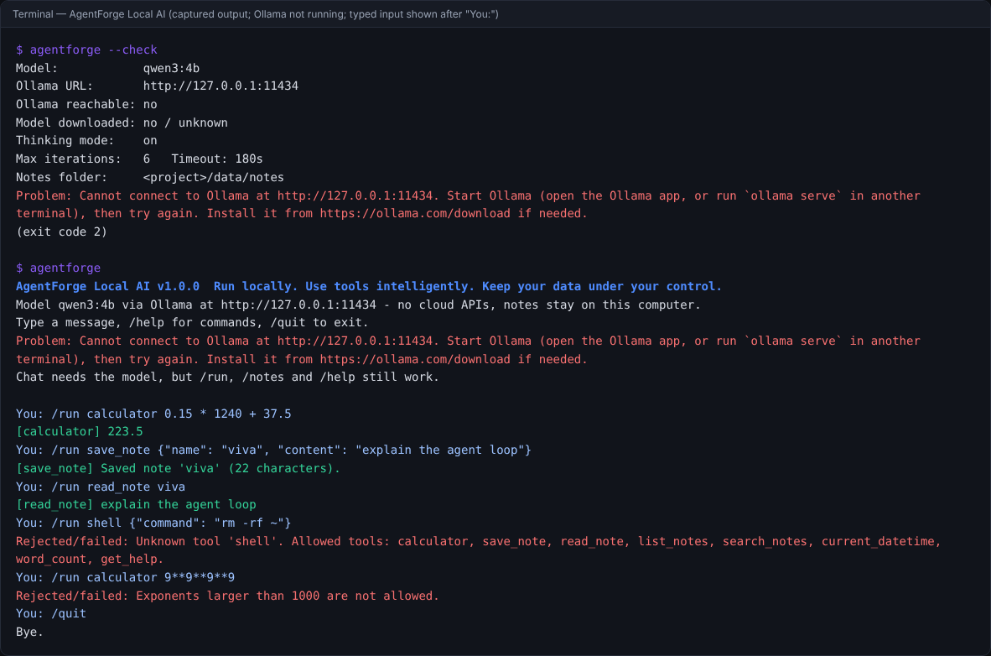
Genuine interface screenshots
Terminal, captured output (Ollama not running). Unknown tool 'shell' rejected; 9**9**9**9 refused; notes saved and read.
Web UI, Ollama not running (real state). Chat is disabled with a clear message; the calculator and a note were used through the direct tool panel.
Home · Architecture · Pipeline · Security · Results · Contact
Notes:
Both captured from the running application on 28 October 2026. No language model was available during development, so neither shows a model reply.

Slide 9
Testing methodology and actual results
214
core tests passed
Python 3.10.12 and 3.12.15
219
incl. 5 browser tests
Python 3.13 + Chromium
0
real-model runs
not yet performed
Quality checks (29 Oct 2026): ruff lint and format clean · mypy clean · bandit: no issues · pip-audit: no known vulnerabilities. Real-model and live tests are still to be run.
Home · Architecture · Pipeline · Security · Results · Contact
Notes:
The chart shows the real number of automated tests per area. No language model was available, so the three live tests were skipped; that run is still to be done on the laptop.

Slide 10


Limitations and future improvements
Limitations
Future improvements
Real-model behaviour not yet verified
Small models may pick the wrong tool
CPU inference can be slow
Cloud-model detection is name-based
Notes not encrypted; single user
Measure tool-selection accuracy and latency (5 runs × 3 models)
Note editing with confirmation
Keyword search over a chosen folder
Streaming responses
Optional encryption of notes
Home · Architecture · Pipeline · Security · Results · Contact
Notes:
Be explicit: validation prevents unsafe actions, not wrong answers. The first future step is a real evaluation.

Slide 11
Conclusion and references
A language model is good at deciding what to do. Exact, safe, auditable doing belongs in validated code. AgentForge keeps both on your own computer.
References
S. Yao et al., “ReAct: Synergizing Reasoning and Acting in Language Models,” ICLR 2023, arXiv:2210.03629.
T. Schick et al., “Toolformer: Language Models Can Teach Themselves to Use Tools,” NeurIPS 2023, arXiv:2302.04761.
A. Yang et al. (Qwen Team), “Qwen3 Technical Report,” arXiv:2505.09388, 2025.
Ollama, https://ollama.com (accessed October 2026).
Upstream baseline: B. Kandala, Fully-Offline-AI-agent-using-SLM, MIT licence, commit ef2d5f5.
Full report: docs/PROJECT_REPORT.md in the repository.
Home · Architecture · Pipeline · Security · Results · Contact
Notes:
Summarise the contribution: the engineering around the model. Point to the references and the project report.

Slide 12





Maintainer and contact
Saqib Ahmad Bhat
Student Developer · B.E. Computer Science and Engineering · Government College of Engineering, Tirunelveli, Tamil Nadu, India
saqibahmadbhat885@gmail.com
linkedin.com/in/saqibahmadbhat
ORCID 0009-0003-9248-6174
github.com/SaqibAhmadBhat/agentforge-local-ai
saqibahmadbhat.github.io/agentforge-local-ai
Academic context: AI/ML EWB internship course, under the supervision of the EWB Courses programme.
Acknowledgement: builds on the MIT-licensed Fully-Offline-AI-agent-using-SLM by Bhargava Kandala; licence notice retained.
Home · Architecture · Pipeline · Security · Results · Contact
Notes:
Thank the audience and the EWB Courses programme, and acknowledge the upstream author. The links on this slide are clickable.

