Slide 1
Packet Tracer
A guideline by Sanjana Shemonti

Slide 2
Packet Tracer
Packet Tracer is a visual simulation tool designed by Cisco Systems that allows users to create network topologies and imitate modern computer networks
The software allows users to simulate the configuration of Cisco routers and switches using a simulated command line interface.
Packet Tracer makes use of a drag and drop user interface, allowing users to add and remove simulated network devices as they see fit.

Slide 3
Installation
An .exe file is provided for cisco packet tracer 6.1.1
Run the .exe file and install packet tracer. It is not a problematic process.

Slide 4
Creating a topology
Use drag and drop method to create a topology, i.e.
Use generic router
Switch 2960
Generic pc and laptop as end devices
Copper straight cable to connect end devices to switch and switch to router
Serial DCE to connect routers
Then configure the components manually

Slide 5
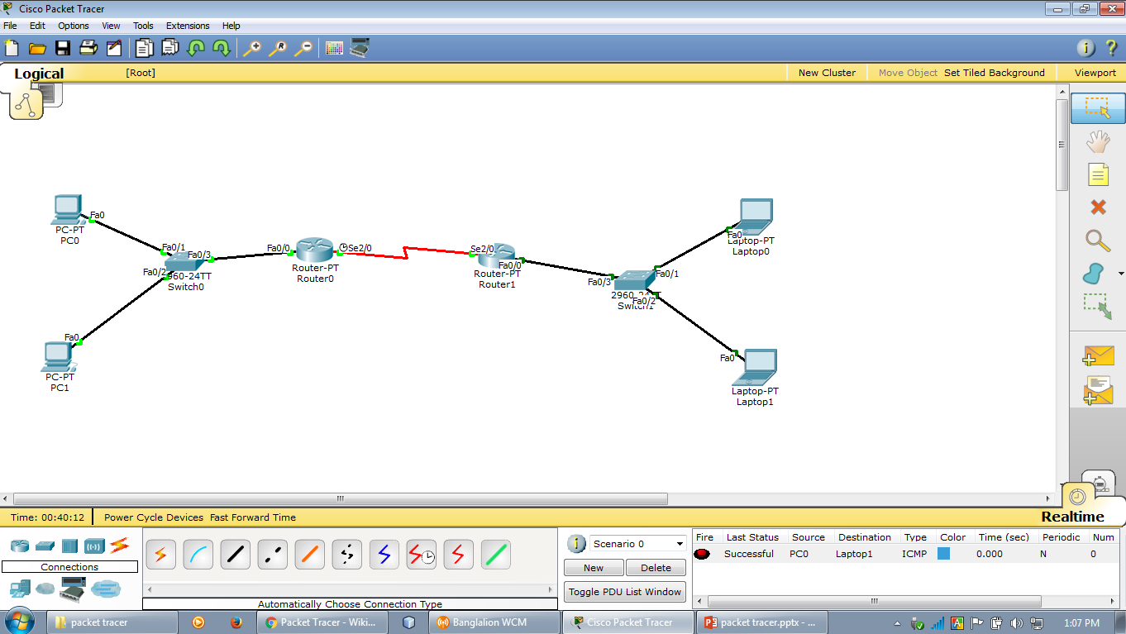
A simple topology

Slide 6
Configuring end devices
Click on the end device you want to configure
Under the Desktop tab, select ip configuration
Select static
Enter ip address, subnet mask and default gateway as per your topology
Close the window
Do it for all the end devices
Be careful about assigning ip address, subnet mask and default gateway

Slide 7
Configuring routers
Click a router
Go to CLI tab, it is the command line interface you will be using
Attention: you will not be using the Config tab for direct configuration!!
In CLI, press enter to get started

Slide 8
Some important points
Router> is the user mode
Router# is the privilege mode
Router(config)# is the global configuration mode
Router(config if)# is the interface configuration mode
You can go back to the previous mode by entering Ctrl+z or exit
To show labels of the components in the topology, go to Options-> Preferences->select show port labels

Slide 9
Router configuration commands
Router> en (short for enable)
Router# config t (configure terminal)
Router(config)# int fa0/0 (interface fa0/0... Fa0/0 can be other labels depending on topology)
Router(config if)# ip add 192.168.1.1 255.255.255.0
router ip subnet mask
# no shutdown
#exit
This will configure the router to its own network

Slide 10
Router configuration commands
For router-router configuration
Router(config)# int Serial2/0
Router(config if)# ip add 192.168.2.1 255.255.255.0
# clock rate 5600
# no shutdown
#exit

Slide 11
Sending packets
To check if the network topology is configured as you wanted
Click on a end device
Go to Desktop tab -> command prompt
Write ping <ip address of another end device you want to send a packet to>
Press enter
It configuration is ok you will see the details of sending packets

Slide 12
Sending packets (simulation)
Go to simulation tab at the bottom right corner
From the list at the right side of the window select the closed envelop, put it from where you want to send packet and to where you want it to go
Click auto capture/play
The envelop will go through its desired configured path, if configuration is ok
It will fail to route, if you have done any mistakes

Slide 13
Routing protocol
Dynamic routing RIP
Commands
Router(config)# router rip
Router(config-router)# network <ip address>
Other commands:
Router(config)# no router rip (to remove routing protocol)
Router# sh run (show run)
Router# sh ip route
Router# wr (to build configuration)

Slide 14
Routing protocol
Static routing
Commands
Router(config)# ip route <destination network address> <subnet mask> <exiting network address>
Router(config)# ip route 192.168.3.0 255.255.255.0 192.168.2.0
Router(config)# end

Slide 15
Tutorial links for RIP and Static
https://www.youtube.com/watch?v=tPUe99KoVxA
https://www.youtube.com/watch?v=1ifYHiFtYBo
https://www.youtube.com/watch?v=QF8pqGNWVqI

Slide 16
That’s All!!

